Slide 1

Functions
The MOST important concept of JavaScript

Slide 2
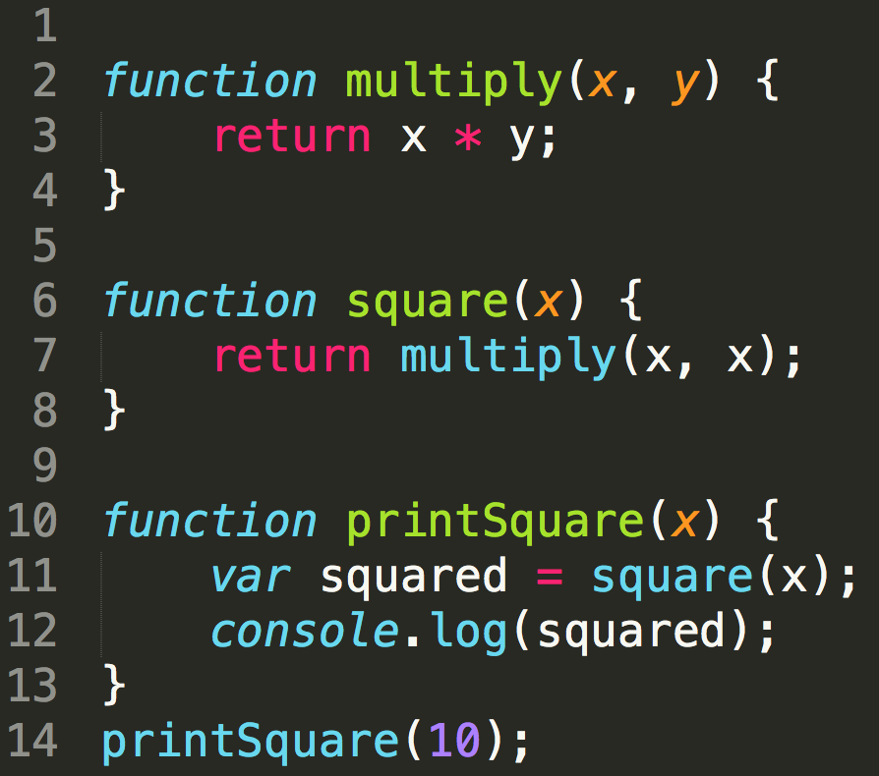

Functions – tomuto všetci asi rozumiete
FunctionDeclaration
ReturnStatement
FunctionDeclaration
ReturnStatement
CallExpression (function call)
FunctionDeclaration
CallExpression (function call)
No return („sub“)
CallExpression („method call“)
CallExpression (function call)

Slide 3
Functions – tomuto všetci asi rozumiete
modularity, reuse
modularity, reuse
composition
final functionality
composition
final functionality

Slide 4
Functions – in JS there is much more (to learn and use)
defining function – several ways declaration, expressions, arrow,...
parameters and arguments – untyped, dynamic
using functions - function is first-class object (can be used „everywhere“)
context in functions (this)
return - explicit implicit
unit of execution (structure of program,modularity, execution)
scope and closures

Slide 5

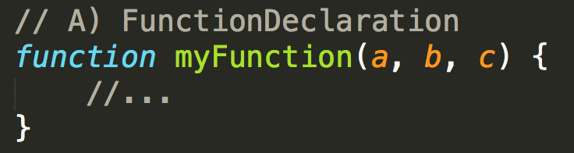
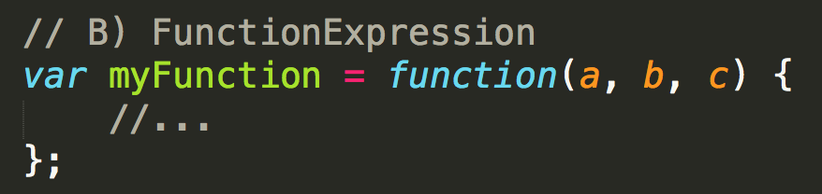
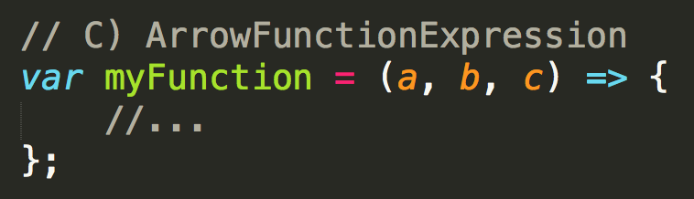
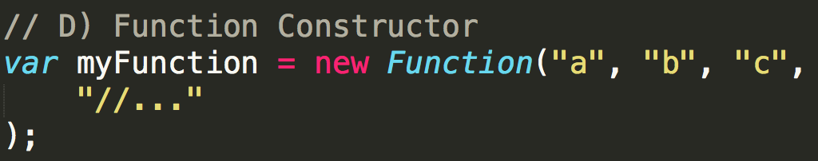
Defining Functions
4 basic ways to define function,
each has own purpose,
but all produce function
standalone, named
“inline“, „function literal“
part of another statement,
anonymous or optionaly named
“inline“, „function literal“, „lambda“
shorter syntax, lexical context
Dynamic, form of eval()
build from strings
Notes:
Bude treba na skusku

Slide 6
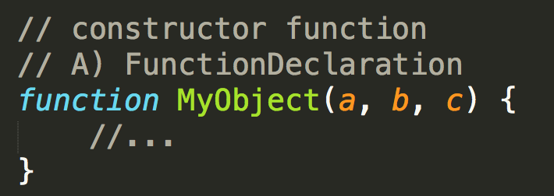
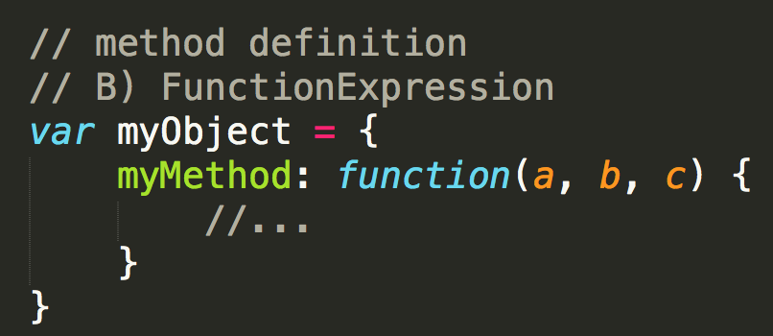
Defining Functions
JS is OO oriented as well, we have also constructor function and methods.
However they use the same concepts of definition and expression
just by naming convention,
To be called with new:
var x=new MyObject();
property pointing to function
function defined in one of the available ways
(more variations in OO lessons)

Slide 7
Parameters and arguments
Terminológia:
parameter - to čo je v definícii
function declaration, function expression, Arrow Function Extrpression
parameters are optional
parameters have no type – actually many APIs accept more types
JS have no concept of overload (matching based on parameter types nor counts), which si good, we do branching inside functions
argument – to čo je vo volaní funkcie (function call, call, apply, bind)
arguments – special keyword

Slide 8

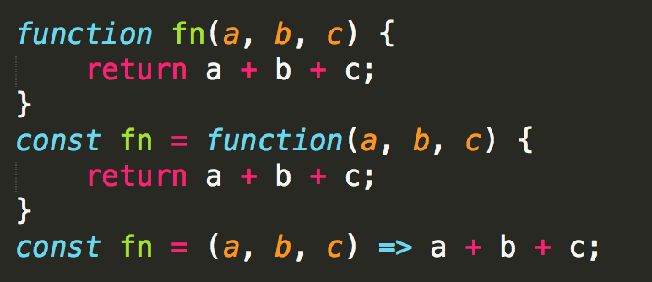
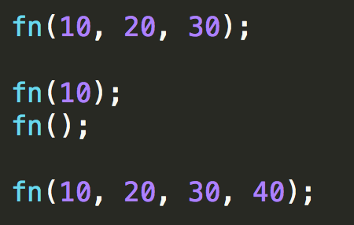
parameters and arguments
parameter – to čo je v definícii
argument – to čo je vo volaní
Môžete volať funkcie s úplne iným počtom argumentov ako majú definovaných parametrov
function definitions
(platí pre všetky spôosoby definície)
parameters
// all arguments
function
calls
// b,c is undefined
arguments
// a,b,c is undefined
// 40 is accessible by argumens[3]
More practical usages in „Patterns lesson“ and „Functional JS lesson“

Slide 9
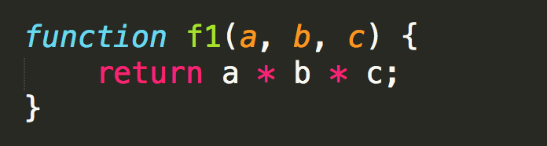
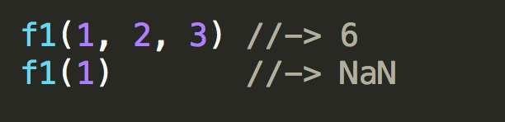
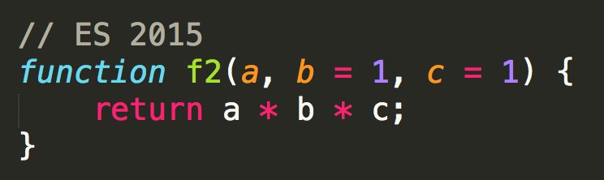
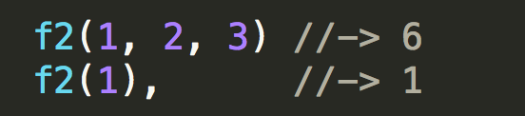
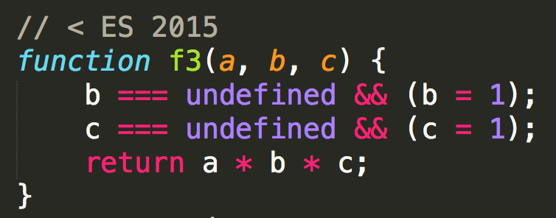


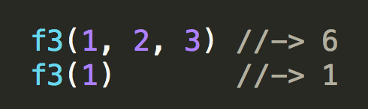
default parameters
Default function parameters allow formal parameters to be initialized with default values if no value or undefined is passed
https://developer.mozilla.org/en-US/docs/Web/JavaScript/Reference/Functions/Default_parameters
Notes:
Skuska – prepisat na ORy

Slide 10

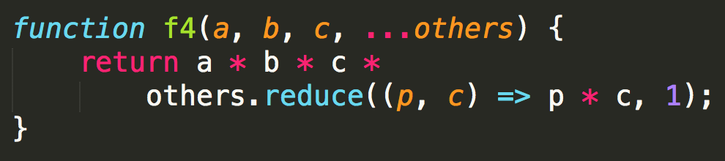

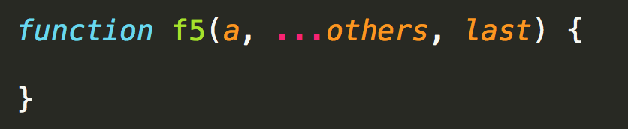
rest parameters
The rest parameter syntax allows us to represent an indefinite number of arguments as an array.
param RestElement
others, Array
SyntaxError:
Rest parameter must be last formal parameter
https://developer.mozilla.org/en-US/docs/Web/JavaScript/Reference/Functions/rest_parameters

Slide 11

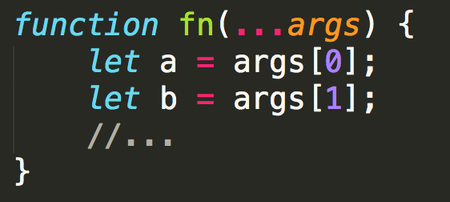
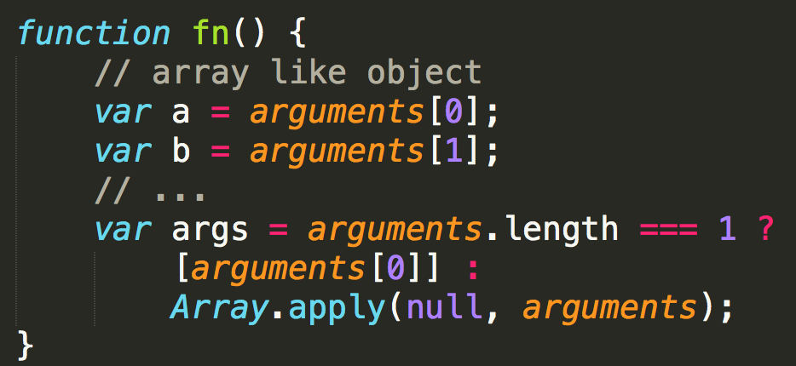
arguments parameter vs. rest parameters
Arbitrary, indefinite arguments:
The arguments object is an Array-like object corresponding to the arguments passed to a function.
The rest parameter syntax allows us to represent an indefinite number of arguments as an array.
Signature with undefined number of parameters.
Using E2015 rest parameter syntax
args – array
Signature with undefined number of parameters.
Pre 2015 syntax
arguments – array like,
Probematic, see links below
https://developer.mozilla.org/en-US/docs/Web/JavaScript/Reference/Functions/arguments, https://github.com/petkaantonov/bluebird/wiki/Optimization-killers#3-managing-arguments

Slide 12
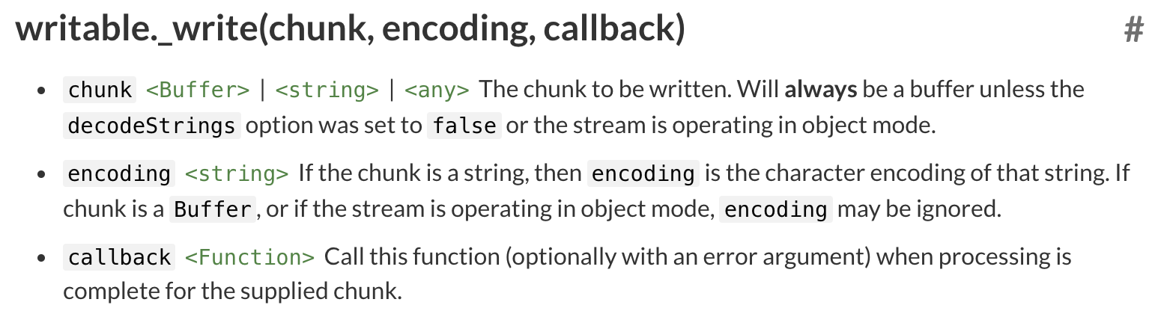
parameters and types
parameters have no type,
often by design they accept several types
or as callbac, function is called with various types
this is by design in JS
accepts various types
Keď implementujete takú funkciu musíte robiť “branching“ na základe typu parametrov alebo normalizáciu parametrov

Slide 13

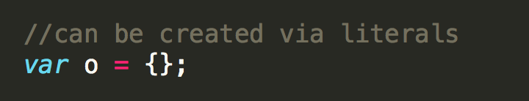
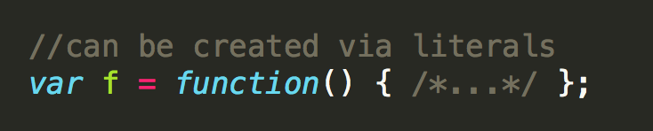
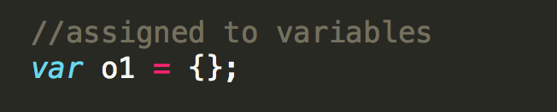
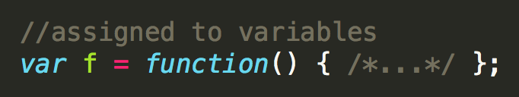
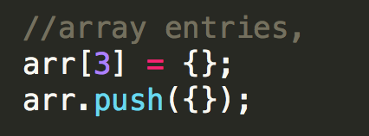
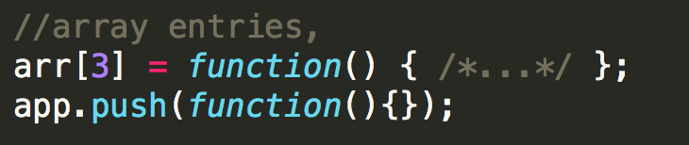
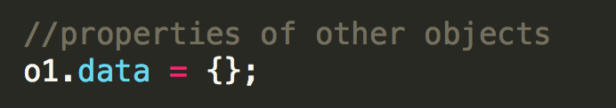
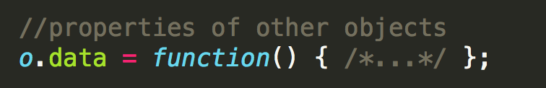
Function is first-class object
Všetko čo viete spraviť s objektom, viete spraviť aj z funkciou.
Všade kde viete použiť objekt viete použiť aj funkciu
object
function

Slide 14
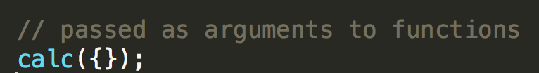
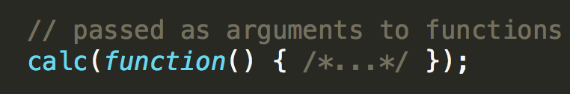
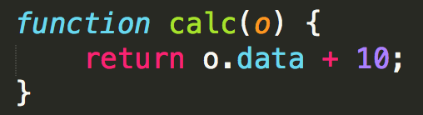
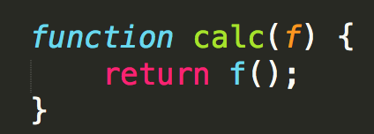
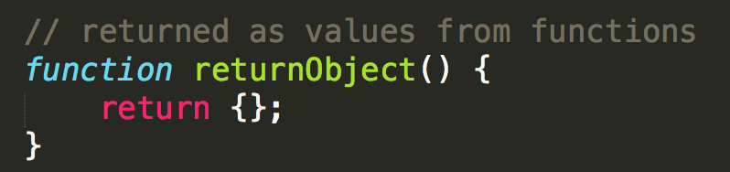
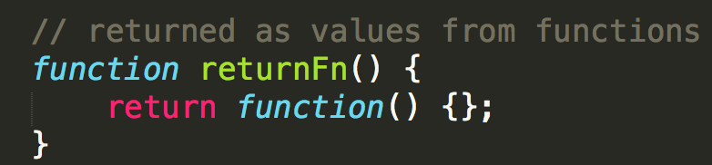
Function is first-class object
Všetko čo viete spraviť s objektom, viete spraviť aj z funkciou.
Všade kde viete použiť objekt viete použiť aj funkciu
object
function

Slide 15
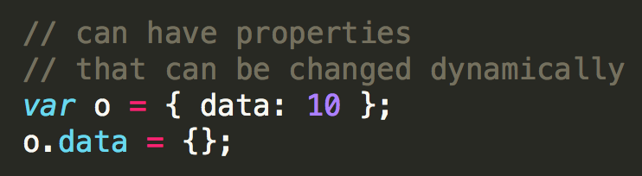
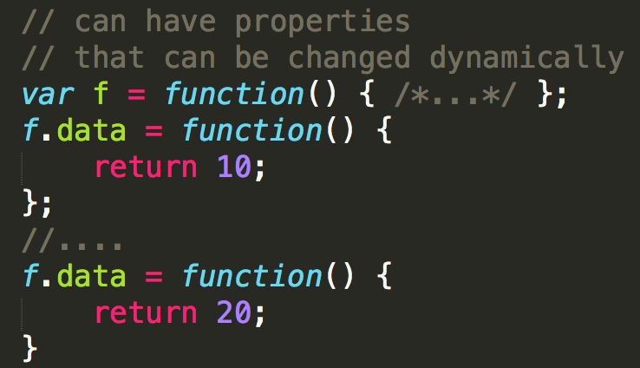
Function is first-class object
Všetko čo viete spraviť s objektom, viete spraviť aj z funkciou.
Všade kde viete použiť objekt viete použiť aj funkciu
object
function

Slide 16
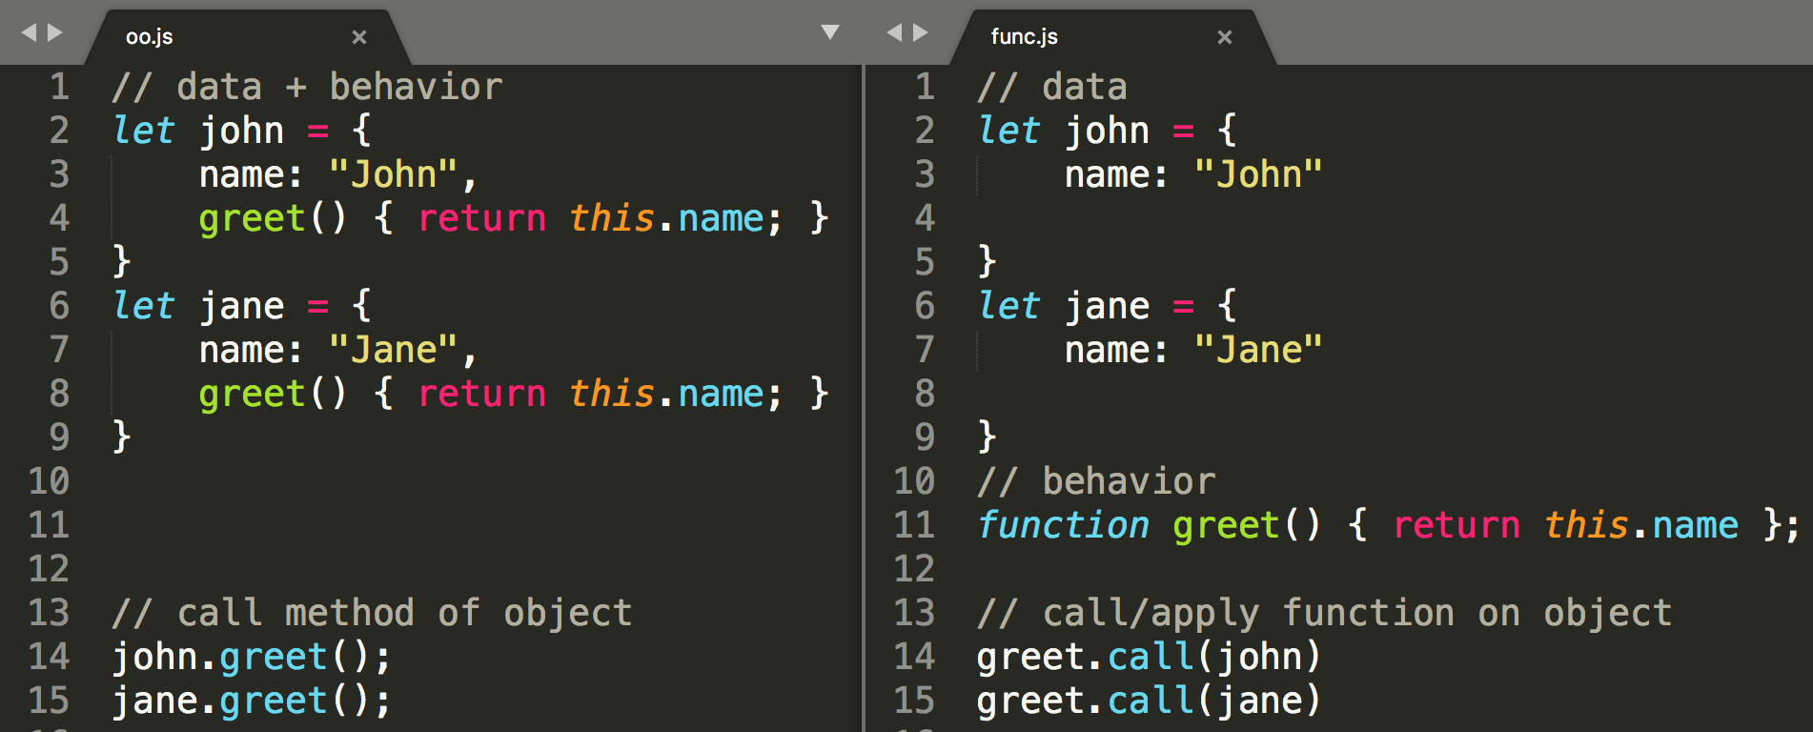
What is context and this in JS ?
Context in javascript has been designed to cover OO and FP features. Context is represented by this keyword
In OO object have behavior (methods)
We call methods on specific objects
Context is enclosing/parent object
In FP objects are pure data
We call function with specific objects (context)
Context is what we decide when invoking function

Slide 17
this – in javascript functions
this - is available in any function
However it does not have to be used in every functions
Common usage of this includes:
methods
functions applicable on data objects
……
function to be used as callbacks
...
this exists
to prevent explicit context passing as parameters
to cover functional as well as object oriented styles
this is
confusing for OO people
hard to mix with OO and event handling and callbacks
often avoided or replaced by other concepts (scoped variables)
„fixed“ to lexical scope with arrow functions

Slide 18
this – in javascript functions
Is available in any function
Value of this depends on:
How the function is invoked
How the function was defined
How it is invoked:
method call
function call
call, apply
new
callbacks, supplied thisArgs
How it is defined:
FunctionDeclaration, FunctionExpression
ArrowFunctionExpression
Bound functions

Slide 19
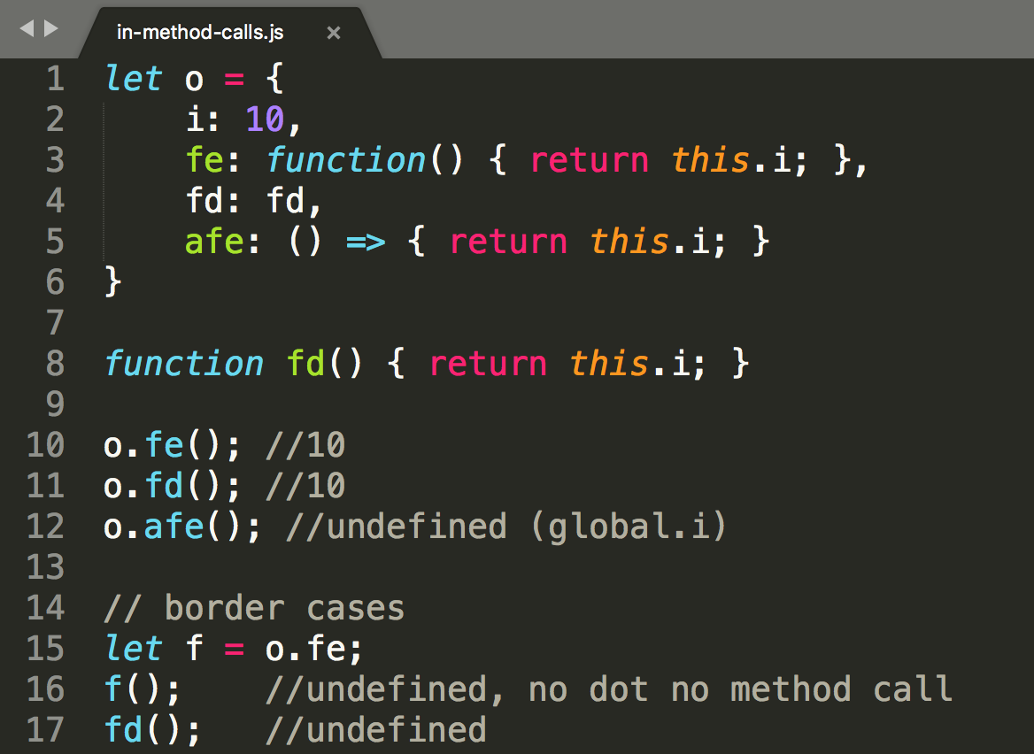
this – in method call
Method call is always written with member expression, dot or braces []
o.m(); o[“m“]()
this points to parent object
ArrowFunctionExpression “does not work” for methods (nema velmi zmysel, kedze je tam ine this)
If dot is missing eg. function reasigned to var, sent as reference, this is lost. Or we could say function does not remember it‘s parent object

Slide 20
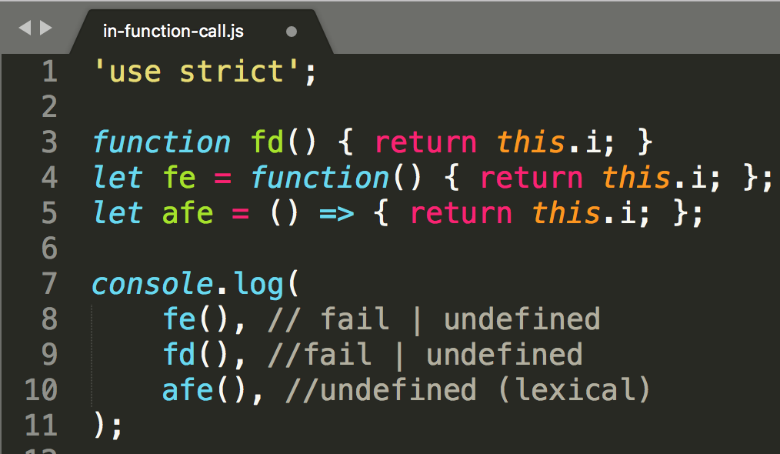
this – in function call
function call without context
function call without dot or []
fd(), fe(), afe()
let f=o.m(); f();
this points to undefined or global if not in strict mode
ArrowFunctionExpression – ignores strict mode, this is always lexial (global)

Slide 21
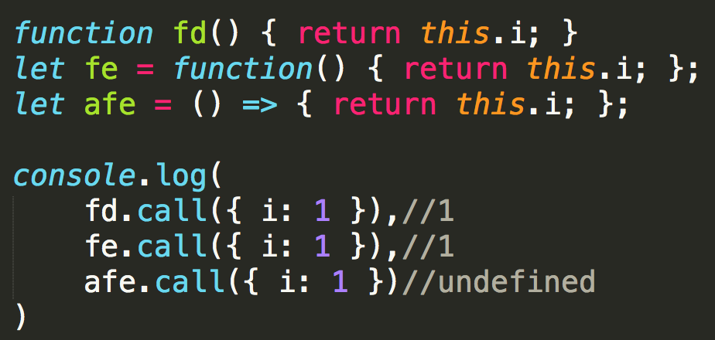
this – in f.call() and f.apply()
function call with context
each function has call() and apply() methods
First param is context that will be bound to this, other params are arguments to function call
Also ArrowFunctionExpression has call and apply but they ignore context, since this is not bindable but is bound to lexical context

Slide 22
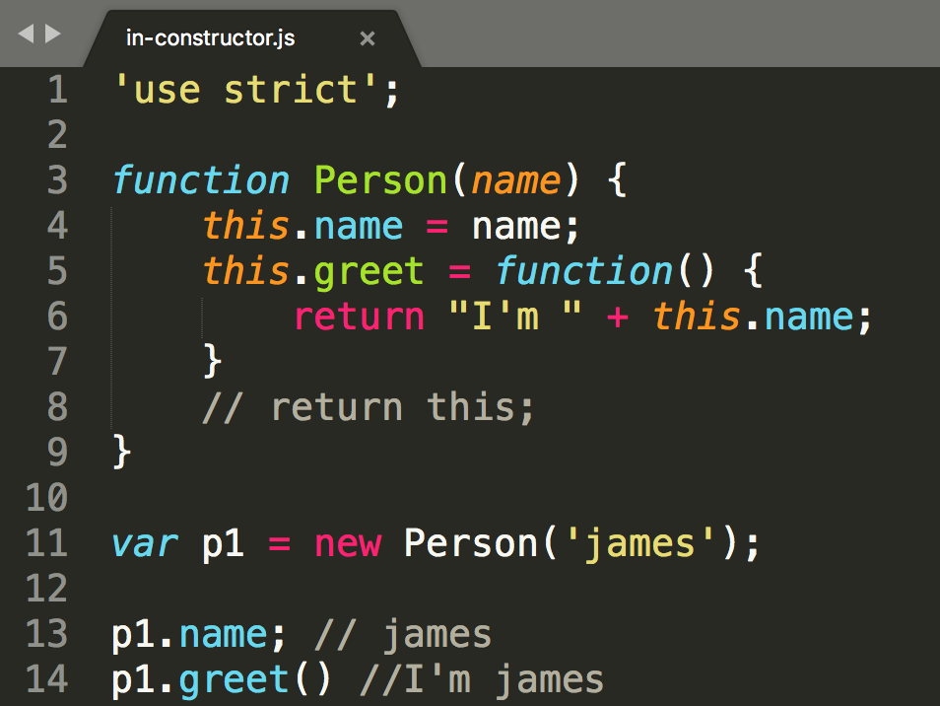

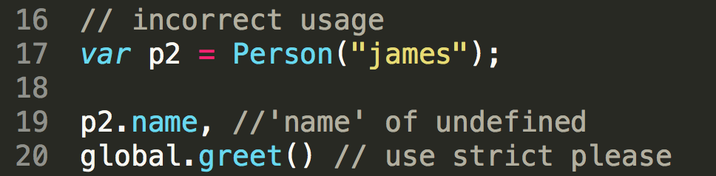
this - in constructor
Constructor function is just normal function (FunctionDefinition, FunctionExpression) to be used with new keyword
this is bound to the new object being constructed
To prevent contructor to be used without new, use strict mode
ArrowFunctionExpression is not usable as constructor

Slide 23
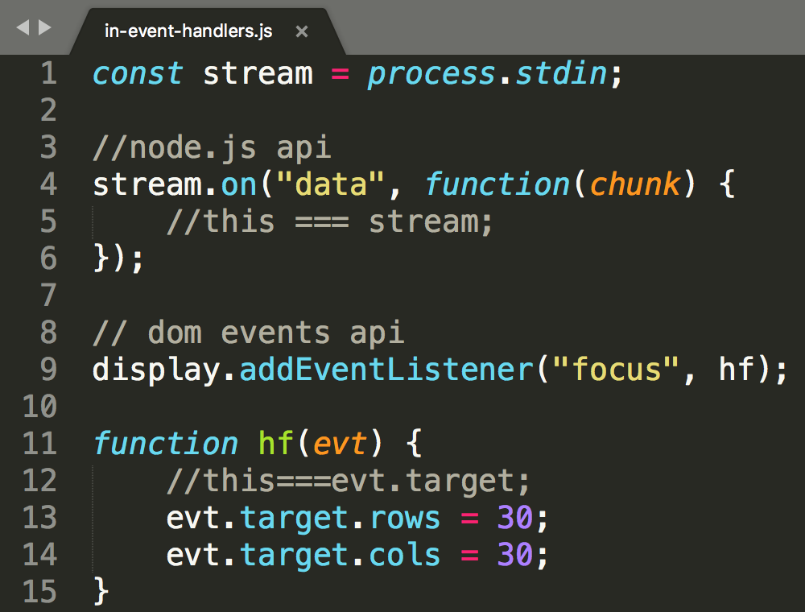
this – in event handlers
Event handlers are functions, they will be called when event occurs,
you implement the function, component calls the function
Component may call you function with call() or apply() and inject context , this inside your function will become something else
Something: usually the component itself or the element where event happened
Always read documentation
This creates problems in OO programs, where you want to attach your method as listener, someone will change your expected this

Slide 24
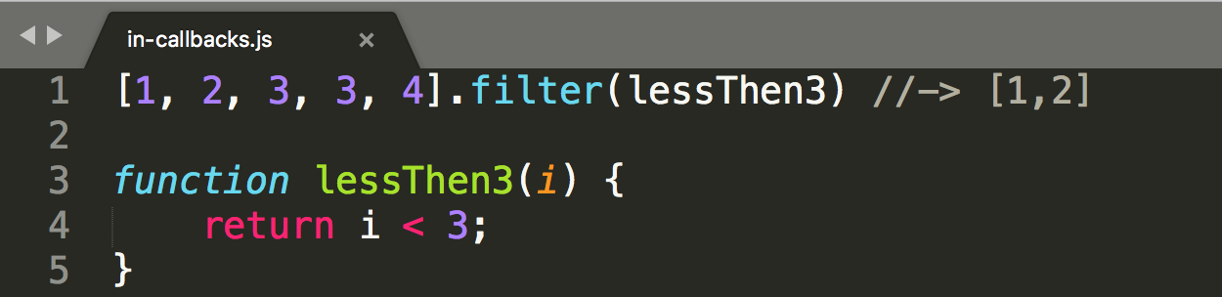

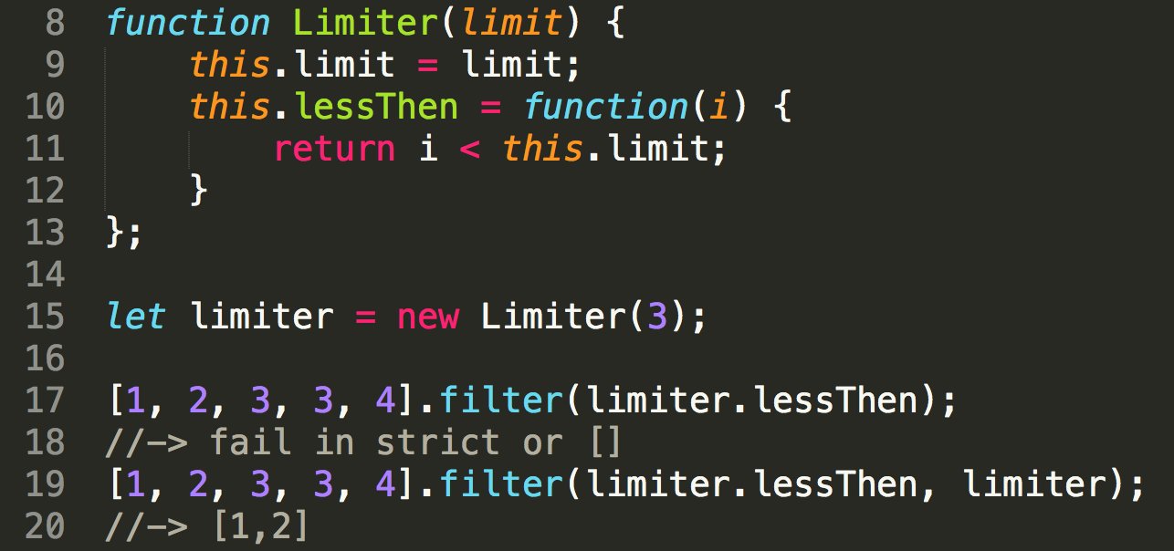
this – in callbacks
callbacks are functions, they will be called by other API you use
you implement the function, API calls the function
Component may call you function with call() or apply() and inject context , this inside your function will become something else
Something: usually null, sometimes the component itself
Some APIs you may specify additional thisArgs, to set back your context
Always read documentation
This creates problems in OO programs, where you want to attach your method as listener, someone will change your expected this
callback
object
Method as callback
thisArg
./03-prednaska/samples/functions/context/in-callbacks.js

Slide 25
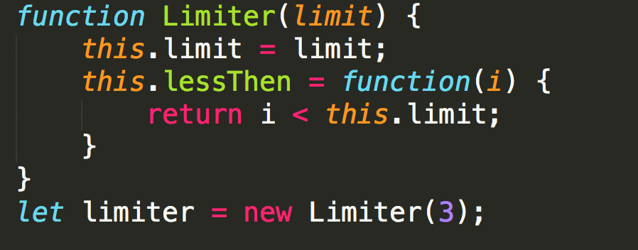
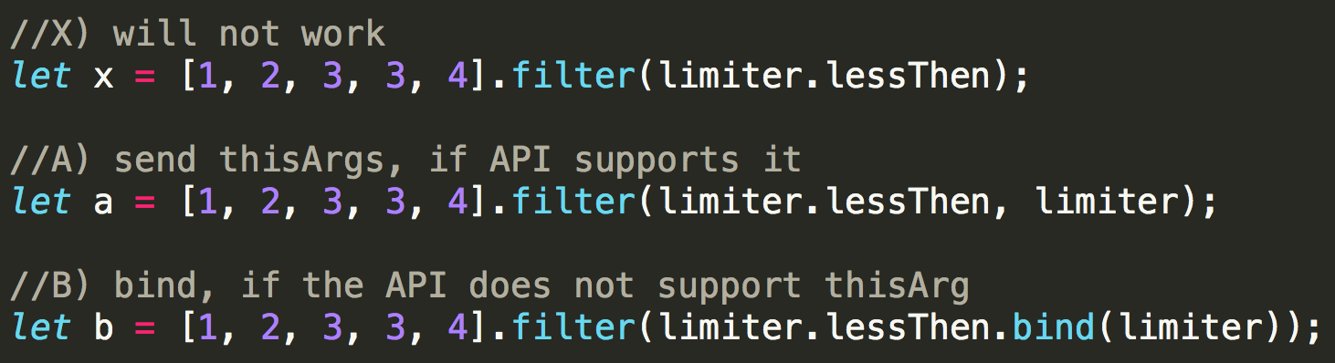
this – recap and why we need bind and arrow
FunctionDeclaration,Function Expression
this depends on how it is called
can be changed by caller with call() and apply()
can be fixed by bind()
ArrowFunctionExpression
this depends on where it is written
can‘t be changed by caller
can‘t be fixed by bind()
main purpose
condensed syntax
fixed this, no need to bind or use _self
Function
Expression or Declaration
Function.prototype.bind

Slide 26
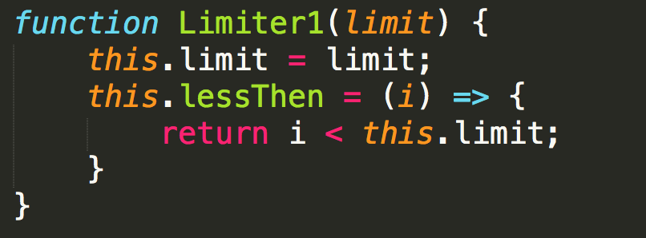
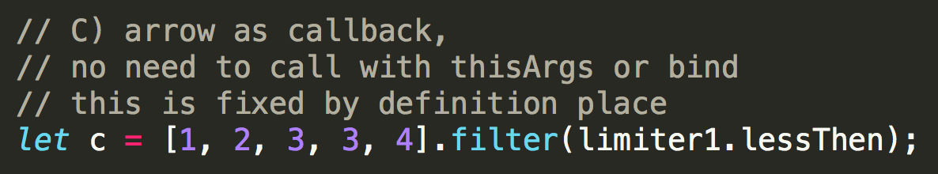
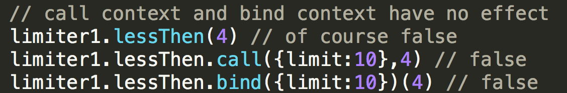
this – recap and why we need bind and arrow
FunctionDeclaration,Function Expression
this depends on how it is called
can be changed by caller with call() and apply()
can be fixed by bind()
ArrowFunctionExpression
this depends on where it is written
can‘t be changed by caller
can‘t be fixed by bind()
main purpose
condensed syntax
fixed this, no need to bind or use _self
Arrow Function
Expression
Fixed this, to enclosing this which is this in constructor which is newly created object
./03-prednaska/samples/functions/context/in-callbacks-arrow.js

Slide 27
Scope and Closures
Definitions
Simplified
scope - visibility of identifiers in certain parts of a program (John R.)
closure is the combination of a function and the lexical environment within which that function was declared (MDN)
Lexical Environments – implementation of scoping and closures in JavaScript (M.M)
scope - ake premenne a funkcie „vidim“/“mam dostupne“ v danom kuse kodu ?
closure – funkcia s odpamätanými premennými z okolia
Lexical Environment – zoznam identifikátorov definovaných v danom scope (inner scope) a linka na outer scope environment

Slide 28


Scope

Slide 29
Scope and Closures
Code
Exection context (stack)
Lexical environment
code consists of nested code structures
global code, function code
code structures gets associated new lexical environment every time such code is evaluated
Whenever a function is created, a reference to the lexical environment in which the function was created is stored in fn.[[Environment]]
function is called, a new function execution context is created and pushed onto the execution context stack
as the outer environment of the newly created lexical environment, JS puts the environment referenced by the called function’s internal [[Environment]] property
lexical environment is associated with a specific structure of JavaScript code
Keeps track of identifier defined
Lexical environment also has to keep track of its outer (parent) lexical environment
A Lexical environment is an internal JavaScript engine construct used to keep track of the mapping from identifiers to specific values.

Slide 30


Scope and Cloures
outer[Environment]
gv
inner[Environment]
ov, op
inner call lexical env
ip,iv

Slide 31

Closure
gv
outer
inner
Position of function definition and the position from where the function is executed, are generally not related
Function defined in one scope can be called in another scopes
Function remembers all definition scope variables in closure
ov
op
inner[[Environment]]=
func-dec
ip
iv
funct call

Slide 32

Closure (basic usage)

Slide 33

Function - Primary unit of execution
Except for global code, all our program is written as functions
Evented – event handling code is written as function
only one function executed at the time (stack, event loop)
run-to-completion – whole function is executed
Global code
Event handle Code
Event handle Code

Slide 34
Na skúšku
Uvedomiť si že JS funkcie sú asi iné ako poznáte z iných jazykov
Rozoznať function declaration od function expression v kóde
Vysvetliť pojem „function is first-class object“
Poznať syntax arrow function a dokázať povedať čo funkcia vracia (v uvedenom príklade)
Dokázať používať this a rozumieť, kedy má akú hodnotu podľa spôsobu definície a typu volania funkcie
Určiť na príklade, ktoré identifikátory sú dostupné pri volaní funkcie a vysvetliť prečo
Funkcia v čase, kedy bola deklarovaná (inner) pozbiera všetky premenné, ktoré vidí a tie si zapamätá. Keď ju potom volám, ona tie premenné má k dispozícii - closure

Slide 35

_aux

Slide 36


arrow functions
Example: usage in node.js source code
Arrow Function Expression can be used everywhere where function expression is used
return value from another function
argument for function call
named expression, for later use, reuse

Slide 37

function defined in function
Example: usage in node.js source code
Very, very common pattern

