Slide 1
COUNTERS

Slide 2
COUNTERS
Counter is a sequential circuit which is used for counting pulses.
Counter is the widest application of flip-flops. It is a group of flip-flops with a clock signal applied
Counters are of two types:
Asynchronous or Ripple Counters
Synchronous Counters
The number of flip-flops determines the count limit or number of states
States = 2 ^{( no of flip-flops)}

Slide 3
COUNTERS
The number of states used is called the MODULUS or MOD
For example, a Modulus-12 counter (Mod-12) would count from 0 (0000) to 11 (1011) and would require four flip-flops (2⁴ = 16 states; 12 are used)
Asynchronous or ripple counters: the first flip-flop is clocked by the external clock pulse, and then each successive flip-flop is clocked by the Q or Q' output of the previous flip-flop.
Synchronous counters: all memory elements are simultaneously triggered by the same clock.
Asynchronous counters are slower than synchronous counters because of the delay in the transmission of the pulses from flip-flop to flip-flop

Slide 4
COUNTERS
Based on their circuitry design, the counters are classified into the following types:
Up Counter
The up-counter counts the states in ascending order.
Down Counter
The down counter counts the states in descending order.
Up-Down Counter
The up and down counter is a special type of bi-directional counter which counts the states either in the forward direction or reverse direction. It also refers to a reversible counter.
The count sequence usually repeats itself.

Slide 5
COUNTERS
Eg: 4-bit Counter or Mod 16 counter
When counting up, the count sequence goes from 0000, 0001, 0010, ... 1110 , 1111 , 0000, 0001, ... etc.
When counting down the count sequence goes in the opposite manner: 1111, 1110, ... 0010, 0001, 0000, 1111, 1110, ... Etc.
JK or T flip-flops are usually used for constructing counters.

Slide 6
Asynchronous/Ripple Counters
Only the first flip-flop is clocked by an external clock.
All subsequent flip-flops are clocked by the output of the preceding flip-flop.
Asynchronous counters are also called ripple-counters because of the way the clock pulse ripples its way through the flip-flops.
The MOD of the ripple counter or asynchronous counter is 2^{n} if n flip-flops are used.

Slide 7
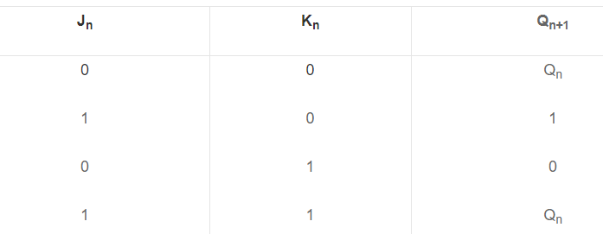
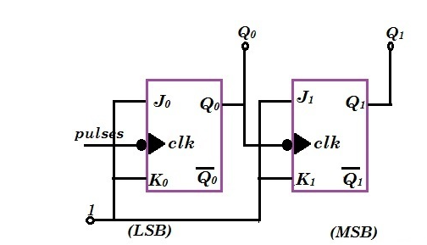
2-bit Ripple Counter
Complimenting Flip-flops are used .
They are obtained with J and K i/p’s tied together or a T flip-flop.
J & K=1

Slide 8
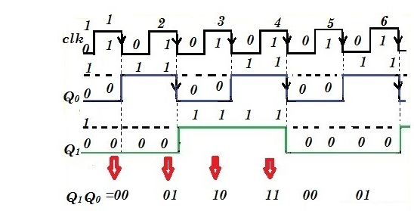
2-bit Ripple Counter
Toggle the state at the negative going end of the clock pulse .i.e. at the transition 1 to 0 of the clock pulse.
00
01
10
11

Slide 9
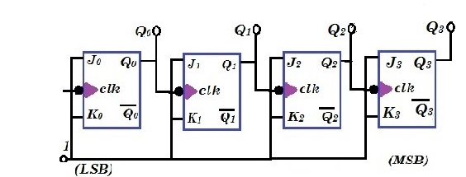
4-bit Ripple Counter Using JK Flip flop

Slide 10
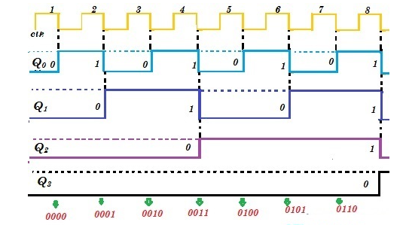
4-bit Ripple Counter Using JK Flip flop
0000
0001
0010
0011
0100
0101
0110
0111
1000
1001
1010
1011
1100
1101
1110
1111

Slide 11
Asynchronous Decade Counters
The binary counters previously introduced have two to the power n states.
But counters with states less than this number are also possible
They are designed to have the number of states in their sequences, which are called truncated sequences.
These sequences are achieved by forcing the counter to recycle before going through all of its normal states.
A common modulus for counters with truncated sequences is ten.
A counter with ten states in its sequence is called a decade counter.

Slide 12
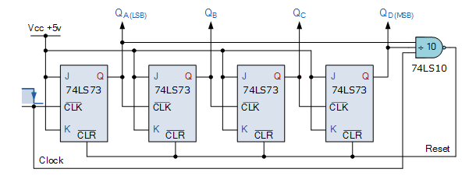
BLOCK DIGARAM

Slide 13
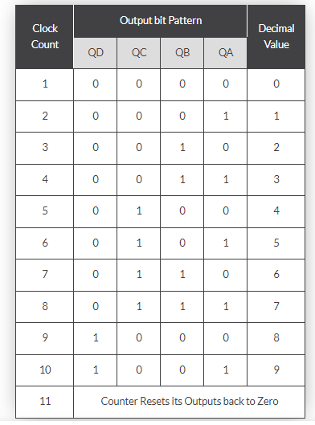
Truth Table
When the Decade counter is at REST, the count is equal to 0000.

Slide 14
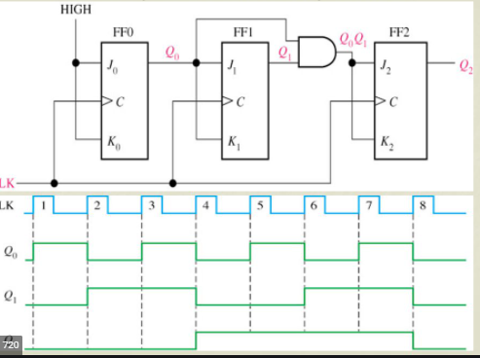
3-bit Synchronous Counter
All flip-flops in the counter are clocked at same time by a common clock pulse
000
001
010
011
100
101
110
111

Slide 15
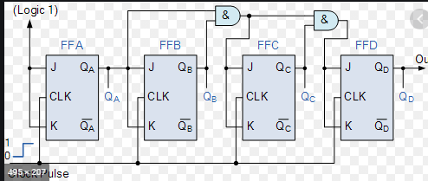
4-bit Synchronous Counter

Slide 16
Down -Counter
A binary counter with reverse count is called a binary down-counter.
The count is decremented by 1 with every clock pulse .
The output of a 4-bit down counter starts from 1111, 1110, 1101, 1100, 1011, 1010…. 0000 and then back to 1111.
The circuits shown previously works as down counters if outputs are taken from Q’ instead of Q.
If we observe count sequence of down counter, it can be noticed that the lowest order bits toggle at each clock pulse.
Any other bit is complemented ,if its previous lower order bit goes from 0 to 1(asynchronous)

Slide 17
UP DOWN COUNTERS
An up-down counter is a combination of an up-counter and a down-counter.
It can count in both directions, increasing as well as decreasing
In the up-counter each flip-flop is triggered by the normal output of the preceding flip-flop
In a down-counter, each flip-flop is triggered by the complement output of the preceding flip-flop

Slide 18
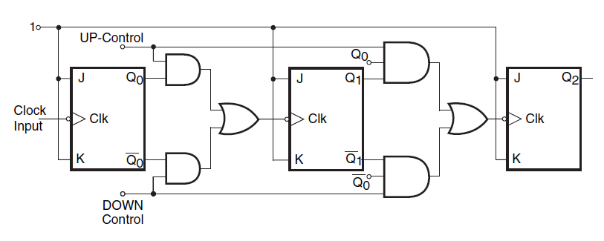
3-bit ripple Up/Down Counter

Slide 19
Up Operation
The counter counts upwards when UP control is logic ‘1 and DOWN control is logic ‘0’.
The lower AND gates will be disabled and their outputs will be zero.
So they will not affect the outputs of the OR gates. At the same time the upper AND gates will be enabled
Hence, Q0 will pass through the OR gate and into the clock input of 2nd FF.
Similarly, Q1 will be gated into the clock input of the 3rd flip-flop.
Thus, as the input pulses are applied, it will count up and follow a natural binary counting sequence from 000 to 111.

Slide 20
Down Operation
The counter counts downwards when the UP control input is logic ‘0’ and DOWN control is logic ‘1’.
The upper AND gates will become disabled and the lower AND gates are enabled.
Q0’and Q1’ will pass through the clock inputs of the following flip-flops.
Hence, in this condition the counter will count in down mode, as the input pulses are applied.

Slide 21
REGISTERS

Slide 22
Registers
Registers are groups of flip-flops, where each flip-flop is capable of storing one bit of information.
An n-bit register is a group of n flip-flops.
The basic function of a register is to hold information in a digital system and make it available to the logic elements for the computing process.
Registers are synchronous circuits thus all flip-flops are controlled by a common clock line.
As registers are often used to collect serial data they are also called accumulators

Slide 23
Shift Register
A register capable of shifting the binary information held in each cell to its neighbouring cell, in a selected direction, is called a shift register.
The logical configuration of a shift register consists of a chain of flip‐flops in cascade, with the output of one flip‐flop connected to the input of the next flip‐flop.
All flip‐flops receive common clock pulses, which activate the shift of data from one stage to the next.

Slide 24



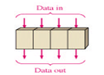
Shift Register
Shift registers operate in one of four different modes with the basic movement of data through a shift register being:
• Serial-in to Serial-out (SISO)
• Serial-in to Parallel-out (SIPO)
• Parallel-in to Serial-out (PISO)
• Parallel-in to parallel-out (PIPO)

Slide 25
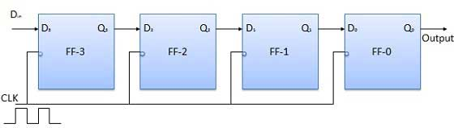
Serial-in to Serial-out (SISO)
The data is shifted serially “IN” and “OUT” of the register, one bit at a time.
It has only three connections
The serial input- which determines what enters the left hand flip-flop
The serial output- which is taken from the output of the right hand flip-flop
Sequencing clock signal

Slide 26
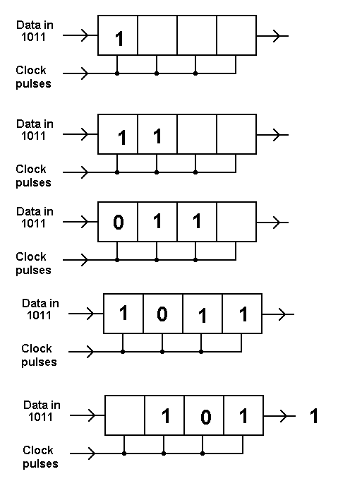
Serial-in to Serial-out (SISO)
The above figure illustrates entry of the four bits 1011 into the register.
After imputing of data’s, Four bits (1011) being serially shifted out of the register and replaced by all zeros

Slide 27
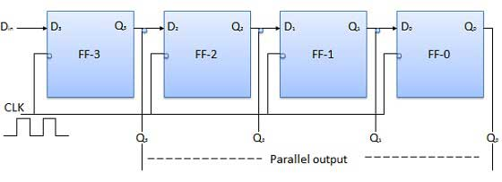
Serial-in to Parallel-out (SIPO)
The register is loaded with serial data, one bit at a time, with the stored data being available at the output in parallel form

Slide 28
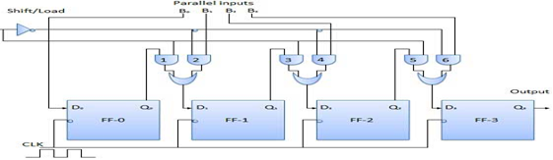
Parallel-in to Serial-out (PISO)
The parallel data is loaded into the register simultaneously.
Values are shifted out of the register serially one bit at a time under clock control.
Output of previous Flip Flop is connected to the input of the next one via a combinational circuit.
The binary input word B₀, B1, B2, B3 is applied though the same combinational circuit.

Slide 29
Parallel-in to Serial-out (PISO)
There are two modes in which this circuit can work namely shift mode or load mode
Load Mode
When the shift/load bar line is low (0), the AND gate 2, 4 and 6 become active. They will pass B₁, B2, and B3 bits to the corresponding flip-flops.
On the low going edge of clock, the binary input B₀, B1, B2, B3 will get loaded into the corresponding flip-flops.
Thus parallel loading takes place.

Slide 30
Parallel-in to Serial-out (PISO)
Shift Mode
When the shift/load bar line is low (1), the AND gate 2, 5 and 6 become inactive. Hence the parallel loading of the data becomes impossible.
But the AND gate 1, 3 and 5 become active.
Therefore the shifting of data from left to right bit by bit on application of clock pulses. Thus the parallel in serial out operation take place.

Slide 31
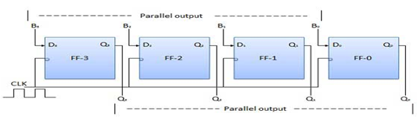
Parallel-in to parallel-out (PIPO)

Slide 32
Parallel-in to parallel-out (PIPO)
The parallel data is loaded simultaneously into the register, and transferred together to their respective outputs by the same clock pulse.
In this mode, the 4 bit binary input B₀, B1, B2, B3 is applied to the data inputs D₀, D1, D2, and D3 respectively of the four flip-flops.
As soon as a negative clock edge is applied, the input binary bits will be loaded into the flip-flops simultaneously.
The loaded bits will appear simultaneously to the output side.

