Slide 1
Sequential circuit - Clocking, Flip flops - SR – JK- D -T flip flops, Counters - Synchronous and asynchronous counters - UP/DOWN counters , Registers - Serial in serial out - Serial in parallel out - Parallel in serial out - Parallel in parallel out registers
Module 2

Slide 2
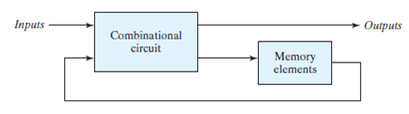
Sequential Circuits
Sequential circuits are constructed by adding an additional memory element to combinational circuit.
They act as storage elements.
They can store and retrieve information when needed at a later time.
block diagram of sequential circuit

Slide 3
Sequential Circuits
Memory elements are capable of storing binary information.
Information stored in memory element defines the state of sequential circuit.
memory elements such as latches and flip flops are used in sequential circuits
The external inputs received by the sequential circuit, together with the values currently stored in the memory element determine binary value at the o/p terminal
Thus, a sequential circuit is specified by a time sequence of inputs, outputs, and internal states.
In contrast, the outputs of combinational logic depend only on the present values of the inputs.

Slide 4
Sequential Circuits
Sequential circuits are classified As:
Synchronous sequential circuit : I/p signals can affect memory elements at discrete instants of time.
Asynchronous sequential circuit: I/p signals can affect memory elements at any instant of time.
Synchronization is achieved by a timing device called a clock generator, which provides a clock signal having the form of a periodic train of clock pulses.
The storage elements (memory) used in clocked sequential circuits are called flip-flops.

Slide 5
FLIP FLOP

Slide 6
LATCHES
Latch is a storage element that can maintain a binary state indefinitely (as long as power is delivered to the circuit), until directed by an input signal to switch states.
They are formed from pairs of logic gates where the gate outputs are fed Into one ,of the inputs of the other gate in the pair.
This results in a regenerative circuit 'having two stable output states.
The major differences among the various types of latches and flip-flops are the number of inputs they possess and the manner in which the inputs affect the binary state

Slide 7
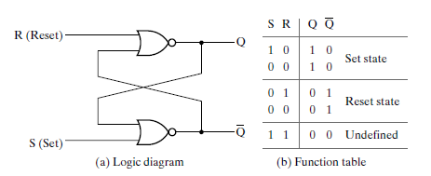
SR LATCH -NOR Gates
The SR latch is a circuit with two cross-coupled NOR gates or two cross-coupled NAND gates, and two inputs labeled S for set and R for reset.
In a NOR gate output is 0 if any of the i/p is 1
The latch has two useful states. When output Q = 1 and Q_ = 0, the latch is said to be in the set state. When Q = 0 and Q’ = 1, it is in the reset state
1
2

Slide 8
SR LATCH
Under normal conditions, both inputs of the latch remain at 0 unless the state is to be changed.
Initially assume that S=1 and R=0. Since Gate 2 has an i/P 1, o/p Q’ must be 0, which puts both i/p at gate 1 to be 0 and o/p Q=1.
When S is returned to 0, O/P remains the same because O/P at Q remains at 1, leaving i/p at gate 2 at 1, causing Q’ to stay at 0 which makes i/p at gate1 at 0 and making Q as 1
when S=0 and R=0 at i/p, it retains previous state.
When both i/p’s are 1 both Q and Q’ will be 0 which violates the fact that Q and Q’ are compliments of each other- this should be avoided

Slide 9
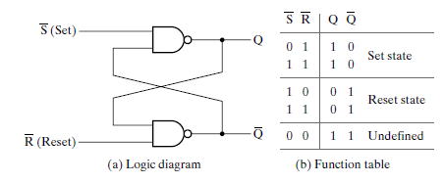
SR LATCH- NAND Gates
In a NAND gate output is 1 if any of the i/p is 0

Slide 10
SR LATCH-NAND GATE
It operates with both inputs normally at 1, unless the state of the latch has to be changed.
The application of 0 to the S input causes output Q to go to 1, putting the latch in the set state.
When the S input goes back to 1, the circuit remains in the set state.
By placing a 0 in the R input, the circuit goes to reset state.
The condition that is forbidden for the NAND latch is both inputs being equal to 0 at the same time, an input combination that should be avoided

Slide 11
Flip-Flop Introduction
Latches are combinational logic circuits where state of its output change when the input states change.
They operate asynchronously and cannot usefully transfer data or receive data from other circuits.
So latches cannot be chained to built more complex circuits like registers and counters.
The solution to these problems is to provide a timing or clock signal that allows all of the the chained circuits to switch simultaneously.

Slide 12
Flip-Flop Introduction
Such circuits generated by adding a clock signal to latches are called Flip-flops
Flip-flops are fundamental building blocks of digital electronics systems used in computers.
A flip flop is an electronic circuit with two stable states that can be used to store binary data
The stored data can be changed by applying varying inputs.
The o/p of the flip-flop changes w.r.t to input based on the presence of an active clock pulse.

Slide 13
FLIP-FLOP Types
There are basically four main types of flip-flops:
SR Flip-flop
D Flip-flop
JK Flip-flop and
T Flip-flop
Differs in the number of inputs they have and how they change state.
Flip-flops can be described fully and uniquely by its logic symbol, characteristic table, characteristic equation

Slide 14
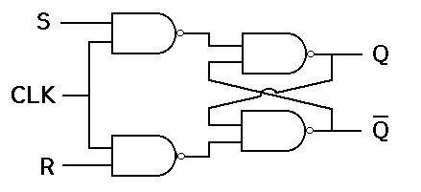
SR or RS Flip Flop
The operation of SR latch can be modified by providing an additional control input(CLK) that determines when the state of the circuit is to be changed.
It consists of an S-R latch circuit and 2 additional NAND gates
The pulse input acts as an enable signal for other two inputs.
The outputs of NAND gates 3 and 4 stay at logic 1 level as long as the CP input remains at o.
3
1
2
4

Slide 15
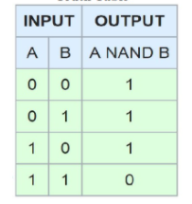
SR or RS Flip Flop
When the pulse input goes to 1, information from S or R is allowed to reach the output
The set state is reached with S=1,R=0 and CP=1.
This causes the output of gate 3 to go to 0 and output of gate 4 to remain at 1, and the output of flip-flop 1 to go to 1
3
1
2
4
NAND gate Truth Table

Slide 16
SR or RS Flip Flop
When CLK=1, the values of S and R are passed on to the gates 1& 2 via gates 3 & 4.
The Flip flop will be in set state when S=1 and R=0 and CP=1.
When S=0,R=1 and CLK=1, S-R moves to its reset state.
When both S and R =1 , causes both the o/p’s to momentarily go to 1.
When CLK is removed, state of Flip-flop is indeterminate,ie, either state may result.
When both S and R =0, it retains the previous state.

Slide 17
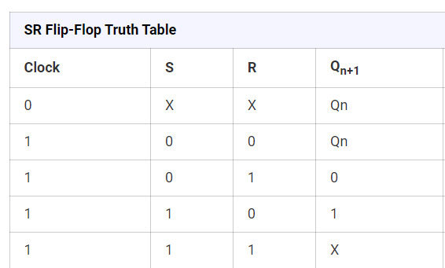
Truth Table
The Qn represents the state of the SR flip-flop before applying the inputs
Q_{n+1} represents the state of the SR flip-flop as output
Now if CLK is 0 irrespective of S & R circuit retains previous state

Slide 18
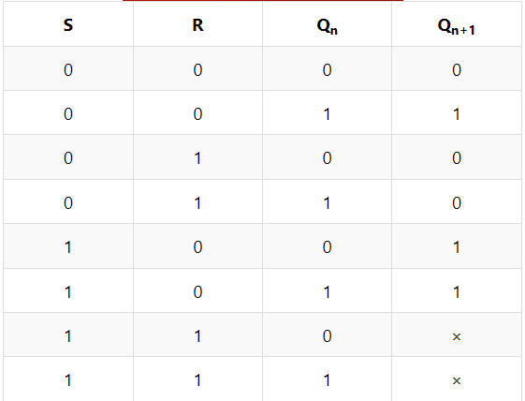
Characteristic Table
Characteristics table is determined by the truth table of any circuit.
It basically takes Q_{n}, S and R as its inputs and Q_{n+1} as output.
Q_{n+1} represents the next state while Q_{n} represents the present state.
While dealing with the characteristics table, the clock is high
for all cases i.e CLK=1.

Slide 19
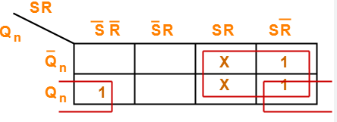
Characteristic Equation
The characteristic equation is an algebraic expression for the characteristic table's binary information.
It specifies the value of the next state of a flip-flop in terms of its present state and present excitation.(S & R Values)
The K-map for the next state Qn+1 in terms of present state and inputs is given
Q_{n+1} = S + Q_{n}R’

Slide 20
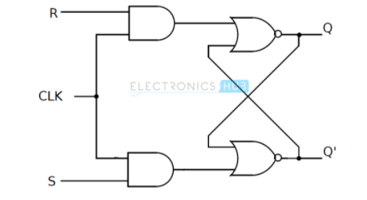
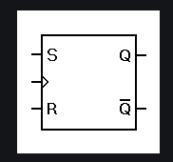
SR or RS Flip Flop
The same can be achieved by using NOR gates.
Not widely used in practical circuits because of their indeterminate state.

Slide 21
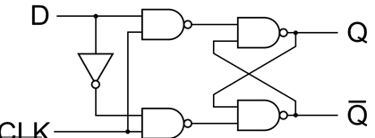
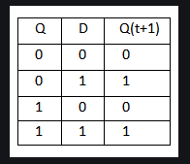
D flip Flop
Designed to eliminate undesirable condition of indeterminate state in S-R Flipflop.
The D-type flip flop is constructed from a SR flip-flop with an inverter(NOT gate) added between the S and the R.
There will be a single input D which goes directly to S input.
It ensures that inputs S and R are never equal to one at the same time, avoiding indeterminate state.
3
1
4
2

Slide 22

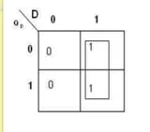

D flip Flop
As long as the CP input remains at o, the outputs of NAND gates 3 and 4 stay at logic 1 level and the circuit cannot change its state regardless of the value of D input.
The D input is sampled when clock pulse Cp=1.
If D=1, the Q output goes to 1, placing the circuit in set state.
If D=0 Q output goes to 0, placing the circuit in reset state.

Slide 23
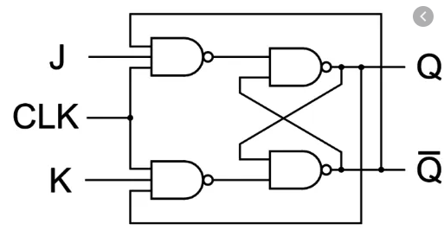
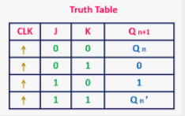
J K Flip flop
Modification of R-S Flip-flop to redefine the indeterminate state in R-S Flip flop
The behaviour of inputs J and K is same as the S and R inputs of the S-R flip flop.
The letter J stands for SET and the letter K stands for RESET/CLEAR

Slide 24

J K Flip flop
O/P of Q is feedback to the input of K along with CP, so that the Flip flop is reset only if Q was previously 1.
O/p of Q’ is feedback to the input of J along with CP, so that the Flip flop is set only if Q’ was previously 1.
It behaves like SR flip flop except when J=K=1.

Slide 25
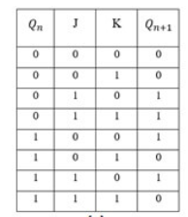
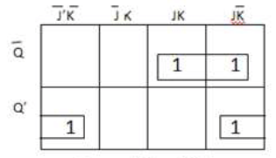

J K Flip flop
When both the inputs J and K have a HIGH state, the flip-flop switch to the complement state. So, for a value of Qn = 1, it switches to Qn+1=0 and for a value of Qn = 0, it switches to Qn+1=1.
When both J=K=0, it retains the previous state.

Slide 26
T Flip flop
Simpler version of the J-K flip flop.
Both the J and K inputs are connected together and thus are also called a single input J-K flip flop.
When clock pulse is given to the flip flop, the output begins to toggle, when T=1.
When T=0, it retains the previous state, provided clock is high.

Slide 27
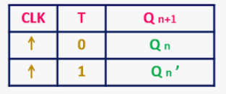
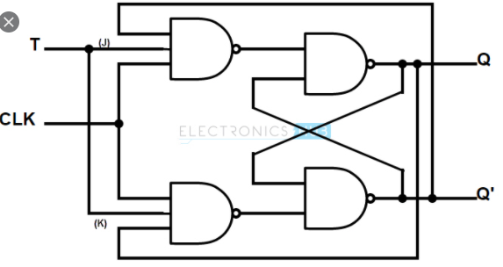
T Flip flop

Slide 28
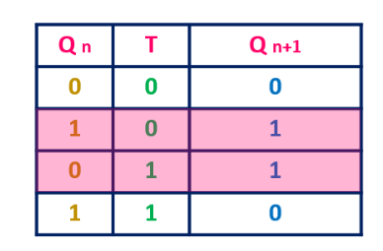

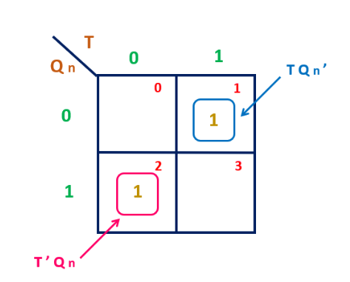

T Flip flop
Characteristic Table :
Characteristic Equation:

Slide 29
Registers

Slide 30
Introduction
groups of flip-flops, where each flip-flop is capable of storing one bit of information
An n-bit register is a group of n flip-flops.
store data words of n bit with typical word lengths of 8, 16, 32 or 64 bit.
Since each flip-flop is capable of storing either a "0" or a "1", there is a finite number of 0-1 combinations that can be stored into a register
Registers are synchronous circuits thus all flip-flops are controlled by a common clock line

Slide 31
Shift Register

