Slide 1


Slide 2


Slide 3


Slide 4
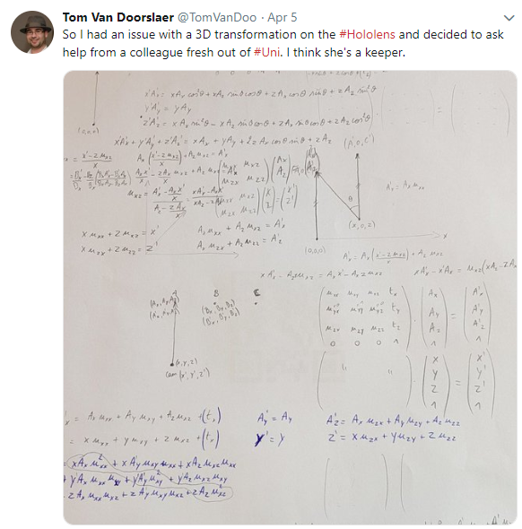

Slide 5


Slide 6


Slide 7
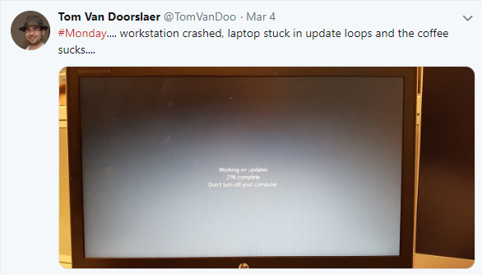

Slide 8


Slide 9


Slide 10
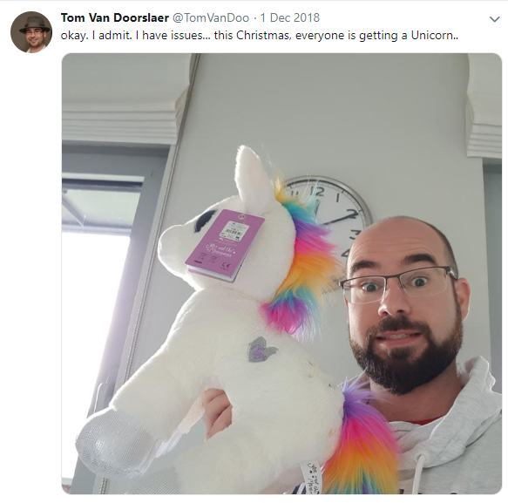

Slide 11
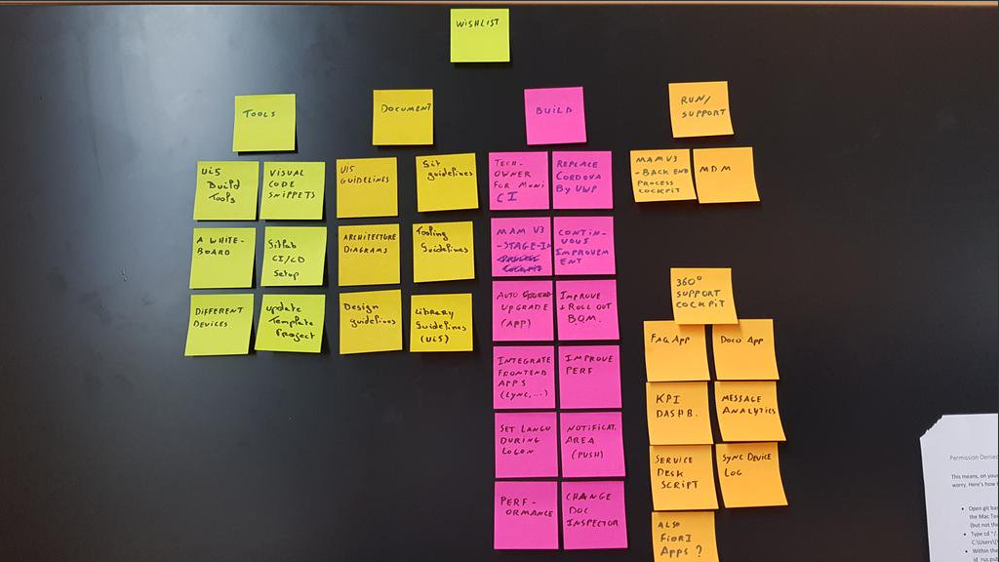

Slide 12
Issues
Started with Excel (yuck)
We tried post-its
Eventually settled for git

