Slide 1
MOTION

Slide 2
Motion
- an act, process, or instance of changing place.
- movement
2 Aspects to any Motion:
The movement itself, whether it is rapid or slow.
The issue of what causes the motion or what changes it.

Slide 3
Mechanics
- a branch of physics that focuses on the motion of objects and the
forces that caused the change.
2 Parts of Mechanics:
Kinematics – deals with concepts that are needed to describe motion w/o references to forces.
(One- dimensional motion)
2) Dynamics – deals with the effect that forces have on motion. (Two-dimensional motion)

Slide 4
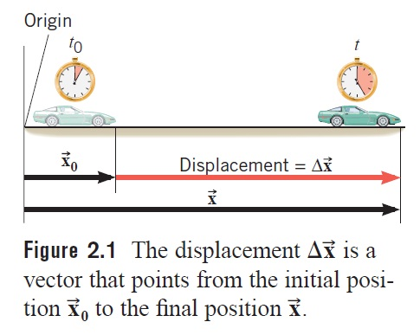
Kinematics
Displacement (s)
- is a vector that points from an object’s initial position to its
final position and has a magnitude that equals the shortest
distance between the two positions.
SI Unit: meter (m)
Ex) A honeybee leaves the hive and
travels a total distance of 2 km
before returning to the hive.
What is the magnitude of the
displacement vector of the bee?

Slide 5
Kinematics
2) Average Speed (v)
- being the distance traveled divided by the time required to cover
the distance:
SI Unit: meter per second (m/s)
Ex) How far does a jogger run in 1.5 hours (5400 s) if his average speed is 2.22 m/s?

Slide 6
Kinematics
3) Average Velocity(v)
- is the displacement of an object divided by the time required to cover the distance:
SI Unit: meter per second (m/s)
Ex) How far does a jogger run in 1.5 hours (5400 s) if his average speed is 2.22 m/s?

Slide 7
Kinematics
4) Average Acceleration(a)
- is the time rate at which the velocity changes:
SI Unit: meter per second squared (m/s²)
Ex) An automobile accelerates at a constant rate from 15 mi/h to
45 mi/h in 10 seconds while travelling in a straight line.
What is the average acceleration?

Slide 8

Ex) The initial speed of a car having excellent brakes is 30 mi/h.
When the brakes are applied, it stops in 2.0 seconds. Find the
acceleration.

Slide 9
Uniformly Accelerated Motion (Rectilinear Motion)
- is the simplest type of accelerated motions.
- is a motion in a straight line in w/c the direction is always the same and the speed changes at a constant rate.
Motion Equations:
1)
2)
3)
where: v_{f} = final velocity
v₀= initial velocity
t = elapsed time
s = displacement
SI Unit: meter per second squared (m/s²)
Ex) An automobile accelerates at a constant rate from 15 mi/h to
45 mi/h in 10 seconds while travelling in a straight line.
What is the average acceleration?

Slide 10
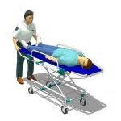
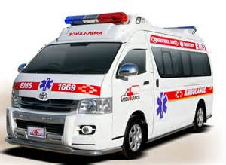
Ex) A gurney with a patient on it is pushed
at a constant acceleration of 2.0 m/s².
If the initial velocity of the gurney is 6.0 m/s,
Find its displacement after 8.0 seconds.
Ex) An ambulance accelerates uniformly from
a standstill to 88 ft/s in 4 seconds. What is
its acceleration? How far does it travel
during this time?

Slide 11
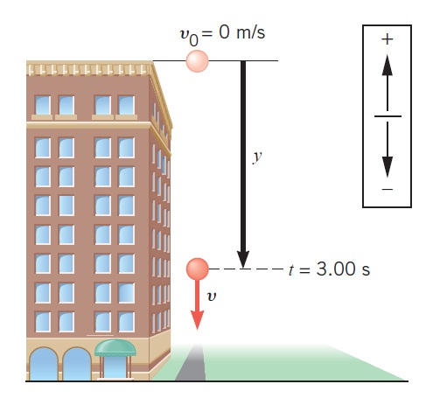
Special Cases of Uniformly Accelerated Motion
1) Free Falling Bodies
is an idealized motion in w/c air resistance is neglected & the
acceleration is constant.
the acceleration is called the acceleration due to gravity & is
directed downward towards the center of the earth.
The motion equations become:
1)
2)
3)
Ex. A stone is dropped from rest from the
top of a tall building. After 3.0 sec
of free fall, what is the displacement
of the stone? What is its velocity?

Slide 12
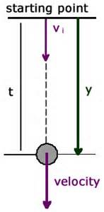
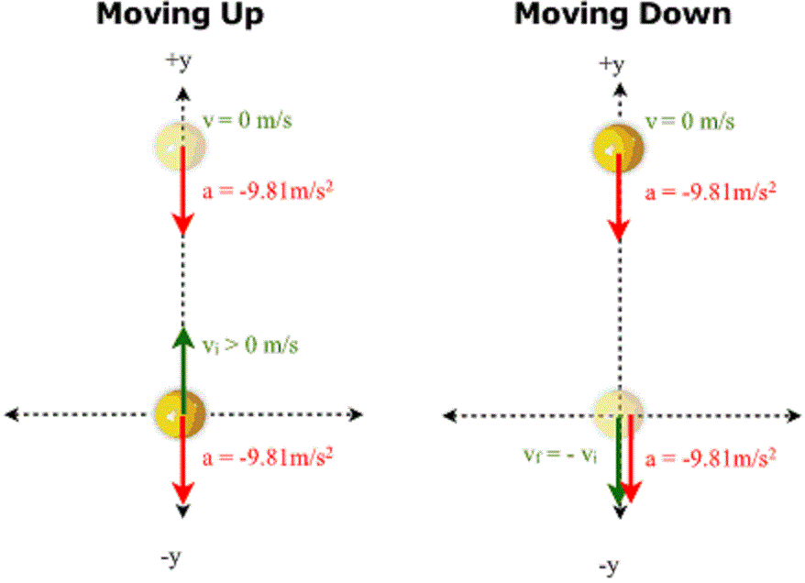
2) Object Thrown Vertically Downward
3) Object Thrown Vertically Upward

Slide 13
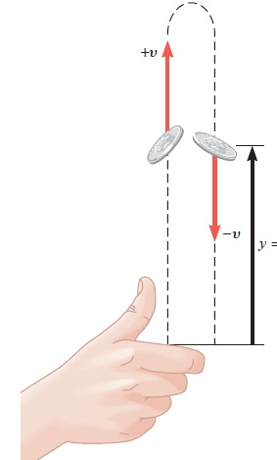
Ex) A coin is being tossed upward with an initial speed of
8 m/s. In the absence of air resistance,
(a) how high does the coin go above its point of release;
(b) what is the total time the coin is in the air before returning
to its release point?

Slide 14
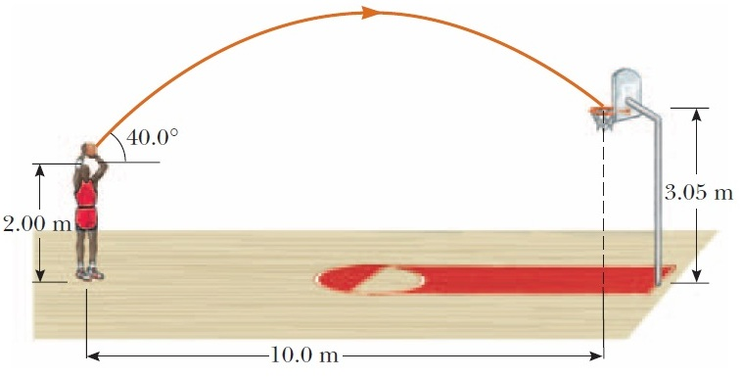
Projectile motion
A projectile is any body that is given an initial velocity and then follows a path determined entirely by the effects of gravitational acceleration and air resistance.
A batted baseball, a thrown football, a package dropped from an airplane, and a bullet shot from a rifle are all projectiles.

Slide 15
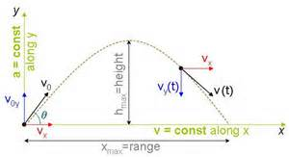
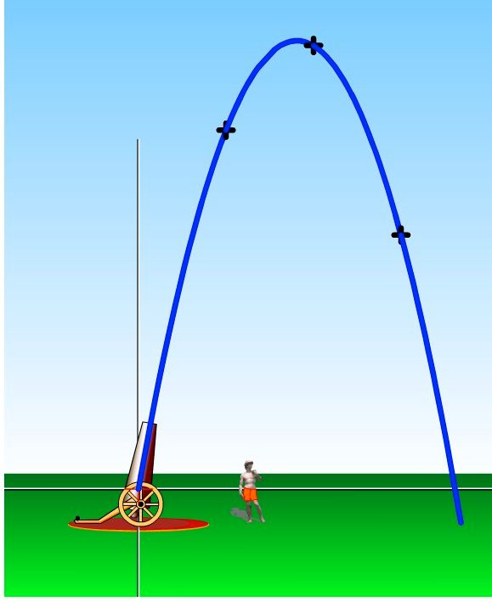
Projectile motion
is a form of motion where an object is thrown obliquely near the earth's surface, & it moves along a curved path under the action of gravity. The path followed by a projectile motion is called its trajectory.
Projectile motion only occurs when there is one force applied at the beginning of the trajectory after which there is no interference apart.

Slide 16
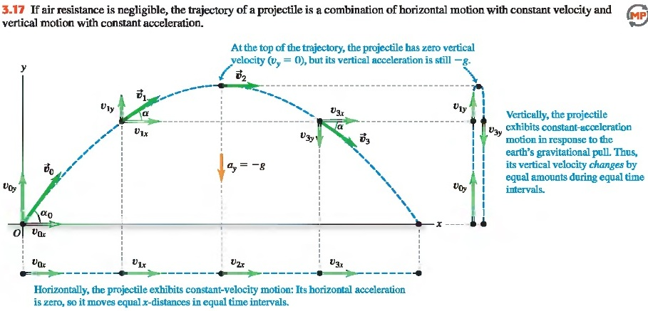
Projectile motion

Slide 17
Projectile motion
The important facts of projectile motion can be summarized as follows:
1. Provided air resistance is negligible, the horizontal component of the velocity vx remains constant because there is no horizontal component of acceleration.
2. The vertical component of the acceleration is equal to the free fall acceleration g.
3. The vertical component of the velocity vy and the displacement in the y -direction are identical to those of a freely falling body.
4. Projectile motion can be described as a superposition of two independent motions in the x - and y -directions.

Slide 18
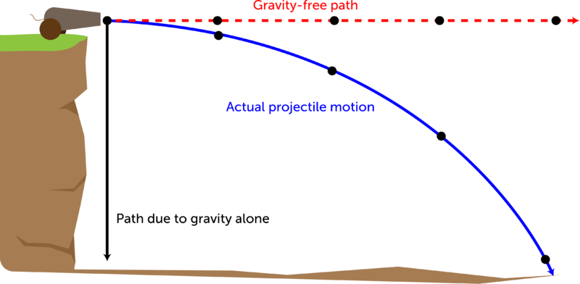
Projectile Motion
A body thrown horizontally with an initial velocity from a certain height. In this motion, there is no horizontal acceleration but there is vertical acceleration following the free fall acceleration. Further, the horizontal velocity is constant while the vertical velocity is increasing at the same time directed downward.

Slide 19
The following equations are used to determine the kinematic descriptions of the projectile motion
Projected Horizontally
Velocity along x-axis = Vx = Vo
Velocity along y-axis = Vy = gt
Actually velocity at any time t:
V = Vo2 + (gt)2
Angle ϴ, ϴ = arctan gt/Vo
Maximum Height : H = ½gt2

Slide 20
Maximum horizontal displacement, Range (R) = Vxt, where t is the total time of flight. Total time of flight: T = 2H g

Slide 23
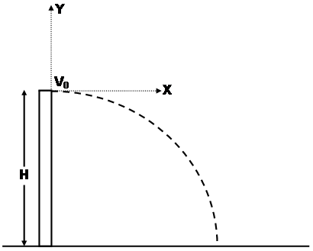
Ex. 2
A ball is projected horizontally with a velocity v_{o} of 8ft/s. Find it’s position and velocity after ¼ sec?
Given: v_{o} = 8 ft/s
t = ¼ sec
v_{o}

Slide 24

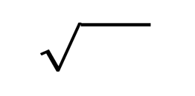

Solution:
The components of velocity are:
V_{x} = v_{o} = 8ft/s
V_{y} = -gt = -32ft/ s² (1/4 s) = -8ft/s
The resultant velocity is
v =
v =
=
=
v = 11.3 ft/s
The angle Ɵ is
Ɵ = tan⁻¹ v_{y}
v_{x}
Ɵ = tan⁻¹-8ft/s
8ft/s
Ɵ = 45˚
V_{x}² + v_{y}²
(8ft/s)² + (-8ft/s)²
64ft²/s² +64ft²/s²
128ft²/s²

Slide 25
Problem Set No. 3
Motion
You step onto a hot beach with your bare feet. A nerve impulse, generated in your foot, travels through your nervous system at an average speed of 110 m/s. How much time does it take for the impulse, which travels a distance of 1.8 m, to reach your brain?
The left ventricle of the heart accelerates blood from rest to a velocity of +26 cm/s.
(a) If the displacement of the blood during the acceleration is +2.0 cm, determine its acceleration (in cm/s²).
(b) How much time does blood take to reach its final velocity?

Slide 26
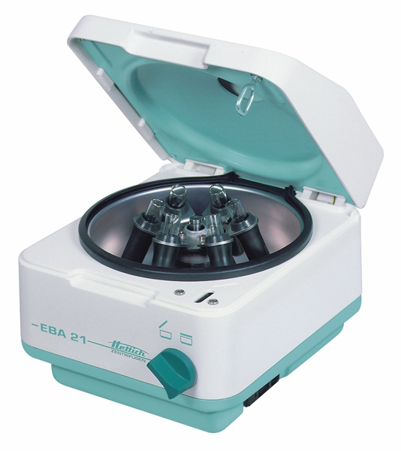
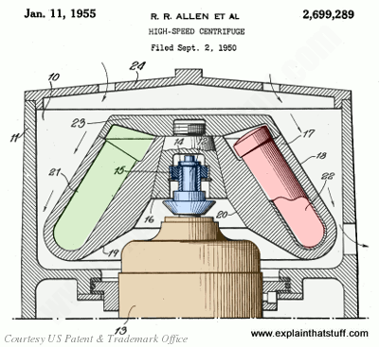

Slide 27
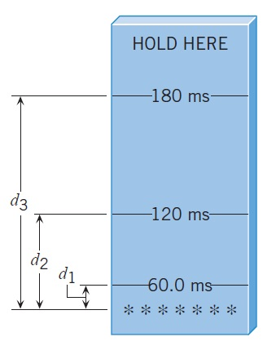
The drawing shows a device that you can
make with a piece of cardboard, which
can be used to measure a person’s reaction
time. Hold the card at the top and suddenly drop it. Ask a friend
to try to catch the card between his or her
thumb and index finger. Initially, your
friend’s fingers must be level with the
asterisks at the bottom. By noting where
your friend catches the card, you can
determine his or her reaction time in
milliseconds (ms). Calculate the distances
d₁, d₂, and d₃.

