Slide 1
ECON 4370: Applied Data Tools for Economics
Causal Inference
Difference-in-Differences
Conceptual Introduction & Storytelling
"What is the causal effect of X on Y?" — the central question in economics
Dr. Fidel González | Sam Houston State University | Spring 2026

Slide 2
Today's Journey
01
The Causal Question
What economists mean by causal effects — and the fundamental problem
02
London, 1854 — John Snow
The original natural experiment and the birth of causal thinking
03
The 2×2 DiD Table
From story to structure: turning intuition into a number
04
The Parallel Trends Assumption
The one thing DiD cannot give you for free — and when it fails
05
Modern Application
Card & Krueger (1994): minimum wages and employment
Dr. Fidel González | ECON 4370 | Sam Houston State University
2

Slide 3
The Central Question in Economics
What is the causal effect of X on Y?
Examples:
What is the effect of education on wages?
What is the effect of a minimum wage increase on employment?
What is the effect of pollution exposure on health?
What is the effect of a new policy on economic outcomes?
Dr. Fidel González | ECON 4370 | Sam Houston State University
3

Slide 4
Correlation Is Not Causation
We observe: Education ↑ → Wages ↑ Does education cause higher wages?
Maybe not — other factors could explain both:
Ability:
Talented people pursue more education AND earn higher wages — a common cause
Family background:
Wealthier families invest in education AND provide better job opportunities
Motivation:
Driven individuals choose more schooling AND work harder at their jobs
Causal inference is about ruling out these alternative explanations — systematically.
Dr. Fidel González | ECON 4370 | Sam Houston State University
4

Slide 5
The Fundamental Problem of Causal Inference
For each unit (person, city, firm), two potential outcomes exist:
OBSERVED
COUNTERFACTUAL (never observed)
Y(1)
Y(0)
−
Outcome if treated
Outcome if NOT treated
Causal Effect = Y(1) − Y(0) | The fundamental problem: we can only ever observe ONE of these.
We need a way to estimate Y(0) — the outcome that never happened.
Dr. Fidel González | ECON 4370 | Sam Houston State University
5

Slide 6
The Ideal Solution: Randomized Experiments
Randomly assign units to treatment or control — then compare outcomes.
Why randomization solves the problem:
On average, the control group is statistically identical to the treated group — same observable and unobservable characteristics
The control group is a valid Y(0): we can directly observe what would have happened without treatment
Treatment is independent of all other factors: Treatment ⊥ Confounders
In economics, randomized experiments are often impossible, unethical, or prohibitively expensive.
Economists rely instead on natural experiments and quasi-experimental designs.
Dr. Fidel González | ECON 4370 | Sam Houston State University
6

Slide 7
The Alternative: Natural Experiments
Situations where treatment is assigned 'as-if' randomly due to external circumstances.
Policy changes:
A law applies to some states but not others, or changes at a specific date
Geographic variation:
A river, border, or physical feature creates different treatment on each side
Historical accidents:
Timing of events creates groups that received different treatments by chance
Institutional rules:
Cutoff rules, lotteries, or quotas that determine who is treated
One of the most famous early natural experiments comes from London, 1854.
Dr. Fidel González | ECON 4370 | Sam Houston State University
7

Slide 8
PART 02
London, 1854
A physician, a pump, and the birth of causal thinking
"Before John Snow, the scientific consensus blamed cholera on bad air.
Snow believed the answer was in the data — and he was right."
Dr. Fidel González | ECON 4370 | Sam Houston State University
8

Slide 9
London, Summer 1854: A City Under Siege
The dominant theory: Miasma — bad air from filth caused disease. Scientific consensus. Dr. John Snow was a skeptic. He suspected contaminated water — but he needed evidence. The Soho outbreak of 1854 gave him a natural experiment. Hundreds died within days — but the deaths were not evenly distributed across the neighborhood.
500+
Deaths in 10 days
1854
Year of outbreak
Soho
Epicenter, London
Key question Snow asked: Why do some households have many deaths while nearby neighbors have none?
Dr. Fidel González | ECON 4370 | Sam Houston State University
9

Slide 10
The Natural Experiment: Two Water Companies
Snow's structural observation: two companies served interleaved households — same streets, same air, same 'miasma.'
Southwark & Vauxhall Co.
Lambeth Water Co.
Source: Thames at Hungerford (downstream of sewage outflow) Contamination: High — sewage in water supply Deaths (1854): 315 per 10,000 households
Source: Thames at Thames Ditton (upstream, above sewage) Contamination: Low — clean water source Deaths (1854): 37 per 10,000 households
The genius:
The ONLY systematic difference between interleaved households was the water company that served them.
This is causal identification: treatment variation is not caused by the outcome.
Dr. Fidel González | ECON 4370 | Sam Houston State University
10

Slide 11
Snow's Critical Insight: Add the Time Dimension
The real power came from a company decision that happened BEFORE the 1854 outbreak.
Before 1852
1852
1854 Outbreak
BOTH companies draw from the same polluted Thames section. Death rates are similar — no difference yet.
Lambeth moves its intake upstream to Thames Ditton — clean water. Southwark & Vauxhall does NOT move.
Now compare: what happened to EACH company's customers AFTER Lambeth's move?
DiD structure: Two groups (Lambeth = treated, S&V = control) × Two periods (Before 1852, After 1852) = the 2×2 table.
Dr. Fidel González | ECON 4370 | Sam Houston State University
11

Slide 12
From John Snow to Modern Econometrics
What Snow Did (1854)
What DiD Does (today)
Identified two groups: polluted vs. clean water
Identify a treated group and a control group
Observed outcomes BEFORE Lambeth's 1852 move
Collect outcome data BEFORE the policy change
Observed outcomes AFTER the move (1854 outbreak)
Collect outcome data AFTER the policy change
Used the unchanged group (S&V) as the counterfactual
Use the control group's trend to build the counterfactual
Difference-in-Differences formalizes Snow's logic into a rigorous econometric estimator.
Dr. Fidel González | ECON 4370 | Sam Houston State University
12

Slide 13
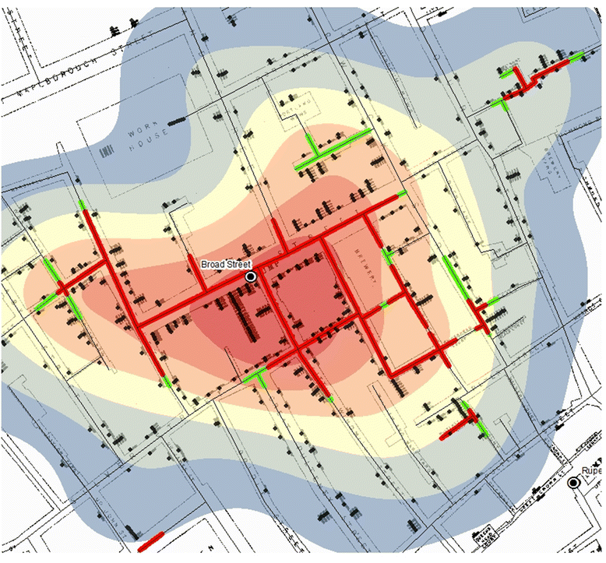
Map of the Cholera Outbreak

Slide 14
PART 03
The 2×2 DiD Table
Turning intuition into a number
Dr. Fidel González | ECON 4370 | Sam Houston State University
13

Slide 15
The Difference-in-Differences Table
Before (1849)
After (1854)
Difference
Lambeth
(Treated)
130
37
−93 ← ΔT
S&V
(Control)
135
315
+180 ← ΔC
DiD
(T − C)
−5 ≈ 0
−278
−273 ← DiD
(Deaths per 10,000 households)
DiD = (37 − 130) − (315 − 135) = −93 − (+180) = −273 Lambeth's cleaner water saved ≈273 lives per 10,000.
Dr. Fidel González | ECON 4370 | Sam Houston State University
14

Slide 16
Why We Subtract Twice: What DiD Removes
Outcome Y
Policy
Common time shock
(affects both groups)
Treatment
Net policy
effect
Baseline
difference
Control
Time
Before
After
First difference removes baseline level differences between groups (treated vs. control)
Second difference removes common time shocks that affect both groups equally (before vs. after)
What remains — under parallel trends — is the net causal effect of the policy
Dr. Fidel González | ECON 4370 | Sam Houston State University
15

Slide 17
PART 04
The Parallel Trends Assumption
The one thing DiD cannot give you for free
"DiD is only as good as the assumption that, in the absence of treatment, both groups would have followed the same trend."
Dr. Fidel González | ECON 4370 | Sam Houston State University
16

Slide 18
The Parallel Trends Assumption
Formal Statement:
In the absence of treatment, the average outcome for the treated group would have changed over time by the same amount as the average outcome for the control group.
In plain English:
✓
Groups can start at DIFFERENT LEVELS — parallel trends does NOT require identical baseline outcomes
✓
Groups must have the SAME TREND before the treatment — the slopes must be parallel in the pre-period
✓
This trend must be what WOULD HAVE CONTINUED after treatment if nothing had changed
!
This is an assumption about the counterfactual — it can never be directly tested, only made plausible
Dr. Fidel González | ECON 4370 | Sam Houston State University
17

Slide 19
DiD Graphically: The Clean Case
Outcome Y
← Parallel pre-trends →
Treatment
starts
Treatment
DiD
effect
Treatment
(counterfactual)
Control
Time
Before
After
The control group's trend builds the counterfactual for the treated group. DiD = gap between actual and counterfactual.
Dr. Fidel González | ECON 4370 | Sam Houston State University
18

Slide 20
When DiD Fails: Non-Parallel Pre-Trends
Outcome Y
Trends are NOT parallel before treatment →
DiD will mix trend differences with the policy effect
Treatment
starts
Treatment
Pre-period
gap is growing!
Control
Time
Selection bias: The treated group was already on a different trajectory before any treatment
Simultaneous shocks: Something else changed at the same time, but only for the treated group
Composition changes: The type of units in each group changes between periods (e.g., people move)
Dr. Fidel González | ECON 4370 | Sam Houston State University
19

Slide 21
Was Parallel Trends Plausible? Back to Snow.
Every DiD paper must evaluate this assumption explicitly — let's practice with Snow.
✓
Same neighborhoods
Lambeth and S&V customers lived on the same streets — same air, poverty, miasma. Only the water source differed.
✓
Similar pre-treatment trends
Before 1852, BOTH companies drew from the same polluted Thames section. Death rates were comparable — pre-trends were parallel.
✓
Exogenous treatment assignment
Lambeth moved its intake for business/engineering reasons — not because its customers were already getting healthier. No selection bias.
?
Potential concern: wealth differences
Wealthier households may have been more likely to be served by one company. Snow addressed this — the effect held even controlling for wealth.
Dr. Fidel González | ECON 4370 | Sam Houston State University
20

Slide 22
Modern Application: Card & Krueger (1994)
What is the effect of raising the minimum wage on employment?
A natural experiment from a state border:
New Jersey — TREATED
Pennsylvania — CONTROL
Minimum wage raised from $4.25 → $5.05
Fast-food employment observed before and after
Minimum wage did not change
Same fast-food restaurants observed over same period
The finding:
Employment in New Jersey's fast-food sector did NOT fall after the minimum wage increase. Using Pennsylvania's employment trend as the counterfactual, Card & Krueger found the wage hike had no significant negative effect — directly challenging the textbook prediction and reshaping policy debates.
Dr. Fidel González | ECON 4370 | Sam Houston State University
21

Slide 23
What We Built Today
01
Causal effects require counterfactuals
We want Y(1) − Y(0), but can only observe one. A valid comparison group estimates the missing potential outcome.
02
John Snow showed us the way
Two water companies, same streets, one policy change — a natural experiment born from circumstance.
03
DiD = subtract twice
First diff: change within each group over time. Second diff: subtract the control's change to remove common shocks.
04
Parallel trends is the key assumption
Without it, DiD mixes trend differences with the policy effect. Always check and defend it explicitly.
05
Real applications are everywhere
Card & Krueger (1994) used exactly this logic to challenge the textbook prediction on minimum wages.
Next: Implementing DiD in Python — regression form + testing parallel trends with real data
Dr. Fidel González | ECON 4370 | Sam Houston State University
22

