Slide 1
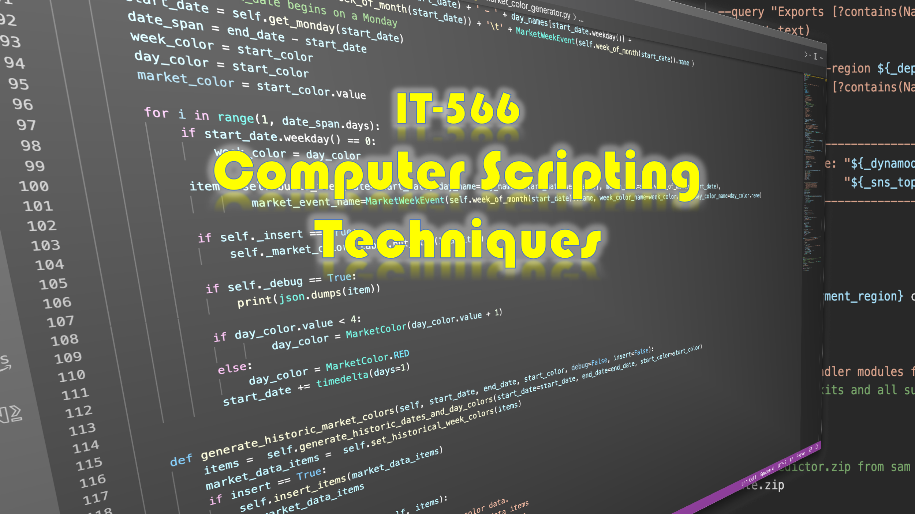

Slide 2
Week 2
Talking Points
Development Environment Setup and Configuration (Loose Ends)
Bash Build Script
Project Organization & Layout
Development Workflow
Topic

Slide 3
Development Environment Setup and Configuration (Loose Ends)

Slide 4
Development Environment and Configuration: Loose Ends
Homebrew MacOS Package Manager
Linux Package Manager
pipenv Setup, Usage & Why You Need It
tree Command
Configure ssh for git
.bash_profile Helpful Settings

Slide 5
Homebrew MacOS Package Manager

Slide 6
Linux Package Manager

Slide 7
Pipenv — Setup, Usage, and Why You Need It

Slide 8
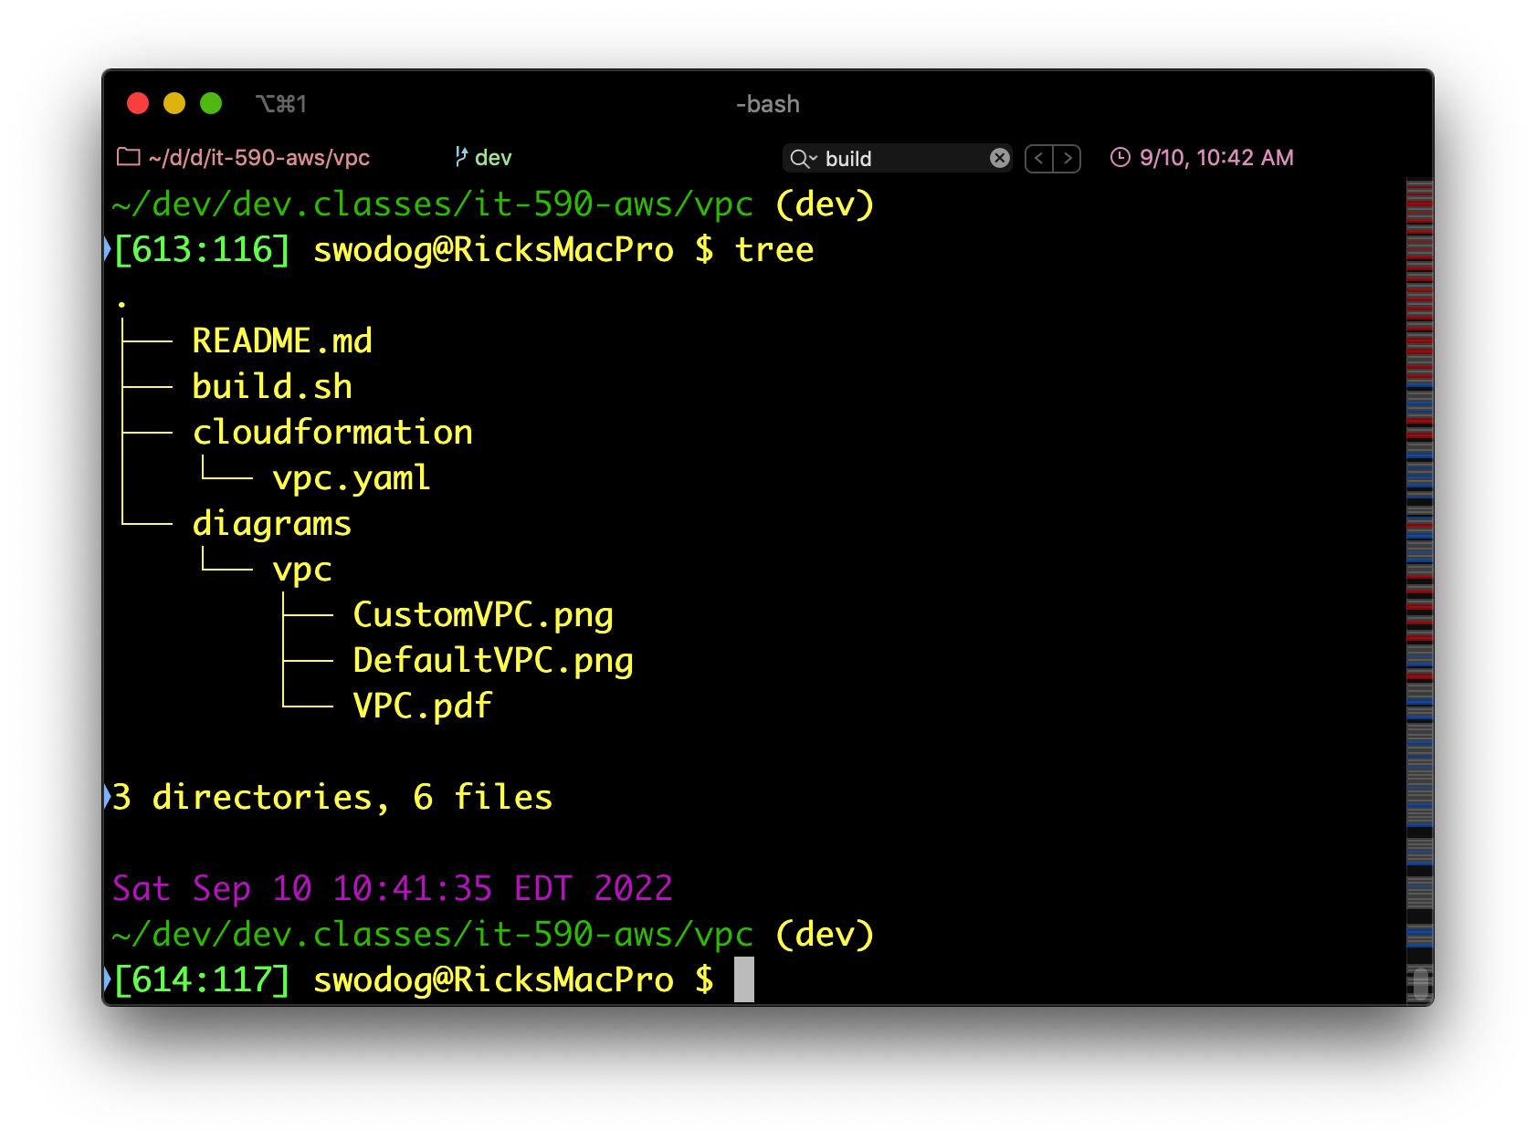
tree Command (MacOS)
Tree view of directory structure
Install with brew

Slide 9
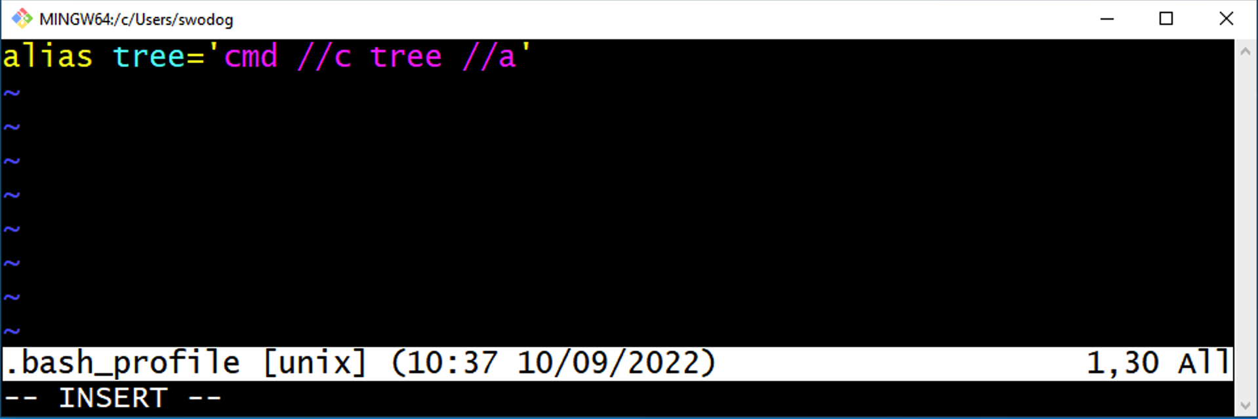
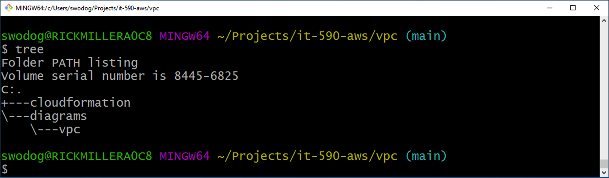
tree Command (Windows)
Add alias to tree command in .bash_profile
Comes with Windows
Must configure to use in git bash
Relaunch Git Bash

Slide 10

Oh Yeah? Show me!

Slide 11
.bash_profile Helpful Settings

Slide 12
Configure SSH for Git

Slide 13
Project Organization & Layout

Slide 14
Project Organization and Layout
Directory Structure

Slide 15
Bash Build Script

Slide 16
Bash Build Script
Topic

Slide 17
Development Workflow

Slide 18
Development Workflow
Topic

Slide 19
Development Workflow

