Slide 1
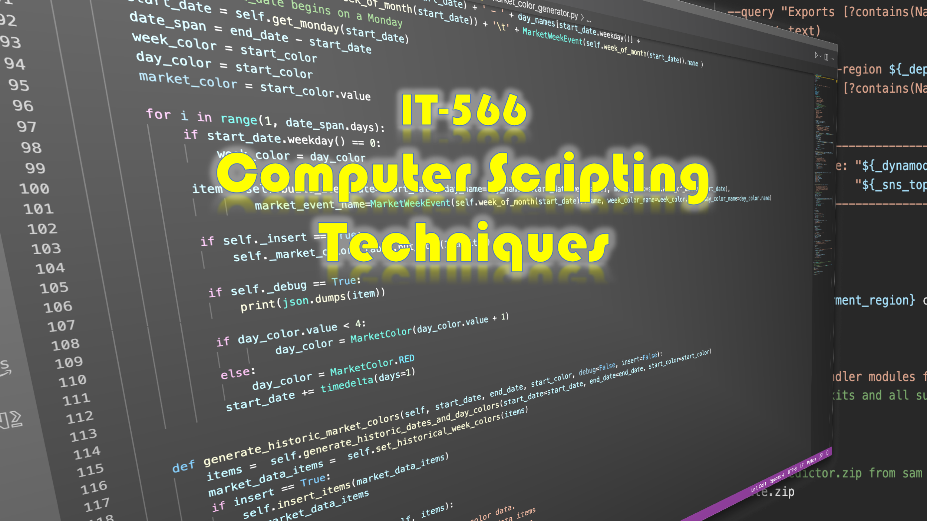

Slide 2
Week 3
Talking point…
Talking Points

