Slide 1
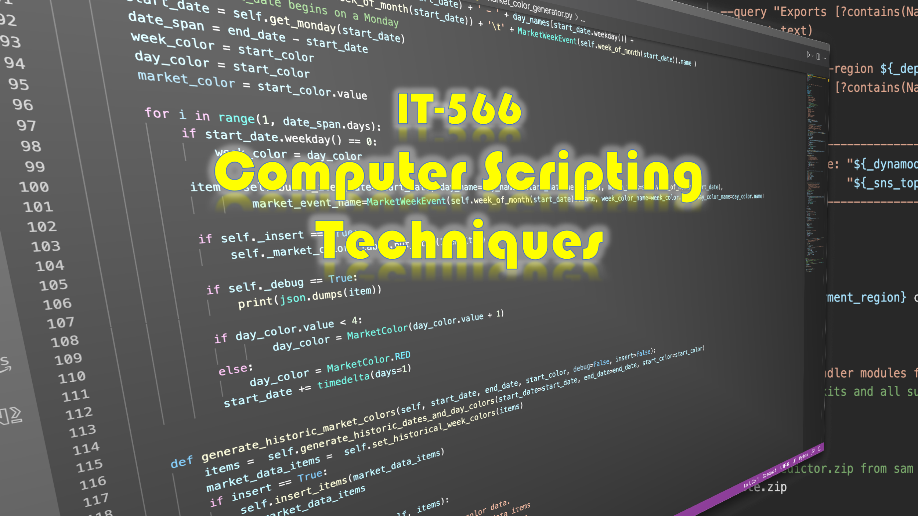

Slide 2


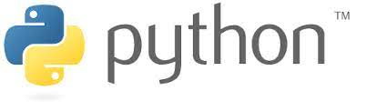

Focus

Slide 3
Along The Way…
GitHub
Methods
IDEs
Bash Syntax
Terminal Config
Unit Testing
Python Syntax
Terminal Commands
Git Commands
Python Syntax
Remote Repos
Constants
Software Design
List
Local Repos
SSH
Variables
SQL
Classes
Dictionary
Functions
File Handling
Exceptions
JSON
. . .

Slide 4
At Any Time…
But This Is What You’re Working On…
You Need to Know This Much Stuff…

Slide 5
How To Learn It All…
Python
Bash
Git
IDE
Software Design
. . .

Slide 6
How To Learn It All…
Python
Bash
Git
IDE
Software Design
. . .

Slide 7
How To Learn It All…
Python
Bash
Git
IDE
Software Design
. . .

Slide 8
How To Learn It All…Eventually
Python
Bash
Git
IDE
Software Design
. . .

Slide 9

Is There An Optimal Learning Sequence?
?

