Slide 1
Leap Data Engineering Track
Working with data in Spark

Slide 2

Data Engineering Roadmap
Business Requirements
Reporting
Data
Fundamentals
Data Modeling
Normalization
Data Analytics
Statistical
Programming
Core SQL
Data
Visualization
NOSQL
& Big Data
PL/SQL
Spark
Cloud
Data
Web Services & MongoDB
Data Quality & Cleansing
Data Integration

Slide 3
Course Description
How is this course valuable to a Data Engineer?
Understand how Spark fits into Big Data and NOSQL solutions
Learn benefits and limitations of each tool for a given set of requirements
Report against LARGE datasets in real time
Store and retrieve data at scale
Solve enterprise problems with best in class tools

Slide 4
Course Objectives
Introduce the architecture, operation, and business benefits of Spark
Explain how Spark differs from traditional database solutions
Explore the role and functionality of the core components of Spark

Slide 5
Course Contents
Introducing Spark
Spark Architecture
Introduction to RDD
Lambda
PySpark
DataFrames
SparkSQL
SparkStreaming
Notes:
The last two chapters are mainly self-study, but that we’ll cover if we have time.

Slide 6
Working with semi-structured data in Spark
Introducing Spark

Slide 7
Let’s Talk About
What is Spark?
RDD (Resilient Distributed Dataset)
How Spark fits into the technology stack

Slide 8

What’s Spark?
Open source (Apache)
Data processing framework
Highly available and fault tolerant
Runs fast
Easier to write and maintain

Slide 9
Where Is Spark Relevant?
The 3 V’s – Volume, Velocity, Variety
Horizontal scaling allows large volumes of data
Parallel processing solves velocity issues
Can be used to parse any kind of data
Being adopted by many companies
Excellent performance and linear scalability
Does NOT store, organize, or protect data.

Slide 10
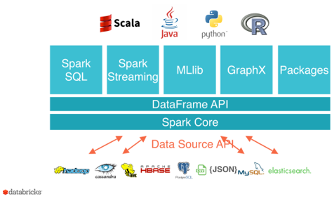
How Spark Adds Value
Fast performance
Automatic load balancing across nodes and network
Based on Map-Reduce concepts
Recovers automatically from lost nodes

Slide 11
Strengths and Weaknesses
Strengths
Makes parallel code easy to write
Tons of supporting libraries for python, ML, etc.
Automatic error handling
Weaknesses
Not well suited to all computational tasks
May not be the most efficient for all use cases

Slide 12
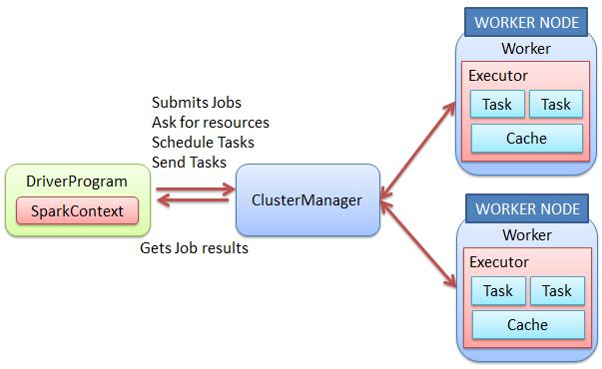
Spark architecture
Code interacts with driver.
Driver gathers resources and distributes work.
Workers handle the load and communicate progress.

Slide 13
Working with Spark
Spark can be deployed…
On a single machine (local)
On a dedicated cluster (stand-alone)
Shared resources with Hadoop using Yarn
Shared OS using Mesos
Cloud
You can start local and scale up as needed.
The same code should run on any of the above solutions!

Slide 14
Working with data in Spark
Introducing RDD
(Resilient Distributed Dataset)

Slide 15
RDD (Resilient Distributed Dataset)
Resilient = can rebuild data if a node fails
Distributed = can scale by splitting data across nodes and can track the state of the data as work completes
Dataset = supports semi-structured collections of records or objects
Developer creates RDD so Spark can manage data at scale
RDD cannot be changed once created. Changes to data require a new RDD. This is a good thing for parallelization and reproducibility

Slide 16
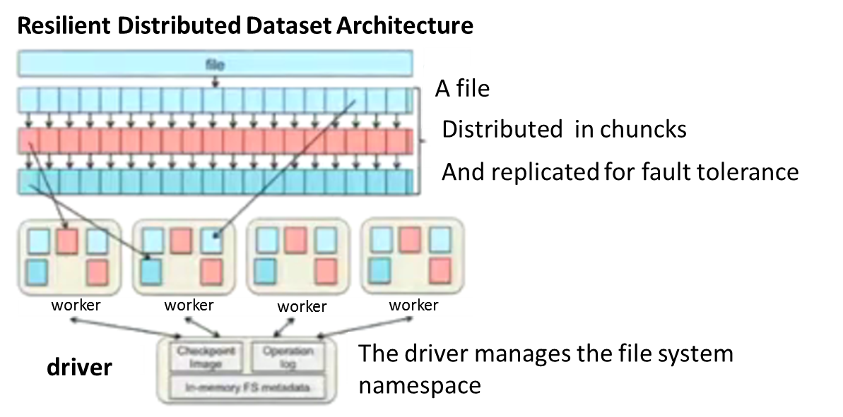
RDD (Resilient Distributed Dataset)
Data loaded into Spark is turned into an RDD
The driver breaks the RDD into chunks
Chunks are distributed to workers
RDD is lazily created
RDD can be cached in memory for re-use

Slide 17
RDD Transformations and Actions
Once an RDD is created it is immutable
Transformations allow you to access/change the data and then store it in a new RDD
Transformations don’t occur until an Action is called (lazy execution)
Notes:
.

Slide 18
RDD Transformations and Actions
Common Transformations:
map: the most basic component of map/reduce with 1:1 correspondence to the original data
flatMap: returns a number of items different from the original data
filter: only keep those elements for which the filter function is TRUE
distinct: only retain the unique elements of the entire RDD
reduceByKey: group elements by key and keep the data distributed
mapPartitions: similar to map but done on a per-partition basis (requires a generator function)
sortBy: sort using the provided function
Notes:
.

Slide 19
RDD Transformations and Actions
Common Actions:
collect: pulls all elements of the RDD to the driver (often a bad idea...)
collectAsMap: like collect but returns a dictionary to the driver which makes it easy to lookup the keys
reduce: reduces the entire RDD to a single value
countByKey/countByValue
take: yields a desired number of items to the driver
first: returns the first element of the RDD to the driver (useful to inspect your data)
Notes:
.

Slide 20
A simple RDD in Python
import pyspark
#Create context to access spark driver
sc = pyspark.SparkContext('local[*]’)
#Add data to context creating an RDD
rdd = sc.parallelize(range(1000))
#Display a random sample of data from RDD
rdd.takeSample(False, 5)
rdd.take(2) #Show first 2
rdd.collect() #Show all – bad if there is a lot of data!

Slide 21
Working with Spark in Python
Lambda

Slide 22
Lambda anonymous functions
Lambda allows us to create anonymous functions
Spark can easily parallelize these functions
Here is a python function:
def fn_multiply (num1,num2):
return num1 * num2
Here is a Lambda function:
fn_multiply = lambda num1, num2 : num1 * num2
Calling the function is the same for both: fn_multiply(2,3)
You can use lambda directly – no need to assign it to a variable.
It always has a single expression that is returned
Notes:
.

Slide 23
Lambda transformations
#Conditionals
fn = lambda x,y: ['Pass', (x+y)/2] if x>=85 and y>=85 else ['Fail', (x+y)/2]
print( fn (75,95) )
#Filter
n = range (-10,10)
neg = list(filter(lambda x: x<0, n))
print(neg)
Notes:
.

Slide 24
Lambda Actions
#Reduce
# we define a list of integers
numbers = [1, 4, 6, 2, 9, 10]
# Define a new lambda function to combine values and wrap in parenthesis
# Convert x and y to strings and create a tuple from x,y
Combine = lambda x,y : "(" + str(x) + ", " + str(y) + ")"
# Use reduce to apply combine function to numbers data
from functools import reduce
reduce(combine,numbers)
Notes:
.

Slide 25
Lambda with Spark
# Using Map and Reduce with Spark to convert Celsius to Kelvin
# First we create an object that Spark will manage
from pyspark import SparkContext
sc = SparkContext.getOrCreate()
temp_c = [10, 3, -5, 25, 1, 9, 29, -10, 5]
# Create an RDD of the data
rdd_temp_c = sc.parallelize(temp_c)
# Spark will now do the work!
rdd_temp_K = rdd_temp_c.map(lambda x: x + 273.15).take(5)
print(rdd_temp_K)
reduce(lambda x,y:x+y,rdd_temp_K)
Notes:
.

Slide 26
Working with Spark in Python
PySpark

Slide 27
Creating our first Spark objects
PySpark allows us to write python code that scales
To do this we need a spark driver and a context
from pyspark import SparkConf, SparkContext
conf = SparkConf().setAppName('Word Counts').setMaster("local[*]")
SparkContext.getOrCreate(conf=conf)
Notes:
.

Slide 28
How would you parse this?
To be, or not to be, that is the question:
Whether 'tis nobler in the mind to suffer
The slings and arrows of outrageous fortune,
Or to take arms against a sea of troubles
And by opposing end them. To die—to sleep,
No more; and by a sleep to say we end

Slide 29
WordCount example
import sys, re
from pyspark import SparkConf, SparkContext
conf = SparkConf().setAppName('Word Counts')
sc = SparkContext.getOrCreate(conf=conf)
wordcounts = sc.textFile("file:///home/foryou/shakespeare.txt") \
.filter(lambda line: len(line) > 0) \
.flatMap(lambda line: re.split('\W+', line)) \
.filter(lambda word: len(word) > 0) \
.map(lambda word:(word.lower(),1)) \
.reduceByKey(lambda t1, t2: t1 + t2) \
.map(lambda x: (x[1],x[0])) \
.sortByKey(ascending=False)\
.persist()
top5words = wordcounts.take(5)
print(top5words)
Notes:
.

Slide 30
Working with Spark in Python
DataFrames

Slide 31
DataFrames
DataFrames vs RDD vs DataSets
DataFrames and DataSets are built on top of RDD
In Spark 2.0, DataFrames and DataSets are merged
So… what is a DataFrame?
Notes:
.

Slide 32
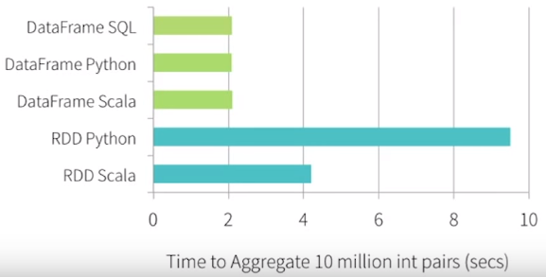
What is a DataFrame
DataFrames are like tables
Built on top of RDD
Improved performance
DataSet with named columns

Slide 33
SparkSession
Create a context for working with spark
SparkSession replaces SparkContext, SQLContext, HiveContext
Can read from CSV, JSON, JDBC, stream
import org.apache.spark.sql.types._
val mySchema = new StructType().add(“ID", "long").add(“Age", "integer")

Slide 34
DataFrame
Pull some CSV data into a DataFrame (using schema we just created)
val df = spark.read.format("csv").option("header", false).schema(mySchema).load("file:///myData/coolFile.csv")
Show the data
df.show()
+--+---+
|ID|Age|
| 1 | 29|
| 2 | 36|

Slide 35
Write some SQL
Create a temporary view
df.createOrReplaceTempView(“ageTable”)
val sqlDF = spark.sql(“SELECT ID, Age from ageTable where ID = 2”)
Show the results
sqlDF.show()
+--+---+
|ID|Age|
| 2 | 36|

Slide 36
Easy to get started but powerful
Create functions and reusable code
Cache data for fast re-use
Add and remove temporary views
Clear cache quickly

Slide 37
Working with Spark in Python
SparkSQL

Slide 38
from pyspark import SparkConf, SparkContext, SQLContext
sc = SparkContext.getOrCreate()
sqlCon = SQLContext(sc)
data = sqlCon.read.format("csv")\
.option("header", "true")\
.option("inferSchema", "true")\
.load("file:///home/jovyan/foryou/mega city.csv")
data.registerTempTable("testData")
mySQL = sqlCon.sql("select * from testData where Patio > 300 order by Patio desc")
mySQL.show(10)

Slide 39
myStates = "Alabama Alaska Arizona Arkansas California Colorado“
from pyspark import SparkConf, SparkContext, SQLContext
sc = SparkContext.getOrCreate()
sqlCon = SQLContext(sc)
rdd = sc.parallelize(myStates.split(" "))
from pyspark.sql import Row
rowData = rdd.map(lambda x: Row(StateName=x))
df = sqlCon.createDataFrame(rowData)
df.registerTempTable("tblStates")
mySQL = sqlCon.sql("select StateName from tblStates")
mySQL.show(10)

Slide 40
Working with Spark in Python
SparkStreaming

Slide 41
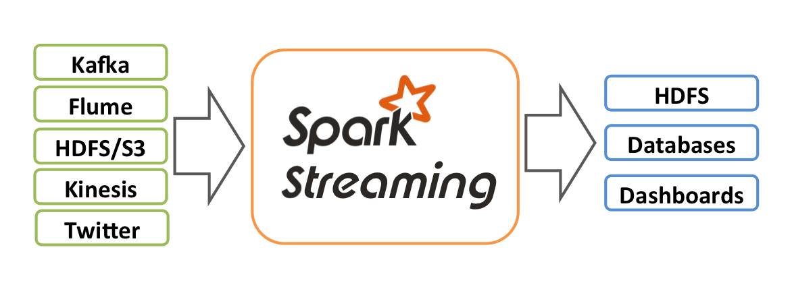
Streaming data with Spark?!?
Yup.
TwitterUtils.createStream(...) .filter(_.getText.contains("Spark")) .countByWindow(Seconds(5))

Slide 42
Working with semi-structured data in Spark
Importing CSV Data

Slide 43
Allowing SparkSQL to infer the schema
from pyspark import SparkConf, SparkContext, SQLContext
sc = SparkContext.getOrCreate()
sqlCon = SQLContext(sc)
data = sqlCon.read.format("csv")\
.option("header", "true")\
.option("inferSchema", "true")\
.load("file:///data/mega city.csv")
data.registerTempTable("testData")
mySQL = sqlCon.sql("select Licensee, Capacity, Patio from testData where Indoor > 300 and Patio > 100 order by Capacity desc")
mySQL.show(3)
mySQL.printSchema()

Slide 44
Working with semi-structured data in Spark
Course Summary

Slide 45
Course Summary
Spark provides fast, reliable, redundant analysis and retrieval of data
Many components make it flexible:
Support for multiple languages
SparkSQL
Spark Streaming
Spark ML

Slide 46
Spark Conclusion
Spark is here to stay
100x performance under the right conditions
Flexible
Multiple API’s
Multiple languages
Multiple data stores
Why isn’t everyone using it?
If it ain’t broke
Not all abstractions are created equal
Custom written MapReduce in Java will not migrate without significant effort and testing…

Slide 47
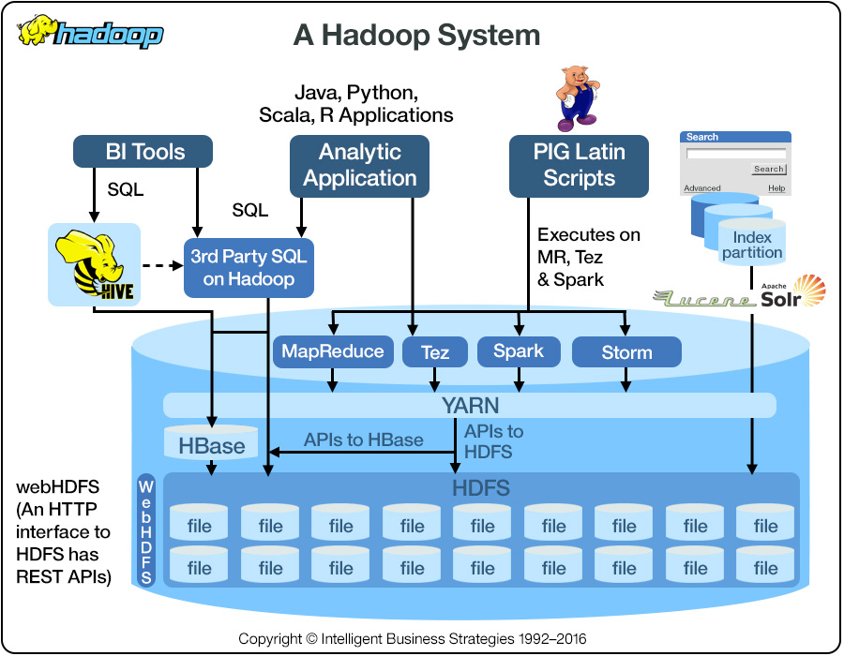
Spark on Hadoop

