Slide 1

Sage 300 - TPAC 2024 Penang, Malaysia Web API Subclassing
John Thomas (JT)
Principal Software Architect
October 2024

Slide 2
Table of contents
Vision
Software Architecture
Web API Subclassing
Overview of Web API
Overview of Subclassing
In-depth Web API and demo
Notes:
And questions, suggestions and feedback are valuable for delivering an API and an SDK that meets as many needs, and requirements of the developer community as possible. So, please let your voice be heard!

Slide 3
Vision
Software Architecture
The Sage 300 Desktop architecture is based on separation of core business logic from user interface and database services
Sage 300 Web Screens aims to be a truly modular, cloud-ready, customizable and extensible business management solution that enables users, customers and partners to achieve a higher level of efficiency and innovation
The Sage 300 Desktop and Web architectures have been created by Sage and is owned by Sage. These architectural technologies are the key distinction between Sage and our competitors.
Notes:
The Sage 300 desktop has been around for decades, and its architecture is solid and fundamentally sound.
The Sage 300 web screens have been around since 2015 and leverages the business and database components of the Sage 300 application. The web screens are architected with the same level of integrity as the other Sage 300 components.
A superior software architecture enables products built within its framework to adapt to fast changing technology and stand the test of time. Sage has made a substantial investment in developing the Sage 300 architectural framework—and this investment continues with the web-based framework for Sage 300 web screens.

Slide 4
Web API
API
REST
OData
Install
Payloads
Access
Security
OpenAPI
Goal
“The goal of the Web API is to provide a stateless protocol for a simple and effective strategy for interacting with Sage 300 data”
Notes:
Starting off with the API, the goal of the API is to provide a simple and effective way to interact with Sage 300 data.
An API, if done correctly, standardizes the exchange of data. Differing technologies or programming languages may have gathered or will receive the data, but the API strategy will allow for seamless communication.
So, let’s see how this is accomplished.

Slide 5
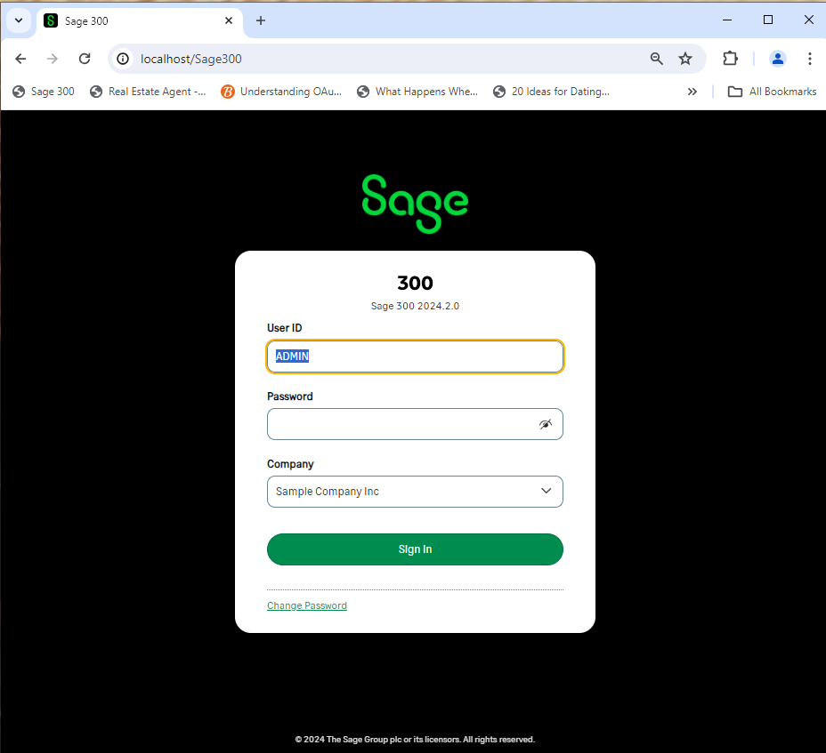




Web API
RESTful Web Services
Request
RESTful
Lightweight MVC Objects
Response
.NET API
MVC Objects
SQL Server
Business Views
APIs are at the heart of Sage 300 and leveraged from multiple clients and technologies
Notes:
The API consists of RESTful web services that use a lightweight MVC model to communicate with the Sage 300 .NET API. This lightweight model is generated by a wizard which generates these models from the Accpac Business Views. Thus, the API does not use the same models as the Web Screens since those models are decorated with attributes and use a mapping layer to move data in and out of the model. The models in the API use reflection to move data in and out.
For those of you who have worked with the .NET API, the web services are a wrapper around this .NET API, which in turn is a wrapper around our COM API. That’s great news since whether data is being accessed via COM, or the .NET API or the web services, the same business logic – validations, restrictions, assumptions, etc., are executed. This API while having a different interface, access and other features will access data with the same integrity as the other APIs.
As you can see, APIs are at the heart of Sage 300.
Let’s consider OData.

Slide 6
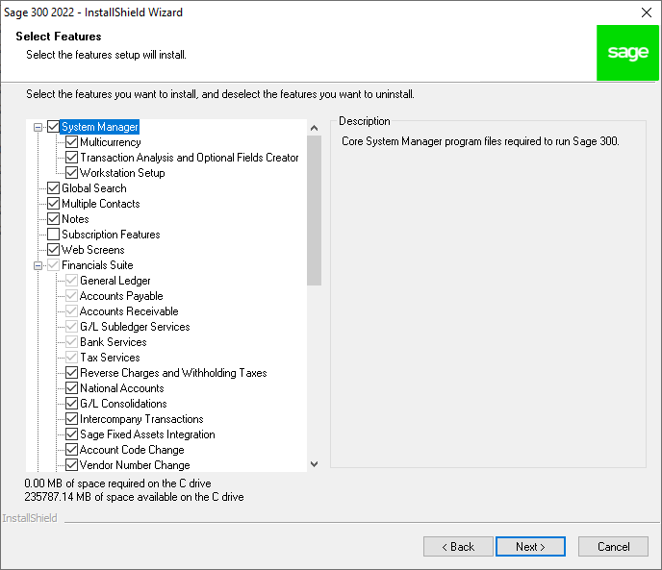
Web API
Installation
Installed with the Web Screens
Notes:
The API is installed when the Sage 300 Web Screens are installed and are part of the application, not the SDK. Although users of the API will typically be SDK users, this is not a requirement. Because of the OData protocol, the OpenAPI implementation (Swagger), the simple to understand URL segments, and simply the technical ability of our partners and customers, using the API is intuitive. The API is installed with the web screens option, and they are ready to use!
There have been some discussions that this API should be a separate installation and not tied to the web screen installation. I’d be interested to hear your thoughts on this!
The Sage 300 web screens even use the API internally to support our integrations with Sage Intelligence Reporting Cloud (SIRC) and Sage CRM. The security groups for the module’s resources must be enabled otherwise access will be denied. I’ll talk about this more when we cover security for the API.
Note, unlike our other APIs, this API does not consume a LanPak license! Let me repeat that. The usage of this API does not consume a LanPak license.
Let’s now talk payloads.

Slide 7
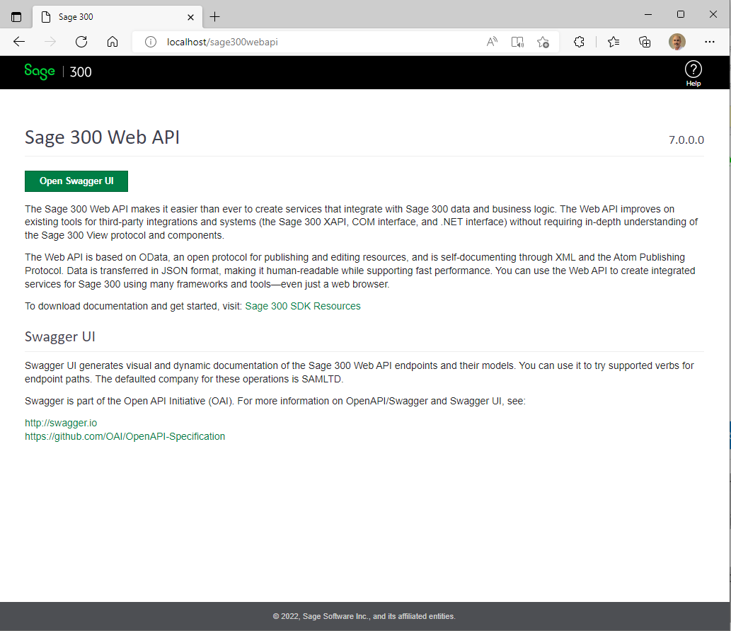
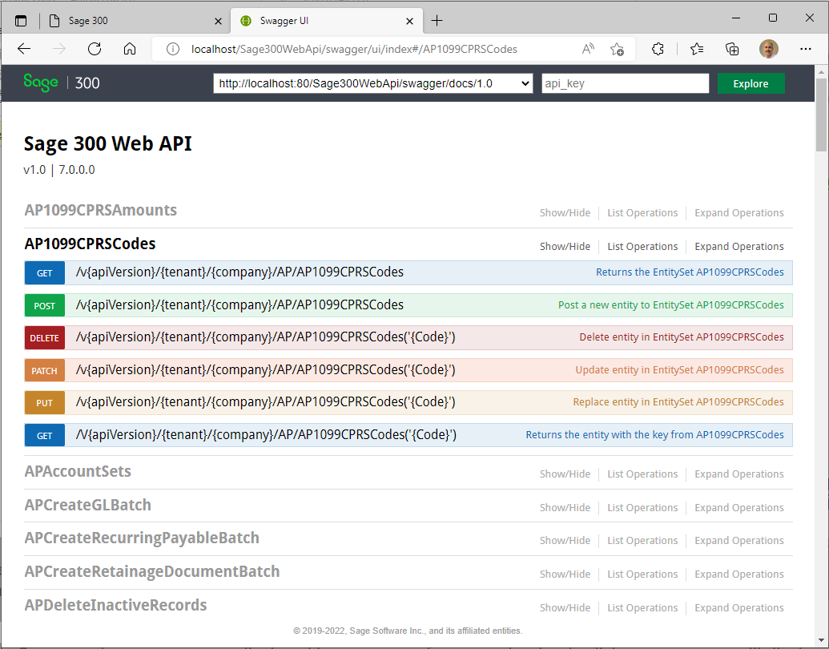
Web API
OpenAPI (Swagger)
Sage 300 Web API Landing Page
Swagger UI
Notes:
Sage 300 provides a landing page where the consumer of the API can go for useful links and resources. The “Open Swagger UI” button will display the Swagger UI for codeless and untethered access to Sage 300 data.
The OpenAPI or Swagger is a specification for machine-readable interface files for describing, producing, consuming and visualizing RESTful web services and Sage 300 has leveraged Swagger to provide a collection of HTML, JavaScript, and CSS assets that dynamically generate beautiful documentation from a Swagger-compliant API. This dynamic documentation feature eliminates the need for static documentation and at the same time offers an intuitive and robust UI for driving the API.
Once in Swagger, the resources are displayed in a summary format and a simple click on a resource will display the various actions or verbs supported by the resource. Note that not all actions are supported by every resource, and we’ve had to decide if a resource should even be exposed (i.e., payroll or users, etc.)). The SDK has documentation for our resources (although Swagger also provides this documentation) as well as a developer reference guide.
What about coded access?

Slide 8
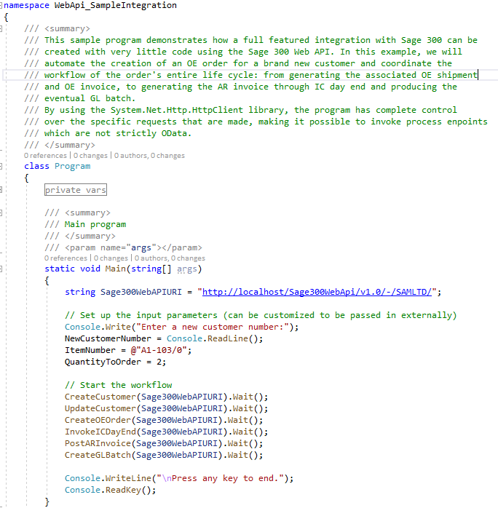
Web API
Coded Access
Samples and Tutorials
Documentation
Notes:
You can use the language of your choice for coded access.
In the SDK you will find multiple completed samples along with documentation with step-by-step instructions for creating the samples from scratch.
For example, the Integration Sample uses a C# console program to illustrate how easy it is to make API calls and you will programmatically create a customer, update the customer, create an order, invoke the inventory control’s day end, post an invoice and finally create a batch all through the API. This is a great sample for getting used to the API and programmatically driving it as well.
There are a couple of other samples that invoke other functionalities such as retrieving a range of customers, retrieving a customer with a key, deleting a customer, and creating an invoice.
There is even a sample that uses Chrome’s Postman Utility to load an execute Postman scripts. This sample was created prior to the adoption of Swagger, and we feel that Swagger is more intuitive, provides better documentation and is easier to use than Postman. However, for the postman users, this sample is still valid and handy!
How about security?

Slide 9
Web API
Benefits
API
Easy to use
Less data transfer
Consistent
No UI
Integration
JSON
Notes:
That’s our Sage 300 Web API!
There are numerous benefits to using it, such as:
It is quick and easy to use whether you are using Swagger to access it or have written a coded access
The structured nature of the endpoints (segments, version, resources, naming conventions, etc.) along with the OData implementation makes for a consistent experience. And consistency is the key!
It supports JSON for a smaller and faster payload plus the payloads can even be minimized to only require requested and/or required fields
Finally, the API can play an important role in any integration, testing, debugging, or validation story
Let’s move on to the SDK.

Slide 10
Subclassing
Overview
Achieving parity between the desktop and the web screens allows user to choose either the desktop or the web screens when using Sage 300.
The subclassing of business views to expose additional fields and functionalities are a core aspect that illustrates the flexibility of the Sage 300 architecture. However, this flexibility is only partially available in the web screens.
The missing functionality is the ability to display and interact with fields added to a business view. When a partner subclasses a business view, these added or joined fields will likely be required to be displayed on a screen for user interaction.
The new Subclassing strategy combined with the Customization strategy in the web brings subclassing that has always been available in the desktop to the web!

Slide 11
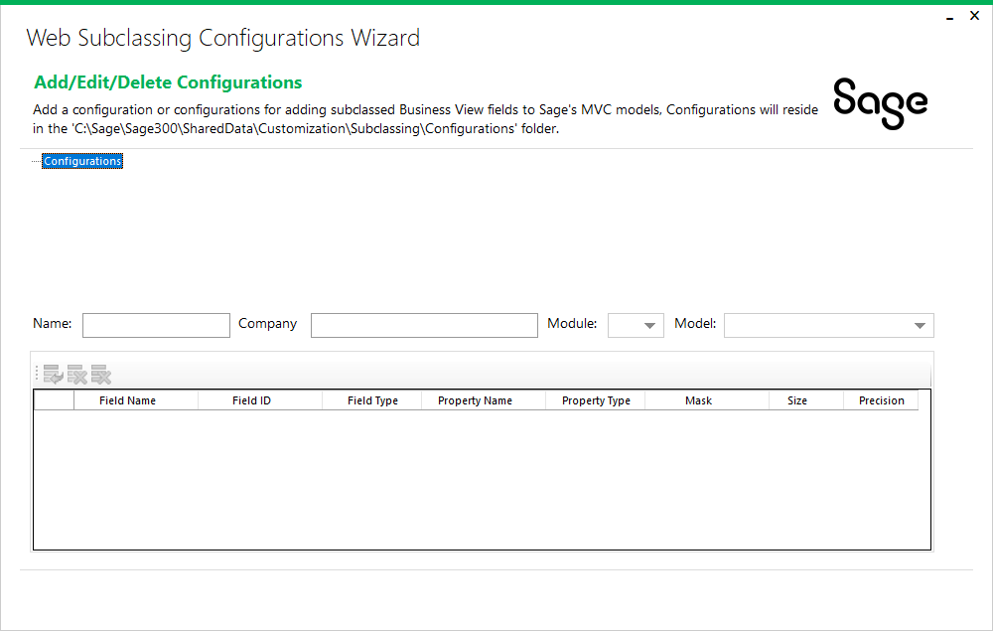
Web SDK
Web Subclassing Configurations Wizard
Create, modify, and delete JSON subclassing configurations
JSON configurations used to describe and associate subclassed fields for an entity (view) and MVC model
Used by external developers to extend the static MVC models to included subclassed fields
To be leveraged by the Web Subclassing Compiler and Deployment Wizard
Notes:
The Web Subclassing Configurations Wizard, which is a standalone executable, is delivered as a binary in the Web SDK’s bin\wizards folder.
This wizard will create JSON configurations that will be used to extend the MVC models in the web screens to expose subclassed fields in the business view.
Refer to the SDK for doc on this wizard

Slide 12
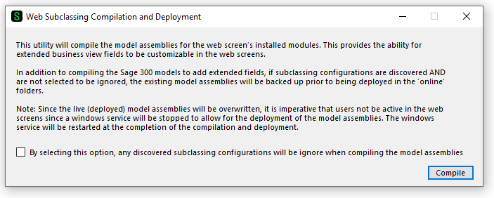
Web SDK
Web Subclassing Compilation and Deployment Wizard
Extend Sage’s MVC models to included subclassed fields from the business view
JSON configurations used to extend the MVC models and recompile the models for deployment by partners
Used by external developers to extend the static MVC models to included subclassed fields
Leverages the configurations created by the Web Subclassing Configuration Wizard
Optionally remove any extended fields by selecting the option to ignore configurations
Notes:
The Web Subclassing Compilation and Deployment Wizard, which is a standalone executable, is delivered as a binary in the Web SDK’s bin\wizards folder.
This wizard will discover any JSON configurations created by the Web Subclassing Configurations Wizard to add these extended properties to the MVC models and then recompile the MVC models which can then be delivered to a customer site.
Refer to the SDK for doc on this wizard

Slide 13

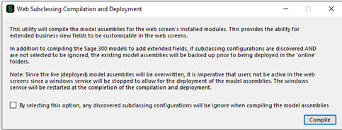
Subclassing
Web Screens Wizards
The Web Subclassing Configurations Wizard is partner facing for the generation and modification of configurations that will later be consumed by the Web Subclassing Compiler and Deployment Wizard.
The Web Subclassing Compiler and Deployment Wizard is partner facing for the consumption, or not, of configurations that will add extended properties to Sage 300 MVC models and deploy the compiled assemblies to the local installation.
A customization will now be able to add these extended properties to the web screen.

Slide 14

Subclassing
Web Screens – Subclassing Already Applied
Pacific Tech has supplied us with a subclassing to the Vendor business view. Many thanks!
Let’s see these extended fields in the View Doc
Let’s see the Vendor screen with these extended fields displayed with Web Screen customization
Let’s move onto the Web API and extend the Vendor API

Slide 15
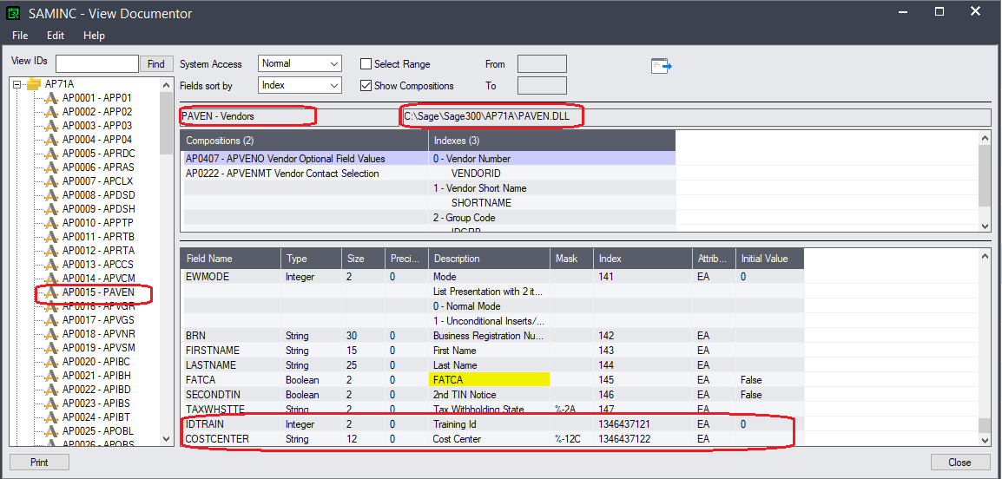
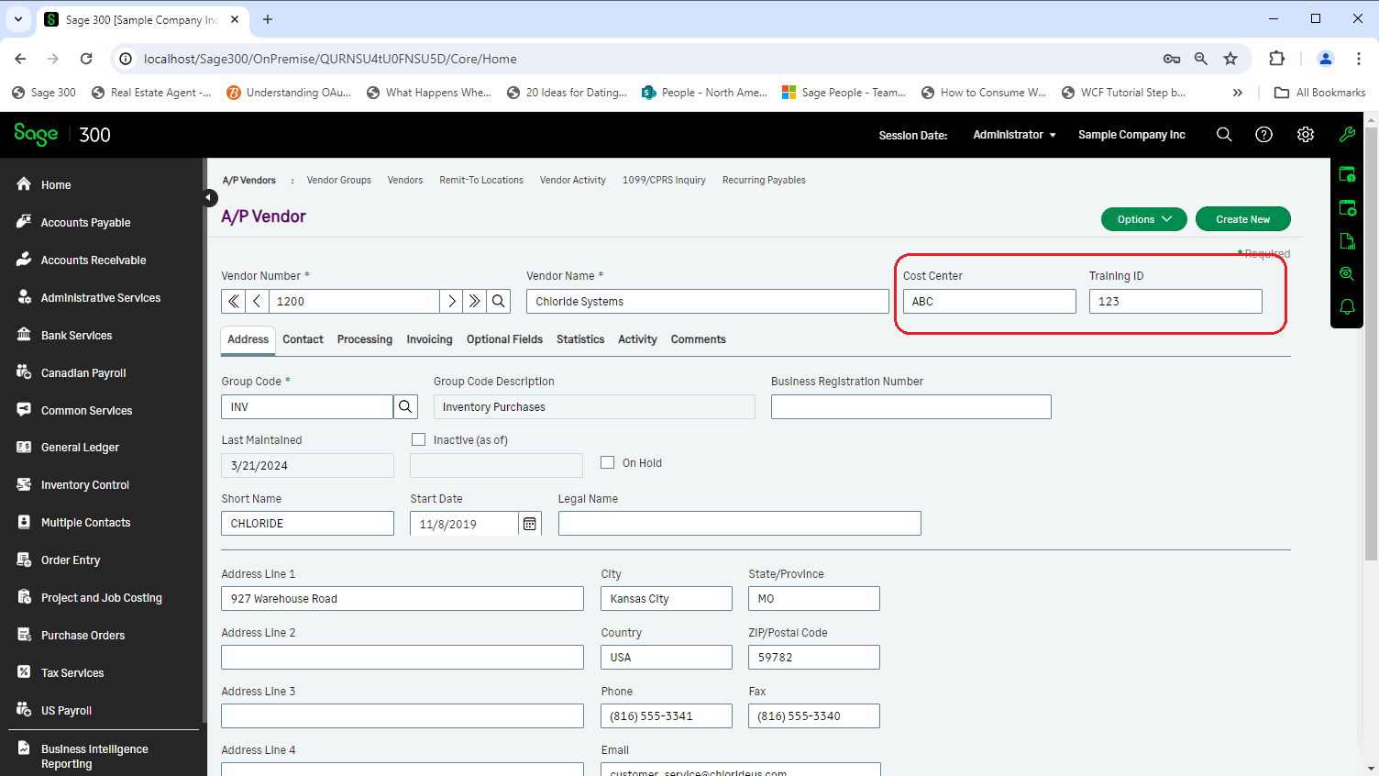
Subclassing
Web Screens – Vendor View and Web Screen

Slide 16
Subclassing
Web API
Using the same subclassing from Pacific Tech
Let’s run the Wizard to create a project
Let’s extended the Sage 300 Vendor endpoint
Let’s copy the assembly to the ..\Online\WebApi\bin folder for discovery
Re-start IIS and Launch the Sage 300 Web API

Slide 17
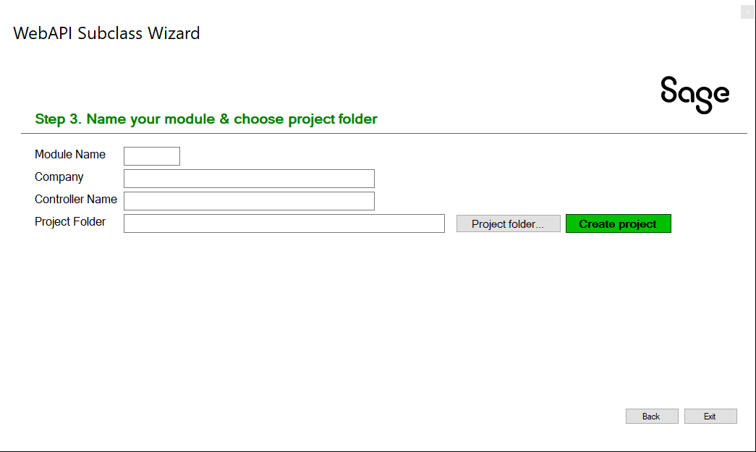
Subclassing
Web API Wizard
The Web API Subclassing Wizard is partner facing for the generation and extension of API endpoints in the Sage 300 Web API.
The Web API has simpler requirements (i.e., no UI) from the Web Screens and therefore a simpler wizard.
This wizard creates a partner specific endpoint while preserving the Sage 300 endpoint for a selected resource.

Slide 18
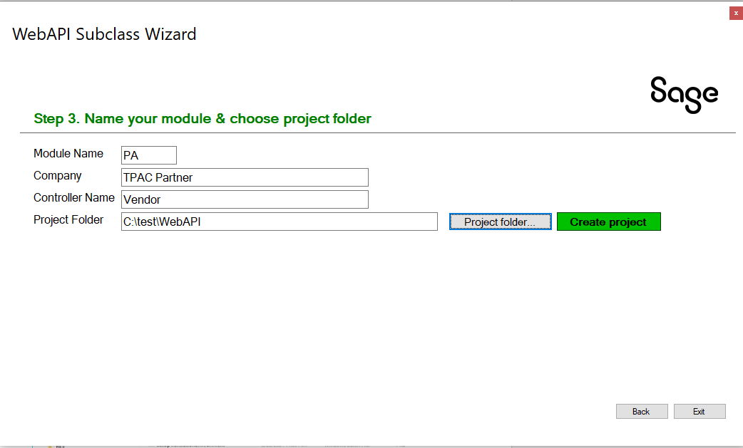
Subclassing
Web API Wizard
Let’s run the Wizard to create a project

Slide 19
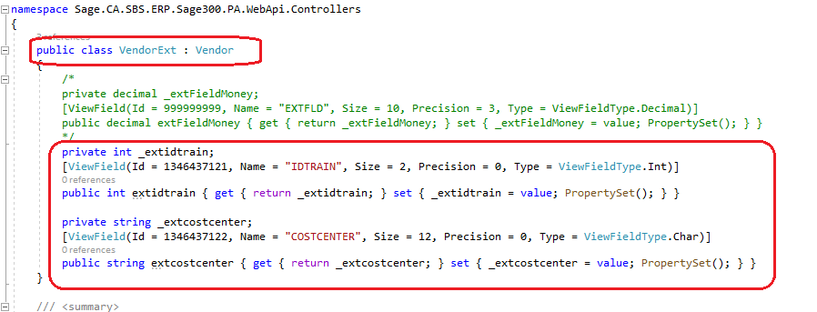
Subclassing
Web API Wizard
Let’s extended the Sage 300 Vendor endpoint

Slide 20
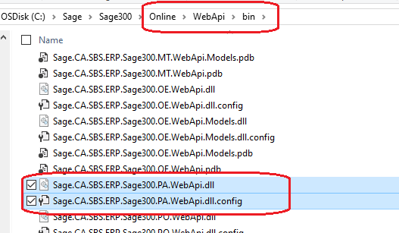
Subclassing
Web API
Let’s copy the assembly to the ..\Online\WebApi\bin folder for discovery

Slide 21
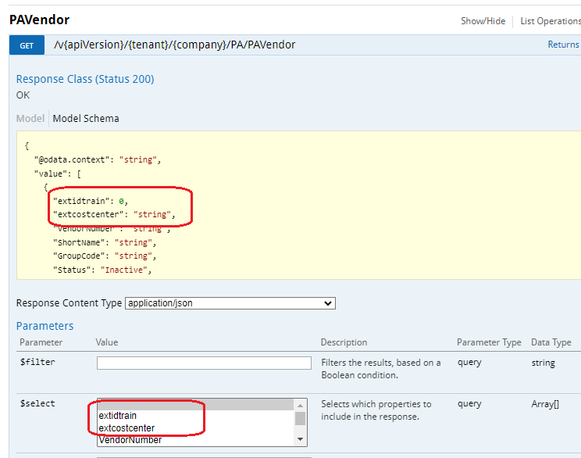
Subclassing
Web API Swagger
Re-start IIS and Launch the Sage 300 Web API (localhost\Sage300WebApi

Slide 22
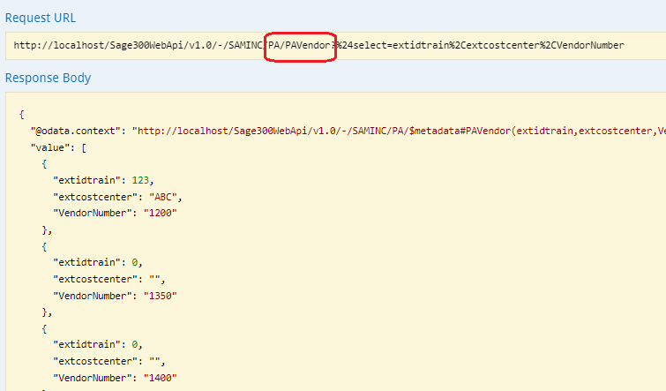
Subclassing
Web API – Looking at URL in Swagger

Slide 23
Subclassing
Summary
Web API
Easy to use, less data transfer, No UI, consistent, JSON, Integration
Subclassing
Expose additional fields and functionalities
Configurations Wizard
Compilation and Deployment Wizard
Use Customization Strategy in the UI to display extended fields
Web API Wizard

Slide 24
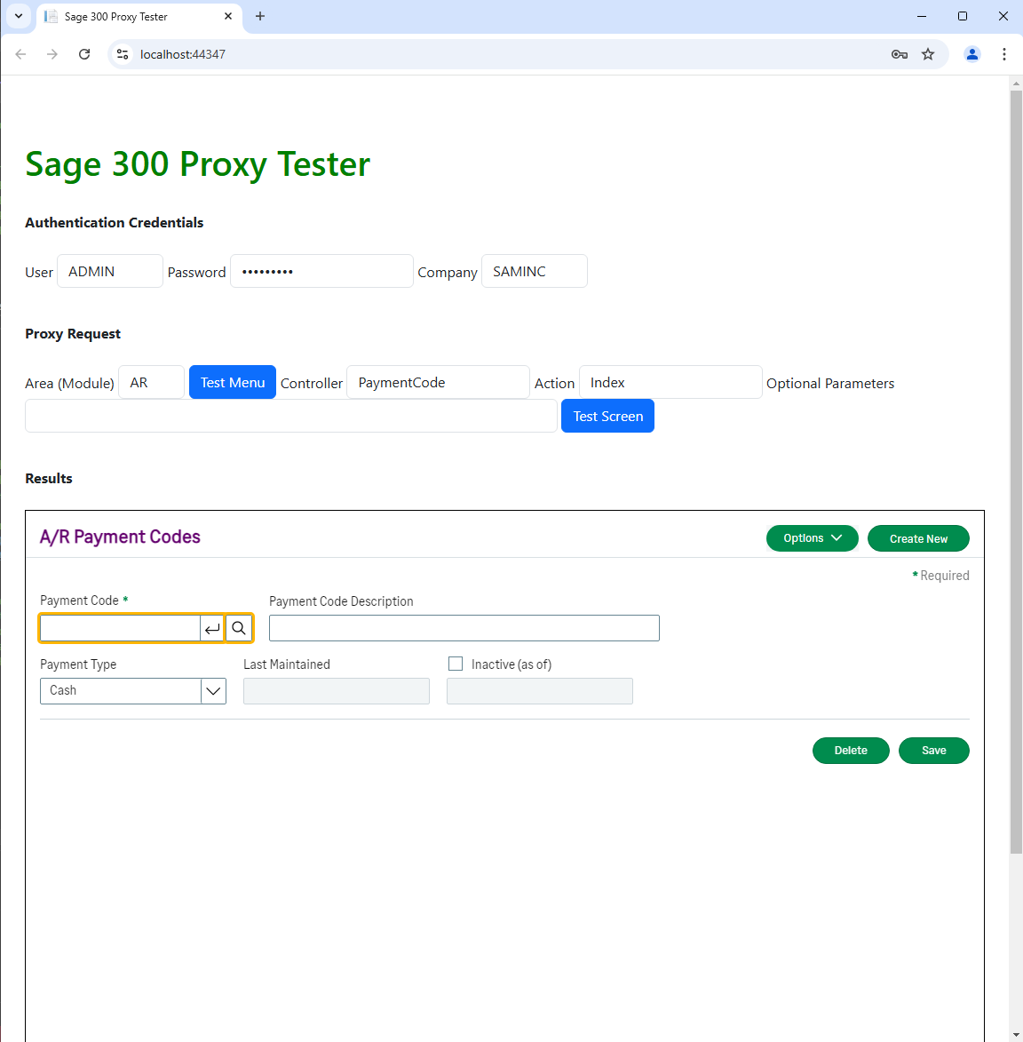
The Proxy is Coming!
Proxy for all using Elliptical Encryption
Proxy allows Sage 300 Web Screens to be hosted in partner web application
Elliptical Encryption for asymmetric public-private keys
No information in URL (it’s in the headers!)
Proxy Tester available in Web SDK 2025.1
Doc on Proxy and Proxy Tester in docs/utilities

Slide 25

The Future is Now!
GitHub Copilot
Are you using GitHub Copilot?
We are! Our developers and QA engineers all have GitHub licenses starting in January 2024.
From a developer perspective we are already seeing increased velocity and developer satisfaction, and well, some amazement too
We will be investigating how we can leverage this in the wizards as well
We’d love your feedback and experiences!

Slide 26
Thank you!

