Slide 1

Sage 300 - TPAC 2024 Penang, Malaysia Translations
John Thomas (JT)
Principal Software Architect
October 2024

Slide 2
Table of contents
Vision
Software Architecture
Translations
Quick Overview for Desktop
In-depth Overview and Demo for Web

Slide 3
Vision
Software Architecture
The Sage 300 Desktop architecture is based on separation of core business logic from user interface and database services
Sage 300 Web Screens aims to be a truly modular, cloud-ready, customizable and extensible business management solution that enables users, customers and partners to achieve a higher level of efficiency and innovation
The Sage 300 Desktop and Web architectures have been created by Sage and is owned by Sage. These architectural technologies are the key distinction between Sage and our competitors.
Notes:
The Sage 300 desktop has been around for decades, and its architecture is solid and fundamentally sound.
The Sage 300 web screens have been around since 2015 and leverages the business and database components of the Sage 300 application. The web screens are architected with the same level of integrity as the other Sage 300 components.
A superior software architecture enables products built within its framework to adapt to fast changing technology and stand the test of time. Sage has made a substantial investment in developing the Sage 300 architectural framework—and this investment continues with the web-based framework for Sage 300 web screens.

Slide 4
Translation Package
Overview - Desktop
Sage 300 is localized in five languages: English, Spanish, French, Chinese Simplified and Chinese Traditional.
Partners may require the ability to localize in other languages beyond the five supported languages. While this has been possible in the desktop in the past and with great involvement by Sage personnel, this ability seems to have been lost over time.
The Translation Package new for the Sage 300 2025 release has also been made available for Sage 300 2024. This package will allow partners to configure and setup the environment for compiling and will guide you through the process of creating the required files to be used by a translator.
Note: this Translation Package is for the desktop resources and for the web, a Language Resource Wizard already exists in the Web SDK!

Slide 5
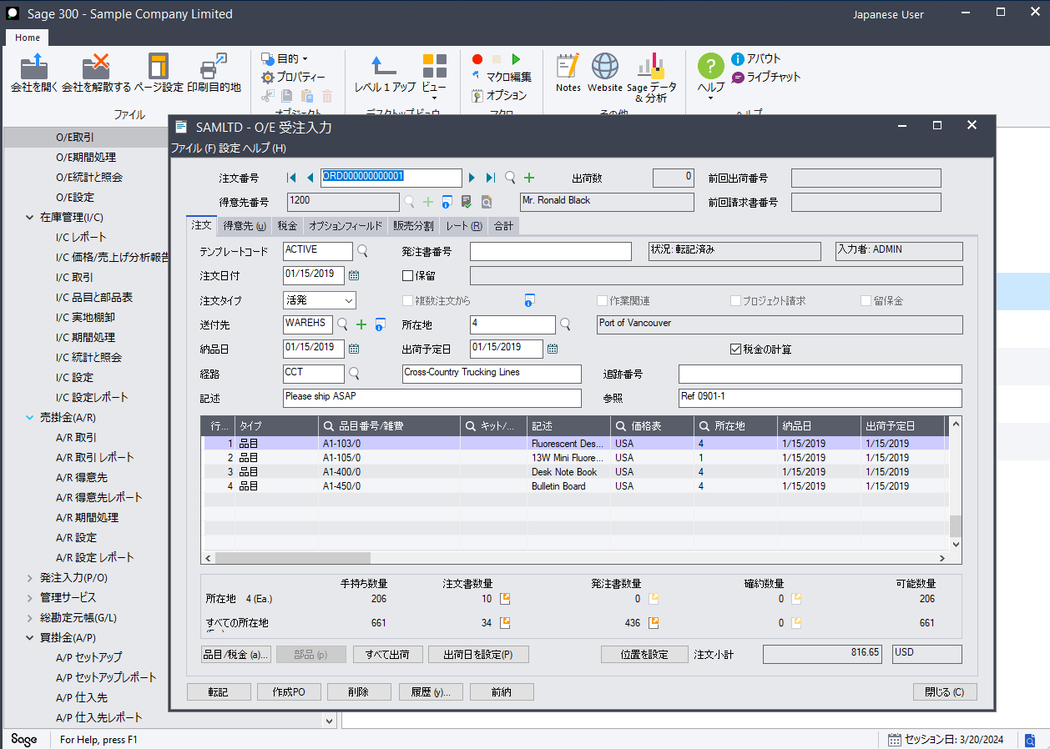
Translation Package
Desktop SDK
Download the Translation Package zip file from the Desktop SDK.
Follow the instructions in the ReadMeFirst file
Test the environment with delivered BAT files
The ACCPAC UI Language Wizard will be executed in Visual Basic readying environment for translators to specify content
As an example, the Sage 300 Desktop in Japanese!

Slide 6
Translation Wizard
Overview – Web Screens
Just like the desktop, the Web Screens are localized in five languages: English, Spanish, French, Chinese Simplified and Chinese Traditional.
Unlike the desktop, the Web Screens have had the Language Resource Wizard in the Web SDK for numerous releases which allows partners requiring the ability to localize the Web Screens in other languages beyond the five supported languages.
Let’s see how this is done!

Slide 7
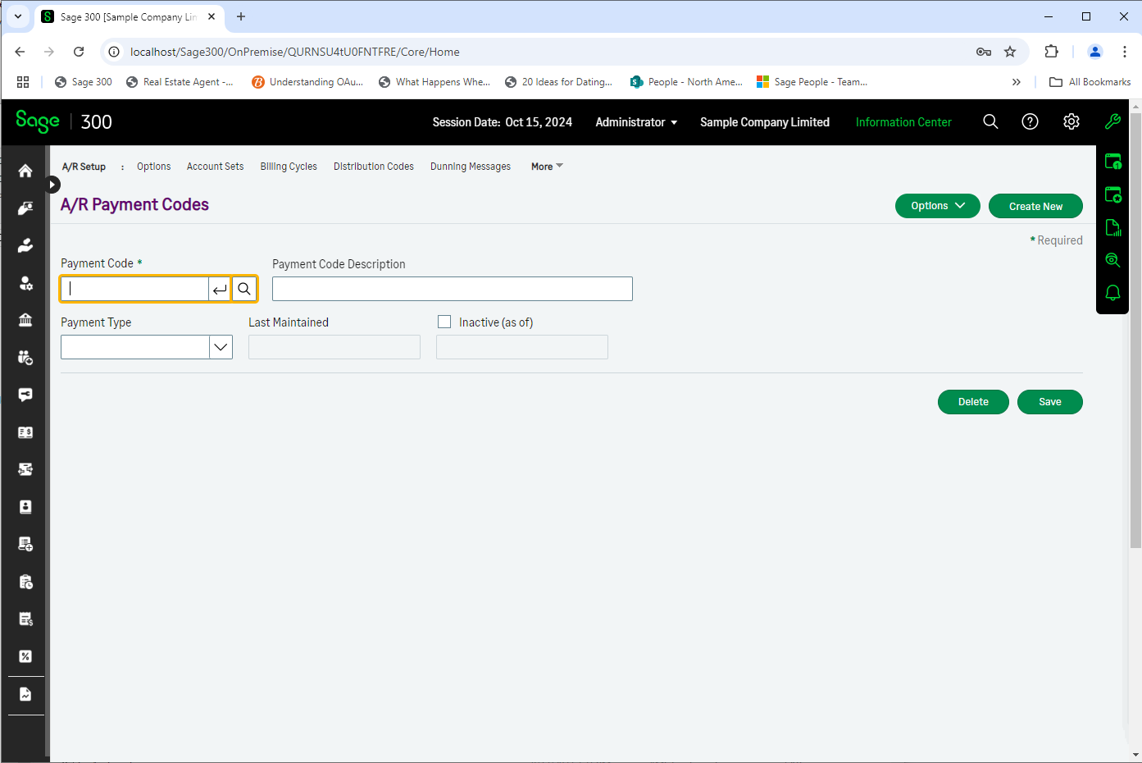
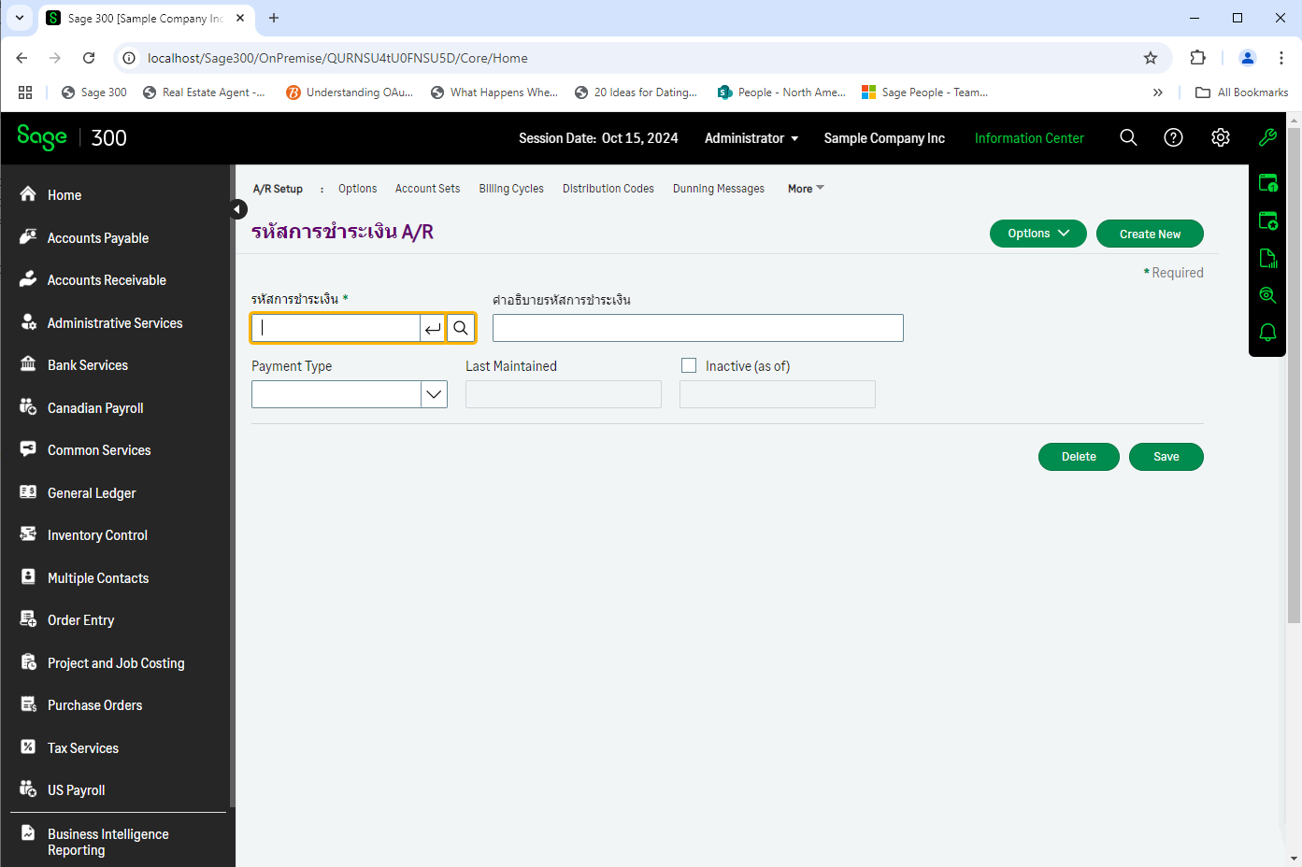
Translation Wizard
Objective – Translate A/R Payment Codes into Thai

Slide 8
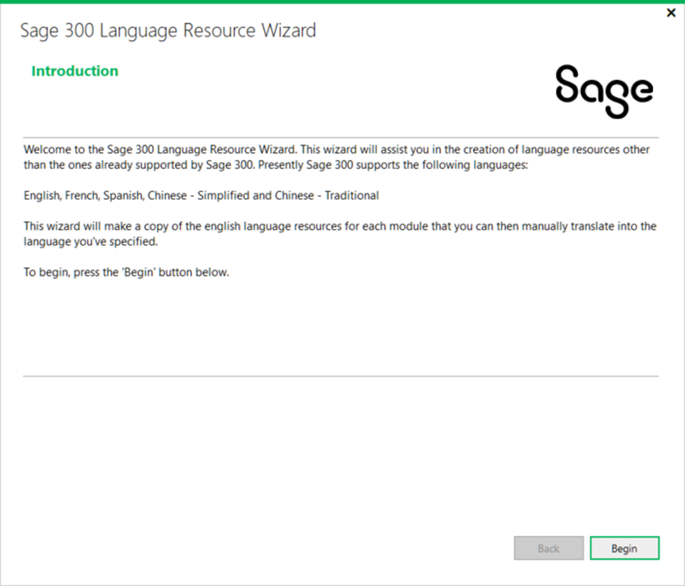
Translation Wizard
Step 1 - Language Resource Wizard
The Language Resource Wizard exists in the Web SDK
All resource files (Resx) for the Web Screens are in the Web SDK as well
This wizard prepares Microsoft RESX files with English context for the language of your choice
Once executed, the environment is ready for translators to specify content

Slide 9
Translation Wizard
Step 1 - Language Resource Wizard
To run the Language Resource Wizard, load the Sage300Resources.sln from the resources\Sage300Resources folder in the Web SDK
This solution holds all of the resources (Resx files) for the Web Screens
Access the Language Resource Wizard from the Sage 300 menu in Visual Studio

Slide 10
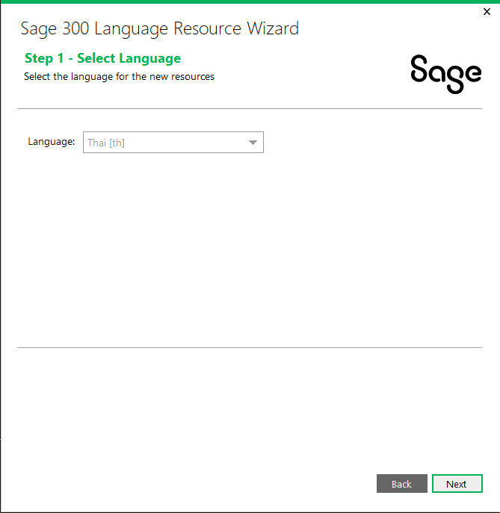
Translation Wizard
Step 1 - Language Resource Wizard
Select the Thai language from the available languages
Select Next and Generate the resource files
English content for the Thai (th) Resx files are generated for every resource

Slide 11
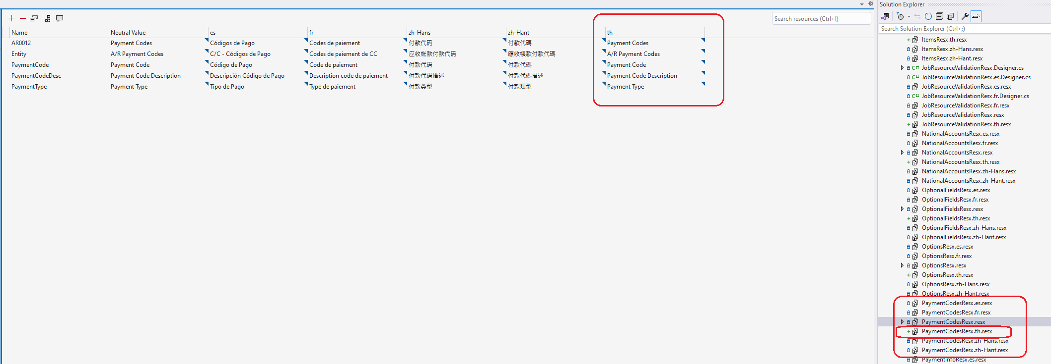
Translation Wizard
Step 2 - Translate the A/R Payment Codes Resource
Now that the Thai (th) Resx files have been generated, let’s modify the content for the A/R Payment Codes screen

Slide 12
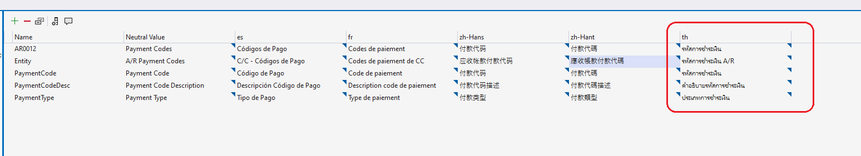
Translation Wizard
Step 2 - Translate the A/R Payment Codes Resource
For my demo, I used Google Translate to look up the Thai values for the English content

Slide 13
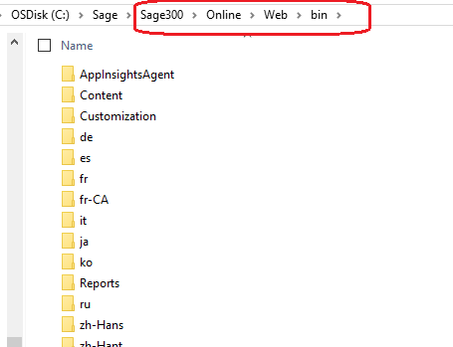
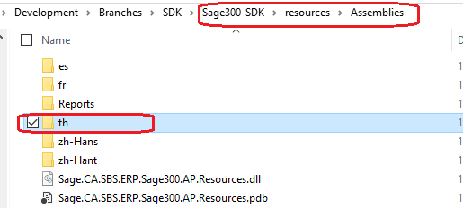
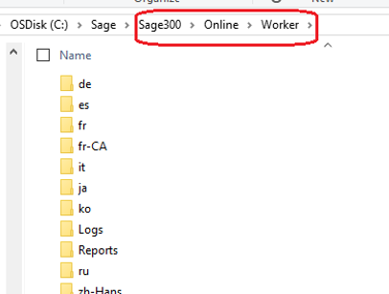
Translation Wizard
Step 3 – Compile and Deploy
By compiling the Sage300Resources solution, I can now copy the compiled resource files (satellite folder for th) to the Web Screen’s ..\Online\Web\bin and ..\Online\Worker folders

Slide 14
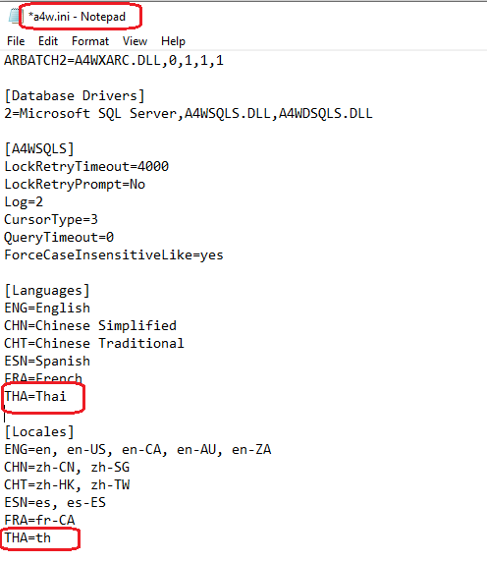
Translation Wizard
Step 4 – Allow for Thai Language in INI file
The Web Screen Resources are ready, but we must modify the a4w.ini file to allow for the Thai language
Note: Be sure to run editor as Administrator
Add entries for Languages and Locales for Thai

Slide 15
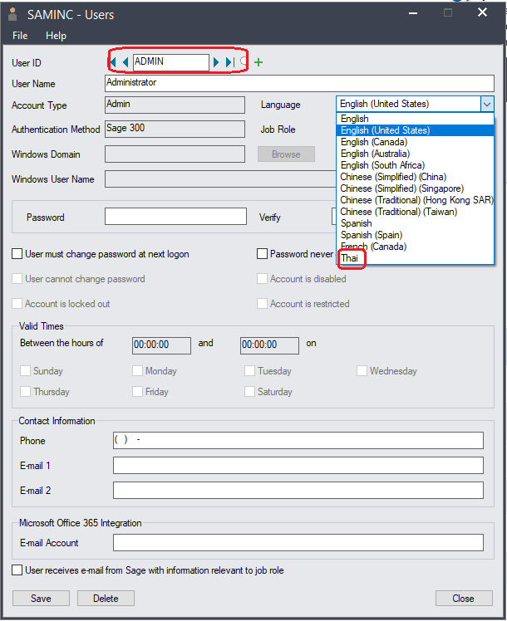
Translation Wizard
Step 5 – Change user to be assigned to Thai language
Run the Users screen in either the desktop or the web and change user to the Thai Language

Slide 16
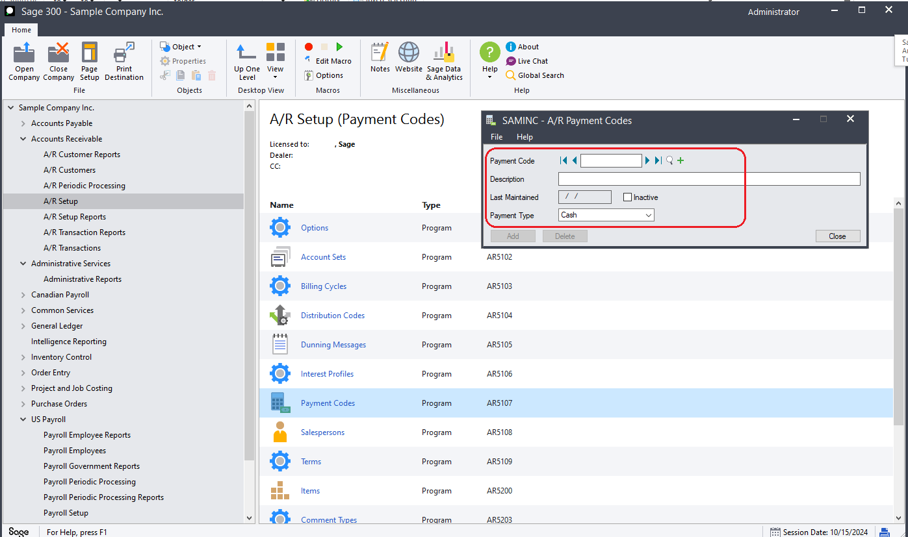
Translation Wizard
Step 6 – Run the Desktop
Running the Desktop and selecting the A/R Payment Codes screen will display it in English!
Remember that we only changed the Web Screen resources and since there are no Thai resources in the desktop, it is expected that the screens are still in English

Slide 17
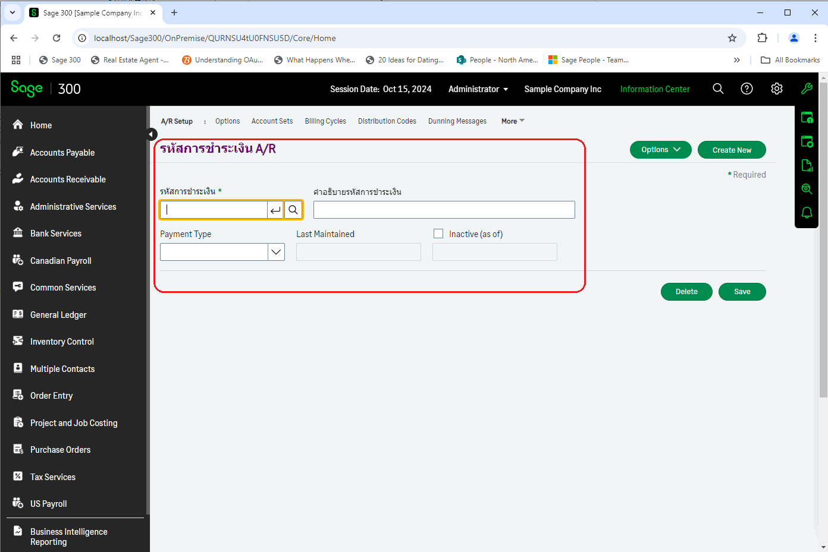
Translation Wizard
Step 7 – Run the Web Screens
Running the Web Screens and selecting the A/R Payment Codes screen will display it in Thai!
Remember that we only changed the Web Screen resource for A/R Payment Code and therefore this is the only screen that changed while all others are in English.

Slide 18
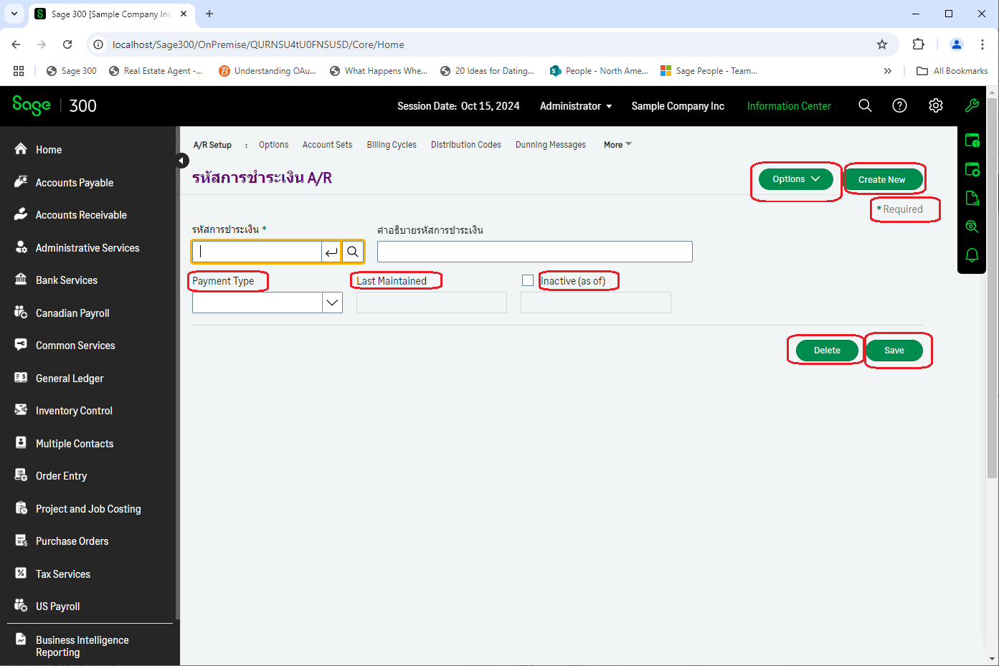
Translation Wizard
Step 7 – Run the Web Screens
Did you notice that not all widgets are in Thai on this screen?
This is because these resource strings are not in the PaymentCodes resx file as the Web Screens have a hierarchical resource structure
Global → Module → Screen
This demo only changed this one screen whereas a complete translation would modify all Resx files and therefore all widgets will be in Thai

Slide 19
Translation Wizard
Summary
Language Resource Wizard to assist with Resx files creation
All resource files are provided in the Web SDK
Partner is responsible for performing translations
a4w.ini modification to allow entry of language in Users screen
Desktop not affected by Web Screen Resx changes
Deployment of new satellite resource folder is required to web\bin and worker folders in Online folder
Note: Messages displayed in the Web Screens come from BOTH the Desktop and the Web. Therefore, only translating the Web Screens Resx files MAY display some messages in English if messages come from the server (desktop)

Slide 20
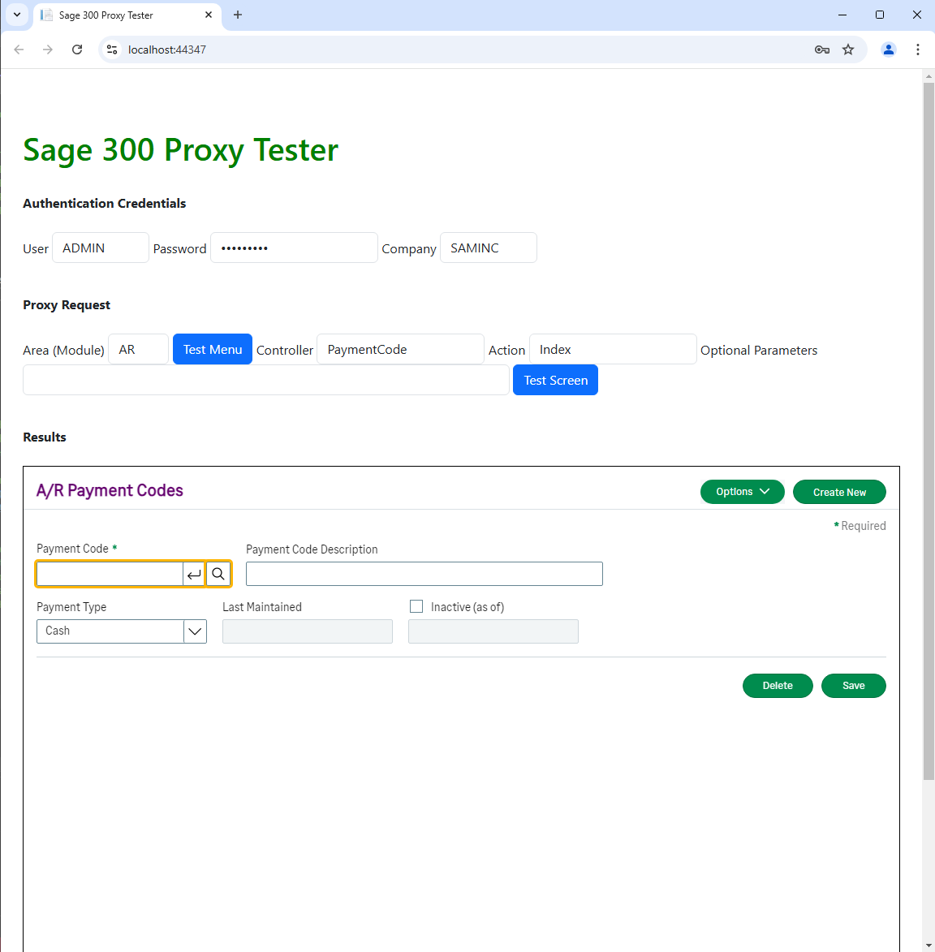
The Proxy is Coming!
Proxy for all using Elliptical Encryption
Proxy allows Sage 300 Web Screens to be hosted in partner web application
Elliptical Encryption for asymmetric public-private keys
No information in URL (it’s in the headers!)
Proxy Tester available in Web SDK 2025.1
Doc on Proxy and Proxy Tester in docs/utilities

Slide 21

The Future is Now!
GitHub Copilot
Are you using GitHub Copilot?
We are! Our developers and QA engineers all have GitHub licenses starting in January 2024.
From a developer perspective we are already seeing increased velocity and developer satisfaction, and well, some amazement too
We will be investigating how we can leverage this in the wizards as well
We’d love your feedback and experiences!

Slide 22
Thank you!

