Slide 1

Sage 300 TPAC 2024 Vancouver, BC
John Thomas (JT)
Principal Software Architect
March 2024

Slide 2
Table of contents
Vision
Software Architecture
Future
Web Screen Proxy
Partner Web API
GitHub Copilot
Web SDK and Web API
Overview
What’s New
Subclassing
Translation Package
Visual Studio 2022
Notes:
And questions, suggestions and feedback are valuable for delivering an API and an SDK that meets as many needs, and requirements of the developer community as possible. So, please let your voice be heard!

Slide 3
Vision
Software Architecture
The Sage 300 Desktop architecture is based on separation of core business logic from user interface and database services
Sage 300 Web Screens aims to be a truly modular, cloud-ready, customizable and extensible business management solution that enables users, customers and partners to achieve a higher level of efficiency and innovation
The Sage 300 Desktop and Web architectures have been created by Sage and is owned by Sage. These architectural technologies are the key distinction between Sage and our competitors.
Notes:
The Sage 300 desktop has been around for decades, and its architecture is solid and fundamentally sound.
The Sage 300 web screens have been around since 2015 and leverages the business and database components of the Sage 300 application. The web screens are architected with the same level of integrity as the other Sage 300 components.
A superior software architecture enables products built within its framework to adapt to fast changing technology and stand the test of time. Sage has made a substantial investment in developing the Sage 300 architectural framework—and this investment continues with the web-based framework for Sage 300 web screens.

Slide 4
Multiple Deployments
One Product
Desktop
On-Premises
Client/Server Install
Business logic layer
Database layer
Not browser based
Web
On-Premises
Web Server Install
Requires desktop components
Same business logic layer
Same database layer
Hybrid
Tethered and untethered
Keep your investment, training, relationships

Slide 5
Web SDK and Web API
Overview

Slide 6
What’s New
Subclassing
Translation Package
Visual Studio 2022

Slide 7
Subclassing
Overview
Achieving parity between the desktop and the web screens allows user to choose either the desktop or the web screens when using Sage 300.
The subclassing of business views to expose additional fields and functionalities are a core aspect that illustrates the flexibility of the Sage 300 architecture. However, this flexibility is only partially available in the web screens.
The missing functionality is the ability to display and interact with fields added to a business view. When a partner subclasses a business view, these added or joined fields will likely be required to be displayed on a screen for user interaction.
The new Subclassing strategy combined with the Customization strategy in the web brings subclassing that has always been available in the desktop to the web!

Slide 8
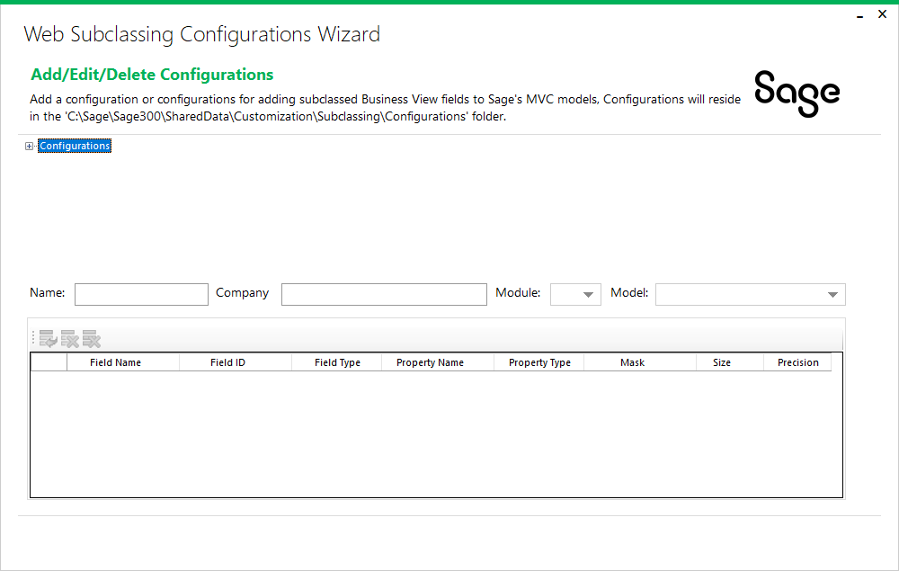
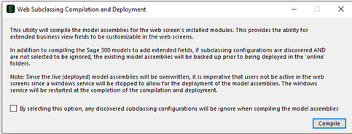
Subclassing
Web Screen Wizards
The Web API Subclassing Wizard is partner facing for the generation and extension of API endpoints in the Sage 300 Web API.
The Web API has simpler requirements (i.e., no UI) from the Web Screens and therefore a simpler wizard.
This wizard creates a partner specific endpoint while preserving the Sage 300 endpoint for a selected resource.

Slide 9
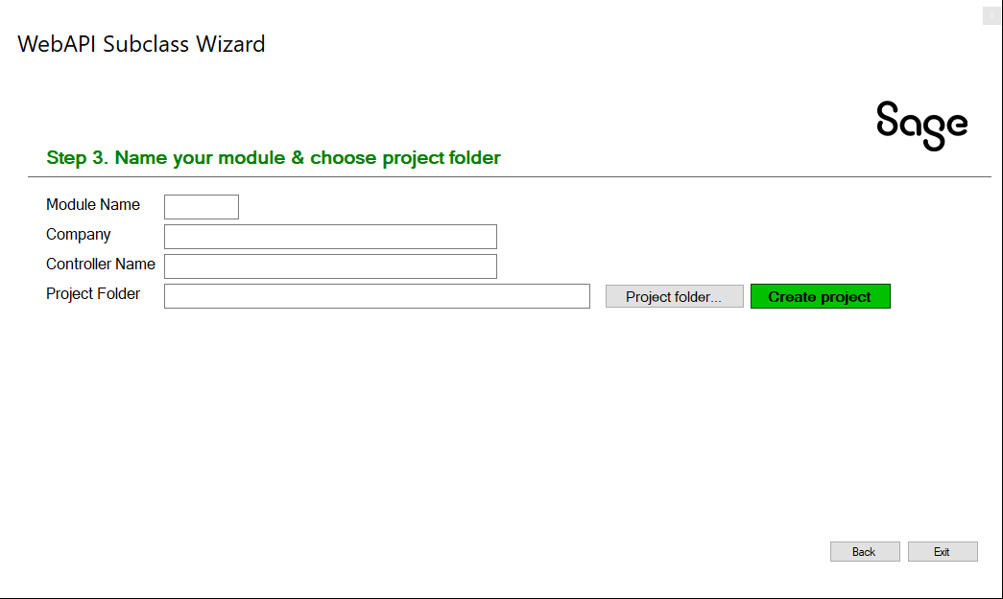
Subclassing
Web API Wizard
The Web Subclassing Configurations Wizard is partner facing for the generation and modification of configurations that will later be consumed by the Web Subclassing Compiler and Deployment Wizard.
The Web Subclassing Compiler and Deployment Wizard is partner facing for the consumption, or not, of configurations that will add extended properties to Sage 300 MVC models and deploy the compiled assemblies to the local installation.
A customization will now be able to add these extended properties to the web screen.

Slide 10
Translation Package
Overview
Sage 300 is localized in five languages: English, Spanish, French, Chinese Simplified and Chinese Traditional.
Partners may require the ability to localize in other languages beyond the five supported languages. While this has been possible in the desktop in the past and with great involvement by Sage personnel, this ability seems to have been lost over time.
The Translation Package new for the Sage 300 2025 release has also been made available for Sage 300 2024. This package will allow partners to configure and setup the environment for compiling and will guide you through the process of creating the required files to be used by a translator.
Note: this Translation Package is for the desktop resources and for the web, a Language Resource Wizard already exists in the Web SDK!

Slide 11
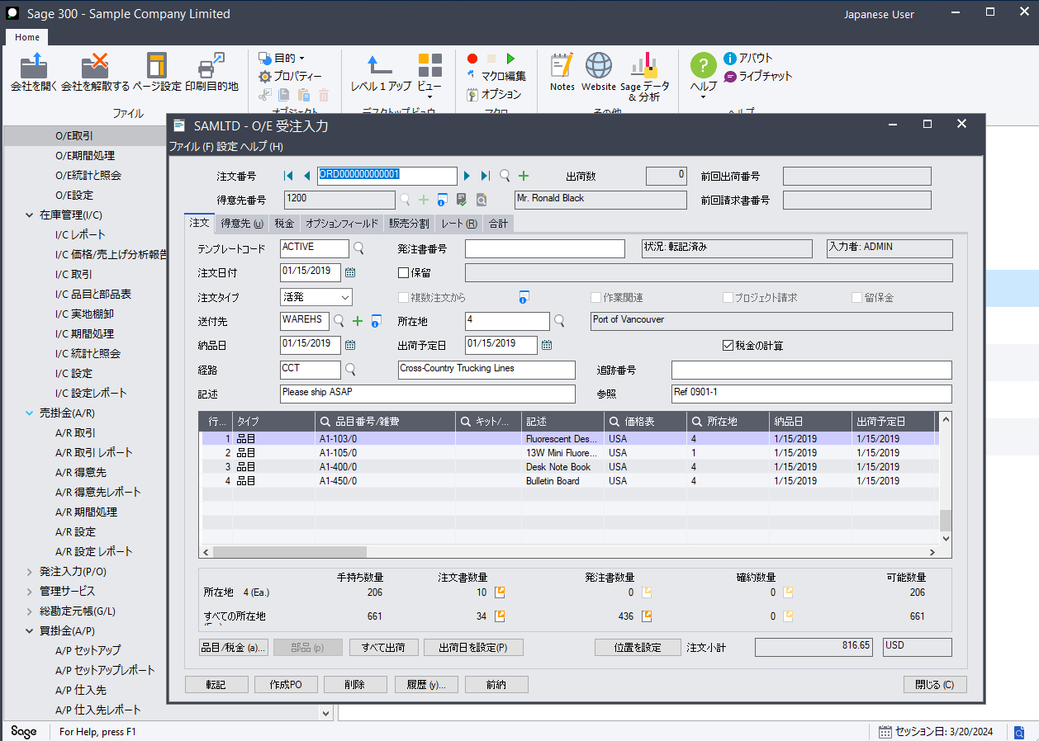
Translation Package
Desktop SDK
Download the Translation Package zip file from the Desktop SDK.
Follow the instructions in the ReadMeFirst file
Test the environment with delivered BAT files
The ACCPAC UI Language Wizard will be executed in Visual Basic readying environment for translators to specify content
As an example, the Sage 300 Desktop in Japanese!

Slide 12
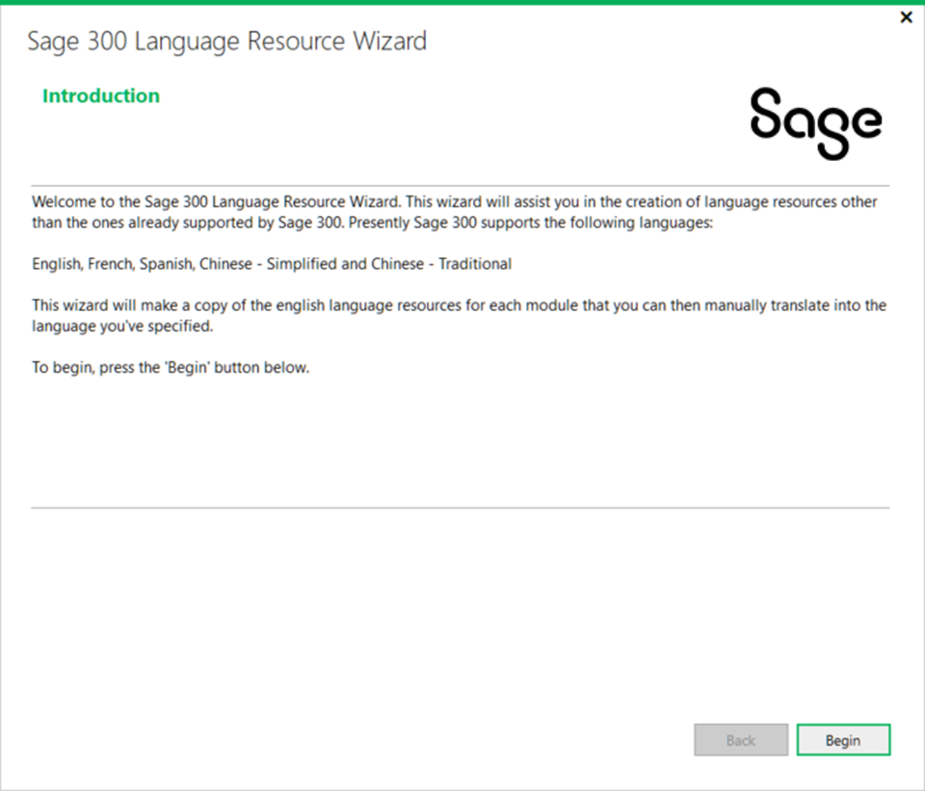
Translation Package
Web SDK
As mentioned, the Language Resource Wizard already exists in the Web SDK
This wizard prepares Microsoft RESX files with English context for the language of your choice
Once executed, the environment is ready for translators to specify content
As in the desktop example, the Web Screens can also be displayed in Japanese by using this wizard!

Slide 13
Visual Studio 2022
Overview
The Sage 300 Web SDK contains over ten wizards with the goal to get developers up and running quickly and easily.
For the upcoming Sage 300 2024.2 release (late April 2024), the wizards will now be compatible only with Visual Studio 2022 (any version).
This ensures that the latest release of our wizards are hosted and executed by the latest version of Visual Studio.

Slide 14
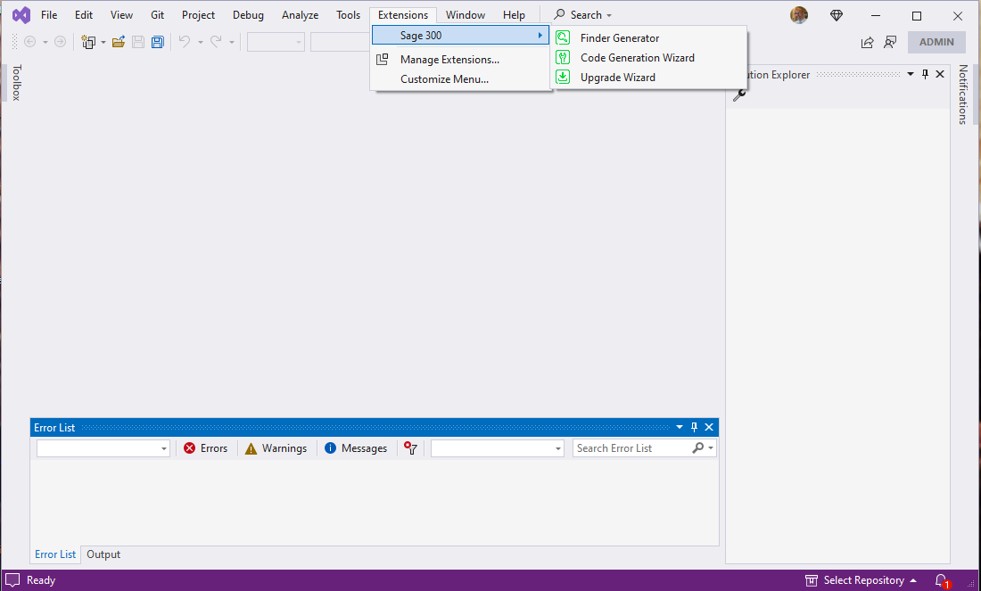
Visual Studio 2022
Web Screen Wizards
Wizards previously accessed by right-clicking in the Solution Explorer’s Context Menu
Starting with Sage 300 2024.2, the plug-in wizards will now be hosted in the Visual Studio Toolbar’s Extension Menu
This location makes more sense and allows more wizards and utilities, when developed, to be seamlessly added to the Visual Studio IDE

Slide 15
Future
Web Screen Proxy
Partner Web API
GitHub Copilot

Slide 16
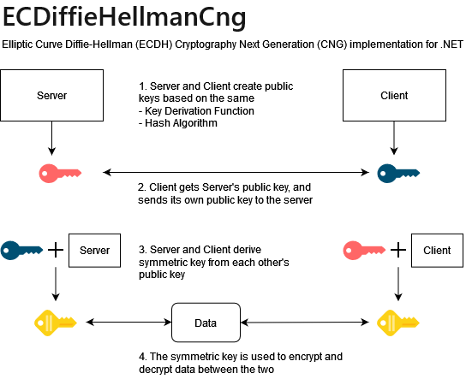
Future
Web Screen Proxy
Currently, there is a proxy that allows for Sage 300 Web Screens to be displayed in Sage CRM. But it is Sage CRM specific!
As we are working on our integration for Sage HRMS, we are developing a universal proxy that can be used by anyone to display Sage 300 Web Screens in their application
Security is of utmost importance, and we are using ECDH (Elliptical Curve Diffie-Hellman Cryptology for encryption
The Web SDK will also contain a proxy tester!

Slide 17

Future
Partner Web API
Partners want the ability to have endpoints in the Sage 300 Web API for their business views
Our subclassing strategy for the Web API introduced in 2024.2 will provide the framework to be leveraged to support this ability
An additional wizard will be required to guide the partner in creating the endpoints much like the Code Generation Wizard guides the partner in the Web Screens
We are targeting Sage 300 2025

Slide 18

Future
GitHub Copilot
Are you using GitHub Copilot?
We are! Our developers and QA engineers all have GitHub licenses starting in January 2024.
From a developer perspective we are already seeing increased velocity and developer satisfaction, and well, some amazement too
We will be investigating how we can leverage this in the wizards as well
We’d love your feedback and experiences!

Slide 19
Thank you!

