Slide 1

Sage 300 - TPAC 2024 Penang, Malaysia Partner Web API
John Thomas (JT)
Principal Software Architect
October 2024

Slide 2
Table of contents
Vision
Software Architecture
Partner Web API
Overview Web API
Partner Overview and demo
Notes:
And questions, suggestions and feedback are valuable for delivering an API and an SDK that meets as many needs, and requirements of the developer community as possible. So, please let your voice be heard!

Slide 3
Vision
Software Architecture
The Sage 300 Desktop architecture is based on separation of core business logic from user interface and database services
Sage 300 Web Screens aims to be a truly modular, cloud-ready, customizable and extensible business management solution that enables users, customers and partners to achieve a higher level of efficiency and innovation
The Sage 300 Desktop and Web architectures have been created by Sage and is owned by Sage. These architectural technologies are the key distinction between Sage and our competitors.
Notes:
The Sage 300 desktop has been around for decades, and its architecture is solid and fundamentally sound.
The Sage 300 web screens have been around since 2015 and leverages the business and database components of the Sage 300 application. The web screens are architected with the same level of integrity as the other Sage 300 components.
A superior software architecture enables products built within its framework to adapt to fast changing technology and stand the test of time. Sage has made a substantial investment in developing the Sage 300 architectural framework—and this investment continues with the web-based framework for Sage 300 web screens.

Slide 4
Web API
API
REST
OData
Install
Payloads
Access
Security
OpenAPI
Goal
“The goal of the Web API is to provide a stateless protocol for a simple and effective strategy for interacting with Sage 300 data”
Notes:
Starting off with the API, the goal of the API is to provide a simple and effective way to interact with Sage 300 data.
An API, if done correctly, standardizes the exchange of data. Differing technologies or programming languages may have gathered or will receive the data, but the API strategy will allow for seamless communication.
So, let’s see how this is accomplished.

Slide 5
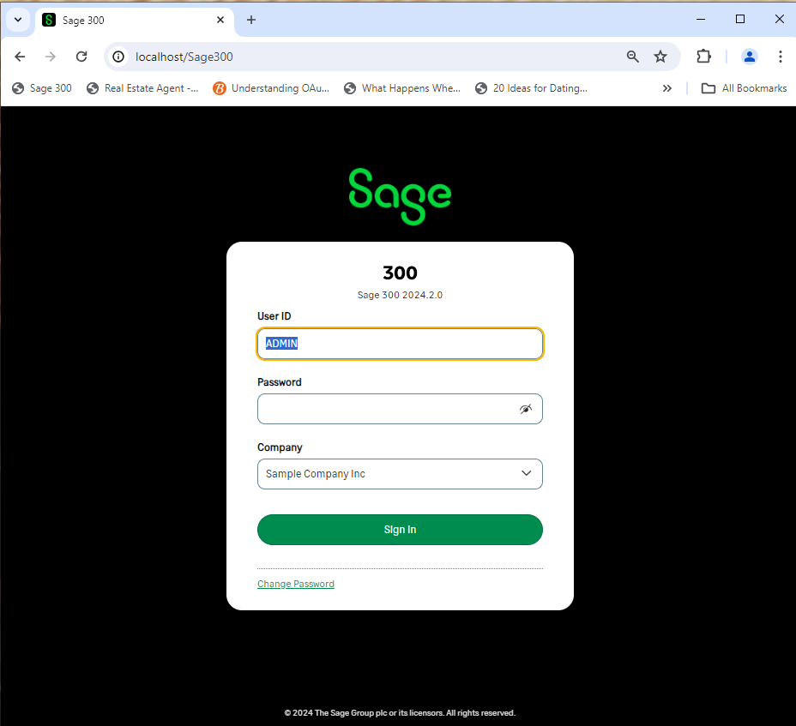




Web API
RESTful Web Services
Request
RESTful
Lightweight MVC Objects
Response
.NET API
MVC Objects
SQL Server
Business Views
APIs are at the heart of Sage 300 and leveraged from multiple clients and technologies
Notes:
The API consists of RESTful web services that use a lightweight MVC model to communicate with the Sage 300 .NET API. This lightweight model is generated by a wizard which generates these models from the Accpac Business Views. Thus, the API does not use the same models as the Web Screens since those models are decorated with attributes and use a mapping layer to move data in and out of the model. The models in the API use reflection to move data in and out.
For those of you who have worked with the .NET API, the web services are a wrapper around this .NET API, which in turn is a wrapper around our COM API. That’s great news since whether data is being accessed via COM, or the .NET API or the web services, the same business logic – validations, restrictions, assumptions, etc., are executed. This API while having a different interface, access and other features will access data with the same integrity as the other APIs.
As you can see, APIs are at the heart of Sage 300.
Let’s consider OData.

Slide 6
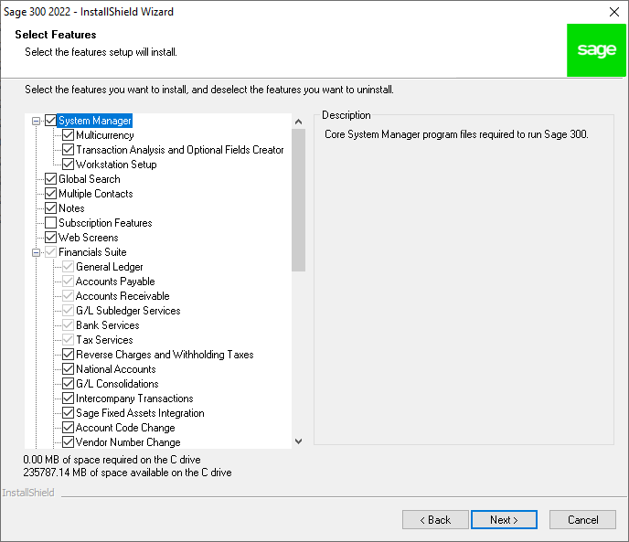
Web API
Installation
Installed with the Web Screens
Notes:
The API is installed when the Sage 300 Web Screens are installed and are part of the application, not the SDK. Although users of the API will typically be SDK users, this is not a requirement. Because of the OData protocol, the OpenAPI implementation (Swagger), the simple to understand URL segments, and simply the technical ability of our partners and customers, using the API is intuitive. The API is installed with the web screens option, and they are ready to use!
There have been some discussions that this API should be a separate installation and not tied to the web screen installation. I’d be interested to hear your thoughts on this!
The Sage 300 web screens even use the API internally to support our integrations with Sage Intelligence Reporting Cloud (SIRC) and Sage CRM. The security groups for the module’s resources must be enabled otherwise access will be denied. I’ll talk about this more when we cover security for the API.
Note, unlike our other APIs, this API does not consume a LanPak license! Let me repeat that. The usage of this API does not consume a LanPak license.
Let’s now talk payloads.

Slide 7
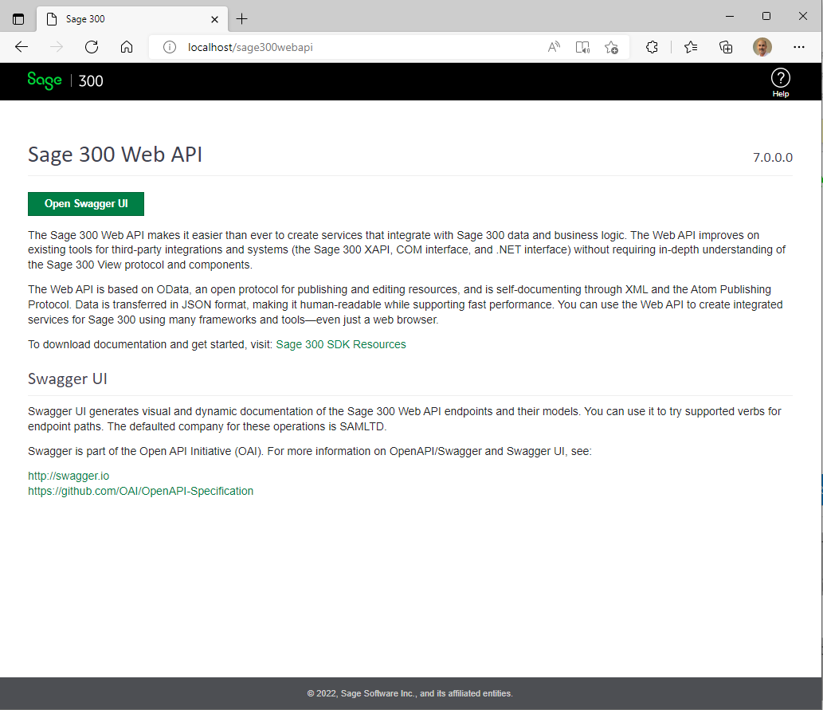
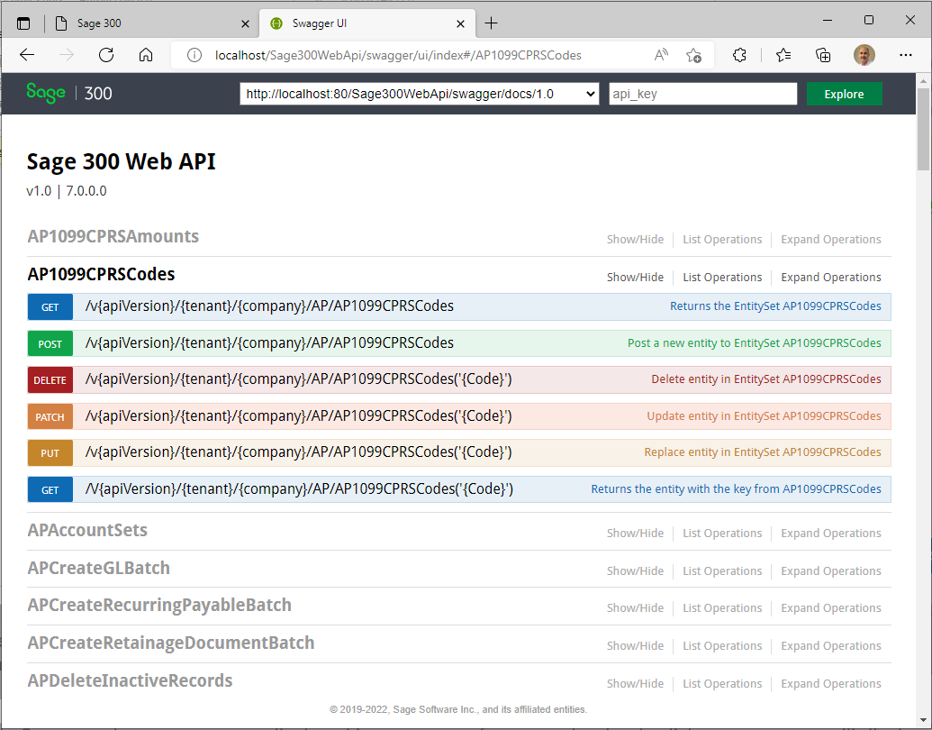
Web API
OpenAPI (Swagger)
Sage 300 Web API Landing Page
Swagger UI
Notes:
Sage 300 provides a landing page where the consumer of the API can go for useful links and resources. The “Open Swagger UI” button will display the Swagger UI for codeless and untethered access to Sage 300 data.
The OpenAPI or Swagger is a specification for machine-readable interface files for describing, producing, consuming and visualizing RESTful web services and Sage 300 has leveraged Swagger to provide a collection of HTML, JavaScript, and CSS assets that dynamically generate beautiful documentation from a Swagger-compliant API. This dynamic documentation feature eliminates the need for static documentation and at the same time offers an intuitive and robust UI for driving the API.
Once in Swagger, the resources are displayed in a summary format and a simple click on a resource will display the various actions or verbs supported by the resource. Note that not all actions are supported by every resource, and we’ve had to decide if a resource should even be exposed (i.e., payroll or users, etc.)). The SDK has documentation for our resources (although Swagger also provides this documentation) as well as a developer reference guide.
What about coded access?

Slide 8
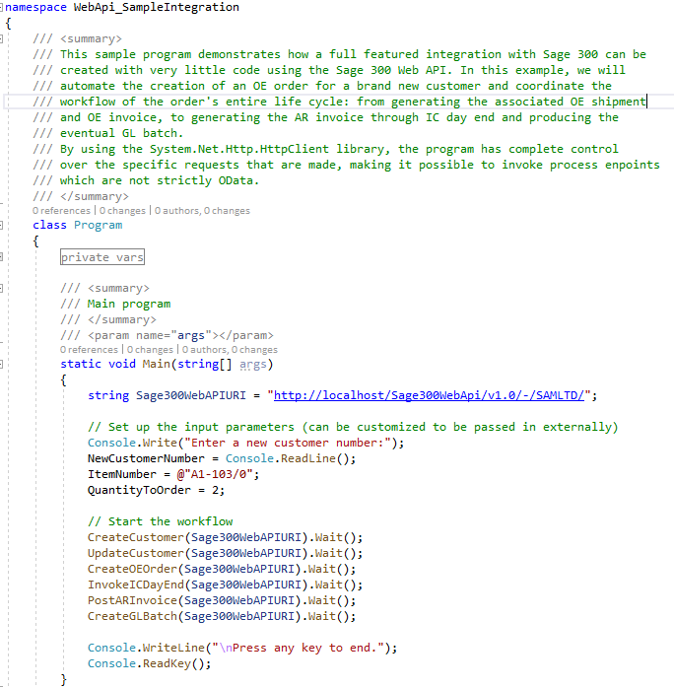
Web API
Coded Access
Samples and Tutorials
Documentation
Notes:
You can use the language of your choice for coded access.
In the SDK you will find multiple completed samples along with documentation with step-by-step instructions for creating the samples from scratch.
For example, the Integration Sample uses a C# console program to illustrate how easy it is to make API calls and you will programmatically create a customer, update the customer, create an order, invoke the inventory control’s day end, post an invoice and finally create a batch all through the API. This is a great sample for getting used to the API and programmatically driving it as well.
There are a couple of other samples that invoke other functionalities such as retrieving a range of customers, retrieving a customer with a key, deleting a customer, and creating an invoice.
There is even a sample that uses Chrome’s Postman Utility to load an execute Postman scripts. This sample was created prior to the adoption of Swagger, and we feel that Swagger is more intuitive, provides better documentation and is easier to use than Postman. However, for the postman users, this sample is still valid and handy!
How about security?

Slide 9
Web API
Benefits
API
Easy to use
Less data transfer
Consistent
No UI
Integration
JSON
Notes:
That’s our Sage 300 Web API!
There are numerous benefits to using it, such as:
It is quick and easy to use whether you are using Swagger to access it or have written a coded access
The structured nature of the endpoints (segments, version, resources, naming conventions, etc.) along with the OData implementation makes for a consistent experience. And consistency is the key!
It supports JSON for a smaller and faster payload plus the payloads can even be minimized to only require requested and/or required fields
Finally, the API can play an important role in any integration, testing, debugging, or validation story
Let’s move on to the SDK.

Slide 10
Partner Web API
Overview
Sage 300 offers multiple APIs for accessing Sage 300 data:
COM API, .NET API, and the Web API.
Partners have requested the ability to participate in the Web API to surface or access data in Sage 300 tables created by partners. Of course, this can be done by a partner writing their own Web API, but that is not a seamless solution.
The new Partner Web API Wizard allows a partner to deliver discoverable endpoints for the Sage 300 Web API.

Slide 11

Partner Web API
Wizards
The Solution Wizard has been enhanced for the creation of either a Web Screen solution or a Web API solution
The Code Generation Wizard has been enhanced for the generation of either Web Screen code or Web API code
Let’s run the Wizards to generate a new solution and generate code for a specified endpoint
We’ll then compile and deploy the discoverable endpoint to the localhost and access it in the Sage 300 Web API

Slide 12
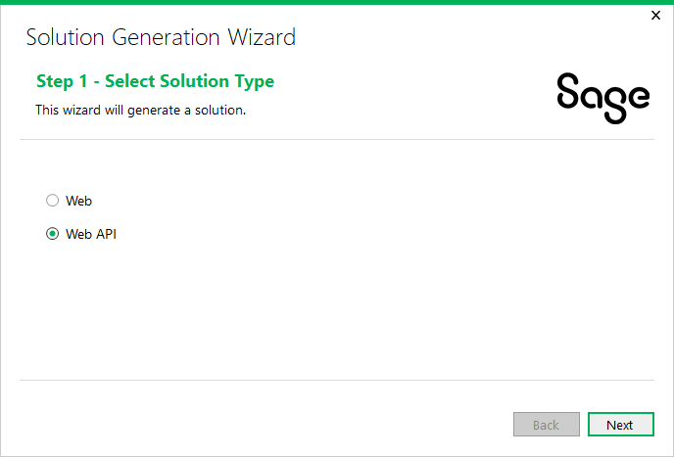
Partner Web API
Solution Wizard
Let’s run the Solution Wizard to create a solution to hold the endpoints that we will later generate with the Code Generation Wizard
Since the Web API does not require UI elements, the Solution Wizard steps for the Web API are minimal

Slide 13
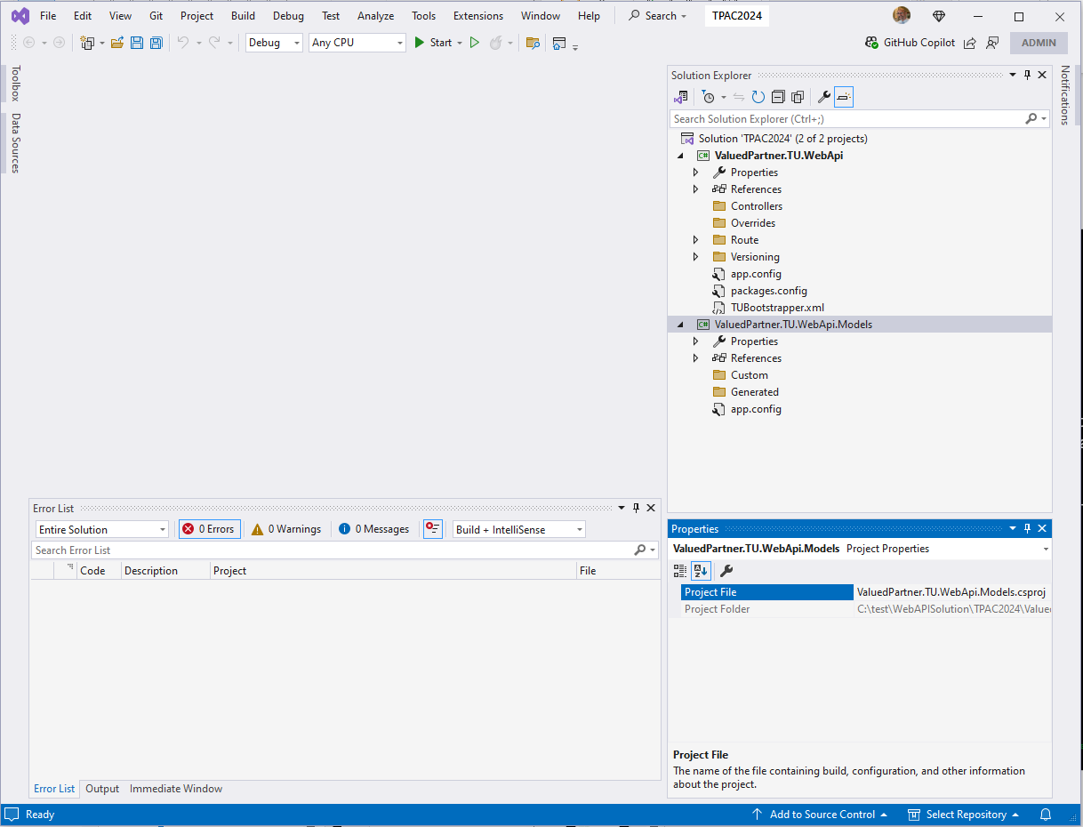
Partner Web API
Web API Solution
Upon completion, a solution is created with two projects whereas the Web Screen solution contains six projects
Restore the Nuget packages and we are ready to generate an endpoint

Slide 14
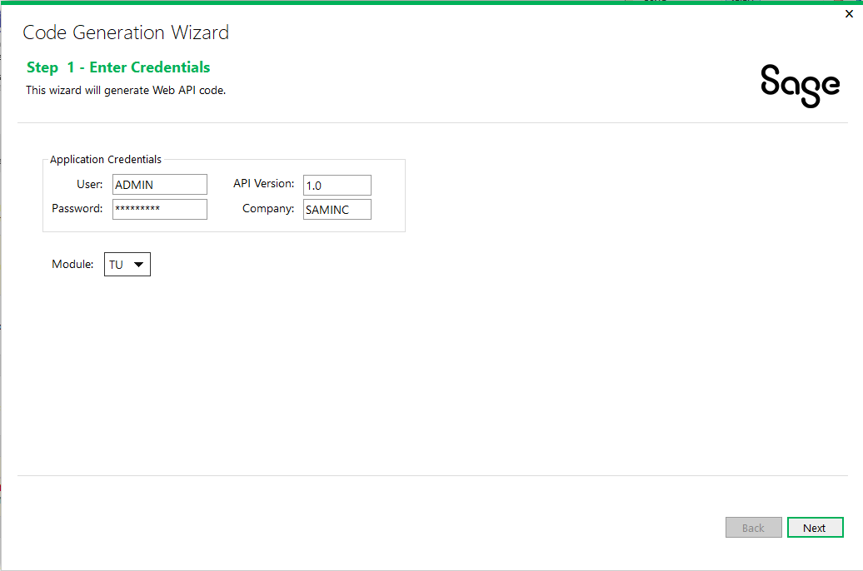
Partner Web API
Code Generation Wizard
Let’s run the Code Generation Wizard to generate an endpoint
Since the Web API does not require UI elements, the Code Generation Wizard steps for the Web API are less than the Web Screen’s steps
No UI Layout Wizard
No Resx Generation
Added API Version field

Slide 15
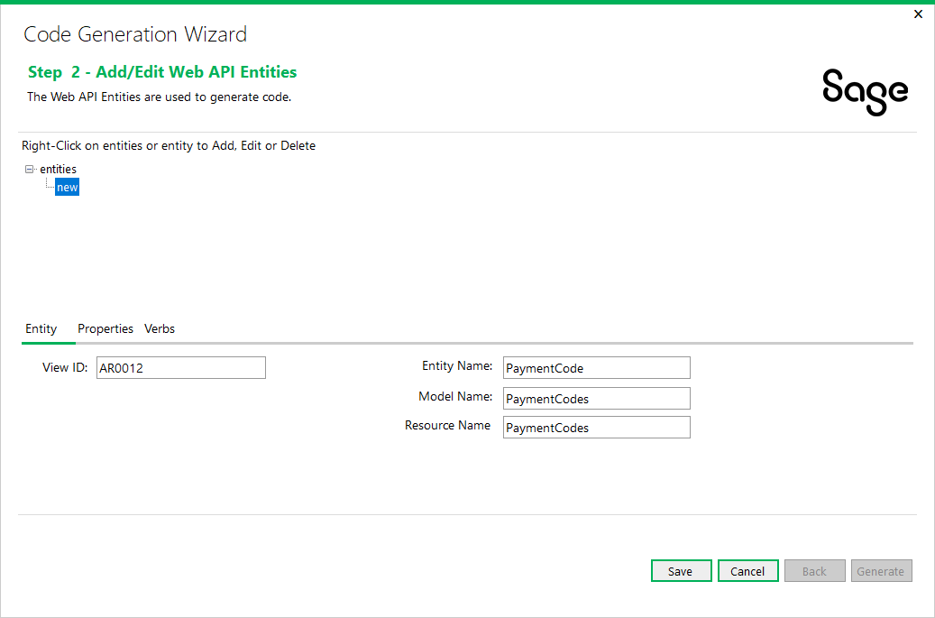
Partner Web API
Code Generation Wizard
Entities are specified just like for Web Screens

Slide 16
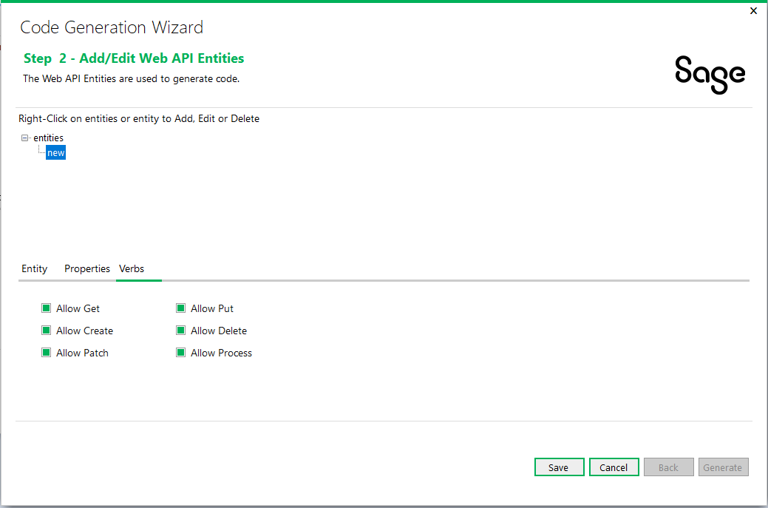
Partner Web API
Code Generation Wizard
A new Verbs tab has been added to allow for selection and deselection of Verbs or Actions for the endpoint

Slide 17
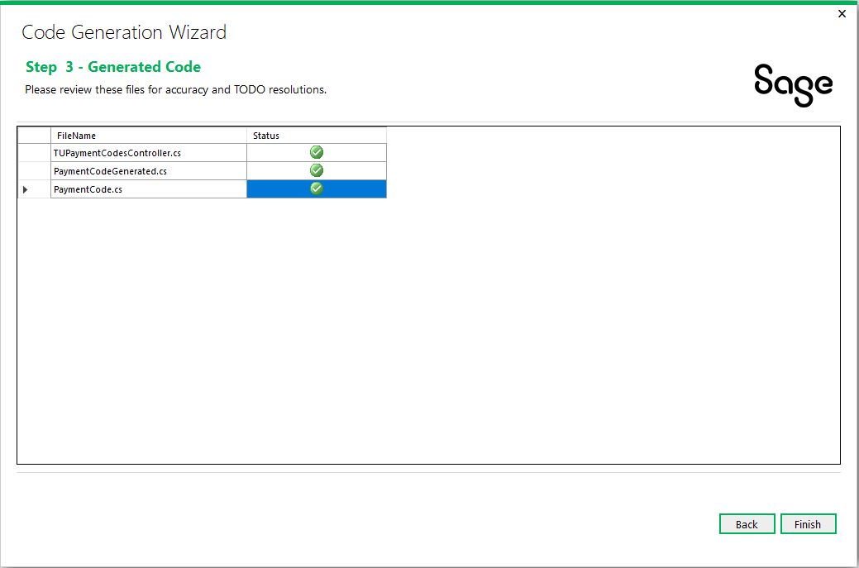
Partner Web API
Code Generation Wizard
Minimal files are generated unlike the Web Screen’s code generation.
We are ready to review and compile!

Slide 18
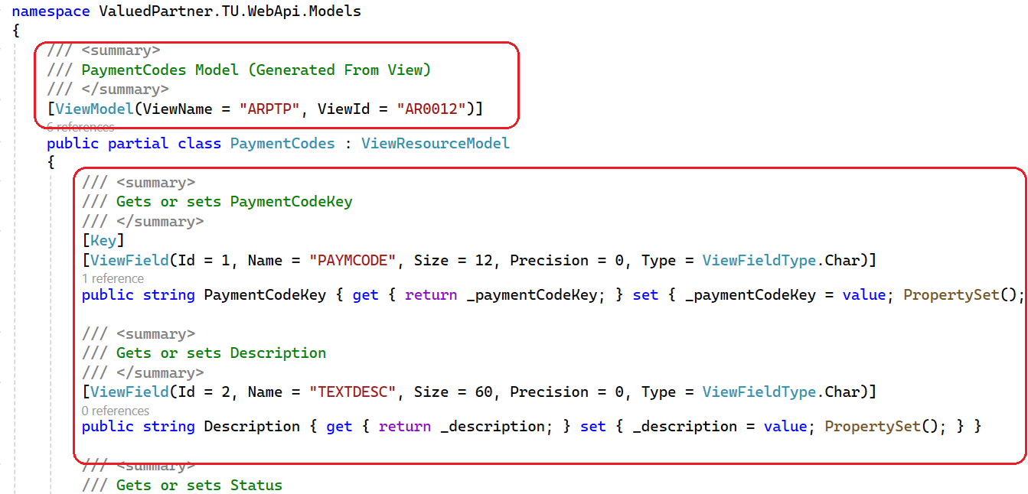
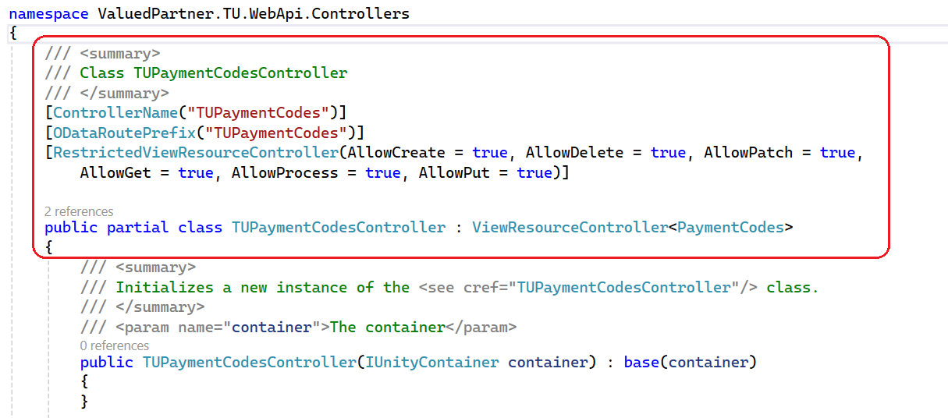
Partner Web API
Web API Project
A model and controller have been generated for the endpoint.
Let’s build to ensure no errors and we are ready to deploy to the WebApi folder.

Slide 19
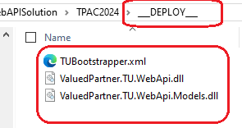
Partner Web API
Web API Assemblies
Upon compiling, a “__DEPLOY__” folder is created with three files that will need to be copied/deployed to the Online\WebApi\bin folder
{module}Bootstrapper.xml - XML file for discovery of partner assemblies
*.{module}.WebApi.dll and *.{module}.WebApi.Models.dll – Partner Assemblies
Let’s run the Sage 300 Web Api to see the new endpoint!

Slide 20
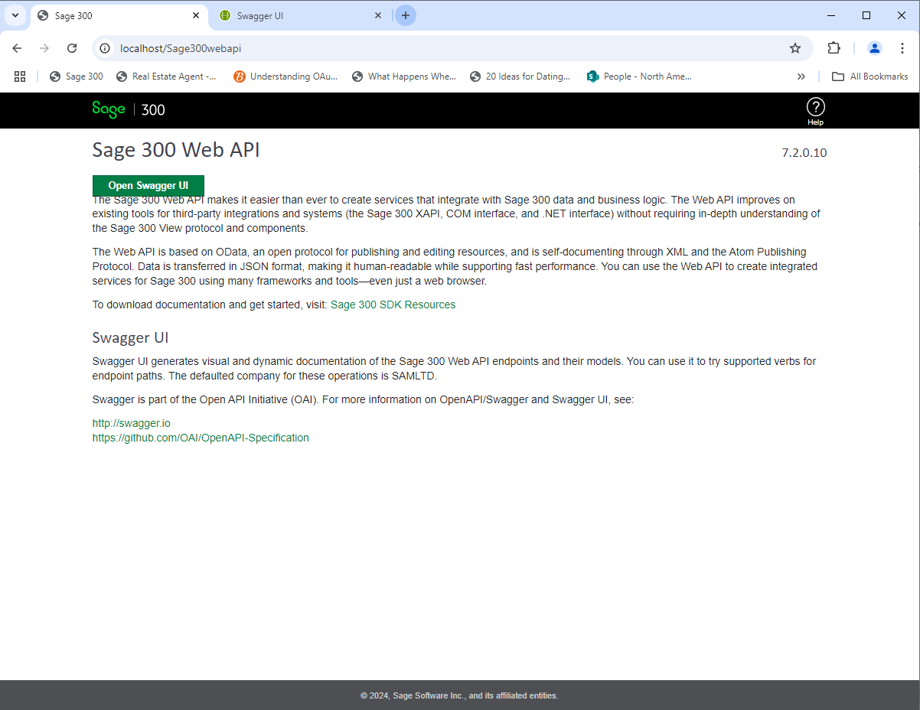
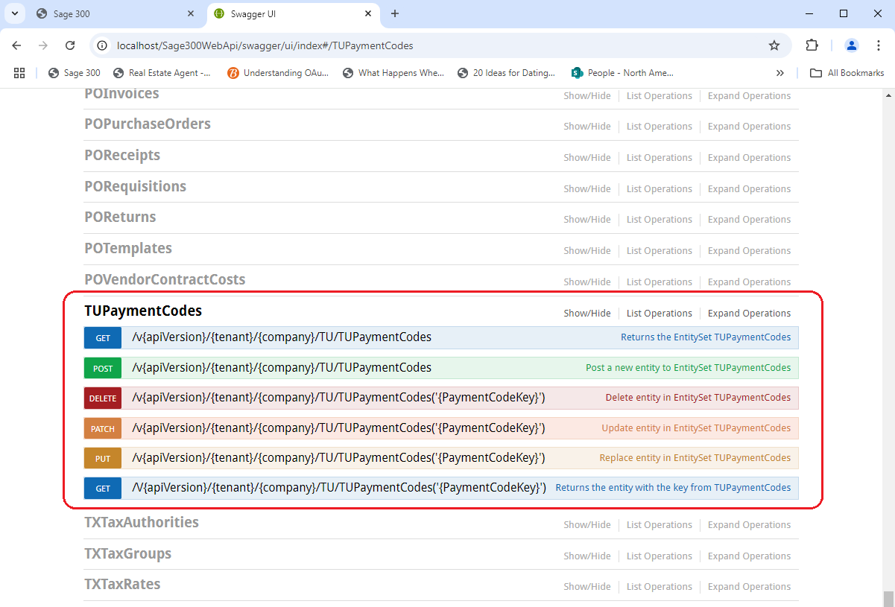
Partner Web API
Sage 300 Web API
Localhost/Sage300WebApi
Select Open Swagger UI
Click on TUPaymentCodes
Let’s try it out!
Hint: If using ADMIN, be sure it is allowed!

Slide 21
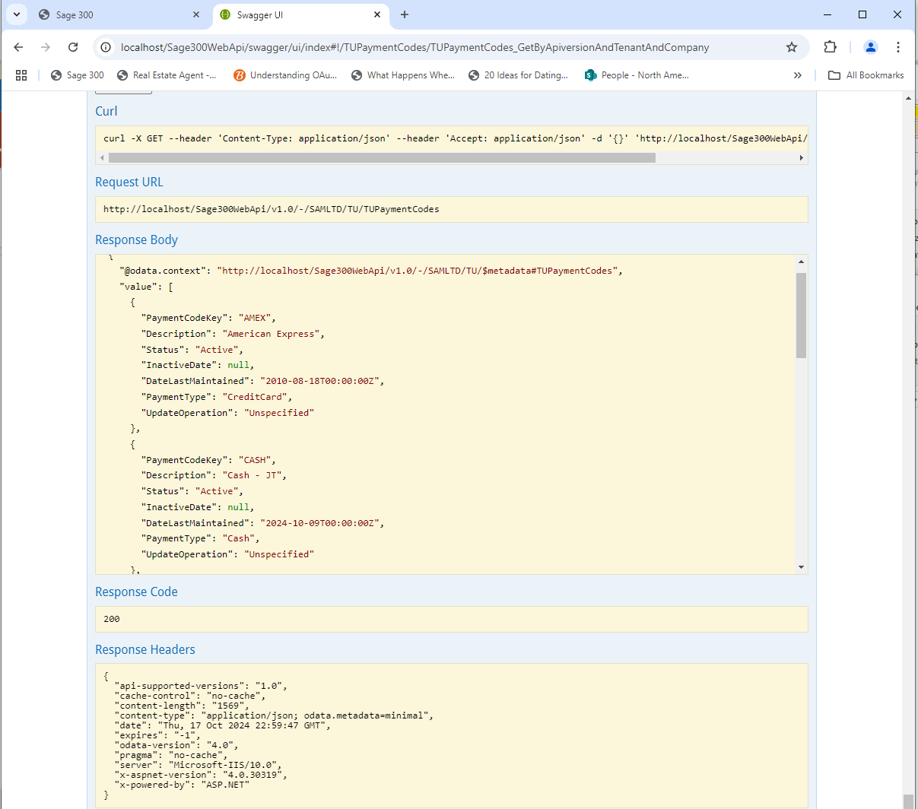
Partner Web API
Sage 300 Web API
Data retrieved!

Slide 22
Partner Web API
Summary
Web API
Easy to use, less data transfer, No UI, consistent, JSON, Integration
Partner Web API
Seamless Integration
Discoverable Endpoints
Solution Wizard enhanced to allow creation of Web API solution
Code Generation Wizard enhanced to allow generation of Web API project code

Slide 23
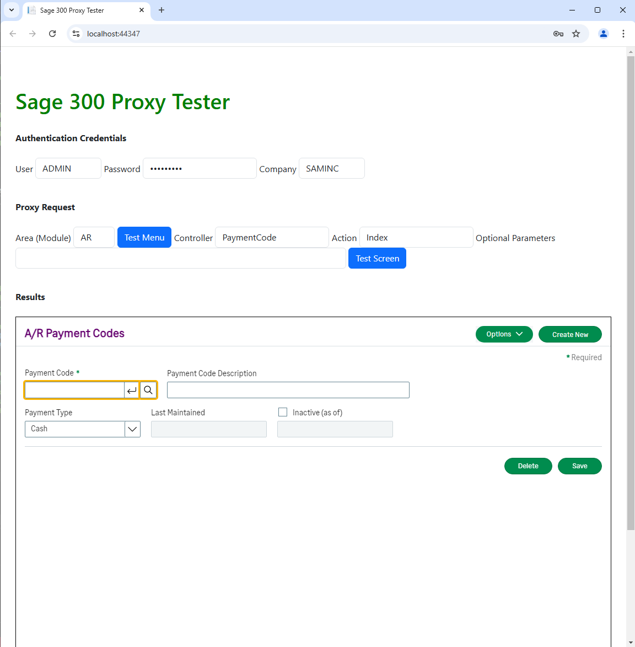
The Proxy is Coming!
Proxy for all using Elliptical Encryption
Proxy allows Sage 300 Web Screens to be hosted in partner web application
Elliptical Encryption for asymmetric public-private keys
No information in URL (it’s in the headers!)
Proxy Tester available in Web SDK 2025.1
Doc on Proxy and Proxy Tester in docs/utilities

Slide 24

The Future is Now!
GitHub Copilot
Are you using GitHub Copilot?
We are! Our developers and QA engineers all have GitHub licenses starting in January 2024.
From a developer perspective we are already seeing increased velocity and developer satisfaction, and well, some amazement too
We will be investigating how we can leverage this in the wizards as well
We’d love your feedback and experiences!

Slide 25
Thank you!

