Slide 1

Sage 300 TPAC 2024 Vancouver, BC
John Thomas (JT)
Principal Software Architect
March 2024

Slide 2
Table of contents
Vision
Software Architecture
Future
Web Screen Proxy
Partner Web API
GitHub Copilot
Web API and Web SDK
Overview
What’s New
Subclassing – Demos!
Translation Package
Visual Studio 2022
Discussion
Questions
Notes:
And questions, suggestions and feedback are valuable for delivering an API and an SDK that meets as many needs, and requirements of the developer community as possible. So, please let your voice be heard!

Slide 3
Vision
Software Architecture
The Sage 300 Desktop architecture is based on separation of core business logic from user interface and database services
Sage 300 Web Screens aims to be a truly modular, cloud-ready, customizable and extensible business management solution that enables users, customers and partners to achieve a higher level of efficiency and innovation
The Sage 300 Desktop and Web architectures have been created by Sage and is owned by Sage. These architectural technologies are the key distinction between Sage and our competitors.
Notes:
The Sage 300 desktop has been around for decades, and its architecture is solid and fundamentally sound.
The Sage 300 web screens have been around since 2015 and leverages the business and database components of the Sage 300 application. The web screens are architected with the same level of integrity as the other Sage 300 components.
A superior software architecture enables products built within its framework to adapt to fast changing technology and stand the test of time. Sage has made a substantial investment in developing the Sage 300 architectural framework—and this investment continues with the web-based framework for Sage 300 web screens.

Slide 4
Multiple Deployments
One Product
Desktop
On-Premises
Client/Server Install
Business logic layer
Database layer
Not browser based
Web
On-Premises
Web Server Install
Requires desktop components
Same business logic layer
Same database layer
Hybrid
Tethered and untethered
Keep your investment, training, relationships

Slide 5
Web API and Web SDK
Overview

Slide 6
Web API
API
REST
OData
Install
Payloads
Access
Security
OpenAPI
Goal
“The goal of the Web API is to provide a stateless protocol for a simple and effective strategy for interacting with Sage 300 data”
Notes:
Starting off with the API, the goal of the API is to provide a simple and effective way to interact with Sage 300 data.
An API, if done correctly, standardizes the exchange of data. Differing technologies or programming languages may have gathered or will receive the data, but the API strategy will allow for seamless communication.
So, let’s see how this is accomplished.

Slide 7
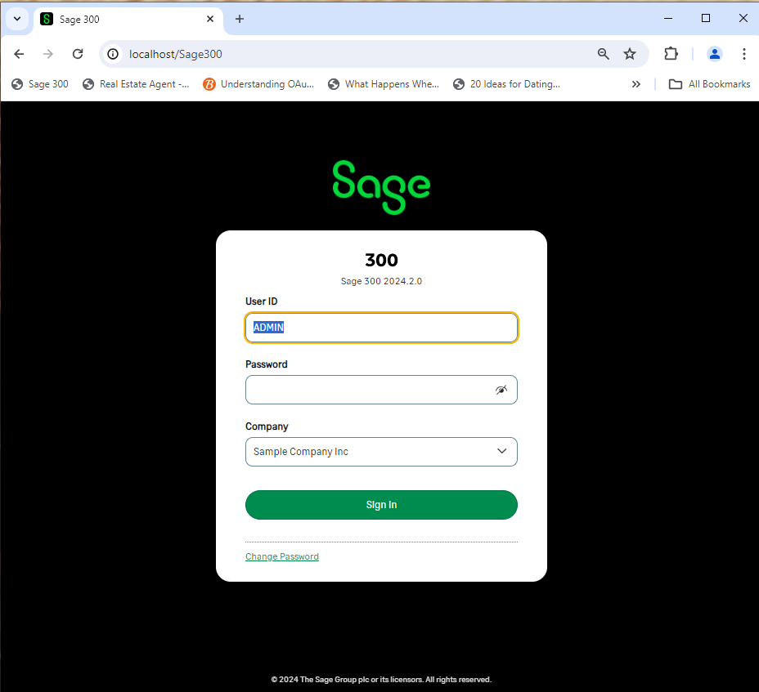




Web API
RESTful Web Services
Request
RESTful
Lightweight MVC Objects
Response
.NET API
MVC Objects
SQL Server
Business Views
APIs are at the heart of Sage 300 and leveraged from multiple clients and technologies
Notes:
The API consists of RESTful web services that use a lightweight MVC model to communicate with the Sage 300 .NET API. This lightweight model is generated by a wizard which generates these models from the Accpac Business Views. Thus, the API does not use the same models as the Web Screens since those models are decorated with attributes and use a mapping layer to move data in and out of the model. The models in the API use reflection to move data in and out.
For those of you who have worked with the .NET API, the web services are a wrapper around this .NET API, which in turn is a wrapper around our COM API. That’s great news since whether data is being accessed via COM, or the .NET API or the web services, the same business logic – validations, restrictions, assumptions, etc., are executed. This API while having a different interface, access and other features will access data with the same integrity as the other APIs.
As you can see, APIs are at the heart of Sage 300.
Let’s consider OData.

Slide 8
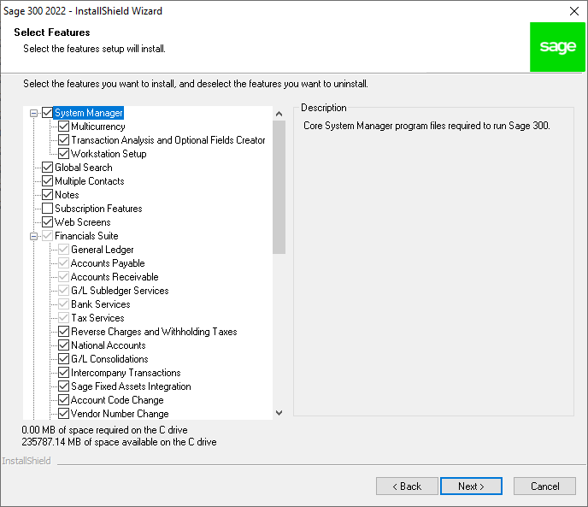
Web API
Installation
Installed with the Web Screens
Notes:
The API is installed when the Sage 300 Web Screens are installed and are part of the application, not the SDK. Although users of the API will typically be SDK users, this is not a requirement. Because of the OData protocol, the OpenAPI implementation (Swagger), the simple to understand URL segments, and simply the technical ability of our partners and customers, using the API is intuitive. The API is installed with the web screens option, and they are ready to use!
There have been some discussions that this API should be a separate installation and not tied to the web screen installation. I’d be interested to hear your thoughts on this!
The Sage 300 web screens even use the API internally to support our integrations with Sage Intelligence Reporting Cloud (SIRC) and Sage CRM. The security groups for the module’s resources must be enabled otherwise access will be denied. I’ll talk about this more when we cover security for the API.
Note, unlike our other APIs, this API does not consume a LanPak license! Let me repeat that. The usage of this API does not consume a LanPak license.
Let’s now talk payloads.

Slide 9
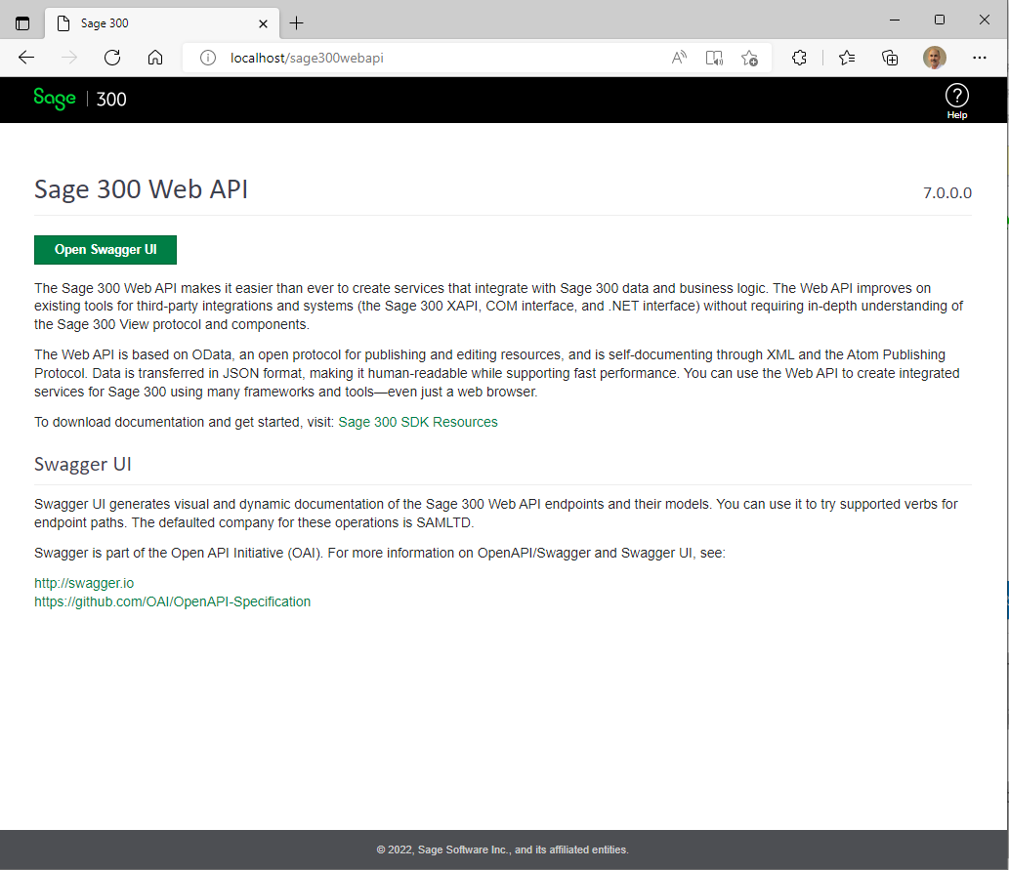
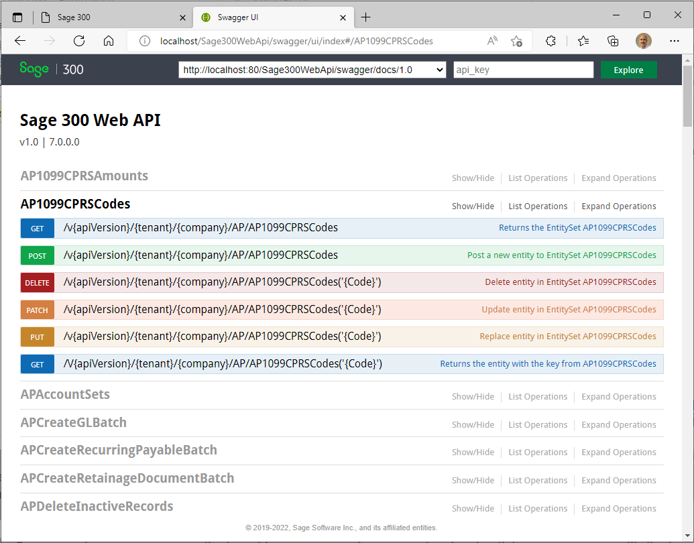
Web API
OpenAPI (Swagger)
Sage 300 Web API Landing Page
Swagger UI
Notes:
Sage 300 provides a landing page where the consumer of the API can go for useful links and resources. The “Open Swagger UI” button will display the Swagger UI for codeless and untethered access to Sage 300 data.
The OpenAPI or Swagger is a specification for machine-readable interface files for describing, producing, consuming and visualizing RESTful web services and Sage 300 has leveraged Swagger to provide a collection of HTML, JavaScript, and CSS assets that dynamically generate beautiful documentation from a Swagger-compliant API. This dynamic documentation feature eliminates the need for static documentation and at the same time offers an intuitive and robust UI for driving the API.
Once in Swagger, the resources are displayed in a summary format and a simple click on a resource will display the various actions or verbs supported by the resource. Note that not all actions are supported by every resource, and we’ve had to decide if a resource should even be exposed (i.e., payroll or users, etc.)). The SDK has documentation for our resources (although Swagger also provides this documentation) as well as a developer reference guide.
What about coded access?

Slide 10
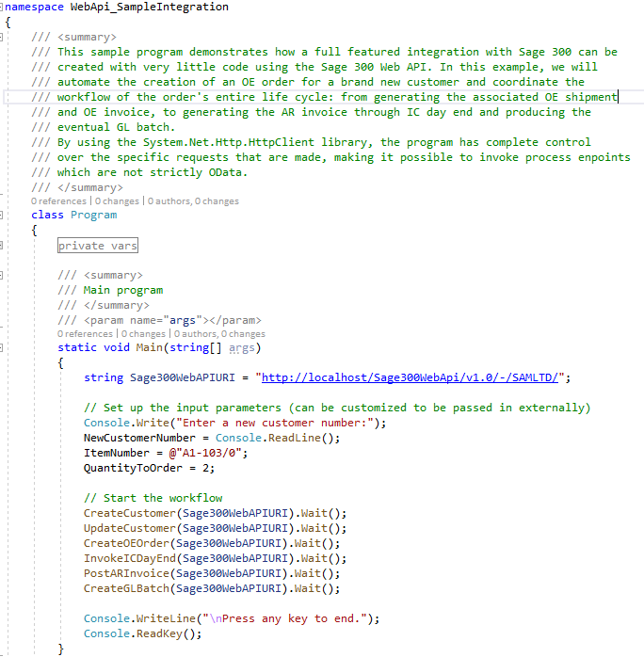
Web API
Coded Access
Samples and Tutorials
Documentation
Notes:
You can use the language of your choice for coded access.
In the SDK you will find multiple completed samples along with documentation with step-by-step instructions for creating the samples from scratch.
For example, the Integration Sample uses a C# console program to illustrate how easy it is to make API calls and you will programmatically create a customer, update the customer, create an order, invoke the inventory control’s day end, post an invoice and finally create a batch all through the API. This is a great sample for getting used to the API and programmatically driving it as well.
There are a couple of other samples that invoke other functionalities such as retrieving a range of customers, retrieving a customer with a key, deleting a customer, and creating an invoice.
There is even a sample that uses Chrome’s Postman Utility to load an execute Postman scripts. This sample was created prior to the adoption of Swagger, and we feel that Swagger is more intuitive, provides better documentation and is easier to use than Postman. However, for the postman users, this sample is still valid and handy!
How about security?

Slide 11
Web API
Benefits
API
Easy to use
Less data transfer
Consistent
No UI
Integration
JSON
Notes:
That’s our Sage 300 Web API!
There are numerous benefits to using it, such as:
It is quick and easy to use whether you are using Swagger to access it or have written a coded access
The structured nature of the endpoints (segments, version, resources, naming conventions, etc.) along with the OData implementation makes for a consistent experience. And consistency is the key!
It supports JSON for a smaller and faster payload plus the payloads can even be minimized to only require requested and/or required fields
Finally, the API can play an important role in any integration, testing, debugging, or validation story
Let’s move on to the SDK.

Slide 12
Web SDK
SDK
Wizards
Docs
Resources
Samples
Source
Goal
“The goal of the Web SDK is to get developers up and running quickly and easily.”
Notes:
The goal of the SDK is to get developers up and running quickly and easily.
The SDK includes productivity tools (wizards and utilities) for the generation and customization of Web UIs. It also includes documentation, language resources, standalone and customization samples, and even source code for the wizards, utilities, and even samples.
The Sage 300 ISV and Development Partner community have applications, add-ons, and plug-ins for Sage 300. These are very exciting and are the life blood to the community and were built with the Sage 300 SDK (non-web) in order to ensure compatibility with Sage frameworks and the Sage 300 application.
It is these applications and customizations that will need to be re-written for Sage 300’s web screens. The SDK will aid in getting screens developed quicker by creating a Visual Studio solution based upon the same structure which Sage 300 uses internally. It will also generate code for a screen/report based upon a business view or business views or a report.
Let’s start looking at the SDK with the wizards.

Slide 13
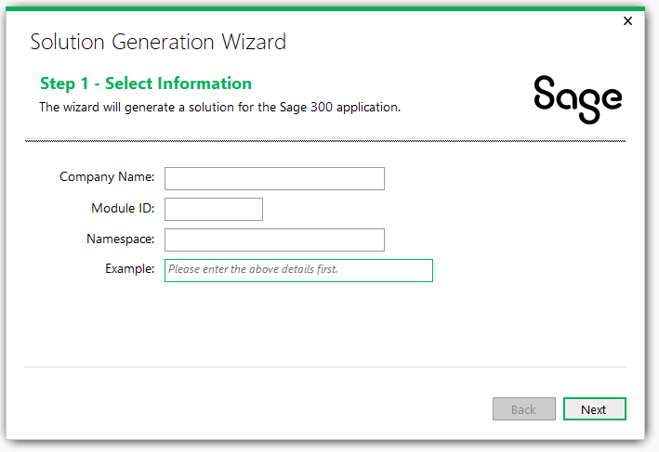
Web SDK
Solution Generation Wizard
Business Repository Project
Code files for the Entity Repositories, Entity Mappers, Menu Navigation XML, Security Constants
Interfaces Project
Code files for the Entity Repository/Service Interfaces
Models Project
Code files for the Models, Model Enumerations, etc.
Resources Project
Code files for the Resources (Resx Files)
Services Project
Code files for the Services
Web Project
Code files based upon MVC patterns (Controllers, View Models, JavaScript, Razor Views, Configuration files, and so on
Notes:
First off is the Solution Wizard, which is a Visual Studio plugin, it is invoked from the New Project dialog in the Visual Studio IDE. It will create the required projects in preparation for creating screens, reports, inquiries, etc. The solution created is aligned with how ASP.NET tools create solutions and allows the wizard to leverage everything built into Visual Studio. Therefore, instead of a separate utility, the wizard is embedded directly into the IDE for efficiency.
Six projects created in the solution:
Business Repository Project - Code files for the Entity Repositories, Entity Mappers, Menu Navigation XML, Security Constants.
Interfaces Project - Code files for the Entity Repository/Service Interfaces.
Models Project - Code files for the Models, Model Enumerations, etc.
Resources Project - Code files for the Resources (Resx Files)
Services Project - Code files for the Services.
Web Project - Code files based upon MVC patterns (Controllers, View Models, JavaScript, Razor Views, Configuration files, and so on.
Refer to the SDK for docs on this wizard in addition to several tutorials

Slide 14
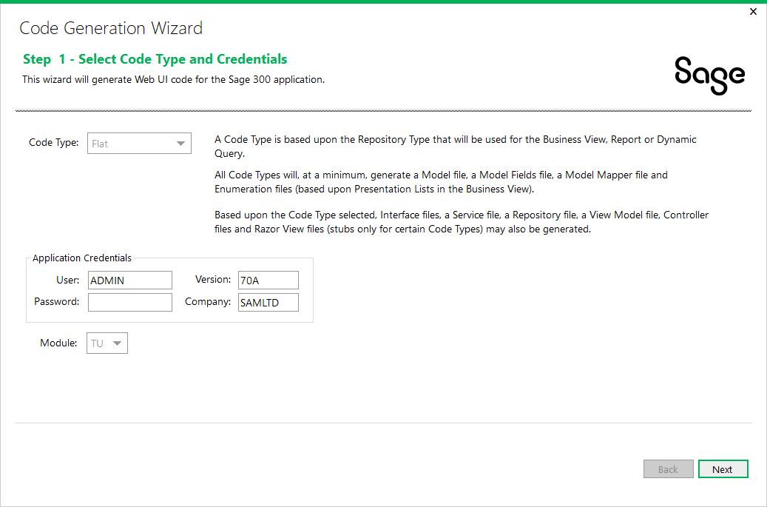
Web SDK
Code Generation Wizard
Generate code in projects based upon code type
Uses Business Views to generate code
Flat Code Type
Simple setup screens using FlatRepository class
Process Code Type
Process screens (long running screens usually with a progress meter) using the ProcessRepository class
Dynamic Query Code Type
Screens without a Business View (i.e., KPI) or where direct SQL Statements are required for performance and uses the DynamicQueryRepository class
Report Code Type
Report screens using the ReportRepository class. It uses a model created in the wizard from the selected report to generate code.
HeaderDetail Code Type
HeaderDetail screens using the HeaderDetailRepository class
Notes:
The Code Generation Wizard, which is a Visual Studio plugin, is invoked from the Solution Explorer. It will generate code in the different projects based upon the selected code type. All code types generate the set of code required to fully compile and run a screen. The projects are aligned with how Sage internal developers create their web screen projects. Accessing the wizard from the right-click of the solution within the Solution Explorer window is ideal since this wizard is available in the IDE and we will be generating code for all projects in the solution.
There are different code types associated with the behavior of the screen:
Flat Code Type - Simple setup screens using the FlatRepository base class. It uses an Accpac Business View to generate code.
Process Code Type - Process screens (long running screens usually with a progress meter) using the ProcessRepository base class. It uses an Accpac Business View to generate code.
Dynamic Query Code Type - Screens without an Accpac Business View (i.e. KPI) or where direct SQL Statements are required for performance. Uses the DynamicQueryRepository base class. It uses a model created in the wizard to generate code.
Report Code Type - Report screens using the ReportRepository base class. It uses a model created in the wizard from the selected report to generate code.
HeaderDetail Code Type - HeaderDetail screens using the HeaderDetailRepository base class. It uses Accpac Business Views to generate code.
Refer to the SDK for docs on this wizard in addition to several tutorials

Slide 15
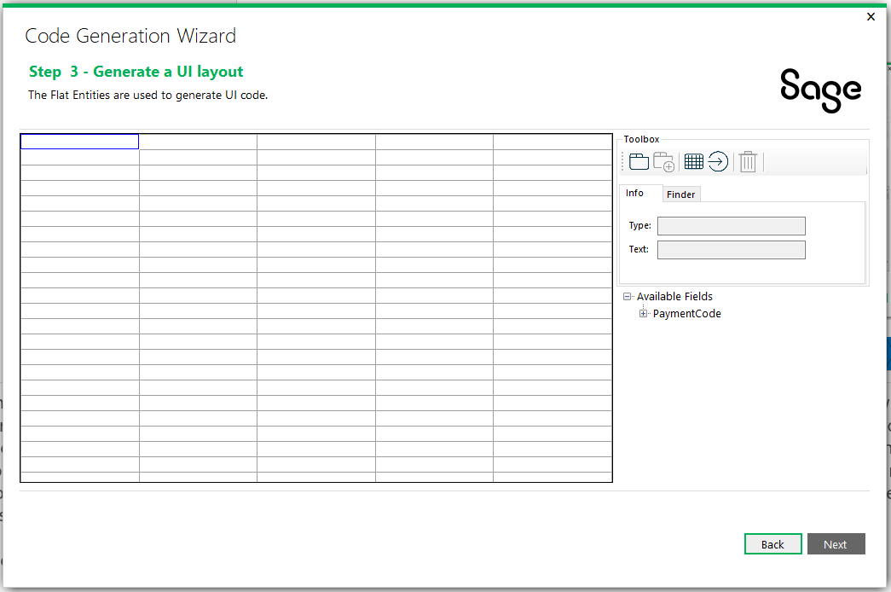
Web SDK
UI Layout Wizard
Wizard for generating UI widgets
Drag and drop model properties on palette
Create tabs and buttons and grids
Generates labels, textboxes, checkboxes, dropdowns, radio buttons, finders, etc.
Notes:
As mentioned, the UI Layout Wizard is a new step that is being added to the Code Generation Wizard. Once a view or views have been specified for creation, there will be an extra step before generation which will give the developer the opportunity to roughly layout the UI. The properties in the new model can be dropped onto a palette indicating their basic placement and their underlying data type will dictate in most cases the widget that will be used, but this can be overridden in some cases. For example, you might want a dropdown control for a list, or you might want radio buttons. The wizard will allow this type of assignment based upon the data type of the property. Additionally, the developer will be able to create tabs and grids and buttons too.

Slide 16
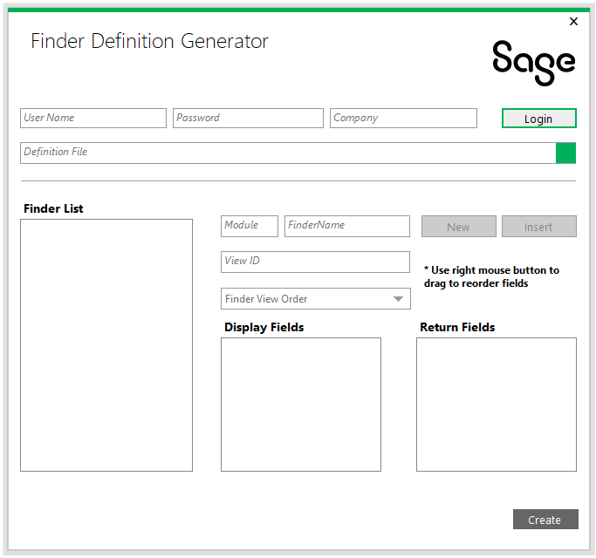
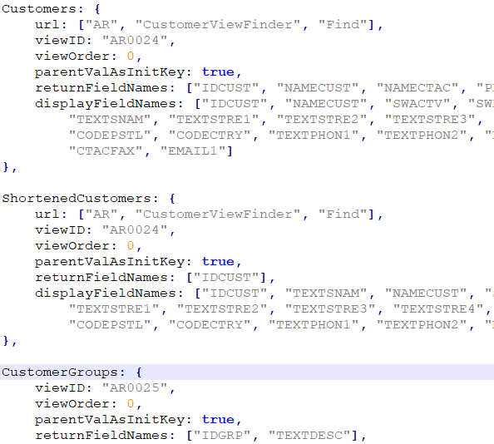
Web SDK
Finder Definition Generator
Create and modify finder definitions
Prerequisite for selecting finder definition in Code Generation Wizard
Notes:
The Finder Definition Generator will allow for the creation of finder definitions. Finders can either be defined in a static JavaScript file or be dynamically created. For finders that are used in multiple places, a common definition is ideal. The UI Layout Wizard will require that fields being specified as requiring a finder have a definition predefined. This wizard will be available from within Visual Studio as a plugin.

Slide 17
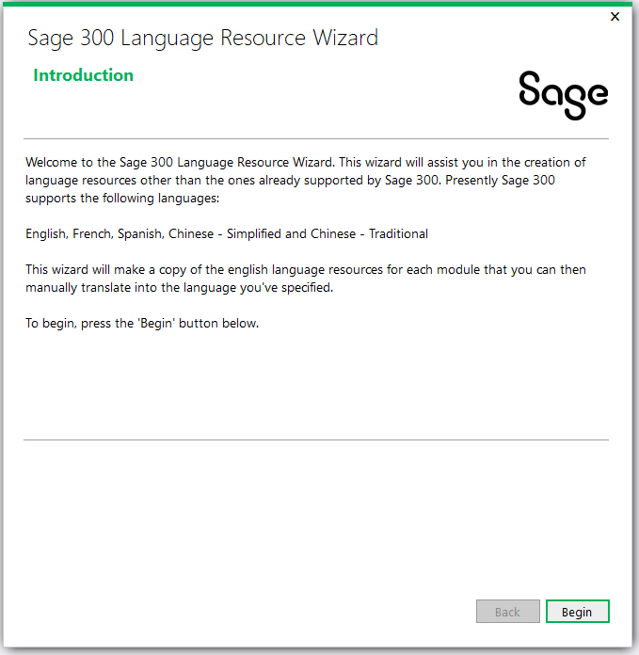
Web SDK
Language Resource Wizard
Generates new language resources for languages other than the supported languages
English, Spanish, French, Chinese Simplified, Chinese Traditional
Notes:
The Language Resource Wizard, which is a Visual Studio plugin, is invoked from the Solution Explorer. It will generate new language resources for languages other than the ones currently supported by Sage 300 (English, French, Spanish, Chinese Simplified and Chinese Traditional).
Language resources are provided for this wizard driven by the English resource to create a new language resource specified in the wizard. The next step is translation which the wizard does not do, and the final step is compilation so that the new language resources can be delivered by the partner to a customer. As an added benefit to including the resources in the SDK is the ability to modify our resources if desired!
Just a note that the web screens may contain messages originating in the web screens or from messages originating in the business layer. The messages originating in the business layer are not available for translation via this utility. That requires some additional steps, but this wizard simplifies the creation of the resources for any new language.
Refer to the SDK for docs on this wizard.

Slide 18
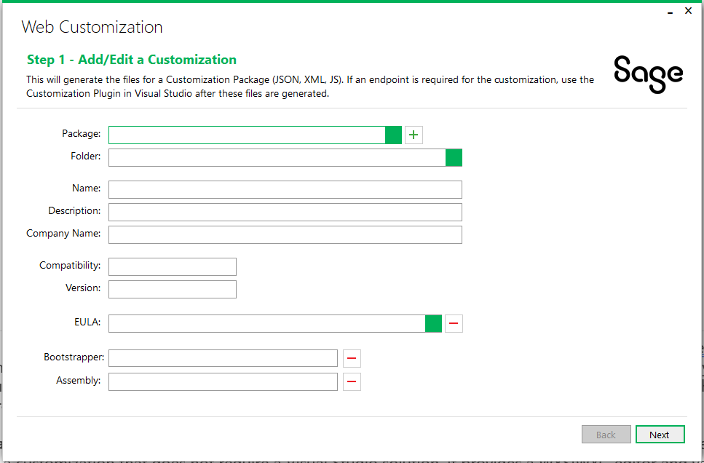
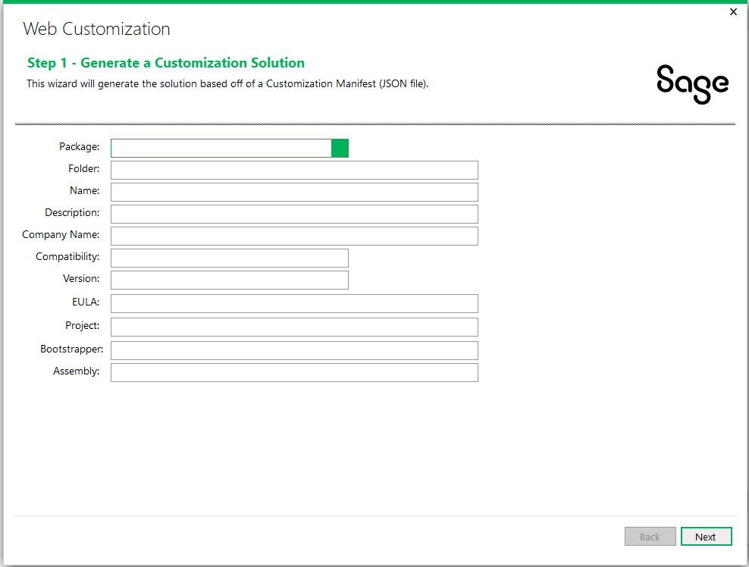
Web SDK
Customization Wizards
Standalone executable
Does not require Visual Studio to establish base customization
Visual Studio add-in and uses manifest established in standalone wizard
Required if endpoint for customization is required
Modifies manifest established in standalone wizard
Notes:
The customization strategy differs drastically between the desktop and the web. Where the desktop is an inheritance model (i.e. the desktop screen’s OCX is inherited and customized as desired), the web strategy is a participation model where a partner or multiple partners may customize the same screen. At the end of the customization process in the web, there is only 1 screen with multiple customizations as opposed to the desktop where there are multiple customized screens.
The Standalone Customization Wizard is an executable which simplifies and enhances the customization experience where developers are not forced into Visual Studio to create a customization that does not require a Visual Studio solution. It provides a WYSIWYG editor and validations for JSON and XML files. The wizard will walk you through screens where you setup the manifest for the customization, select the screen or screens to be customized, select the control or controls (if required) to be added to the screen to support the customization and finally let’s you review the customization before generating the manifest, xml settings file and a JavaScript template file.
The Plugin Customization Wizard, which is a Visual Studio plugin , is invoked from the New Project dialog. It simplifies the creation of the Visual Studio solution by reading the JSON manifest created in the standalone customization wizard. This wizard is only required if the customization requires an MVC project (i.e., endpoints). Once the solution is created this wizard will update the manifest with relevant information in the manifest when an assembly is attached, such as, Assembly Name, Bootstrapper Name, etc.
Refer to the SDK for docs on these wizards

Slide 19
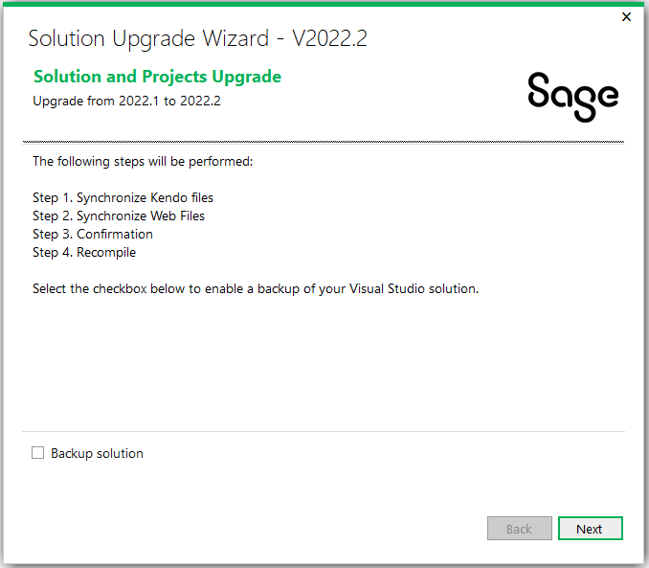
Web SDK
Upgrade Wizard
Upgrades solution and projects from a previous release to current release
Manual steps may be required and are documented if wizard is unable to perform an upgrade step
Notes:
The Upgrade Wizard, which is a Visual Studio plugin, is invoked from the Solution Explorer. It will upgrade any Visual Studio solution and projects from a prior release in order to be compatible with a new version of Sage 300 and the SDK. Note that the upgrade is only relevant for the previous version as it does not upgrade any version to the current release.
Every release, Sage may have made changes to global framework files provided in the SDK. Therefore, these files in existing partner solutions will need to be synchronized with the latest versions of these files. The wizard will provide this synchronization. Sage may have also made changes to other framework components or code that was generated by the wizards and even code created by a partner (following a particular pattern or standard). If possible, the wizard will include processes to update this code as well. If code changes are required but it is impossible to codify in the wizard, the steps will be spelled out in the upgrade document for manual processing by the partner.
As I mentioned, we make every attempt to perform all upgrades by the wizard for a seamless upgrade. However, there are some changes that require manual intervention by the developer.

Slide 20
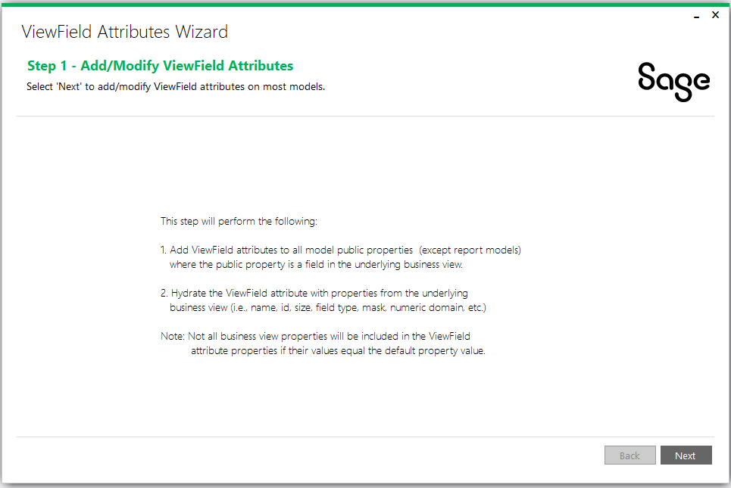
Web SDK
View Field Attribute Wizard
Adds ‘ViewField’ attribute to model’s public properties
Hydrates attribute properties from underlying business view’s fields
Used by JavaScript developers to leverage framework helpers for assigned model property values
To be leveraged in the future by new HTML Helpers which will reduce CSHTML code
Notes:
The ViewField Attributes Wizard, which is a Visual Studio executable, is not delivered as a binary in the Web SDK’s bin folder. This is because usage of this wizard by a third-party will require modifications to the wizard prior to running.
This wizard will modify the model classes in the solution’s ‘Models’ project to add the ViewField attribute to public properties and hydrate the attribute properties from the underlying business view.
Refer to the SDK for doc on these wizard

Slide 21
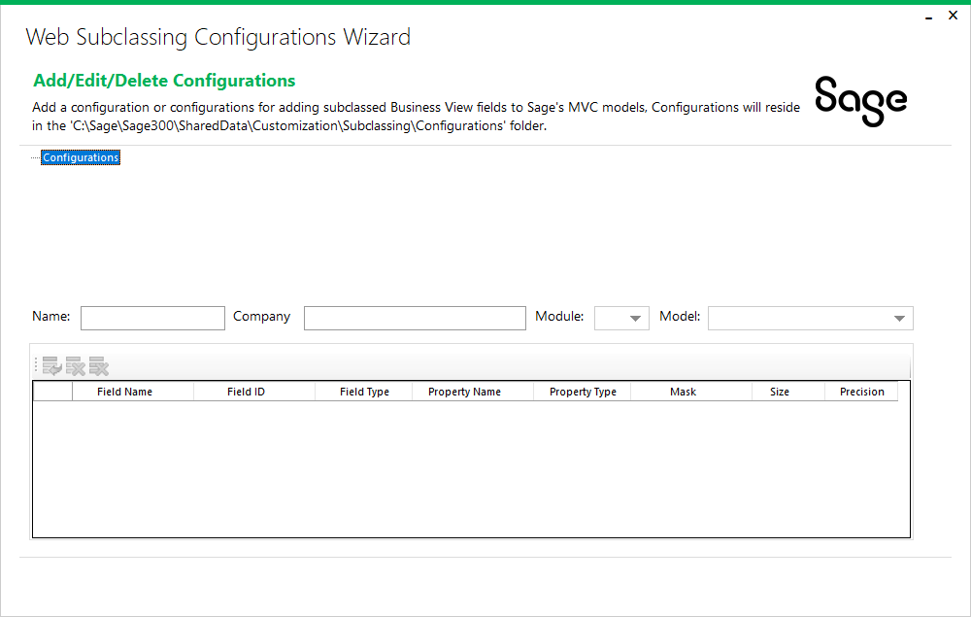
Web SDK
Web Subclassing Configurations Wizard (New!)
Create, modify, and delete JSON subclassing configurations
JSON configurations used to describe and associate subclassed fields for an entity (view) and MVC model
Used by external developers to extend the static MVC models to included subclassed fields
To be leveraged by the Web Subclassing Compiler and Deployment Wizard
Notes:
The Web Subclassing Configurations Wizard, which is a standalone executable, is delivered as a binary in the Web SDK’s bin\wizards folder.
This wizard will create JSON configurations that will be used to extend the MVC models in the web screens to expose subclassed fields in the business view.
Refer to the SDK for doc on this wizard

Slide 22
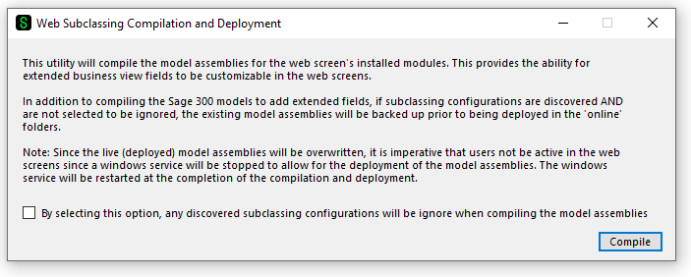
Web SDK
Web Subclassing Compilation and Deployment Wizard (New!)
Extend Sage’s MVC models to included subclassed fields from the business view
JSON configurations used to extend the MVC models and recompile the models for deployment by partners
Used by external developers to extend the static MVC models to included subclassed fields
Leverages the configurations created by the Web Subclassing Configuration Wizard
Optionally remove any extended fields by selecting the option to ignore configurations
Notes:
The Web Subclassing Compilation and Deployment Wizard, which is a standalone executable, is delivered as a binary in the Web SDK’s bin\wizards folder.
This wizard will discover any JSON configurations created by the Web Subclassing Configurations Wizard to add these extended properties to the MVC models and then recompile the MVC models which can then be delivered to a customer site.
Refer to the SDK for doc on this wizard

Slide 23
Web SDK
Docs
Custom
Dev
Help
Patterns
Standards
Upgrades
Web API
Wizards
Docs
Architecture
How To
Tutorials
Interface
Notes:
Documentation is an important aspect of an SDK and there are documents which are a required reading for any developer creating screens or customizations.
You will find documents on the architecture of the Sage 300 web application and various tutorials for creating web screens. There is a great document once the architecture documents have been reviewed which explains why it is important to understand the process and flow of the web screens and what is being created via the wizards.
There is a CHM file to assist external developers in drilling down into the various common and core libraries on valuable and required methods and functions.
There are two pattern documents. One is for Visual Design Patterns and the other is for Code Patterns. The Visual Design Patterns document presents the Visual Basic components and what are analogous components in the web screens. This is a great document for not only understanding how the Visual Basic screens compare to the web screens, but for also understanding the styling and sizing of the web screens.
There are standards documents that are a required reading before any development begins. They explain the standards used for managed code, JavaScript and CSHTML.
There is an upgrade guide which explains the steps being performed by the Upgrade Wizard plus additional documents for manual steps that the Wizard is unable to perform.
There are resource and developer reference documents for the API.
There are documents which walk you through using the wizards. These are a must read for any developer writing a module or a customization as they explain and illustrate the flow of the wizards and explain the solutions, projects and code generated by the various wizards.
There can never be enough documentation, and we recognize that more is needed in the SDK. This is on our roadmap to deliver more docs!

Slide 24
Web SDK
Resx
English
Spanish
French
Chinese
???
Resources
Resource files included in the SDK
Can be leveraged by Language Resource Wizard
Notes:
Language resources are included in the SDK. These are the language resources used by the Sage 300 web screens and can be leveraged by the Language Resource Wizard to generate resources for a non-supported language. As mentioned earlier, these are only the resources for the web screens as the desktop has its own set of resource files (DLLS).
A couple of notes on the resource files:
Not all resource files require localization as some as used to store operands, SQL statements and other information.
There are global resources, module resources and screen resources. This hierarchy is basically the same as the desktop resource structure in an effort to minimize localizations and to re-use commonly used strings.
Let’s look at the samples.

Slide 25
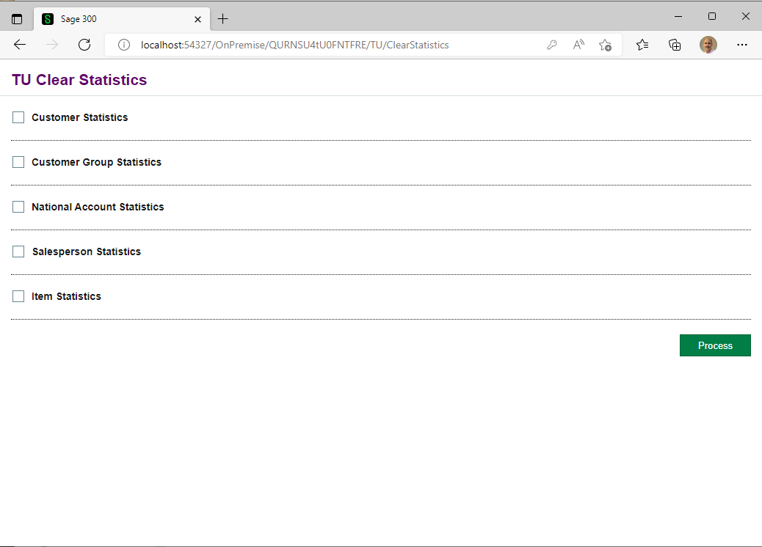
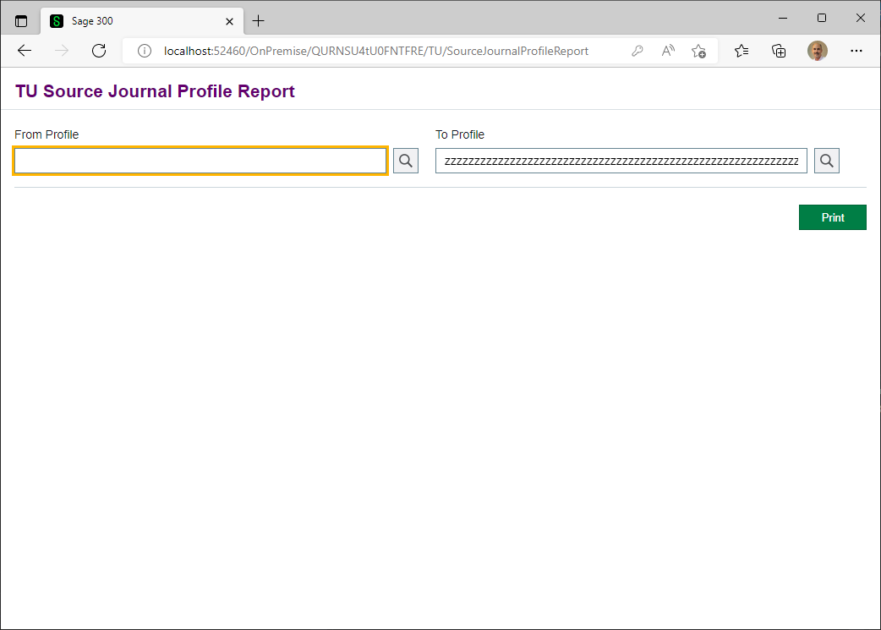
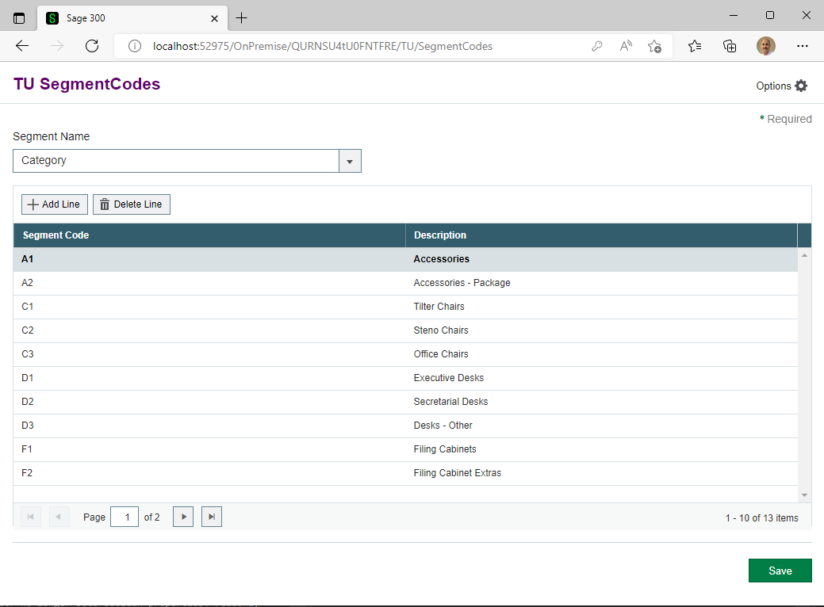
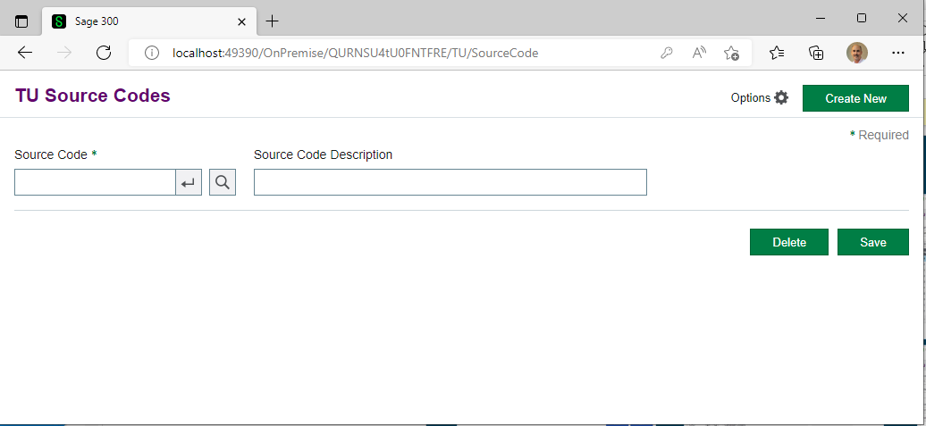
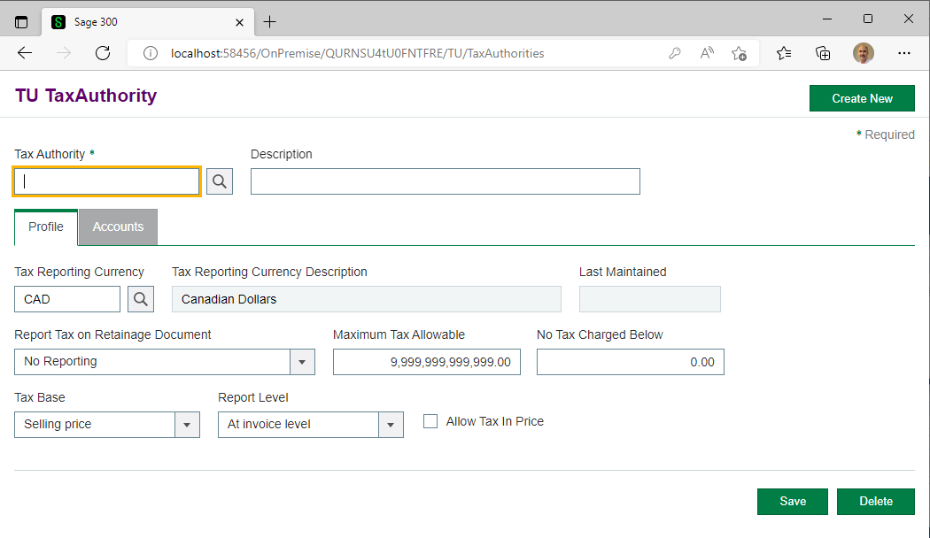
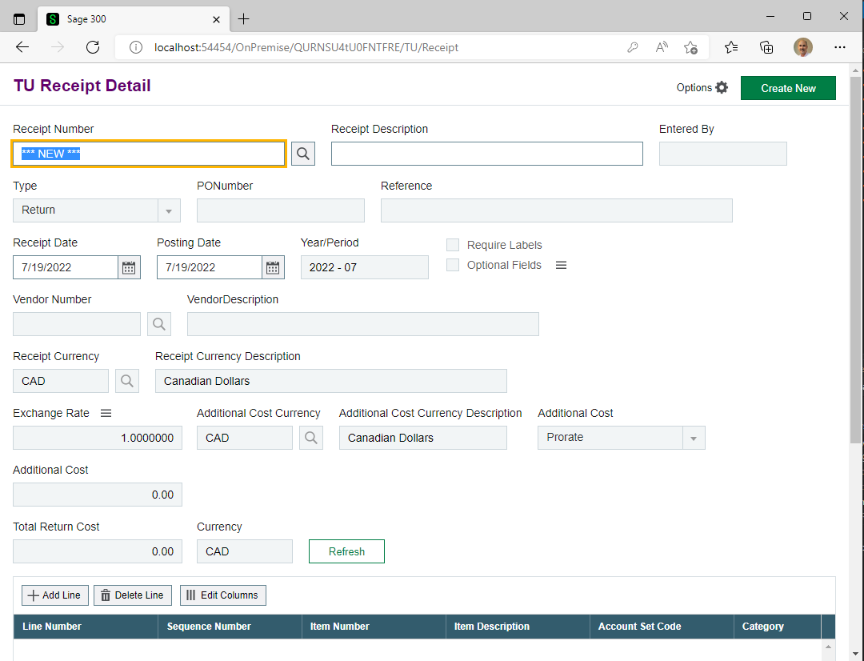
Web SDK
Samples
Notes:
Samples are great learning tools and numerous samples are included to reflect the different screen or code types. These samples are standalone examples of current Sage 300 web screens which can be debugged to understand the structures, the code flow, and the interaction of the various components. There is a README file in the root folder of the samples which discusses compiling and even a prerequisite (Environment Var) that must be established prior to running the samples. But, once this is setup, it is simply a matter of loading, resolving Nuget references, compiling, and debugging.
The samples listed here reflect processing, flat, report, and header detail code types. Of special note on the processing type, the Clear Statistics sample, is that there is a SQL script that must be applied to the Portal/Sage Landlord database since a processing code type involves our workflow engine and this is driven from our Portal/Landlord database. There is a README file in the folder for that sample. It is required reading!

Slide 26
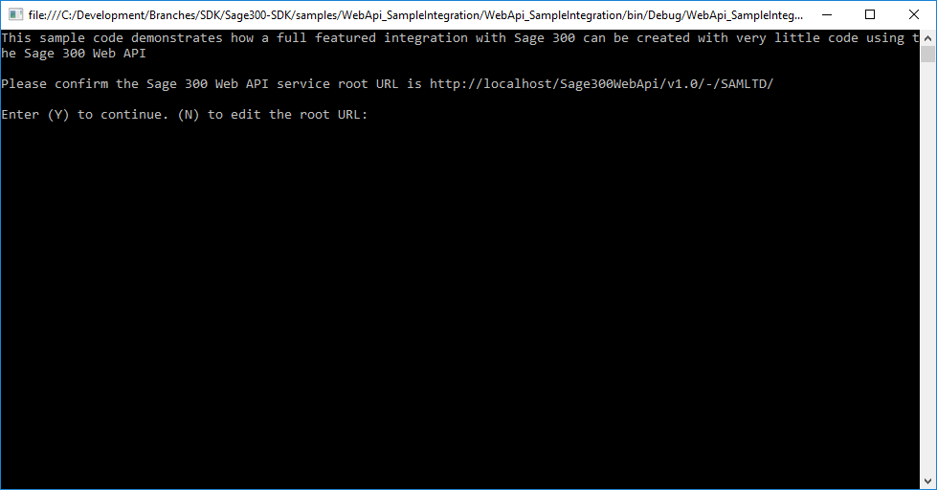
Web SDK
Web API Integration Sample
C# Console Program
Completed source
Document for creating from scratch
How to create a customer
How to create a batch
How to create an order
How to create an invoice
Notes:
The Sage 300 Web SDK Web API Integration Sample uses a C# console program to illustrate how easy it is to make web api calls.
The sample program is already complete and ready to go, but if you prefer to create it manually, the WebAPI_SampleIntegration_Instructions Word document in the samples/WebAPI_SampleIntegration folder of the Web SDK provides a step-by-step tutorial for creating this sample program.
In this sample, you will programmatically create a customer, update the customer, create an order, invoke the inventory control’s day end, post an invoice and finally create a batch all through the web api. This is a great sample for getting used to the web api and programmatically driving it as well.
So, is source included in the SDK?

Slide 27
Web SDK
How to Use
SDK Wizards
Development
QA
Release
Docs
Samples
Debug
Partner
SDK
Notes:
Here is a simple example of an SDLC. Once the wizards and utilities are registered as plugins (Visual Studio plugins are VSIX files), these wizards accelerate the initial creation of the web screens and customizations.
As this illustration describes, once the wizards are used to generate a solution and starting code for a screen or screens, documentation is referenced, tutorials and samples are viewed, debugged and understood, which feeds into the development cycle of the screen. Thus, acceleration of the development process. Of course, implementing business logic is not a feature of today’s SDK. As I will demonstrate in the What’s coming in August section, we are looking for ways to accelerate the development process by generating more UI elements and as much template and stubbed code as possible.

Slide 28
Web SDK
SDK
Faster Dev
Best Practices
Security
Brand Image
Open Source
Benefits
Code Generation
Consistent
Secure
Modular
Integration ready
Extensible
Core business logic and services
Open Source
https://github.com/SageNADev/Sage300-SDK
Notes:
There are numerous benefits to the SDK: Accelerated development is just one benefit. The wizards will generate a scaffolded solution while delivering generated code for a more robust starting point while the samples illustrate the structured and organized implementation within our screens. We recognize the Sage 300 developer community and strive to ensure that these implementations are also available to the community. If we can implement something internally then so should an external developer! Of course, a solution and project can be generated from scratch, but why would you?
By providing documentation, samples and generated code, we strive for consistency and best practices in our implementation.
Security is always a concern and a high priority for Sage 300. We perform Penetration Tests and Code Scans to ensure our implementations are secure and consistent, and this is reflected in the code we generate.
The SDK strives for seamless integrations as partner modules and customizations want to blend into the Sage 300 palette and not to be seen as differing from the patterns and practices within the Sage 300.
The SDK is open source! All tools can only be so much to everyone in order to consider everyone’s base needs while providing functionality that is easy to use. The open sourcing of the SDK has allowed the community to extend, enhance and even tailor the SDK to their specific needs. Sage wants this community to be successful in the conversion of their applications to the web paradigm. The open sourcing of the SDK will allow those who wish to contribute to the Web SDK to do so in a way that not only addresses their needs, but potentially the needs of others as well.

Slide 29
What’s New
Subclassing
Translation Package
Visual Studio 2022

Slide 30
Subclassing
Overview
Achieving parity between the desktop and the web screens allows user to choose either the desktop or the web screens when using Sage 300.
The subclassing of business views to expose additional fields and functionalities are a core aspect that illustrates the flexibility of the Sage 300 architecture. However, this flexibility is only partially available in the web screens.
The missing functionality is the ability to display and interact with fields added to a business view. When a partner subclasses a business view, these added or joined fields will likely be required to be displayed on a screen for user interaction.
The new Subclassing strategy combined with the Customization strategy in the web brings subclassing that has always been available in the desktop to the web!

Slide 31

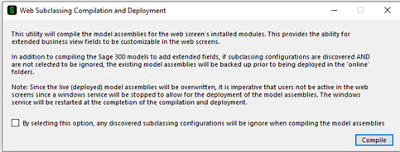
Subclassing
Web Screens Wizards
The Web Subclassing Configurations Wizard is partner facing for the generation and modification of configurations that will later be consumed by the Web Subclassing Compiler and Deployment Wizard.
The Web Subclassing Compiler and Deployment Wizard is partner facing for the consumption, or not, of configurations that will add extended properties to Sage 300 MVC models and deploy the compiled assemblies to the local installation.
A customization will now be able to add these extended properties to the web screen.

Slide 32
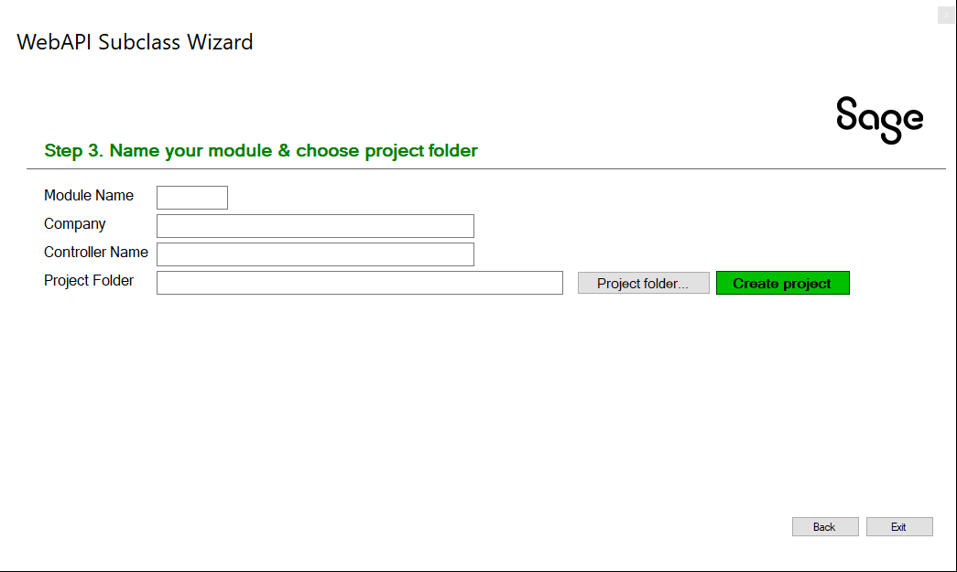
Subclassing
Web API Wizard
The Web API Subclassing Wizard is partner facing for the generation and extension of API endpoints in the Sage 300 Web API.
The Web API has simpler requirements (i.e., no UI) from the Web Screens and therefore a simpler wizard.
This wizard creates a partner specific endpoint while preserving the Sage 300 endpoint for a selected resource.

Slide 33

Subclassing
Demo – Web Screens
Pacific Tech has supplied us with a subclassing to the Vendor business view. Many thanks!
Let’s see these extended fields in the View Doc
Let’s create a subclassing configuration for the web screens
Let’s extended the Sage 300 Vendor web model to include these extended properties
Let’s create a customization for these new properties
Let’s apply this customization to display the extended fields

Slide 34
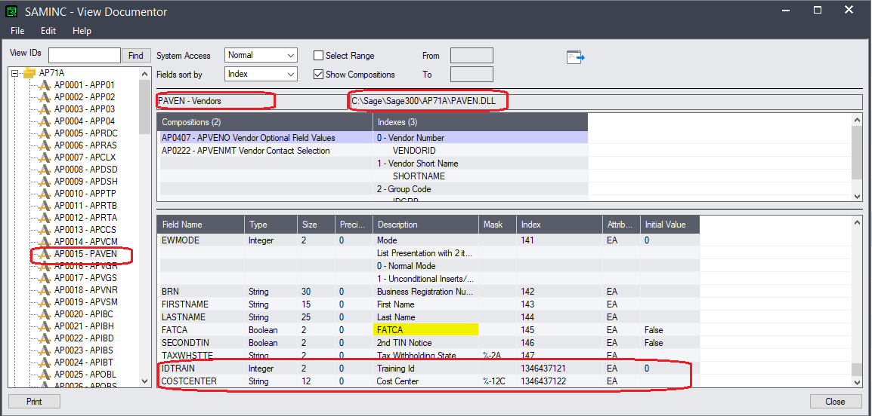
Subclassing
Demo – Web Screens
Let’s see these extended fields in the View Doc

Slide 35
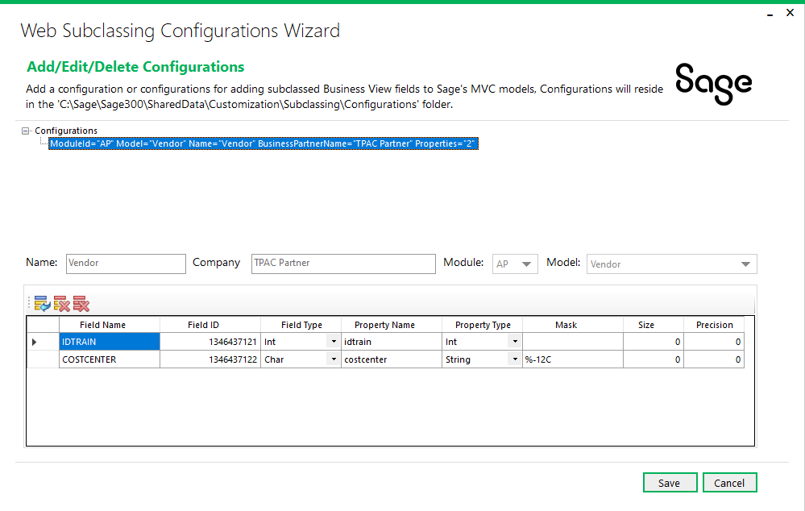
Subclassing
Demo – Web Screens
Let’s create a subclassing configuration for the web screens

Slide 36
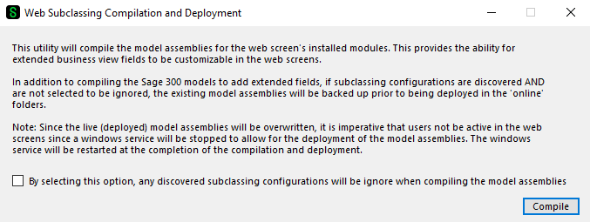
Subclassing
Demo – Web Screens
Let’s extended the Sage 300 Vendor web model to include these extended properties

Slide 37
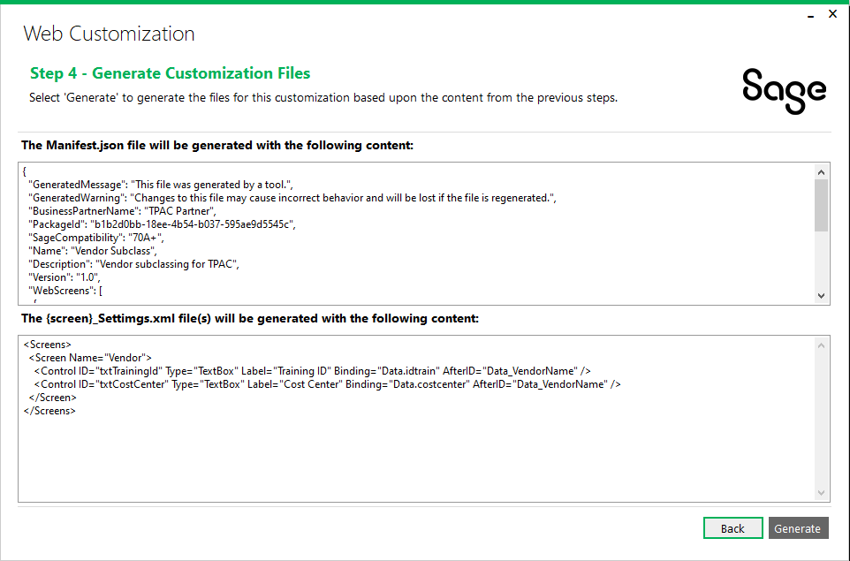
Subclassing
Demo – Web Screens
Let’s create a customization for these new properties

Slide 38
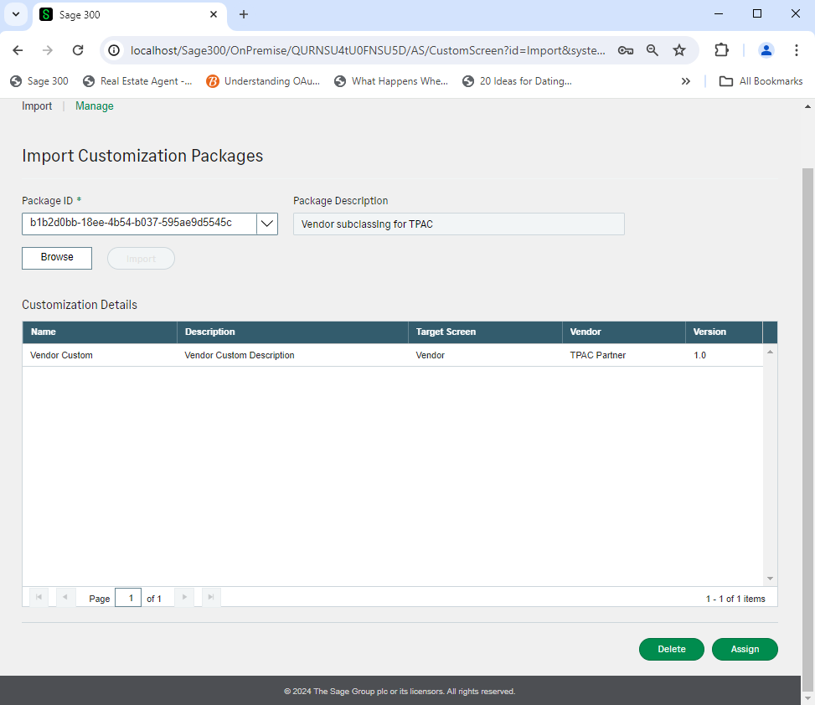
Subclassing
Demo – Web Screens
Let’s apply this customization to display the extended fields

Slide 39
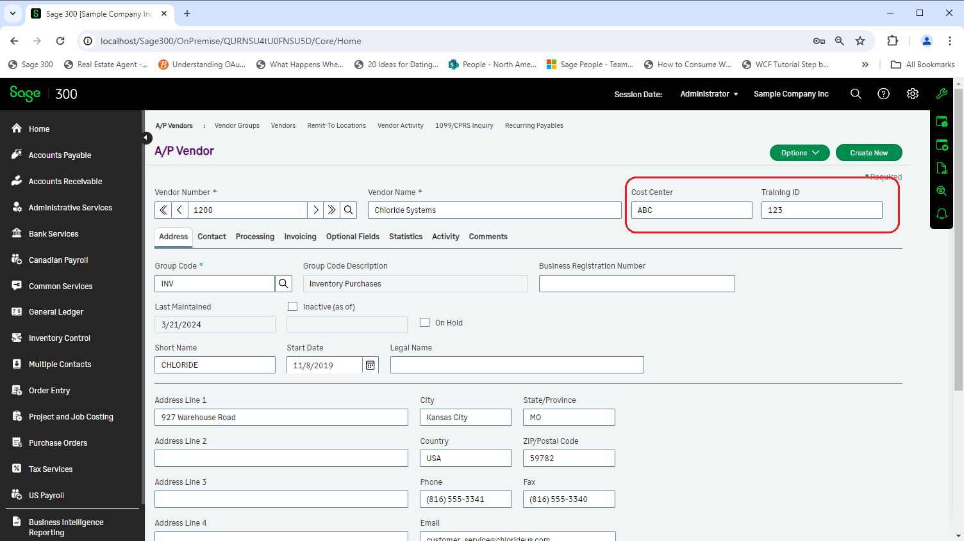
Subclassing
Demo – Web Screens

Slide 40
Subclassing
Demo – Web API
Using the same subclassing from Pacific Tech
Let’s run the Wizard to create a project
Let’s extended the Sage 300 Vendor endpoint
Let’s copy the assembly to the ..\Online\WebApi\bin folder for discovery
Re-start IIS and Launch the Sage 300 Web API

Slide 41
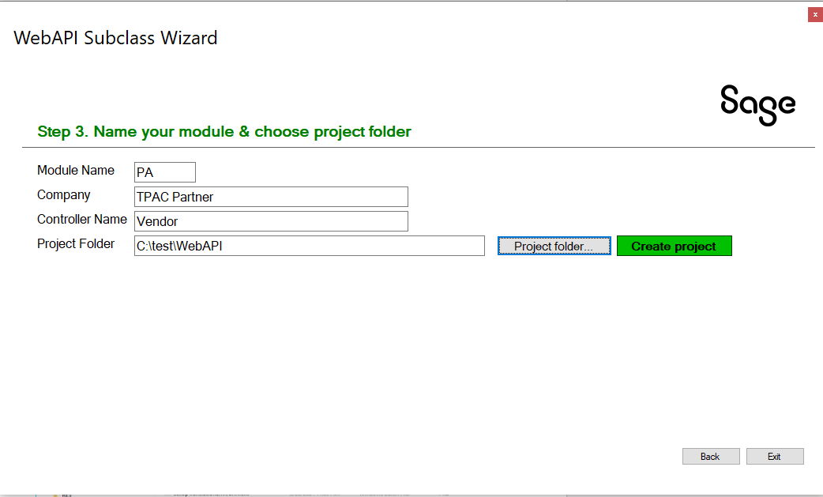
Subclassing
Demo – Web API
Let’s run the Wizard to create a project

Slide 42
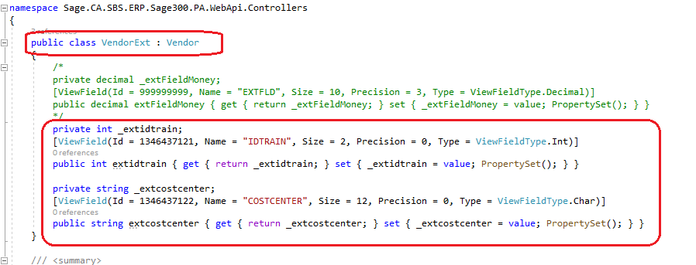
Subclassing
Demo – Web API
Let’s extended the Sage 300 Vendor endpoint

Slide 43
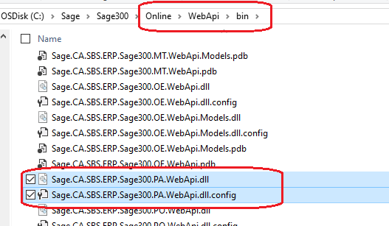
Subclassing
Demo – Web API
Let’s copy the assembly to the ..\Online\WebApi\bin folder for discovery

Slide 44
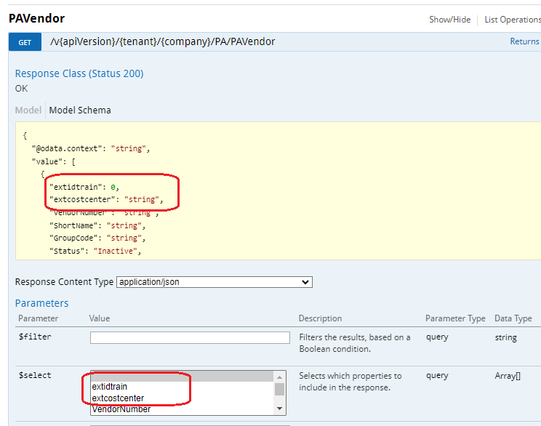
Subclassing
Demo – Web API
Re-start IIS and Launch the Sage 300 Web API

Slide 45
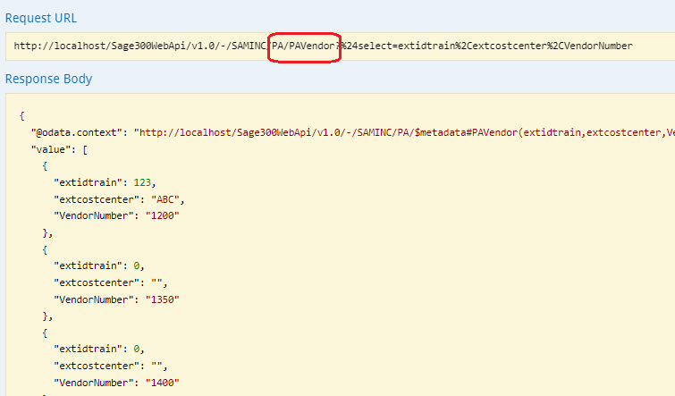
Subclassing
Demo – Web API

Slide 46
Translation Package
Overview
Sage 300 is localized in five languages: English, Spanish, French, Chinese Simplified and Chinese Traditional.
Partners may require the ability to localize in other languages beyond the five supported languages. While this has been possible in the desktop in the past and with great involvement by Sage personnel, this ability seems to have been lost over time.
The Translation Package new for the Sage 300 2025 release has also been made available for Sage 300 2024. This package will allow partners to configure and setup the environment for compiling and will guide you through the process of creating the required files to be used by a translator.
Note: This Translation Package is for the desktop resources and for the web, a Language Resource Wizard already exists in the Web SDK!

Slide 47

Translation Package
Desktop SDK
Download the Translation Package zip file from the Desktop SDK.
Follow the instructions in the ReadMeFirst file
Test the environment with delivered BAT files
The ACCPAC UI Language Wizard will be executed in Visual Basic readying environment for translators to specify content
As an example, the Sage 300 Desktop in Japanese!

Slide 48
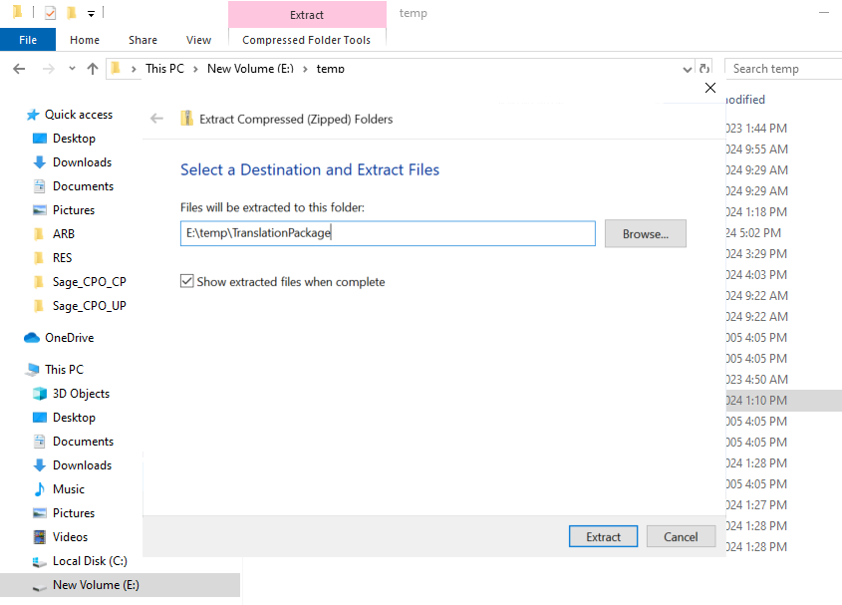
Translation Package
Desktop SDK
Download the Translation Package zip file from the Desktop SDK.

Slide 49
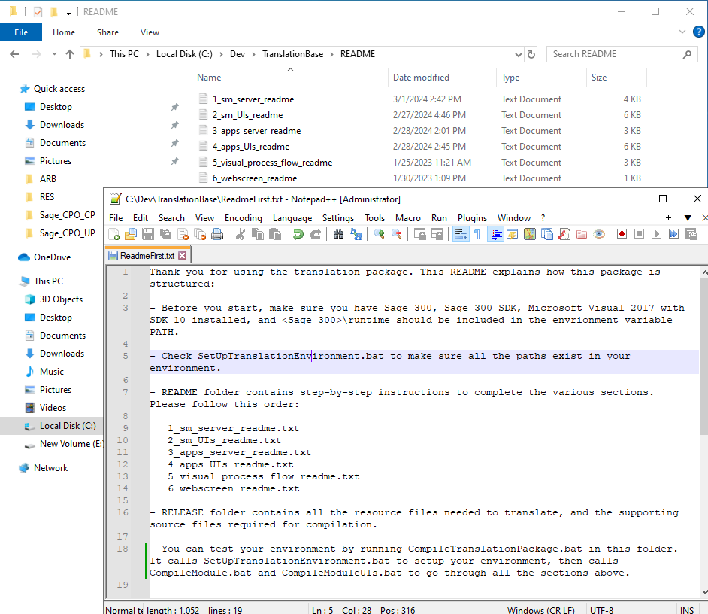
Translation Package
Desktop SDK
Follow the instructions in the ReadMeFirst file

Slide 50
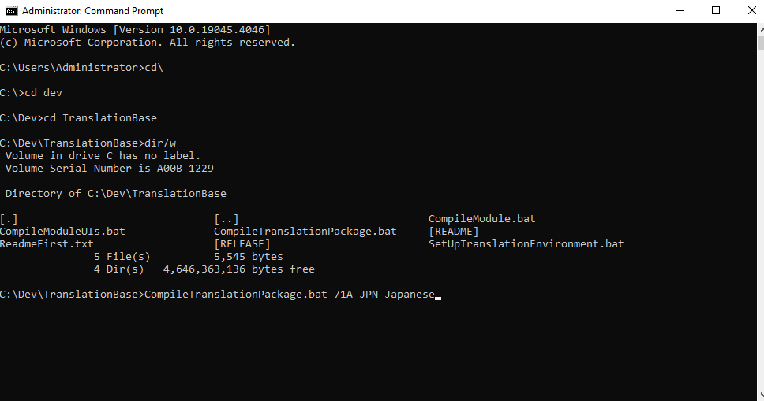
Translation Package
Desktop SDK
Test the environment with delivered BAT files

Slide 51
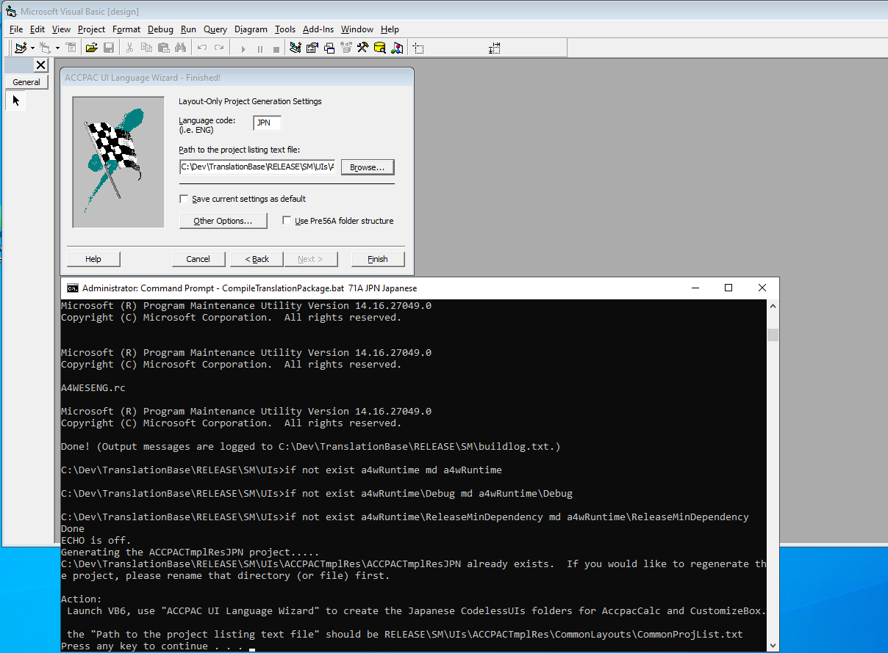
Translation Package
Desktop SDK
The ACCPAC UI Language Wizard will be executed in Visual Basic readying environment for translators to specify content

Slide 52
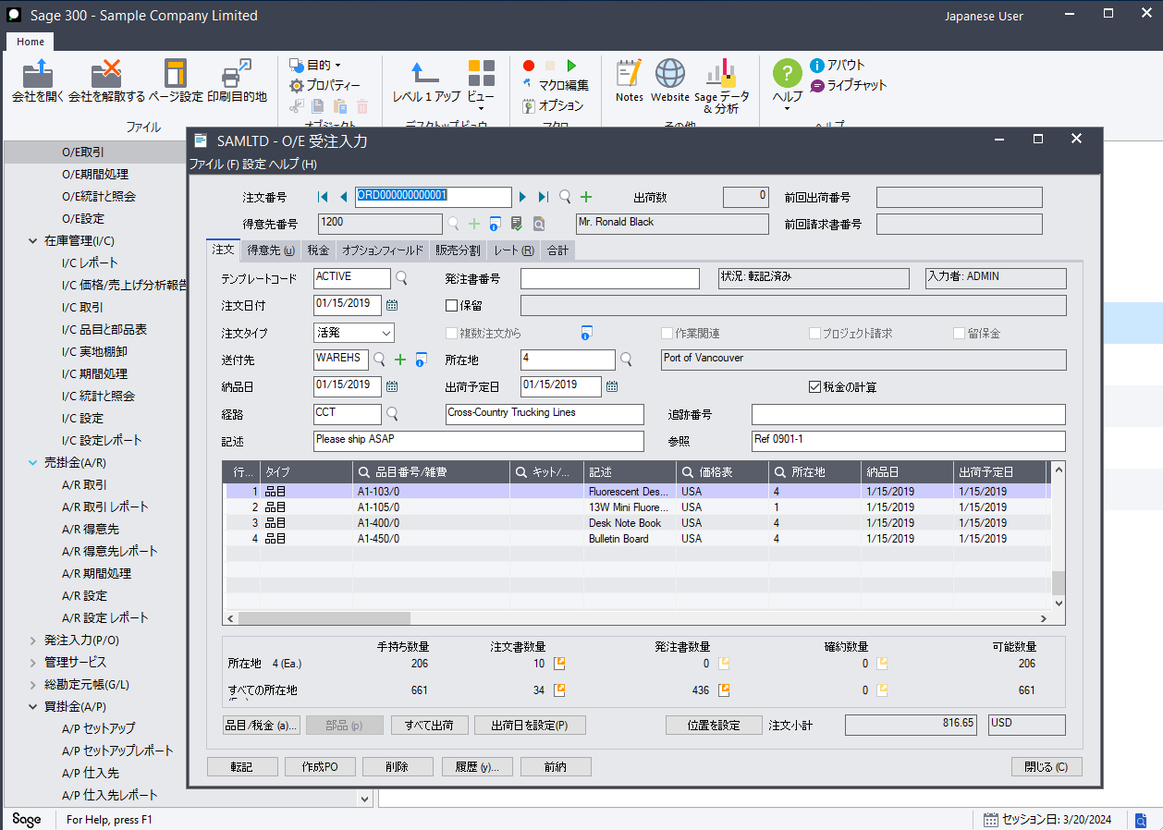
Translation Package
Desktop SDK
As an example, the Sage 300 Desktop in Japanese!

Slide 53
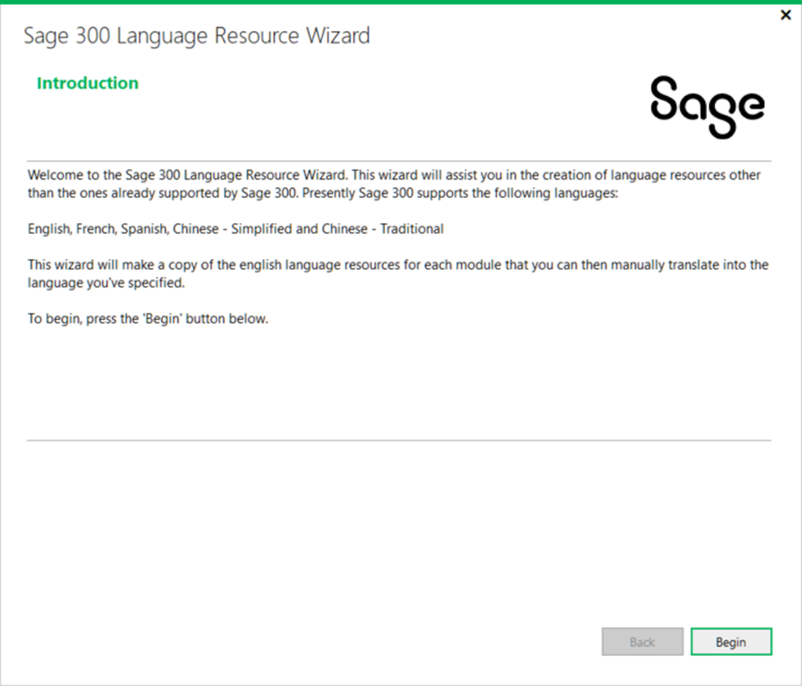
Translation Package
Web SDK
As mentioned, the Language Resource Wizard already exists in the Web SDK
This wizard prepares Microsoft RESX files with English context for the language of your choice
Once executed, the environment is ready for translators to specify content
As in the desktop example, the Web Screens can also be displayed in Japanese by using this wizard!

Slide 54
Visual Studio 2022
Overview
The Sage 300 Web SDK contains over ten wizards with the goal to get developers up and running quickly and easily.
For the upcoming Sage 300 2024.2 release (late April 2024), the wizards will now be compatible only with Visual Studio 2022 (any version).
This ensures that the latest release of our wizards are hosted and executed by the latest version of Visual Studio.

Slide 55
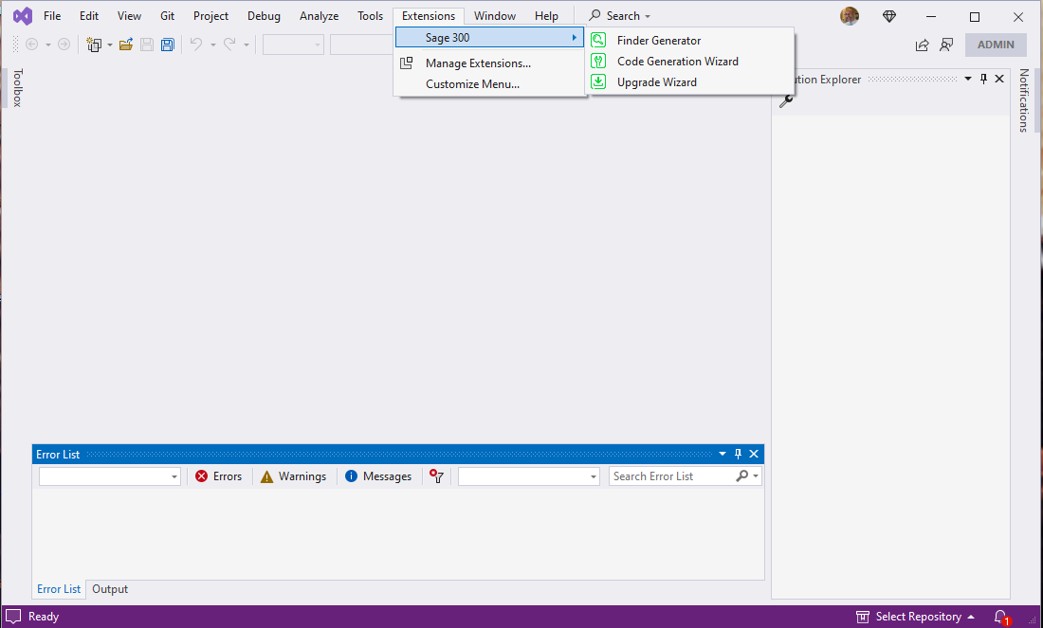
Visual Studio 2022
Web Screen Wizards
Wizards previously accessed by right-clicking in the Solution Explorer’s Context Menu
Starting with Sage 300 2024.2, the plug-in wizards will now be hosted in the Visual Studio Toolbar’s Extension Menu
This location makes more sense and allows more wizards and utilities, when developed, to be seamlessly added to the Visual Studio IDE

Slide 56
Future
Web Screen Proxy
Partner Web API
GitHub Copilot

Slide 57
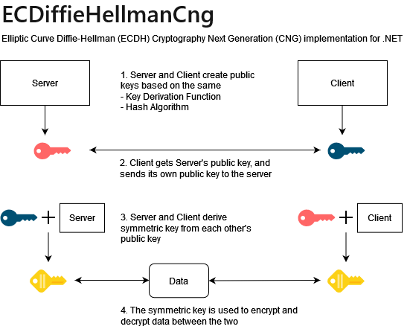
Future
Web Screen Proxy
Currently, there is a proxy that allows for Sage 300 Web Screens to be displayed in Sage CRM. But it is Sage CRM specific!
As we are working on our integration for Sage HRMS, we are developing a universal proxy that can be used by anyone to display Sage 300 Web Screens in their application
Security is of utmost importance, and we are using ECDH (Elliptical Curve Diffie-Hellman Cryptology for encryption
The Web SDK will also contain a proxy tester!

Slide 58

Future
Partner Web API
Partners want the ability to have endpoints in the Sage 300 Web API for their business views
Our subclassing strategy for the Web API introduced in 2024.2 will provide the framework to be leveraged to support this ability
An additional wizard will be required to guide the partner in creating the endpoints much like the Code Generation Wizard guides the partner in the Web Screens
We are targeting Sage 300 2025

Slide 59

Future
GitHub Copilot
Are you using GitHub Copilot?
We are! Our developers and QA engineers all have GitHub licenses starting in January 2024.
From a developer perspective we are already seeing increased velocity and developer satisfaction, and well, some amazement too
We will be investigating how we can leverage this in the wizards as well
We’d love your feedback and experiences!

Slide 60
Discussion
Questions
What’s on your mind?
What do you want to see in the Web SDK?
What do you want to see in the Web API?
What do you …

Slide 61
Thank you!

