Slide 1

Project Title -
Seasonal Agriculture Performance Analysis
FAMEED SHAIK
SREE VENKATESWARA COLLEGE OF ENGINEERING
AICTE STU ID : STU689cad2edb2a61755098414

Slide 2

PROBLEM STATEMENT
Agricultural activities are influenced by seasonal variations in in environmental conditions, farming practices, resource availability and market conditions. As a result, agricultural may differ from one season to another. However, result, agricultural performance perf raw agricultural data does not clearly explain how agricultural performance changes across seasons or what patterns can be observed in different seasonal conditions. The problem is to analyze the given agricultural datase and investigate seasonal differences in agricultural performance by identifying meaningful patterns, trends, relationships and variations within the available data.

Slide 3
The Seasonal Agriculture Performance Analysis project focuses on analyzing agricultural data collected across different seasons, crops, geographical areas, farming practices, environmental conditions, resource usage, and economic outcomes. The project uses Python, Pandas, NumPy, Matplotlib, Seaborn, and Jupyter Notebook to explore and prepare the dataset, handle missing values, identify patterns, compare seasonal performance, and visualize important relationships. The analysis investigates how agricultural performance varies across Kharif, Rabi, and Zaid seasons, with particular focus on yield, production, rainfall, temperature, soil conditions, irrigation, resource usage, revenue, cost, and profit. The objective is to transform raw agricultural data into meaningful, evidence-based insights that can help understand seasonal variations and support better agricultural planning and decision-making.
Project Description

Slide 4

WHO ARE THE END USERS?
• Farmers and farm managers – compare seasonal performance and resource use. • Agricultural planners – understand seasonal and crop-level patterns. • Agronomists and field advisors – examine yield, irrigation and environmental relationships. • Agricultural analysts and researchers – use farm-level evidence for further study. • Students and data analysts – practice real-world agricultural data analysis.

Slide 5

Technology Used
Python Pandas – data loading, cleaning, grouping and aggregation NumPy – numerical operations Matplotlib – analytical visualizations Seaborn – univariate, bivariate and multivariate plots Jupyter / Google Colab – notebook-based analysis Dataset: 4,000 records × 28 variables

Slide 6
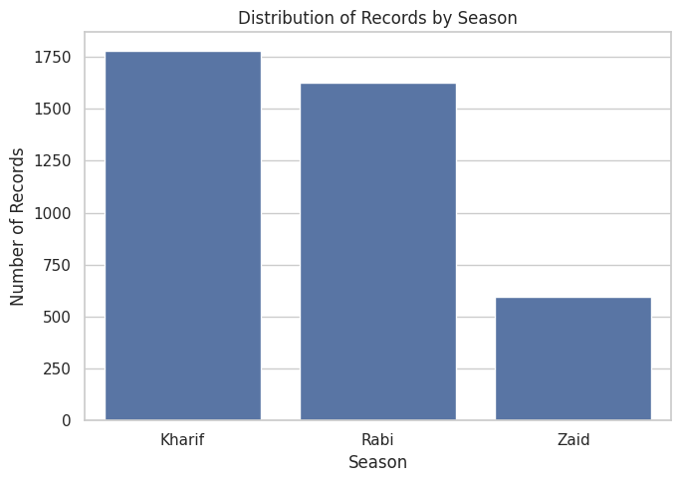
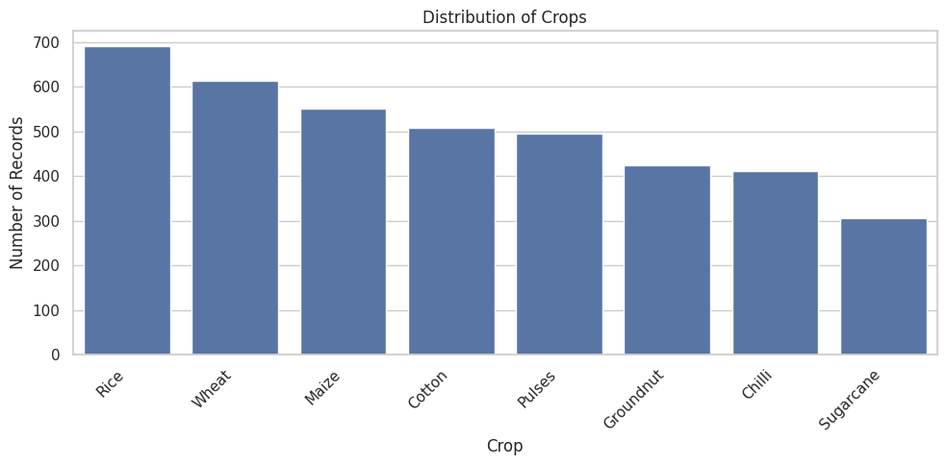
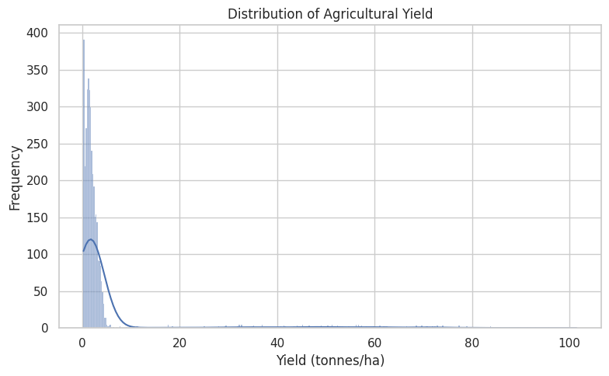
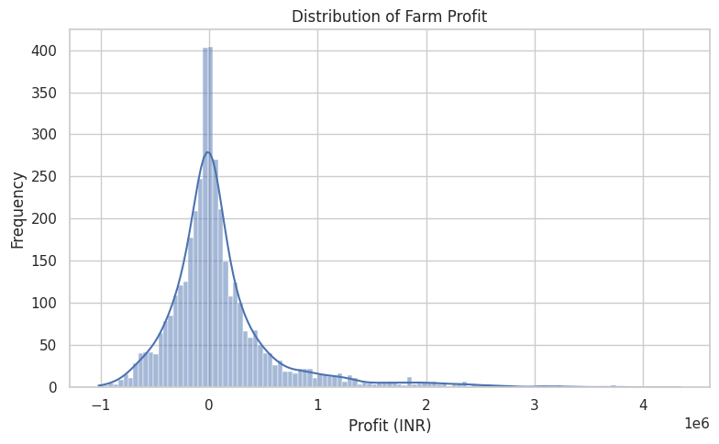
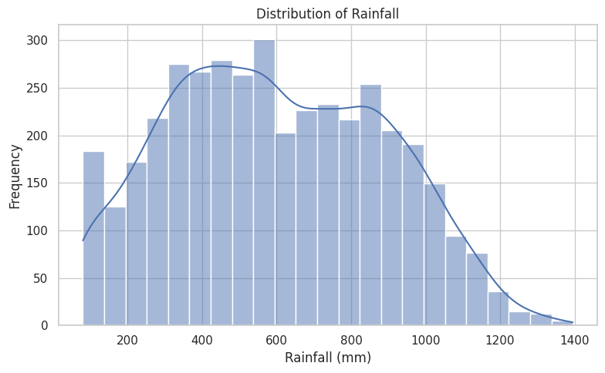
RESULTS

Slide 7
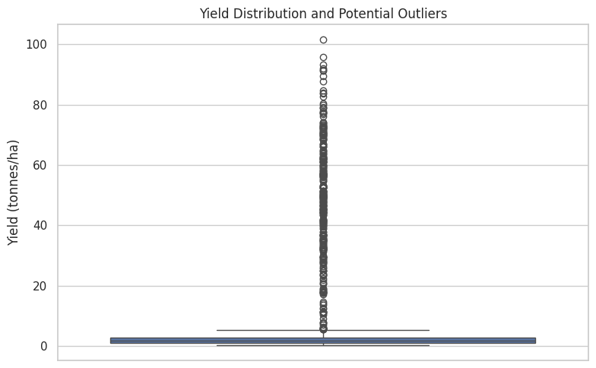
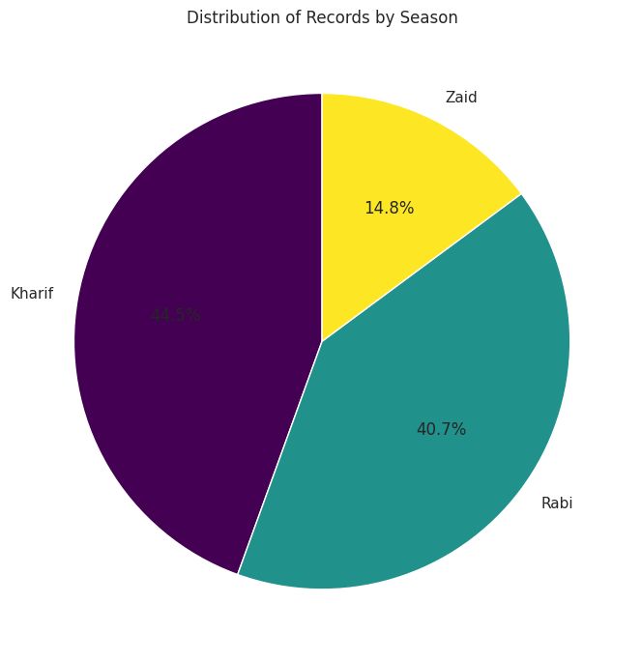
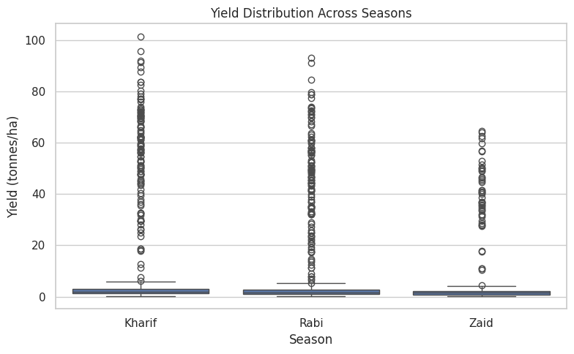
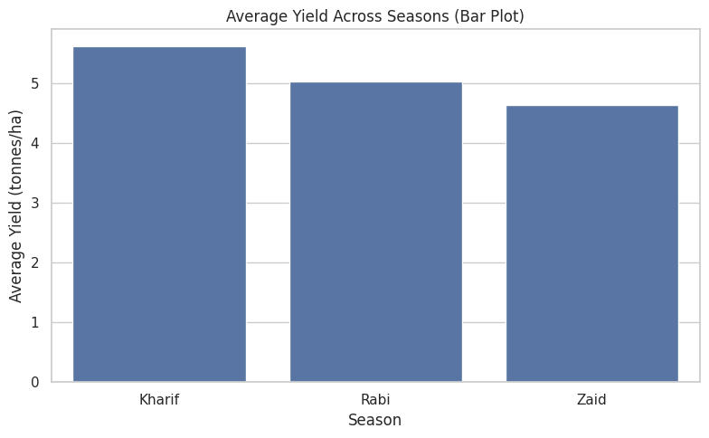
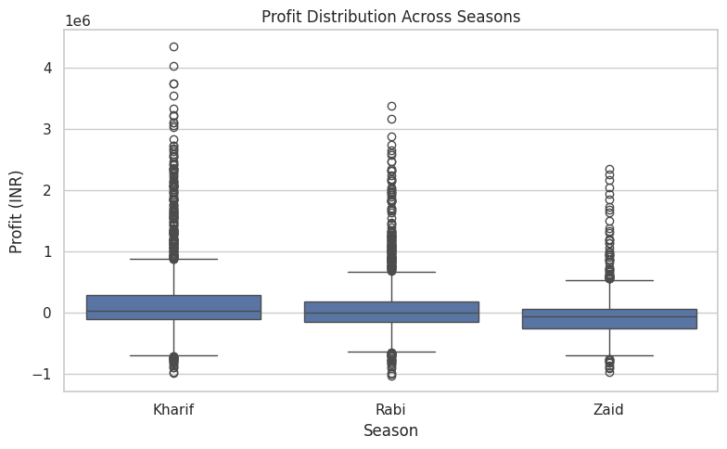
RESULTS

Slide 8
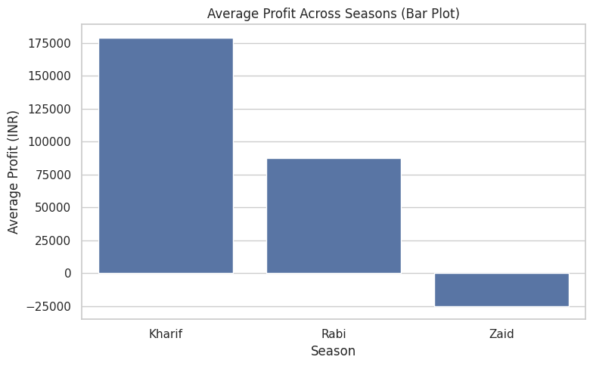
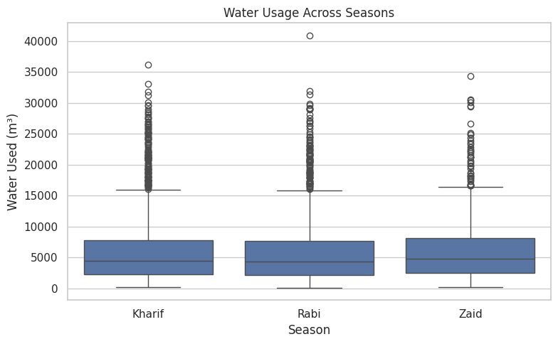
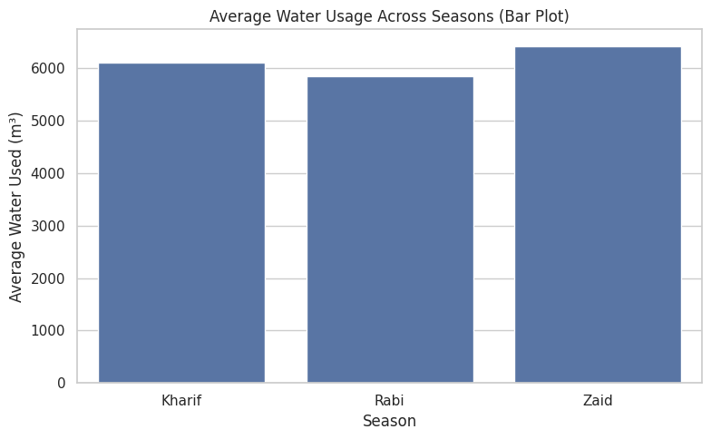
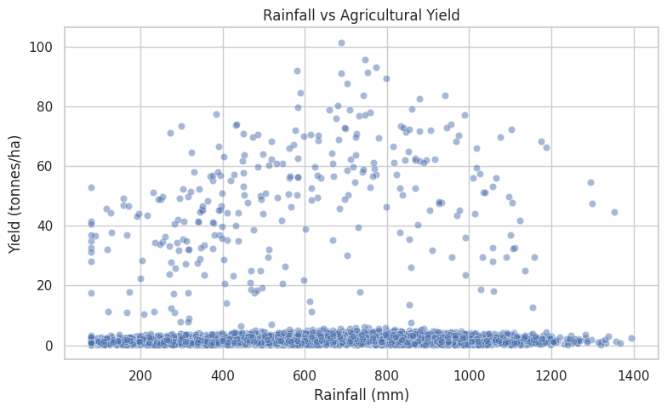
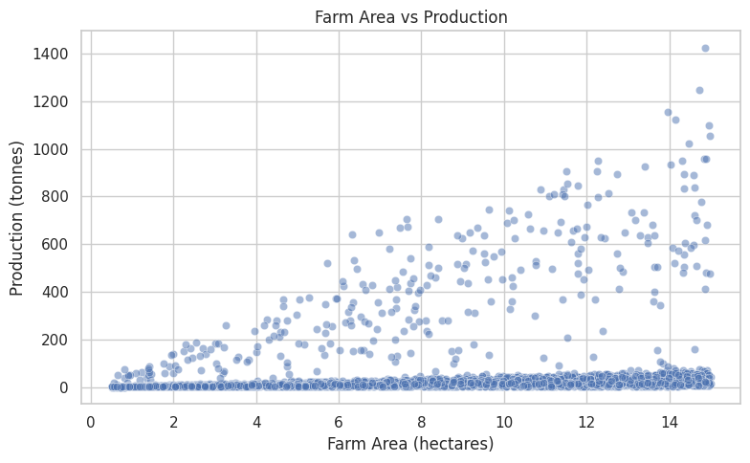
RESULTS

Slide 9
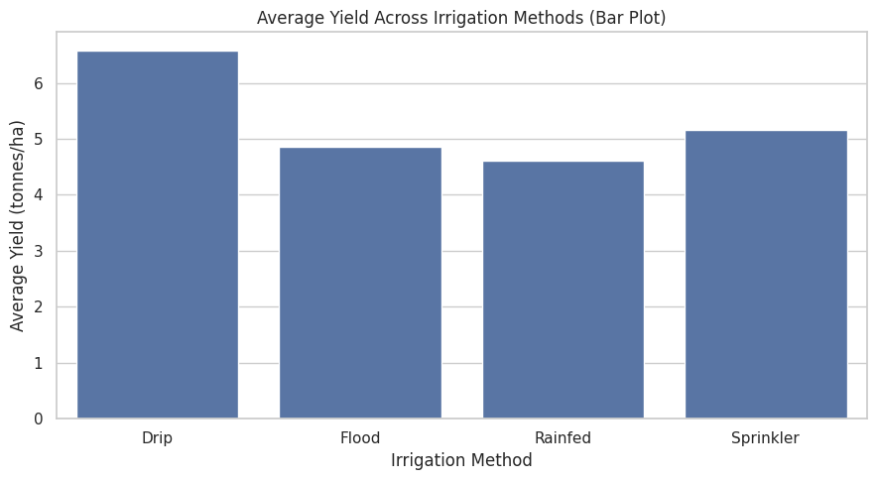
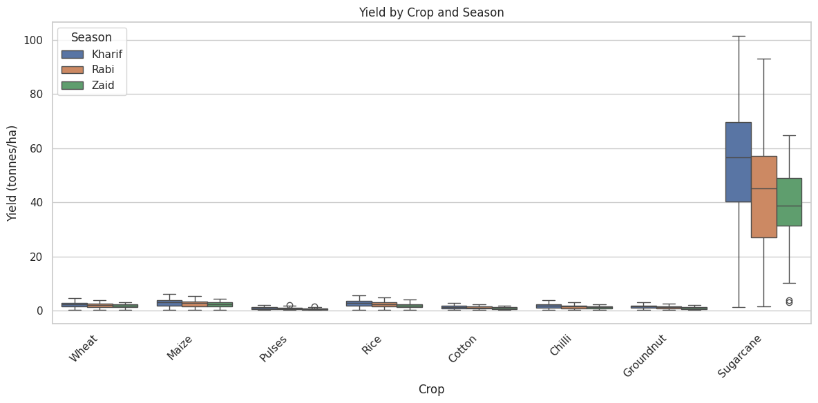
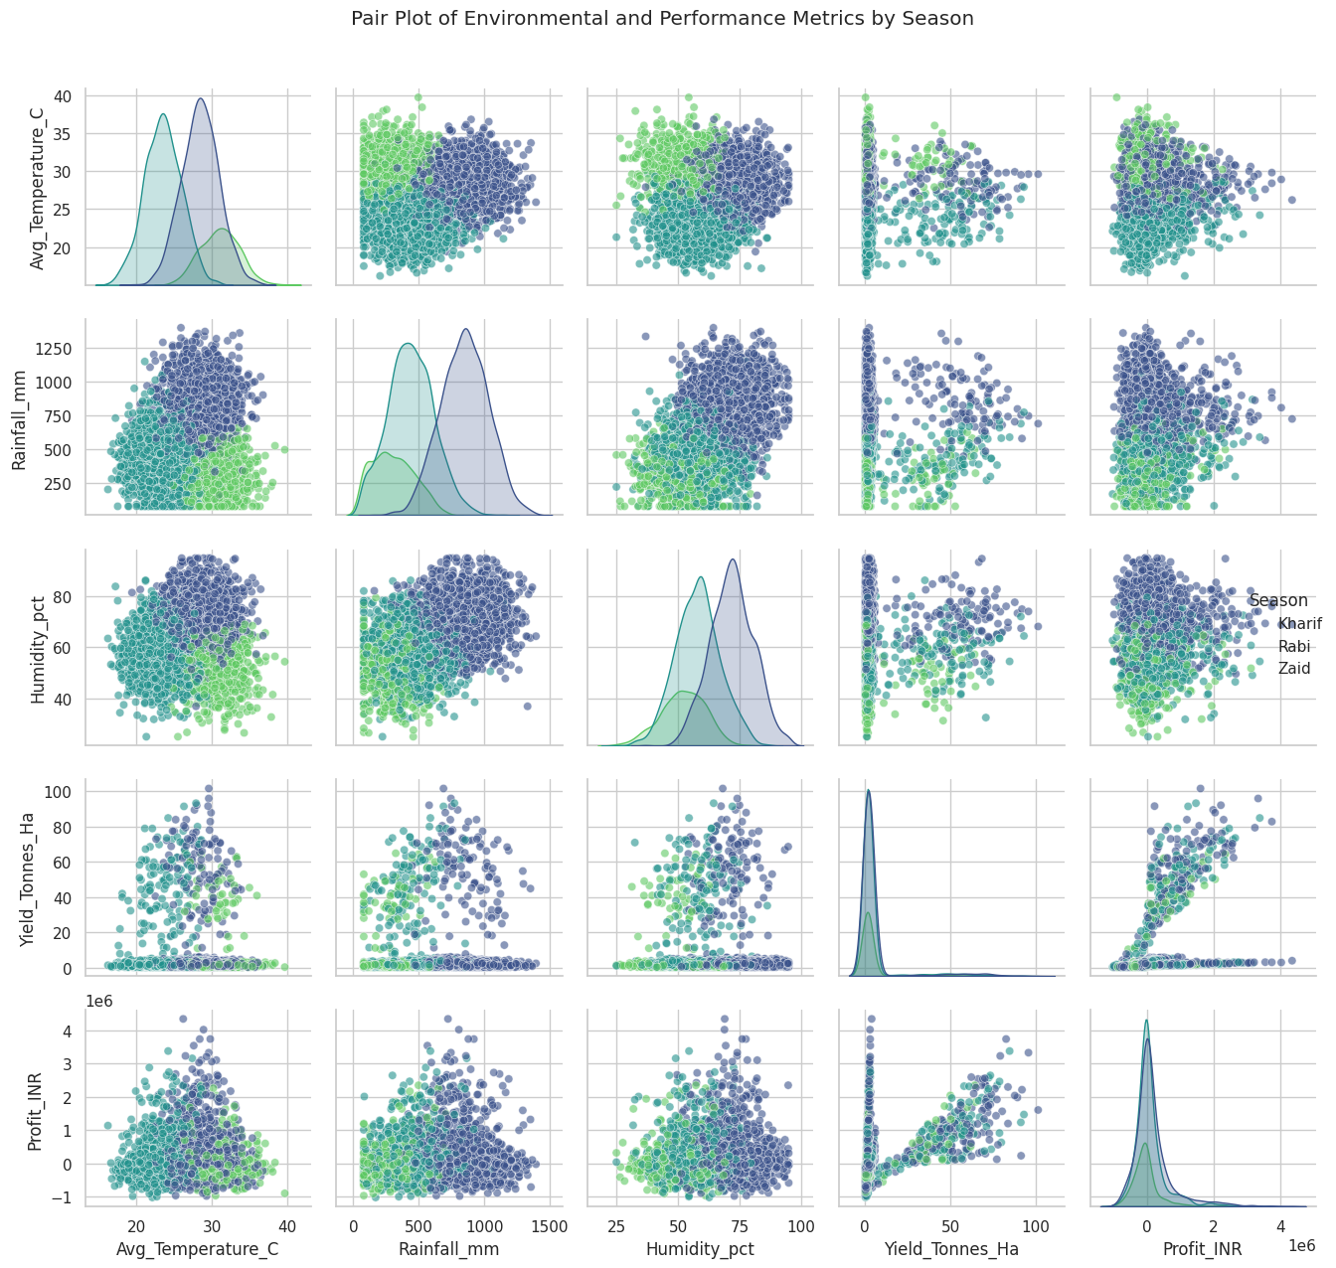
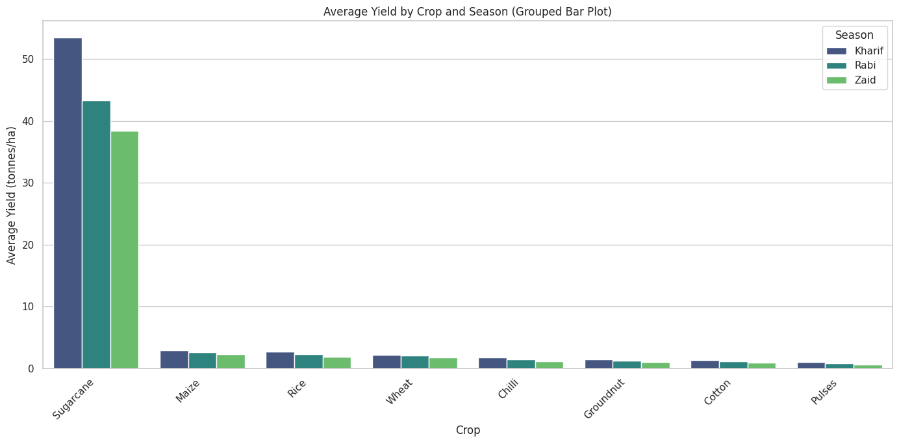
RESULTS

Slide 10
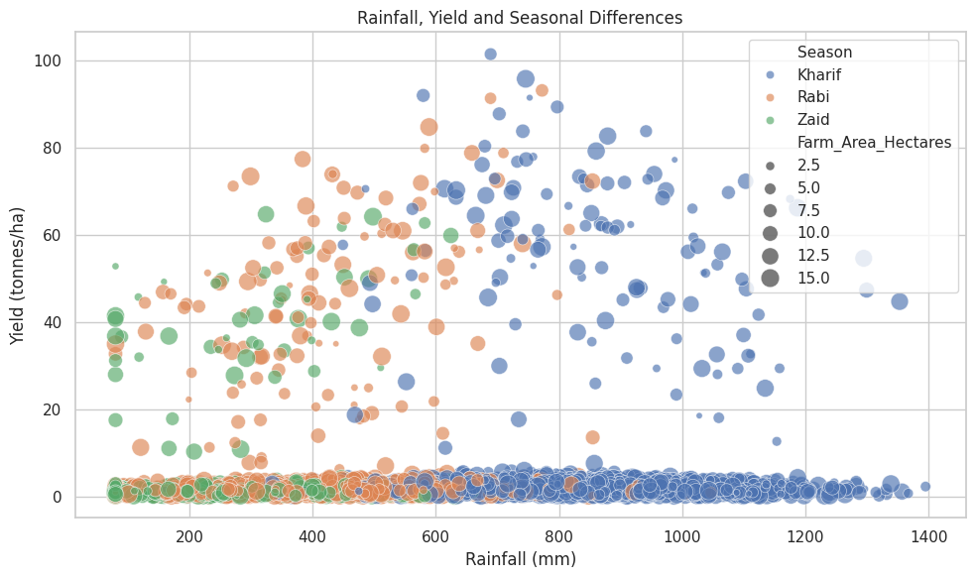
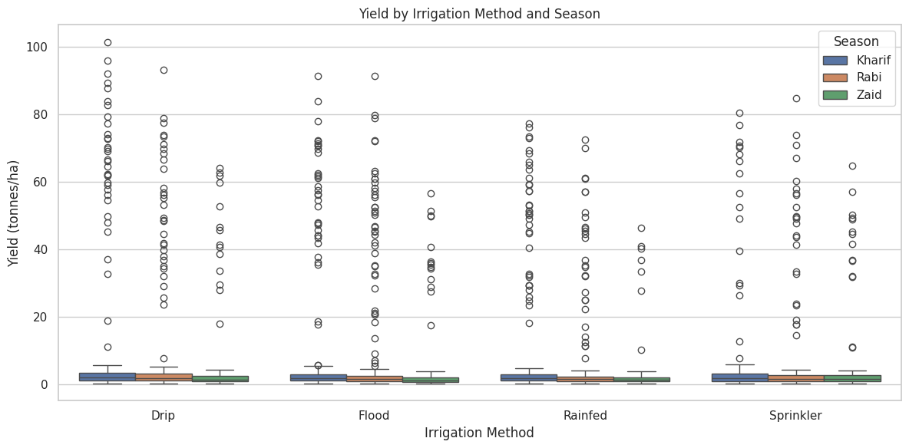
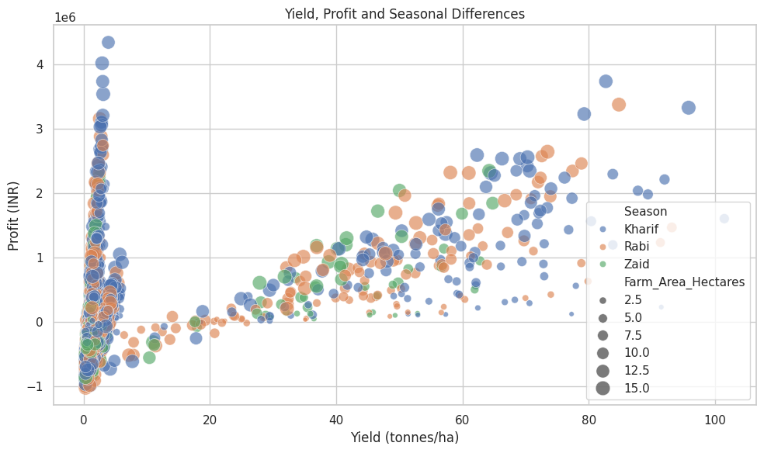
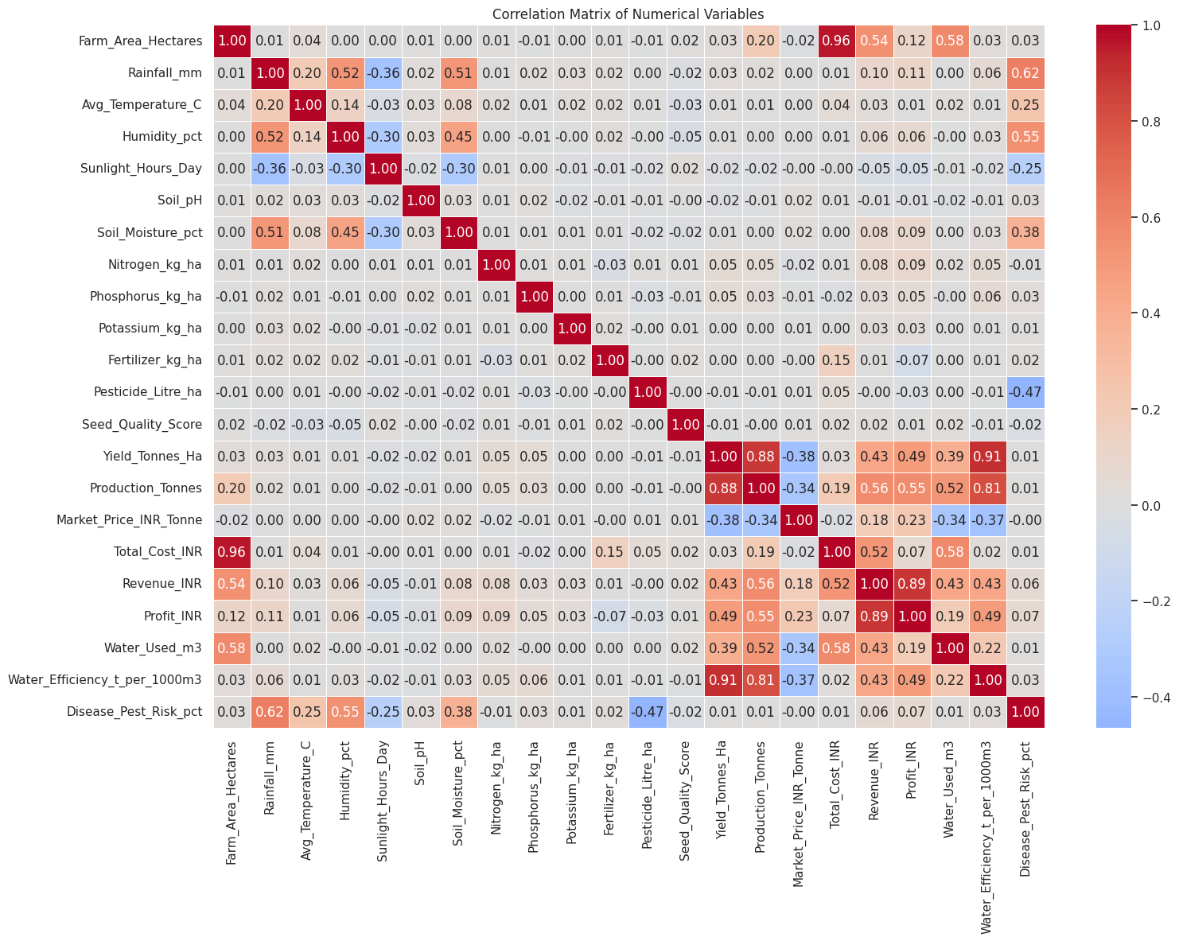
RESULTS

Slide 11
Future scope
• Extend the analysis with more years and larger regional datasets. • Add deeper crop-wise and region-wise seasonal comparisons. • Study resource optimization for water, fertilizer and pesticide usage. • Investigate relationships between environmental conditions, risk and profitability. • Build interactive visual reporting in a future phase. • Use the analytical findings as a foundation for future predictive studies.

Slide 12
GitHub Link
https://github.com/Fidrik-333/Seasonal-Agriculture-Performance-Analysis.git

Slide 13

VOIS Course completion certificate -
Course name- Data Visualization

Slide 14
Thank you
.
.

