Slide 1
FPGA Project
Charles Roques Carmes, Fadi Atieh

Slide 2
How did we start?
Learned first half of 6.004 (Computation Structures)
Learned VHDL
Downloaded Quartus Prime (Not Vivado) as the FPGA software
Started designing ☺

Slide 3
Design Layout
Interactive Memory (Stores Noise)
Constant Memory (Stores Matrix/Thresholds)
Engine

Slide 4
ENGINE layout
Matrix Multiplication
Noise Adder
Threshold Checker

Slide 5
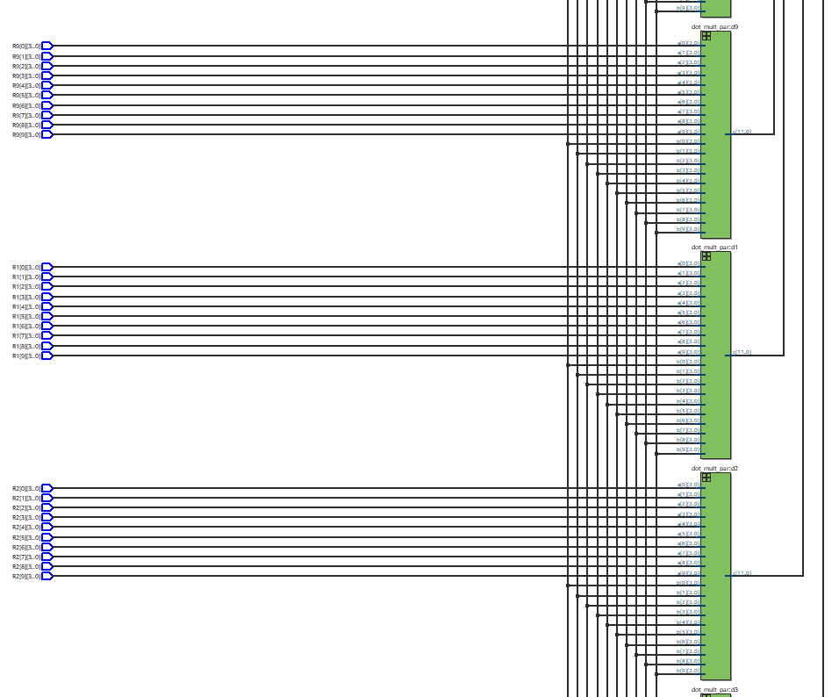
Important Optimizations
Row Parallelization
Every horizontal band represents a row
The vector (x) gets distributed on the bands in parallel
Every green box represents a dot product device
The output of each green box(dot product) is a scalar
The scalars from all of the green boxes are combined to form the output vector

Slide 6
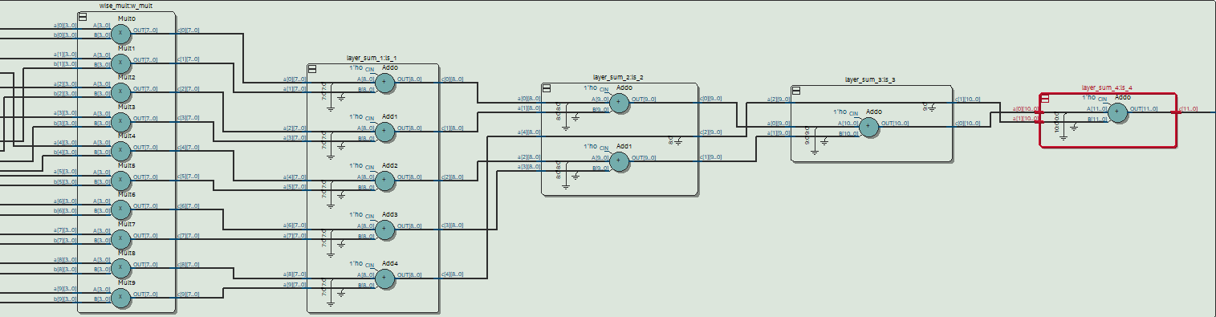
Important Optimizations
Here, we consider two vectors
a = (a1, a2, …, a_n)
b = (b1, b2, …, b_n)
Dot Product Parallelization:
The first column of green blobs represents multipliers doing element-wise multiplication of the two vectors in parallel (i.e (a1*b1 = c1),(a2*b2 = c2)… )
The second column of blobs clumps the results in pairs and adds them in parallel (d1 = c1+ c2, d2 = c3 + c4…)
The process gets repeated, requiring log(n) columns of blobs to do dot product
The whole process takes log(n) times

Slide 7
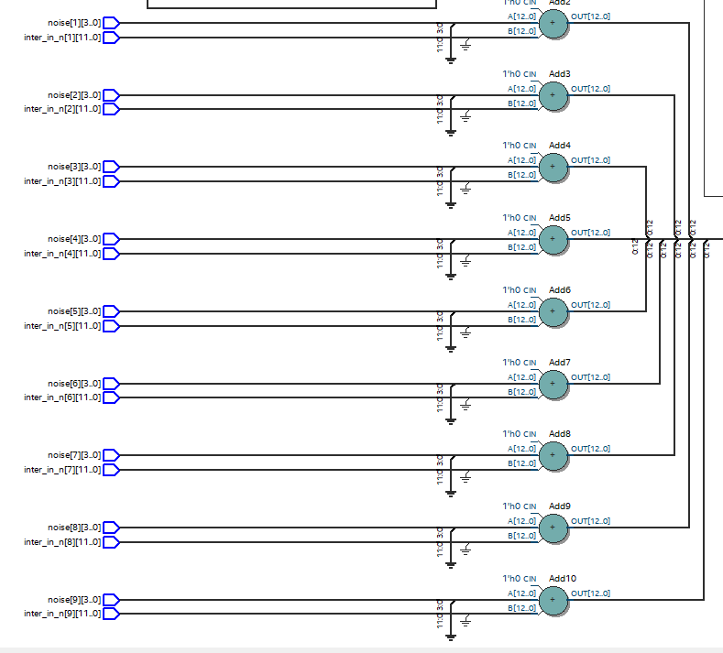
Important Optimizations
Let our vector be
a = (a1, a2, …, a_n)
Let the noise vector be
m = (m1, m2, …, m_n)
Noise Addition Parallelization:
Noise gets added element-wise to the vector in parallel (i.e the operations (a1 + m1), (a2 + m2),…) are done in parallel
So the whole process takes constant time O(1)

Slide 8
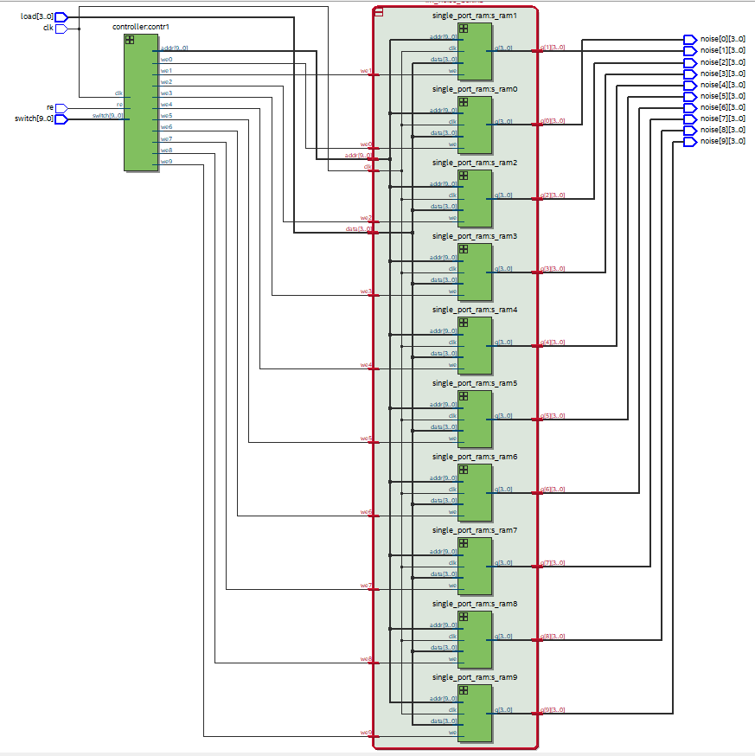
Memory Implementation
Noise storage implementation:
The following memory is designed to store noise for 1000 iterations for a 10x10 Matrix
The column of green devices represents a collection of 10 RAMs. Each RAM can store 1024 words
At each iteration, we change the address of all the RAMs simultaneously, accessing the same index in each one of them
Combining the RAMs outputs gives us the noise vector

Slide 9
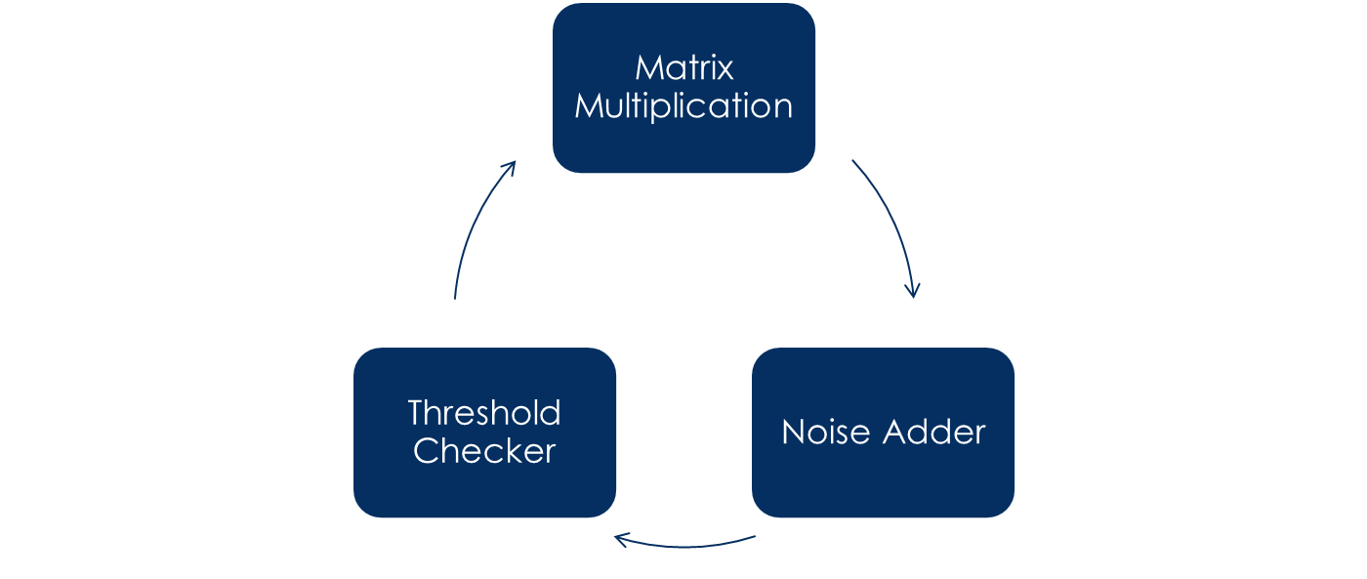
Time Estimates
According to the current design: Each Iteration takes O(log(n)) steps for an (nxn) Matrix
For a 100x100 Matrix, It will take approximately around 10 steps
If every step is to be synchronized it will take 10 clock periods (30~60 ns)
If every higher level operation (look at the diagram) is to be synchronized, it will take around 3 clock cycles (9~18 ns)
If no synchronization is implemented and everything is dependent on the gate delays, it will take around (2~3 ns)

Slide 10
Things still need to be done
Build an accurate functioning simulation for one iteration and estimate the time it takes.
Do further optimizations on the design
Fitting everything together
Actual implementation on the physical FPGA chip and testing

Slide 11
Thank you

