Slide 1
Population Coding of Motion in the Retina
Colleen Rhoades
December 5, 2014

Slide 2
Motion Signal Thought to be Encoded in Parasol Cells
Parasol largely project to magnocellular pathway of LGN while midgets largely project to the parvocellular pathway of the LGN (Perry 1984)
People argue the pathways are separate all the way through visual processing (Maunsell 1990)
Shabana 2003
Notes:
image from Shabana 2003

Slide 3
Is there actually a motion signal in the midget cells?

Slide 4
Method: Record spikes from complete mosaics of parasols and midgets with a moving bar stimulus

Slide 9
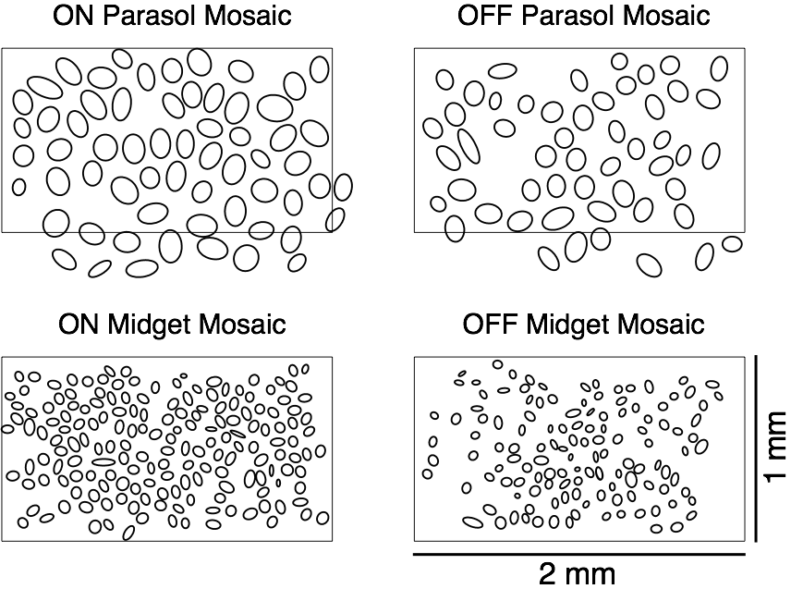

Slide 10
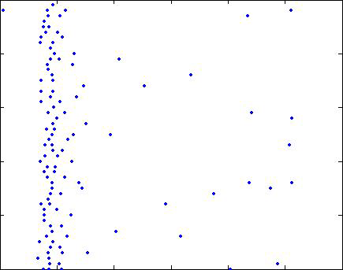
Recoding is Stable across 50 Trials
Stability of Firing Of Each Cell Across All Trials
Trial Number
Time

Slide 11
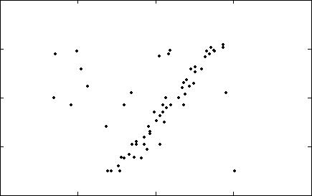
Cells Respond As Bar Passes Over Their Position
All Cells Responses Plotting Over Many Trials
Cell Centroid Distance from Ref.
Time

Slide 12
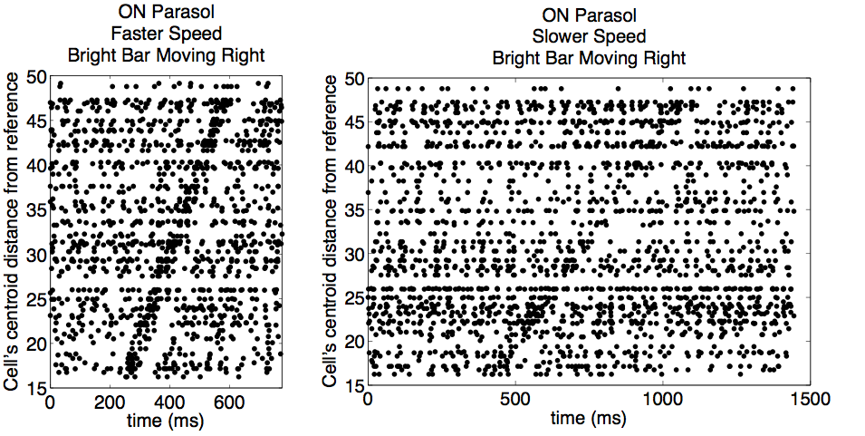
Different Speeds Have Different Rasters

Slide 13
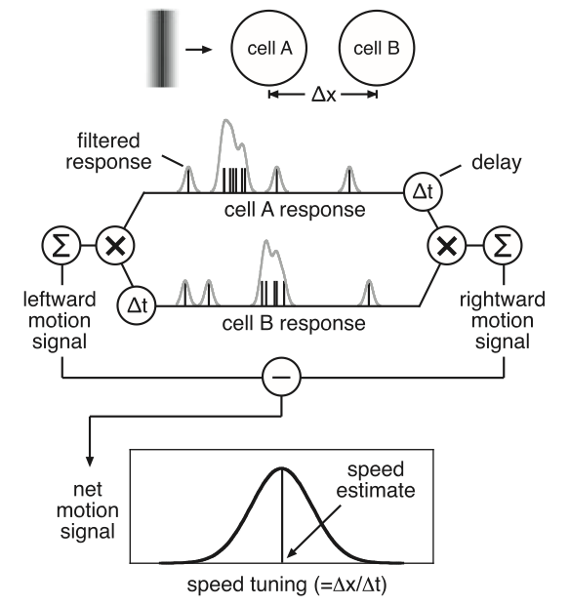
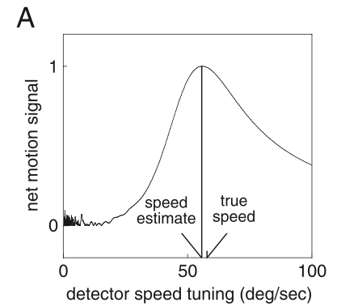
Algorithm
Previous Result
(Frechette 2005)

Slide 14
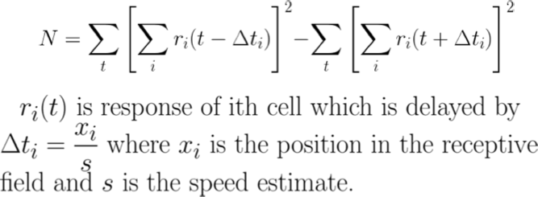
Faster Implementation

Slide 15
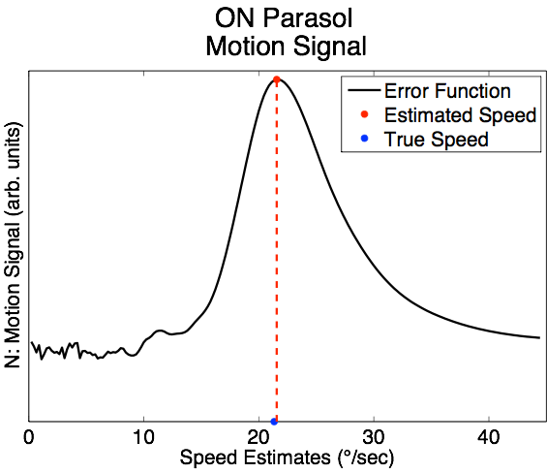
Maximally Align Spike Trains
Motion Signal
Estimated Speed
True Speed

Slide 16
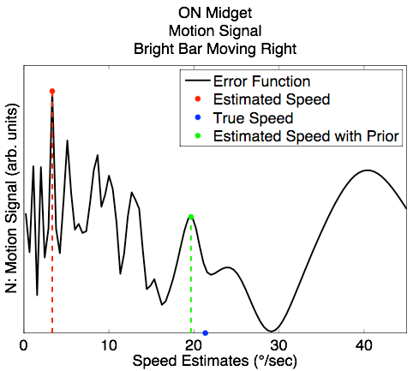
Using Priors For Speed Estimate
Motion Signal
Estimated Speed
True Speed
Estimated Speed with Prior

Slide 17
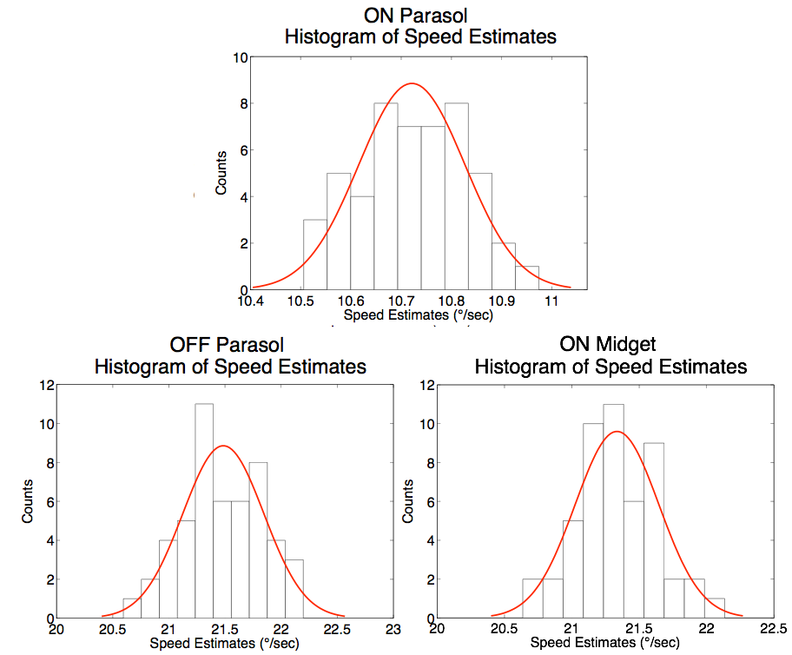

Slide 18
Factors that affect motion estimate
Stimulus contrast
Stimulus direction
Stimulus speed
Stimulus width
Tissue sample
Gaussian filter width

Slide 19
Factors that affect motion estimate
Grouping population signals
Unequal firing rates
Incomplete mosaics
Spike sorting

Slide 20
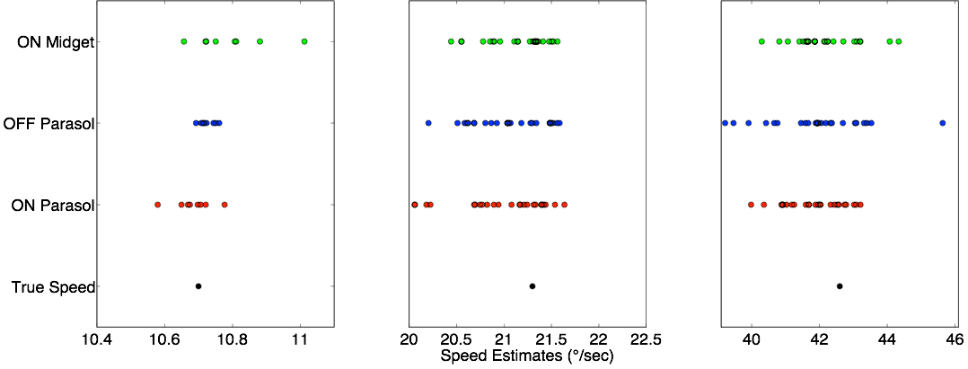
Mean Speed Estimate Per Run

Slide 21
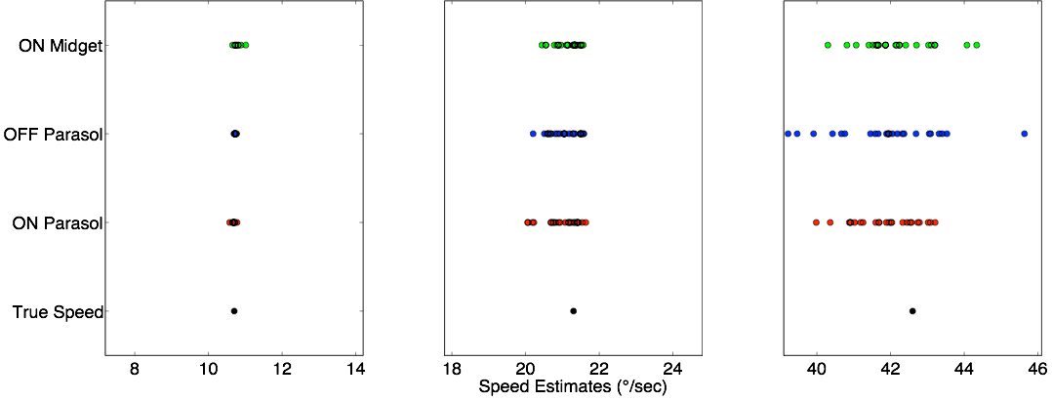
Speed Estimates on the Same Scale

Slide 22
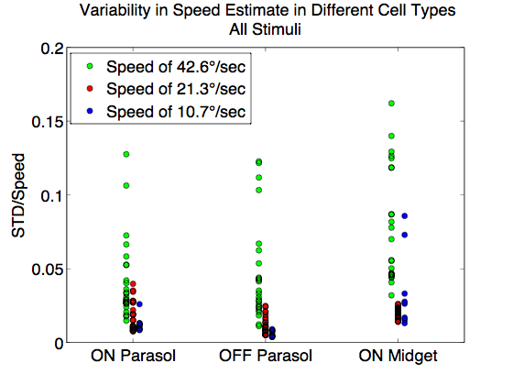
Speed

Slide 23
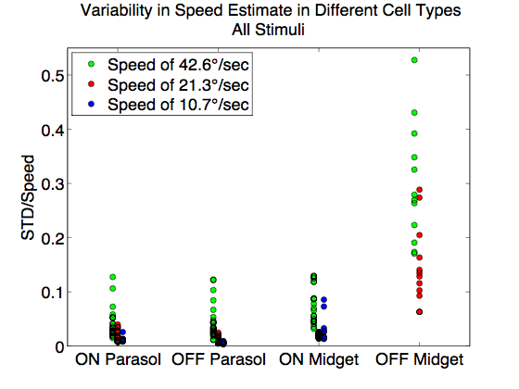
OFF Midgets

Slide 24
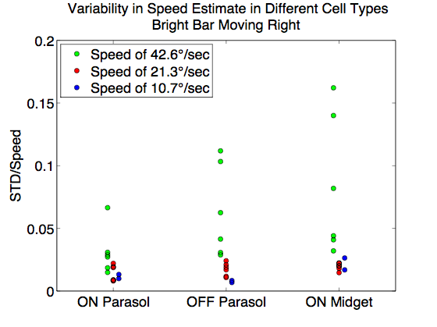
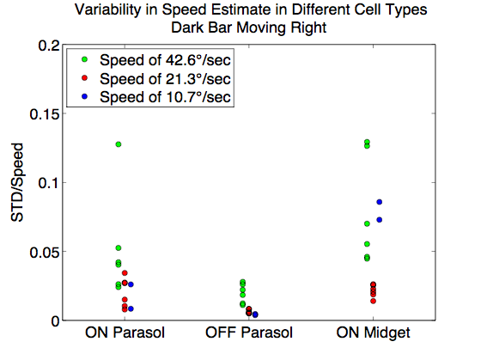
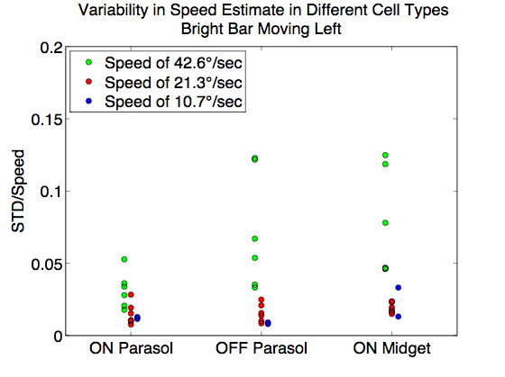
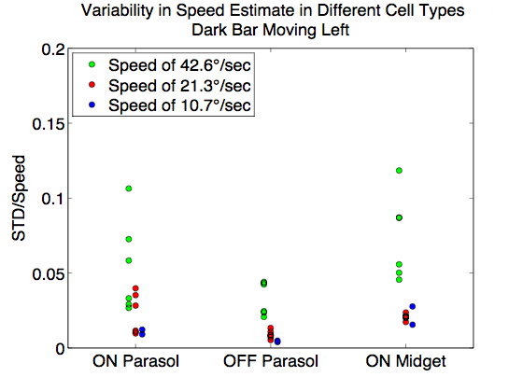
Speed Broken Down by Stimulus Type

Slide 25
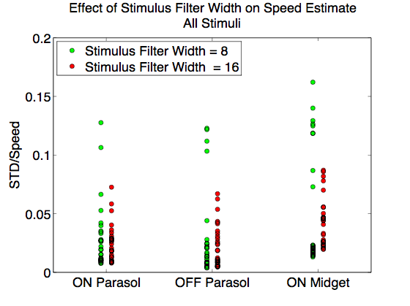
Stimulus Width

Slide 26
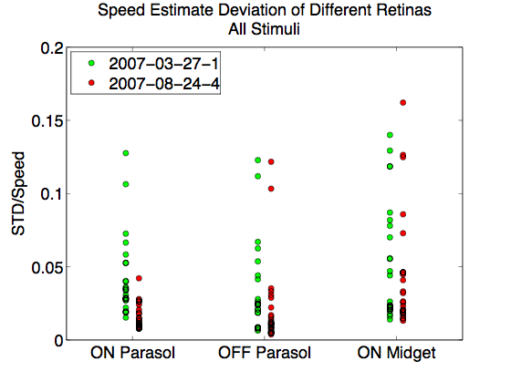
Tissue Sample

Slide 27
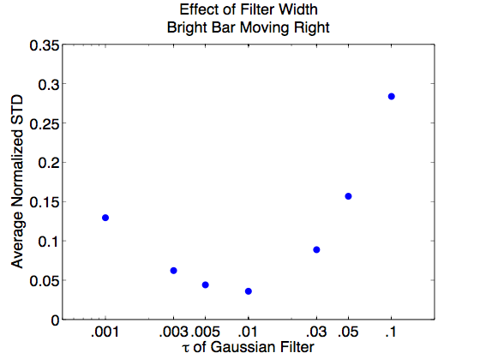
Gaussian Filter Width
w = w∞ + α/(sc)
where the optimal filter width depends on the speed, contrast, and asymptotic filter width for high speed/high contrast (Chichilnisky and Kalmar, 2003)

Slide 28
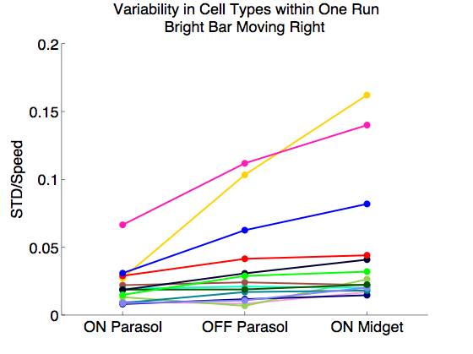
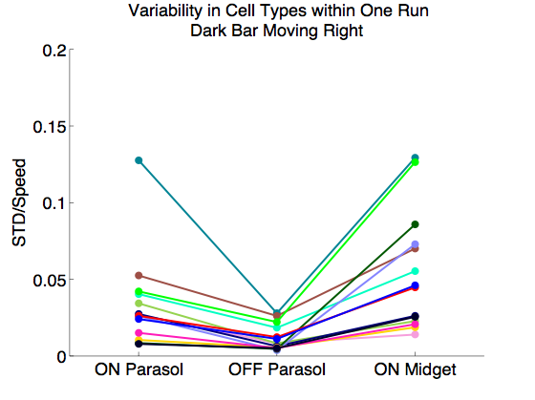
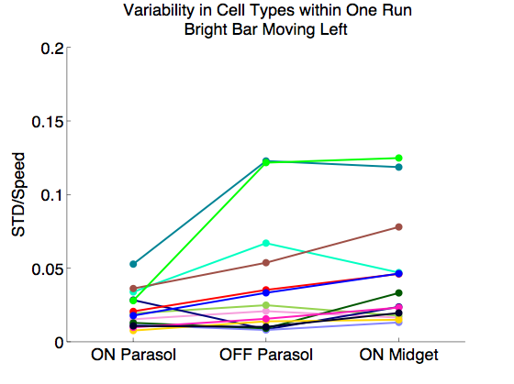
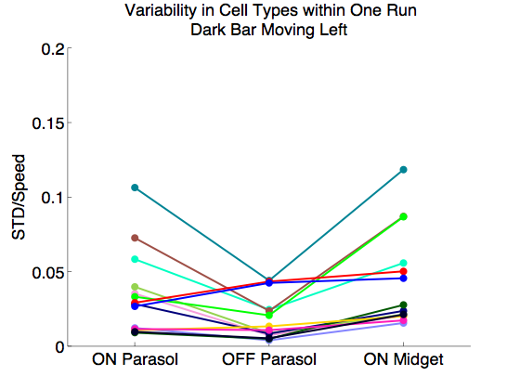
Do certain runs have higher variability across all cell types?

Slide 29
Conclusion
Is there actually a motion signal in the midget cells?
Yes! ON midget cells are more variable than parasol
cells, but a robust motion signal is still present.
Additionally,
ON and OFF parasol cells have similar variability
~10 ms appears to be the optimal filter width

Slide 30
Future
For this model:
Take a closer look at OFF midget cells
Down sample to account for firing rate differences
Down sample to account for incomplete mosaics
Verify spike sorting
Big Picture:
Is the brain actually performing these computations?
What other models should be considered?
How do cortical neurons process this information?
What about accelerating motion?

Slide 31
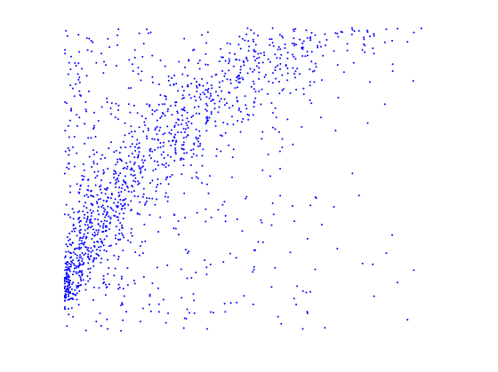
Acceleration
Cell centroid distance from ref.
Time

