Slide 1
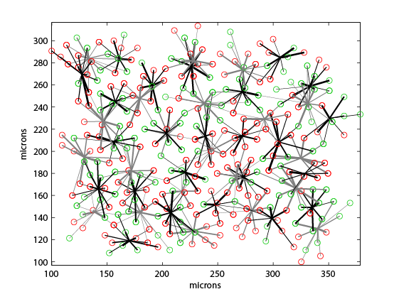
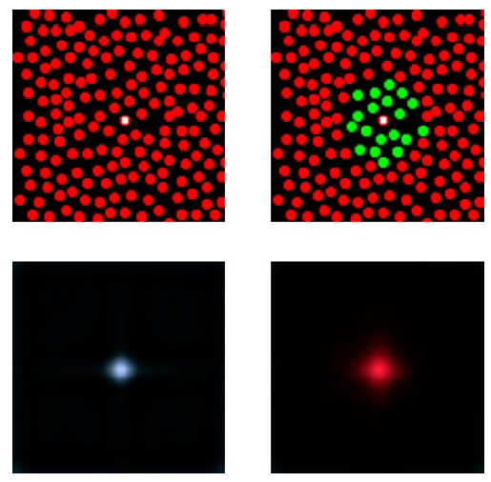
The Concept
Brainard et al. Journal of Vision 2008
ON midgets
OFF midgets

Slide 2
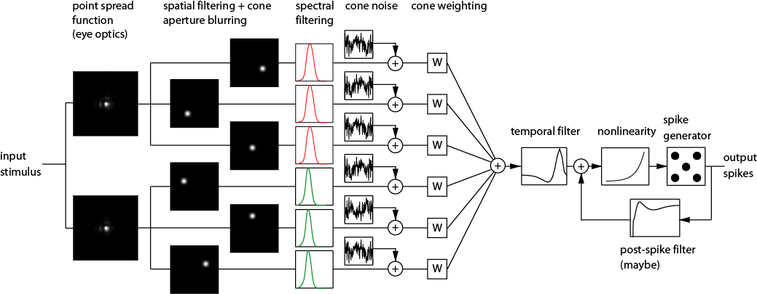
The Model

Slide 3
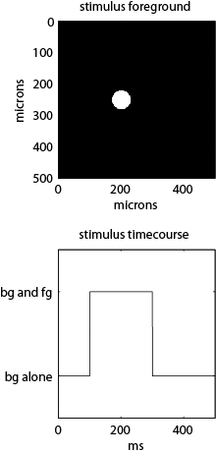
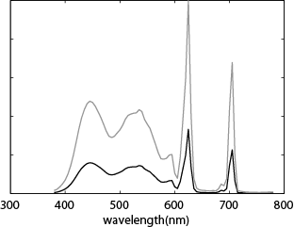
Test Stimulus
(50% contrast)

Slide 4
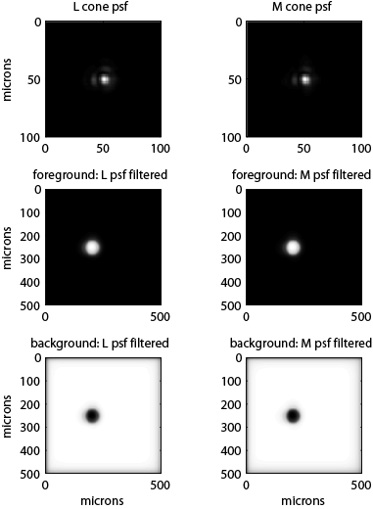
Step 1: Eye Optics PSF

Slide 5
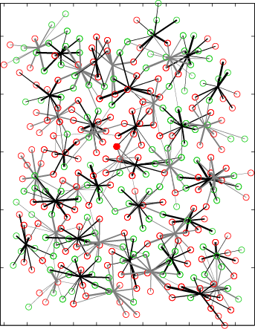
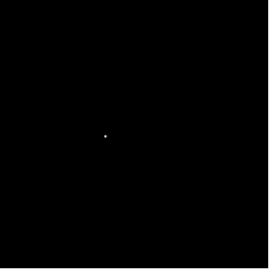
Steps 2,3: Spatial Filtering/Cone Aperture Blurring, Spectral Filtering

Slide 6
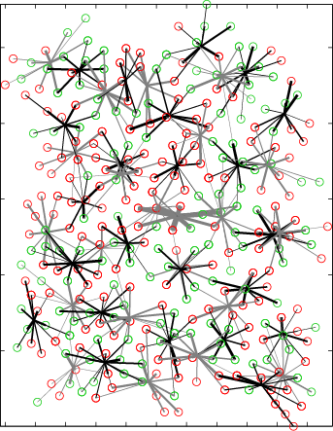
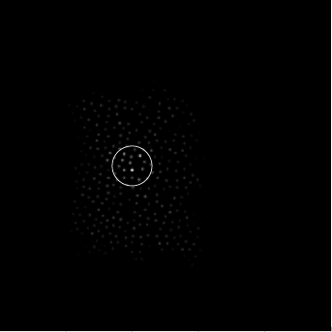
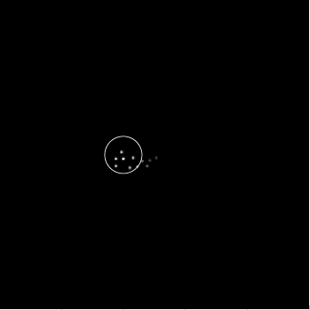
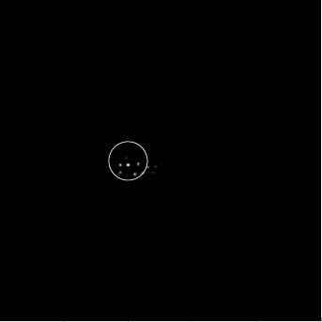
Step 5: Cone Weighting, Summing

Slide 7
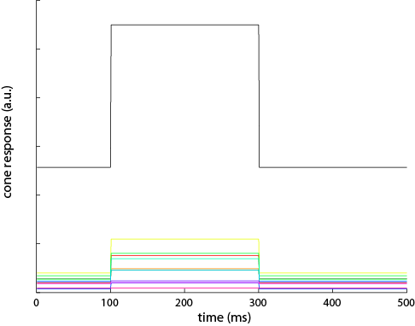
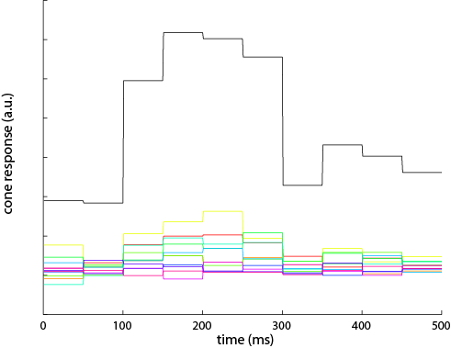
Step 4: Adding Cone Noise

Slide 8
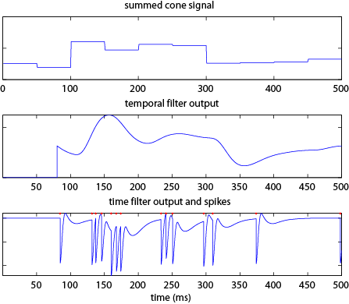
Steps 6+: Temporal Filtering, Nonlinearity, Poisson Spiking + Feedback

Slide 9
Unfinished Parts…
p(stim|spikes) = C*p(spikes|stim)p(stim)

