Slide 1
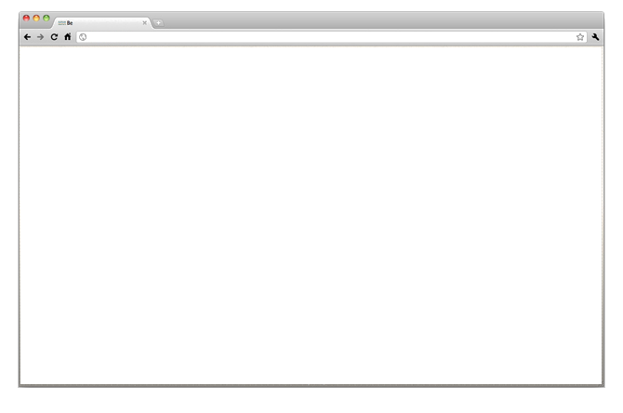
Architecture
LevelDB
CouchDB
IndexedDB
LocalStorage
PouchDB
Handlebars.js
Nano.js
Cradle
Backbone-pouchdb.js
Text.js
Backbone-couchdb.js
Underscore.js
Backbone.js
JQuery
Require.js
Cookies
Node.js
Chrome
Extension

