Slide 1

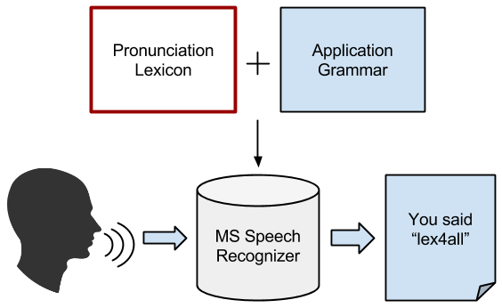
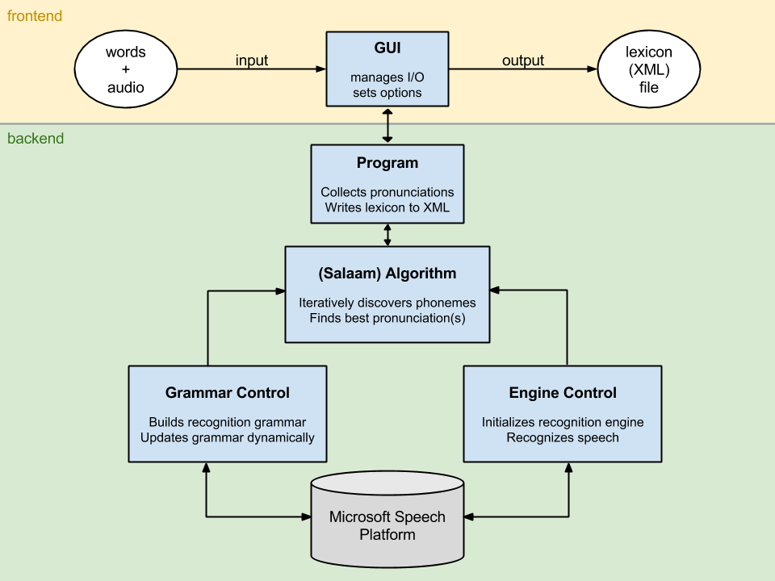
lex4all: A language-independent tool for building and evaluating pronunciation lexicons for small-vocabulary speech recognition
Anjana Vakil and Max Paulus
Department of Computational Linguistics, University of Saarland
Introduction
Algorithm
Additional Features
This poster presents lex4all, an easy-to-use application that allows even non-expert users to quickly and easily create pronunciation lexicons for words in any low-resource language (LRL), using:
a small number of audio recordings
a pre-existing recognition engine in a high-resource language (HRL)
The resulting lexicon can then be used to add small-vocabulary speech recognition functionality to applications in the LRL.
The backend of lex4all uses the Salaam method [1, 2] for the automatic discovery of the best pronunciation sequence for each word in the target vocabulary.
The Salaam method [1, 2]:
A “super-wildcard” grammar instructs the recognizer to treat each audio sample as a “phrase” consisting of 0-10 “words”, where each “word” is a sequence of 1-3 source-language phonemes, i.e.:
where * represents a single phoneme of the source language.
An iterative training algorithm uses the HRL recognizer and the “super-wildcard” grammar to discover the best pronunciation sequence(s) for each word in the target (low-resource) language vocabulary, one phoneme at a time
The automatically generated pronunciations yield higher recognition accuracy than pronunciations hand-written by expert linguists [1]
Evaluation module
Allows the user to test built lexicons in recognizing real audio
Audio recording
Enables the user to record new sound files within the application
Discriminative training [2]
An additional training step that removes any pronunciations in the lexicon that may reduce recognition accuracy by matching multiple words in the vocabulary
BackGround
One of the major issues when working with LRLs is that large collections of data, e.g. speech recordings, are simply not available. Such data is, however, essential for the training of acoustic models in speech recognizers.
However, for small-vocabulary applications (requiring recognition of a few dozen terms), we can use an existing, trained recognizer for a HRL such as English (e.g. the Microsoft Speech Platform recognition engine [3]) to accomplish recognition. The idea is to feed the engine with a pronunciation lexicon generated by lex4all.
The recognition task requires:
audio input in the target LRL
application-specific grammar
lexicon for the words in the grammar
existing recognition engine for the HRL
Future work
Challenge: Running time
Possible future extensions of the project include:
Online lexicon repository
Adding an option for users to upload their created lexicons to a central web repository would allow sharing and re-use of lexicons across languages and language families.
Additional source-language recognizers
The Microsoft Speech Platform currently supports recognition in over 20 different (high-resource) languages [3]. It is possible that using a source language that shares more phonemes with the target language could improve recognition accuracy, though this topic calls for further research.
User interface improvements
The main challenge we faced in engineering a user-friendly application based on the Salaam algorithm (see above) was the long training time due to the large “super-wildcard” grammar required by the algorithm.
Original backend: 1-3 phonemes per sub-word
40 phonemes (English) → 64,000 possible combinations
Training time (25 words, 5 samples/word): approx. 60-120 minutes
New backend: only 1 phoneme per sub-word
40 phonemes → 40-line wildcard
Training time (25 words, 5 samples/word): approx 2-5 minutes
Result: ≈20x faster training, no significant drop in recognition accuracy
System overview
conclusion
The lex4all tool enables the rapid and automatic creation of pronunciation lexicons in any low-resource language, using an out-of-the-box commercial recognition engine [3] for a high-resource language (English) and an existing algorithm for cross-language pronunciation mapping [1, 2].
We hope that this tool will help developers to create speech interfaces for applications in low-resource languages, as well as facilitate research in small-vocabulary speech recognition for such languages.
References
[1] Fang Qiao, Jahanzeb Sherwani, and Roni Rosenfeld, 2010. “Small-vocabulary speech recognition for resource- scarce languages,” in Proceedings of the First ACM Symposium on Computing for Development (ACM DEV ‘10). ACM, New York, NY, USA, pp. 3:1–3:8.
[2] Hao Yee Chan and Roni Rosenfeld, 2012. “Discriminative pronunciation learning for speech recognition for resource scarce languages,” in Proceedings of the 2nd ACM Symposium on Computing for Development (ACM DEV ‘12). ACM, New York, NY, USA, pp. 12:1–12:6,.
[3] Microsoft, 2012. Microsoft Speech Platform SDK 11 Documentation. http://msdn.microsoft.com/en-us/library/dd266409

