Slide 1

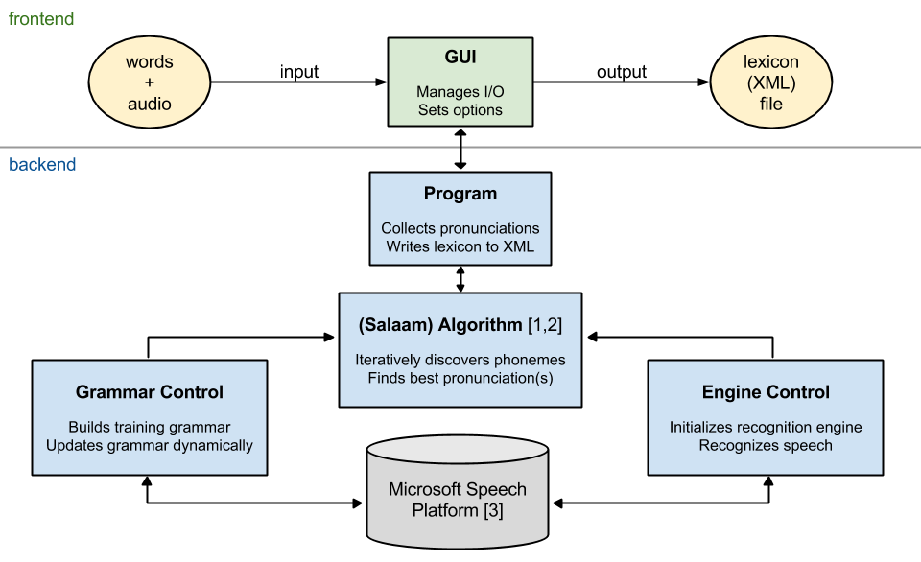
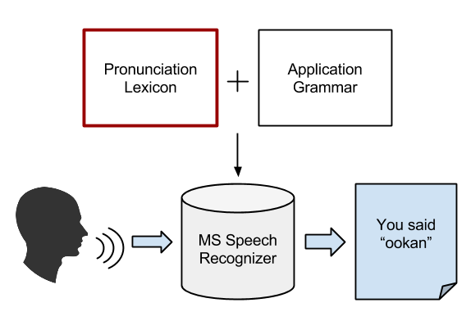
lex4all: A language-independent tool for building and evaluating pronunciation lexicons for small-vocabulary speech recognition
Anjana Vakil and Max Paulus
Department of Computational Linguistics, University of Saarland
Introduction
System overview
Challenge: Running time
This poster presents lex4all, an easy-to-use PC application that allows even non-expert users to quickly and easily create pronunciation lexicons for words in any low-resource language (LRL), using:
a small number of audio recordings
a pre-existing recognition engine in a high-resource language (HRL)
The resulting lexicon can then be used to add small-vocabulary speech recognition functionality to applications in the LRL.
The main challenge we faced in engineering a user-friendly application based on the Salaam algorithm (see above) was the long training time due to the large “super-wildcard” grammar required by the algorithm.
Original backend: 1-3 phonemes per sub-word
40 phonemes (English) → 64,000 possible combinations
Training time (25 words, 5 samples/word): approx. 60-120 minutes
New backend: only 1 phoneme per sub-word
40 phonemes → 40-line wildcard
Training time (25 words, 5 samples/word): approx 2-5 minutes (≈20x faster)
Evaluation
Tested on Yoruba data (25 words, 2 speakers, 5 samples/word/speaker)
Result: no significant drop in recognition accuracy (see Figure 1)
BackGround & Goal
Motivation
Speech interfaces beneficial for developing-world applications [1, 2]
Training recognition engines for new languages typically requires:
Large collections of speech data (not available for LRLs)
Expertise with speech/language technologies
Strategy
Use existing recognizer trained for a HRL to recognize LRL speech
High-quality commercial engines available in languages such as English
e.g. Microsoft Speech Platform, 20+ HRLs [3]
Recognition task requires:
Application-specific grammar (small vocabulary)
Pronunciation lexicon for terms in grammar
Key component: lexicon
Maps each term in target vocabulary to sequence(s) of HRL phonemes
Recognizer can model these phonemes & recognize the sequences
lex4all: Pronunciation Lexicons for Any Low-resource Language
Fast, user-friendly tool for lexicon building
GUI-based desktop application for Windows
Backend built using:
Microsoft Speech Platform [3]
Salaam algorithm for pronunciation mapping [1, 2] (see “Algorithm”)
Algorithm
We use the Salaam method [1, 2] for the automatic discovery of the best pronunciation sequence for each word in the target vocabulary.
The Salaam method [1, 2]:
“Super-wildcard” grammar:
Instructs the recognizer to treat each audio sample as a “phrase” consisting of 0-10 “words”, where each “word” is a sequence of 1-3 source-language phonemes, i.e.:
where * represents a single phoneme of the source language.
Iterative training algorithm
Uses this grammar and the HRL recognizer to discover the best pronunciation sequence(s) for each word in the target vocabulary, one phoneme at a time
Yields more accurate recognition than expert-written pronunciations[1]
Conclusion & Future Work
The lex4all tool enables the rapid and automatic creation of pronunciation lexicons in any LRL, using an out-of-the-box commercial recognizer [3] for a HRL (English) and an existing algorithm for cross-language pronunciation mapping [1, 2].
We hope that this tool will help developers create speech interfaces for applications in LRL, as well as facilitate research in small-vocabulary speech recognition for such languages.
Possible future extensions of the project include:
Online lexicon repository
Adding an option for users to upload created lexicons to an online repository would allow sharing and re-use of lexicons across languages/language families.
Additional source-language recognizers
Microsoft offers recognizers in over 20 languages [3]. Using a source language that is more similar to the target language could improve recognition accuracy.
Additional Features
Discriminative training [2]
An additional training step removes pronunciations in the lexicon that may reduce recognition accuracy by matching multiple words in the vocabulary
Evaluation module
Facilitates research by automatically simulating recognition on a test set of audio samples. Reports recognition accuracy rates and confusion matrix.
Built-in audio recorder
References
[1] Fang Qiao, Jahanzeb Sherwani, and Roni Rosenfeld, 2010. “Small-vocabulary speech recognition for resource- scarce languages,” in Proceedings of the First ACM Symposium on Computing for Development (ACM DEV ‘10). ACM, New York, NY, USA, pp. 3:1–3:8.
[2] Hao Yee Chan and Roni Rosenfeld, 2012. “Discriminative pronunciation learning for speech recognition for resource scarce languages,” in Proceedings of the 2nd ACM Symposium on Computing for Development (ACM DEV ‘12). ACM, New York, NY, USA, pp. 12:1–12:6.
[3] Microsoft, 2012. Microsoft Speech Platform SDK 11 Documentation. http://msdn.microsoft.com/en-us/library/dd266409
Acknowledgments
Many thanks to Roni Rosenfeld, Hao Yee Chan, and Mark Qiao for generously sharing their data and providing valuable advice on implementing the Salaam method.

