Slide 1
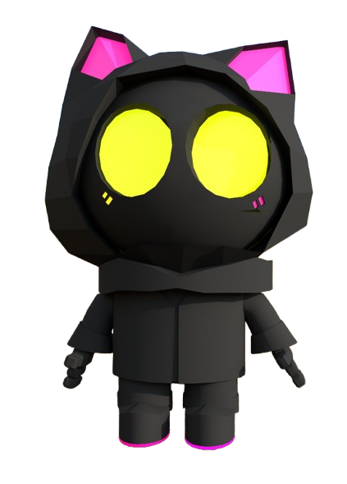
Silly Box Pushing Game
Cute chaos, delivered
by Clover and Rebecca

Slide 2
Overview
Play as Ninja, a clumsy determined cat robot courier! Your mission: deliver the packages through the puddle-covered chaos.
Each tile earns you money, just don’t let the box take a dip, or it’s game over for delivery day.

Slide 3
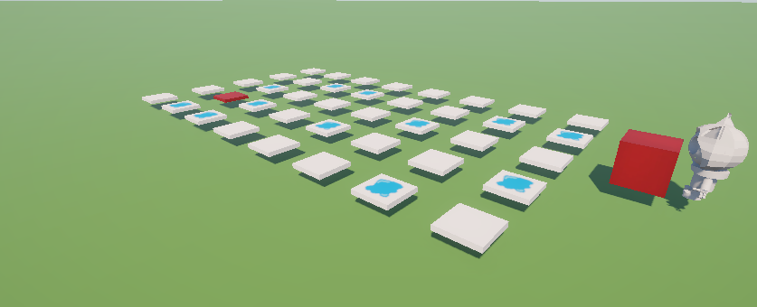
Gameplay loop
1. Move with WASD to keep the box moving.
2. Avoid puddles, and obstacles.
3. Earn cash as you push the box, the further you go the more cash you earn.
4. Deliver the box and unlock new levels and upgrades.

Slide 4
Key features
Customizable Cat Bot:
colours.
Hoods.
glowing eyes.
Upgradable Packages:
tougher boxes withstand more hits.
Comedy Physics:
Slips.
bumps.
bounces.
Progression System upgrade:
Expand your routes.

Slide 5
Art Style
Low-poly 3D world with vibrant colours and lighting.
The Ninja cat’s glowing eyes are a standout feature against cozy, natural environments.

Slide 6
Why it works
Quick to learn, hard to master.
Adorable character design.
Perfect for short addictive play sessions.

Slide 7
Vision
Even a stumble can be smooth if you own it!
A physics-fueled delivery run where every dodge counts, and every dry delivery is a win.

