Slide 1
Guide of NEW YORK City- some of the good and bad of food
By Mitchell Fields

Slide 2

Over-View of the data
Who does this data apply to?
Camis, DBA, BORO, BUILDING, STREET, ZIPCODE, PHONE, CUISINE DESCRIPTION, INSPECTION DATE, ACTION, VIOLATION CODE, VIOLATION DESCRIPTION, CRITICAL FLAG, SCORE, GRADE, GRADE DATE, RECORD DATE, INSPECTION TYPE, LATITUDE, LONGITUDE, COMMUNITY BOARD, COUNCIL DISTRICT, CENSUS TRACT, BIN, BBL, NTA

Slide 3
What is important about the Dataset?
STREET, ZIPCODE, PHONE, CUISINE DESCRIPTION, VIOLATIO, GRADE, DESCRIPTION, CRITICAL FLAG, GRADELATITUDE, LONGITUDE, COMMUNITY BOARD
Grading system: grade A, grade B, Grade C, Grade N, Grade P, Grade Z

Slide 4
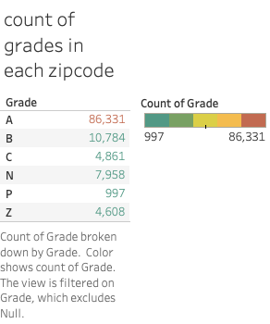
Size of the data

Slide 5
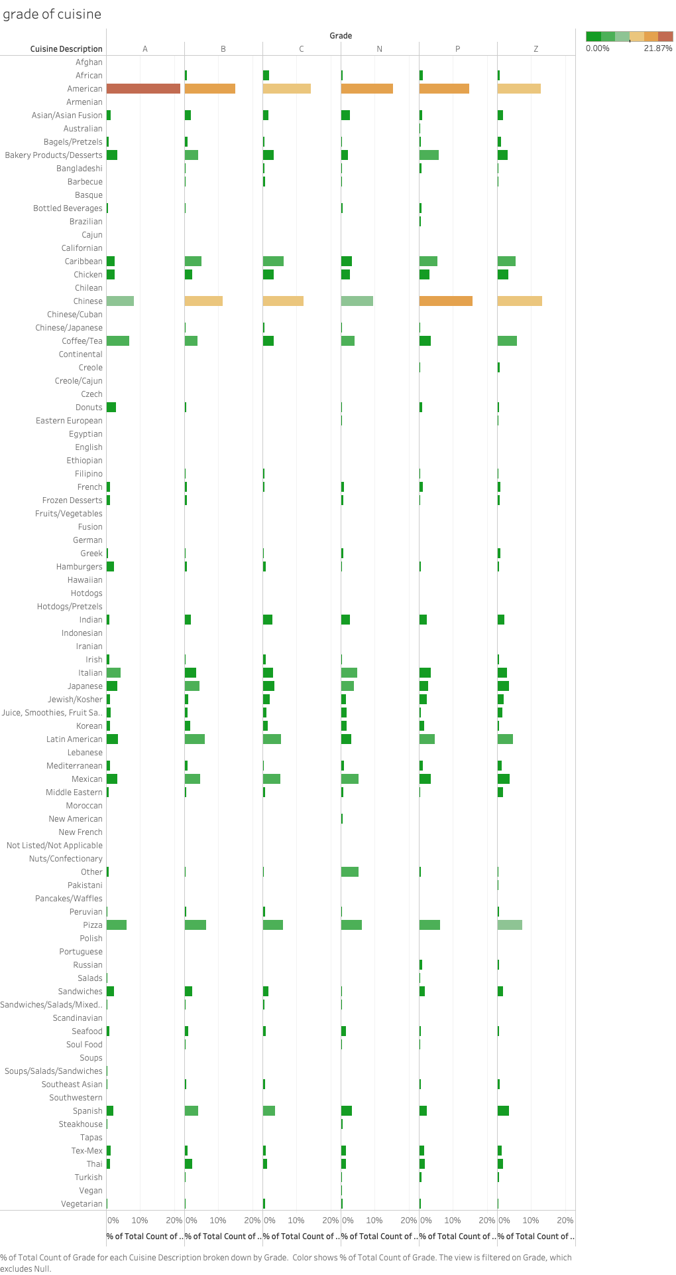
Notes:
This is a grade of cuisine percent average of each. There are 6 grades used in the dataset; Grade associated with the inspection; • N = Not Yet Graded• Z = Grade Pending• P= Grade Pending issued on re-opening following an initial inspection that resulted in a closure

Slide 6
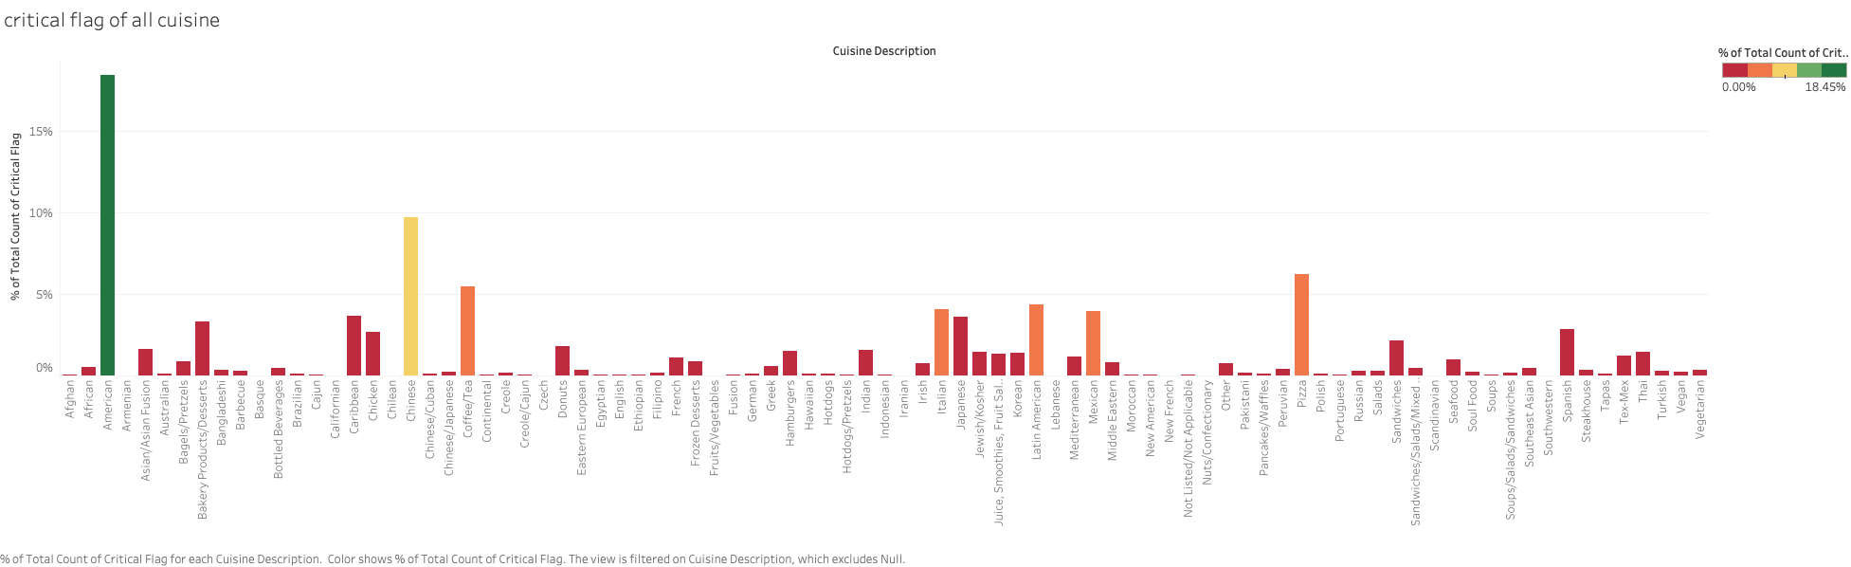

Slide 7
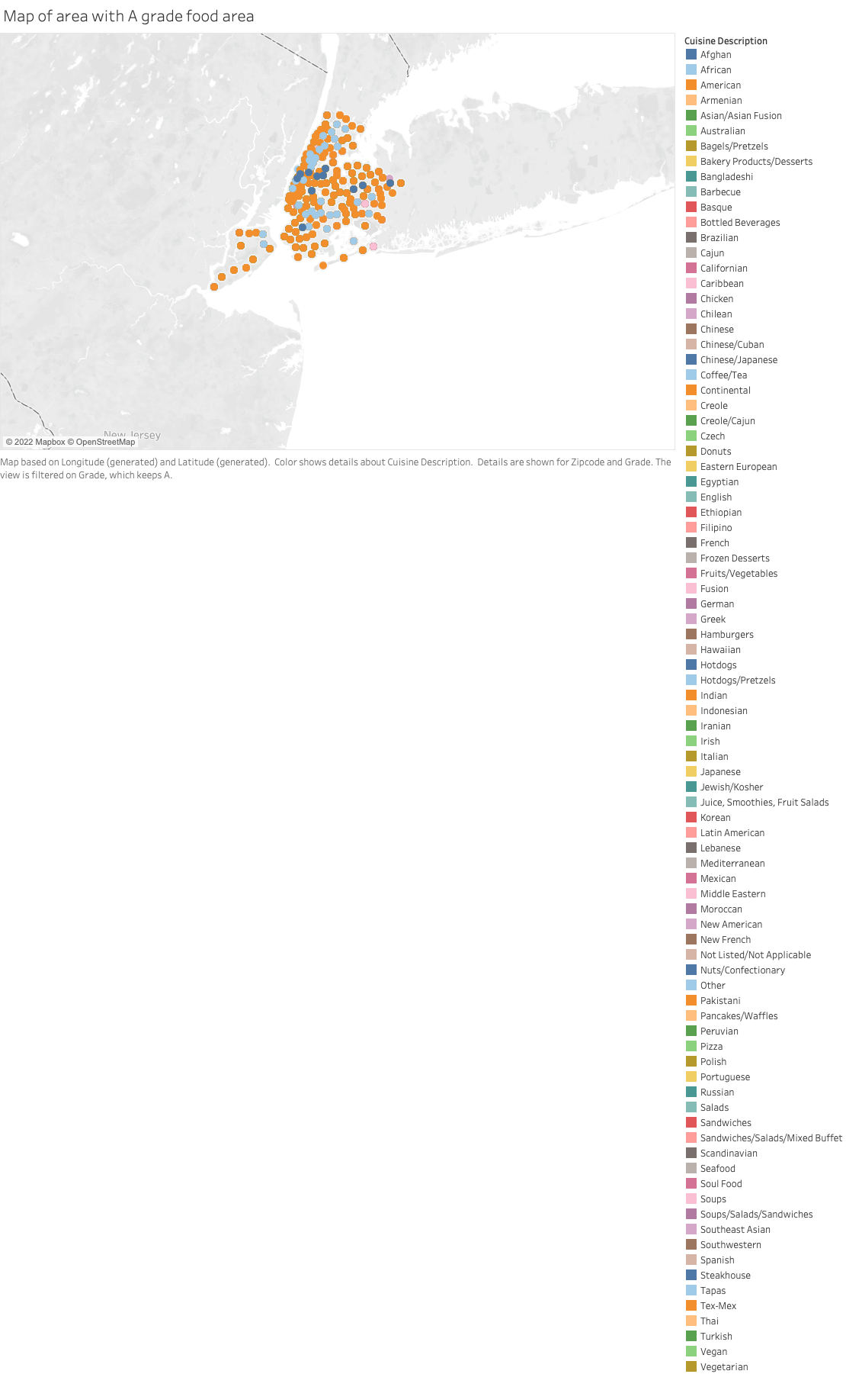

Slide 8
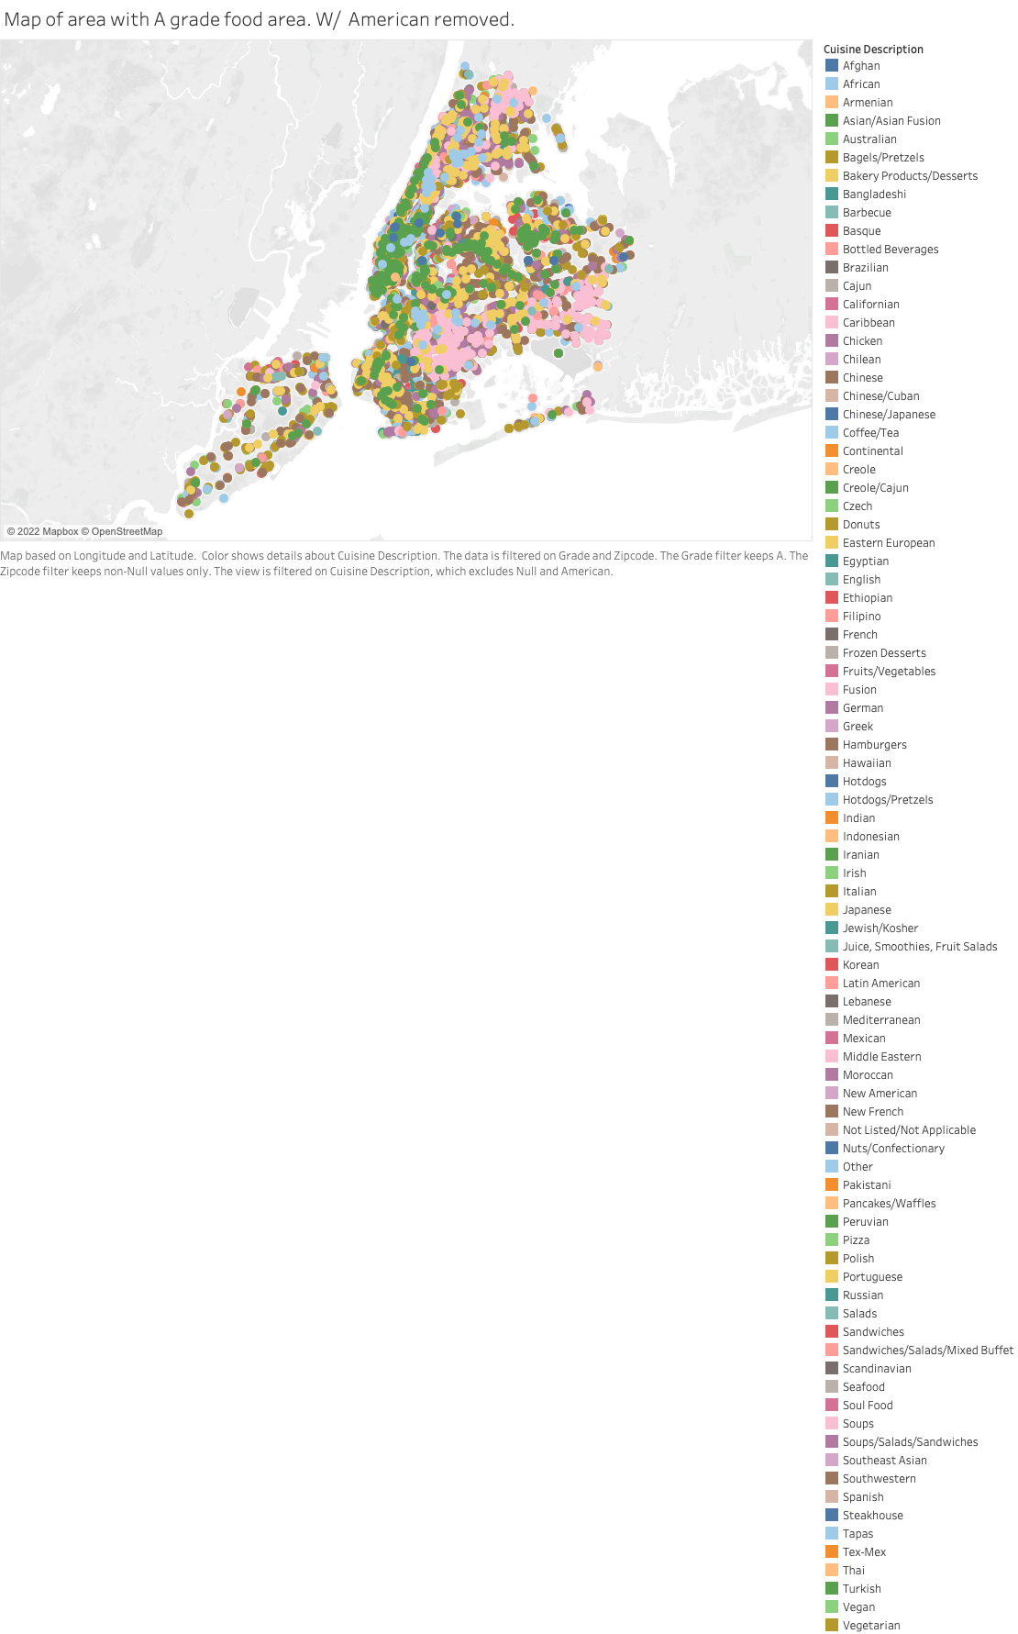

Slide 9
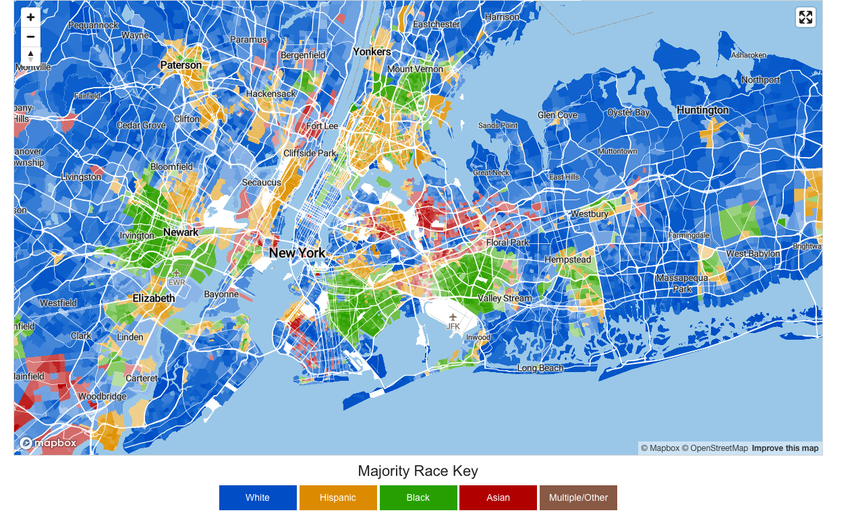
Race, Diversity, and Ethnicity in New York, NY
I do not own this map
Used from: https://bestneighborhood.org/race-in-new-york-ny/

Slide 10
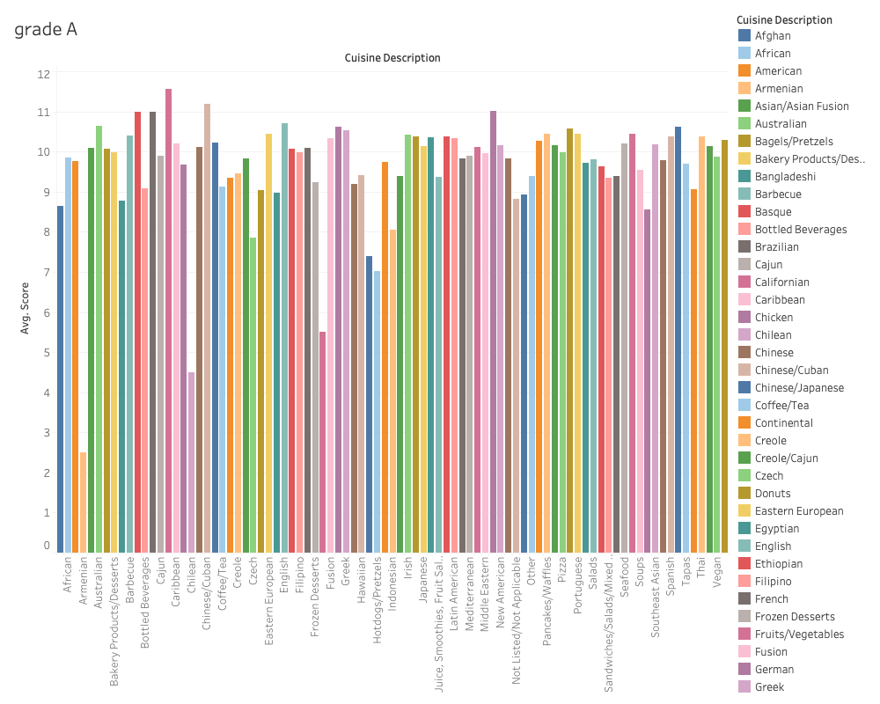

Slide 11
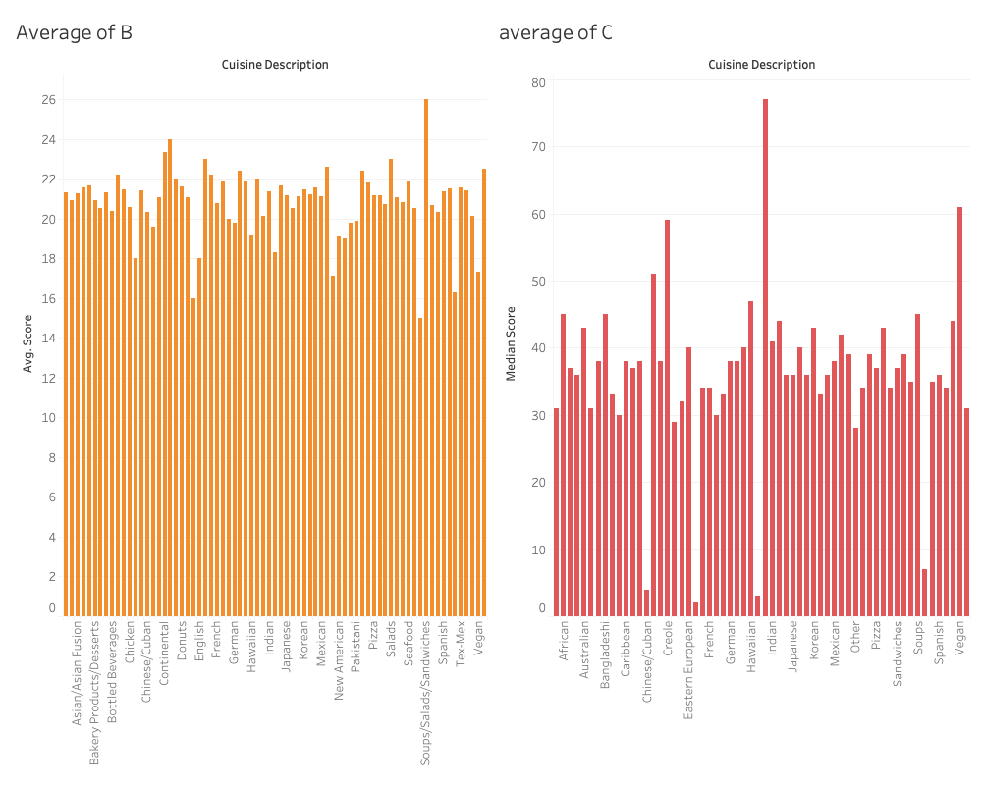

Slide 12
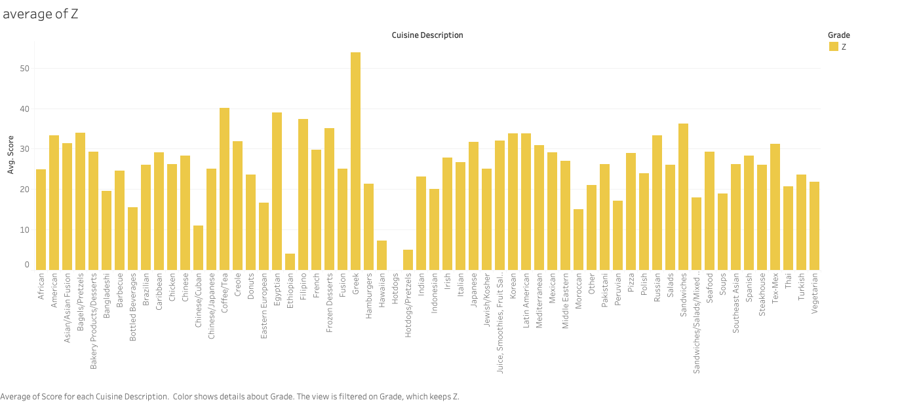

Slide 13
