Slide 1
Houses market model
By Mitchell Fields

Slide 2
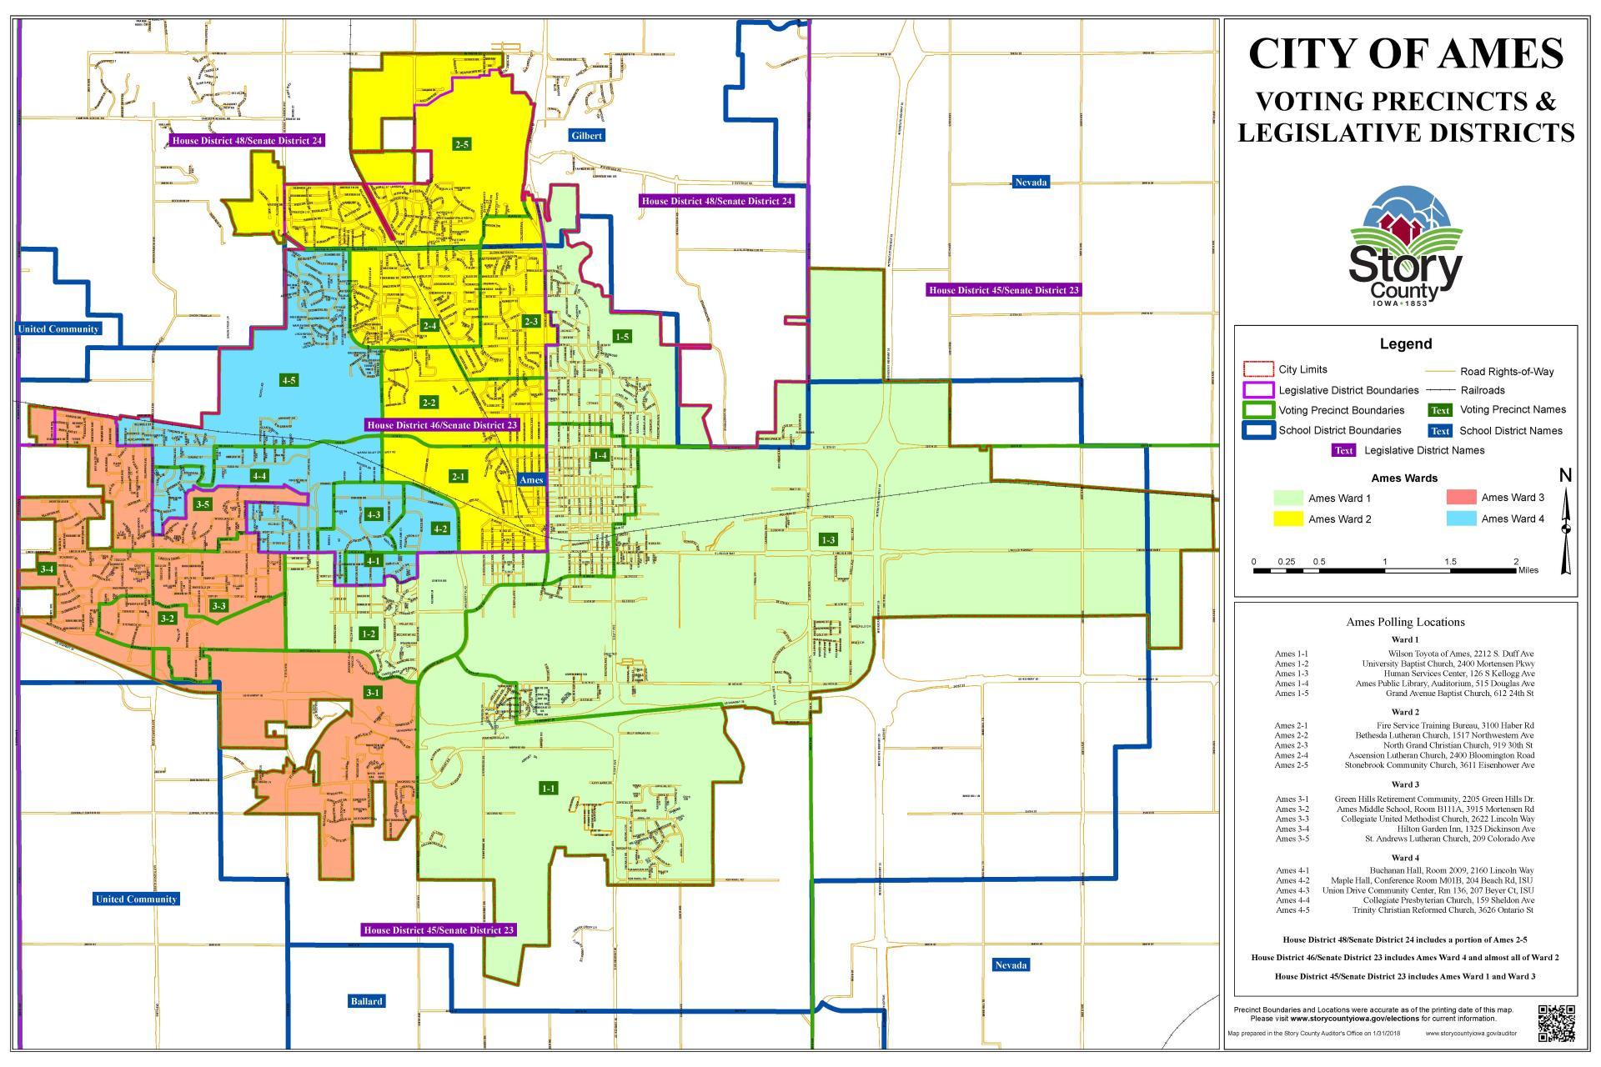
Overview
Sales information on house in the region
Region is a city called Ames located in lowa

Slide 3
List of the values:
Id MSSubClass MSZoning LotFrontage LotArea Street Alley LotShape LandContour Utilities LotConfig LandSlope Neighborhood Condition1 Condition2 BldgType HouseStyle OverallQual OverallCond YearBuilt YearRemodAdd RoofStyle RoofMatl Exterior1st Exterior2nd MasVnrType MasVnrArea ExterQual ExterCond Foundation BsmtQual BsmtCond BsmtExposure BsmtFinType1 BsmtFinSF1 BsmtFinType2 BsmtFinSF2 BsmtUnfSF TotalBsmtSF Heating HeatingQC CentralAir Electrical 1stFlrSF 2ndFlrSF LowQualFinSF GrLivArea BsmtFullBath BsmtHalfBath FullBath HalfBath BedroomAbvGr KitchenAbvGr KitchenQual TotRmsAbvGrd Functional Fireplaces FireplaceQu GarageType GarageYrBlt GarageFinish GarageCars GarageArea GarageQual GarageCond PavedDrive WoodDeckSF OpenPorchSF EnclosedPorch 3SsnPorch ScreenPorch PoolArea PoolQC Fence MiscFeature MiscVal MoSold YrSold SaleType SaleCondition SalePrice

Slide 4
Sales Prices defines the values of the products worth
Highest valued house- $ 755,000
Neighborhood-NoRidge
About the house
Lot size - 21535
2 story, 1 family house
4 bedrooms
Built in 1994
Finished basement- 2444 sq ft
3.5 bathrooms
3 car garages attached to house
Over quality is 10
Lowest valued house- $34900
Neighborhood-IDOTRR
About the house
lot size - 7879
1 story, 1 family
2 bedrooms
Built in 1920
Unfinished basement- 720 sq ft
1 bathroom
No garage
Over quality is 4

Slide 5
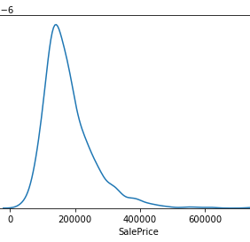
Sales Price
Mean value of Sale Price 180921.20

Slide 6
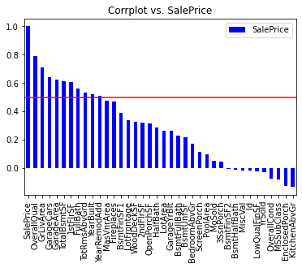
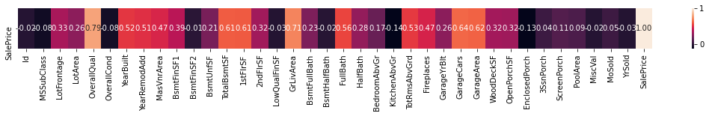
Correction to sale price
Top Correction to Sale price
(.50 and over)
OverallQual TotalBsmtSF
GrlivArea 1stFlrSF
GarageCars FullBath
GarageArea TotrmsAbvGrd

Slide 7
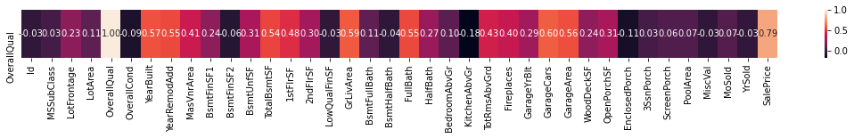
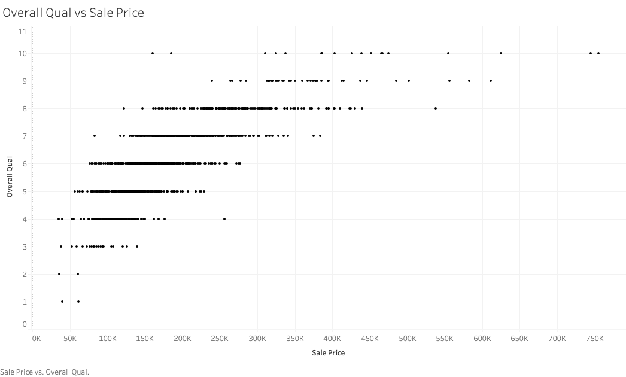
OverallQual

Slide 8
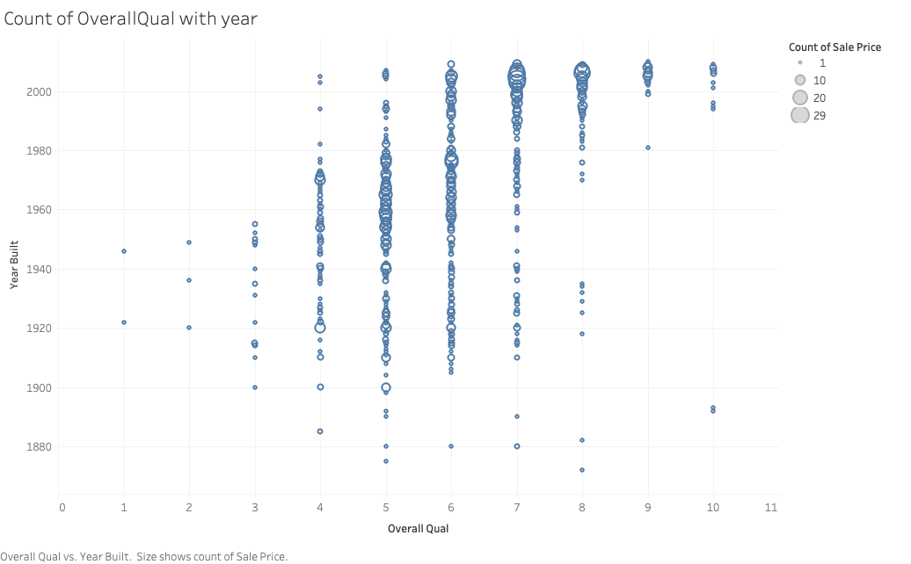

Slide 9
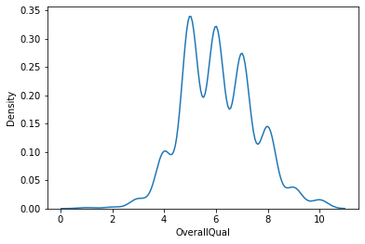
OverallQual

Slide 10
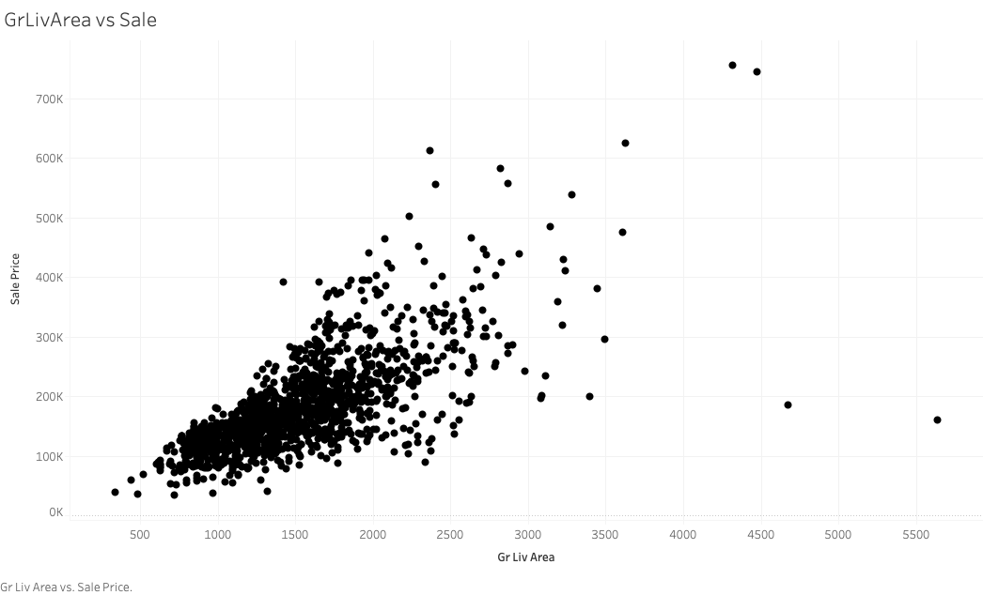

Slide 11
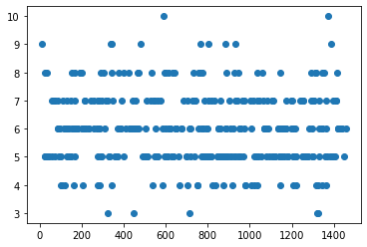
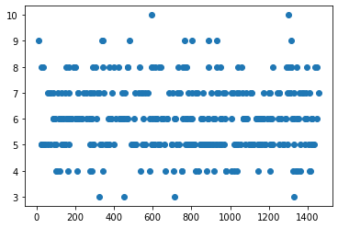
Linear regression
Train
Test

Slide 12
Lasso Regression
Training
rmse on train set: 0.00023378189950111936
rmse on validation set: 8.681457612872672
r2_square on validation set: -44.20549023798318
The best value of Alpha is: {'alpha': 0.0001}
Test values
rmse on train set: 0.01191973752142423
rmse on validation set: 8.698369876921367
r2_square on validation set: -44.2232523143366
The best value of Alpha is: {'alpha': 0.0001}

Slide 13
Ridge Regression
Training data
r2_square on validation set: -79.64963078013625 The best value of Alpha is: {'alpha': 1}
Test data
r2_square on validation set: -506117.51212957746 The best value of Alpha is: {'alpha': 1}

Slide 14
Random Forest Regression
Training data
Failure to get to work
Got params
Test data
Failure to get to work

Slide 15
Regression picked
Lasso regression had lowest numbers of Root mean square error (RMSE) this mean that the predicted model fits the actual model

Slide 16
Dependent Variable
From the data I believe that the dependent variable is OverallQual
It has a strong correction with SalePrice
All other facts play a role in OverallQual

Slide 17
Adding and remove from data
Removed: (80% or higher emty values)- MiscFeature, Fence, PoolQC, Alley, MSZoning, Street, LotShape
Filled with None,no or Non values for missing data in the data set

