Slide 1

Data Modeling and Constraints in LCNC Platforms
January 2024

Slide 2
Content
Legend
What is Legend?
Data modeling and constraints
Demo
DMN
What is DMN?
Data modeling and constraints
Overall structure of jDMN
Demo
Q&As

Slide 3
What is Legend
Legend is an LCNC data platform
Studio is a data model editor that allows you to describe, connect, and visualize your data.
Query enables users to access modeled data in Legend, using a hosted graphical, drag-and-drop, self-service user interface.
Services can be used to share high-quality data reliably with other applications via APIs. Any self-service query can be promoted to a production-quality Legend service, fully backed by SDLC.
Engine is the execution engine for Legend.
SDLC Server provides a rich REST API allowing users to safely manage metadata.

Slide 4
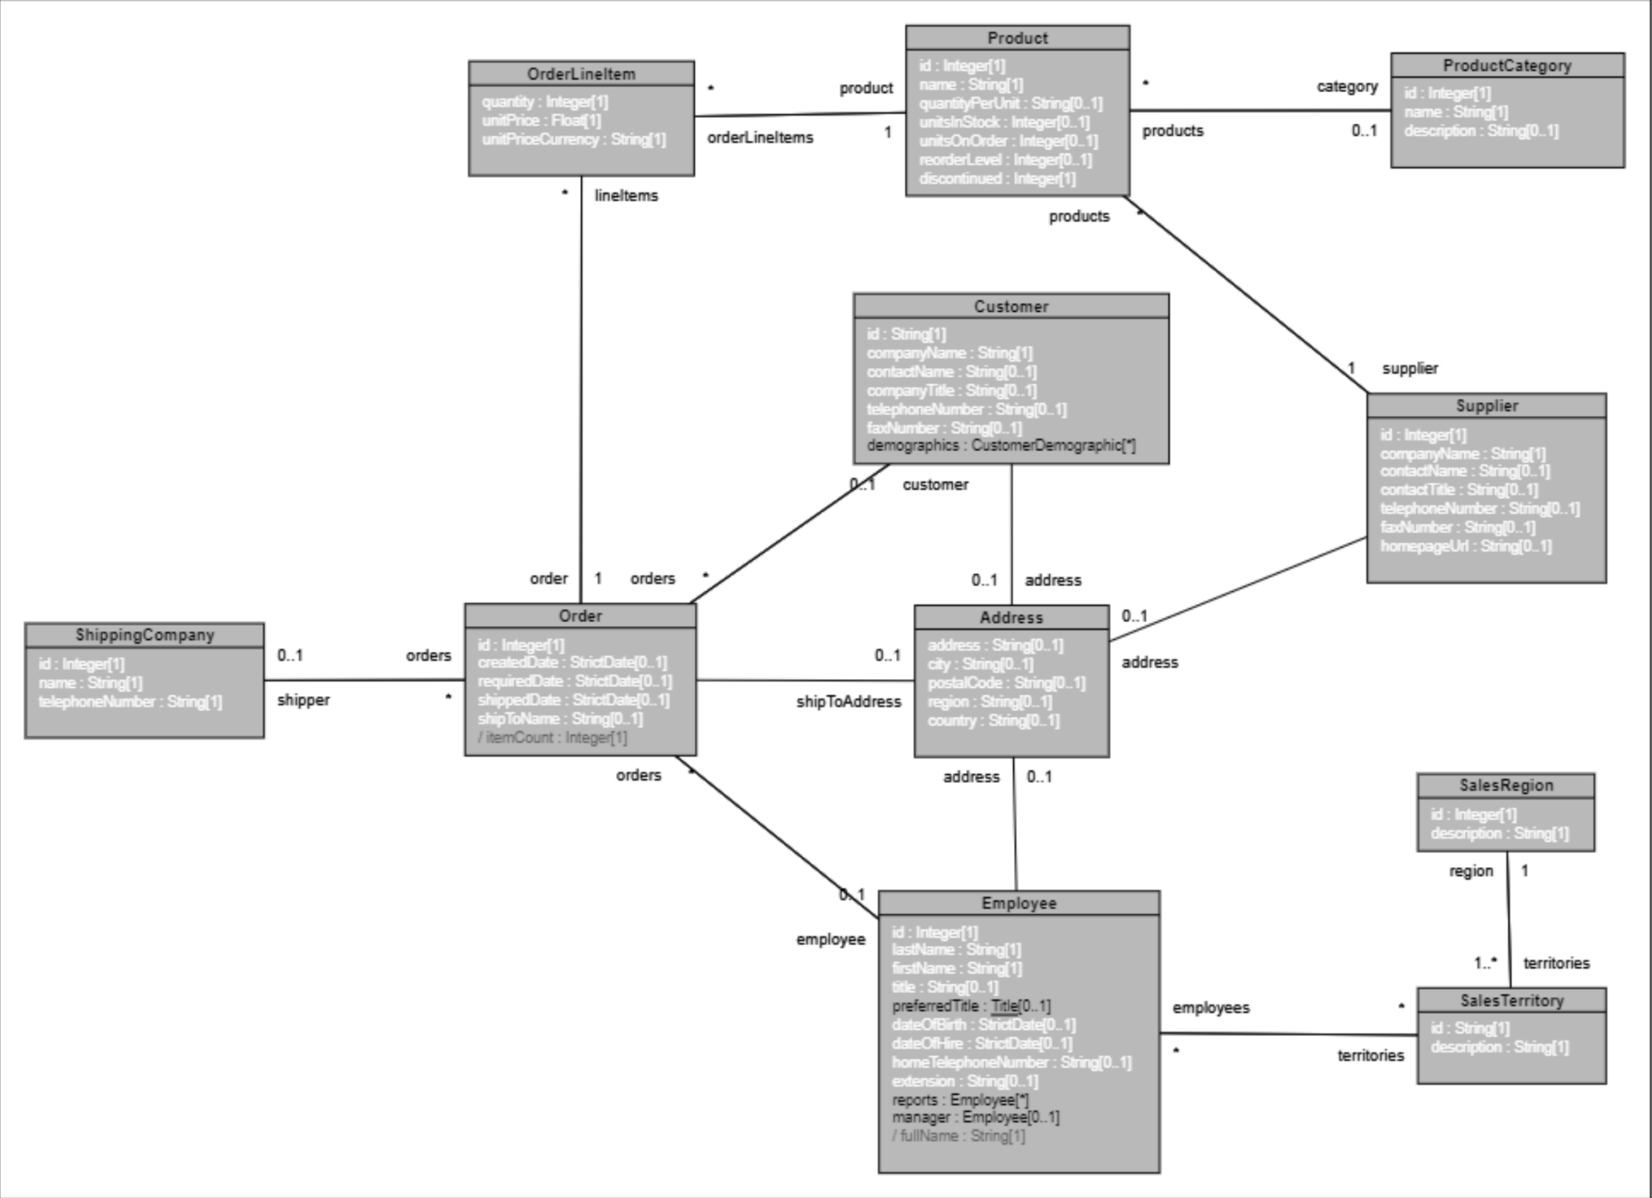
Data Model Sample

Slide 5
Data: Primitive Types
Number (Integer, Float)
String
Boolean
Date (StrictDate, DateTime)
The date type is an abstract class with two subtypes: StrictDate and DateTime. A date is automatically cast into one of these two types.
The syntax for StrictDate is %YYYY-MM-DD
The syntax for DateTime is %YYYY-MM-DD'T'HH:MM:SS

Slide 6
Data: Classes
Class northwind::model::OrderLineItem {
quantity: Integer[1];
unitPrice: Float[1];
unitPriceCurrency: String[1];
comment: String[0..1];
}
Cardinality indicates the range in the size of the set.

Slide 7
Data: Enumerations
Enum CompanyType{
Corporation,
LimitedLiabilityCorporation
}
Class Firm{
name: String[1];
companyType: CompanyType[1];
}

Slide 8
Data: Associations
Class northwind::model::Order { id: Integer[1]; createdDate: StrictDate[0..1]; requiredDate: StrictDate[0..1]; shippedDate: StrictDate[0..1]; shipToName: String[0..1]; shipToAddress: northwind::model::geography::Address[0..1]; itemCount() {$this.lineItems->count()}: Integer[1]; }
Class northwind::model::crm::Employee {
. . .
}
Association northwind::model::associations::Order_Employee { orders: northwind::model::Order[*]; employee: northwind::model::crm::Employee[0..1]; }

Slide 9
Functions: Standalone
Builtin
https://legend.finos.org/docs/reference/released-functions
Variable
let myVar = 0.75;
let x = $myVar;
Arrow notation
$myVar->ceiling();
Lambda { parameter | body with operation }.
{myInteger | $myInteger + 33}

Slide 10
Functions: Standalone
Function add(
a: Integer[1],
b:Integer[1])
: Integer[1]
{
a + b
}

Slide 11
Functions: Methods
Class northwind::model::crm::Employee {
. . .
fullName() {
if(
$this.preferredTitle->isNotEmpty(),
|$this.preferredTitle->toOne()->toString()+'',
|if(
$this.title->isNotEmpty(),
|$this.title->toOne() + ' ',
|''
)
) + $this.firstName + ' ' + $this.lastName}: String[1];
. . .
}

Slide 12
Functions: if, map, and filter
if ( $myVar >= 0,
| "accept",
| "reject"
);
$myCollection->map( y | $y+1);
x | filter($x.name->startsWith('S'))

Slide 13
Extensions: Profiles
Profile profile {
stereotypes: [important],
tags: [doc]
}
Stereotype
Class << profile.important>> Firm
{
name: String[1];
companyType: CompanyType[1];
}
Tagged value
Class
<< profile.important>>
{profile.doc = 'Represent a company.'} Firm
{
name: String[1];
companyType: CompanyType[1];
}

Slide 14
Extensions: Derivation
Class <<extension.important>>
{doc.doc = 'Represent a company.'} Firm
[
isCorporation: $this.companyType == CompanyType.Corporation
]
{
name: String[1];
companyType: CompanyType[1];
isCorporation(): {
if($this.companyType == CompanyType.Corporation,
| true,
| false
)
}:Boolean[1];
}

Slide 15
Extensions: Constraints
Class northwind::model::inventory::Product
[
idNotNegative: $this.id >= 0,
nameNotBlank: $this.name->length() > 0
]
{
id: Integer[1];
name: String[1];
quantityPerUnit: String[0..1];
unitsInStock: Integer[0..1];
unitsOnOrder: Integer[0..1];
reorderLevel: Integer[0..1];
discontinued: Integer[1];
}

Slide 16
Extensions: Constraints
Class northwind::model::crm::Employee
[
dateOfBirthNotInTheFuture: $this.dateOfBirth < now(),
dateOfBirthValid: $this.dateOfBirth > %1900-01-01,
employeeIsOverEighteen: $this.dateOfBirth->dateDiff(
today(), meta::pure::functions::date::DurationUnit.YEARS
) >= 18,
employeeIsUnderEighty: $this.dateOfBirth->dateDiff(
today(), meta::pure::functions::date::DurationUnit.YEARS
) < 80,
notDateOfHireNotBeforeDateOfBirth:
$this.dateOfHire > $this.dateOfBirth
]
{
…
}

Slide 17
Demo
Model + Constraints
Relational Store + Mapping
Legend URL
https://www.finos.org/legend
Studio URL
https://legend.finos.org/studio
Gitlab URL
https://gitlab.com/finosfoundation/legend/showcase/legend-showcase-northwind-data
Sample Constraints
Customer
https://gitlab.com/finosfoundation/legend/showcase/legend-showcase-northwind-data/-/blob/master/legend-showcase-northwind-data-entities/src/main/pure/showcase/northwind/model/crm/Customer.pure?ref_type=heads

Slide 18
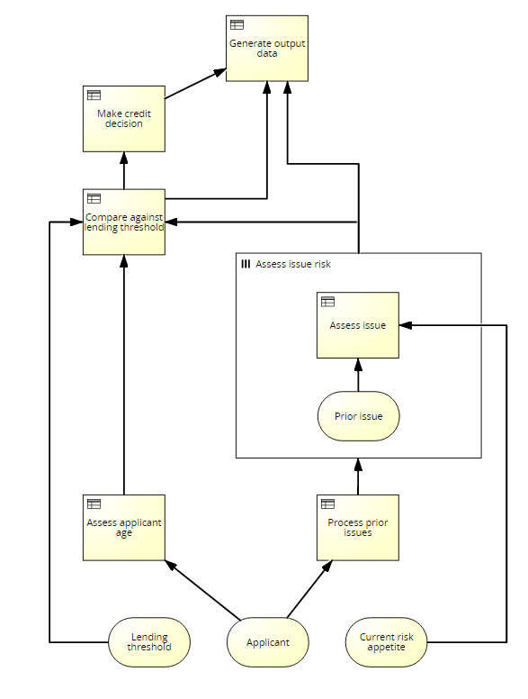
What is DMN?
Decision Model and Notation (DMN)
Standard published by OMG
Notation to support decision management and business rules
Users
Business People: manage and monitor decisions
BAs or Functional Analysists: specify decision models
Technical developers: execution and automation
DSL
Diagrammatic notation
Templates
Expression language FEEL
Standalone or with BPMN & CMMN
Integration with PMML and native platforms

Slide 19
Data: Primitive Types
number
string
boolean
time, date, date and time
years and months duration
days and time duration

Slide 20
Data: ItemDefinition

Slide 21
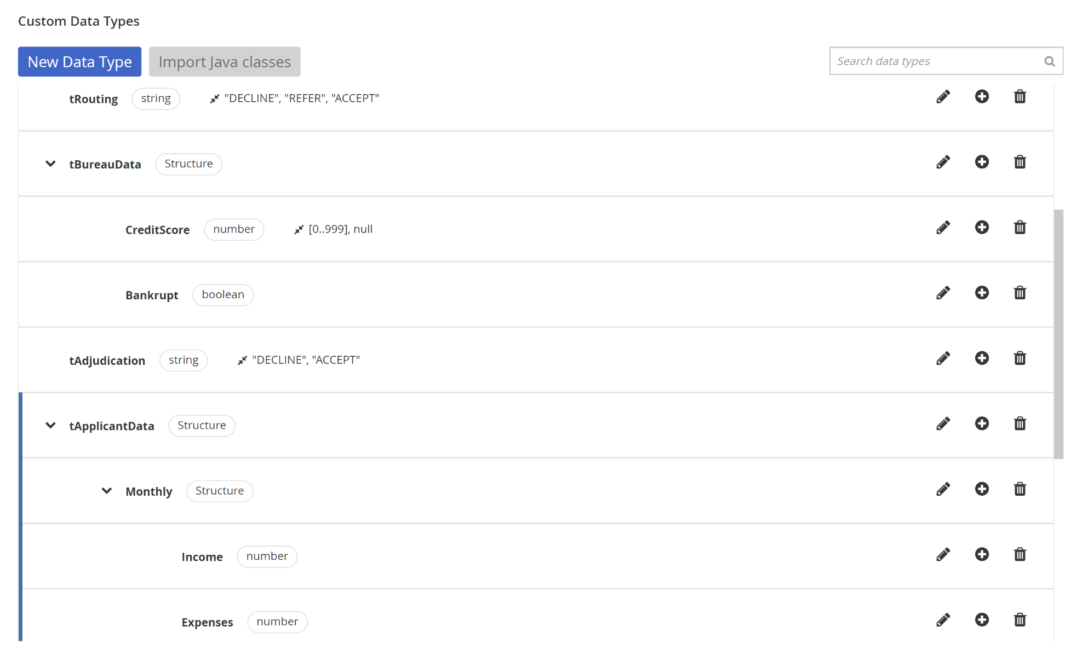
Data: Item Definition Samples

Slide 22
Data: Item Definition Samples
<itemDefinition name="Person">
<itemComponent name="name">
<typeRef>string</typeRef>
</itemComponent>
<itemComponent name="age">
<typeRef>number</typeRef>
</itemComponent>
<itemComponent name="dateOfBirth">
<typeRef>date</typeRef>
</itemComponent>
<itemComponent name="creditScore">
<typeRef>number</typeRef>
</itemComponent>
</itemDefinition>

Slide 23
Data: FEEL Constraints
DMN 1.1 – 1.4
An ItemDefinition element may restrict the values that are allowed from typeRef, using the allowedValues attribute.
The allowedValues are an instance of unaryTests that specifies the allowed values or ranges of allowed values within the domain of the typeRef.
The type of the allowed values SHALL be consistent with the containing ItemDefinition element.
If an ItemDefinition element contains one or more allowedValues, the allowedValues specifies the complete range of values that this ItemDefinition represents.
If an ItemDefinition element does not contain allowedValues, its range of allowed values is the full range of the referenced typeRef.
In cases where the values that an ItemDefinition element represents are collections of values in the allowed range, the multiplicity can be projected into the attribute isCollection. The default value for this attribute is false.

Slide 24
Data: FEEL Constraints
DMN 1.5
An ItemDefinition element may restrict the values that are allowed from typeRef, using the allowedValues attribute.
The allowedValues is an instance of UnaryTests that constraints the domain of the typeRef.
If an ItemDefinition element does not contain allowedValues, its range of allowed values is the full range of the referenced typeRef.
When an ItemDefinition has sibling itemComponents, their values are available in the evaluation context of the UnaryTests of the allowedValues.
In cases where the isCollection attribute of an ItemDefinition is true, each element of the collection must satisfy the UnaryTests of the allowedValues, i.e. the allowedValues are projected onto the collection elements.
The default value of isCollection is false.
The allowedValues attribute has been deprecated as of DMN 1.5 and replaced with the typeConstraint attribute. The typeConstraint attribute differs from allowedValues by not projecting onto collection elements but directly constraining the collection.

Slide 25
Data: FEEL Constraints Samples
Person.age
?.age >= 18
Person.dateOfBirth
>= @"1960-01-01"
Person.creditScore
[0..999], null
Person.sex
"male", "female", "unknown"

Slide 26
Overall Structure
DMN Processors
Reader / Writer
Validators
Transformers
Interpreter
Translator
Dialects
DMN 1.1 – 1.5
Signavio

Slide 27
Overall Structure
Syntax Analyzer
Source
Text
Lexical Analyzer
Source
Tokens
Parser
AST
Semantic Analyzer
Error Manager
& Logger
Semantic
Tree
Code
Generator
Interpreter

Slide 28
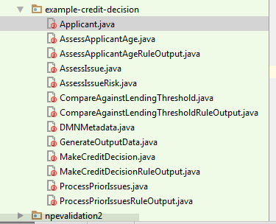
Translation

Slide 29
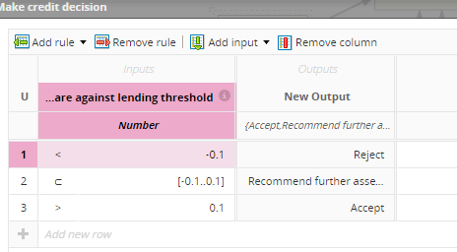
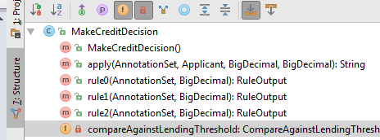
Translation

Slide 30
Translation
How did we built it?
Syntax-Driven Translation Schematas (SDTS)
Based on Knuth’s attributed gramars
Synthesized attributes
Inherited Attributes
Expr₁ → Expr₂ + Term { Expr₁.value = Expr₂.value + Term.value }
Expr → Term { Expr.value = Term.value }
Term₁ → Term₂ * Factor { Term₁.value = Term₂.value * Factor.value }
Term → Factor { Term.value = Factor.value }
Factor → "(" Expr ") { Factor.value = Expr.value }
Factor → integer { Factor.value = strToInt(integer.str) }

Slide 31
Translation
Advantages include
Performance: we have seen runtimes 4-10 times faster than previous engine execution in complex decision tests
Stability: given that we now control the code generation, we are able to resolve issues without relying on the vendor
Functionality: the fact that we control the code generation means that we are also able to enable more advanced functionality for DMN/Java models

Slide 32
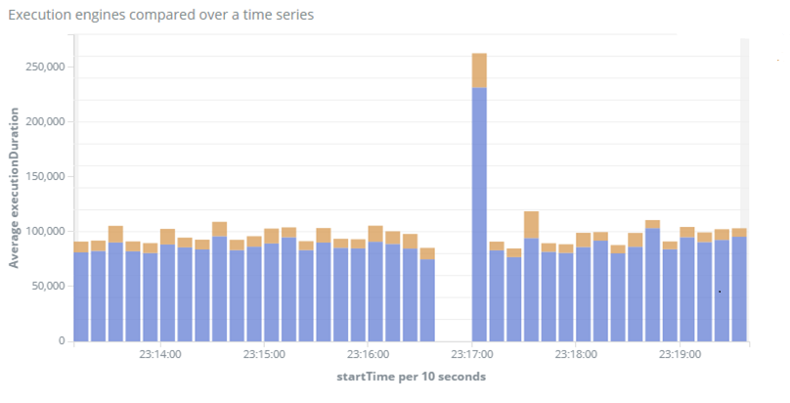
Performance
jDMN
Previous

Slide 33






Code Optimisation – Model Level
AWS Lambda
gRPC / protobuf
AWS Stack
Message Bus
Users

Slide 34
Code Optimisation – DRG Element Level
Caching
Map-reduce for
MID

Slide 35
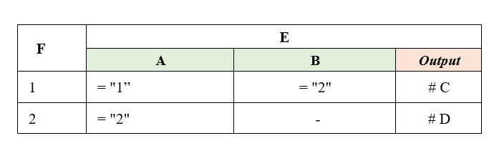
Code Optimisation – DRG Element Level
Lazy evaluation
Inner nodes (Decisions, BKMs, Decision Services)
Leaves (Input Data)

Slide 36
Code Optimisation – DRG Element Level
Performance Before DRG Optimization
Decision Name | Request Count | Response Time 90th (ms) | Min Response Time (ms) | Max Response Time (ms)
D1 | 12899 | 40 | 4 | 5562
D2 | 361 | 6676 | 21 | 9653
D3 | 28731 | 15 | 1 | 933
D4 | 86165 | 39 | 4 | 6367
Performance After DRG Optimization
Decision Name | Request Count | Response Time 90th (ms) | Min Response Time (ms) | Max Response Time (ms)
D1 | 12899 | 35 | 5 | 7150
D2 | 361 | 315 | 153 | 4603
D3 | 28745 | 12 | 1 | 606
D4 | 86204 | 37 | 4 | 7736

Slide 37
Code Optimisation at FEEL level
Native Types
Built-in functions
Native Compiler / Interpreter (e.g. JIT compiler)

Slide 38
Demo
https://www.omg.org/dmn/
VSCode and RedHat extensions
Model & constraints

Slide 39

Questions?
opatrascoiu@yahoo.com

