Slide 1


PRINCIPLES OF HCI

Slide 2



The golden principle in HCI is that “people should come first” or called “user-centered design”.

Slide 3
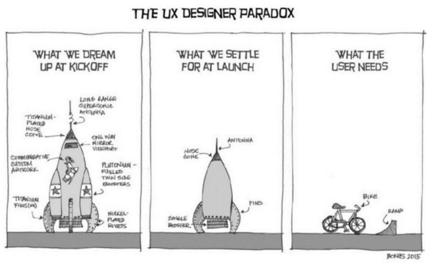
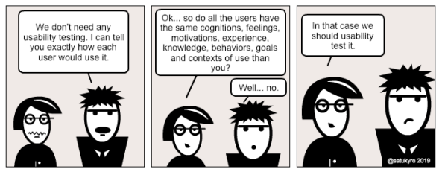



“Know Thy User”
This principle simply states that the interaction and
interface should cater to the needs and capabilities of the target user of the system in design.

Slide 4
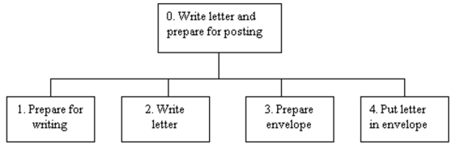
Understand the Task
Another almost-commonsensical principle is to base HCI design on the understanding of the task.

Slide 5

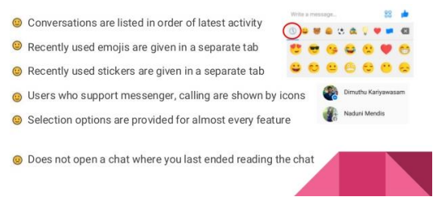


Reduce Memory Load
Designing interaction with as little memory load as
possible is a principle that also has a theoretical basis. Humans are certainly more efficient in carrying out tasks that require less memory burden, long or short term. Keeping the user’s shortterm memory load light is of particular importance with regard to the interface’s role as a quick and easy guidance to the completion of the task.

Slide 6


Strive for Consistency
In the longer term, one way to unburden the
memory load is to keep consistency [4]. This applies to (a) both within an application and across different applications and (b) both the interaction model and interface implementation.

Slide 7
Remind Users and Refresh Their Memory
Any significant task will involve the use of memory,
so another good strategy is to employ interfaces that give continuous reminders of important information and thereby refresh the user’s memory.

Slide 8
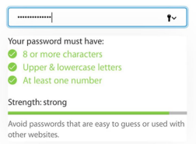
Prevent Errors/Reversal of Action
While supporting a quick completion of the task is important, error free operation is equally important. As such, the interaction and interface should be designed to avoid confusion and mental overload.

Slide 9



Naturalness
The final major HCI principle is to favor “natural”
interaction and interfaces. Naturalness refers to a trait that is reflective of various operations in our everyday life. For instance, a perfect HCI may one day be realized when a natural language–based conversational interface is possible, because this is the prevalent way that humans communicate.

