Slide 1
Photon Mapping on Programmable Graphics Hardware
Timothy J. Purcell, Craig Donner, Mike Cammarano, Henrik Wann Jensen, and Path Hanrahan
Presented by Jason Stredwick

Slide 2
Photon Mapping Overview
Global illumination model
Every surface will have an extra texture associated with it, called a photon map
Photon mapping is a two stage process
  Simulating the movement of photons and recording their interactions with each surface
  During rendering, using the photon density around a point on a surface to determine its radiance
All the stages are performed on hardware

Slide 3
Process of Recording Photons
Recording photons occurs during the simulation phase
A predetermined number of photons are used
All photons begin on the light sources with a random direction
When released each photon bounces a specified number of times
Each bounce is recorded in the photon map

Slide 4
Photon Map Data Structure
Original structure was a balance k-d tree
k-d trees are not feasible on the GPU due to the need for random access writes
Proposed a uniform grid to divide the map
Each photon hit has its surface location and cell location recorded

Slide 5
Building the Grid
Two methods were proposed
  Photon cell sorting
  Pseudo rendering algorithm

Slide 6
Bitonic Merge Sort
Uses bitonic merge sort
  Doesn’t require extra memory
  Reuses the photon map memory
  Each step performs n comparisons and swaps
Sorting step run time of O(log²n)
Binary search is used to locate the first photon for each cell

Slide 7
Stencil Routing
The GPU vertex programs provide a special glPoint mechanism for drawing to a location in memory
Memory must be allocated for the grid on the card
The grid is subdivided into mxm pixels
The cell number is computed when the photon hits the surface

Slide 8
Stencil Routing Cont.
Using glPointSize set to m, the pixel width of a cell
Draw a point at the cell location
Using a stencil buffer, the photon is routed to a specific location in the cell
The power of a photon is distributed to all the photons in the cell if there is no more room in the cell

Slide 9
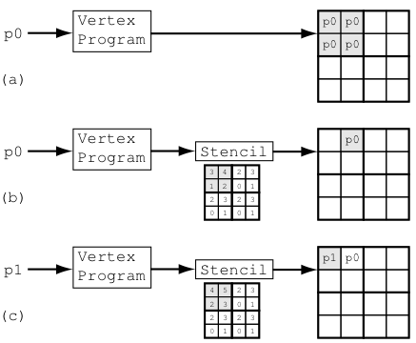
Stencil Routing Cont.

Slide 10
Stencil Routing Cont.
Disadvantages
  Potential for many empty cells
  Need to read from the texture memory to get photon location and other information
Advantages
  Fast
  Easy to implement
  Still faster than the bitonic merge sort

Slide 11
Radiance Estimate
Once all the photons have been mapped, it is ready for the rendering phase
The photon map is used to estimate the radiance at a surface location
kNN-grid algorithm is used to determine the photon density
Using statistics, the density and other photon information is converted into a radiance value

Slide 12
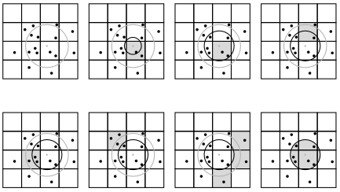
kNN Grid Selection

Slide 13
Test Scenes
Glass ball
Flat metal ring
Cornell Box

Slide 14
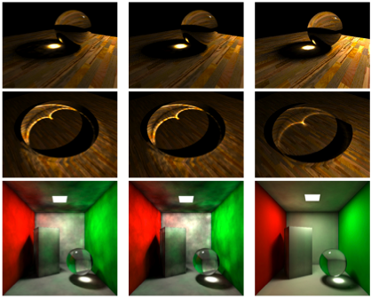
Bitonic
Stencil Routing
Software

Slide 15
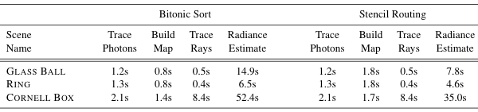
Results

Slide 16
Conclusions
Demonstrated an approach to GPU bound photon mapping
Uniform grid based photon map
Fast design
Approximation for global illumination

