Slide 1
Random Number Generators
In Use
Jason Stredwick

Slide 2
Motivations
Original desire for this course was to learn about random number generators (RNGs)
What RNG options are available?
How to make intelligent choices about RNGs

Slide 3
Organization
Different types of RNGs: LCG, MRG, Combination, Cellular Automata, Physical Based
Basic information to look for in a RNG
Information sources and references

Slide 4
DIEHARD
Created by G. Marsaglia
A battery of 15 empirical statistics tests
From most of the sources I have read, this test suite appears to be becoming a minimum set of tests for any RNG

Slide 5
Refresher - Properties of RNGs
Period/Cycle Length
Low correlation between generated numbers
Reproducibility

Slide 6
Linear Congruential Generation LCG
x_{i} = (a * x_{i-1}) mod m (0,1) [1, m-1]
x_{i} = (a * x_{i-1} + c) mod m [0,1) [0, m-1]
u_{i} = x_{i} / m
Full period means all possible values have been selected before a repeat of the seed (x₀)
m is typically prime, which has the best chance for a full period for a subset of possible values of a
m = 2³² - 1 (largest 32 bit prime) is the most common value for m
0 < a < m

Slide 7
Minimum Standard LCG
A minimum standard LCG was proposed which stated coefficients should have three properties, proposed in [2]
  Full period [1, m-1]
  The period sequence is statistically random
  Can be implemented efficiently with 32-bit math
a = 16807 and m = 2³²-1 meets these properties discovered by Lewis, Goodman, and Miller in 1969

Slide 8
Minimum Standard LCG Cont.
For m = 2³² -1
534 million multiplier values meet requirement 1
11465 multipliers met both requirement 1 and 3
After performing statistical tests, 410 of the 534 million were found to be optimal multipliers
The best found were a = 48,271 and 69,621

Slide 9
Multiplatform Implementation
One key to making LCG multiplatform is fix the overflow problem when multiplying two 32 bit numbers
Schrage solved this by doing an approximate factorization of m such that
  m = aq + r : q = (int)(m/a), r = m mod a
x_{i} = a(x_{i-1} mod q) - r*(int)(x_{i-1}/q) if x_{i-1} >= 0
x_{i} = a(x_{i-1} mod q) - r*(int)(x_{i-1}/q) + m otherwise
m=16807 becomes q = 127773 and r = 2836

Slide 10
Knuth’s Subtractive Method
Keeps a circular list of 56 random numbers
Initialization is process of filling the list, then randomize those values with a specific deterministic algorithm
Two indices are kept which are 31 apart
A new random number is the difference of the two list values at the two indices
The new random number is stored in the list

Slide 11
Multiple Recursive Generator MRG
x_{i} = (a_{i}*x_{i-1} + … + a_{k}*x_{i-k}) mod m
u_{i} = x_{i} / m
k is the order of the recursion
Sequence is periodic with length p = m^{k} - 1
Current area of research
Popular due to its much longer period than LCGs

Slide 12
MRG Example DX-k-s
(DX-120-4) Generator
s number of terms in the function
Primary property is that all coefficients are equal, x_{i} = B(x_{i-k}+x_{i-(2k/3)}+x_{i-(k/3)}+x_{i-1})
After solving for an optimum B, they were able to get a period of approx. 0.679*10¹¹²⁰
Able to produce approx. 1 billion RNs in 23sec. on a 1.4 GHz Athlon
No mention was made of statistical validation, but reference [7] gives confidence to the procedure

Slide 13
Cellular Automata(CA) RNG
Cellular Automata is a lattice structure of sites where each site has a state and a set of transition rules for changing state
The system designed by Shackleford, Tanaka, Carter, and Snider is an asynchronous CA with four neighbors
Asynchronous does not refer to time, but the lack of uniformity for neighbor connections

Slide 14
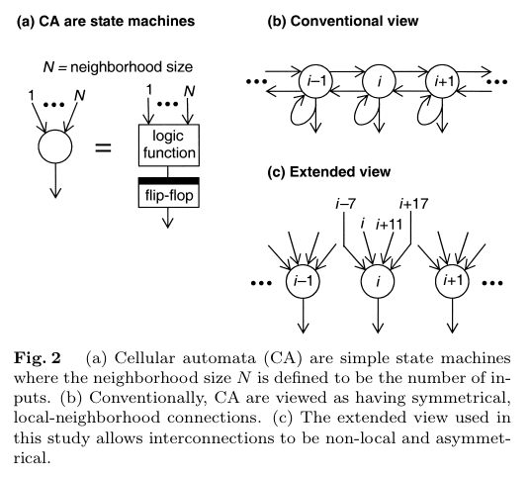
CA RNG Setup

Slide 15
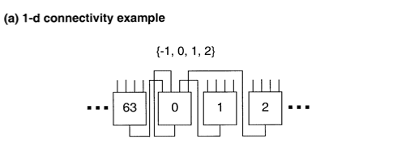
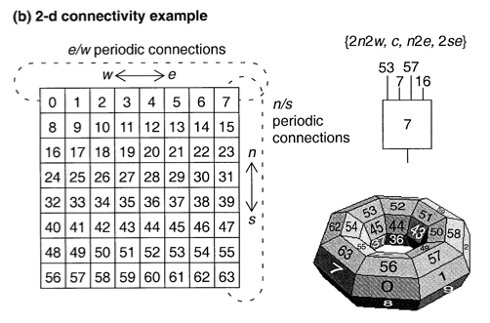

Slide 16
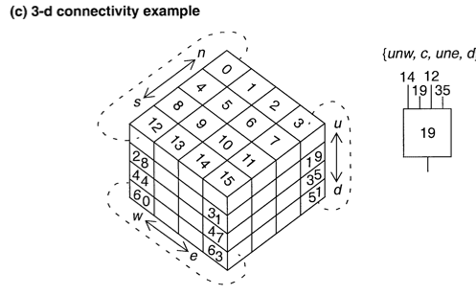

Slide 17
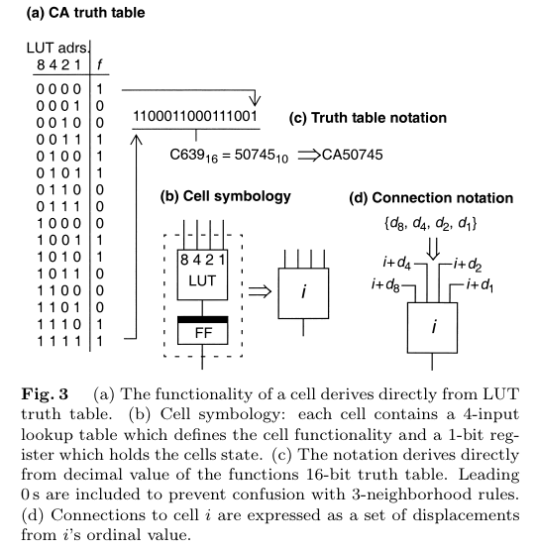
CA RNG Workings

Slide 18
CA RNG Candidates
Each CA was seeded with the first site in state 1 and all other sites were in state 0
Because there are four inputs, with a truth table of size 16, there are 2¹⁶ possible CAs
To find good candidates for a RNG, they exhaustively searched all CAs and determined their entropy, keeping the highest 1000
They took the 1000 best and subjected them to the DIEHARD test suite to find those that qualify for RNG status

Slide 19
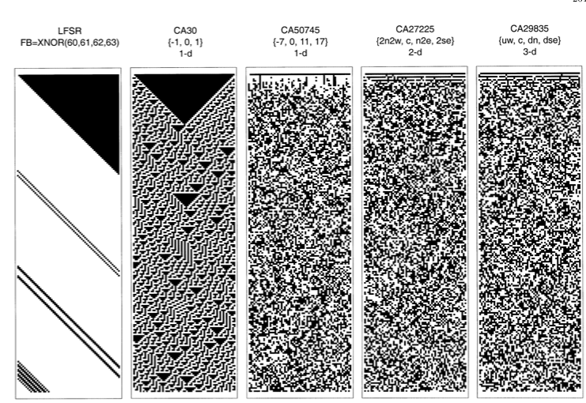

Slide 20
CA RNG Cycle Length Results
The following are three of the largest cycle lengths found for the 167 64-bit CA with connectivity {-7, 0, 7, 17}
  122,900,296,320 1.22 * 10¹¹
  122,900,296,320 1.22 * 10¹¹
  79,149,345,600 7.9 * 10¹⁰

Slide 21
Physical Based RNGs
Difficulties
  Bits must be constructed into a real number
  Distributions tend to be exponential, and must be converted to a uniform distribution
  Some can not compete with LCGs for speed
Advantages
  No period, just continuous random data
  Independent
  High dimensionality

Slide 22
Physical Based RNGs Cont.
Example devices:
  noise produced by a semiconductor diode
  time intervals of a geiger counter
  HotBits [10]
HotBits is available over the internet
Connects a geiger counter for beta radiation from the decay of Krypton-85
Produces approximately 240 bits per second
Java code (randomX) which will pull random numbers on demand from their website

Slide 23
What is desirable?
Beware of LCGs whose modulus value is not prime (periods will often not be full)
Sample size required < Sqrt(period length)
Prefer RNGs that have passed the DIEHARD set of statistical tests[5]

Slide 24
References
[1] Numerical Recipes in C, Press WH, Teukolsky SA, Vetterling WT, Flannery BP, 274-328
[2] Random number generators: good ones are hard to find, Park SK, Miller KW, COMMUNICATIONS OF THE ACM, Vol 31 No 10, 1192-1201, OCT 1988
[3] Good random number generators are (not so) easy to find, Hellekalek P, MATHEMATICS AND COMPUTERS IN SIMULATION, Vol 46, 485-505, 1998
[4] http://random.mat.sbg.ac.at/ Information about RNGs
[5] http://stat.fsu.edu/~geo/diehard.html DIEHARD website

Slide 25
References Cont.
[6] A system of high-dimensional, efficient, long-cycle and portable uniform random number generators, Lih-Yuan Deng, Hongquan Xu, ACM TRANSACTIONS ON MODELING AND COMPUTER SIMULATION Vol 13 No. 4, 299-309, OCT 2003
[7] On the Deng-Lin random number generators and related methods, L’Ecuyer P, Touzin R, MAY 2003
[8] Random number generators implemented with neighbor-of-food, non-locally connected cellular automata, Shackleford B, Tanaka M, Carter RJ, Snider G, IEICE TRANSACTIONS OF FUNDAMENTALS OF ELECTRONICS COMMUNICATIONS AND COMPUTER SCIENCE E85A(12): 2612-2623 FEB 2003
[9] Generating random numbers of prescribed distribution using physical sources, Neuenschwander D, Zeuner H, STATISTICS AND COMPUTING 13(1): 5-11 FEB 2003
[10] http://www.fourmilab.ch/hotbits/

Slide 26
Minimum LCG
#define IA 16807
#define IM 2147483647
#define AM (1.0/IM)
#define IQ 127773
#define IR 2836
#define NTAB 32
#define NDIV (1+(IM-1)/NTAB)
#define EPS 1.2e-7
#define RNMX (1.0-EPS)
float ran1(long *idnum) {
// Return uniform random deviate
// between 0.0 and 1.0 (exclusively)
// Call with negative number to seed
// then do not alter idnum until next seed
int j;
long k;
static long iy = 0;
static long iv[NTAB];
float temp;
if(*idnum < 0 || !iy) {
if(-(*idnum) < 1) *idnum = 1;
else *idnum = -(*idnum);
for(j=NTAB+7;j>=0;j--) {
k=(*idnum)/IQ;
*idnum=IA*(*idnum-k*IQ)-IR*k;
if(*idnum < 0) *idnum += IM;
if(j < NTAB) iv[j] = *idnum;
}
iy = iv[0];
}
k = (*idnum)/IQ;
*idnum=IA*(*idnum-k*IQ)-IR*k;
if(*idnum < 0) *idnum += IM;
j = iy / NDIV;
iy = iv[j];
iv[j] = *idnum;
if((temp = AM*iy) > RNMX) return RNMX;
else return temp;
}

Slide 27
LCG with period (> 2*10¹⁸)
#define IM1 2147483563
#define IM2 2147483399
#define AM (1.0/IM1)
#define IMM1 (IM1-1)
#define IA1 40014
#define IA2 40692
#define IQ1 53668
#define IQ2 52774
#define IR1 12211
#define IR2 3791
#define NTAB 32
#define NDIV (1+IMM1/NTAB)
#define EPS 1.2e-7
#define RNMX (1.0-EPS)
Long period (>2*10¹⁸) random
number generator of L’Ecuyer with
Bays-Durham shuffle and added safeguards. Returns a uniform
random deviate between 0.0 and 1.0 (exclusive of the endpoint values).
Call with idnum a negative integer
to initialize; therefore, do not alter idnum between successive deviates
in a sequence. RNMX should approximate the largest floating
value that is less than 1.

Slide 28
LCG with period (> 2*10¹⁸) Cont.
float ran2(long *idnum) {
int j;
long k;
static long idnum2=123456789;
static long iy=0;
static long iv[NTAB];
float temp;
if(*idnum <= 0) {
if(-(*idnum) < 1) *idnum = 1;
else *idnum = -(*idnum);
idnum2 = (*idnum);
for(j=NTAB+7;j>=0;j--) {
k = (*idnum)/IQ1;
*idnum = IA1*(*idnum-k*IQ1)-k*IR1;
if(*idnum < 0) *idnum += IM1;
if(j<NTAB) iv[j] = *idnum;
}
iy = iv[0];
}
k = (*idnum)/IQ1;
*idnum = IA1*(*idnum-k*IQ1)-k*IR1;
if(*idnum < 0) *idnum += IM1;
k = idnum2/IQ2;
idnum2 = IA2*(idnum2-k*IQ2)-k*IR2;
if(idnum2 < 0) idnum2 += IM2;
j = iy/NDIV;
iy = iv[j]-idnum2;
iv[j] = *idnum;
if(iy < 1) iy += IMM1;
if((temp=AM*iy) > RNMX) {
return RNMX;
} else {
return temp;
}
}

Slide 29
Knuth’s Subtractive Method
Returns a uniform random deviate
between 0.0 and 1.0. Set idnum to
any negative value to initialize or
reinitialize the sequence.
To convert this algorithm to
Floating-point, simply declare mj,
mk, and ma[] as float, define mbig
and mseed as 4000000 and
1618033 respectively.
According to Knuth, any large
MBIG, and any smaller(but still
large) MSEED can be substituted
for the above values.
#include <stdlib.h>
// May need math.h instead
#define MBIG 1000000000
#define MSEED 161803398
#define MZ 0
#define FAC (1.0/MBIG)

Slide 30
Knuth’s Subtractive Method Cont.
float ran3(long *idnum) {
static int inext, inextp;
static long ma[56];
static int iff=0;
long mj, mk;
int i, ii, k;
if(*idnum < 0 || iff == 0) {
iff=1;
mj=labs(MSEED-labs(*idnum));
mj %= MBIG;
ma[55] = mj;
mk = 1;
for(i=1;i<=54;i++) {
ii = (21*i) % 55;
ma[ii] = mk;
mk = mj - mk;
if(mk < MZ) mk += MBIG;
mj = ma[ii];
}
for(k=1;k<=4;k++) {
for(i=1; i<=55; i++) {
ma[i] -= ma[1+(i+30) % 55];
if(ma[i] < MZ) ma[i] += MBIG;
}
}
inext = 0;
inextp = 31;
*idnum = 1;
}
if(++inext == 56) inext = 1;
if(++inextp == 56) inextp = 1;
mj = ma[inext] - ma[inextp];
if(mj < MZ) mj += MBIG;
ma[inext] = mj;
return mj*FAC;
}

Slide 31
DX-120-4
Data types
#if defined(_WIN32)
typedef __int64 XXTYPE;
#define DMOD(n, p) ((n)%(p))
#elif defined(__GNUC__)
typedef int64_t XXTYPE
#define DMOD(n, p) ((n) %(p))
#else
#include <math.h>
typedef double XXTYPE;
#define DMOD(n, p) fmod((n), (p))
#endif

Slide 32
DX-120-4 Initialization
#define KK 120
#define 2147483647
#define HH 1.0/(2.0*PP)
#define B_LCG 16807
static XXTYPE XX[KK];
static int II;
static int K12;
static int K13, K23;
void su_dx(unsigned in seed) {
int i;
if(seed == 0) seed = 12345;
XX[0] == seed;
for(i=1; i<KK; i++) XX[i] = DMOD(B_LCG * XX[i-1], PP);
II = KK - 1;
K12 = KK/2-1;
K13 = KK/3-1; K23 = 2*KK/3-1;
}

Slide 33
DX-120-4 Generator 1
#define BB4 521673
double u_dx4(void) {
int II0 = II;
if(++II >= KK) II = 0;
if(++K13 >= KK) K13 = 0;
if(++K23 >= KK) K23 = 0;
XX[II] = DMOD(BB4 * (XX[II]+XX[K13]+XX[K23]+XX[II0]), PP);
return ((double) XX[II] / PP) + HH;
}

Slide 34
DX-120-4 Generator 2
static unsigned long XX[KK];
unsigned long MODP(unsigned long z) { return (((z)&PP)+((z)>>31)); }
#define MUL20(x) ( ((x)>>11) + ((x)<<20) & PP )
#define MUL9(x) ( ((x)>>22) + ((x)<<9) & PP )
double u_dx2d(void) {
int II0 = II;
unsigned long S;
if(++II >= KK) II = 0;
S = MODP(XX[II] + XX[II0]);
XX[II] = MODP(MUL20(S) + MUL9(S));
return ((double) XX[II] / PP) + HH;
}

