Slide 1
Quantifying Population Extinction and Examining the Effects of Different Mutation Rates
Jason Stredwick
Farshad Samimi
Wei Huang
Matt Luciw
Matthew Rupp

Slide 2
Outline
Project Overview and Goals
Project Description
  Baseline configuration
  Experiment design
Experiments / Discussion
  Copy-point, cosmic-point, insertion and deletion mutation rates
  Population size, genome length
  Different mutation rates, extinction rates
Conclusions

Slide 3
Project Overview
Mutation rates past a certain point will almost always drive a population to extinction.
The questions we posed were the following:
  Will extinction always occur at some fixed minimum mutation rate or will it follow some type of probability gradient?
  How do different types of mutation rates affect extinction?
  What other parameters might affect when a population will go extinct?
  For surviving populations, what are the effects of different mutation rates?

Slide 4
Project Setup: Baseline Configuration
All mutation rates are zero
40 by 40 population size
  Initially full of identical organisms
Fixed genome length of 100 instructions
Death is on
  2000 instructions executed (reset when it gives birth)
Local replacement birth method
Different random number seeds for each run
Experiments stopped after 30,000 updates
25 samples per data point, unless otherwise specified

Slide 5
Project Setup: Experiment Design
To understand the affect of mutation rates on the probability of extinction, a simple mapping of the probability of extinction for each mutation rate type sampled.
A mutation type, copy-point, was chosen to test the effects of the genome length and population size parameters on the probability of extinction.
Three mutation rates were chosen to determine the effect of genome length and population size.
  The effects were studied by varying both parameters independently vs P(e).
To tie high mutation rates to commonly used mutation rates, a brief look at the evolution ability was sampled for a few common rates approaching the rates studied in this project.
  Evolution ability was studied by looking at the number of tasks completed, and the fitness of the dominant organism.

Slide 6
Local replacement birth method problem
Local replacement prefers empty cells over occupied cells
Death timer is reset after every birth
Effectively immortal
A single organism was able to survive by only producing children (all broken) and never overwriting itself.

Slide 7
Cosmic-point Mutation
Cosmic-point mutations means each site in the genome has a chance to mutate every update.
Initial population dips of ~900+ tended to survive, while lower dips would proceed to zero.
Populations rebounded, though not always completely
Sampling some of the trials show that if a population survives, it fitness will also begin to increase and tasks would be evolved

Slide 8
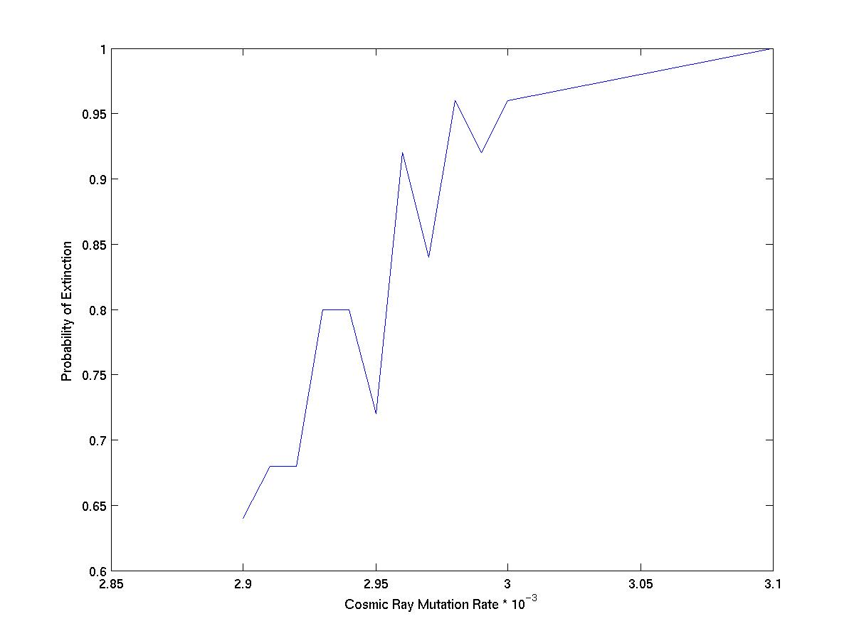
Cosmic-point Mutation

Slide 9
Insertion and Deletion Mutations

Slide 10
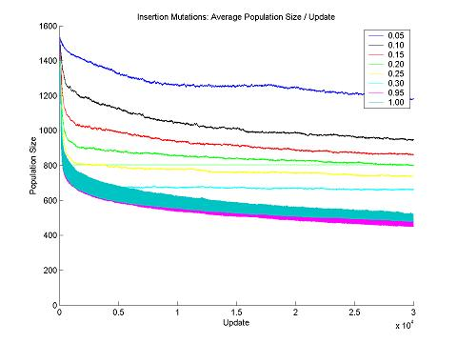

Slide 11
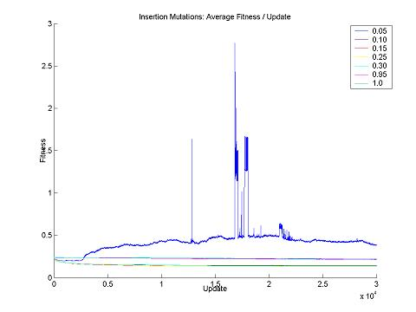

Slide 12
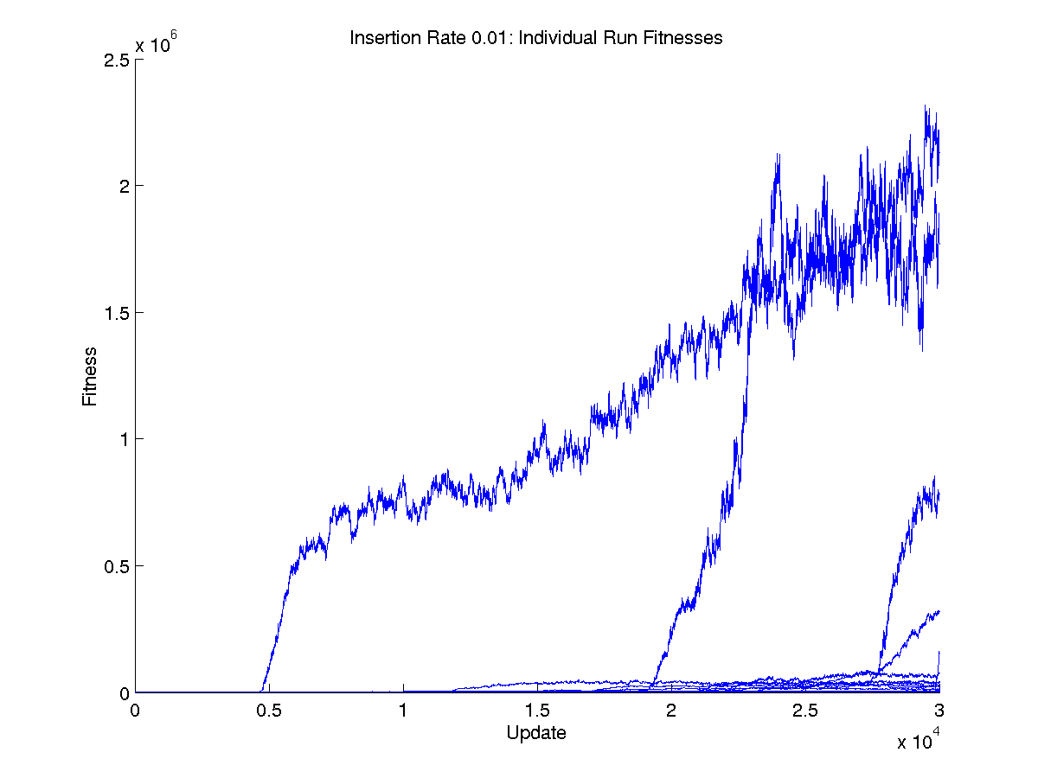

Slide 13
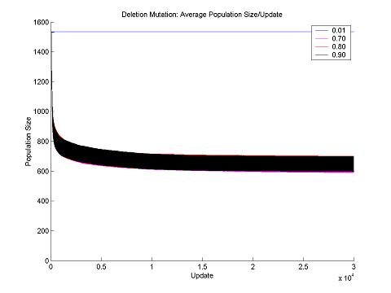

Slide 14
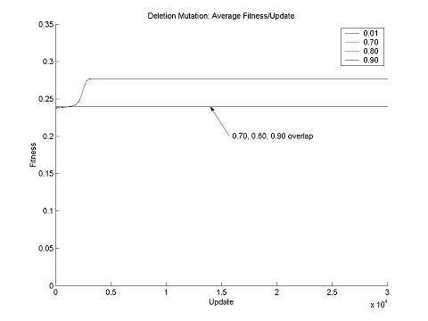

Slide 15
Copy-point Mutation
Copy-point mutation means that every genome site has a chance of mutating on every divide.
Surviving populations would crash to a very small number of organisms (as small as 2)
Populations would begin to recover but tended to have an upper bound.
Some of the trials were sampled and noted that none did any task.
Sampling some of the trials, only one survival method was noted
  Due to the local replacement problem, a viable organism would be immortal or would only be replaced by another viable organism.

Slide 16
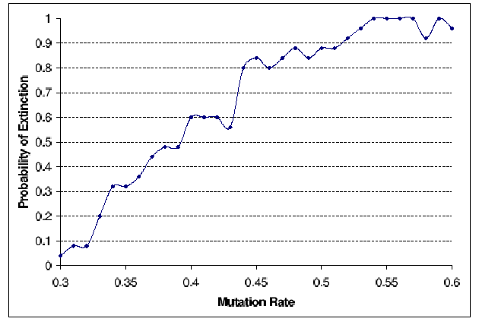
Copy-point mutation rate vs. Probability of Extinction

Slide 17
Other factors?
Determine the affect of genome length and population size on the probability of extinction.
Copy-point mutation rates of 0.3, 0.35, and 0.53 were chosen for contrast based on their P(e) values (high, medium, low)

Slide 18
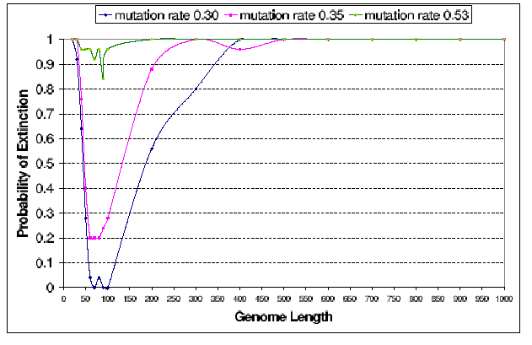
Genome Length vs. Mutation Rate

Slide 19
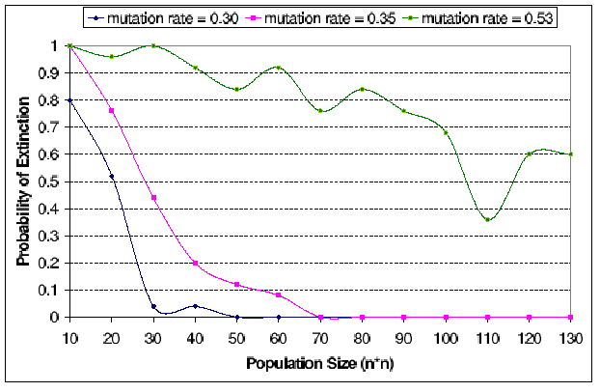
Population Size vs. Mutation Rate

Slide 20
Relationship to common mutation rates
An examination of copy-point mutations at common values
How are dominant fitness and the ability to do tasks affected as mutation rates get larger approaching the high extinction mutation rates?
Only 20 trials were taken for each data point, due to time constraints

Slide 21
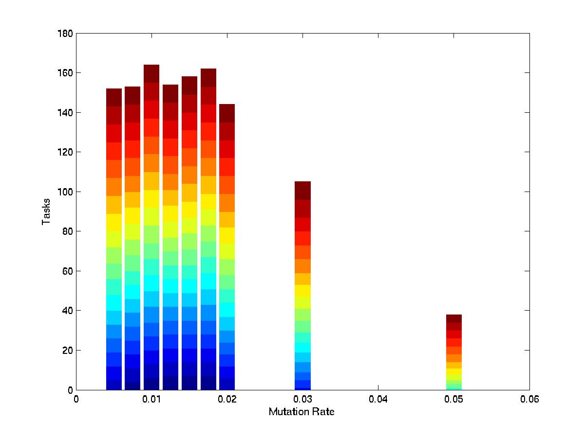
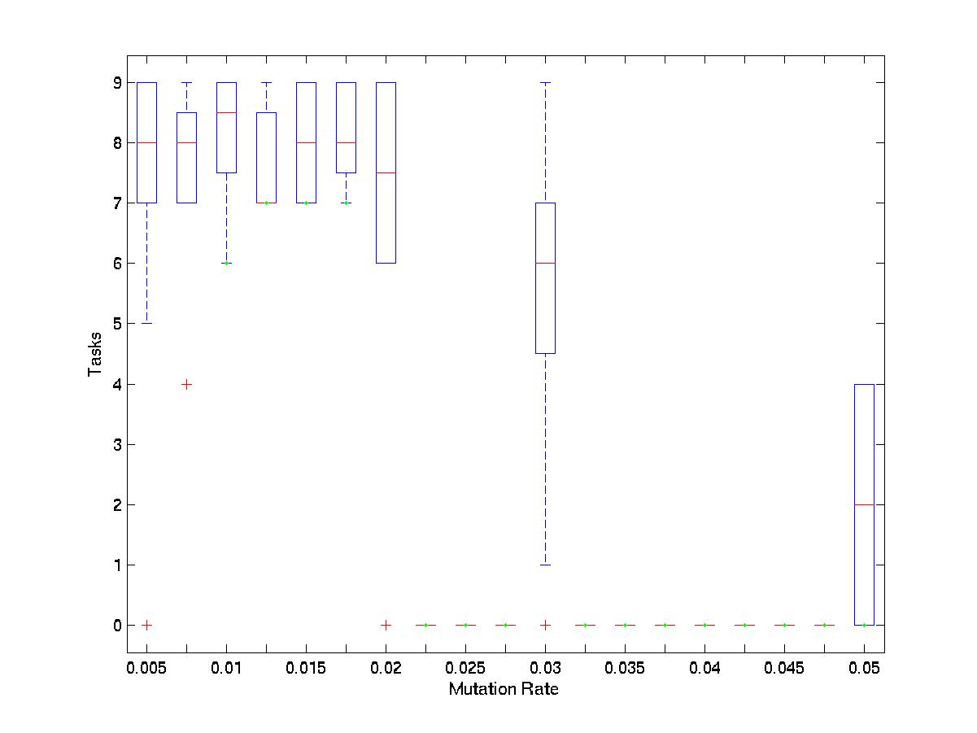
Mutation Rate vs.
Number of Tasks

Slide 22
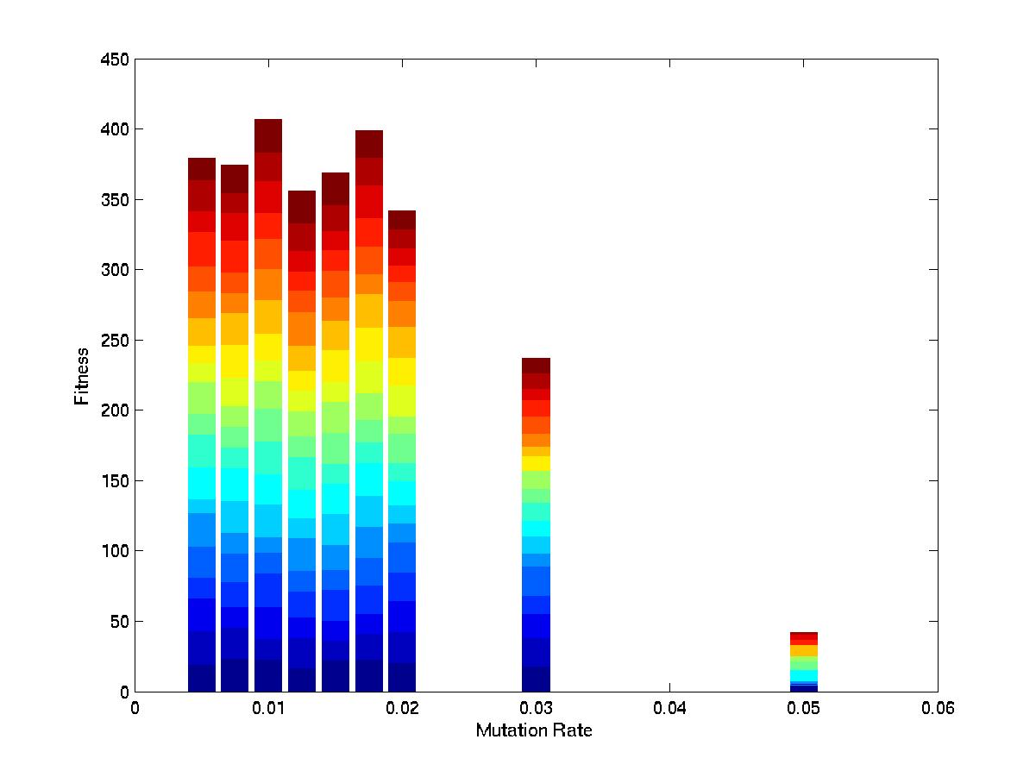
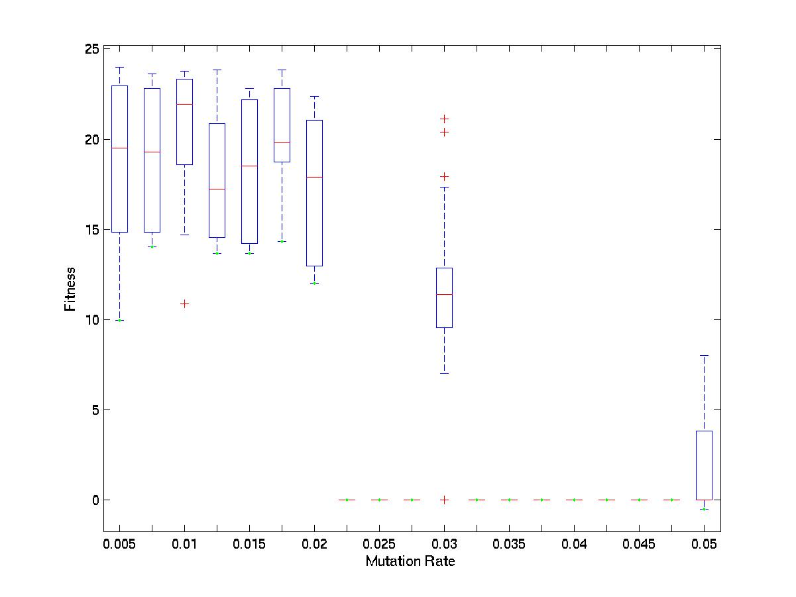
Mutation Rate vs. log Fitness

Slide 23
Conclusions
For copy-point and cosmic-point mutation rates, we observed that there is not a hard boundary but more of a continuum for P(e).
While time did not permit further mapping, we expect that curve is more of sigmoid
  For copy-point mutation rates higher than 0.6, P(e) goes to 1.0 as the mutation rate goes to 1.0
  For copy-point mutation rates lower then 0.3, P(e) goes to 0.0 as the mutation rate goes to zero
Survival may still be high at a copy-point mutation rate of 0.3, but it is still unsuited for evolution purposes
Changing from local replacement birth method to mass action birth method would have changed the entire dynamic that was found.

Slide 24
Conclusions (Cont.)
For insertion and deletion, there was no extinction.
  The size of the resulting populations were affected
  Use of the deletion only scenario would prove useful for code reduction once an end result has been evolved
Genome length and population size did influence P(e) for copy-point mutations.
  There is an optimal genome length where P(e) is minimized for a particular mutation rate.
  Genome length can only make the probability of survival worse.
  On the other hand, larger population sizes increases the survivability of a population

Slide 25
Thank You
Any Questions?

