Slide 1
Submissions
USER
SubmissionMongoAdapter
SubmissionProcessor
FireWorks
COMPUTERS
FireWorks
VASP
SNL

Slide 2
use_test
CODEBASE
DATABASE/settings
production (e.g. prod/codes)
production (e.g prod/config)
PMG FW MPW Cust
FW submit SNL vasp
testing (e.g., test/codes)
testing (e.g. test/config
PMG FW MPW Cust
FW submit SNL vasp
JCESR_testing (e.g., jcesr_test/codes
JCESR testing (e.g. jcesr_test/config)
PMG FW MPW Cust Rub
FW submit SNL mols

Slide 3
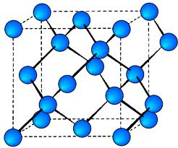
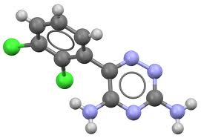
FW 1
or
FW 2
FW 3
FW 4

Slide 4
FireWork 1
Spec: {input}
Write input files (calc 1)
Run code (calc 1)
Move files / DB insertion
Modify input files (calc 2)
Run code (calc 2)
Move files / DB insertion

Slide 5
FireWork 1
Spec: {input}
Write input files (calc 1)
Run code (calc 1)
Move files / DB insertion
FireWork 2
Spec: {input}
Write input files (calc 2)
Run code (calc 2)
Move files / DB insertion

Slide 6
FireWork 1
FireWork 2
Spec: {input}
Spec: {input}
Write input files (calc 1)
Move files / DB insertion
Run code (calc 1)
FireWork 3
FireWork 4
Spec: {input}
Spec: {input}
Write input files (calc 2)
Move files / DB insertion
Run code (calc 2)

