Slide 1

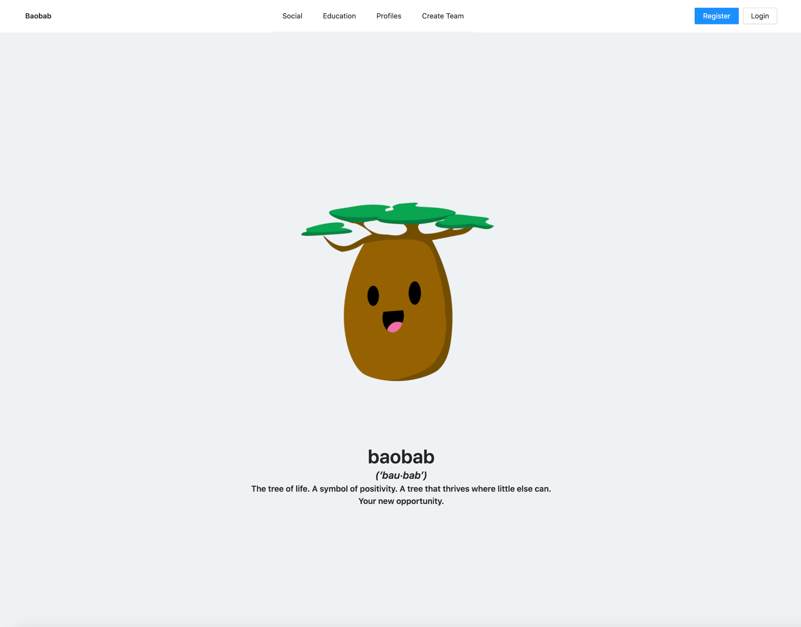
Baobab
A tree that thrives where little else can.

Slide 2
01
Our Product
Baobab

Slide 3
Why Baobab?
Build Your Brand
Learn Valuable Skills
01
02
Customize your own profile to market yourself to your peers.
Learn the skills you need to thrive as an entrepreneur.
Meet New People
All at Once
03
04
Network with other budding entrepreneurs.
Baobab has you covered, from ideation to product release.

Slide 4
Features
Posts
Assignments
Profiles
Network and ask questions
Learn and get feedback
Market yourself, your way

Slide 5
02
Our Team
Fifth Order Ignorant

Slide 6

Maryam
Backend
GitHub
Meetings
Manager
contributed to the backend of the project!
learned TypeScript
reviewed/merged most of the PRs and resolved conflicts
planned and scheduled sprint meetings and standups

Slide 7
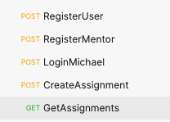
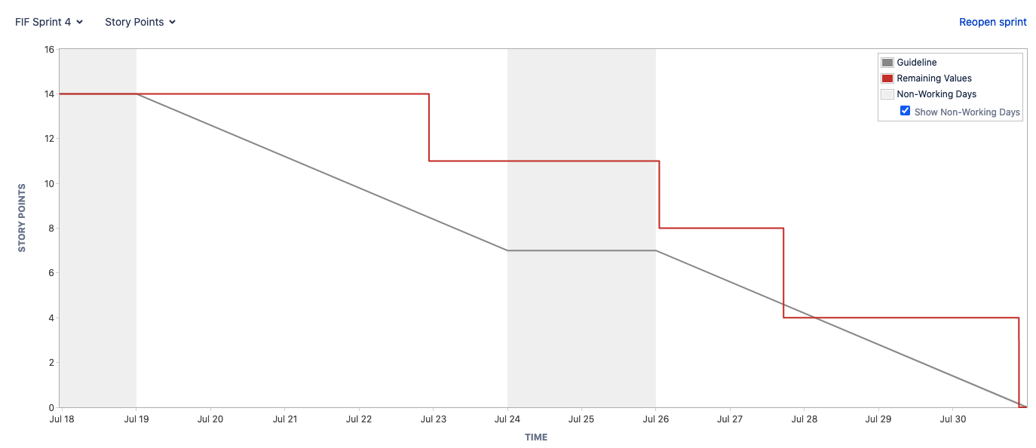
Michael
Backend Developer
Documentation
The Design Person

Slide 8

Akira
Entities, DAOs, etc
Pagination
Sprint Docs
Pastor of Pagination
Worked on the backend for the project!
Learned TypeScript
Created oodles of noodles of pagination APIs
Proofread sprint documents

Slide 9




Jan
Frontend Developer (Sprint 1-4)
Discussion Board UI (post pagination, creating replies, tags)
Individual Profile UI (activity, profile layout)
Assignment UI (View submission pagination)
Backend Developer (Sprint 3 & 4)
Fullstack Developer
Converting in-memory DAOs into MongoDB DAOs
Writing API endpoints for submissions
Notes:
Hi, I’m Jan, and I worked as a full stack developer for Baobab! I have contributed to the discussion, profile, and assignment UIs, and created API endpoints for submissions and helped with integrating MongoDB with the application.

Slide 10

Hai Yang
Authentication
File Uploads
Testing & CI
Created Express middleware which authenticates incoming requests using JWT cookies.
Implemented saving user uploaded files locally and eventually on a MongoDB server.
Set up ESLint, Jest, and GitHub Actions to maintain code quality.

Slide 11
Catherine
Frontend Developer
Editing Profile UI (editing names, bio, job)
New Role Request UI
Admin’s Role Promotion UI
Assignment Creation UI (includes file upload)
Assignment Feedback UI (marks and feedback)
Fifth order ignorant?
More like backend ignorant.
PR reviewing
Reviewed front end PRs

Slide 12
Ethan Lam
Full Stack
Ethan Lam
MongoDB
Presentations
Ethan Lam
Worked on the frontend pagination pages
Worked on the backend APIs
Ethan Lam
Helped transition from in-memory to MongoDB
Yeah, I code and talk

Slide 13
Live Demo

Slide 14
03
Our Process
Try, Learn, Try again

Slide 15
Team Communication
Discord
Standups
Google Docs
We used a Discord server to communicate asynchronously
(and send memes)
We regularly discussed our progress
We used a shared drive to keep track of all our meetings and notes

Slide 16
Processes and Standards
Sprint Planning
PRs
Communication
We met before each sprint to set expectations and roadmap the sprint
All code had to be tested and reviewed by someone else before merging
We received input from the product owners and discussed expectations
We did not discuss design thoroughly when planning features
PRs would sometimes remain unmerged for days
We were not able to include every feature that was requested

Slide 17
Techniques
Testing
Linting
Workspaces
We used Jest to set up endpoint testing and used CI/CD to test our code on every push
We set up a linter so that all of our code followed industry style standards
We used NPM workspaces to modularize our code,
so we wouldn’t create unintentional dependencies

Slide 18
04
Our Software
The Nitty Gritty
Notes:
Okay so now let’s talk about the software.

Slide 19







Technologies
TypeScript
Next.js
redis
MongoDB
Figma
React.js
Swagger
Storybook
Nest.js
Ant Design
...and more
Notes:
We used lots of technologies. For the frontend we use React and Ant Design. For the backend we use TypeScript and Nest.js. We use redis for in memory storage and MongoDB for the database. And also we also use Storybook for frontend documentation and Swagger for the backend documentation.

Slide 20
Three Tiered Architecture
Users
Presentation Layer
Next.js
React
AntUI
Logic Layer
Nest.js
TypeScript
Data Layer
MongoDB
Notes:
And this fits under the Three Tiered Architecture. Our users interact with the presentation layer. The presentation layer makes API Requests to the logic layer and the logic layer uses the Data Access Object design pattern to write the changes to MongoDB.

Slide 21
Example Request
Suppose a user wants to make a Post...
Users
Presentation Layer
Next.js
React
AntUI
Logic Layer
Nest.js
TypeScript
Data Layer
MongoDB
Click a button
API Request
Update database through DAO
Notes:
For example, suppose a user is making a post in the discussion board. The user will fill in the post information, and wil click on a button to publish the post. When this button is clicked, the presentation layer will make an API Request to add a post. This API request is handled by the logic layer, where the Data Access Object writes a query to update the database.
Updates to Database through DAO

Slide 22
Technical Challenges
Merge Conflicts
API Guards
01
02
In rare scenarios, resolving merge conflicts introduced bugs.
API guards were particularly complex as they needed to be applied in a certain order.
Inconsistency
Learning
03
04
After implementing backend APIs, we realized frontend needed a different implementation.
Members had to learn tons of new technologies for this project.

Slide 23
Questions?

