Slide 1
IBRD Loan DATA Kyoosik Kim
Data Analysis and Prediction Model
Using Python

Slide 2
Loan cancellations cause cost time and money. Predicting loans with high chance of cancellation would be helpful for management.

Slide 3
Contents
Intro (dataset): Description, Size, How to Get it
Data Cleansing: Column, Row, Null Value
Data Exploration: Stat, Histogram, Scatterplot
Independent Variable: Query, Filtering Observations
New Variables: Extract Numbers, Reduce Categories
Analysis and Feature Selection: Mann-Whitney, Barplot
Predictive Models: Balancing Classes, Machine Learning
Conclusion and References

Slide 4
Dataset IBRD
International Bank for Reconstruction and Development
Formed in 1944 for rebuilding Europe after WW II
Provides financial services like loans
Low-income countries as beneficiary
About the Dataset
Source: World Bank
Size: 749,693 cases as of 10/31/2018

Slide 5
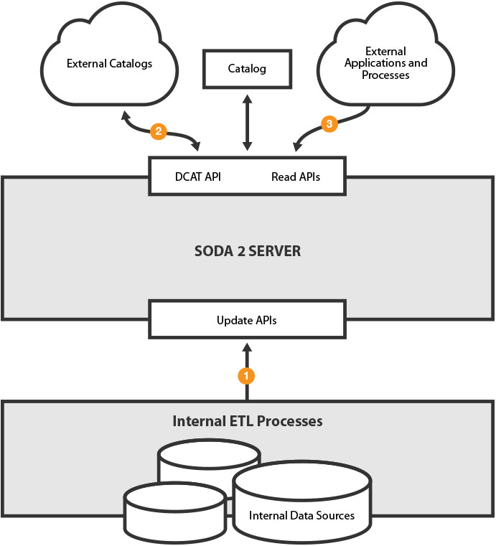
How to Obtain IBRD Dataset
World Bank Finance
Download in CSV or other formats
Socrata API
Open data service
Query available
Useful for applications
Just need dataset code

Slide 6
1.
Data Cleansing
Meaningless Columns
Rows with Null Values
Type Conversion

Slide 7
Columns Not Applicable to the Goal
“Repaid to XXX” : Only for repaid loans
“Cancelled XXX” : Only for cancelled loans
Columns with Meaningless Information
“XXX ID” : Numbers to identify cases
Some columns are empty or have a single identical value

Slide 8
Starting with 326,674 rows by querying loans closed after 1980 to investigate modern trends
Rows with Null Values
Luckily a small portion of null values
Unluckily difficult to fill them
Column (order of examination) | Imputation
Project Name | Drop 20,279 rows due to difficulty in filling
Agreement Signing Date | Drop 1,721 rows due to difficulty in filling
Interest Rate | Fill with mean value by country

Slide 9
Convert data type for analysis
“Data always come in undesirable type”
Date → datetime
Columns with only a few values → category
Independent Variable (loan status) → int
Loan Status → 0: Repaid 1: Cancelled for convenience

Slide 10
2.
Data Exploration
Basic Statistics
Histogram
Scatterplot

Slide 11
Numerical Variables
Column | Mean | Std | Median
Interest Rate (%) | 5.98 | 2.79 | 6.18
Loan Status | 0.04 | 0.17 | 0.00
Original Principal Amount ($) | 62,000,000 | 111,163,100 | 29,000,000
Days for Signing | 116.17 | 279.16 | 38.00
Days for Repayment | 4304.07 | 1443.21 | 4202.00
The mean of loan status = cancellation rate

Slide 12
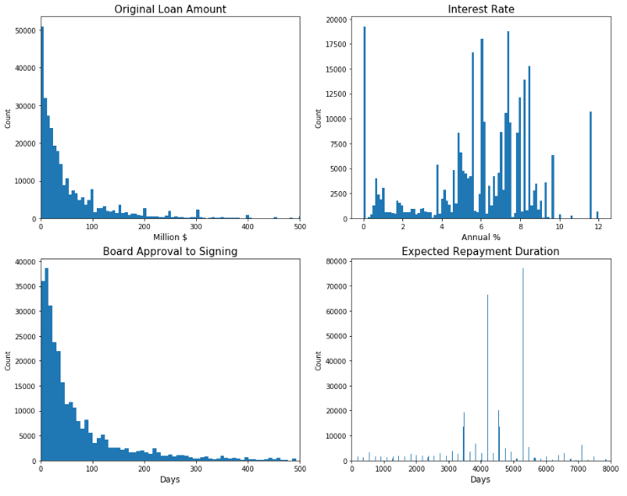
Transformation might be considered for linear-based models

Slide 13
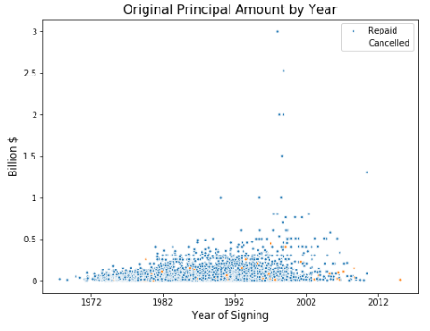
Some outliers to be deleted
Cancelled loans seem to be randomly scattered
Thus seasonality issues can be ignored

Slide 14
Categorical Variables
Column | Unique | Top | Frequency
Borrower | 713 | Ministry of Finance | 39100
Country | 109 | Indonesia | 29880
Loan Type | 8 | Pool Loan | 140768
Project Name | 2849 | Education II | 1796
Region | 6 | Latin America and Caribbean | 48158
Country should not be used as the focus is to find a general trend not limited to a certain country
Project name and Borrower have too many values

Slide 15
3.
Independent
Variable
Fact Check
Rows of Interest

Slide 16
Top 5 Borrowers (billion $)
Mexico (1610.01)
Brazil (1609.47)
Indonesia (1576.86)
India (1257.13)
Turkey (856.75)
Top 5 Cancellation (rate %)
Yugoslavia (66.67)
Uzbekistan (53.85)
Sudan (50.00)
Sri Lanka (25.10)
Dominica (24.32)
Countries that never cancelled any loan
Bahamas, Belarus, Congo, Croatia, Honduras, Liberia, Montenegro, Senegal, Trinidad and Tobago, and many others
Countries with high cancellation rates went through hard time
There seems no particular relationship between country and cancellation overall
100% repaying countries tend to have borrowed less times

Slide 17
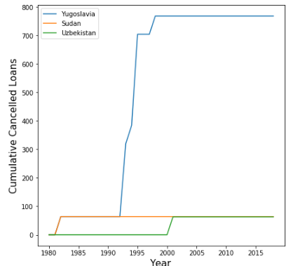
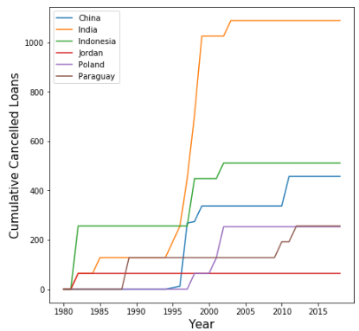
What year did they cancel loans?
Flat line means
zero cancelled
Not always but only when they had economic recessions

Slide 18
Example: Mexico suffered a recession in 2008
Data | Year
{column 1, column 2, …} | 2008
{column 1, column 2, …} | 2009
{column 1, column 2, …} | 2008
{column 1, column 2, …} | 2010
{column 1, column 2, …} | 2008
… | …
Data | Year
{column 1, column 2, …} | 2008
{column 1, column 2, …} | 2008
{column 1, column 2, …} | 2008
… | …
Dataset reduced down to 41,614 rows

Slide 19
4.
New Variables
Extract Numbers
Reduce Categories

Slide 20
Extract information from dates
Days taken for signing (int)
“Agreement for Signing” - “Board Approval Date”
Days for repayment on contract (int)
“Last Repayment Date” – “First Repayment Date”
→ Cancelled loans still have both dates

Slide 21
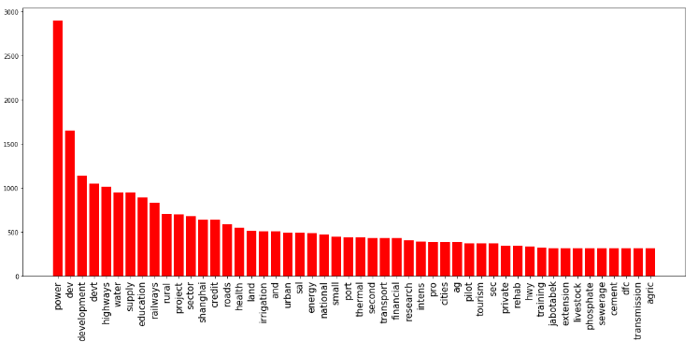
fuzzywuzzy for words similarity
Now 453 different project names reduced to 15 sectors
→ Example: “power” : [“pw”, “power”, “gas”, “oil”, “petroleum”, …]

Slide 22
5.
Analysis and Feature Selection
Mann-Whitney U Test
Category Barplot

Slide 23
Mann-Whitney U Test
Similar with T test but with no normality
H₀ : The two data are from the same distributions
→ Trying to reject this
Numerical features to be tested in two groups
→ Repaid vs. Cancelled
If p-value is not significant, the feature does nothing to divide loans into Repaid and Cancelled

Slide 24
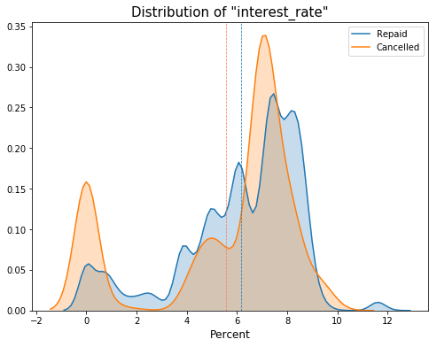
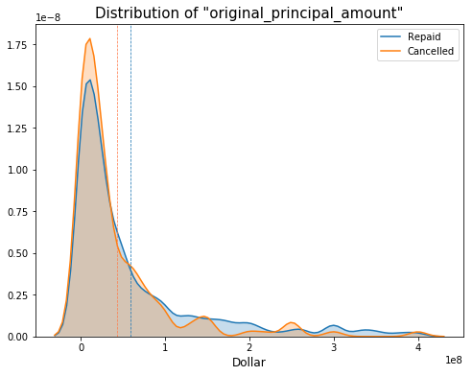
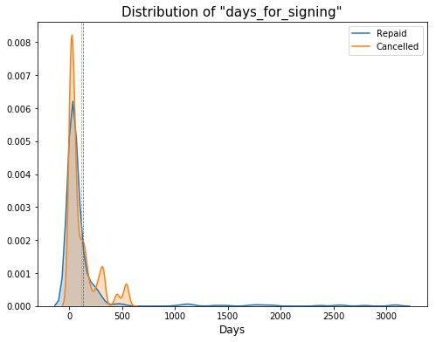
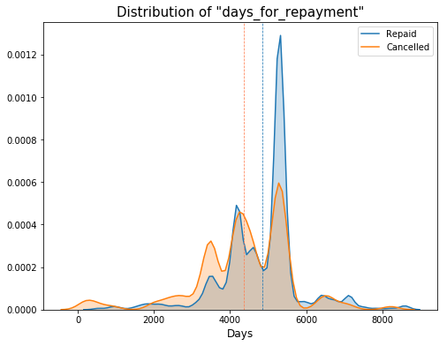
P-value of all < 0.05
→ Useful for classifying

Slide 25
Numerical Features Analysis
Feature | P-Value | Repaid (mean/med) | Cancelled (mean/med)
Interest Rate (%) | 0.00 | 6.17 / 6.90 | 5.55 / 6.93
Interest Rate (0% removed) | 0.00 | 6.42 / 7.00 | 6.85 / 7.07
Original Principal Amount (mil $) | 0.00 | 59.23 / 25.00 | 42.76 / 20.00
Days for Signing (days) | 0.00 | 126.25 / 36.00 | 109.08 / 45.00
Days for Repayment (days) | 0.00 | 4851.94 / 5294.00 | 4369.11 / 4564.00
0% loans removed : Interest rates of cancelled loans are higher than repaid loans → cancelling higher rates first
Bigger amount less cancelled : The bigger amount is the project would be enough not to stop
Longer days to signing : Problems already in the beginning
Shorter days for repayment : Smaller projects correlated with loan amount

Slide 26
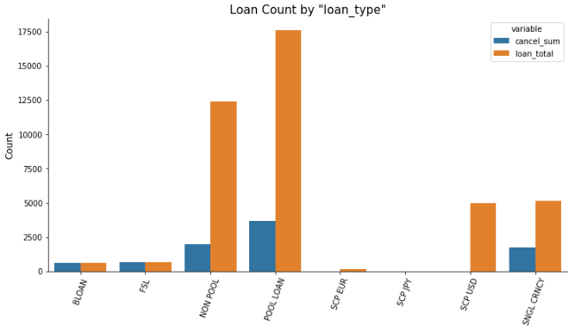
Categorical Features Analysis: Loan Type
100 | 100 | 15.97 | 21.08 | 0.00 |  | 0.00 | 34.48 | Cancelled (%)
B-loan : Co-financing that participants share risks (less responsibility)
FSL : Based on spread that could be variable with exchange rate

Slide 27
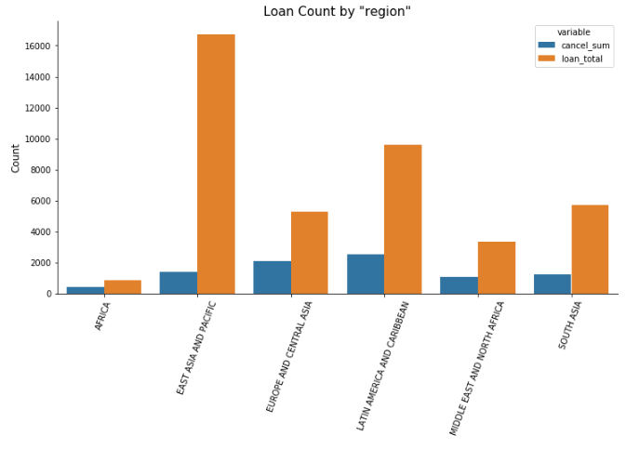
Categorical Features Analysis: Region
50.06 | 8.45 | 39.58 | 26.40 | 32.22 | 21.45 | Cancelled (%)
Africa : Weak economic backgrounds
Europe and Central Asia : The Soviet Union collapse

Slide 28
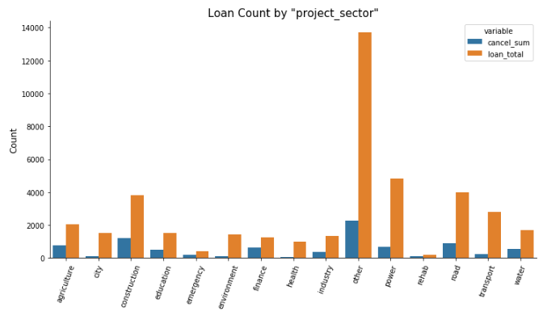
Categorical Features Analysis: Project Sector
 | 8.44 | 47.99 |  | 6.43 | 16.66 | 58.52 | 32.94 | Cancelled (%)

Slide 29
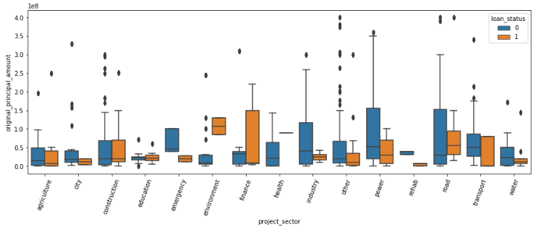
Can these work together for classification?
The goal is to classify Repaid and Cancelled
→ Example: Emergency projects are perfectly dividable
with help of original principal amount”

Slide 30
6.
Predictive Models
Balancing Classes
Naïve Bayes
Decision Tree
Support Vector Machine
Gradient Boosting

Slide 31
Features (X) and Classes (y)
Numerical
Interest Rate
Original Principal Amount
Days for Signing
Days for Repayment
Categorical
Loan Type
Region
Project Sector
Total: 41,614
Repaid: 32,817
Cancelled: 8,797
Balanced Training Set: 14,074
Repaid/Cancelled: 7,037
Balanced Validation Set: 3,520
Repaid/Cancelled: 1,760
Repaid and Cancelled are 50 : 50
in balanced sets

Slide 32
Baseline Model: Naïve Bayes
Cross Validation Accuracy: 0.54 (+/- 0.01)
Confusion Matrix
Precision/Recall/F1-score
Class | Predict Repaid | Predict Cancelled
Repaid | 338 | 1422
Cancelled | 217 | 1543
Class | Precision | Recall | F1-Score | Support
Repaid | 0.61 | 0.19 | 0.29 | 1760
Cancelled | 0.52 | 0.88 | 0.65 | 1760
Average | 0.56 | 0.53 | 0.47 | 3520

Slide 33
Candidate Model: Decision Tree
Cross Validation Accuracy: 1.00 (+/- 0.00)
Confusion Matrix
Precision/Recall/F1-score
Class | Predict Repaid | Predict Cancelled
Repaid | 1757 | 3
Cancelled | 0 | 1760
Class | Precision | Recall | F1-Score | Support
Repaid | 1.00 | 1.00 | 1.00 | 1760
Cancelled | 1.00 | 1.00 | 1.00 | 1760
Average | 1.00 | 1.00 | 1.00 | 3520

Slide 34
Candidate Model: SVC
Cross Validation Accuracy: 1.00 (+/- 0.00)
Confusion Matrix
Precision/Recall/F1-score
Class | Predict Repaid | Predict Cancelled
Repaid | 1760 | 0
Cancelled | 0 | 1760
Class | Precision | Recall | F1-Score | Support
Repaid | 1.00 | 1.00 | 1.00 | 1760
Cancelled | 1.00 | 1.00 | 1.00 | 1760
Average | 1.00 | 1.00 | 1.00 | 3520

Slide 35
Candidate Model: Gradient Boosting
Cross Validation Accuracy: 0.96 (+/- 0.02)
Confusion Matrix
Precision/Recall/F1-score
Class | Predict Repaid | Predict Cancelled
Repaid | 1643 | 117
Cancelled | 46 | 1714
Class | Precision | Recall | F1-Score | Support
Repaid | 0.97 | 0.93 | 0.95 | 1760
Cancelled | 0.94 | 0.97 | 0.95 | 1760
Average | 0.95 | 0.95 | 0.95 | 3520

Slide 36
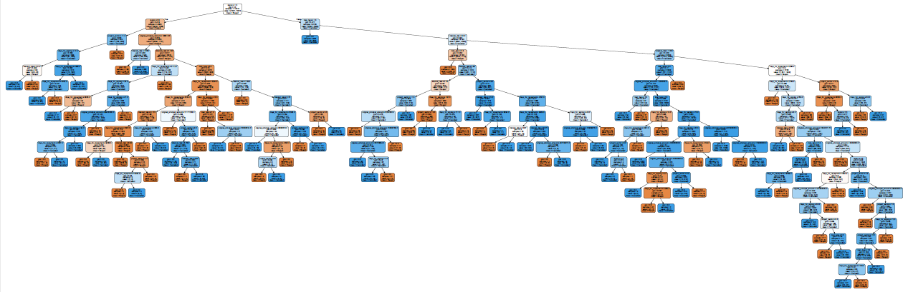
Model Selection: Occam’s Razor
Decision tree above might look complicated but still can be drawn while it’s not quite possible for the others to be visualized
Simply just track down the branches for classification

Slide 37
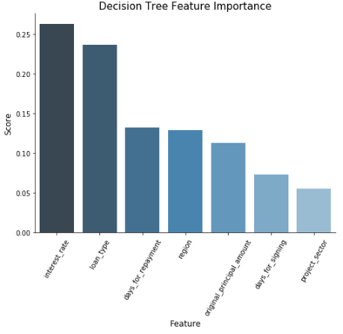
Decision Tree Feature Importance
Top 2 Features
Accuracy 0.89
F1-score 0.88
But that 0.11 is what makes it perfect!
The rest of five still pay off for efforts

Slide 38
Conclusion
Individual features are not as strong but strongest when put together
Interest rate is the best feature but does not perform alone
Major features do the most of the jobs but minor features complete predictions
Complicated models are not always better
Gradient boosting is considered more sophisticated but decision tree works better
The simpler the better for the same performance

Slide 39
References and Contact
Dataset: World Bank “IBRD”
Data Science Techniques
Elite Data Science: “How to Handle Imbalanced Classes”
Analytics Vidhya: “7 Important Model Evaluation Error Metrics”
Machine Learning Mastery: “Introduction to Nonparametric Statistical Significance Tests”
Python Syntax
Sodapy, Sklearn (Decision Tree/SVM/ Gradient Boosting), Fuzzywuzzy
Contact: qshickkim@gmail.com

