Slide 1

IoT Device to Detect Anemia
Project ID: 19-129
Members:
M.H.M.Akmal
M.Pravienth
N.Kayanthan
H.S.M.H.Fernando
Supervisor:
Ms. Shashika Lokuliyana

Slide 2
What is Anemia?
Anemia is disease caused by lower iron(Fe) levels in the body
Iron is the main factor to produce hemoglobin in red blood cells(oxygen level reduces)
This disease is mainly caused by;
1. Blood loss
2. Low production of RBC or over destruction of RBC
3. Hereditary

Slide 3
Research Problem
Anemia is not detected an early stage
Lack of portable devices for anemia detection
The World Health Organization has ranked iron-deficiency anemia as the third leading cause of disability adjusted life years lost for females from 15 to 44 years of age.
Blood is extracted for testing

Slide 4
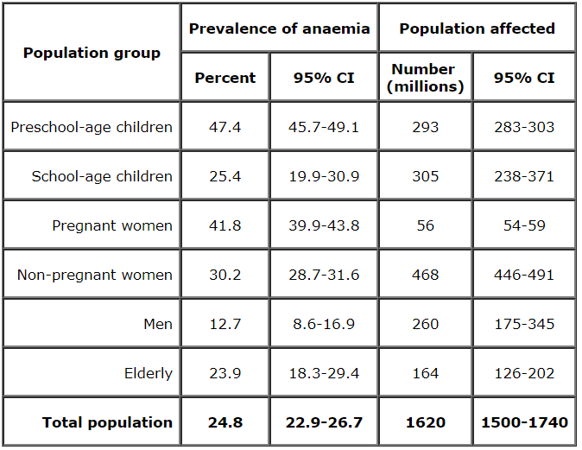
Statistics of Anemia infected Patients
Source: World Health Organization, 2008

Slide 5



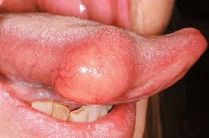
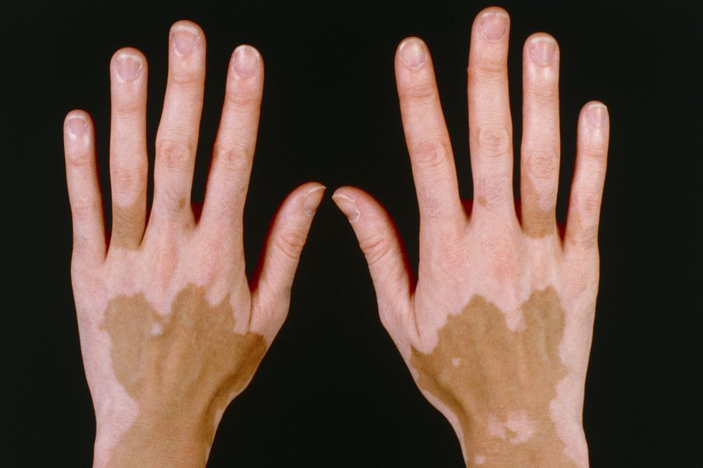
Disease Symptoms Examples
Dizziness
Fatigue
Leg Cramps
Swollen Tongue
Pale Skin

Slide 6
Objective
The main objective of this research is to detect anemia at early stage and increase the accuracy of detection.
Implementation of the product as a business product

Slide 7
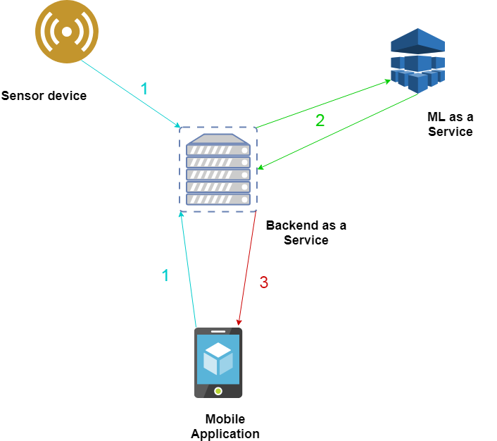
Research Solution
Developing a portable device with anemia detection capabilities

Slide 8
Related Devices Developed
 | Anemia detection Device by Jaime Punter(2015) | Anemia detection device by De Benoist B(2013) | Research product
Portability | ✓ | ✓ | ✓
Non Invasive method | × | ✓ | ✓
Number of symptoms accessed | Blood Test | Hb measurement | Based on 5 - 10 symptoms and image of fingertip
Mobile Application | × | × | ✓
IoT implementation | × | × | ✓
Products
Features

Slide 9
Future Benefits
The device can be modified to detect hemoglobin in the blood which would be a vital factor in detecting many diseases.

Slide 10
Scope of work
The project can be divided into 4 major components;
Compilation of hardware
Development of image processing
Building mobile application with IoT connectivity
Data processing and server configuration

Slide 11
Business Scope
According to statistics of UN and Sri Lankan Health authorities there are plenty of anemia infected patients so there exists a profitable market for this type of product.
We can provide this product at hospitals at a reasonable cost

Slide 12
Thank You!!
☺

