Slide 1
xHealth
01
What is xHealth ?
02
(in a nutshell)
Who are the main users?
A simplified introduction to the project xHealth and it’s functionality
03
How is the project implemented ?
View Slides

Slide 2
What is xHealth?
Is a software for the medical section
It helps doctors more than patients
Help enhances our life quality and reduce time for diagnoses

Slide 3

Who are the main users?
System admins
Doctors
patients
Fig 1.0
The persons in Fig 1.0 are main system users

Slide 4
(a programming language that reads more like English)
Same Pervious code but in High-Level Language
a high-level programming language
Print(“Hello, World!”)
Examples
We will learn programming by coding in an easy-to-read programming language called python
Java
Python
C & C++

Slide 5
What is Python
Python is one of the most popular and easiest to learn programming languages
It is used in everything from building web servers to creating desktop applications
It is interpreted

Slide 6
Compiler vs Interpreter
Compiling code is faster than interpreting it
Compilation is translation from-(easy-to-read) -source language to target language
Interpreting is another common kind of language processor
Interpreter directly executes the operations line by line
Interpreter gives better error diagnostics than a compiler

Slide 7
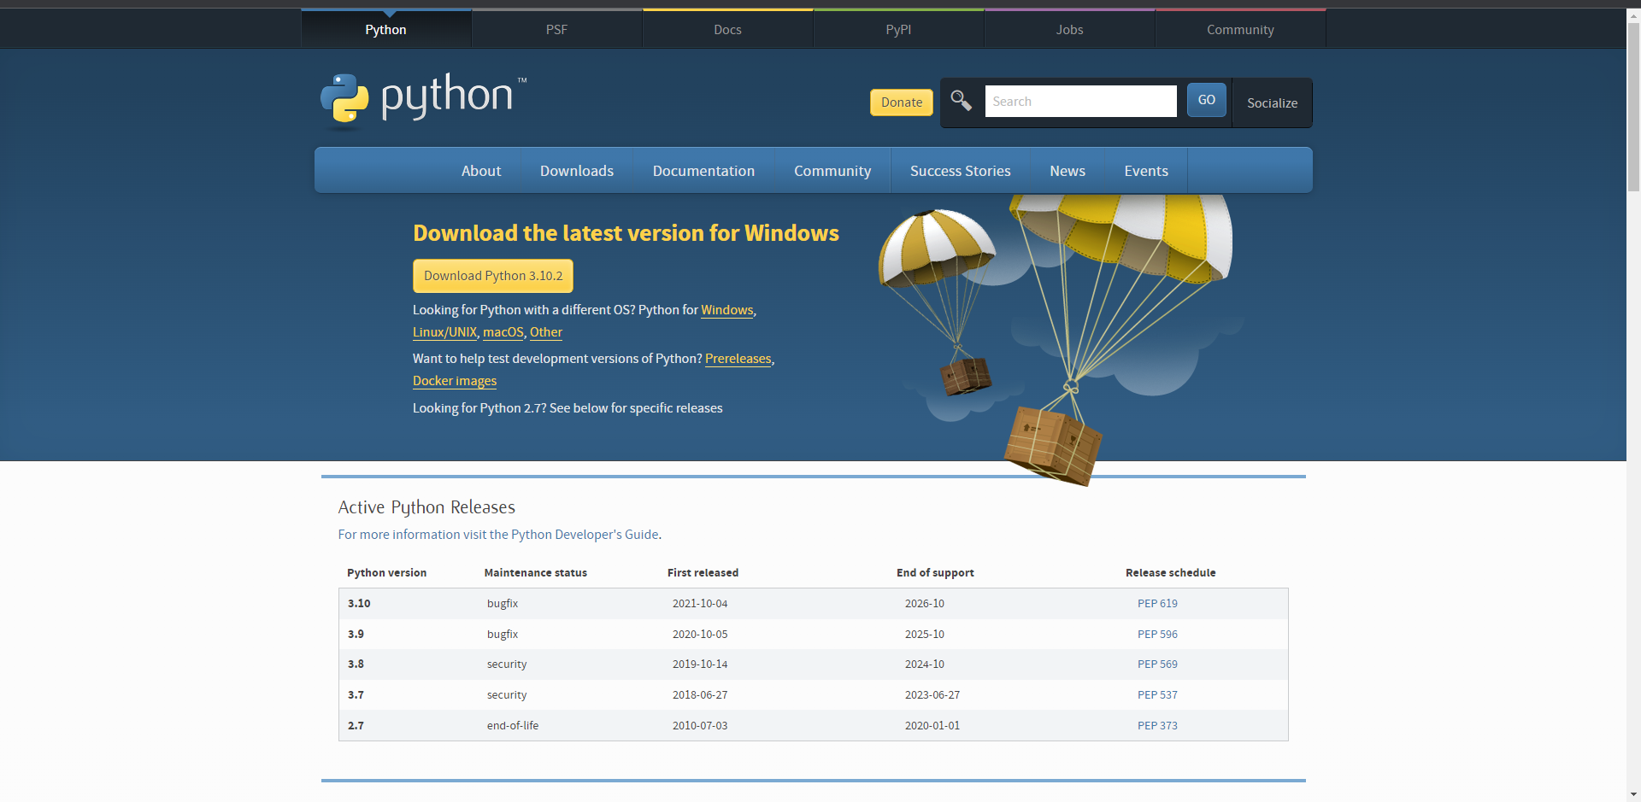
Installing Python
download Python for Windows and OS X at http://python.org/downloads .
If you are on Ubuntu Python comes installed by default
Click on Download as
Shown in Fig 1.1
Fig 1.1

Slide 8
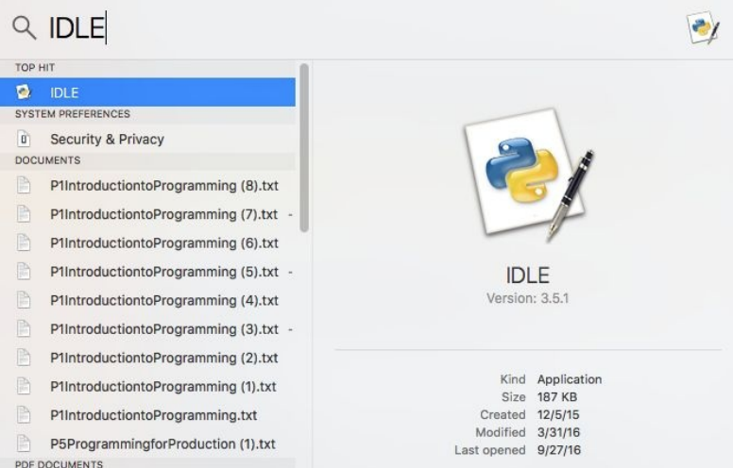
The Interactive Shell
Python comes with a program called IDLE
Shorthand for interactive development environment
search for IDLE in Explorer to open it as in fig 1.2
Fig 1.2

Slide 9
Data types in Python
data in Python are grouped into different categories (data types)
each value in python is called an object for example “Hello, World”
Objects with a data type NoneType always have the value None

Slide 10
Comments in Python
Comments in python are made with:
# this is a code to help teammates
You can also comment multiple lines using the following but it’s not a best practice so avoid using it
“””
this is a code
to help
teammates
“””

Slide 11
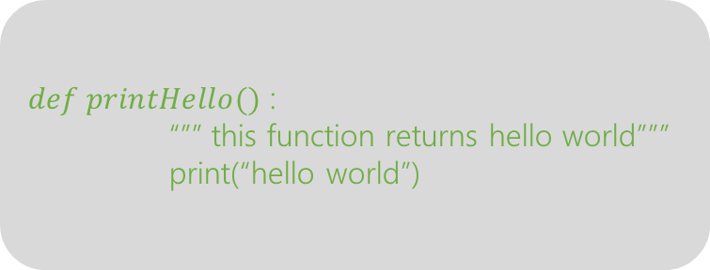
Documenting in Python
Documenting your code is very essential thing so others know what this code is intended to do and what is the expected output
$def printHello()$ :
“”” this function returns hello world”””
print(“hello world”)

Slide 12
01
Text type : str
06
Boolean type : bool
Numerical types : int, complex, float
02
07
Binary Types : bytes,
Bytearray, memoryview
03
Sequence types : list, tuple. range
04
Pre-Built data types in python
mapping types : dicit
05
set types : set, frozenset
Variables can store data of different types, and different types can do different things
x = 10
print(x)
print(type(x))

Slide 13
Operators in Python
Arithmetic operators
Assignment operators
Comparison operators
Bitwise operators
Logical operators
Identity operators
Membership operators
Operators are used to perform operations on variables and values

Slide 14
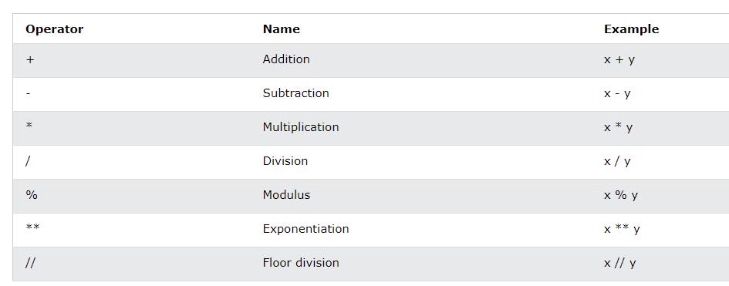
Arithmetic Operators
are used with numeric values to perform common mathematical operations

Slide 15
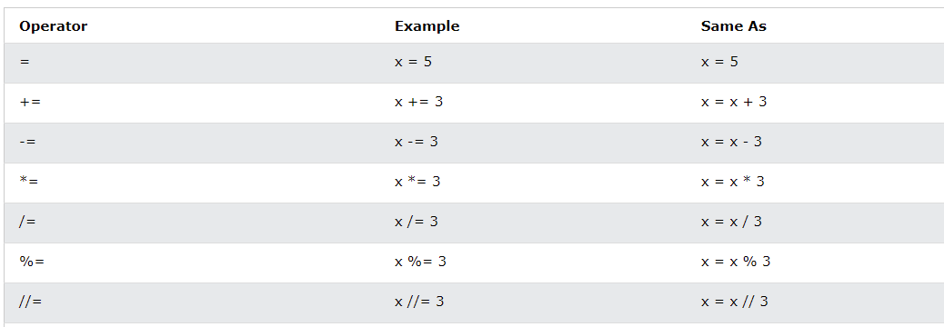
Assignment Operators
are used to assign values to variable

Slide 16
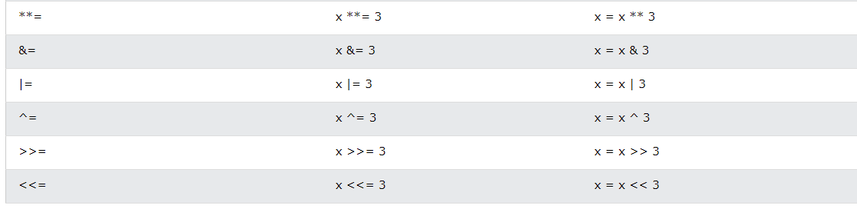
Assignment Operators (cont.)

Slide 17
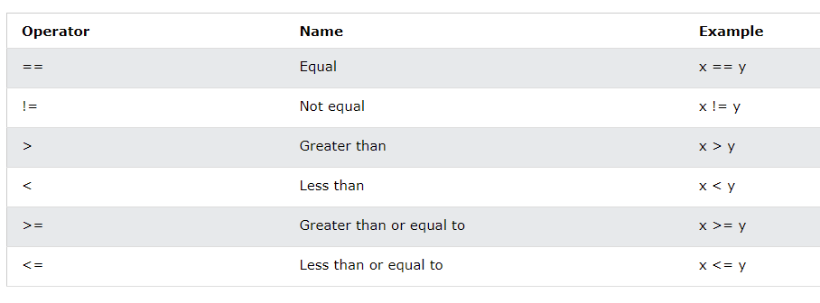
Comparison Operators
are used compare two values

Slide 18
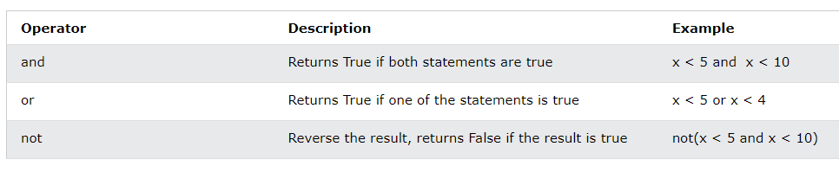
Logical Operators
are used combine conditional statements

Slide 19
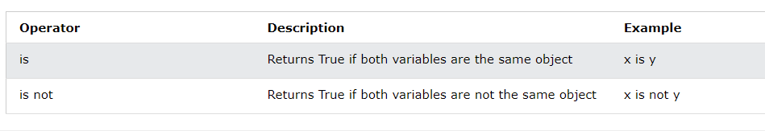
Identity Operators
are used to compare the objects, not if they are equal, but if they are the same object, with the same memory location

Slide 20
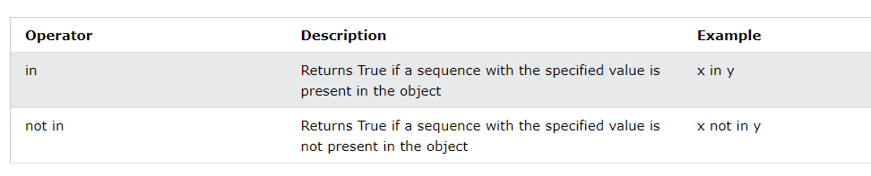
Membership Operators
are used to test if a sequence is presented in an object

Slide 21
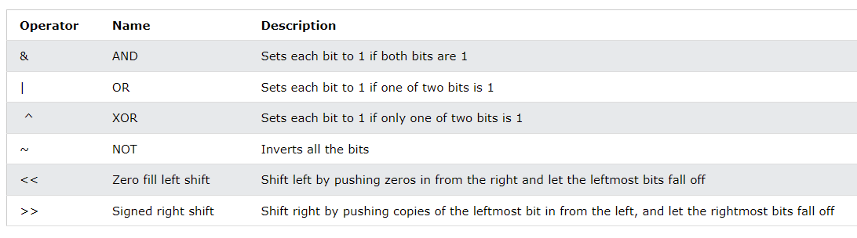
Bitwise Operators
are used to compare (binary) numbers
Exclusive or means one of them but not both

Slide 22
Python Lists & arrays
Lists in python are just dynamic-sized arrays in other languages
Lists in python are non-homogenous so they can have different datatypes
Lists in python are mutable
There are prebuilt functions on lists
Are indexed

Slide 23
Python tuples
is a collection which is ordered and unchangeable
Allow duplicate values
Are indexed
There are prebuilt functions on tuples

Slide 24
Python sets
is a collection which is unordered, unchangeable, and unindexed
Don’t allow duplicate values
Not indexed
There are prebuilt functions on sets

Slide 25
Python dictionaries
is a collection which is ordered and changeable
Don’t allow duplicate values
items are presented in key:value pairs
There are prebuilt functions on dicits

Slide 26
Syntax
If (condition) :
…..
Elif condtion:
….
Else:
….
Python If .. Else
Shorthand
If(condition): …..

Slide 27
Syntax
while (condition) :
….. ….
While Loops
Don’t forget to increment or decrement the loop

Slide 28
Syntax
for x in list :
….. ….
For Loops
for x in range() :
….. ….
# the else won’t be
# executed if loop #stopped by a break
else:
…….
Else in For Loop specifies a block of code to be executed when the loop is finished

Slide 29
Syntax
void
def funcName(args):
...
functions
return value
Lambda functions
x = lambda args: expression
x(args)
def funcName(args):
return ..

Slide 30
References
Cory-Althoff-The-Self-Taught-Programmer_-The-Definitive-Guide-to-Programming-Professionally-Self-Taught-Media-2016
https://docs.python.org/3/
https://www.w3schools.com/python/

Slide 31
Thank You !

