Slide 1
1.自定义函数实现直方图均衡化
【例1】使用python语言自定义函数来实现直方图均衡化。程序代码如下：
import cv2
import numpy as np
import matplotlib.pyplot as plt
def Origin_histogram(img):
# 建立原始图像各灰度级的灰度值与像素个数对应表
histogram = {}
for i in range(img.shape[0]):
for j in range(img.shape[1]):
    k = img[i][j]
    if k in histogram:
    histogram[k] += 1
    else:
    histogram[k]=1
    sorted_histogram={ }
    # 建立排好序的映射表
    # 根据灰度值进行从低至高的排序
sorted_list = sorted(histogram)
for j in range(len(sorted_list)):
sorted_histogram[sorted_list[j]] = histogram[sorted_list[j]]
return sorted_histogram

Slide 2
def equalization_histogram(histogram, img): #直方图均衡化
pr = {} # 建立概率分布映射表
for i in histogram.keys():
pr[i] = histogram[i] / (img.shape[0] * img.shape[1])
tmp = 0
for m in pr.keys():
tmp += pr[m]
pr[m] = max(histogram) * tmp
new_img = np.zeros(shape=(img.shape[0], img.shape[1]), dtype=np.uint8)
for k in range(img.shape[0]):
for l in range(img.shape[1]):
new_img[k][l] = pr[img[k][l]]
return new_img
def GrayHist(img): # 计算灰度直方图
height, width = img.shape[:2]
grayHist = np.zeros([256], np.uint64)
for i in range(height):
for j in range(width):
grayHist[img[i][j]] += 1
return grayHist

Slide 3
if __name__ == '__main__':
img = cv2.imread('pout.tif', cv2.IMREAD_GRAYSCALE)
# 计算图像灰度直方图
origin_histogram = Origin_histogram(img)
# 直方图均衡化
new_img = equalization_histogram(origin_histogram, img)
origin_grayHist = GrayHist(img)
equaliza_grayHist = GrayHist(new_img)
# 绘制灰度直方图
x = np.arange(256)
plt.figure(num=1)
plt.plot(x, origin_grayHist, 'r', linewidth=1, c='blue')
plt.title("Origin"), plt.ylabel("number of pixels")
plt.figure(num=2)
plt.plot(x, equaliza_grayHist, 'r', linewidth=1, c='blue')
plt.title("Equalization"), plt.ylabel("number of pixels")
plt.show()
cv2.imshow("Origin", img)
cv2.imshow("Equalization", new_img)
cv2.waitKey(0)
cv2.destroyAllWindows()

Slide 4
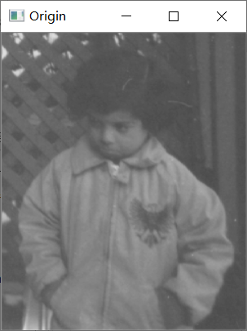
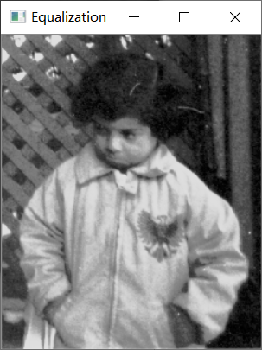
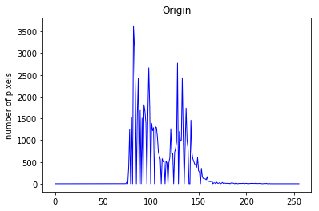
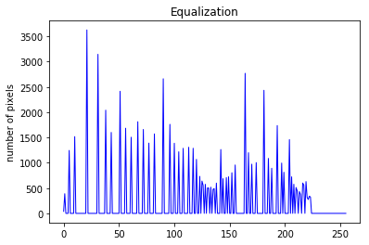
(a)原灰度图
(b)均衡化图像
(c)原图直方图分布
(d)均衡化分布
图1. 图像均衡化运行结果

Slide 5
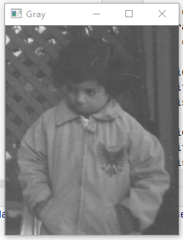
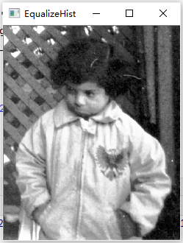
2 使用OpenCV函数实现直方图均衡化
【例2】使用cv2.equalHist()函数来实现直方图均衡化。
import cv2
import matplotlib.pyplot as plt
img = cv2.imread('pout.tif')
img_Gray = cv2.cvtColor(img, cv2.COLOR_BGR2GRAY)
equ = cv2.equalizeHist(img_Gray)
plt.figure("原始灰度直方图")
plt.title('Origin')
plt.hist(img_Gray.ravel(),256)
plt.figure("均衡化直方图")
plt.title('Equalization')
plt.hist(equ.ravel(),256)
plt.show()
cv2.imshow("Gray", img_Gray)
cv2.imshow("EqualizeHist", equ)
cv2.waitKey(0)
cv2.destroyAllWindows()

