Slide 1
Chapter 4
The MAC Sublayer (cont'd) 介质访问控制子层(续)

Slide 2

Classification of Networks
by transmission media传输介质:
Wireless networks / Wired networks
REVIEW

Slide 3






802.11 LAN architecture
Internet
wireless host communicates with base station
base station = access point (AP)
Basic Service Set (BSS) (aka “cell”) in infrastructure mode contains:
wireless hosts
access point (AP): base station
ad hoc mode: hosts only
switch
or router
BSS 1
BSS 2

Slide 4
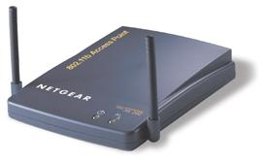
802.11 Topologies Infrastructure Basic Service Set
Access Point
(AP)
Internet
BSS
BSS: Basic Service Set
基本服务集

Slide 5
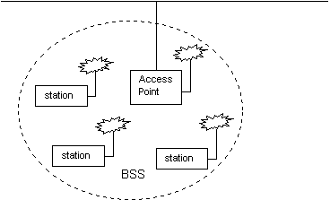
802.11 Topologies Infrastructure Basic Service Set
An Infrastructure Basic Service Set is a BSS with an Access Point (AP).
Infrastructure Basic Service Set

Slide 6
Wired and Wireless, What Difference ?
Ethernet LAN
Wireless LAN
B
A
B
C
A
C
If both A and C sense the channel to be idle at the same time, they send at the same time;
Collision can be detected at sender in Ethernet;
Half-duplex radios in wireless cannot detect collision at sender.

Slide 7
IEEE 802.11 MAC Protocol: CSMA/CA载波监听多点接入/冲突避免
avoid collisions: 2⁺ nodes transmitting at same time
802.11: CSMA – sense(监听) before transmitting
don’t collide with ongoing transmission by other nodes

Slide 8
IEEE 802.11 MAC Protocol: CSMA/CA载波监听多点接入/冲突避免
802.11: no collision detection(没有冲突检测)!
can’t sense all collisions in any case: fading, hidden station
A
B
C
C
A’s signal
strength
C’s signal
strength
B
A
space

Slide 9
IEEE 802.11 MAC Protocol: CSMA/CA载波监听多点接入/冲突避免
802.11: no collision detection(没有冲突检测)!
goal: avoid collisions: CSMA/ C(ollision) A(voidance)
A
B
C
C
A’s signal
strength
C’s signal
strength
B
A
space

Slide 10
Hidden station & exposed station
隐蔽站与暴露站问题
Multiple wireless senders and receivers create additional problems (beyond multiple access):
Hidden station problem
(隐蔽站问题)
B, A hear each other
B, C hear each other
A, C can not hear each other
C
B
A
means A, C unaware of their interference at B

Slide 11
Hidden station & exposed station
隐蔽站与暴露站问题
Signal fading(信号衰减):
B, A hear each other
B, C hear each other
A
B
C
A’s signal
strength
C’s signal
strength
space
A, C can not hear each other interfering at B

Slide 12
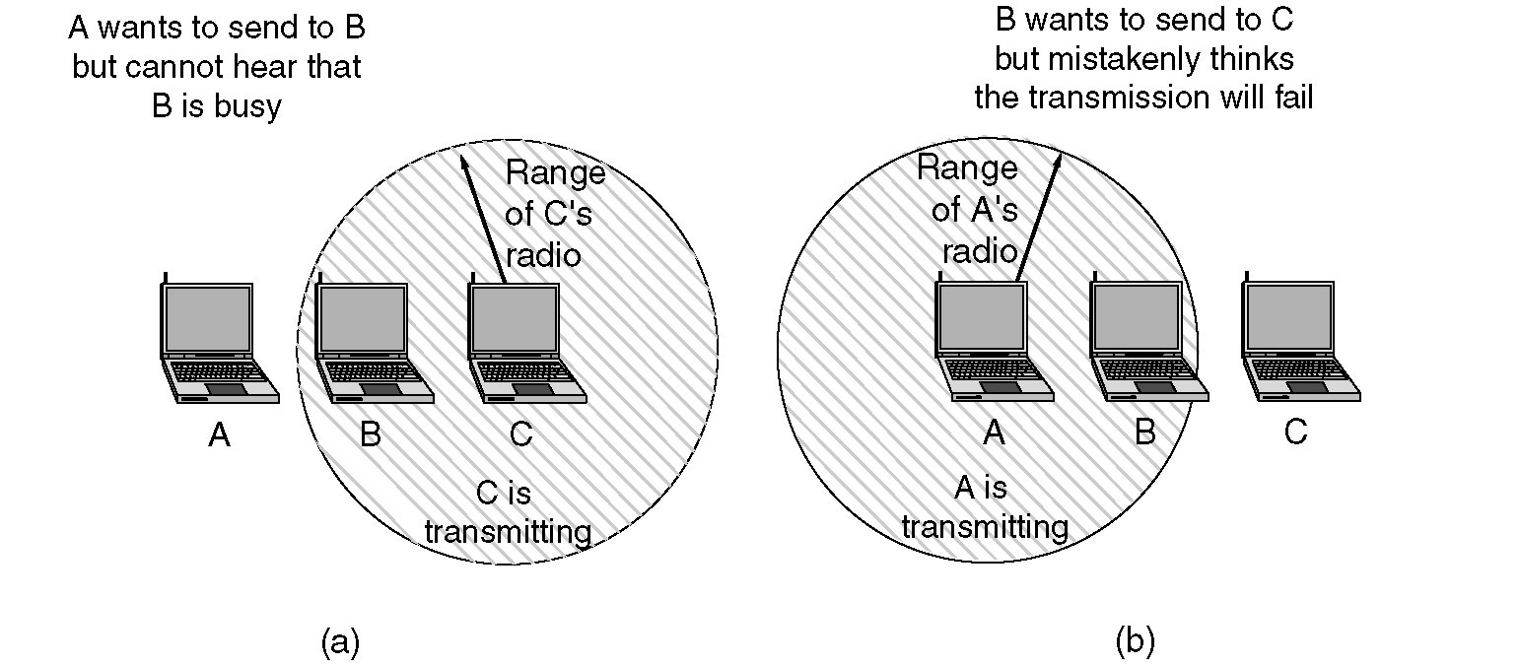
Hidden Station & Exposed Station
隐蔽站与暴露站问题
(a) The hidden station problem.
(b) The exposed station problem.

Slide 13
The hidden station problem 隐蔽站问题
隐蔽站是指在接收结点的覆盖范围内而在发送结点的覆盖范围外的结点。
隐蔽站因听不到发送结点的发送而可能向同样的接收结点发送数据，造成数据包在接收结点处冲突。
冲突后发送结点要重发冲突的数据包，从而降低了信道的利用率。

Slide 14
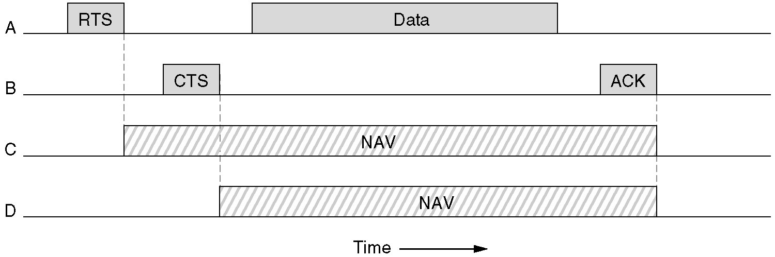
Knowledge Checks
Four stations, A, B, C, and D, are shown. Which of the last two stations do you think is closest to A and why?

