Slide 1
The Network Layer (continued)
Chapter 5

Slide 2
Internetworking 网络互联
How Networks Differ;
How Networks Can Be Connected;
Tunneling;
Internetwork Routing;
Fragmentation.
The Network Layer in the Internet

Slide 3
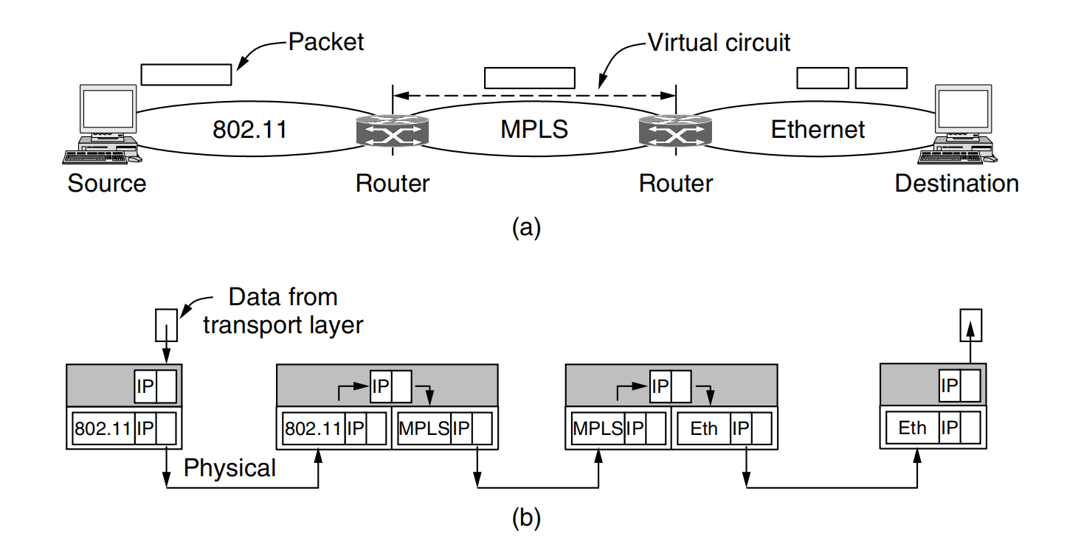
How Networks Can Be Connected
An internet comprised of 802.11, MPLS, and Ethernet networks.Suppose that the source machine on the 802.11 network wants to send a packet to the destination machine on the Ethernet network.
Notes:
源端接受来自传输层的数据，并生成一个
带有公共网络层的头，这个例子中采用的是 IP 协议。网络层的头包含了最终的接收方地址，
这个地址被用来确定数据包应该通过第一个路由器发送。因此，包被封装在 802.11 帧内并
且被发送出去，帧的目标地址是第一个路由器的地址。在路由器，数据包从帧的数据宇段
中被提取出来， 802.11 帧头被丢弃：现在路由器检查数据包中的 地址，并查询其路由表：
根据这个地址，路由器决定将数据包发送到第二个路由器。对于路径中的这部分，路由器
必须建立一条到第二个路由器的虚电路，并且必须用 MPLS 报头封装该数据包。在
远端， MPLS 头被丢弃，并在此检查网络地址，以便寻找下一跳网络层。这下一跳就是目
标网络本身。由于数据包太长无法通过以太网发送，它被拆分为两部分。每一部分被放入
以太网帧的数据宇段，并被发送到目的地的以太网地址。在接收方，剥掉每个帧的以太网
帧头，将帧的数据内容重新组合。至此，数据包终于到达了它的目的地。
这个例子网络层用的相同协议，如果是不同的呢？
IPv4和IPv6

Slide 4
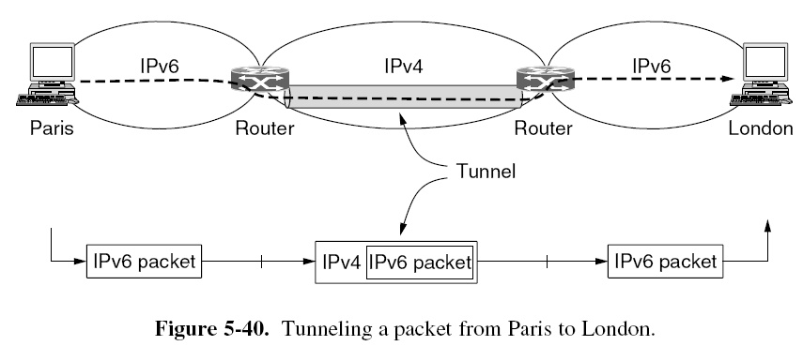
Tunneling 隧道技术
We can solve a lot of the internetworking problems when we can assume that the source and destination of the same type of network is connected by different network, we need only to tunnel packets through intermediate networks.
Notes:
可以处理多个网络协议的路由器称为多协议路由器
这个问题的解决方案是一种称为隧道的技术。为了给伦敦办事处的主机
发送一个 IP 数据包，巴黎的主机构造一个包含伦敦 1Pv6 地址的数据包，然后将该数据包
发送到连接巴黎 1Pv6 网络到 IPv4 Internet 上的多协议路由器：当该多协议路由器获得 IPv6数据包后，它把该数据包用一个 1Pv4 头封装，封装后的 1Pv4 数据包指向多协议路由器另
一边的 1Pv4 ，该网络与伦敦的 1Pv6 网络相连：也就是说，路由器将一个（1Pv6 ）数据包放
入到一个 CIPv4 ）数据包中。当这个包裹着的数据包到达伦敦路由器，原来的 1Pv6 数据包
被提取出来，并被发送给最终的目标主机。

Slide 5
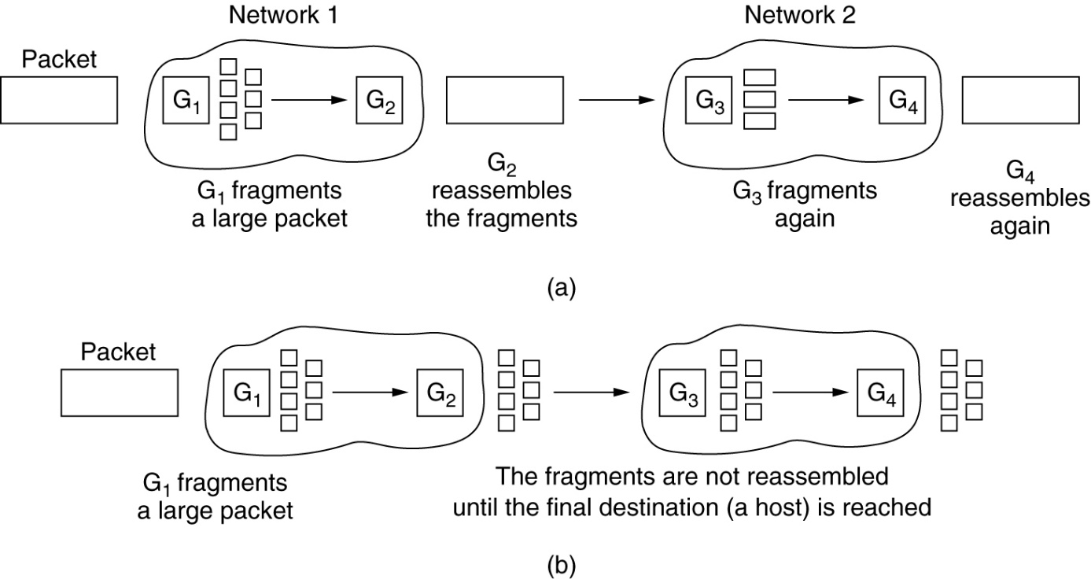
Fragmentation分段
Fragmentation: Different networks may impose different maximum packet sizes. This means that we may have to split a packet into smaller ones when forwarding it through a network whose maximum packet size is too small
Notes:
第一种策略，由“小数据
包”网络引起的分段过程对于沿途后续的网络都是透明的，也就是说，从该网络一直到最
终的目标途中的每个网络都感觉不到曾经发生过分段，如图 5-42 Ca ）所示。在这种方法中，
当一个超大数据包到达 G1 ，该路由器将它分割成多个段：每个段都发向同样的出口路由器
G2 ’在这里这些段被重新组合起来。按照这种方法，任何一个数据包通过这样的小数据包
网络都是透明的。后续的网络根本感觉不到曾经发生过分段。
透明的分段过程非常直接、简单，但是也有一些问题。首先，出口路由器必须知道什
么时候它己经接收到了全部的段，所以每个分段中必须提供一个计数字段或者一个“数据
包结束”标志位。其次，由于所有的数据包必须经过同一个出口路由器才能进行重组，因
此路由受到了限制。由于不允许有些段沿着一条路径到达最终目标，而另一些段沿着一条
不相交路径到达最终目标，所以，可能会损失一些性能。更为重要的是，路由器可能不得
不做大量的工作。如果不是所有的段都己到达，它还需要缓冲到达的段，并且决定何时丢
弃这些段。某些工作可能纯粹是一种浪费，因为当一个数据包需要通过一系列的小数据包
网络时，需要多次被分段和重组。
另一种分段策略是避免在任何一个中间路由器上重新组合分段。一旦一个数据包己经被分段，
则每个段都被当作原始的数据包 样来对待。 路由器传递 段的情形
5~42 Cb ）所示，重组过程只在目标主机上进行。

Slide 6
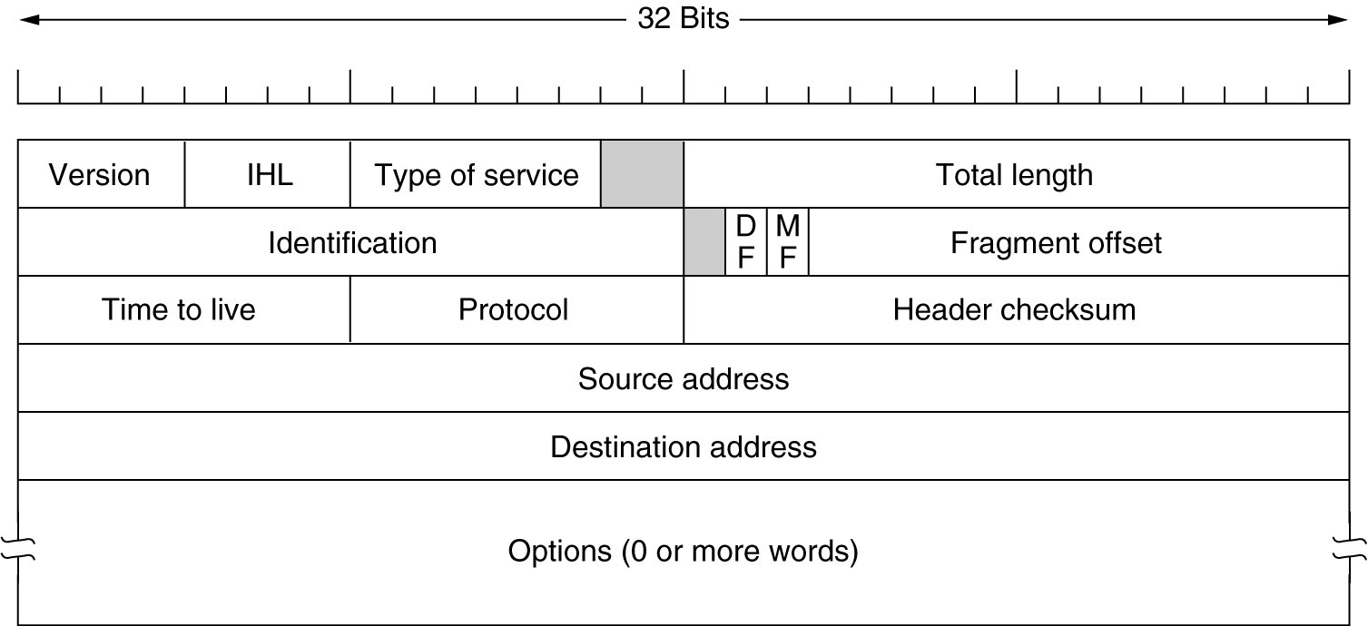
The IP datagram数据报
The IPv4 header.
Notes:
版本（Version ）字段记录了数据报属于协议哪个版本。版本4主宰着今天的 Internet,
这也就是为什么我们从这里开始学习的真正原因。IPv6的地址是128位,
这里顺便提一下， 1Pv5 是一个试验性的实时流协议，它一直
没有被广泛应用。
IHL( Internet Header Length IHL):
由于头的长度不固定，所以头的 IHL 字段指明了头到底有多长（以 32 位字长度为单
位）。 IHL 的最小值为5，这表明头没有可选项。该4位字段的最大值为 15 ，把头的长度限
制为最大 60 字节，因此选项（ Options ）宇段最多为 40 字节。

Slide 7
IP Datagram format
32 bits
1B
IP protocol version number
head.
len
type of
service
total datagram
length (bytes)
4B
ver
length
header length(bytes)
“type” of service:
diffserv (0:5)
ECN (6:7)
16-bit identifier
flgs
fragment
offset
fragmentation/
reassembly
8B
time to
live
upper
layer
header
checksum
header checksum
TTL: remaining max hops
(decremented at each router)
source IP address
32-bit source IP address
destination IP address
Maximum length: 64K bytes
Typically: 1500 bytes or less
upper layer protocol (e.g., TCP or UDP)
32-bit destination IP address
options (if any)
e.g., timestamp, record route taken
payload data
(variable length,
typically a TCP
or UDP segment)

Slide 8
Fragmentation & Reassembly分段与重组
Example
4000 byte datagram
MTU = 1500 bytes
length
=4000
ID
=x
fragflag
=0
offset
=0
One large datagram becomes
several smaller datagrams
Data:3980 bytes
length
=1500
ID
=x
fragflag
=1
offset
=0
1480
1480 bytes in data field
length
=1500
ID
=x
fragflag
=1
offset
=185
1480
offset =1480/8=185
length
=1040
ID
=x
fragflag
=0
offset
=370
1020
The Fragment offset分段偏移 tells where in the current datagram this fragment belongs. All fragments except the last one in a datagram must be a multiple of 8 bytes, the elementary fragment unit.

Slide 9
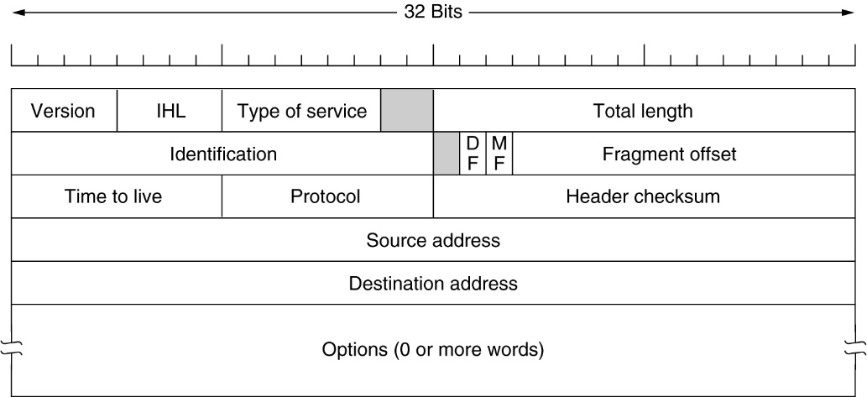
The IP datagram
Source Address: The 32-bit IP address of the originator of the datagram.
Destination Address: The 32-bit IP address of the intended recipient of the datagram.
Options: One or more of several types of options may be included after the standard headers in certain IP datagrams.
Data: The data to be transmitted in the datagram.

Slide 10
IP Addresses
Each IP address is 32 bits long, e.g.
10000000 00001011 00000011 00011111
it is usually written in dotted decimal notation(点分十进制记法) ，e.g. 128.11.3.31
just easy to read!
The IP address is divided into two parts:
IPaddr::={<net-id>, <host-id>}

Slide 11
计算机中的数制转换：二进制数➔十进制数
基本原理：将二进制数从小数点开始，往左从0开始对各位进行正序编号，往右序号则分别为 -1，-2，-3,...直到最末位，然后分别将各位上的数乘以2的k次幂所得的值进行求和，其中k的值为各个位所对应的上述编号。
举例：将二进制数1101.101转换为十进制数
编号: 3 2 1 0 -1 -2 -3
结果： (1 1 0 1.1 0 1)₂ = (13.625)₁₀

Slide 12
IP: SUMMARY
Each IP address is 32 bits long, e.g.
10000000 00001011 00000011 00011111

Slide 13
IP: SUMMARY
Each IP address is 32 bits long, e.g.
10000000 00001011 00000011 00011111
128.11.3.31 (dotted decimal notation)
just easy to read!

Slide 14
IP Addresses
Every node on the Internet has an IP address, used to identify the network and the host on a given network
Each IP address consists of net-id and host-id;

Slide 15
IP: SUMMARY
Each IP address is 32 bits long, e.g.
10000000 00001011 00000011 00011111
128.11.3.31 (dotted decimal notation)
just easy to read!
The IP address is divided into two parts:
IP_{addr}::={<net-id>, <host-id>}

Slide 16
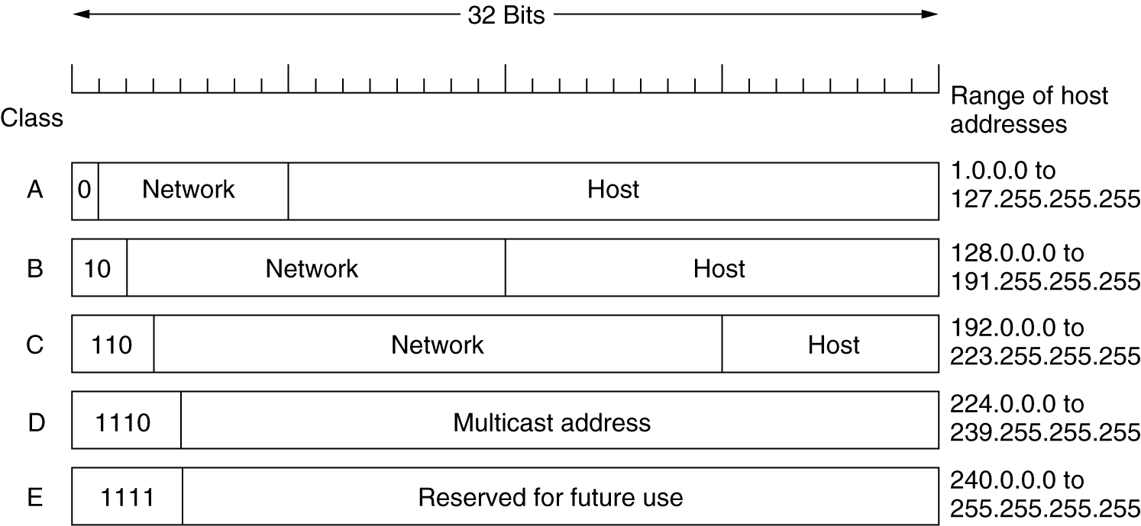
Classes of IP Addresses IP地址分类
IP address formats.

Slide 17
Classes of IP Addresses IP地址分类
The following IP addresses are not allowed in the public Internet:
Class C：192.168.X.X
Class B：172.X.X.X
Class A：10.X.X.X

Slide 18
Subnetting划分子网
Proposed in RFC950: (Request For Comments 网络技术文件)
Basic idea:
A organization with a large network can be divided to many smaller networks, i.e. subnets. Subnetting is an intramural matter.
take some bits from the host number part to create a “subnet” number.
IPaddr ::= { <net-id>, <host-id>}
IPaddr ::= {<net-id>, <subnet-id>, <host-id>}

Slide 19
Subnetting划分子网
Packet routing from the source to the destination across the network:
→ Destination Network
→ Destination Subnet
→Destination Host
Subnet masks子网掩码 indicates which part of a 32-bit IP address represents net-id and subnet-id

Slide 20
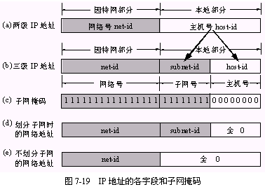
Subnets子网

Slide 21
Quiz
Question: With a subnet mask of 255.255.0.0, do IP addresses 172.16.1.58 and 172.16.4.36 belong to the same network?
172.16.1.58 10101100 00010000 00000001 00111010
255.255.0.0 11111111 11111111 00000000 00000000
AND 10101100 00010000 00000000 00000000
------------------------------------------------
172.16.4.36 10101100 00010000 00000100 00100100
255.255.0.0 11111111 11111111 00000000 00000000
AND 10101100 00010000 00000000 00000000
YES!

Slide 22
Subnet Example #1
IP Address: 130.97.16.132
Subnet Mask: 255.255.255.192
Net-id=?
Host-id=?

Slide 23
Subnet Example #1
IP Address: 130.97.16.132
Subnet Mask: 255.255.255.192
10000010 01100001 00010000 10000100
11111111 11111111 11111111 11000000
Net-id
10000010 01100001 00010000 10000000
→ 130.97.16.128
Host-id
00000000 00000000 00000000 00000100
→ 0.0.0.4

Slide 24
Subnet Example #2
IP Address: 130.97.17.132
Subnet Mask: 255.255.254.0

Slide 25
Subnet Example #2
IP Address: 130.97.17.132
Subnet Mask: 255.255.254.0
10000010 01100001 00010001 10000100
11111111 11111111 11111110 00000000
Net-id
10000010 01100001 00010000 00000000
→ 130.97.16.0
Host-id
00000000 00000000 00000001 10000100
→ 0.0.1.132

Slide 26
Example: LAN1, LAN2 and LAN3 are connected by three routers, i.e. R1, R2 and R3.
222.1.1.1
222.1.1.2
222.1.1.3
LAN₁
222.1.1.
222.1.1.4
R₁
LAN₃
222.1.5.1
222.1.6.1
222.1.3.3
222.1.3.
222.1.2.1
N₃
222.1.6.
LAN₂
N₂
222.1.5.
222.1.2.
222.1.5.2
222.1.6.2
222.1.3.1
R₃
N₁
222.1.4.
R₂
222.1.2.5
222.1.2.2
222.1.3.2
222.1.4.2
222.1.4.1
B
222.1.2.4
222.1.2.3
互联网

Slide 27
IP address space
The address space of IPv4 is extreme wasteful! We must improve the utilization of the IP address space !
CIDR: Classless InterDomain Routing
NAT: Network Address Translation
We need a new IP protocol!
IPv4→IPv6

Slide 28
CIDR – Classless InterDomain Routing无类域间路由选择
CIDR: Classless InterDomain Routing (pronounced “cider”)
subnet portion of address of arbitrary length
address format: a.b.c.d/x, where x is # bits in subnet portion of address
subnet
part
host
part
11001000 00010111 00010000 00000000
200.23.16.0/23
Notes:
This slash notation that we've been using has a name. It's called classless inter-domain routing (CIDR) and actually pronounced "cider" due to its historical origins.
The subnet portion of the address can be any number of bits x, and a CIDR-ized address is one of the form ABCD/X, where X is the number of bits in the subnet address, and sometimes the D is emitted when it's zero.
Here's an example of a 32-bit IP address and its CIDR-ized dotted decimal notation.
Well, let's wrap up our discussion of IPv4 and addressing by posing a question that maybe you've been wondering about: how does one actually get an IP address in the first place?

Slide 29
CIDR – Classless InterDomain Routing无类域间路由选择
net-id and host-id are replaced by network-prefix网络前缀
i.e. IPaddr ::= {<net-prefix>, <host-id>}. e.g. 128.14.46.34/20
→ 10000000 00001110 00101110 00100010
net-prefix host-id

Slide 30
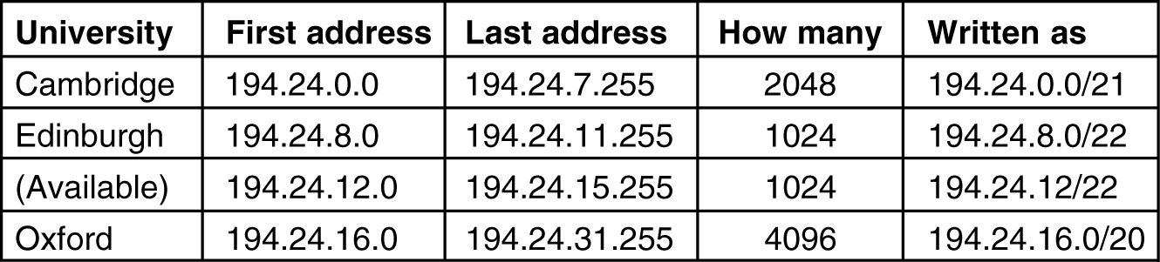
CIDR – Classless InterDomain Routing
5-59
A set of IP address assignments.

Slide 31
QUIZ
A large number of consecutive IP address are available starting at 192.168.0.0. Suppose that an organization requests 500 addresses.
Please determine
the first IP address assigned,
the last IP address assigned,
and the mask in the w.x.y.z/s notation.

Slide 32
How long is the Host-id and Net-prefix?
The organization wants to have 500 addresses, so the address for it must have a host-id of 9 bits long (2⁹=512), i.e. 2 blocks of class C Address.
The net-prefix is 23 bits long.
The starting address, ending address, and mask are as follows:
192.168.0.0 — 198.16.1.255
written as 192.168.0.0/23

Slide 33
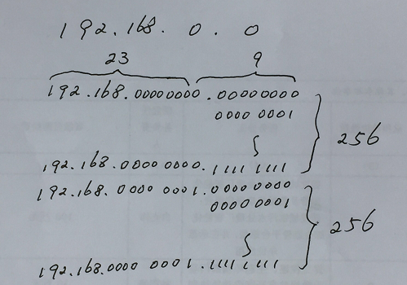


Slide 34
How long is the Host-id and Net-prefix?
The organization wants to have 500 addresses, so the address for it must have a host-id of 9 bits long (2⁹=512), i.e. 2 blocks of class C Address.
The net-prefix is 23 bits long.
The starting address, ending address, and mask are as follows:
192.168.0.0 — 198.16.1.255
written as 192.168.0.0/23

Slide 35
How long is the Host-id and Net-prefix?
The organization wants to have 500 addresses, so the address for it must have a host-id of 9 bits long (2⁹=512), i.e. 2 blocks of class C Address.
The net-prefix is 23 bits long.
The starting address, ending address, and mask are as follows:
192.168.0.0 — 192.168.1.255
written as 192.168.0.0/23

Slide 36
Chapter 5, Problem
A large number of consecutive IP address are available starting at 198.16.0.0. Suppose that four organizations, A, B, C, and D, request 4000, 2000, 4000, and 8000 addresses, respectively, and in that order. For each of these, give the first IP address assigned, the last IP address assigned, and the mask in the w.x.y.z/s notation.

Slide 37
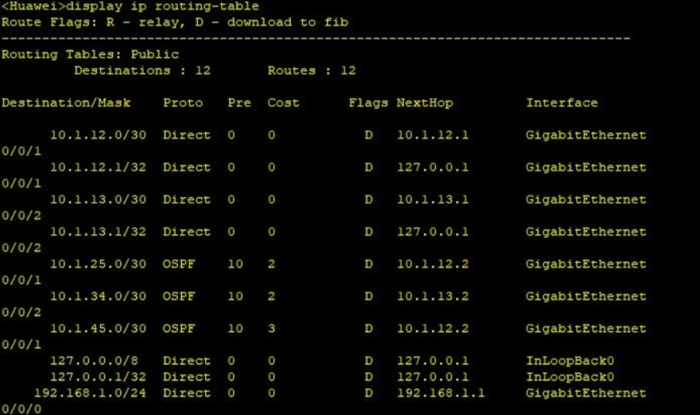
CIDR – Classless InterDomain Routing
Routing table
Network | Mask | Next Hop

Slide 38
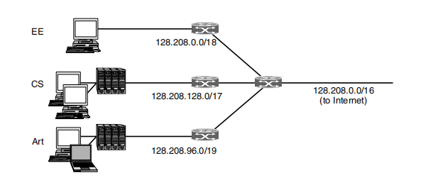

CIDR – Classless InterDomain Routing
When a packet arrives, the router looks at the destination address of the packet and checks which subnet it belongs to. The router can do this by ANDing the destination address with the mask for each subnet and checking to see if the result is the corresponding prefix.
dest.IP:128.208.2.151

Slide 39
CIDR – Classless InterDomain Routing
Route aggregation(路由聚合)
Combine multiple small prefixes into a single larger prefix. The resulting larger prefix is sometimes called a supernet, to contrast with subnets as the division of blocks of addresses.

Slide 40
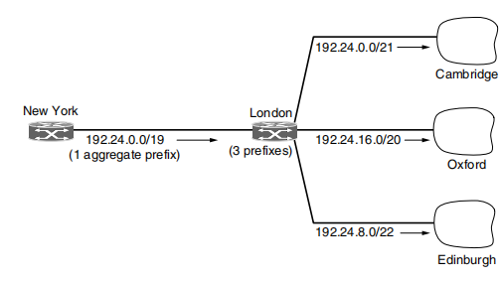
CIDR – Classless InterDomain Routing
Route aggregation(路由聚合)
192.24.00000000.0/21
192.24.00010000.0/20
192.24.00001000.0/22
aggregate
192.24.0.0/19
Aggregation is heavily used throughout the Internet and can reduce the size of router tables to around 200,000 prefixes.

Slide 41
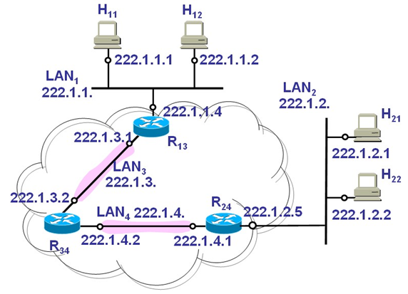
课堂练习：如图所示，四个局域网(LAN₁, LAN₂, LAN₃和LAN₄)通过路由器R₁₃, R₂₄和R₃₄互联。子网掩码为255.255.255.0
(1)试问主机H₂₁和H₂₂的默认网关地址是多少？

Slide 42
课堂练习：如图所示，四个局域网(LAN₁, LAN₂, LAN₃和LAN₄)通过路由器R₁₃, R₂₄和R₃₄互联。子网掩码为255.255.255.0
(1)试问主机H₂₁和H₂₂的默认网关地址是多少？
答：222.1.2.5

Slide 43
课堂练习：如图所示，四个局域网(LAN₁, LAN₂, LAN₃和LAN₄)通过路由器R₁₃, R₂₄和R₃₄互联。子网掩码为255.255.255.0
(2)请完成路由器R₃₄的路由表配置
目的网络 | 子网掩码 | 下一跳地址

Slide 44
课堂练习：如图所示，四个局域网(LAN₁, LAN₂, LAN₃和LAN₄)通过路由器R₁₃, R₂₄和R₃₄互联。子网掩码为255.255.255.0
(2)请完成路由器R₃₄的路由表配置
目的网络 | 子网掩码 | 下一跳地址
222.1.1.0 | 255.255.255.0 | 222.1.3.1
222.1.2.0 | 255.255.255.0 | 222.1.4.1

Slide 45
Addresses
At the Network Layer
Each IP packet contains source and destination IP addresses （端到端主机）
Packets are routed, based on the net-id in the destination IP address
At the Data link layer
Each frame contains src and des MAC addresses （相邻节点）

Slide 46
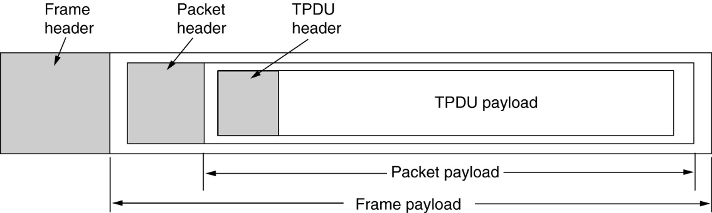
IP 地址与硬件地址
Addresses
首部
应用层数据
IP 地址
TCP 报文
网络层及以上
使用 IP 地址
首部
硬件地址
IP 数据报
首部
尾部
链路层及以下
使用硬件地址
MAC 帧

Slide 47
Addresses
Addressing hosts using IP addresses is great, e.g. 192.168.1.1
these addresses are not recognized by the hardware of those hosts.
a host on an Ethernet LAN will only read messages encapsulated in frames containing that host’s hardware (MAC) address, like 00:D0:C9:35:56:11

Slide 48
Encapsulation and Demultiplexing

Slide 49
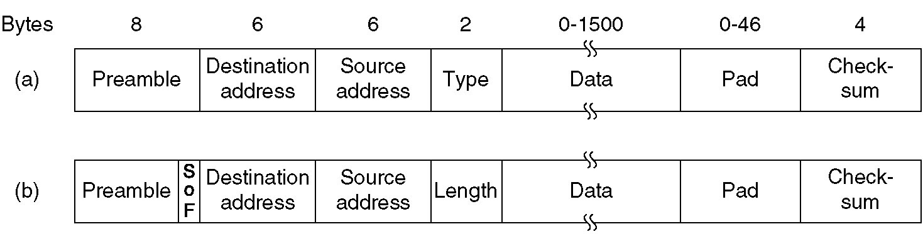
Encapsulation and Demultiplexing: Ethernet Header

Slide 50
Encapsulation and Demultiplexing: IP Header

Slide 51
Encapsulation and Demultiplexing: IP Header

Slide 52
ARP & RARP
Address Resolution: map IP addresses onto data link layer addresses, i.e. MAC addresses
ARP (Address Resolution Protocol)地址解析协议
RARP (Reverse Address Resolution Protocol)逆地址解析协议
IP address (32 bits) MAC address (48 bits)

Slide 53
The Network Layer Protocols in the Internet
DHCP (Dynamic Host Configuration Protocol动态主机配置协议)
allows both manual IP address assignment and automatic assignment;
DHCP server is given a block of IP addresses to choose from;

Slide 54


DHCP client-server scenario
DHCP server: 223.1.2.5
DHCP discover
Arriving client
src : 0.0.0.0, 68
dest.: 255.255.255.255,67
yiaddr: 0.0.0.0
transaction ID: 654
Broadcast: is there a DHCP server out there?
DHCP offer
src: 223.1.2.5, 67
dest: 255.255.255.255, 68
yiaddrr: 223.1.2.4
transaction ID: 654
lifetime: 3600 secs
Broadcast: I’m a DHCP server! Here’s an IP address you can use
The two steps above can be skipped “if a client remembers and wishes to reuse a previously allocated network address” [RFC 2131]
DHCP request
src: 0.0.0.0, 68
dest:: 255.255.255.255, 67
yiaddrr: 223.1.2.4
transaction ID: 655
lifetime: 3600 secs
Broadcast: OK. I would like to use this IP address!
DHCP ACK
src: 223.1.2.5, 67
dest: 255.255.255.255, 68
yiaddrr: 223.1.2.4
transaction ID: 655
lifetime: 3600 secs
Broadcast: OK. You’ve got that IP address!
Notes:
In the first step, the arriving client broadcasts a DHCP message that will be received on the interfaces of all of the hosts and routers in the subnet to which it's attaching.
The Discover message basically says, "Hey, is there a DHCP server out there?" This is a form of service discovery. The host knows the service it needs (DHCP), so it sends out a broadcast to discover the server that can provide DHCP service.
DHCP runs over UDP. The client uses port 68, and the server will use port 67. In particular, the server will be listening on a socket associated with UDP port 67 for incoming DHCP messages.
And here are the details of the fields in the DHCP Discover message: the client's source IP address containing the UDP segment that contains the DHCP Discover message is zero because the client doesn't have an IP address yet, and the destination IP address is the IP broadcast address, that is all ones (255.255.255.255), and the UDP destination port number is 67, as we just noted before.
Hopefully, there'll be a DHCP server sitting out there somewhere on the subnet, listening for this service discovery message.
Note also that there's a transaction ID field. It's got a value of 654 here, and this will be used by the client to match any reply to this request.
Here's the second step: any DHCP server that receives this broadcast Discoverer message (and there might be several such servers) can reply with a DHCP offer message.
This message basically says, "Hey, I'm a DHCP server, and here's an IP address that you can use."
If we look at the details of this offer message, we see that it comes from the DHCP server with an IP address of 223.1.2.5, as in our figure earlier, and from port number 67. This offer message is being broadcast to all interfaces on the subnet. The DHCP message contains the IP address that the requesting host can use (that's the (Yiaddr) field) and a lifetime in this case of 3600 seconds, that the address can be used for.
Note that the transaction ID here matches the transaction ID of the initial offer message - that's to say, this is a reply to that message.
A client can receive offers from multiple DHCP servers, and this might occur, for example, if there are multiple routers on that subnet.
Now, the first two steps that we've seen here are actually optional. The way to think of the third step (which could also be the first step if the two optional steps aren't taken) is that the arriving client comes in and says, "Hey, here's an IP address that I want to use"
- maybe that's the IP address that it was told it could use in step two (if that step was executed), or maybe it's an address that it already has, in which case the client is really renewing its use of that address, or perhaps it's an address that the client has used before.
You can see here that this message is also broadcast, and then it contains the IP address that the host is proposing to use, and that there's a new transaction ID and a lifetime as well.
The final message is the ACK message from the DHCP server, saying basically, "Okay, you can use that IP address with this given lifetime."

Slide 55
课堂练习
37. 某网络拓扑如下图所示，路由器R₁只有到达子网192.168.1.0/24的路由。为使R₁可以将IP分组正确地路由到图中所有子网，则在R₁中需要增加的一条路由（目的网络，子网掩码、下一跳）是
R₁
192.168.1.1
192.168.1.0/24
192.168.2.0/25
R₂
192.168.1.2
192.168.2.128/25
192.168.2.1
192.168.2.130

Slide 56
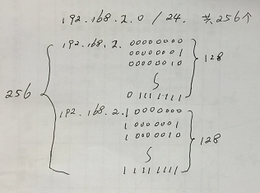
课堂练习
37. 某网络拓扑如下图所示，路由器R₁只有到达子网192.168.1.0/24的路由。为使R₁可以将IP分组正确地路由到图中所有子网，则在R₁中需要增加的一条路由（目的网络，子网掩码、下一跳）是
R₁
192.168.1.1
192.168.1.0/24
192.168.2.0/25
R₂
192.168.1.2
192.168.2.128/25
192.168.2.1
192.168.2.130

Slide 57
课堂练习
37. 某网络拓扑如下图所示，路由器R1只有到达子网192.168.1.0/24的路由。为使R1可以将IP分组正确地路由到图中所有子网，则在R1中需要增加的一条路由（目的网络，子网掩码、下一跳）是
192.168.2.0 255.255.255.128 192.168.1.1
192.168.2.0 255.255.255.0 192.168.1.1
192.168.2.0 255.255.255.128 192.168.1.2
192.168.2.0 255.255.255.0 192.168.1.2

Slide 58
2011年全国硕士研究生入学统一考试 计算机学科专业基础综合
37. 某网络拓扑如下图所示，路由器R1只有到达子网192.168.1.0/24的路由。为使R1可以将IP分组正确地路由到图中所有子网，则在R1中需要增加的一条路由（目的网络，子网掩码、下一跳）是
192.168.2.0 255.255.255.128 192.168.1.1
192.168.2.0 255.255.255.0 192.168.1.1
192.168.2.0 255.255.255.128 192.168.1.2
192.168.2.0 255.255.255.0 192.168.1.2

Slide 59
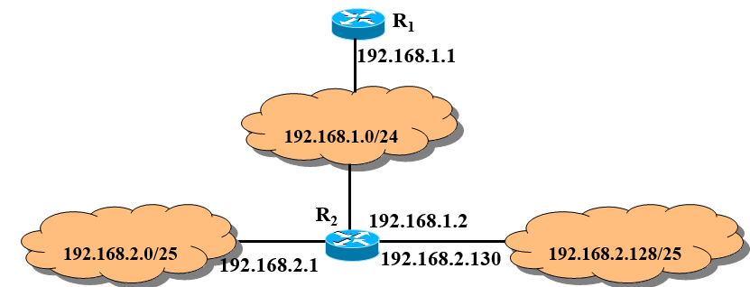
2011年全国硕士研究生入学统一考试 计算机学科专业基础综合
37. 某网络拓扑如下图所示，路由器R1只有到达子网192.168.1.0/24的路由。为使R1可以将IP分组正确地路由到图中所有子网，则在R1中需要增加的一条路由（目的网络，子网掩码、下一跳）是
192.168.2.0 255.255.255.128 192.168.1.1
192.168.2.0 255.255.255.0 192.168.1.1
192.168.2.0 255.255.255.128 192.168.1.2
192.168.2.0 255.255.255.0 192.168.1.2

Slide 60
Routing in the Internet
The Internet is made up of a large number of autonomous systems (AS)自治系统.
An AS refers to the networks in an internetworks which are independent of each other.
Internet is a collection of ASs connected together by a bunch of backbones.

Slide 61
Routing in the Internet
Interior Gateway Routing内部网关协议: Intra-AS routing is concerned with getting packets from source to destination. It should do this as best as possible (optimal routing).
Exterior Gateway Routing外部网关协议: Inter-AS routing has to deal with a lot of politics, e.g., some ASes should not be traversed at all, whereas some do not accept “foreign” packets.

Slide 62
QUIZ
1. As an intermediate device, what is the difference between a repeater, a network bridge, a router, and a gateway?

Slide 63
QUIZ
2. Suppose that host A is connected to a router R1, R1 is connected to another router, R2, and R2 is connected to host B. Suppose that a TCP message that contains 900 bytes of data and 20 bytes of TCP header is passed to the IP code at host A for delivery to B. Show the Total length, Identification(ID = x), DF, MF, and Fragment offset fields of the IP header in each packet transmitted over the three links. Assume that link A-R1 can support a maximum frame size of 1024 bytes including a 14-byte frame header, link R1-R2 can support a maximum frame size of 512 bytes, including an 8-byte frame header, and link R2-B can support a maximum frame size of 512 bytes including a 12-byte frame header.

Slide 64
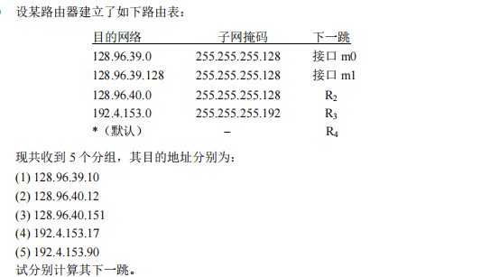
QUIZ

Slide 65
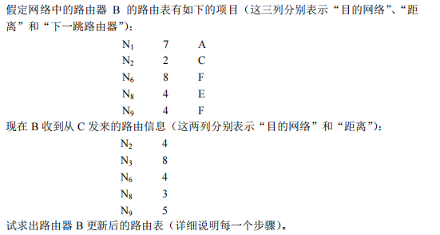
QUIZ

