Slide 1
The Network Layer 网络层
Chapter 5

Slide 2
The network layer, based on services provided by the data link layer, provides a end-to-end transparent path for end-to-end transparent data transmission across networks.
Router

Slide 3
The network layer protocols, running in every host and router, is mainly concerned with getting packets from the source to the destination, via different routes
H4
H2
H6
B
D
A
E
H1
C
H5
H3

Slide 4
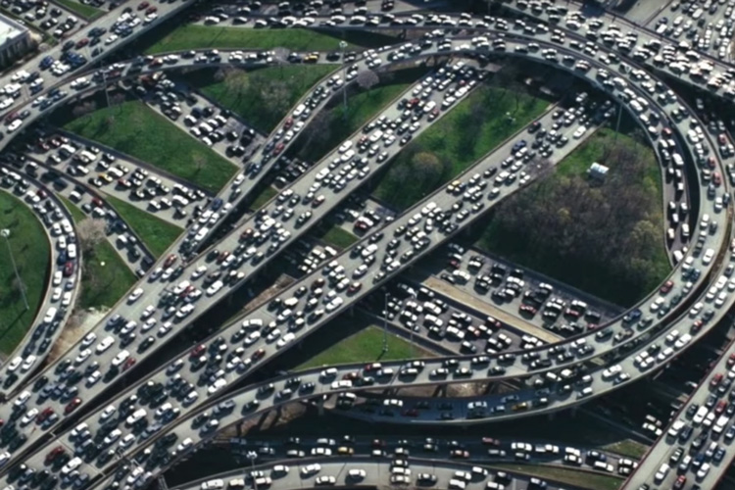
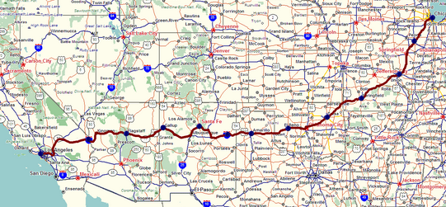
Two key network-layer functions
network-layer functions:
forwarding: move packets from a router’s input link to appropriate router output link
analogy: taking a trip
forwarding: process of getting through single interchange
routing: process of planning trip from source to destination
routing: determine route taken by packets from source to destination
routing algorithms
forwarding
routing
Notes:
This distinction between local versus global considerations is a good one for us to keep in mind.
Local means a decision or an action that's made at an individual router, whereas global means sort of end-end or network-wide.
We see this distinction very clearly in the network layer's two key functions.
The first important function is forwarding.
Forwarding is the router's local action of moving packets from over outer's input port to one of its output ports.
This typically happens at a nanosecond time scale and is implemented in hardware.
The second key function is that of routing, and that's a network-wide activity of determining the route that's taken by packets from sources to destination host.
Routing takes place on a much longer time scale, typically seconds, and we'll see that it's often implemented in software.
A good analogy for this difference between forwarding and routing is the example of taking a trip, say by car.
You could think of forwarding as the process of getting through a single interchange, say going through a roundabout or an intersection, and routing is the process of planning and taking a trip all the way from the source city to the destination city, passing through many intersections.

Slide 5
Network Layer Design Issues
The functions of network layer includes:
Store-and-Forward Packet存储转发数据包
Routing 路由选择
Congestion control 拥塞控制
Internetworking 网络互联

Slide 6
Forwarding vs. Routing
Forwarding转发: move packets from router’s input to appropriate router output.
Routing路由选择: determine the path taken by packets as they flow from a sender to a receiver.
Routing algorithms – run at routers to determine “paths”;
Destination address-based in Datagram networks
Virtual circuit ID-based in VC Networks
Routers have a forwarding table

Slide 7
Forwarding vs. Routing
routing algorithm
local forwarding table
header value
output link
0100
0101
0111
1001
3
2
2
1
value in arriving
packet’s header
1
0111
3
2

Slide 8
Routing Algorithms路由算法
The main function of the network layer is routing packets from the source machine to the destination machine.
Routing involves the
selection of the
paths for the
packets
B
D
A
E
H1
C
H2

Slide 9
Classification of Routing Algorithms
Shortest Path Routing 最短路由选择
Flooding 扩散法、泛洪法
Distance Vector Routing 距离矢量路由选择
Link State Routing 链路状态路由选择
Hierarchical Routing 分级路由选择
Broadcast Routing 广播路由选择
Multicast Routing 组播路由选择
Routing for Mobile Hosts 移动主机的路由选择
Routing in Ad Hoc Networks自组织网路由选择

Slide 10
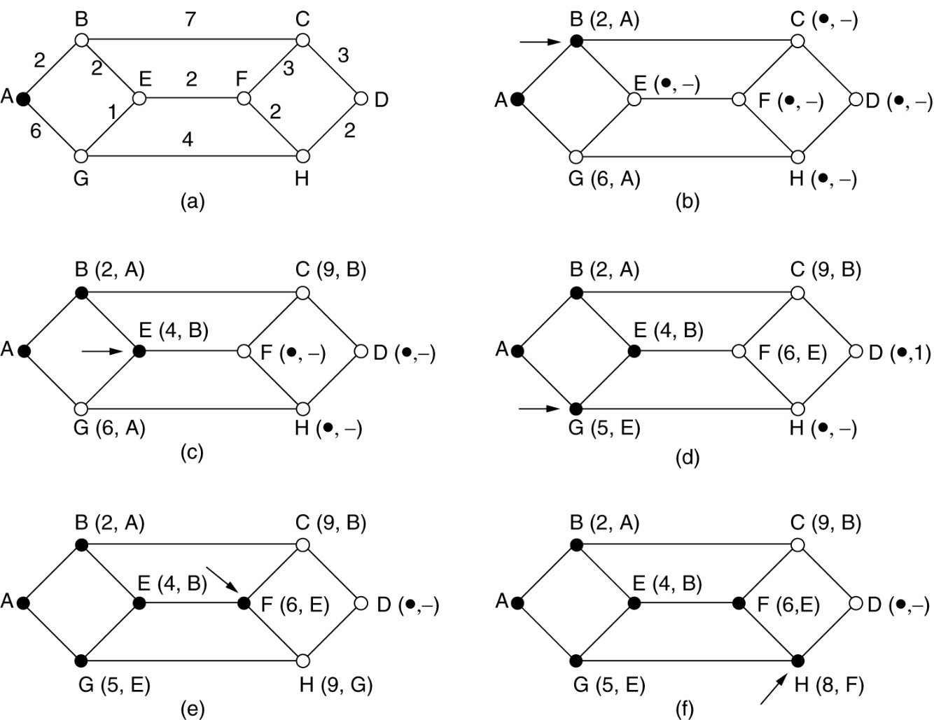
Shortest Path Routing最短路由选择
a graph of the subnet:
each node of the graph representing a router
each arc of the graph representing a link.
To choose a route between a given pair of routers, the algorithm just finds the shortest path between them on the graph.

Slide 11
Flooding泛洪法
Every incoming packet is sent out on every outgoing line except the one it arrived on.
S
D
……
We must take some measures to damp the process!我们必须采取措施控制/抑制这个过程！

Slide 12
Distance Vector Routing 距离矢量路由选择
This is a dynamic routing algorithm which takes the current network load into account.
Each router maintains a table giving the best known distance to each destination and which line to use to get there.
These tables are updated regularly定期更新by exchanging information with the neighbors.
It is widely used in the ARPANET

Slide 13
Distance vector algorithm
Based on Bellman-Ford (BF) equation (dynamic programming):
Bellman-Ford equation
Let D_{x}(y): cost of least-cost path from x to y.
Then:
D_{x}(y) = min_{v} { c_{x,v} + D_{v}(y) }
v’s estimated least-cost-path cost to y
min taken over all neighbors v of x
direct cost of link from x to v
Notes:
the Distance Vector algorithm for computing least-cost paths is based on what's known as the Bellman-Ford equation shown here.
And while the equation itself might look a little bit daunting, it's really pretty intuitive.
The Bellman-Ford equation expresses the notion that if I want a minimum cost from source X to destination Y, then that path must have one of X's neighbors, say V, as a first hop.
So I'll sum the cost of getting from source X to neighbor V plus the cost of then getting from neighbor V to destination Y.
This is X's cost of getting to destination Y through neighbor V.
And then I'll take the minimum cost path over all neighbors V, since X's minimum-cost path must pass through one of its neighbors V.
That's it.
That's the Bellman-Ford equation.

Slide 14
Bellman-Ford Example
Suppose that u’s neighboring nodes, x,v,w, know that for destination z:
D_{v}(z) = 5
D_{w}(z) = 3
Bellman-Ford equation says:
5
D_{u}(z) = min { c_{u,v} + D_{v}(z),
c_{u,x} + D_{x}(z),
c_{u,w} + D_{w}(z) }
v
3
w
2
5
u
2
1
z
3
= min {2 + 5,
1 + 3,
5 + 3} = 4
1
x
2
1
y
D_{x}(z) = 3
node achieving minimum (x) is next hop on estimated least-cost path to destination (z)
Notes:
Well, probably the best way to understand Bellman-Ford is to take a look at an example.
So let's do that in the context of the network which you'll recognize.
We're going to look at a source node U and a destination node Z.
And notice that U has three neighbors, V, X, and W.
And here's what the neighbors know: neighbor V knows that it can reach destination Z with a cost of five; neighbor X knows that it can reach destination Z with a cost of three; and neighbor W knows that it can reach destination Z with a cost of three.
So that's what the neighbors know.
The neighbors are going to communicate this information back to U.
What is this going to mean for U?
For this example, the Bellman-Ford equation says that the minimum cost path from U to Z is going to be the minimum of three quantities: the cost of getting from source U to neighbor V plus the cost of getting from neighbor V to destination Z; the cost of getting from U to neighbor X plus the cost of getting from X to Z; and the cost of getting from U to W plus the cost of getting from W to Z.
If you plug in the numbers here, you'll find the minimum cost to get from U to Z is via neighbor X and at a cost of 4.
Well, the Bellman-Ford equation expresses a relationship among the distance vectors in neighboring nodes, but of course, we still need to compute these distance vectors.
But the way to do that is naturally expressed by the form the relationship between distance vectors and neighboring nodes function.
How we compute these distance vectors

Slide 15
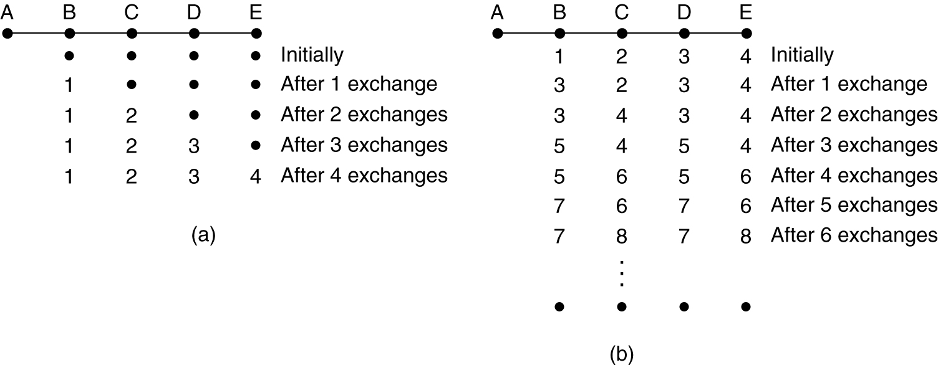
Distance Vector Routing 距离矢量路由选择
Distance vector routing works in theory. However, it has a serious drawback in practice……理论上可以工作，但实际上存在致命的缺点.
Good news travels fast , bad news travels slow好消息传播快，坏消息传播慢。
The Count-to-Infinity Problem 无穷计算问题

Slide 16
Link State Routing 链路状态路由选择
The primary disadvantages of Distance Vector Routing:
the algorithm often takes too long to converge 收敛, due to the count-to-infinity problem
without consideration of the line bandwidth when choosing routes;
→ in 1979, it was replaced by link state routing

Slide 17
Link State Routing 链路状态路由选择
Advantages:
Good consistency of each router information
Quick convergence for good and bad news
Disadvantages:
Each router need large memory to store the input states of other routers
The computation time can be an issue.

Slide 18
Comparison of LS and DV algorithms
message complexity
LS: n routers, O(n²) messages sent
DV: exchange between neighbors; convergence time varies
robustness: what happens if router malfunctions, or is compromised?
LS:
router can advertise incorrect link cost
each router computes only its own table
DV:
DV router can advertise incorrect path cost (“I have a really low cost path to everywhere”): black-holing
each router’s table used by others: error propagate thru network
speed of convergence
LS: O(n²) algorithm, O(n²) messages
may have oscillations
DV: convergence time varies
may have routing loops
count-to-infinity problem
Notes:
Let's wrap up our discussion of routing algorithms with a comparison of link-state and distance-vector algorithms.
Let's start off with message complexity.
We saw earlier that the message complexity to do link-state dissemination is order n squared for the link-state algorithm.
For distance vector, we learned that it takes the order the diameter of the network, potentially order n, for information to propagate from one end of the network to the other.
And we saw that at each step, a node may potentially need to communicate with each of its neighbors.
In terms of speed of convergence, we saw that link state is an order n squared computational algorithm and an order n squared communication algorithm.
We also saw that there can be oscillations in the case of distance vector.
Under distance vector, convergence times can also vary, and there can actually be routing loops while the algorithm is converging.
Lastly, let's think about what can happen in a link state or a distance vector algorithm if a router malfunctions or is compromised.
Under link state, a router can advertise incorrect link costs, but each router computes its own routing and forwarding tables, so failure is rather localized.
Under distance vector, a router can advertise an incorrect path cost.
For example, a router could say, "Hey, I've got a really low path cost to everywhere in the internet." This is known as blackholing.
Since each router's distance vector is used by others, errors can then propagate through the network as additional routers advertise their new distance vector.
This type of black hole routing failures actually occurred in the internet when a small ISP advertised, "Hey, I've got a zero-cost path to a major ISP." I think that ISP was AT&T when this ISP wasn't really connected to that major ISP.
And hey, what network can pass up a zero path cost to a major destination network? So many other networks in the internet who wanted to route traffic to AT&T sent their traffic to this small ISP where it was blackholed.
Now imagine you're AT&T, and you're saying, "Hey, why am I no longer receiving traffic from a good portion of the internet anymore?" The answer was that traffic's been blackholed in a small ISP instead due to a misconfigured router in that ISP.
Well, that wraps up our discussion of routing algorithms, Dijkstra's centralized link state algorithm, and the distributed Bellman-Ford algorithm.
In the next two sections, we're going to cover the embodiment of these routing algorithms in internet routing protocols: the Open Shortest Path First (OSPF) routing protocol and the Border Gateway Protocol (BGP).
I think you'll enjoy them.

Slide 19
Hierarchical Routing分级路由选择
Our routing study thus far - idealization 理想化
all routers identical, network “flat”
scale: with millions destinations？
As networks grow in size, the router routing tables grow proportionally
can’t store all dest’s in routing tables!
routing table exchange would swamp links!
more CPU time is needed to scan them
It is not possible for every router to have an entry for every other router in the world!

Slide 20
Congestion Control Algorithms 拥塞控制算法
General Principles of Congestion Control
Congestion Prevention Policies拥塞预防策略
Congestion Control in Virtual-Circuit Subnets
Congestion Control in Datagram Subnets
Load Shedding减轻负载
Jitter Control延迟抖动(延时差)控制

Slide 21
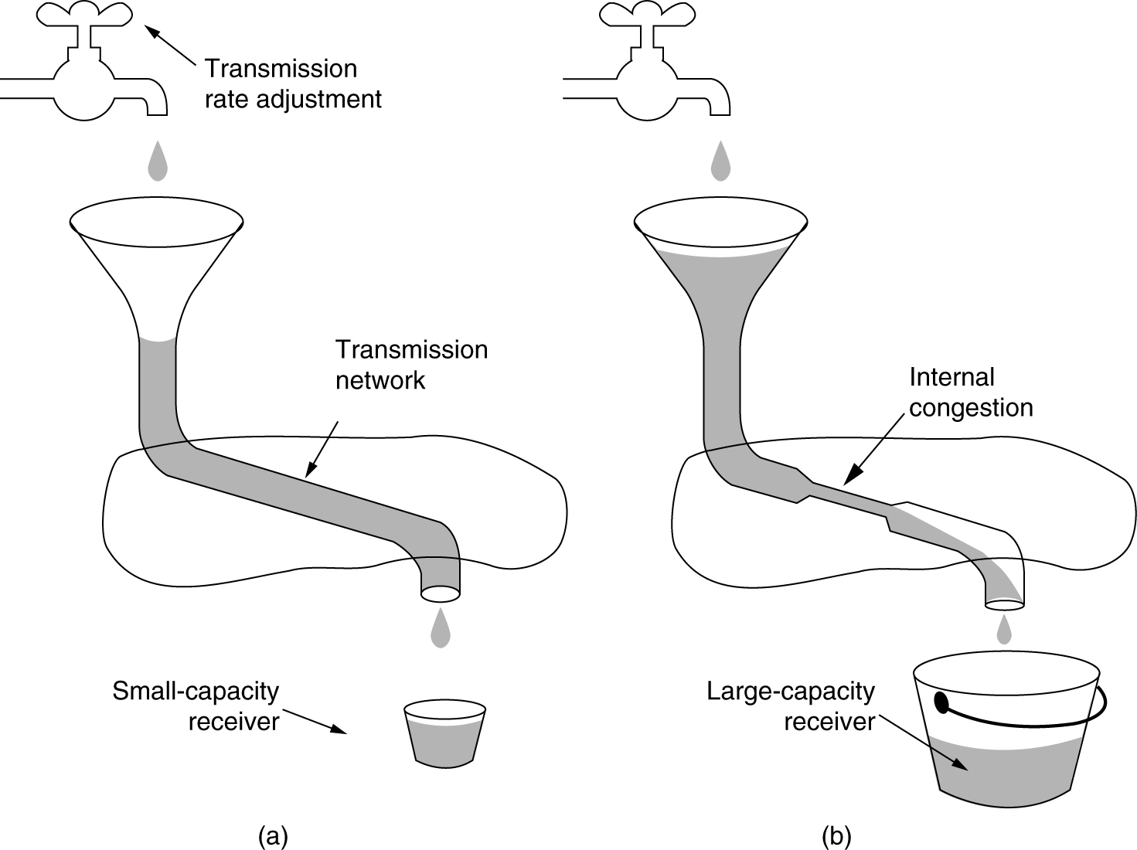
Congestion Control vs. Flow control 拥塞控制 vs. 流量控制

Slide 22
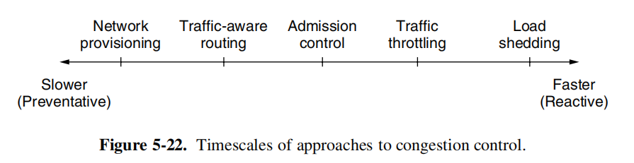
General Principles of Congestion Control
The presence of congestion means that the load is (temporarily) greater than the resources (in a part of the network) can handle. Two solutions come to mind:increase the resources or decrease the load.
网络供给
流量感知路由
准入控制
流量限制
负载脱落

Slide 23
Load Shedding减轻负载
When routers are being inundated淹没 by packets that they cannot handle, they just throw them away.
Which packets should be dropped?
at random
depend on the applications running, e.g. file transfer, multimedia
packets with priority

Slide 24
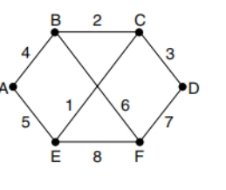
Knowledge Checks
Consider the subnet of Fig. 5-12(a), but ignore the weights on the lines. Distance vector routing is used, and the following vectors have just come in to router C: from B: (5, 0, 8, 12, 6, 2); from D: (16, 12, 6, 0, 9, 10); and from E: (7, 6, 3, 9, 0, 4). The measured delays to B, D, and E, are 6, 3, and 5, respectively. What is C's new routing table? Give both the outgoing line to use and the expected delay.

Slide 25
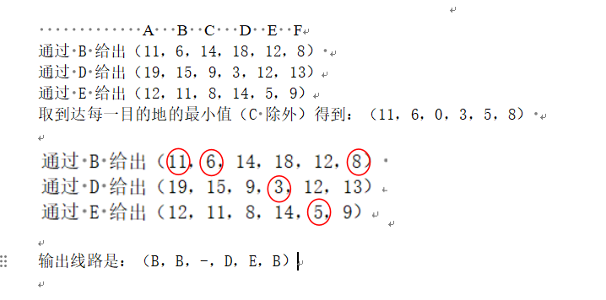
Knowledge Checks

Slide 26
Knowledge Checks
If delays are recorded as 8-bit numbers in a 50-router network, and delay vectors are exchanged twice a second, how much bandwidth per (full-duplex) line is chewed up by the distributed routing algorithm? Assume that each router has three lines to other routers.

