Slide 1
The Transport Layer 传输层
Chapter 6

Slide 2
Transport Layer vs. Network Layer
The network layer provides communication between two (end-to-end) hosts.
The transport layer provides communication between two processes（进程） running on different hosts.

Slide 3
传输层为相互通信的应用进程提供了逻辑通信
AP₁
应用进程
应用进程
AP₄
5
4
3
2
1
AP₂
AP₃
5
4
3
2
1
端口
传输层提供应用进程间的逻辑通信
端口
IP 层
主机 A
主机 B
路由器 1
路由器 2
AP₁
AP₃
LAN₁
WAN
LAN₂
AP₂
AP₄
IP 协议的作用范围
传输层协议 TCP 和 UDP 的作用范围

Slide 4
Sockets套接字
It is a software interface designed to communicate between the user program and TCP/IP protocol stack
AP
用户程序
Socket
interface
Transport
通信网络
Network
Data Link
NA

Slide 5
Addressing 寻址
An application process at the source host must know the address of another process at the destination host, i.e. transport addresses
These transport addresses are called
TSAP (Transport Service Access Point传输服务访问点) in the OSI.
Port-Numbers(端口号) in the TCP/IP

Slide 6
Addressing
In the Internet, the following factors uniquely identifies a process-to-process connection
source port,
source IP address,
destination port,
destination IP address,
transport layer protocol

Slide 7
OSI Model versus TCP/IP
Layer 7
Application
DNS
Telnet
FTP
HTTP
SMTP
Layer 6
Presentation
Layer 5
Session
Layer 4
Transport
TCP
UDP
Network
IP
Layer 3
ICMP
ARP
Data Link
MAC
Layer 2
LLC
Layer 1
Physical
Physical Link

Slide 8
The Internet Transport Protocols
TCP (Transmission Control Protocol传输控制协议) → reliable, connection-oriented, error-free byte stream delivering; handles flow control
UDP (User Datagram Protocol用户数据报协议) → unreliable, connectionless; No TCP’s flow control; applications where prompt delivery more important than accurate delivery (speech, video, …)

Slide 9
TCP: overview RFCs: 793,1122, 2018, 5681, 7323
point-to-point:
one sender, one receiver
reliable, in-order byte steam:
no “message boundaries"
full duplex data:
bi-directional data flow in same connection
MSS: maximum segment size
cumulative ACKs
pipelining:
TCP congestion and flow control set window size
connection-oriented:
handshaking (exchange of control messages) initializes sender, receiver state before data exchange
flow controlled:
sender will not overwhelm receiver
Notes:
As we've seen, TCP operates in a point-to-point manner, that is, between one sender and one receiver, and the semantics of its reliable data transfer are that of an in-order byte stream.
We should contrast that with UDP, where we saw that UDP was message-oriented. What TCP implements is a reliable byte stream abstraction.
TCP is also full-duplex, meaning that data payloads can flow in both directions
. The data that's contained as a payload in a TCP segment has a maximum segment size of MSS, and this is typically 1460 bytes in practice but it could be any of a number of different values
as we've seen, and we'll illustrate shortly. TCP uses cumulative acknowledgments and is a pipelined protocol.
It's also connection-oriented, which means that there's a handshake that occurs between the sender and the receiver before data actually begins to flow. We'll take a look at that handshake procedure shortly.
TCP is also flow-controlled, which means that the sender and the receiver or speed match so that the sender won't overwhelm the receiver with data.

Slide 10
Introduction to TCP
Converting an unreliable connection into a reliable connection is basically the same problem we have considered at the data link layer, and essentially the same solution is used:
TCP numbers each segment and uses an ARQ（自动重发请求） protocol to recover lost segments.
The sliding window protocol is used for flow control使用滑动窗口协议进行流量控制.
Some versions of TCP implement Go Back N and other versions implement Selective Repeat.

Slide 11
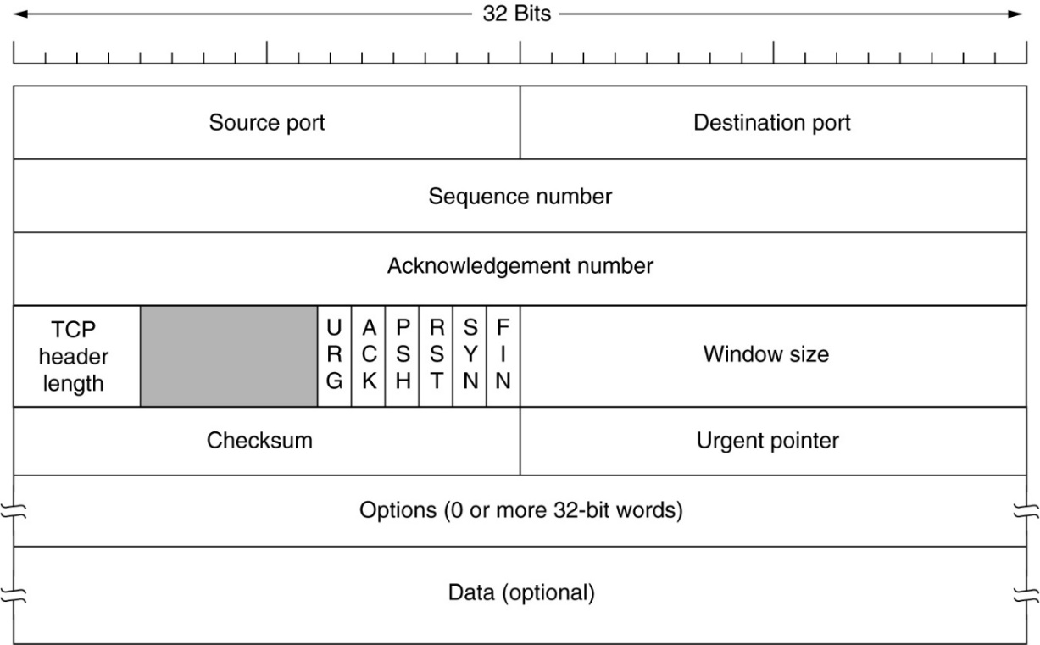
The TCP Service Model
A TCP TPDU is called a segment, consisting of (minimal) 20-byte header.
20 bytes

Slide 12
The TCP Service Model
32 bits
source port #
dest port #
segment seq #: counting bytes of data into bytestream (not segments!)
ACK: seq # of next expected byte; A bit: this is an ACK
sequence number
acknowledgement number
length (of TCP header)
head
len
not
used
A
receive window
flow control: # bytes receiver willing to accept
C
P
S
E
R
F
U
Internet checksum
checksum
Urg data pointer
C, E: congestion notification
options (variable length)
TCP options
application
data
(variable length)
data sent by application into TCP socket
RST, SYN, FIN: connection management
Notes:
Let's next take a look at the TCP segment structure.
The TCP header contains a 32-bit sequence number and a 32-bit acknowledgment number. The application data, which is the payload being carried by the TCP segment, is at the bottom of the segment.
The TCP header also has an internet checksum, just as we saw in UDP.
TCP also has a set of options, and there's a variable number of options that could be included. We're not going to go into those, but that makes the header that we see here of variable length. Because the header can be of variable length, we need to have a length field of the TCP header itself.
The reset (RST), SYN, and FIN bits are used for connection management.
There's a field in the header that's used for flow control, where the receiver can tell the sender the number of bytes it's willing to accept.
There are two bits in the header that are used for congestion notification.
The urgent field, which contains two bits in one field, is not really used in practice.

Slide 13

TCP sequence numbers, ACKs
Host A
Host B
User types‘C’
Seq=42, ACK=79, data = ‘C’
host ACKs receipt of‘C’, echoes back ‘C’
Seq=79, ACK=43, data = ‘C’
host ACKs receipt of echoed ‘C’
Seq=43, ACK=80
simple telnet scenario
Notes:
So let's next look at a very simple example of TCP in action, looking at sequence numbers and acknowledgment numbers.
In this example, we're looking at a simple Telnet scenario where Host A sends a character to Host B, and Host B echoes that single character back.
So you're going to want to take a careful look at the sequence and ACK numbers on the segment shown in this example.
The key thing to note here is that the ACK number of 43 on the B to A segment is 1 more than the sequence number 42 on the A to B segment that triggered that acknowledgment.
Similarly, the ACK number 80 on the last segment of B is 1 more than the sequence number 79 on the B to A segment that triggered that acknowledgment.
Well, we've seen that TCP uses sequence numbers and acknowledgments pretty much as we would have anticipated from our principled study.
We saw that there were a couple of differences: the byte stream semantics and the fact that sequence numbers and acknowledgments correspond to offsets in that byte stream.

Slide 14
The TCP Segment Header
TCP is full duplex – numbering of data is independent in each direction
Initial sequence number is chosen randomly随机选择初始序列号
Sequence numbers are over bytes, not segments序列号按照字节编号，而不是按段
ACKs are cumulative累积确认
Acknowledgement number is the sequence number of the next byte expected from the sender

Slide 15
TCP seq. number’s and ACKs
Seq. number’s:
byte stream “number” of first byte in segment’s data
ACKs:
seq number. of next byte expected from other side
cumulative ACK
Host A
Host B
1000 byte
data
Seq=42, ACK=79, data
host ACKs
receipt of
data
Seq=79, ACK=1042, no data
Host sends
another
500 bytes
Seq=1042, ACK=79, data
Seq=79, ACK=1542, no data
time

Slide 16
TCP Timer Management
The retransmission timer (重传计时器) is very important for TCP
When a segment is sent, a retransmission timer is started.
Notes:
在这里面主要涉及到重传计时器（retransmission timer），它是TCP协议中最重要的计时器。根据《Computer Networks, Fourth Edition》，当报文段发出后，重传计时器立即启动，如果发送端在计时器超时之前得到ACK，则计时器停止；如果计时器超时后仍然没有收到ACK，那么报文段就重传，并且计时器重新启动。计算超时的主要公式有： Timeout = RTT + 4×D D = α D + (1－α) | RTT － M | RTT = α RTT + (1－α) M 其中M 、RTT、D均为可变值，M是当次的RTT值。

Slide 17
How to Estimate RTT?
Timeout = RTT + 4×D
D = α* D + (1－α) | RTT － M |
RTT = α* RTT + (1－α) M
Where M, RTT and D are variable
RTT: best current estimate of round-trip delay
D: estimate of deviation of round-trip delays
M: measured round-trip delay
α : smoothing factor平滑因子that determines how much weight is given to the old value.

Slide 18
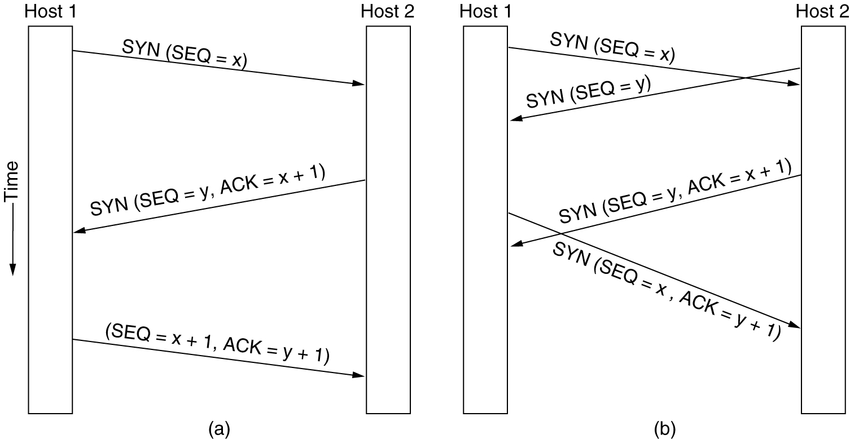
TCP Connection Establishment
Three way handshake:
Step 1: client sends TCP SYN segment to server with initial seq number, but no data
Step 2: server receives SYN, replies with SYN/ACK segment
server allocates buffers
specifies server initial seq. no.
Step 3: client receives SYN/ACK, replies with ACK segment, which may contain data
6-31

Slide 19
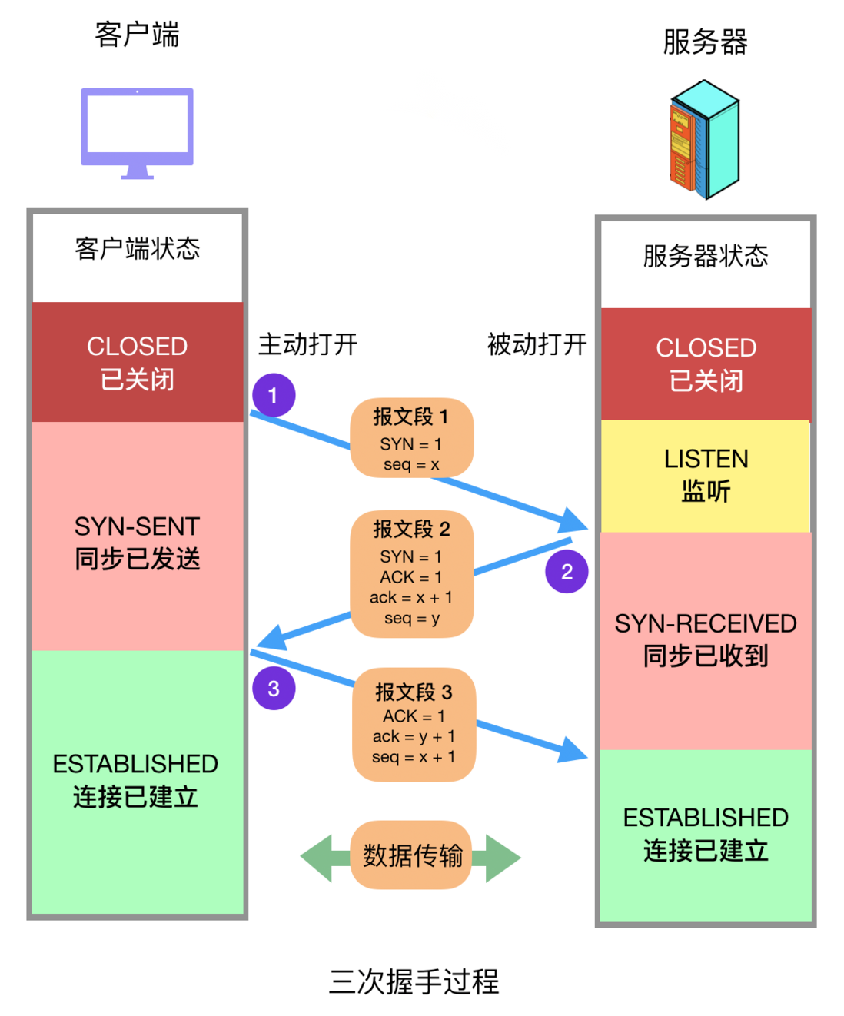

Slide 20
Connection Release释放连接
Connection release using a three/four-way handshake is not perfect, but okay in practice
A
B
FIN, SEQ=x
ACK=x+1
FIN,SEQ=y,ACK=x+1
ACK=y+1

Slide 21
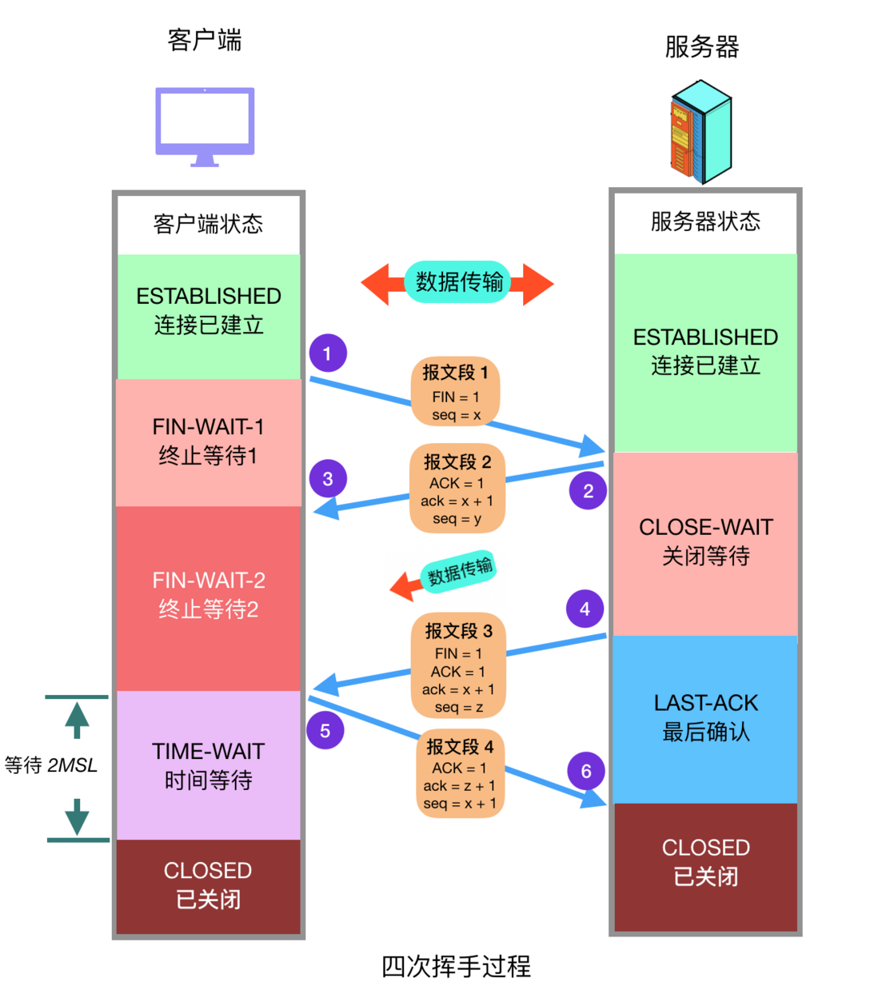

Slide 22
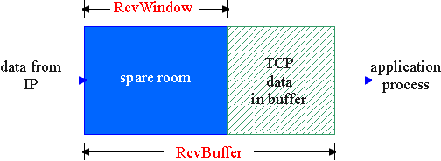
TCP Flow Control
The receive side of TCP connection has a receive buffer:
flow control
sender won’t overflow receiver’s buffer by transmitting too much, too fast
speed-matching service: matching the send rate to the receiving app’s drain rate
The application process may be slow at reading from the buffer

Slide 23
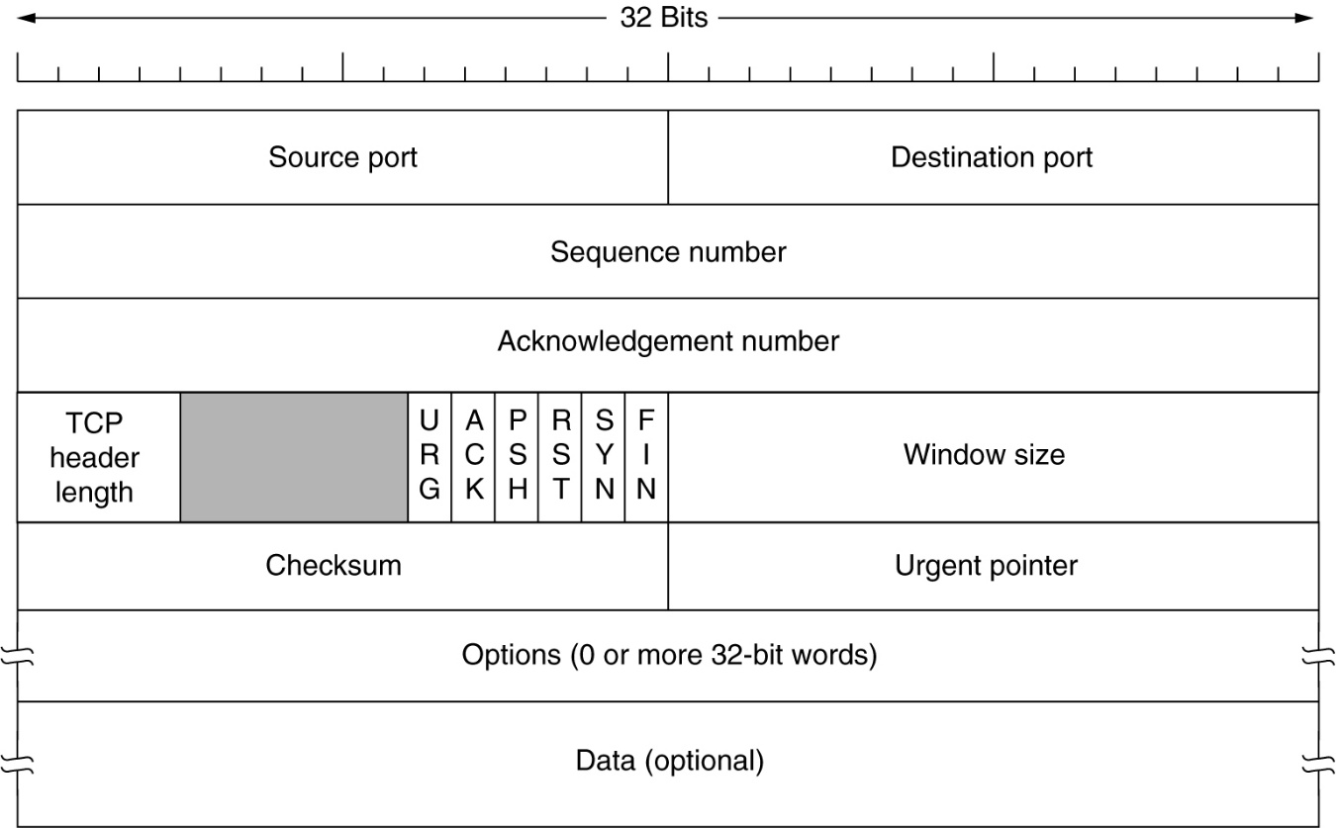
TCP Flow control: how it works
Receiver advertises spare room(声明可用空余空间) by including value of RcvWindow in TCP segments
Sender limits unACKed data to RcvWindow
guarantees receive buffer doesn’t overflow
(Suppose TCP receiver discards out-of-order segments)
spare room in buffer
= RcvWindow
= RcvBuffer-[LastByteRcvd - LastByteRead]

Slide 24
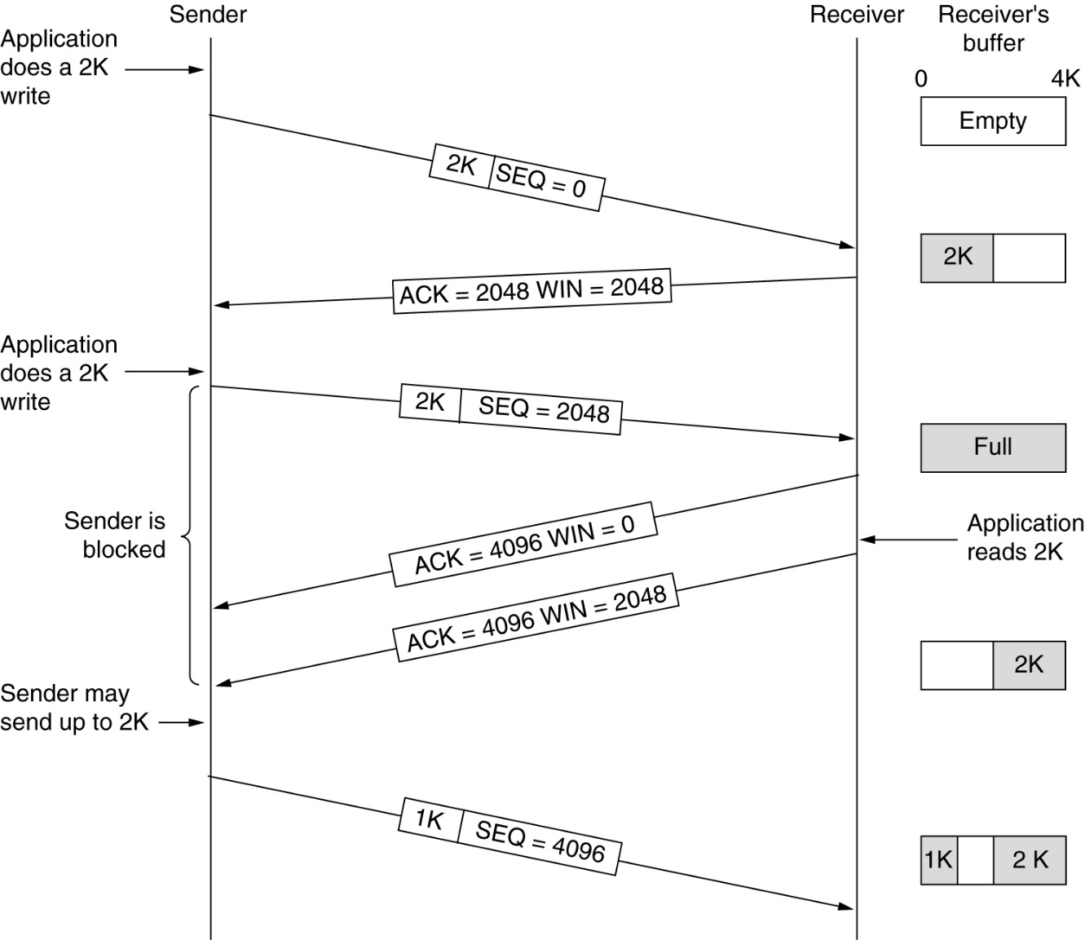
TCP Transmission Policy传输策略
Window management in TCP.

Slide 25
例题1
主机甲与主机乙之间已建立一个TCP连接，双方持续有数据传输，且数据无差错与丢失。若甲收到1个来自乙TCP报文段，该段的序号为1913，确认序号为2046，有效载荷为100字节，则主机甲立即发送给主机乙的TCP报文段的序号和确认号分别是多少？

Slide 26
例题1,答案
解析：
若甲收到1个来自乙TCP报文段，该段的序号seq=1913，确认序号ack=2046，有效载荷为100字节，
则主机甲立即发送给主机乙的TCP报文段
序号seq1=ack=2046
确认号ack1=seq+100=2013

Slide 27
TCP Congestion Control 拥塞控制
Congestion: informally: “too many sources sending too much data too fast for network to handle”
A top-10 problem in the networking technology
Different from flow control不同于流量控制!

Slide 28
TCP Congestion Control 拥塞控制
TCP Tahoe (Jacobson 1988)
Slow Start
Congestion Avoidance
Fast Retransmit
TCP Reno (Jacobson 1990)
Fast Recovery

Slide 29
TCP Congestion Control 拥塞控制
Congestion Control by adjusting transmit rate on the sending side
Congestion Window (拥塞窗口) : cwnd, or W
it is the network capacity. sender
Receiver Window (接收端窗口): rwnd，
it is the receiver capacity. receiver
Slow Start Threshold (SSTHRESH慢启动阈值): window size after which TCP cautiously probes小心试探 for bandwidth. Initially, ssthresh=64 KB, i.e. 65535 bytes

Slide 30
TCP Congestion Control 拥塞控制
TCP拥塞控制是通过调节一些重要参数的改变而实现的。TCP用于拥塞控制的参数主要有：
(1) 拥塞窗口(cwnd):拥塞控制的关键参数，它描述源端在拥塞控制情况下，一次最多能发送的数据量。
(2) 接收端窗口(rwnd), 或称为通告窗口(aWin): 接收端给源端预设的发送窗口大小，它只在TCP连接建立的初始阶段发挥作用。
(3) 发送窗口(win):源端每次实际发送数据的窗口大小。

Slide 31
TCP Congestion Control 拥塞控制
TCP拥塞控制是通过控制一些重要参数的改变而实现的。TCP用于拥塞控制的参数主要有：
(4) 慢启动阈值(ssthresh):拥塞控制中慢启动阶段和拥塞避免阶段的分界点。初始值通常设为65535 bytes。
(5) 回路响应时间(RTT):一个TCP报文从源端发送到接收端，源端收到接收端确认的时间间隔。
(6) 超时重传计数器(RTO):描述报文从发送到失效的时间间隔，是判断报文丢失与否，及网络是否拥塞的重要参数。通常设为2RTT或5RTT。

Slide 32
TCP Congestion Control 拥塞控制
TCP拥塞控制是通过控制一些重要参数的改变而实现的。TCP用于拥塞控制的参数主要有：
(7) 快速重传阈值(tcprexmtthresh):能触发快速重传的源端收到重复确认包ACK的个数。当此个数超过tcprexmtthresh时，网络就进入快速重传阶段。tcprexmtthresh缺省值为3。

Slide 33
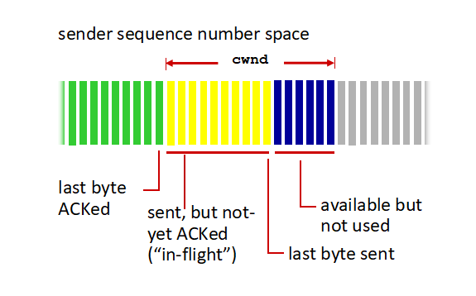
TCP Congestion Control 拥塞控制
Congestion Window (cwnd) is a variable held by the TCP source for each connection.
cwnd is set based on the perceived level of congestion. The Host receives implicit (packet drop) or explicit (packet mark) indications of internal congestion.
MaxWindow= :: min (cwnd , rwnd)
EffectiveWindow = MaxWindow – (LastByteSent -LastByteAcked)

Slide 34
Slow Start (SS) 慢速启动算法
“Slow Start” is used to reach the equilibrium state平衡状态
Initially: ssthresh
SS:
Initially: W = 1 (slow start)
On each successful ACK:
Exponential growth of W
each RTT: W ← 2 x W
Enter CA when “a timeout occurs” or W >= ssthresh
sender
receiver
cwnd
1
data segment
ACK
2
3
4
5
6
7
8
Notes:
在拥塞窗口大小未达到ssthresh之前，它以指数速度增长；

Slide 35
Slow Start (SS) 慢速启动算法
“Slow Start” is used to reach the equilibrium state平衡状态
sender
receiver
cwnd
1
data segment
Slow start?
ACK
No, it is not slow at all
2
显然，W的增长将随RTT呈指数级(exponential)增长：1个、2个、4个、8个……。源端向网络中发送的数据量将急剧增加。☺
3
4
5
6
7
8
Notes:
在拥塞窗口大小未达到ssthresh之前，它以指数速度增长；

Slide 36
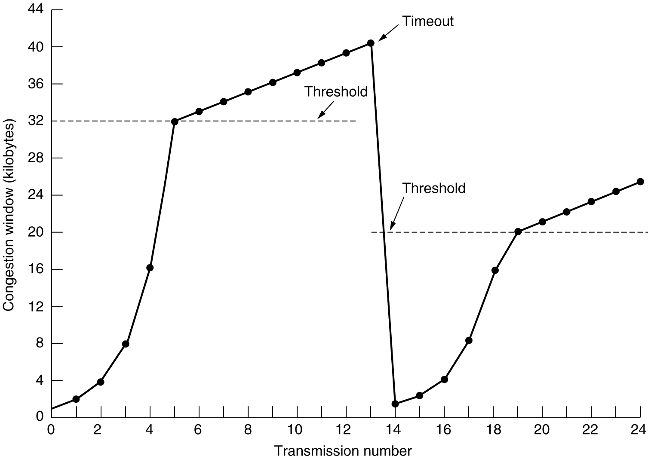
SS

Slide 37
Slow Start (SS) 慢速启动算法
Slow Start goes to end when
a timeout occurs or
W >= ssthresh
Then enter Congestion Avoidance phase (CA)

Slide 38
SS
CA

Slide 39

Congestion Avoidance (CA) 拥塞避免
CA
/* SS is over */
/* W > ssthresh */
Until (loss event) {
every w segments ACKed:
W++
}
ssthresh = W/2
W = 1
Enter SS

Slide 40
AIMD Additive Increase, Multiplicative Decrease
We have “additive increase（加法形式增加）” in the absence of loss events
After loss event, decrease congestion window by half – “multiplicative decrease（倍数形式减少）”
ssthresh = W/2
Enter Slow Start
Notes:
发送端一旦监测到数据包丢失（其原因可能是重传计时器超时，亦可能是收到重复的ACK信令），它就会开始调整发送速率。这包括，ssthresh调整为当前拥塞窗口的一半，同时拥塞窗口将降低到1个报文段。然后，随着通信过程的恢复，拥塞窗口持续增长。在拥塞窗口大小未达到ssthresh之前，它以指数速度增长；到达之后则开始线性增长。有趣的是，虽然这种算法称为慢速启动算法，但实际上一点儿也不慢，它是指数增长的。

Slide 41
SS
CA
SS

Slide 42
课堂练习
如果主机A向主机B发起一个TCP连接，最大段长MSS=1KB，RTT=5ms，主机B开辟的接收缓存为64KB。则主机A从连接建立成功至发送窗口达到32KB，至少需要经过多少时间？

Slide 43
课堂练习
答案：从TCP连接建立好开始，主机A的发送窗口初始值为1个MSS段。
在slow start阶段按照指数规律增长：
1→2→4 → 8 → 16 → 32，......
经过5个RTT后，发送窗口增长到32个MSS段，即32KB。因此 5xRTT=25ms

Slide 44
课堂练习
答案：从TCP连接建立好开始，主机A的发送窗口初始值为1个MSS段。
在slow start阶段按照指数规律增长：
1→2→4 → 8 → 16 → 32，......
经过5个RTT后，发送窗口增长到32个MSS段，即32KB。因此 5xRTT=25ms

Slide 45
课堂练习
答案：从TCP连接建立好开始，主机A的发送窗口初始值为1个MSS段。
在slow start阶段按照指数规律增长：
1→2→4 → 8 → 16 → 32，......
经过5个RTT后，发送窗口增长到32个MSS段，即32KB。因此 5xRTT=25ms

Slide 46
Slow Start (SS) 慢速启动算法
“Slow Start” is used to reach the equilibrium state平衡状态
Initially: ssthresh = 65535
SS:
Initially: W = 1 (slow start)
On each successful ACK:
W ← W + 1
Exponential growth of W
each RTT: W ← 2 x W
Enter CA when “a timeout occurs” or W >= ssthresh
sender
receiver
cwnd
1
data segment
ACK
2
3
4
5
6
7
8
Notes:
在拥塞窗口大小未达到ssthresh之前，它以指数速度增长；

Slide 47
TCP Tahoe

Slide 48
TCP Tahoe: Summary
Basic ideas
Gently probe network for spare capacity逐渐探测网络可用容量
Drastically reduce rate on congestion一旦出现拥塞迅速降低发送速率
Windowing: self-clocking
Other functions: round trip time estimation, error recovery
慢启动+拥塞避免+超时重传

Slide 49
Detecting Packet Loss丢包检测机制
Assumption: loss indicates congestion
Option 1: timeout超时重传(TCP Tahoe)
Waiting for a time-out can be long!
Option 2: duplicate ACKs (TCP Reno)
How many? At least 3.
10
11
12
X
13
14
15
16
17
10
11
11
11
11
Sender
Receiver
Notes:
丢包检测机制有如下两种 (1). 重复ACK信令 重复ACK有两个作用，其一，发送端可以确信该ACK序列号之前的TCP报文段都已经被接收端成功接收；其二，发送端可以据此判断出接收端接收到的TCP报文段发生了乱序的情况和接收端当前期待的TCP报文段序列号，从而触发其拥塞控制策略。 (2). 超时重传 发送端发出报文段后，在规定的时间内没有能够收到接收端返回的ACK信令，从而使得发送端认为该报文段丢失，触发其拥塞控制策略。

Slide 50
Detecting Packet Loss丢包检测机制
Assumption: loss indicates congestion
Option 1: timeout超时重传(TCP Tahoe)
Waiting for a time-out can be long!
Option 2: duplicate ACKs (TCP Reno)
How many? At least 3.
10
11
12
X
13
14
15
16
17
10
11
11
11
11
12
17
Notes:
丢包检测机制有如下两种 (1). 重复ACK信令 重复ACK有两个作用，其一，发送端可以确信该ACK序列号之前的TCP报文段都已经被接收端成功接收；其二，发送端可以据此判断出接收端接收到的TCP报文段发生了乱序的情况和接收端当前期待的TCP报文段序列号，从而触发其拥塞控制策略。 (2). 超时重传 发送端发出报文段后，在规定的时间内没有能够收到接收端返回的ACK信令，从而使得发送端认为该报文段丢失，触发其拥塞控制策略。

Slide 51
Fast Retransmit快速重传算法
Basic Idea of the TCP Reno：
Wait for a timeout is quite long！
using duplicate ACKs to signal lost packet.
Upon receipt of three duplicate ACKs, the TCP Sender retransmits the lost packet right away!
Notes:
快速重传算法 当发送端连续收到3个对应于同一个序列号的ACK信令时，就触发了其快速重传算法，即发送端不等重传计时器超时，立即向接收端发送指定的报文段。

Slide 52
Fast Retransmit快速重传算法
Sender assumes that packet has been lost when receiving 3 dup ACKs
Immediately retransmits after 3 dup. ACKs without waiting for timeout. This yields roughly a 20% improvement in throughput.
Adjusts ssthresh
ssthresh ← W/2
Enter Slow Start
W = 1
Notes:
快速重传算法 当发送端连续收到3个对应于同一个序列号的ACK信令时，就触发了其快速重传算法，即发送端不等重传计时器超时，立即向接收端发送指定的报文段。

Slide 53
Questions?
To what value is ssthresh initialized to at the start of the algorithm?
Why is “Fast Retransmit” triggered触发 on receiving 3 duplicate ACKs (i.e., why isn’t it triggered on receiving a single duplicate ACK)?
Can we do better than TCP Tahoe?

Slide 54
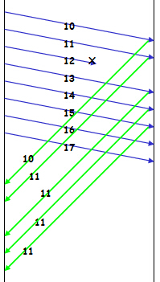
TCP Reno: Fast Recovery快速恢复
Objective: prevent `pipe’ from emptying after fast retransmit
each dup ACK represents a packet having left the pipe (successfully received)
Let’s enter the “FR/FR” mode on 3 dup ACKs

Slide 55
TCP Reno: Fast Recovery快速恢复
ssthresh ← W/2
retransmit lost packet /*快速重传*/
W ← ssthresh + 3
On another dup ACK /*收到另一个重复ACK，窗口+1 */
W++
On non-dup ACK (1 RTT later, i.e. a new ACK)
W ← ssthresh
enter CA mode /*一旦收到新的ACK, 直接进入
拥塞避免，注意：没有慢启动！*/

Slide 56
TCP Reno: Summary
On 3 duplicate ACKs
Fast retransmit and fast recovery
(Fast Recovery along with Fast Retransmit used to avoid Slow Start (SS))
On timeout
Fast retransmit and slow start

Slide 57
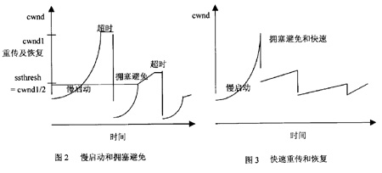
SS+CA ---------- FR+FR
Fast retransmit and slow start
Fast retransmit and fast recovery

Slide 58
AIMD Additive Increase, Multiplicative Decrease
The key assumption is that a dropped packet and the resultant timeout are due to congestion at a router or a switch.
Multiplicate Decrease:: TCP reacts to a timeout by halving cwnd.
It has been shown that AIMD is a necessary condition for TCP congestion control to be stable.

Slide 59
AIMD Additive Increase, Multiplicative Decrease
Although cwnd is defined in bytes, the literature often discusses congestion control in terms of packets (or more formally in MSS == Maximum Segment Size).
cwnd is not allowed below the size of a single packet.

Slide 60
UDP (User Datagram Protocol)
As a connectionless transport protocol, it does not have to establish a connection to another process at the destination host before sending data.
Takes the data from the application layer, packs it into a UDP segment (TPDU), and then hands it to the IP layer.

Slide 61
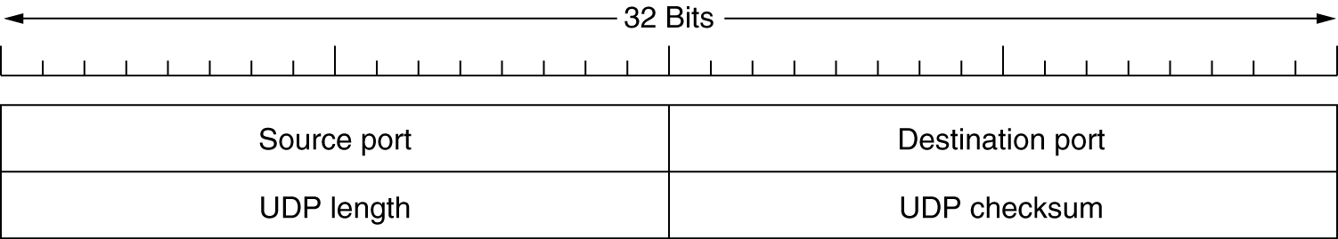
Introduction to UDP
The two ports are used to identify the processes within the source and destination hosts.
The length field gives the length of the entire segment including the header.
The checksum is calculated on the entire segment
Data

Slide 62
Real-time multimedia applications
Why RTP uses UDP instead of TCP?
For multimedia stream, lost packet is better than high jitter;
RTP has no flow control, no acknowledgements, and no retransmissions. That’s just what UDP provides!

Slide 63
Real-time multimedia applications
Why RTP uses UDP instead of TCP?
No status maintained at server side;
Smaller header means higher bandwidth efficiency;
Support for multicasting.

Slide 64
Knowledge Checks
Consider the effect of using slow start on a line with a 10-msec round-trip time and no congestion. The receive window is 24 KB and the maximum segment size is 2 KB. How long does it take before the first full window can be sent?

Slide 65
Knowledge Checks
sender
receiver
cwnd
1
data segment
ACK
2
3
4
5
6
7
8

Slide 66
Knowledge Checks
Suppose that the TCP congestion window is set to 18 KB and a timeout occurs. How big will the window be if the next four transmission bursts are all successful? Assume that the maximum segment size is 1 KB.

Slide 67
TCP Tahoe

Slide 68
Knowledge Checks
A TCP machine is sending full windows of 65,535 bytes over a 1-Gbps channel that has a 10-msec one-way delay. What is the maximum throughput achievable? What is the line efficiency?

Slide 69
Knowledge Checks
主机 A 向主机 B连续发送了两个TCP 报文段，其序号分别为 70 和 100。试问:第一个报文段携带了多少个字节的数据? 主机 B收到第一个报文段后发回的确认中的确认号应当是多少?如果主机 B收到第二个报文段后发回的确认中的确认号是180，试问A发送的第二个报文段中的数据有多少字节? 如果A 发送的第一个报文段丢失了，但第二个报文段到达了B。B在第二个报文段到达后向A 发送确认。试问这个确认号应为多少?

Slide 70
Knowledge Checks
设 TCP 的 ssthresh 的初始值为8(单位为报文段)。当拥塞窗口上升到12 时网络发生了超时，TCP 使用慢开始和拥塞避免。试分别求出第1次到第15 次传输的各拥塞窗口大小。你能说明拥塞控制窗口每一次变化的原因吗?

Slide 71
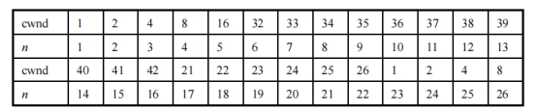
Knowledge Checks
TCP 的拥塞窗口 cwnd 大小与传输轮次 n的关系如下所示:
(1)试画出拥塞窗口与传输轮次的关系曲线。 (2)指明 TCP 工作在慢开始阶段的时间间隔。 (3)指明 TCP 工作在拥塞避免阶段的时间间隔。 (4)在第16 轮次和第 22 轮次之后发送方是通过收到三个重复的确认还是通过超时检测到丢失了报文段? (5)在第1轮次、第 18 轮次时，门限 ssthresh 分别被设置为多大? (6)假定在第 26 轮次之后收到了三个重复的确认，因而检测出了报文段的丢失，那么拥塞窗口 cwnd 和门限 ssthresh 应设置为多大?

