Slide 1
The Application Layer 应用层 DNS, Email,…
Chapter 7

Slide 2
OSI Model versus TCP/IP
Layer 7
Application
DNS
Telnet
FTP
HTTP
SMTP
Layer 6
Presentation
Layer 5
Session
Layer 4
Transport
TCP
UDP
Network
IP
Layer 3
ICMP
ARP
Data Link
MAC
Layer 2
LLC
Layer 1
Physical
Physical Link

Slide 3
DNS – The Domain Name System 域名系统
Instead of using the numeric IP Address of the host, it is possible to use the host name. For example:
www.google.com
www.njtech.edu.cn
Translation of host names to IP Addresses is done by nodes called Name Servers域名服务器

Slide 4
Sending a packet from Argon to Neon

Slide 5
Sending a packet from Argon to Neon
128.143.71.21 is not on my local network.
Therefore, I need to send the packet to my
default gateway with address 128.143.137.1
128.143.71.21 is on my local network.
Therefore, I can send the packet directly.
DNS: What is the IP address of “neon.tcpip-lab.edu”?
DNS: The IP address of “neon.tcpip-lab.edu” is 128.143.71.21
ARP: What is the MAC address of 128.143.137.1?
ARP: The MAC address of 128.143.137.1 is 00:e0:f9:23:a8:20
ARP: What is the MAC address of 128.143.71.21?
ARP: The MAC address of 128.143.71.21 is 00:20:af:03:98:28
frame
frame

Slide 6

E-mail
user
agent
Three major components:
user agents
mail servers
simple mail transfer protocol: SMTP
User Agent
a.k.a. “mail reader”
composing, editing, reading mail messages
e.g., Outlook, iPhone mail client
outgoing, incoming messages stored on server
mail
server
user
agent
SMTP
mail
server
user
agent
SMTP
SMTP
user
agent
mail
server
user
agent
user
agent
outgoing
message queue
user mailbox

Slide 7
E-mail: mail servers
user
agent
mail servers:
mailbox contains incoming messages for user
message queue of outgoing (to be sent) mail messages
SMTP protocol between mail servers to send email messages
client: sending mail server
“server”: receiving mail server
mail
server
user
agent
SMTP
mail
server
user
agent
SMTP
SMTP
user
agent
mail
server
user
agent
user
agent
outgoing
message queue
user mailbox

Slide 8
Some “Web” Terminology术语
Web page consists of objects, each of which can be stored on different Web servers
Object can be HTML 超文本链接语言file, JPEG image, Java applet, audio file,…
Each object is addressable by a URL (Uniform Resource Locaters通用资源定位器*):
http://www.someschool.edu/someDept/pic.gif
protocol
host name
path name
*URL：识别Internet上的文档或资源的一种标准化方法。

Slide 9
HTTP (HyperText Transfer Protocol)
Web’s application layer protocol
client/server model
client: browser that requests, receives, “displays” Web objects
server: Web server sends objects in response to requests
HTTP 1.0: RFC 1945
HTTP 1.1: RFC 2616
HTTP request
PC running
Explorer
HTTP response
HTTP request
Server
running
Apache Web
server
HTTP response
Mac running
Navigator

Slide 10
Layers in the Example
Send HTTP Request to neon
Establish a connection to 128.143.71.21 at port 80
Open TCP connection to 128.143.71.21 port 80
IP datagram is a TCP segment for port 80
Send IP data-gram to 128.143.71.21
Send a datagram (which contains a connection request) to 128.143.71.21
Send IP datagram to 128.143.71.21
Frame is an IP datagram
Frame is an IP datagram
Send the datagram to 128.143.137.1
Send the datagram to 128.143.7.21
Send Ethernet frame to 00:e0:f9:23:a8:20
Send Ethernet frame to 00:20:af:03:98:28

Slide 11
Example Web Page
Harry Potter Movies
As you all know,
the new HP book
will be out in June
and then there will
be a new movie
shortly after that…
“Harry Potter and
the Bathtub Ring”
hpface.jpg
page.html
castle.gif

Slide 12
Client
Server
TCP SYN
G
page.html
The “classic” approach
in HTTP/1.0 is to use one
HTTP request per TCP
connection, serially.
TCP FIN
TCP SYN
G
hpface.jpg
TCP FIN
TCP SYN
G
castle.gif
TCP FIN

Slide 13
Client
Server
The “persistent HTTP”
approach can re-use the
same TCP connection for
multiple HTTP transfers,
one after another, serially.
Amortizes TCP overhead,
but maintains TCP state
longer at server.
TCP SYN
G
page.html
G
hpface.jpg
G
castle.gif
Timeout
TCP FIN

Slide 14
Synthesis: a day in the life of a web request
our journey for the protocol stack is now complete!
physical, link, network, transport, application
putting-it-all-together: synthesis!
goal: identify, review, understand protocols (at all layers) involved in seemingly simple scenario: requesting www page
scenario: student attaches laptop to campus network, requests/receives www.google.com
Notes:
We're going to put together a cross-section of everything we've learned so far in the class to look at a day in the life of a web request.
We've made it as far down the protocol stack as we're going to go.
The only thing left below layer 2 is the physical layer, which doesn't have protocols per se and is really the domain of physicists and electrical engineers.
But we've looked at application protocols, the transport layer, network and routing protocols, and most recently, the link layer.
So we can now put all the pieces together that are required to execute a web request from beginning to end.
And the goal here is just to tie together everything we've looked at so far into one big picture.
Our scenario is that a student is bringing their laptop and connecting it to the campus network before connecting to a search engine.

Slide 15
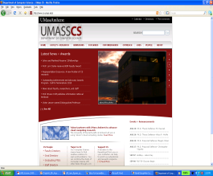



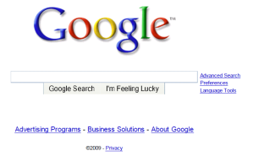
A day in the life: scenario
scenario:
DNS server
arriving mobile client attaches to network …
browser
Comcast network
68.80.0.0/13
requests web page: www.google.com
school network
68.80.2.0/24
web page
Sounds
simple!
web server
Google’s network
64.233.160.0/19
64.233.169.105
Notes:
Remember, the internet is a network of networks, so we have our school campus network connected to an ISP, which in turn is connected to Google's network.
So, our mobile laptop arrives and connects to the campus network.
It requests a webpage, and it can display the search engine's homepage.
But it's not quite that simple,

Slide 16
A day in the life: connecting to the Internet
DHCP
DHCP
UDP
IP
Eth
Phy
connecting laptop needs to get its own IP address, addr of first-hop router, addr of DNS server: use DHCP
DHCP
DHCP
arriving mobile:
DHCP client
DHCP
DHCP
DHCP request encapsulated in UDP, encapsulated in IP, encapsulated in 802.3 Ethernet
DHCP
DHCP
UDP
IP
Eth
Phy
DHCP
DHCP
DHCP
DHCP
Ethernet frame broadcast (dest: FFFFFFFFFFFF) on LAN, received at router running DHCP server
router has
DHCP server
Ethernet demuxed to IP demuxed, UDP demuxed to DHCP
Notes:
as we know.
Before the browser will be able to connect to anything, the device needs an address on the network that it just connected to.
Unlike most campus networks, it will use DHCP to get the address.
The DHCP client is an application running over UDP, so the request will be encapsulated in UDP and then in an IP and then in an Ethernet frame to be forwarded over the network.
Remember, the client doesn't know where the DHCP server is, so it will just broadcast this request.
And when it reaches the server, that frame will be demultiplexed to IP and then to UDP and then up to the DHCP server.

Slide 17
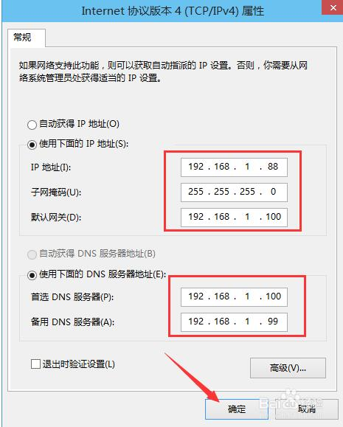
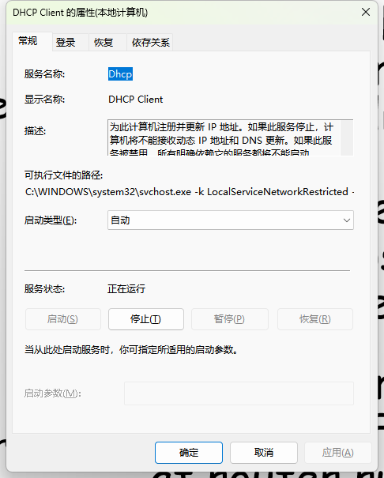
A day in the life: connecting to the Internet
DHCP
DHCP
UDP
IP
Eth
Phy
connecting laptop needs to get its own IP address, addr of first-hop router, addr of DNS server: use DHCP
DHCP
DHCP
arriving mobile:
DHCP client
DHCP
DHCP
DHCP request encapsulated in UDP, encapsulated in IP, encapsulated in 802.3 Ethernet
DHCP
DHCP
UDP
IP
Eth
Phy
DHCP
DHCP
DHCP
DHCP
Ethernet frame broadcast (dest: FFFFFFFFFFFF) on LAN, received at router running DHCP server
router has
DHCP server
Ethernet demuxed to IP demuxed, UDP demuxed to DHCP
Notes:
as we know.
Before the browser will be able to connect to anything, the device needs an address on the network that it just connected to.
Unlike most campus networks, it will use DHCP to get the address.
The DHCP client is an application running over UDP, so the request will be encapsulated in UDP and then in an IP and then in an Ethernet frame to be forwarded over the network.
Remember, the client doesn't know where the DHCP server is, so it will just broadcast this request.
And when it reaches the server, that frame will be demultiplexed to IP and then to UDP and then up to the DHCP server.

Slide 18
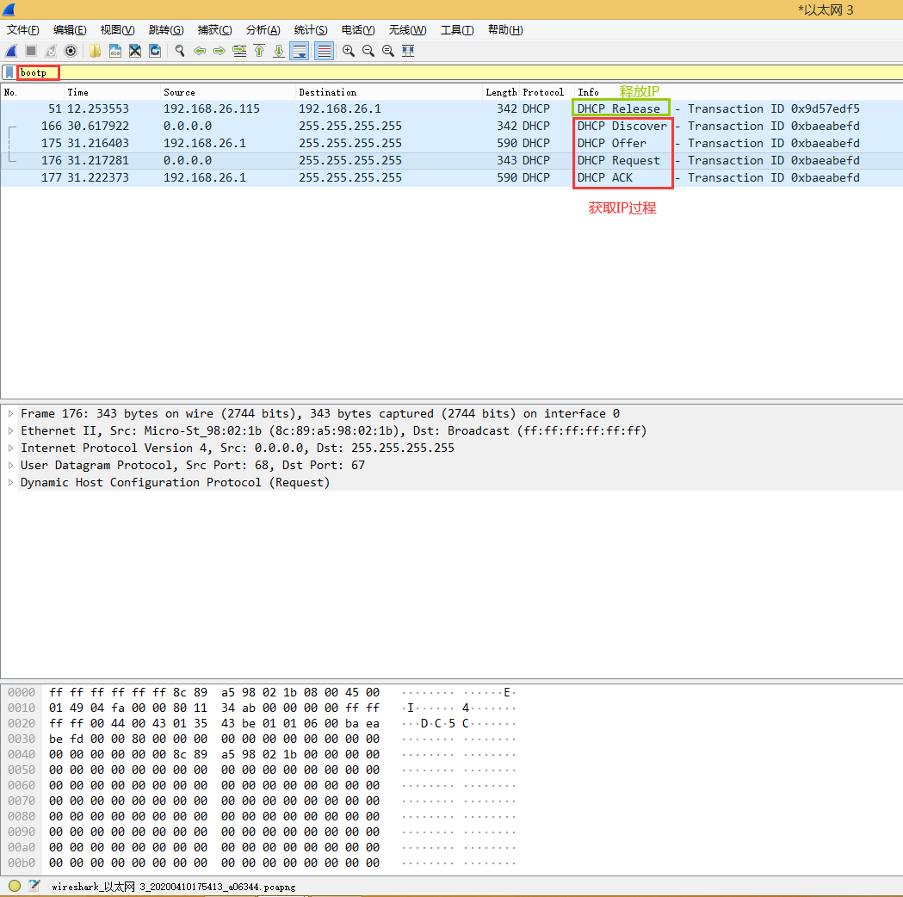
Notes:
as we know.
Before the browser will be able to connect to anything, the device needs an address on the network that it just connected to.
Unlike most campus networks, it will use DHCP to get the address.
The DHCP client is an application running over UDP, so the request will be encapsulated in UDP and then in an IP and then in an Ethernet frame to be forwarded over the network.
Remember, the client doesn't know where the DHCP server is, so it will just broadcast this request.
And when it reaches the server, that frame will be demultiplexed to IP and then to UDP and then up to the DHCP server.

Slide 19


DHCP client-server scenario
DHCP server
DHCP discover
Arriving client
src : 0.0.0.0, 68
dest.: 255.255.255.255,67
yiaddr: 0.0.0.0
transaction ID: 654
Broadcast: is there a DHCP server out there?
Notes:
In the first step, the arriving client broadcasts a DHCP message that will be received on the interfaces of all of the hosts and routers in the subnet to which it's attaching.
The Discover message basically says, "Hey, is there a DHCP server out there?" This is a form of service discovery. The host knows the service it needs (DHCP), so it sends out a broadcast to discover the server that can provide DHCP service.
DHCP runs over UDP. The client uses port 68, and the server will use port 67. In particular, the server will be listening on a socket associated with UDP port 67 for incoming DHCP messages.
And here are the details of the fields in the DHCP Discover message: the client's source IP address containing the UDP segment that contains the DHCP Discover message is zero because the client doesn't have an IP address yet, and the destination IP address is the IP broadcast address, that is all ones (255.255.255.255), and the UDP destination port number is 67, as we just noted before.
Hopefully, there'll be a DHCP server sitting out there somewhere on the subnet, listening for this service discovery message.
Note also that there's a transaction ID field. It's got a value of 654 here, and this will be used by the client to match any reply to this request.
Here's the second step: any DHCP server that receives this broadcast Discoverer message (and there might be several such servers) can reply with a DHCP offer message.
This message basically says, "Hey, I'm a DHCP server, and here's an IP address that you can use."
If we look at the details of this offer message, we see that it comes from the DHCP server with an IP address of 223.1.2.5, as in our figure earlier, and from port number 67. This offer message is being broadcast to all interfaces on the subnet. The DHCP message contains the IP address that the requesting host can use (that's the (Yiaddr) field) and a lifetime in this case of 3600 seconds, that the address can be used for.
Note that the transaction ID here matches the transaction ID of the initial offer message - that's to say, this is a reply to that message.
A client can receive offers from multiple DHCP servers, and this might occur, for example, if there are multiple routers on that subnet.
Now, the first two steps that we've seen here are actually optional. The way to think of the third step (which could also be the first step if the two optional steps aren't taken) is that the arriving client comes in and says, "Hey, here's an IP address that I want to use"
- maybe that's the IP address that it was told it could use in step two (if that step was executed), or maybe it's an address that it already has, in which case the client is really renewing its use of that address, or perhaps it's an address that the client has used before.
You can see here that this message is also broadcast, and then it contains the IP address that the host is proposing to use, and that there's a new transaction ID and a lifetime as well.
The final message is the ACK message from the DHCP server, saying basically, "Okay, you can use that IP address with this given lifetime."

Slide 20
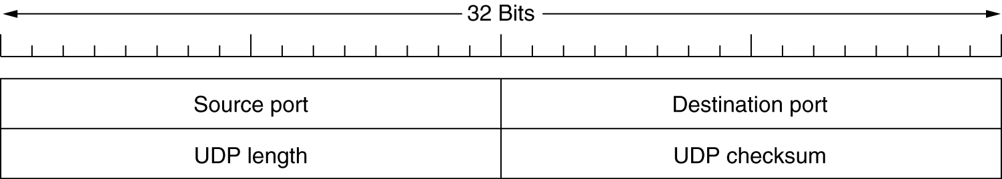
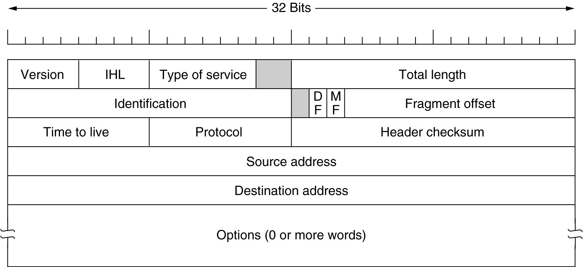
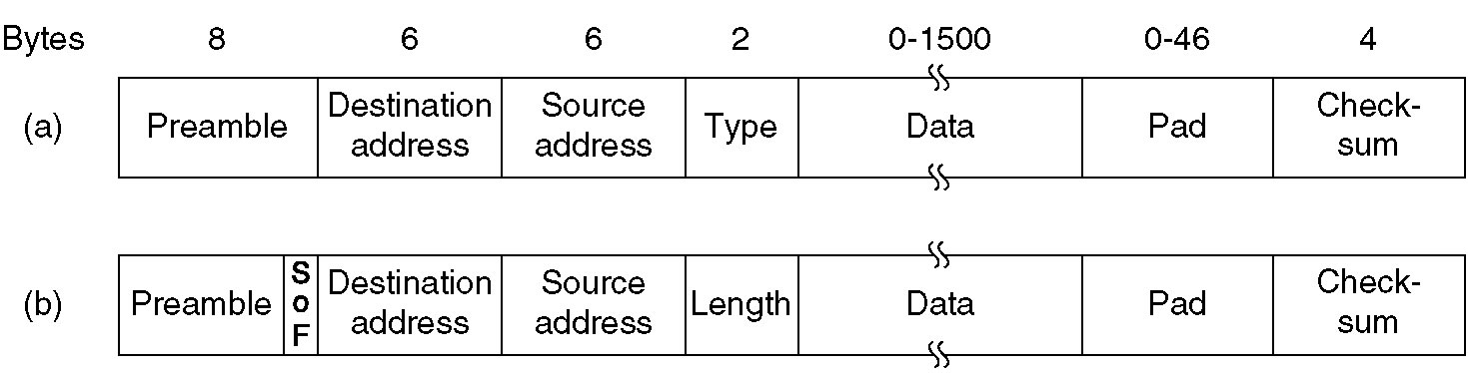
datagram
Data
packet
frame

Slide 21
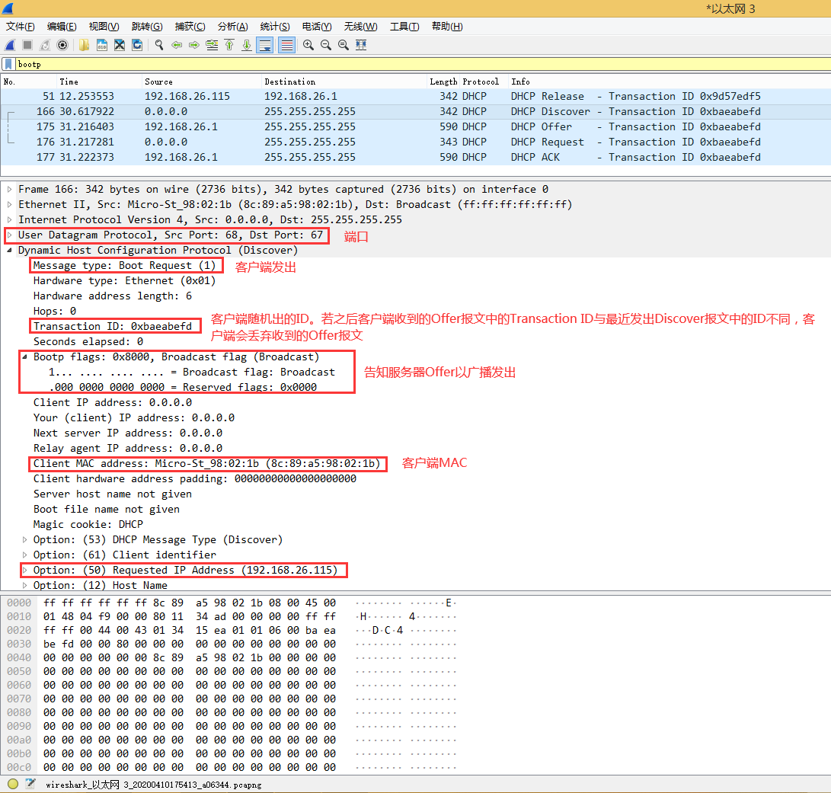
DHCP discover

Slide 22
DHCP client-server scenario
DHCP server
DHCP discover
Arriving client
src : 0.0.0.0, 68
dest.: 255.255.255.255,67
yiaddr: 0.0.0.0
transaction ID: 654
Broadcast: is there a DHCP server out there?
DHCP offer
src: 223.1.2.5, 67
dest: 255.255.255.255, 68
yiaddrr: 223.1.2.4
transaction ID: 654
lifetime: 3600 secs
Broadcast: I’m a DHCP server! Here’s an IP address you can use
Notes:
In the first step, the arriving client broadcasts a DHCP message that will be received on the interfaces of all of the hosts and routers in the subnet to which it's attaching.
The Discover message basically says, "Hey, is there a DHCP server out there?" This is a form of service discovery. The host knows the service it needs (DHCP), so it sends out a broadcast to discover the server that can provide DHCP service.
DHCP runs over UDP. The client uses port 68, and the server will use port 67. In particular, the server will be listening on a socket associated with UDP port 67 for incoming DHCP messages.
And here are the details of the fields in the DHCP Discover message: the client's source IP address containing the UDP segment that contains the DHCP Discover message is zero because the client doesn't have an IP address yet, and the destination IP address is the IP broadcast address, that is all ones (255.255.255.255), and the UDP destination port number is 67, as we just noted before.
Hopefully, there'll be a DHCP server sitting out there somewhere on the subnet, listening for this service discovery message.
Note also that there's a transaction ID field. It's got a value of 654 here, and this will be used by the client to match any reply to this request.
Here's the second step: any DHCP server that receives this broadcast Discoverer message (and there might be several such servers) can reply with a DHCP offer message.
This message basically says, "Hey, I'm a DHCP server, and here's an IP address that you can use."
If we look at the details of this offer message, we see that it comes from the DHCP server with an IP address of 223.1.2.5, as in our figure earlier, and from port number 67. This offer message is being broadcast to all interfaces on the subnet. The DHCP message contains the IP address that the requesting host can use (that's the (Yiaddr) field) and a lifetime in this case of 3600 seconds, that the address can be used for.
Note that the transaction ID here matches the transaction ID of the initial offer message - that's to say, this is a reply to that message.
A client can receive offers from multiple DHCP servers, and this might occur, for example, if there are multiple routers on that subnet.
Now, the first two steps that we've seen here are actually optional. The way to think of the third step (which could also be the first step if the two optional steps aren't taken) is that the arriving client comes in and says, "Hey, here's an IP address that I want to use"
- maybe that's the IP address that it was told it could use in step two (if that step was executed), or maybe it's an address that it already has, in which case the client is really renewing its use of that address, or perhaps it's an address that the client has used before.
You can see here that this message is also broadcast, and then it contains the IP address that the host is proposing to use, and that there's a new transaction ID and a lifetime as well.
The final message is the ACK message from the DHCP server, saying basically, "Okay, you can use that IP address with this given lifetime."

Slide 23
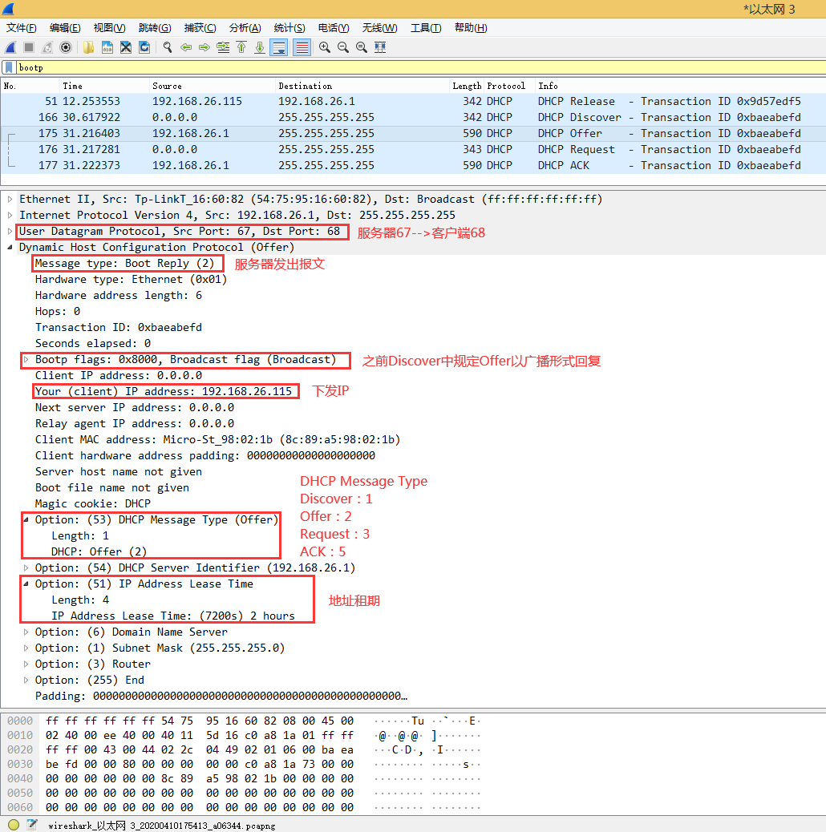
DHCP offer

Slide 24
DHCP client-server scenario
DHCP server
DHCP discover
Arriving client
src : 0.0.0.0, 68
dest.: 255.255.255.255,67
yiaddr: 0.0.0.0
transaction ID: 654
Broadcast: is there a DHCP server out there?
DHCP offer
src: 223.1.2.5, 67
dest: 255.255.255.255, 68
yiaddrr: 223.1.2.4
transaction ID: 654
lifetime: 3600 secs
Broadcast: I’m a DHCP server! Here’s an IP address you can use
DHCP request
src: 0.0.0.0, 68
dest:: 255.255.255.255, 67
yiaddrr: 223.1.2.4
transaction ID: 655
lifetime: 3600 secs
Broadcast: OK. I would like to use this IP address!
Notes:
In the first step, the arriving client broadcasts a DHCP message that will be received on the interfaces of all of the hosts and routers in the subnet to which it's attaching.
The Discover message basically says, "Hey, is there a DHCP server out there?" This is a form of service discovery. The host knows the service it needs (DHCP), so it sends out a broadcast to discover the server that can provide DHCP service.
DHCP runs over UDP. The client uses port 68, and the server will use port 67. In particular, the server will be listening on a socket associated with UDP port 67 for incoming DHCP messages.
And here are the details of the fields in the DHCP Discover message: the client's source IP address containing the UDP segment that contains the DHCP Discover message is zero because the client doesn't have an IP address yet, and the destination IP address is the IP broadcast address, that is all ones (255.255.255.255), and the UDP destination port number is 67, as we just noted before.
Hopefully, there'll be a DHCP server sitting out there somewhere on the subnet, listening for this service discovery message.
Note also that there's a transaction ID field. It's got a value of 654 here, and this will be used by the client to match any reply to this request.
Here's the second step: any DHCP server that receives this broadcast Discoverer message (and there might be several such servers) can reply with a DHCP offer message.
This message basically says, "Hey, I'm a DHCP server, and here's an IP address that you can use."
If we look at the details of this offer message, we see that it comes from the DHCP server with an IP address of 223.1.2.5, as in our figure earlier, and from port number 67. This offer message is being broadcast to all interfaces on the subnet. The DHCP message contains the IP address that the requesting host can use (that's the (Yiaddr) field) and a lifetime in this case of 3600 seconds, that the address can be used for.
Note that the transaction ID here matches the transaction ID of the initial offer message - that's to say, this is a reply to that message.
A client can receive offers from multiple DHCP servers, and this might occur, for example, if there are multiple routers on that subnet.
Now, the first two steps that we've seen here are actually optional. The way to think of the third step (which could also be the first step if the two optional steps aren't taken) is that the arriving client comes in and says, "Hey, here's an IP address that I want to use"
- maybe that's the IP address that it was told it could use in step two (if that step was executed), or maybe it's an address that it already has, in which case the client is really renewing its use of that address, or perhaps it's an address that the client has used before.
You can see here that this message is also broadcast, and then it contains the IP address that the host is proposing to use, and that there's a new transaction ID and a lifetime as well.
The final message is the ACK message from the DHCP server, saying basically, "Okay, you can use that IP address with this given lifetime."

Slide 25
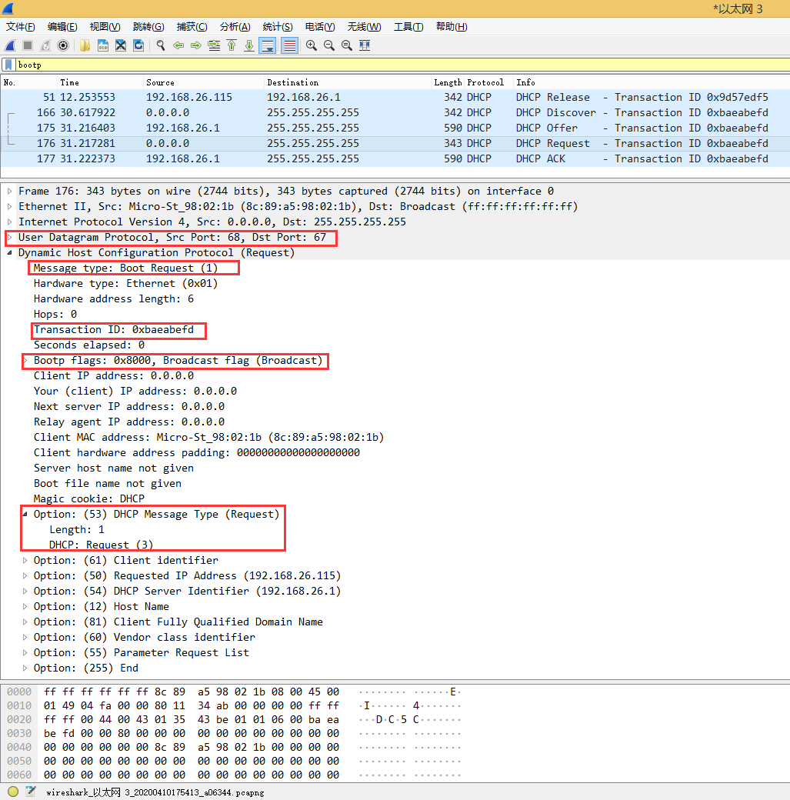
DHCP request

Slide 26
DHCP client-server scenario
DHCP server
DHCP discover
Arriving client
src : 0.0.0.0, 68
dest.: 255.255.255.255,67
yiaddr: 0.0.0.0
transaction ID: 654
Broadcast: is there a DHCP server out there?
DHCP offer
src: 223.1.2.5, 67
dest: 255.255.255.255, 68
yiaddrr: 223.1.2.4
transaction ID: 654
lifetime: 3600 secs
Broadcast: I’m a DHCP server! Here’s an IP address you can use
The two steps above can be skipped “if a client remembers and wishes to reuse a previously allocated network address” [RFC 2131]
DHCP request
src: 0.0.0.0, 68
dest:: 255.255.255.255, 67
yiaddrr: 223.1.2.4
transaction ID: 655
lifetime: 3600 secs
Broadcast: OK. I would like to use this IP address!
DHCP ACK
src: 223.1.2.5, 67
dest: 255.255.255.255, 68
yiaddrr: 223.1.2.4
transaction ID: 655
lifetime: 3600 secs
Broadcast: OK. You’ve got that IP address!
Notes:
In the first step, the arriving client broadcasts a DHCP message that will be received on the interfaces of all of the hosts and routers in the subnet to which it's attaching.
The Discover message basically says, "Hey, is there a DHCP server out there?" This is a form of service discovery. The host knows the service it needs (DHCP), so it sends out a broadcast to discover the server that can provide DHCP service.
DHCP runs over UDP. The client uses port 68, and the server will use port 67. In particular, the server will be listening on a socket associated with UDP port 67 for incoming DHCP messages.
And here are the details of the fields in the DHCP Discover message: the client's source IP address containing the UDP segment that contains the DHCP Discover message is zero because the client doesn't have an IP address yet, and the destination IP address is the IP broadcast address, that is all ones (255.255.255.255), and the UDP destination port number is 67, as we just noted before.
Hopefully, there'll be a DHCP server sitting out there somewhere on the subnet, listening for this service discovery message.
Note also that there's a transaction ID field. It's got a value of 654 here, and this will be used by the client to match any reply to this request.
Here's the second step: any DHCP server that receives this broadcast Discoverer message (and there might be several such servers) can reply with a DHCP offer message.
This message basically says, "Hey, I'm a DHCP server, and here's an IP address that you can use."
If we look at the details of this offer message, we see that it comes from the DHCP server with an IP address of 223.1.2.5, as in our figure earlier, and from port number 67. This offer message is being broadcast to all interfaces on the subnet. The DHCP message contains the IP address that the requesting host can use (that's the (Yiaddr) field) and a lifetime in this case of 3600 seconds, that the address can be used for.
Note that the transaction ID here matches the transaction ID of the initial offer message - that's to say, this is a reply to that message.
A client can receive offers from multiple DHCP servers, and this might occur, for example, if there are multiple routers on that subnet.
Now, the first two steps that we've seen here are actually optional. The way to think of the third step (which could also be the first step if the two optional steps aren't taken) is that the arriving client comes in and says, "Hey, here's an IP address that I want to use"
- maybe that's the IP address that it was told it could use in step two (if that step was executed), or maybe it's an address that it already has, in which case the client is really renewing its use of that address, or perhaps it's an address that the client has used before.
You can see here that this message is also broadcast, and then it contains the IP address that the host is proposing to use, and that there's a new transaction ID and a lifetime as well.
The final message is the ACK message from the DHCP server, saying basically, "Okay, you can use that IP address with this given lifetime."

Slide 27
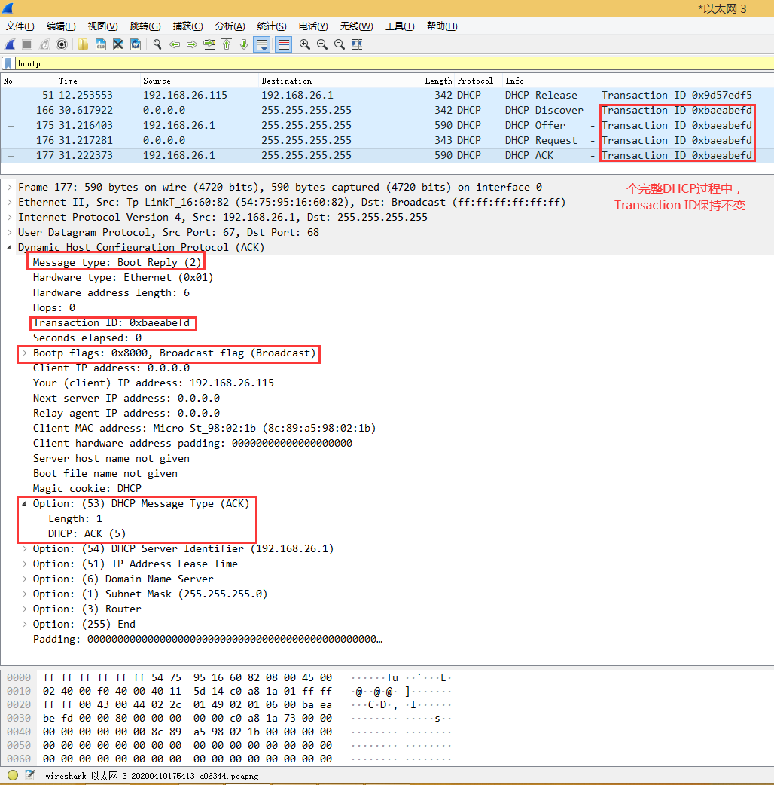
DHCP ack

Slide 28

A day in the life: connecting to the Internet
DHCP
UDP
IP
Eth
Phy
DHCP server formulates DHCP ACK containing client’s IP address, IP address of first-hop router for client, name & IP address of DNS server
DHCP
DHCP
arriving mobile:
DHCP client
DHCP
DHCP
DHCP
DHCP
UDP
IP
Eth
Phy
encapsulation at DHCP server, frame forwarded (switch learning) through LAN, demultiplexing at client
DHCP
DHCP
DHCP
DHCP
router has
DHCP server
DHCP client receives DHCP ACK reply
Client now has IP address, knows name & addr of DNS
server, IP address of its first-hop router
Notes:
Then the server will create the DHCP ACK, encapsulate it back down through all the layers, and broadcast it over the network once again to the client, where it will be returned to the DHCP application.
Remember that in order to accept this, the client will send out another request for that specific address, and it will be confirmed by the server.
So, there are four parts to this exchange.
At that point, the client will have its address, and it will also have the address of some DNS servers and the gateway router, and maybe some other details of the local network.

Slide 29
A day in the life… ARP (before DNS, before HTTP)
DNS
DNS
UDP
IP
Eth
Phy
before sending HTTP request, need IP address of www.google.com: DNS
DNS
DNS
ARP
arriving mobile:
ARP client
ARP query
DNS query created, encapsulated in UDP, encapsulated in IP, encapsulated in Eth. To send frame to router, need MAC address of router interface: ARP
ARP
ARP query broadcast, received by router, which replies with ARP reply giving MAC address of router interface
ARP reply
Eth
Phy
router has
ARP server
client now knows MAC address of first hop router, so can now send frame containing DNS query
Notes:
But we're still not ready to send the application-level request because we need to know what IP address to send that request to.
So, we're going to get ready to send the DNS request.
Again, DNS is an application that runs over UDP over IP over Ethernet, etc.
And so, that request will get encapsulated, and it will get down to the link layer.
And this DNS server is not on the local subnet, so that request needs to go through the gateway router.
While the host knows that it needs to send this to the gateway router, it doesn't have the MAC address for the gateway router.
So before we can go any further, we have to use the Address Resolution Protocol (ARP).
So, our ARP query is broadcast through the network, 'Who has this IP address?' And when the gateway router receives it, it will respond back with its MAC address.
So then, at that point, we have the necessary ARP table entry to send the frame for the DNS request out to the gateway router.

Slide 30
ARP: address resolution protocol
Question: how to determine interface’s MAC address, knowing its IP address?
ARP table: each IP node (host, router) on LAN has table
ARP
137.196.7.78
IP/MAC address mappings for some LAN nodes:
< IP address; MAC address; TTL>
TTL (Time To Live): time after which address mapping will be forgotten (typically 20 min)
ARP
1A-2F-BB-76-09-AD
ARP
LAN
71-65-F7-2B-08-53
58-23-D7-FA-20-B0
137.196.7.23
137.196.7.14
ARP
0C-C4-11-6F-E3-98
137.196.7.88
Notes:
So our next problem is how do we find out what MAC address to use as a destination to a frame? The device knows its own MAC address to use in the source field, and we've talked about how a host can use DNS to find out the IP address that it needs to send the IP packet to. But how does it find the MAC address using the destination field of the layer 2 frame? That relies on a protocol called ARP, the Address Resolution Protocol. And this is another distributed database lookup type function, but instead of mapping from a hostname to an IP address, it maps from an IP address to a MAC address.So every node on a network has to maintain an ARP table or a mapping of the IP address-MAC address pairs that it's aware of. Like most other mappings, there's a TTL after which this entry is considered stale and removed from the table. A common default for this TTL is minutes.

Slide 31
ARP protocol in action
example: A wants to send datagram to B
B’s MAC address not in A’s ARP table, so A uses ARP to find B’s MAC address
A broadcasts ARP query, containing B's IP addr
destination MAC address = FF-FF-FF-FF-FF-FF
all nodes on LAN receive ARP query
Ethernet frame (sent to FF-FF-FF-FF-FF-FF)
1
C
Source MAC: 71-65-F7-2B-08-53
Source IP: 137.196.7.23
Target IP address: 137.196.7.14
…
ARP table in A
A
B
IP addr
MAC addr
TTL
1
71-65-F7-2B-08-53
58-23-D7-FA-20-B0
137.196.7.23
137.196.7.14
D
Notes:
Now, let's see how we populate this table. We have Host A, and they want to send a datagram to Host B. We assume that Host A has already found out the IP address for Host B, and now it needs the MAC address. When it looks in its ARP table, it doesn't have a mapping for that IP address. So it will send out a broadcast ARP message.Just like the broadcast address in IP is the all-ones address, the broadcast address in Layer 2 is the all-ones address, represented by all "F"s in hexadecimal. So this Layer 2 message says, "Who has this destination IP address that A is looking for?" Every node on the local network will receive this broadcast message, and whichever one has that address should reply using its own MAC address.

Slide 32
ARP protocol in action
example: A wants to send datagram to B
B’s MAC address not in A’s ARP table, so A uses ARP to find B’s MAC address
ARP message into Ethernet frame (sent to 71-65-F7-2B-08-53)
C
Target IP address: 137.196.7.14
Target MAC address:
58-23-D7-FA-20-B0
…
ARP table in A
IP addr
MAC addr
TTL
A
B
2
71-65-F7-2B-08-53
58-23-D7-FA-20-B0
137.196.7.23
137.196.7.14
2
B replies to A with ARP response, giving its MAC address
D
Notes:
The frame has a source MAC address and inside it has a source IP address and a target IP address. Now, Host B receives this message and says, "Oh, that's my IP address!" So it responds back using an ARP response that includes its MAC address. It knows what MAC address to send this back to due to the contents of the original message.
so it has the mapping between its ip address and MAC address

Slide 33
ARP protocol in action
example: A wants to send datagram to B
B’s MAC address not in A’s ARP table, so A uses ARP to find B’s MAC address
C
ARP table in A
IP addr
MAC addr
TTL
TTL
A
137.196.
7.14
58-23-D7-FA-20-B0
500
B
71-65-F7-2B-08-53
58-23-D7-FA-20-B0
137.196.7.23
137.196.7.14
3
A receives B’s reply, adds B entry into its local ARP table
D
Notes:
Host A can then update its ARP table with the contents of this message, and then it can send out all the frames that it needs to the destination MAC address.

Slide 34
A day in the life… ARP (before DNS, before HTTP)
DNS
DNS
UDP
IP
Eth
Phy
before sending HTTP request, need IP address of www.google.com: DNS
DNS
DNS
ARP
arriving mobile:
ARP client
ARP query
DNS query created, encapsulated in UDP, encapsulated in IP, encapsulated in Eth. To send frame to router, need MAC address of router interface: ARP
ARP
ARP query broadcast, received by router, which replies with ARP reply giving MAC address of router interface
ARP reply
Eth
Phy
router has
ARP server
client now knows MAC address of first hop router, so can now send frame containing DNS query
Notes:
But we're still not ready to send the application-level request because we need to know what IP address to send that request to.
So, we're going to get ready to send the DNS request.
Again, DNS is an application that runs over UDP over IP over Ethernet, etc.
And so, that request will get encapsulated, and it will get down to the link layer.
And this DNS server is not on the local subnet, so that request needs to go through the gateway router.
While the host knows that it needs to send this to the gateway router, it doesn't have the MAC address for the gateway router.
So before we can go any further, we have to use the Address Resolution Protocol (ARP).
So, our ARP query is broadcast through the network, 'Who has this IP address?' And when the gateway router receives it, it will respond back with its MAC address.
So then, at that point, we have the necessary ARP table entry to send the frame for the DNS request out to the gateway router.

Slide 35
A day in the life… using DNS
DNS
DNS
UDP
IP
Eth
Phy
DNS
DNS
DNS
UDP
IP
Eth
Phy
demuxed to DNS
DNS replies to client with IP address of www.google.com
DNS
DNS
DNS
DNS
DNS
DNS
server
DNS
DNS
Comcast network
68.80.0.0/13
IP datagram containing DNS query forwarded via LAN switch from client to 1st hop router
IP datagram forwarded from campus network into Comcast network, routed (tables created by RIP, OSPF, IS-IS and/or BGP routing protocols) to DNS server
Notes:
In this case, the DNS server is being run by the ISP.
And so, our UDP packet gets to the gateway router and then it can be forwarded over to the ISP's network and through their network to the DNS server.
But remember, for all that to work, the ISP's intra-domain routing protocol must be working in order to distribute the forwarding tables to the routers.
And also, BGP must be working between the campus network and the ISP.
Alright, now that our frame has arrived at the DNS server, it's demultiplexed up through the stack to the DNS application running over UDP.
This will be a recursive resolver.
In this case, it looks like it already has Google's IP address cached.
But if it didn't, it would have to go out through the DNS hierarchy, querying the root and then the TLD servers and then Google's authoritative name server to get that IP address back and send it back to the requesting client.

Slide 36
A day in the life…TCP connection carrying HTTP
HTTP
HTTP
TCP
IP
Eth
Phy
to send HTTP request, client first opens TCP socket to web server
SYNACK
SYN
SYNACK
SYN
SYNACK
SYN
SYN
Comcast network
68.80.0.0/13
TCP SYN segment (step 1 in TCP 3-way handshake) inter-domain routed to web server
TCP
IP
Eth
Phy
SYNACK
SYN
SYNACK
SYN
web server responds with TCP SYNACK (step 2 in TCP 3-way handshake)
SYNACK
SYNACK
SYN
Google web server
64.233.169.105
TCP connection established!
Notes:
Now that the client knows what IP address to send the request to, we finally get to the HTTP protocol itself, where the GET request is created.
But before that can be encapsulated, we have to perform the TCP connect.
So, TCP creates the control message, encapsulates it down to the stack, and completes part one of the three-way handshake.
When that reaches the transport layer, TCP will respond to the SYN-ACK and send that back through the network to the client.
Once TCP ACKs the SYN-ACK, the connection is fully established.
Usually, TCP will piggyback the initial data with that ACK, so the GET request can be sent out at this point.

Slide 37
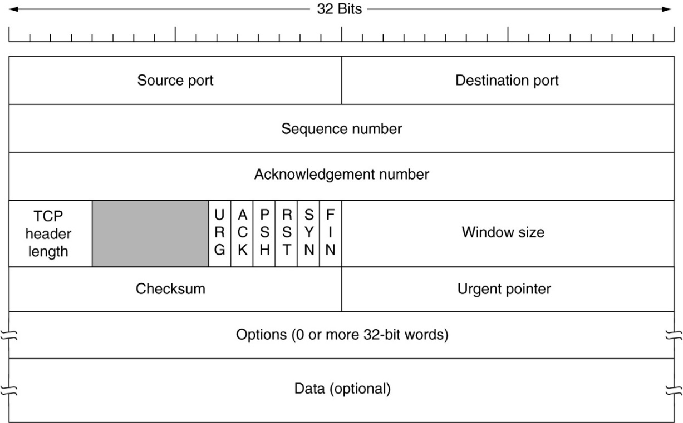

Slide 38
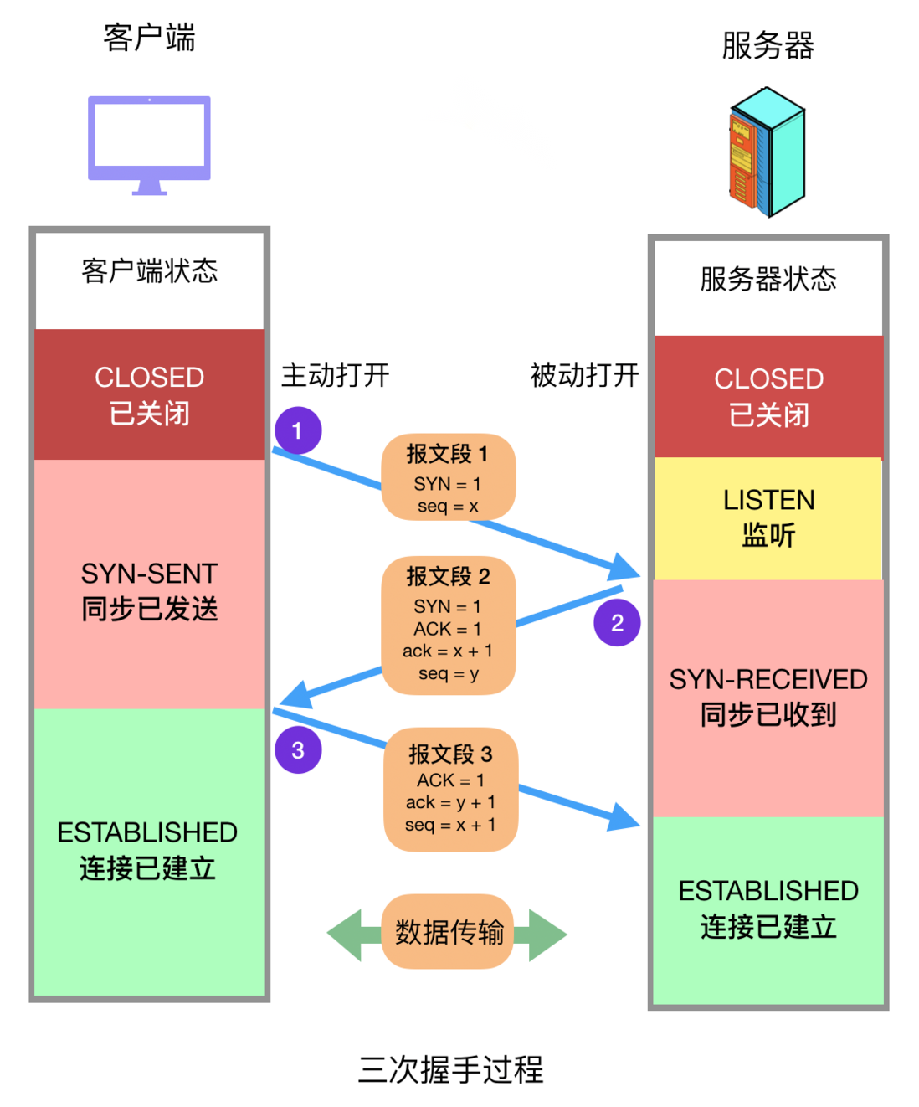

Slide 39
A day in the life… HTTP request/reply
HTTP
HTTP
TCP
IP
Eth
Phy
HTTP request sent into TCP socket
HTTP
HTTP
HTTP
web page finally (!!!) displayed
HTTP
HTTP
HTTP
HTTP
HTTP
Comcast network
68.80.0.0/13
IP datagram containing HTTP request routed to www.google.com
web server responds with HTTP reply (containing web page)
HTTP
HTTP
TCP
IP
Eth
Phy
HTTP
HTTP
HTTP
HTTP
IP datagram containing HTTP reply routed back to client
Google web server
64.233.169.105
Notes:
Now we can look at the HTTP layer finally, and we see the GET request being encapsulated over TCP and sent out.
Keeping in mind, TCP will be employing slow start and congestion management throughout all of this.
So, that message is sent over to the server, which decapsulates it up to the web server application.
And the server can respond back with the reply, which would contain the web page requested, assuming the request is valid.
Then, once that packet gets back to the client and demultiplexed up to the application, it can begin displaying the web page.
Of course, this initial object would only be the base HTML, and any style or graphics or what have you that are referenced in that HTML would have to be retrieved in additional connections.
So, as complicated as this day in the life of a web request process was, we still had to simplify a number of steps along the way.
But hopefully, that's helpful in connecting the dots between all of the layers that we've looked at so far in the class.

Slide 40
A day in the life… HTTP request/reply
HTTP request sent into TCP socket
initiate TCP
connection
IP datagram containing HTTP request routed to www.google.com
RTT
request file
RTT
time to
transmit
file
web server responds with HTTP reply (containing web page)
file received
IP datagram containing HTTP reply routed back to client
time
time

Slide 41
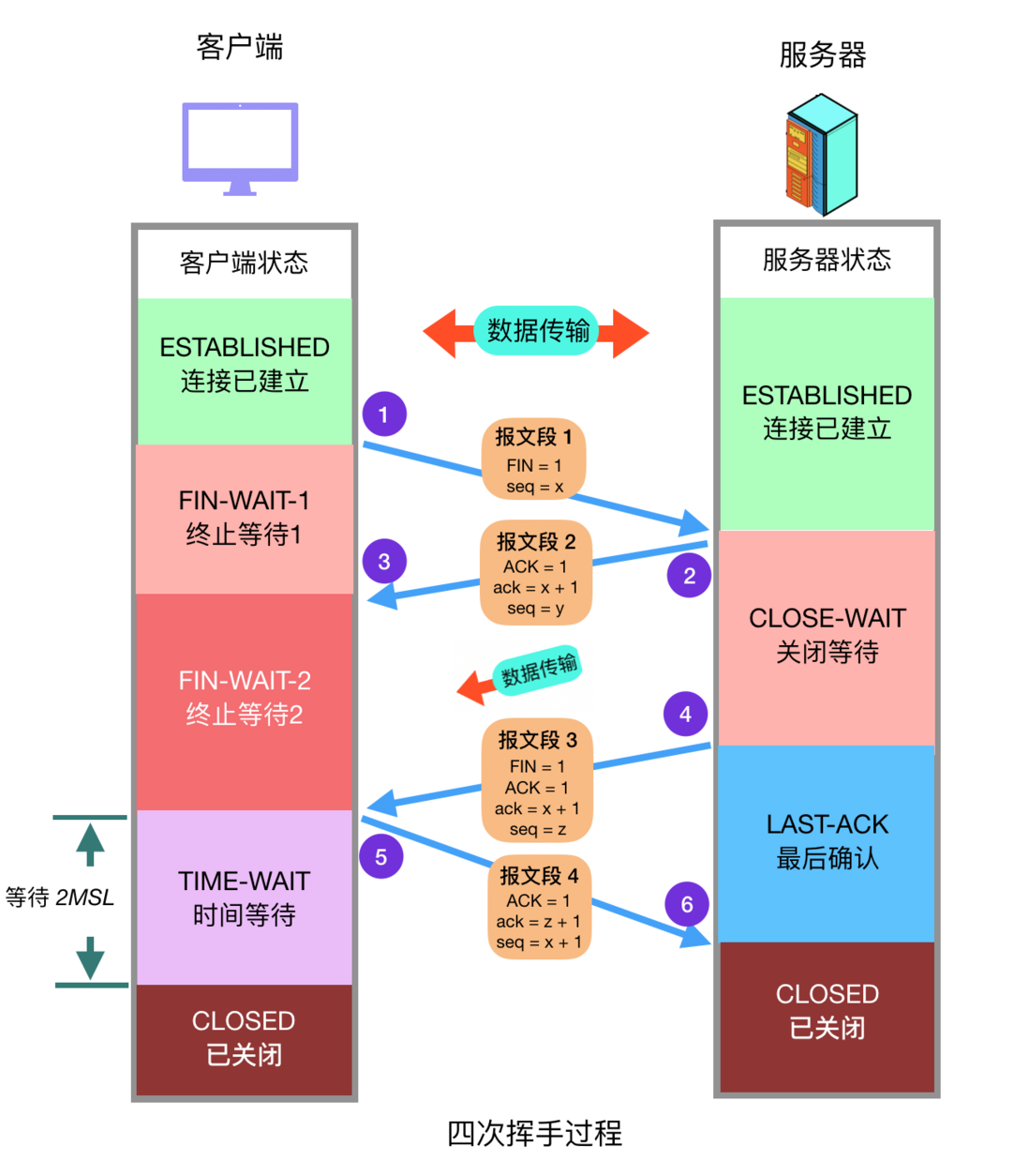

Slide 42
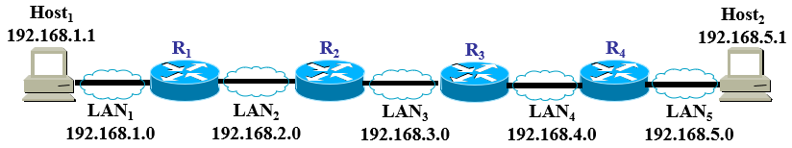
An internet consists of LAN₁, LAN₂, LAN₃, LAN₄ and LAN₅, which are connected by four routers, i.e. R₁, R₂, R₃ and R₄, with a subnet mask of 255.255.255.0
Please configure IP address for all routers

Slide 43
An internet consists of LAN₁, LAN₂, LAN₃, LAN₄ and LAN₅, which are connected by four routers, i.e. R₁, R₂, R₃ and R₄, with a subnet mask of 255.255.255.0
Please configure routing tables for router R₂ so that all IP packets can be routed to any destination network. (Do not use the Default route)
destination network | subnet mask | next hop

Slide 44
If we capture a data frame from the data link layer at LAN₃, as shown in the following figure. What are the source IP address and destination IP address in the Packet header (in dotted decimal notation以点分十进制的形式) ? What are the port numbers to indicate the source and destination processes on the host and the Web server respectively?
Frame Header: Frame Type 0x0800
Destination MAC Address | 00:21:27:21:51:EE
Source MAC Address | 00:15:C5:C1:5E:28
Frame Data 0000-000F 45 00 01 EF 11 3B 40 00 F8 06 BA 9D C0 A8 01 01 0010-001F C0 A8 05 01 04 FF 00 50 E0 E2 00 FA 7B F9 F8 05 0020-002F 50 18 FA F0 1A C4 00 00 47 45 54 20 2F 72 66 63 0030-003F 2E 68 74 6D 6C 20 48 54 54 50 2F 31 2E 31 0D 0A

Slide 45
If we capture a data frame from the data link layer at LAN₃, as shown in the following figure. What are the source IP address and destination IP address in the Packet header (in dotted decimal notation以点分十进制的形式) ? What are the port numbers to indicate the source and destination processes on the host and the Web server respectively?
Frame Data 0000-000F 45 00 01 EF 11 3B 40 00 F8 06 BA 9D C0 A8 01 01 0010-001F C0 A8 05 01 04 FF 00 50 E0 E2 00 FA 7B F9 F8 05 0020-002F 50 18 FA F0 1A C4 00 00 47 45 54 20 2F 72 66 63 0030-003F 2E 68 74 6D 6C 20 48 54 54 50 2F 31 2E 31 0D 0A

Slide 46
An internet consists of LAN₁, LAN₂, LAN₃, LAN₄ and LAN₅, which are connected by four routers, i.e. R₁, R₂, R₃ and R₄, with a subnet mask of 255.255.255.0
Assuming Host 2 is a web server. Using HTTP/1.1 protocol with persistent connections in Non-pipelined mode (HTTP/1.1协议，持续的连接，非流水线方式), and the time for one "HTTP Request-Response" is RTT. The Web page (page.html) contains 5 JPEG images. How many RTT will be needed for the host to get the whole Web page?

Slide 47
The End!
Thanks for your attention!

