Slide 1
计算机网络复习

Slide 2
About this course …
Course Work and Evaluation:
Assignments作业（10%）（考前拍照扫描提交，带封面，修改订正）
Labs实验（20%）（提交时间后续通知，智能2班下周一前提交前两个实验报告到605，班委收齐）
Final Examination期末考试 (70%):8 道大题（简答题+分析题+计算题）闭卷，120min

Slide 3
Introduction (contd.)
Chapter 1

Slide 4
The Client-Server Partnership
Applications (1)
Client-Server 客户/服务器模式
Internet
Two pieces of software that work together
Client: software application on user’s computer which retrieves查询, displays information for user
Server: stores and sends information to clients as requested
Notes:
Rogers Cable and your TV set (if you have a black-and-white Model, you can’t see the colour programs that Rogers provides). Rogers (the server)sends out the signal to your TV (the client)
The server, which can be any Internet computer
One of the main relationships governing the Internet

Slide 5
Client-Server 客户/服务器模式
Applications (1)
Client-Server networking is a distributed application architecture that partitions tasks or work loads between
servers (service providers)
clients (service requesters)
Often clients and servers operate over a computer network on separate hardware.

Slide 6
Applications (2)
Peer-to-Peer 对等模式
A peer-to-peer(P2P) is a distributed network architecture composed of participants that make a portion of their resources directly available to other network participants.

Slide 7
Classification of Networks
by scale覆盖范围:
LAN (Local Area Network)
MAN (Metropolitan Area Network)
WAN (Wide Area Network)

Slide 8

Classification of Networks
by transmission media传输介质:
Wireless network
Wired network

Slide 9
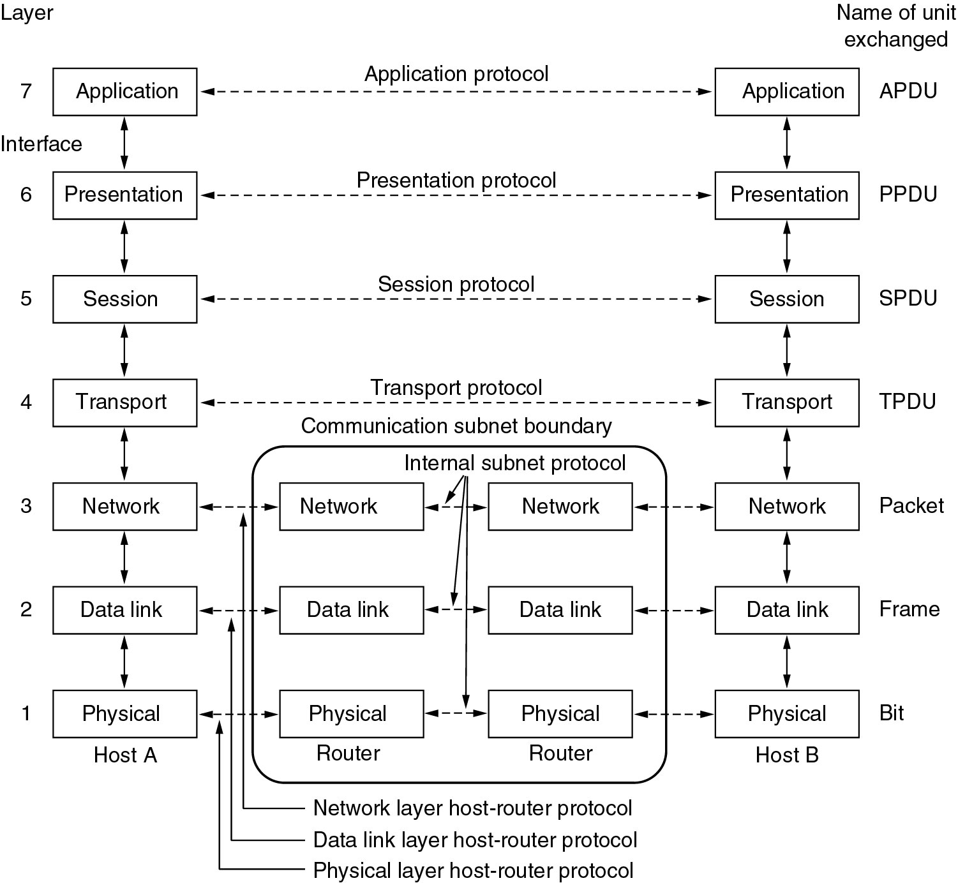
The ISO/OSI Reference Models
应用层
表示层
会话层
运输层
网络层
数据链路层
物理层

Slide 10
Data Transmission from one host to another one across the network
Application
Application
Presentation
Presentation
Session
Session
TCP Header | Data
Transport
Transport
IP Header | Data
Network
Network
Ethernet Header | Data
Data Link
Data Link
Physical
Physical
Physical

Slide 11
The ISO/OSI Reference Models
One layer offers services to the layer above it using an inter-face 每层通过接口向上一层提供服务
Each layer passes data & control information to the layer below; eventually physical medium is reached每层传递数据和控制信息到下一层，直到物理介质

Slide 12
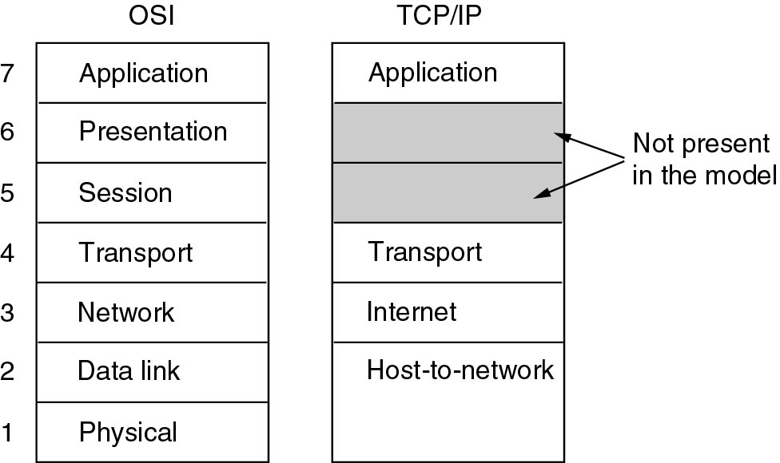
Reference Models
The TCP/IP reference model.

Slide 13
The ISO/OSI Reference Models
Physical → how to transmit bits位
Data link → how to transmit frames数据帧
Network → how to route packets数据包 to the node
Transport → how to send messages报文 to the application processes
Session → manage connections
Presentation → encode/decode data, security
Application → everything else!

Slide 14
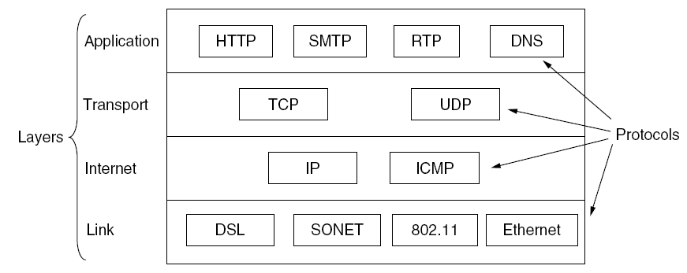
Reference Models
Protocols and networks in the TCP/IP model initially.

Slide 15
The Network Core
mesh of interconnected routers
the fundamental question: how is data transferred through net?
Circuit-switching电路交换
packet-switching分组交换

Slide 16
The total delay
总时延=处理时延+排队时延+发送时延+传播时延
H4
H2
H6
B
D
A
E
H1
C
H5
H3

Slide 17
Internet structure: a “network of networks”
Tier 1 ISP
Tier 1 ISP
Google
IXP
IXP
IXP
Regional ISP
Regional ISP
access
ISP
access
ISP
access
ISP
access
ISP
access
ISP
access
ISP
access
ISP
access
ISP
At “center”: small # of well-connected large networks
“tier-1” commercial ISPs (e.g., Level 3, Sprint, AT&T, NTT), national & international coverage
content provider networks (e.g., Google, Facebook): private network that connects its data centers to Internet, often bypassing tier-1, regional ISPs
Notes:
at the center of the internet we have a relatively small number of well-connected large networks/ these are sometimes called tier 1 commercial isps such as level 3/ sprint /at&t /ntt that have national and international coverage /moving closer to the edge there are the regional networks interconnecting with each other / and at the very edge of the network then are the access networks /and then of course there are the content provider networks like google and facebook /the private networks that connect their data centers and services to the internet and sometimes bypassing tier one and regional isps /
we've introduced a number of really important concepts here/ we talked about the packet forwarding process /we talked about store and forward networks /we talked about queuing delays /the possibility for packet loss and we distinguished between packet forwarding and packet routing/ we also talked about an alternative to packet switch networks known as circuit switch networks /and we talked about the pros and cons of each and we finished up by talking about the concept the internet being a network of networks/ coming up next we're going to take a look at network performance

