Slide 1
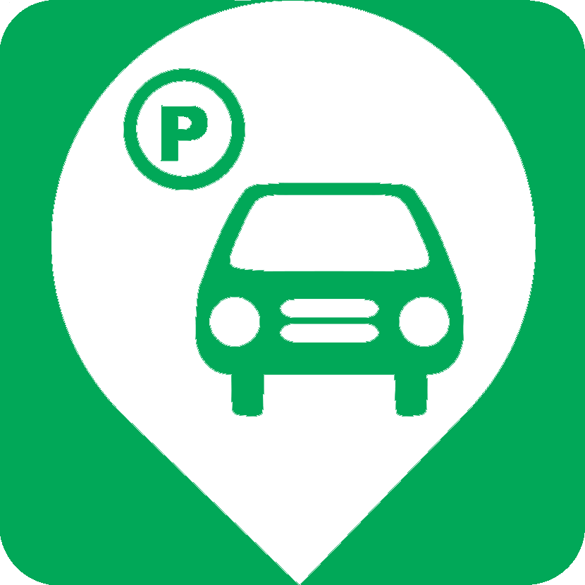

WaterPark
Making The Parking Efficient and Economical
- Sanam / Bastin / Vishal
Notes:
Waterloo + Parking
Something useful to normal public
Economical

Slide 2
Technicality
Making multiple datasets available through REST services
Real-time data about parking
Private
Public
Google Maps V3 API
Notes:
Tomcat with MongoDB database
UI on Android with Material Design interface

Slide 3


Originality
Collaboration of private parking
Offer your driveway for a sum per day
Easy search: Those who need parking will all parking spaces
Private – markers shown in Azure color
Public – markers shown in Orange color
Public and Private parking available on same platform

Slide 4
Practicality & aesthetic
Solves the problem of parking space.
Online status of public parking.(Approx.)
A great way to use unused parking spaces at home to make money.

Slide 5
Dataset usage
City of Waterloo
OpenData Bicycle Parking
OpenData Parking Lots (includes Motorcycle/Car)
University of Waterloo
UWaterloo Parking Dataset

Slide 6
Dataset usage
City of Waterloo
OpenData Bicycle Parking
OpenData Parking Lots (includes Motorcycle/Car)
University of Waterloo
UWaterloo Parking Dataset
Bonus
Creating more datasets (Not Open though)

Slide 7
Wow Factor
AIRPNP
(AirBnB of the parking (huge monetary aspect))
Navigation to the parking Space
Online status update of private parking

Slide 8
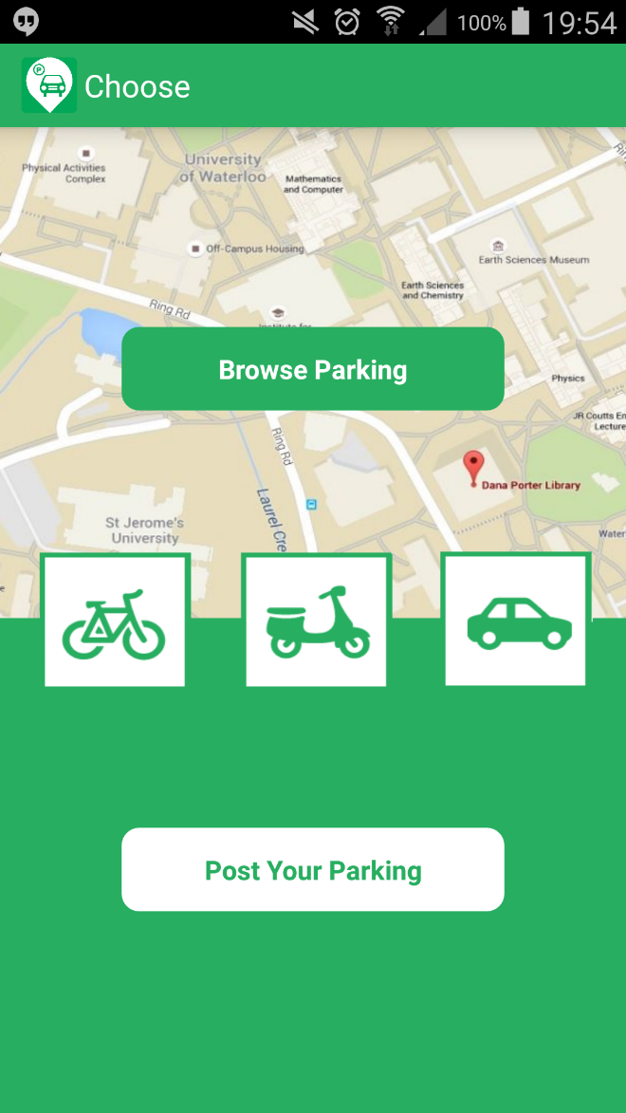
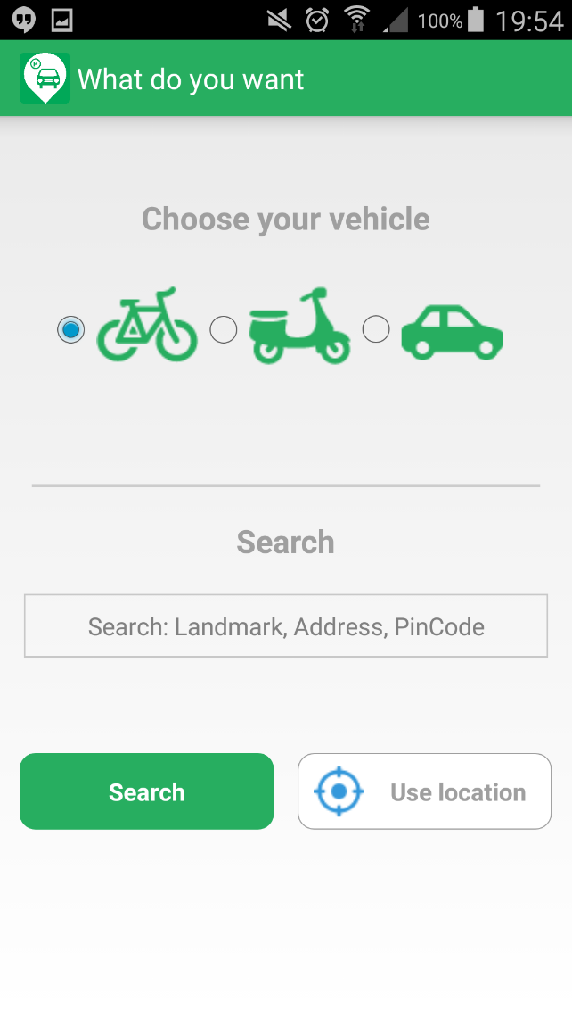
Screen Flow

Slide 9
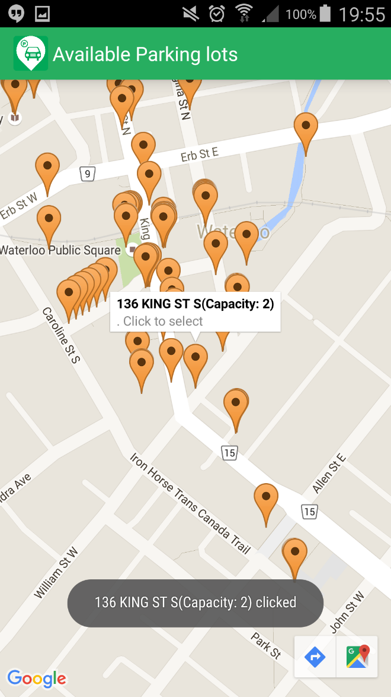
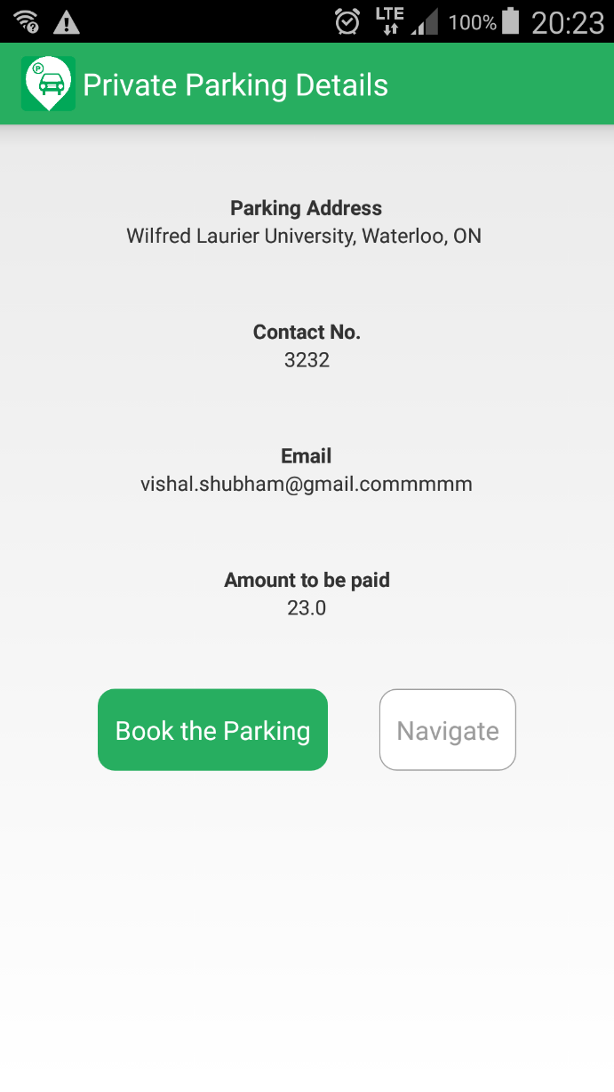
Screen Flow

Slide 10
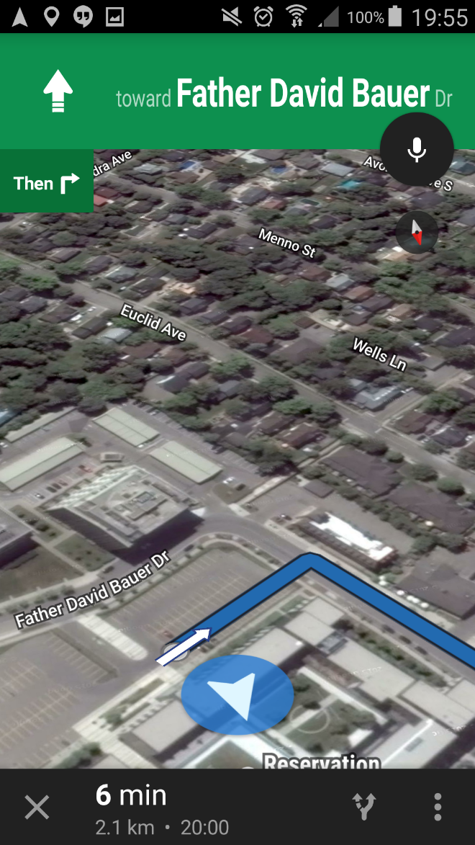
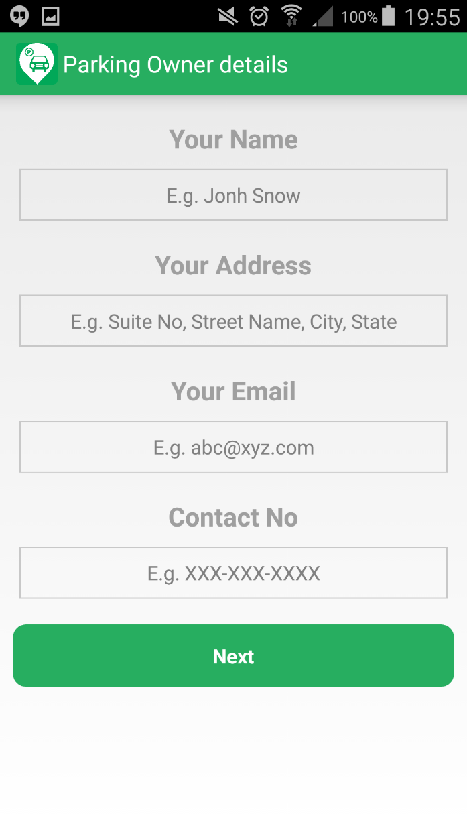
Screen Flow

Slide 11
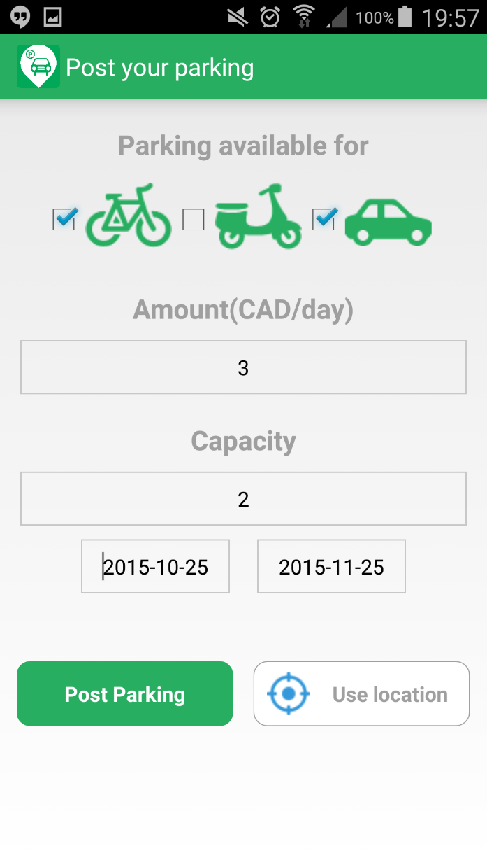
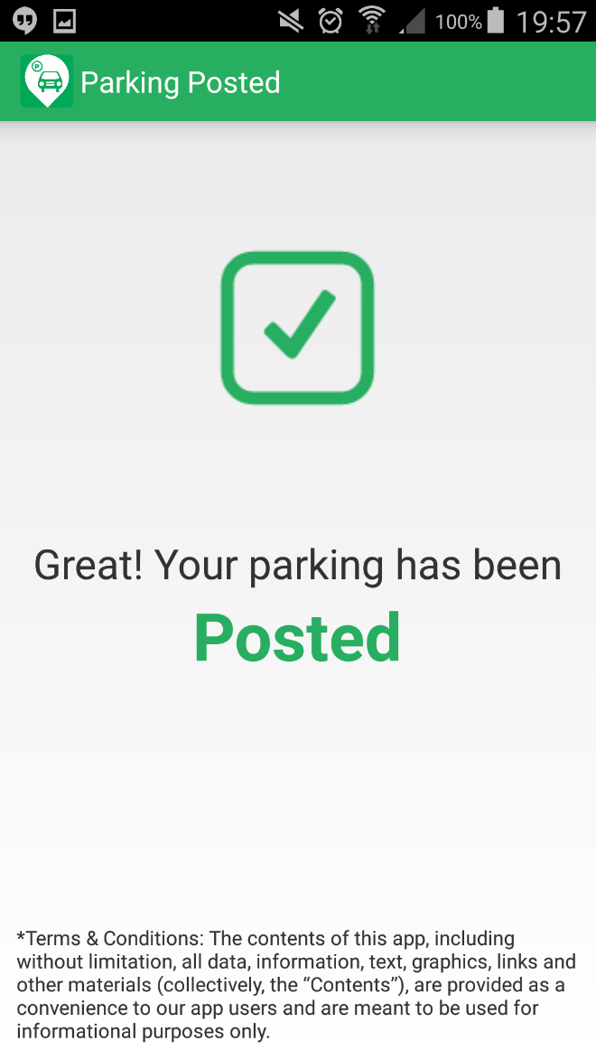
Screen Flow

Slide 12
Q & A
Github.com/vishalshubham/waterpark

