Slide 1
Sonic Disk Single Level Version Assembly

Slide 2
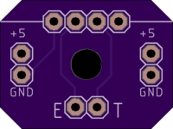
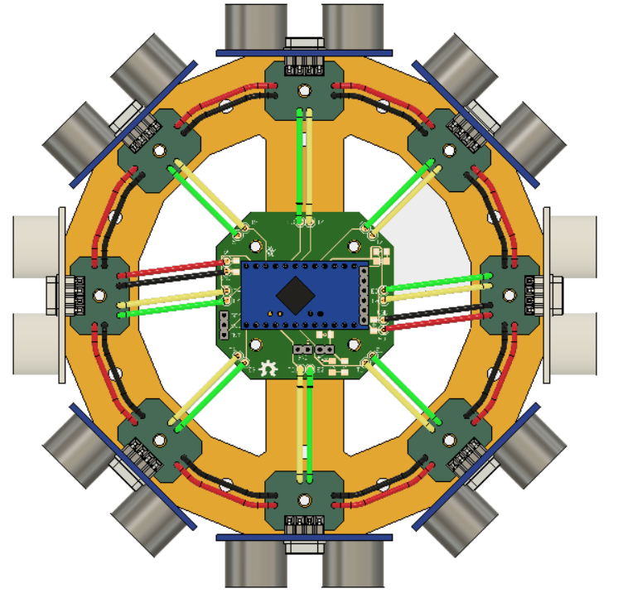
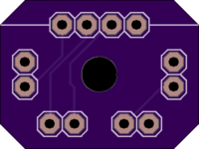
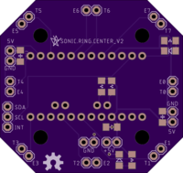
RingSection_B: need 6 – t these each hold one sonic sensor
RingSection_C: need 2 – these each hold one sonic sensor, and also connect power to the RingCenter
RingCenter_v2: need 1 – this is the center

Slide 3
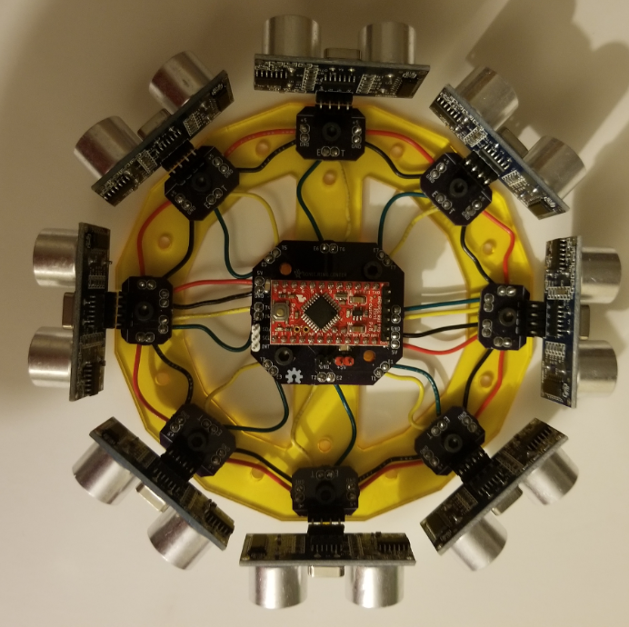
The center ring has spaces for
SMD pullup resistors on the I2C lines,
Some filter caps , and LEDS (a power LED and an indicator LED)
It uses a pro mini, and has header pins for I2C, & INT outputs, and power.

Slide 4
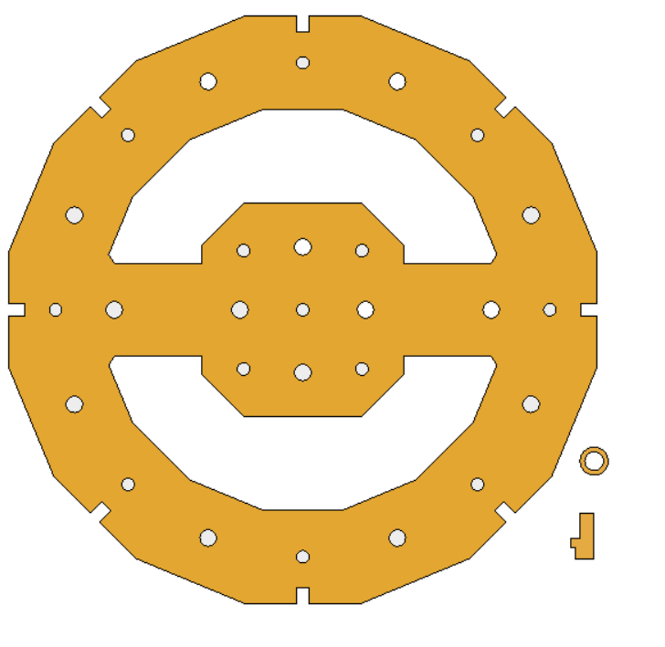
PCBS are screwed to a laser cut 2.75mm acrylic plate using ¼” 6-32 screws
(92196A144)
Tap Holes
Remaining holes are for attachment to your project
Standoffs for PCB
Use weld-on 4 to put these in the grooves to
stop the PCBS rotatings while you are putting it together
(probably not necessary, and weld-on 4 is highly toxic so may not be worth it)

Slide 5
