Slide 1


PROJECT PRESENTATION
Design and Implementation of a Smart Attendance System Using Acoustic Beacon and BLE Proximity Verification
UNIVERSITY OF ILORIN, ILORIN Faculty of Communication and Information Sciences Department of Telecommunication Science
Presented by:
OLUGBEMI Joshua Iyanuoluwa – 21/52HP071
Project Supervisor:
Dr. IMAM FULANI
March, 2026

Slide 2
INTRODUCTION
Background of the Study
Attendance management in higher education is still affected by operational delay and weak proof of physical presence:
- Manual roll call reduces teaching time and becomes difficult in large classes.
- Paper registers can be altered or signed by proxy.
- Static QR codes and PINs can be copied or shared outside the classroom.
- Login-based systems confirm identity, but may not prove classroom proximity.
From a telecommunications perspective, attendance can be treated as signal verification: the lecturer broadcasts a short-lived proof, the student device receives it through BLE or acoustic scanning, and the backend validates the submitted proof.
In the current design, BLE provides the main practical classroom-range signal, acoustic beaconing provides short-range copresence evidence, and the hosted backend handles freshness, replay, duplicate, and device-trust checks.
Smart Attendance System | Dept. of Telecommunication Science | University of Ilorin

Slide 3
LITERATURE REVIEW
S/N | TITLE | AUTHOR & YEAR | WORK DONE | RESULT | WEAKNESS / GAP
1 | Location-aware Event Attendance System using QR Code and GPS Technology | Ayop et al. (2018) | Developed a mobile/web attendance system combining QR code, GPS location, identity and timestamp. | Improved attendance tracing and event registration speed. | QR codes can still be shared; GPS is less reliable for indoor classroom proximity.
2 | Ultrasonic Communication Using Consumer Hardware | Getreuer et al. (2018) | Implemented near-ultrasonic token transmission using commodity smartphone speakers and microphones. | Showed that phones can exchange short copresence tokens acoustically. | Not an attendance system; performance depends on speaker, microphone, distance and noise.
3 | Neutralizing BLE Beacon-Based Electronic Attendance System Using Signal Imitation Attack | Kim et al. (2018) | Analyzed BLE beacon attendance systems and demonstrated signal imitation/forwarding risks. | Proved that BLE attendance must not trust beacon detection alone. | Requires freshness, replay protection and backend validation to reduce attack risk.
4 | Classroom Attendance Systems Based on Bluetooth Low Energy Indoor Positioning Technology for Smart Campus | Puckdeevongs et al. (2020) | Used BLE RSSI and indoor-positioning methods to support classroom attendance monitoring. | Demonstrated BLE usefulness for smart-campus attendance and classroom location estimation. | RSSI varies with room layout, obstacles, phone model and beacon placement.
5 | A Practice of BLE RSSI Measurement for Indoor Positioning | Ramirez et al. (2021) | Studied practical BLE RSSI measurements for indoor positioning and proximity analysis. | Showed that BLE RSSI can support indoor proximity estimation. | RSSI fluctuates due to device differences, obstacles, orientation and indoor conditions.
Smart Attendance System | Dept. of Telecommunication Science | University of Ilorin

Slide 4
Problem Statement
Attendance in many higher-education classrooms is still recorded through manual roll calls, paper registers, static QR codes, or PIN-based systems. These approaches may record names, but they often do not provide strong evidence that the authenticated student is physically present in the classroom.
- Manual attendance wastes teaching time, especially in medium and large classes.
- Paper registers and shared codes are vulnerable to proxy attendance and tampering.
- QR codes, PINs, and login-only systems can be copied, forwarded, or reused outside the intended classroom context.
- Many existing systems verify identity but do not adequately verify proximity, signal freshness, replay resistance, or device trust.
Therefore, the problem addressed by this project is the need for a mobile attendance system that combines session-specific proximity proof with backend validation, so that attendance submissions are faster, harder to duplicate, and more resistant to proxy or replay-based abuse.
Smart Attendance System | Dept. of Telecommunication Science | University of Ilorin

Slide 5
AIM AND OBJECTIVES
AIM:
To design and implement a secure, role-aware smart attendance system that uses BLE and acoustic proximity proof with hosted backend validation to reduce fraud and attendance processing delay.
OBJECTIVES:
1
Design a mobile-based smart attendance system for creating and broadcasting session-specific attendance signals.
2
Implement proximity verification using Bluetooth Low Energy as the main classroom-range signal and acoustic beaconing as short-range copresence evidence.
3
Develop a hosted backend validation system using session identity, freshness, duplicate prevention, replay protection, and device-trust checks.
4
Provide lecturer and student interfaces for scanning, proof submission, attendance history, validation reports, and CSV export.
5
Evaluate the system on real Android devices under different distances, permission states, signal conditions, and classroom-like scenarios.
Smart Attendance System | Dept. of Telecommunication Science | University of Ilorin

Slide 6
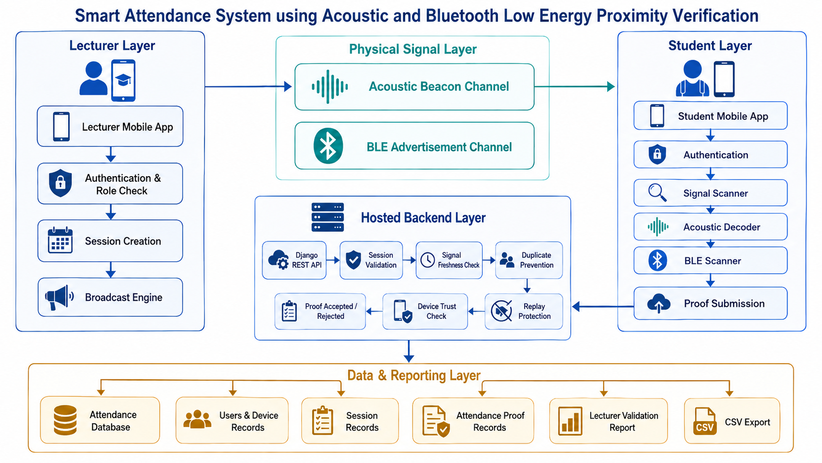
METHODOLOGY: SYSTEM ARCHITECTURE
CLIENT TIER — Flutter (Android)
Research Basis
- BLE attendance: Puckdeevongs et al. (2020)
- BLE security: Kim et al. (2018)
- BLE RSSI limits: Ramirez et al. (2021)
- Acoustic channel: Getreuer et al. (2018)
Smart Attendance System | Dept. of Telecommunication Science | University of Ilorin

Slide 7
METHODOLOGY: CODE-LEVEL DESIGN
Key backend models and proof-validation logic used in the implementation
Django Data Models
Proof Construction Fields
- Session: course, lecturer, room, start/end time, active state.
- UserProfile: student/lecturer role, matric number, registered_device_id.
- AttendanceProof: submitted proof, device ID, RSSI, timestamp and trust status.
- AttendanceReplayGuard: stores used proof combinations to prevent reuse.
- Student identity comes from authenticated login, not manual input.
- Device ID is submitted from the registered student phone.
- BLE nonce and/or acoustic token are captured from live classroom broadcast.
- observed_at records when the student device captured the signal.
Backend Validation Logic
Report and Output Layer
- Serializer checks freshness window and active session ownership.
- Duplicate check enforces one accepted proof per student per session.
- Replay guard rejects reused challenge/nonce combinations.
- Device-trust check blocks or flags mismatched registered devices.
- Lecturer validation report is filtered by the selected/current session.
- Attendance record includes student name, matric number, device ID and scan mode.
- CSV export supports administrative use after attendance collection.
- Clear error messages reduce confusing technical failures during tests.
Implementation principle: the mobile app captures evidence, but the backend models and serializers enforce the attendance rules.
Smart Attendance System | Dept. of Telecommunication Science | University of Ilorin

Slide 8
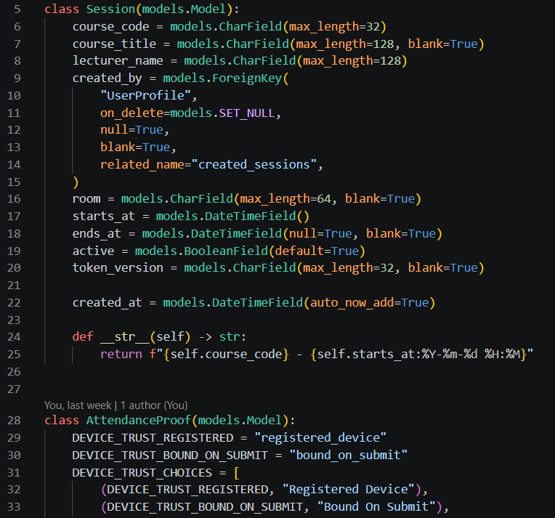
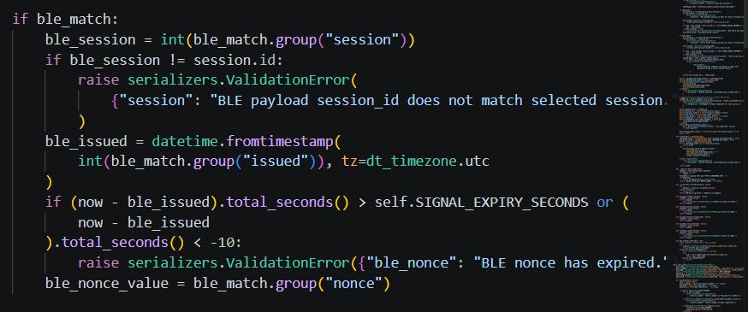
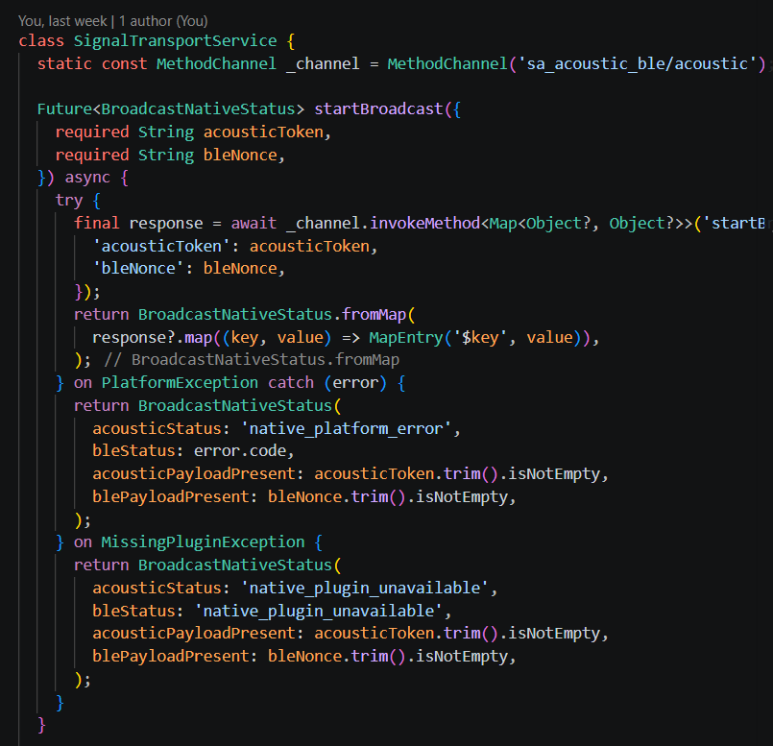
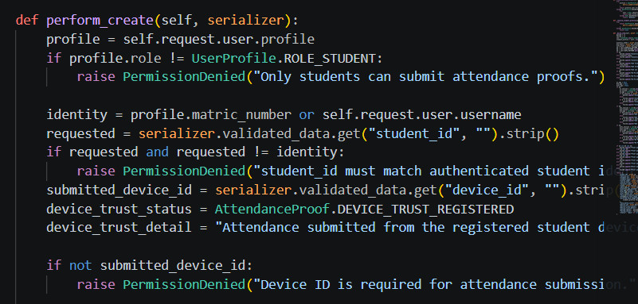
IMPLEMENTATION: CODE SCREENSHOTS
8
2. Proof
Validation
1. Data
Structure
Checks active session, freshness, proof format, duplicate submission and replay attempts before storage.
Defines sessions, student profiles, attendance proofs, registered devices and replay-guard records.
3. Anti-Fraud
Control
4. Mobile Signal Capture
Flutter service bridges the app to native
BLE/acoustic broadcast, scan and
permission functions.
Binds a student to a registered device and rejects mismatched device submissions.
Smart Attendance System | Dept. of Telecommunication Science | University of Ilorin

Slide 9
SYSTEM FLOWCHART
9
How BLE/acoustic attendance proof is accepted, rejected, or flagged
Read proof fields
Valid format?
Active session?
Fresh signal?
Reject invalid
Submit proof
No
Yes
Duplicate?
Replay?
Device trusted?
Store record
Update report & CSV
No
No
Yes
Yes
Yes
No
Reject / flag
Accepted
Smart Attendance System | Dept. of Telecommunication Science | University of Ilorin

Slide 10
TESTING AND PRELIMINARY RESULTS
Early Android-device tests used to confirm functionality, signal behaviour and backend validation
Functional and Security Tests
Preliminary Signal Observations
Test Area | What was tested | Observed result | Status
Workflow | Login, session creation, scan, submit | End-to-end flow worked | Pass
BLE scan | Lecturer broadcast + student scan | Detected after permissions | Pass
Acoustic scan | Phone speaker to microphone token | Decoded at close range | Pass
Validation | Duplicate/replay/device checks | Invalid cases rejected/blocked | Pass
Reporting | Session report and CSV export | Report/export generated | Pass
Signal | Condition | Observed range | Result
BLE | Bluetooth + Nearby + Location permissions enabled | About 5-10 m | Detected
BLE | Required permission missing | Very limited / none | Prompts
Acoustic | Quiet/controlled phone-to-phone test | About 30 cm+ | Detected
Acoustic | Noise, distance or poor orientation | Shorter/unstable | Inconsistent
Smart Attendance System | Dept. of Telecommunication Science | University of Ilorin

Slide 11
CONCLUSION
- The project successfully demonstrates a mobile-based smart attendance system that verifies attendance using signal-based classroom proximity evidence.
- Bluetooth Low Energy serves as the main practical classroom-range channel for detecting a session-specific attendance broadcast.
- Acoustic beaconing provides an additional short-range copresence proof through the lecturer phone speaker and student phone microphone.
- The hosted backend strengthens the system by validating session identity, signal freshness, duplicate submission, replay status and registered device trust.
- The implemented lecturer and student interfaces support session creation, scanning, proof submission, validation reports and CSV export.
- Preliminary testing shows that BLE provides better range than acoustic, while acoustic remains useful as a close-range secondary proof.
- Overall, the system links telecommunication signal transmission with secure backend-controlled attendance record management.
Smart Attendance System | Dept. of Telecommunication Science | University of Ilorin

Slide 12
REFERENCES
Selected verified sources supporting the project design and methodology
Ayop, Z., Lin, C. Y., Anawar, S., Hamid, E., & Azhar, M. S. (2018). Location-aware event attendance system using QR code and GPS technology. International Journal of Advanced Computer Science and Applications, 9(9), 466-473. https://doi.org/10.14569/IJACSA.2018.090959
Getreuer, P., Gnegy, C., Lyon, R. F., & Saurous, R. A. (2018). Ultrasonic communication using consumer hardware. IEEE Transactions on Multimedia, 20(6), 1277-1290. https://doi.org/10.1109/TMM.2017.2766049
Kim, M., Lee, J., & Paek, J. (2018). Neutralizing BLE beacon-based electronic attendance system using signal imitation attack. IEEE Access, 6, 77921-77930. https://doi.org/10.1109/ACCESS.2018.2884488
Puckdeevongs, A., Tripathi, N. K., Witayangkurn, A., & Saengudomlert, P. (2020). Classroom attendance systems based on Bluetooth Low Energy indoor positioning technology for smart campus. Information, 11(6), Article 329. https://doi.org/10.3390/info11060329
Ramirez, R., Huang, C.-Y., Liao, C.-A., Lin, P.-T., Lin, H.-W., & Liang, S.-H. (2021). A practice of BLE RSSI measurement for indoor positioning. Sensors, 21(15), Article 5181. https://doi.org/10.3390/s21155181
Smart Attendance System | Dept. of Telecommunication Science | University of Ilorin

