Slide 1
Data Structures and Algorithms
Fikadu Wayesa

Slide 2
Course Details
Data Structures and Algorithms is a course for everyone who wishes to become a programmer and who want to understand about Data structures.
Specially gear for computing area departments (IT, CS, SWE, IS)
This course will cover-
Theory and Algorithms
Understand the working of DS and Algorithms that operate on them
Visualize data structures in the form of diagrams and DRY-RUN algorithms step by step to understand working’
Practical Implementation (Programs)
Implement the data structures and algorithms in the form of computer programming using C++ programming language

Slide 3
Topics Covered
Non-linear Data structures
Trees: Definition, types of tree, Operations of tree DS, working
Binary Tree: Definition, Operations (Insertion, Deletion)
AVL Tree: Definition, Operations, rotations, etc
M way Tree, B Tree, B*Tree, etc
Graphs: Definition, Types, Operations, Traversal, algorithms
Hashing
Different Hashing techniques, address calculation techniques, common Hashing functions,
Collision resolutions: Linear probe, quadratic probe, rehashing etc
Introduction to DS and Algorithms
What is a data structure? What is Algorithm?
Performance Analysis: Space Complexity, Time Complexity, Asymptotic Notation (Big O, Omega, Theta)
Sorting and Searching Algorithms
Bubble sort,Insertion Sort, radix sort, quick sort, merge sort, shell sort, etc
Linear search and Binary serach
Linear Data structures
Linked List: Definition, Operations, uses, implementation, Types(Singly, Doubly, Circular)
Stack: Definition, Operations, uses, implementation
Queue: Definition, Operations, uses, implementation, Types of Queue

Slide 4
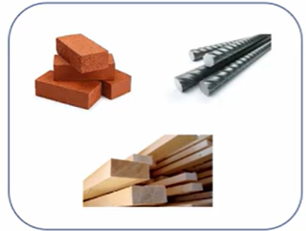
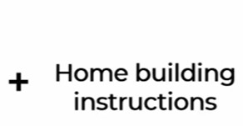
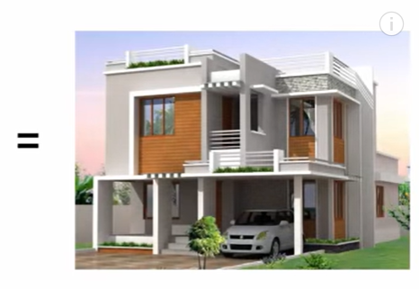
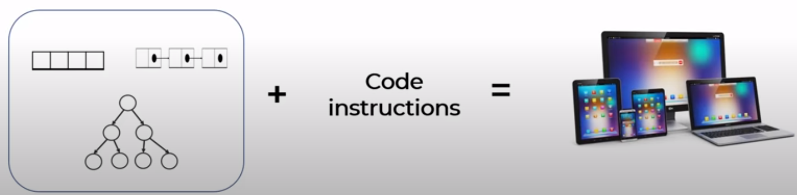
Introduction
When we building a home you need certain building blocks and materials such as bricks, woods furniture and metals, etc
On top of that you applies a set of instructions for building home and we get a home as a result.
Similarly, when we are building a software applications we need raw building blocks which are basically data structures such as Arrays, Linked List , tree, graphs and etc. Then we get a software application

Slide 5
Program
It is a set instructions.
Program = Data Structure + Algorithms
Data Structure
It is a scheme for organizing data in the memory of a computer.
The way in which the data is organized affects the performance of a program for different tasks.
Computer programmers decide which data structures to use based on the nature of the data and the processes that need to be performed on that data.

Slide 6
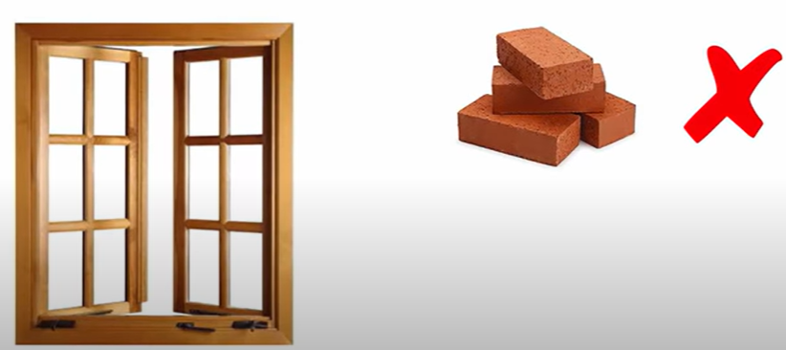

Introduction to Data Structures and Algorithms
Data Structure is a way of collecting and organising data in a way that we can perform operations on these data in an effective way.
DS are building blocks or raw materials for any software programs.
One cannot become a good programmer without sound understanding of data structures
Data Structures is about rendering data elements in terms of some relationship, for better organization and storage.
Use a right data structure for a problem
If you are building a window, if you start building a window using bricks that is not good, you have to use woods materials.
So, as SW engineer, your role is to pick the right DS for a right problem

Slide 7
Introduction Data Structures and Algorithms
What is Data Structure?
Data Structure is a (programmatic) way of collecting and organising data in a way that we can perform operations on these data in an effective way.
Data Structures is about rendering data elements in terms of some relationship, for better organization and storage.
For example, we have some data which has, Student's name “Peter" and age 26. Here “Peter" is of String data type and 26 is of integer data type.
We can organize this data as a record like Student record, which will have both student's name and age in it.
Now we can collect and store player's records in a file or database as a data structure.
For example: “Abebe" 30, “Girma" 31, “Sara" 33

Slide 8
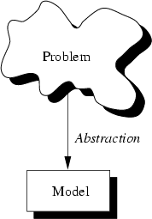
Data Types
Data type is a system to define basic properties and operations allowed on the data.
Properties such as – acceptable values, range, bytes required in memory etc.
Data types can be further classified in three primary categories.
Primitive data type
Example: byte , short , int , long , float , double , boolean and char
Non-Primitive data type
Example: Strings, Arrays, Classes, Interface
Abstract data type (ADT)
Create a model from a problem with abstraction.
The model defines an abstract view to the problem. This implies that the model focusses only on problem related stuff and that you try to define properties of the problem.
These properties include
the data which are affected and
the operations which are identified
by the problem.

Slide 9
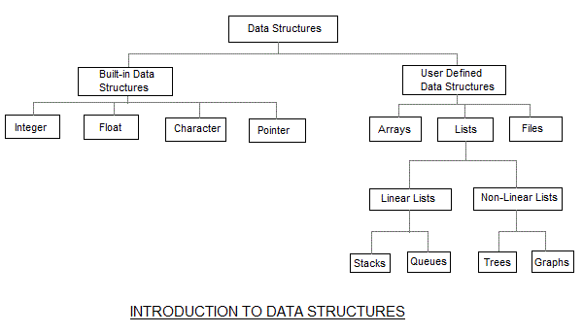
Data Types
Anything that can store data can be called as a data structure, hence Integer, Float, Boolean, Char etc, all are data structures.
They are known as Primitive Data Structures.
Then we also have some complex Data Structures, which are used to store large and connected data.
Some example of Abstract Data Structure are :Linked List, Tree, Graph, Stack, Queue

Slide 10
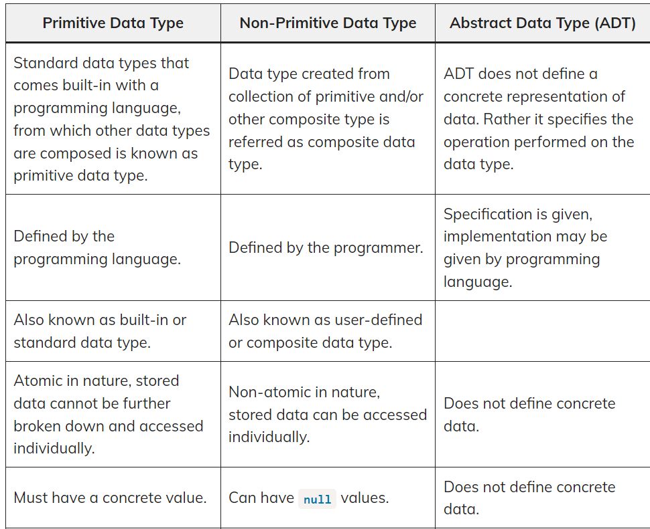
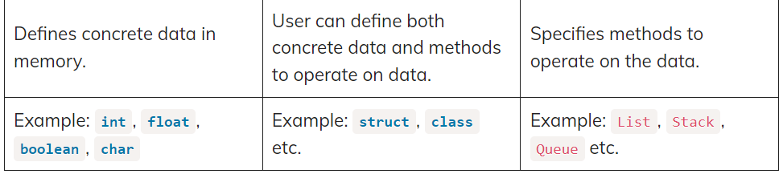

Slide 11
Cont..
Abstract data type (ADT): A set of values (the carrier set), and operations on those values.
Here are some examples of ADTs:
Boolean—The value of the Boolean ADT is the set { true, false }. The operations on these values are negation, conjunction, disjunction, conditional, is equal to, and perhaps some others.
Integer—The carrier set of the Integer ADT is the set { ..., -2, -1, 0, 1, 2, ... }, and the operations on these values are addition, subtraction, multiplication, division, remainder, is equal to, is less than, is greater than, and so on.
Note that although some of these operations yield other Integer values, some yield values from other ADTs (like true and false), but all have at least one Integer value argument.
String—The carrier set of the String ADT is the set of all finite sequences of characters from some alphabet, including the empty sequence (the empty string).
Operations on string values include concatenation, length of, substring, index of, and so forth.

Slide 12
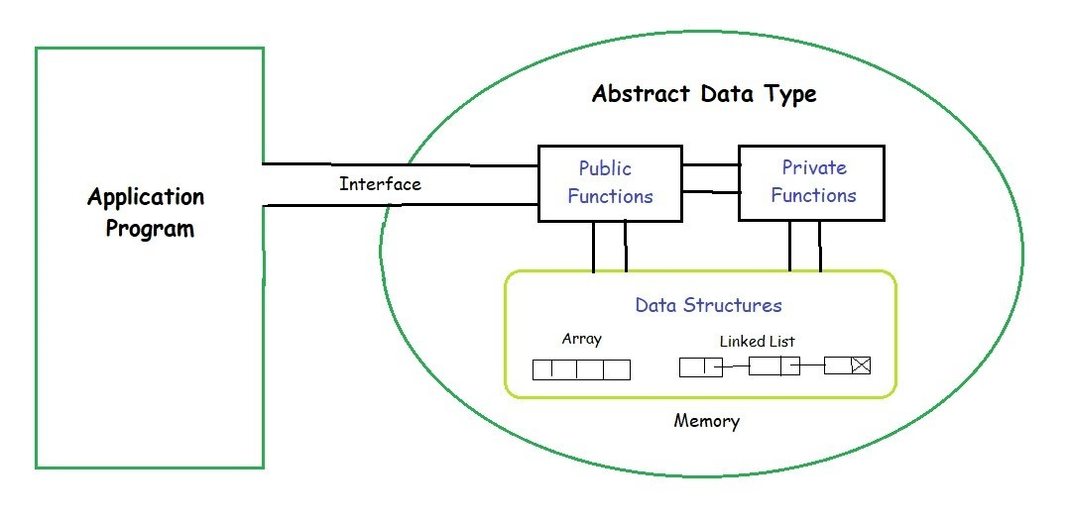
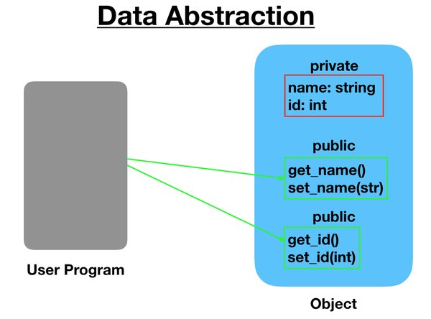
Abstract Data type (ADT)
It is a type (or class) for objects whose behavior is defined by a set of values and a set of operations.
The definition of ADT only mentions what operations are to be performed but not how these operations will be implemented.
It does not specify how data will be organized in memory and what algorithms will be used for implementing the operations.
It is called “abstract” because it gives an implementation-independent view.
The user of data type does not need to know how that data type is implemented, for example, we have been using Primitive values like int, float, char data types only with the knowledge that these data type can operate and be performed on without any idea of how they are implemented.
So a user only needs to know what a data type can do, but not how it will be implemented.
Abstraction: The user does not need to know the implementation of the data structure only essentials are provided.

Slide 13
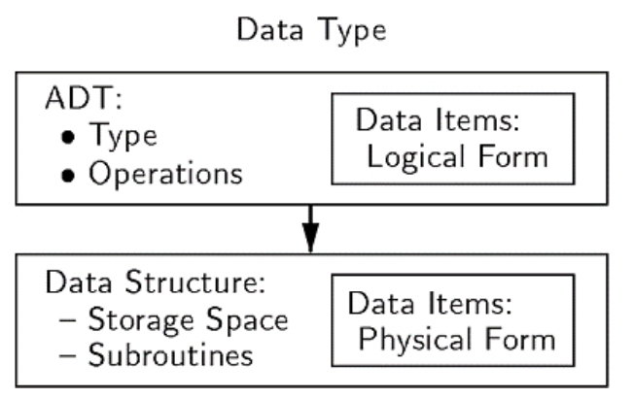
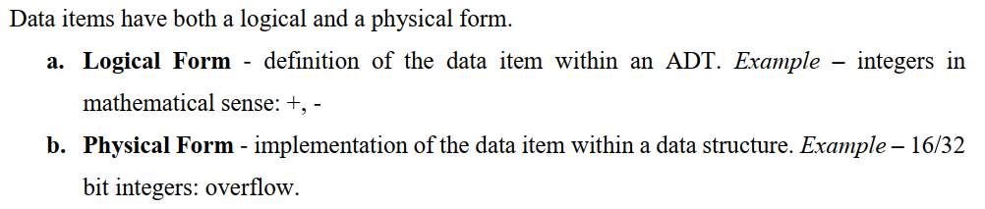
Abstract Data Type (ADT)

Slide 14
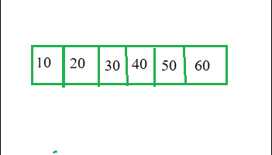
Think of ADT as a black box which hides the inner structure and design of the data type.
Now we’ll define three ADTs namely List ADT, Stack ADT, Queue ADT.
List ADT:
https://www.geeksforgeeks.org/abstract-data-types/

Slide 15
Data Structures - Algorithms Basics
Algorithm is a step-by-step procedure, which defines a set of instructions to be executed in a certain order to get the desired output.
Algorithms are generally created independent of underlying languages, i.e. an algorithm can be implemented in more than one programming language.
From the data structure point of view, following are some important categories of algorithms
Search − Algorithm to search an item in a data structure.
Sort − Algorithm to sort items in a certain order.
Insert − Algorithm to insert item in a data structure.
Update − Algorithm to update an existing item in a data structure.
Delete − Algorithm to delete an existing item from a data structure.

Slide 16
Characteristics of an Algorithm
Not all procedures can be called an algorithm. An algorithm should have the following characteristics −
Unambiguous − Algorithm should be clear and unambiguous. Each of its steps (or phases), and their inputs/outputs should be clear and must lead to only one meaning.
Input − An algorithm should have 0 or more well-defined inputs.
Output − An algorithm should have 1 or more well-defined outputs, and should match the desired output.
Finiteness − Algorithms must terminate after a finite number of steps.
Feasibility − Should be feasible with the available resources.
Language Independent − An algorithm should have step-by-step directions, which should be independent of any programming code.
Correctness -It must compute correct answer for all possible legal inputs in few time as expected.
Efficiency -it must solve with the least amount of computational resources such as time and space.
Definiteness - Each step must be clearly defined, having one and only one interpretation.
Sequence - Each step must have a unique defined preceding and succeeding step.
Feasibility -It must be possible to perform each instruction.
Completeness -It must solve the problem completely
Effectiveness -It must perform each step exactly and in a finite amount of time.
Generality -it should be valid on all possible inputs.

Slide 17
How to Write an Algorithm?
There are no well-defined standards for writing algorithms.
Rather, it is problem and resource dependent.
Algorithms are never written to support a particular programming code.
As we know that all programming languages share basic code constructs like loops (do, for, while), flow-control (if-else), etc.
These common constructs can be used to write an algorithm.
We write algorithms in a step-by-step manner, but it is not always the case.
Algorithm writing is a process and is executed after the problem domain is well-defined.
That is, we should know the problem domain, for which we are designing a solution.

Slide 18
Example
Problem − Design an algorithm to add two numbers and display the result.
Step 1 − START
Step 2 − declare three integers a, b & c
Step 3 − define values of a & b
Step 4 − add values of a & b
Step 5 − store output of step 4 to c
Step 6 − print c
Step 7 − STOP
Algorithms tell the programmers how to code the program. Alternatively, the algorithm can be written as −
Step 1 − START ADD
Step 2 − get values of a & b
Step 3 − c ← a + b
Step 4 − display c
Step 5 − STOP

Slide 19
Classification Data Structures:
Basically, data structures are divided into two categories:
Linear data structure
In linear data structures, the elements are arranged in sequence one after the other.
Non-linear (Hierarchical) data structure
Unlike linear data structures, elements in non-linear data structures are not in any sequence.
Instead they are arranged in a hierarchical manner where one element will be connected to one or more elements.

Slide 20
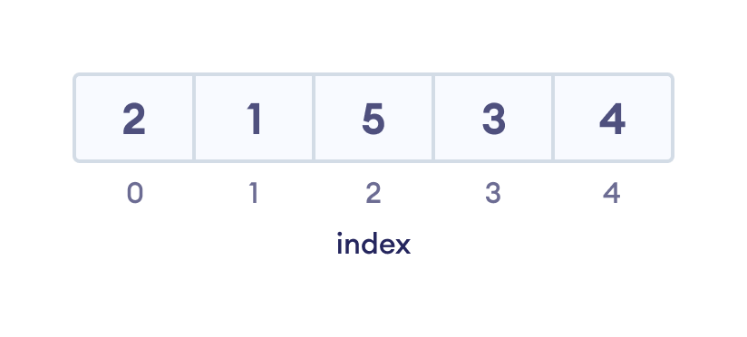
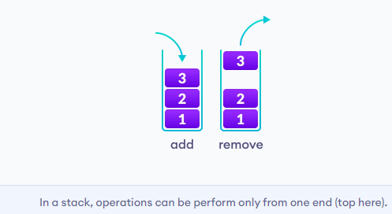
Popular linear data structures:
1. Array Data Structure- In an array, all elements (of same type) in memory are arranged in continuous memory.
2. Stack Data Structure- In stack data structure, elements are stored in the LIFO principle. That is, the last element stored in a stack will be removed first.

Slide 21
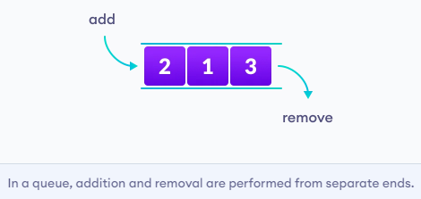
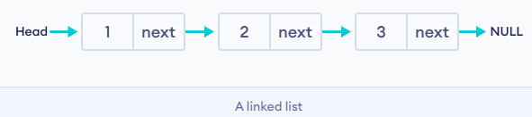
3. Queue Data Structure- Unlike stack, the queue data structure works in the FIFO principle where first element stored in the queue will be removed first.
4. Linked List Data Structure- In linked list data structure, data elements are connected through a series of nodes. And, each node contains the data items and address to the next node.

Slide 22
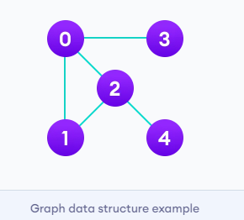
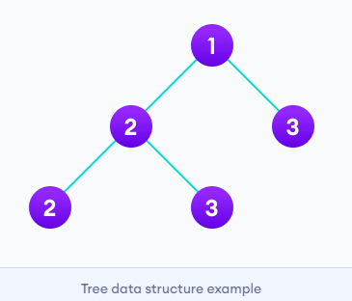
Popular Non linear data structures
Unlike linear data structures, elements in non-linear data structures are not in any sequence.
Instead they are arranged in a hierarchical manner where one element will be connected to one or more elements.
Non-linear data structures are further divided into graph and tree based data structures.
In graph data structure, each node is called vertex and each vertex is connected to other vertices through edges.
Similar to a graph, a tree is also a collection of vertices and edges. However, in tree data structure, there can only be one edge between two vertices.

Slide 23
Cont….
Popular Graph Based Data Structures:
Popular Tree based Data Structure
Spanning Tree and Minimum Spanning Tree
Strongly Connected Components
Adjacency Matrix
Adjacency List
Binary Tree
Binary Search Tree
AVL Tree
B-Tree
B+ Tree
Red-Black Tree

Slide 24
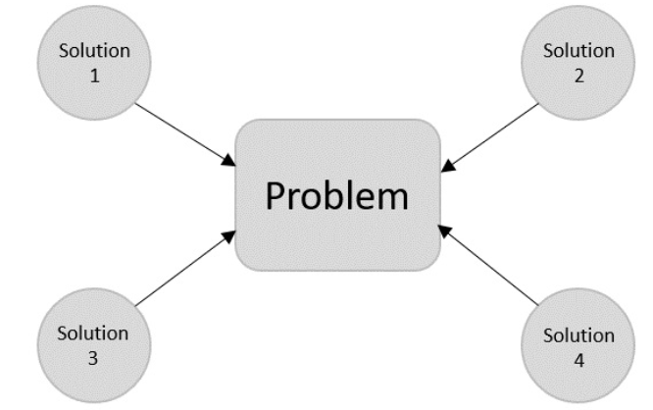
In design and analysis of algorithms, usually the second method is used to describe an algorithm. It makes it easy for the analyst to analyze the algorithm ignoring all unwanted definitions. He can observe what operations are being used and how the process is flowing.
Writing step numbers, is optional.
We design an algorithm to get a solution of a given problem. A problem can be solved in more than one ways.

Slide 25
Hence, many solution algorithms can be derived for a given problem. The next step is to analyze those proposed solution algorithms and implement the best suitable solution.
Efficiency of an algorithm can be analyzed at two different stages, before implementation and after implementation. They are the following −
A Priori Analysis − This is a theoretical analysis of an algorithm. Efficiency of an algorithm is measured by assuming that all other factors, for example, processor speed, are constant and have no effect on the implementation.
A Posterior Analysis − This is an empirical analysis of an algorithm. The selected algorithm is implemented using programming language. This is then executed on target computer machine. In this analysis, actual statistics like running time and space required, are collected.
Algorithm analysis deals with the execution or running time of various operations involved. The running time of an operation can be defined as the number of computer instructions executed per operation.

Slide 26
Measuring Complexity of an Algorithms
It is the process of determining, as precisely as possible, how many resources (such as time and memory) an algorithm consumes when it executes.
Different algorithms can be used to solve the same problem.
Thus, it makes sense to develop techniques that allow us to:
We compare different algorithms with respect to their “efficiency”.
We choose the most efficient algorithm for the problem.
The efficiency or running time of an algorithm is stated as a function relating the input length to the number of steps, known as time complexity, or volume of memory, known as space complexity:
Time Efficiency: the time it takes to execute (The CPU time required to execute the algorithm).
The time complexity of an algorithm is the total amount of time required by an algorithm to complete its execution.
Space Efficiency: the space (primary or secondary memory) it uses (The amount of memory used by the algorithm for execution).
The lesser resources that an algorithm uses, the more efficient it is.
We will focus on an algorithm’s efficiency with respect to time.
The evaluation of efficiency should be machine independent like particular computer, OS, Programming Languages, Compilers, etc.

Slide 27
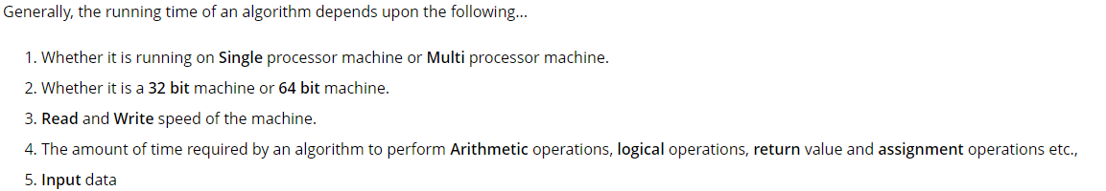

Slide 28
To classify data structures and algorithms as good, we need precise ways of analyzing them in terms of resource requirement.
The main resources are:
Running Time (program lifecycle phase) -the period during which a computer program is executing.
It is affected by:
The hardware environment (e.g., the processor, clock rate, memory, disk)
Software environment (e.g., the operating system, programming language) in which the algorithm is implemented and executed.
Memory Usage -how much memory our program uses, we can count the number of variables and weight them by the number of bytes according to their types.
Communication Bandwidth

Slide 29
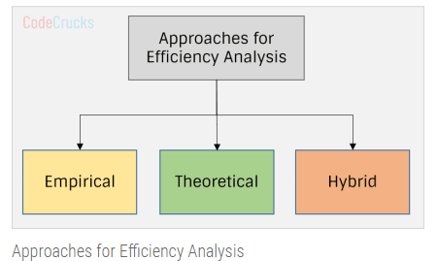
The Need for Analysis
The need for analysis of algorithms and how to choose a better algorithm for a particular problem as one computational problem can be solved by different algorithms.
Algorithms are often quite different from one another, though the objective of these algorithms are the same.
For example, we know that a set of numbers can be sorted using different algorithms.
There are three approaches to measure the efficiency of algorithms:
A. Empirical
B. Theoretical
C. Hybrid

Slide 30
Empirical approach- This approach is applied to the program.
Various problem-solving strategies, such as greedy algorithm, dynamic programming, incremental approach, and so on, are turned into the programme and then tested on the computer for various input cases.
This method is also known as a posterior approach. It is also possible to test an algorithm for a large number of instances.
Theoretical approach - The necessary resources are estimated mathematically in this approach.
This strategy is also known as the priori approach because it is immediately applied to an algorithm that has yet to be changed in the program.
The algorithm is evaluated for many scenarios. The size of the problem is not measured in bits or bytes, but in the number of items in the problem.
In sorting issues, the size of an instance is the number of elements to be sorted. The size of the challenge for traversing the linked list is a number of nodes. The size of a graph problem is determined by the number of edges and vertices.

Slide 31
A character, integer, float, double, or any other data type may be used as an input element.
We aren’t concerned with how much RAM each piece of the input list takes up.
Hybrid approach - It combines the best aspects of the priori and posterior approaches.
The theoretical technique is used to determine the function characterizing the algorithm’s efficiency, and the empirical approach is used to derive the requisite numerical parameters by running a program on the machine.

Slide 32
Complexity analysis involves two distinct phases:
Algorithm Analysis - analysis of the algorithm or data structure to produce a function T(n) that describes the algorithm in terms of the operations performed in order to measure the complexity of the algorithm.
Order of Magnitude Analysis - analysis of the function T(n) to determine the general complexity category to which it belongs
There is no generally accepted set of rules for algorithm analysis.
However, an exact count of operations is commonly used.

Slide 33
Algorithm Analysis Rules:
We assume an arbitrary time unit for every algorithm. They are
1. The execution times of any of the following operations are 0.
Any header files and main functions. - #include "iostream“, int main()
Variable declarations except array and pointers, because the variable declaration requires space from the computer’s memory.
2. Execution of one of the following operations takes time 1.
Assignment operation.
Single input/output operation.
Single Boolean operations.
Single arithmetic operations.
Function return.

Slide 34
3. The running time of one of the following operations is N times.
Declaration of an array and pointers.
Accessing an array and pointers.
Initializing an array and pointers (for an array that initialized more than one values).
4. The increment and decrement operations within looping of outer loops executed N times and within the inner loops, it is executed N-1 times, because, the inner loop is controlled by the outer loop.
But with the number of increment or decrement the execution time may varies in accordance with regard to the incremented or decremented variable name.
Example – If the variable is incremented by 3, the execution time is divided by 3, .i.e., 𝐍 𝟑 times in the outer loop.

Slide 35
5. Running time of a selection statement (if, switch) is the time for the condition evaluation plus the maximum of the running times for the individual clauses in the selection.
The execution time of the conditions is N times.
6. Running time for a loop is equal to the running time for the statements inside the loop time’s (*) number of iterations.
The total running time of a statement inside a group of nested loops is the running time of the statements multiplied (*) by the product of the sizes of all the loops. For nested loops, analyze inside out.
Always assume that the loop executes the maximum number of iterations possible.
The test condition of any outer loop executes N+1 time and the inner loop executes N times.

Slide 36
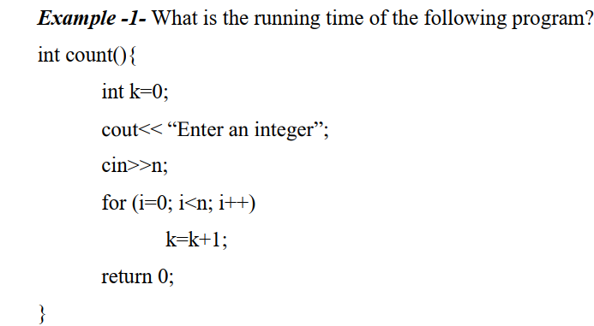
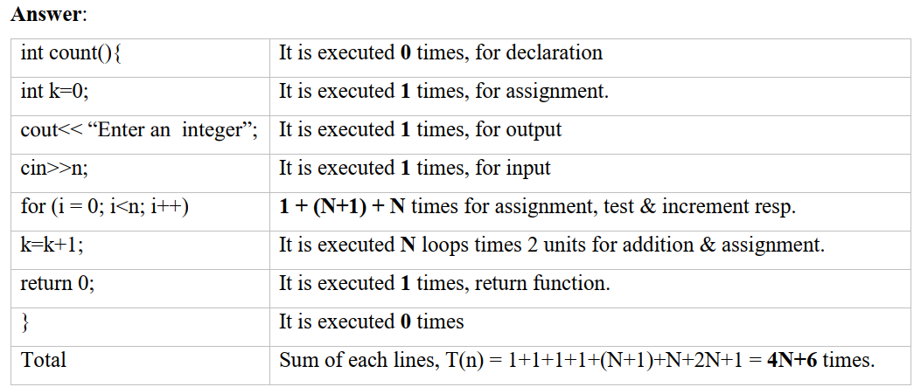
7. Running time of a function call is 1 for setup plus the time for any parameter calculations plus the time required for the execution of the function body.

Slide 37
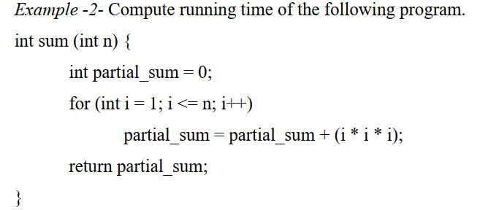
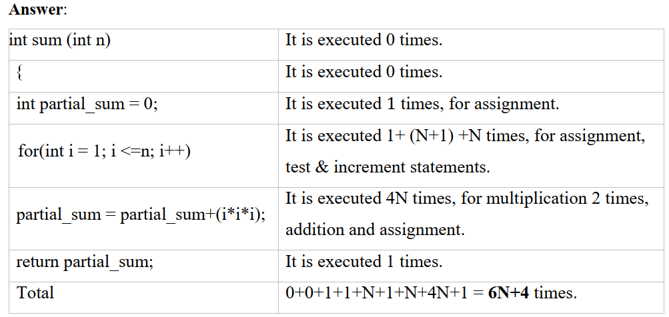

Slide 38

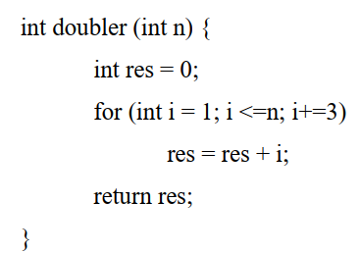
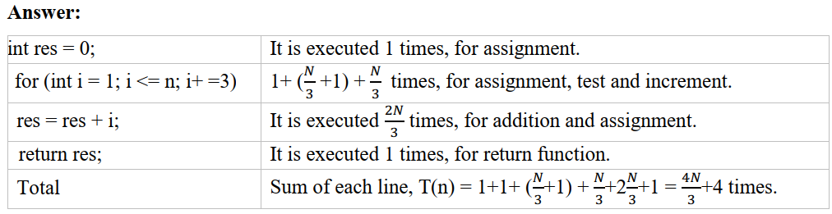

Slide 39
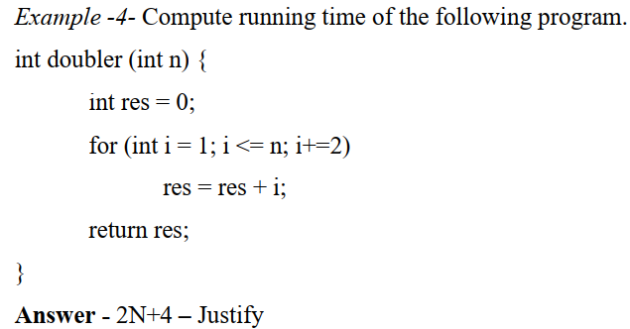

Slide 40
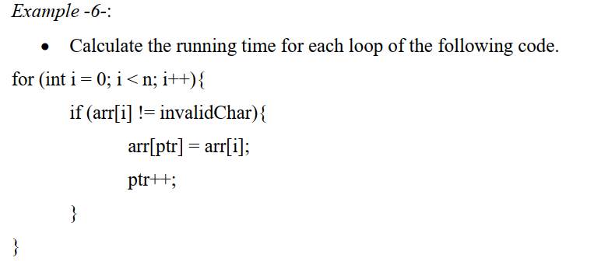
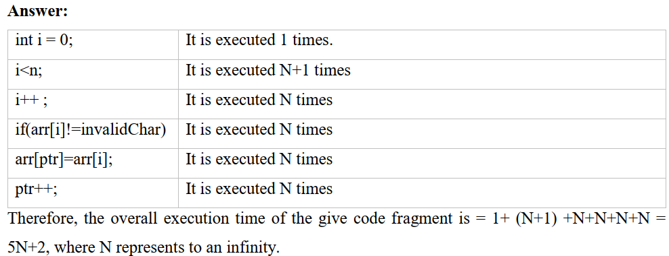

Slide 41

Measures of Time:
In order to determine the running time of an algorithm it is possible to define three functions of time complexity algorithm analysis.
A. Worst Case (Tworst) – is the maximum number of basic operations performed by an algorithm for any input of size N, i.e., if the last position in the array contains K, then the running time is relatively long, because the algorithm must examine N values. Example - The worst case running time of an input size N is N.
B. Best Case (Tbest) – is the minimum number of basic operations performed by an algorithm for any input of size N, i.e., if the first integer in the array could have value K, and so only one integer is examined. In this case the running time is short. Example - The best-case running time is 1
C. Average Case (Tavg) – is the average number of basic operations performed by an algorithm for all inputs of size N.

Slide 42
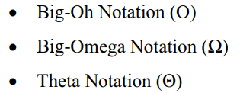
Asymptotic Analysis of an Algorithms -Notations
It is concerned with how the running time of an algorithm increases with the size of the input in the limit, as the size of the input increases without bound.
Asymptotic notations for calculating an algorithms.
There are many types of asymptotic analysis.
Among them the following are some of them.
-Upper bound of a function
-Lower bound of a function
-Average bound of a function

Slide 43
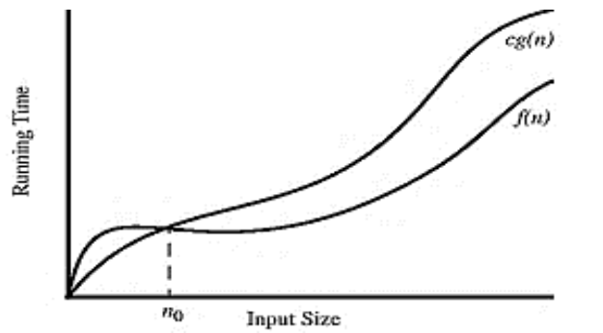
Big-Oh Notation (O)
Big O notation is a mathematical concept used to describe the efficiency of algorithms. It measures the worst-case scenario for an algorithm's time or space complexity as the input size grows.
It is a way of comparing algorithms and is used for computing the complexity of algorithms; i.e., the amount of time that it takes for computer program to run.
It calculates the worst case time complexity or the maximum time an algorithm will take to complete the execution.
For example, let's say we have an algorithm that takes n steps to complete.
In Big O notation, we would write this as O(n). This means that as the input size grows, the number of steps required to complete the algorithm will grow linearly with it.

Slide 44
Big-Omega Notation (Ω)
The systematic way to express the lower bound of an algorithm’s running time.
It calculates the best case time complexity or the shortest time an algorithm will take to complete.

Slide 45
https://www.programiz.com/dsa/insertion-sort
https://www.programiz.com/dsa/

