Slide 1
Chapter 2 Time Complexity of Known Algorithms
Fikadu Wayesa

Slide 2
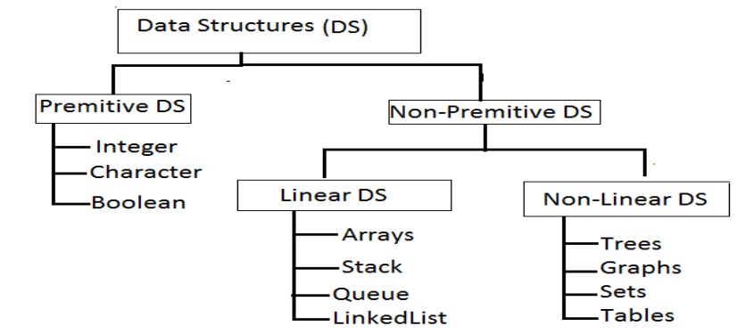
Taxonomy of Data Structures

Slide 3
Introduction
Linear data structures organize their data elements in a linear fashion, where data elements are attached one after the other.
Linear data structures are very easy to implement, since the memory of the computer is also organized in a linear fashion.
Some commonly used linear data structures are arrays, linked lists, stacks and queues.
In nonlinear data structures, data elements are not organized in a sequential fashion.
Data structures like multidimensional arrays, trees, graphs, tables and sets are some examples of widely used nonlinear data structures.

Slide 4
Operations on the Data Structures
Following operations can be performed on the data structures:
Sorting- It is used to arrange the data items in some order i.e. in ascending or descending
Searching- It is used to find out the location of the data item if it exists in the given collection of data items.
Traversing - It is used to access each data item exactly once so that it can be processed.
Inserting - It is used to add a new data item in the given collection of data items.
Deleting - It is used to delete an existing data item from the given collection of data items.
Merging- It is used to combine the data items of two sorted files into single file in the sorted form.

Slide 5
Algorithms Operations
Sorting and Searching is one of the most essential topics in data structure and algorithms.
Any computer-technology, storing, and retrieving information is one of the most common application.
In a database, time is very vital the amount of data and information stored and accessed.
So many techniques and algorithms have been developed to efficiently maintain and process information in databases.
The processes of looking up a particular data record in the database is called searching.
The process of ordering the records in a database is called sorting.
Sorting and searching together constitute a major area of study in computational methods.

Slide 6
Sorting
Sorting is the process of rearranging a sequence of items so as to put them in some logical order (either increasing or decreasing order - number and alphabetically - letters).
All computer systems have implementations of sorting algorithms, for use by the system and by users.
Our primary concern is algorithms for rearranging arrays of items where each item contains a key.
The sorting algorithm refers to the data only through two operations:
Compares items
Exchanges them.
When studying sorting algorithms, we count compares and exchanges.

Slide 7
Sorting Algorithms
list={21,38,29,17,4,25,11,32,9}
How do we sort?
We can use separate array, but requires additional memory?
So What is the solution?
We have to do on the same array; To do this we do have many Sorting algorithms:
Selection Sort
Insertion Sort
Bubble Sort
Quick Sort
Merge Sort
Shell Sort

Slide 8
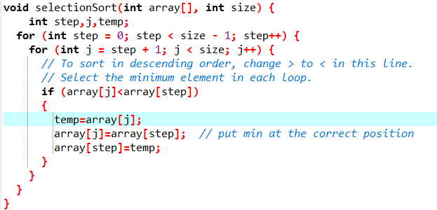
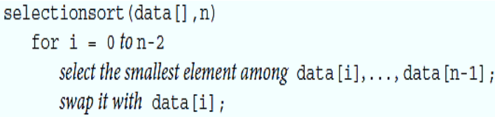
Selection Sort and Its Complexity Analysis
Steps:
Find the smallest or largest item in the array and exchange it with the first entry (itself if the first entry is already the smallest).
Then, find the next smallest or largest item and exchange it with the second entry.
Continue in this way until the entire array is sorted.
This method is called selection sort because it works by repeatedly selecting the smallest or largest remaining item.

Slide 9
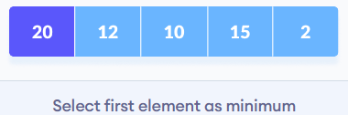
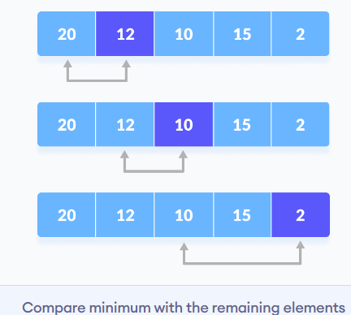
Working of Selection Sort
Set the first element as minimum.
Compare minimum with the second element. If the second element is smaller than minimum, assign the second element as minimum.
Compare minimum with the third element. Again, if the third element is smaller, then assign minimum to the third element otherwise do nothing. The process goes on until the last element.

Slide 10
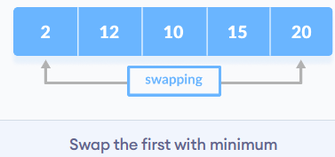
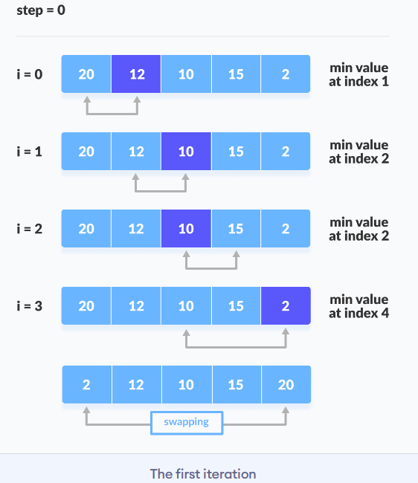
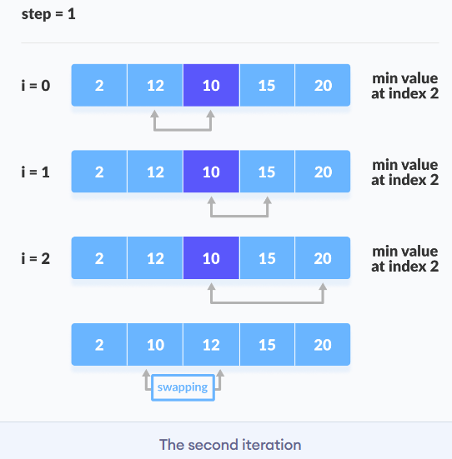
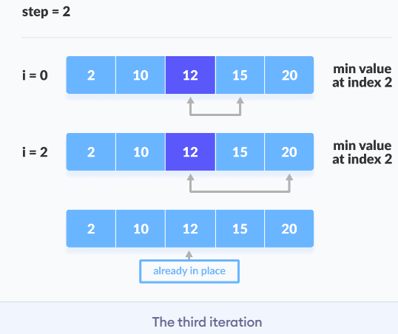
After each iteration, minimum is placed in the front of the unsorted list.
For each iteration, indexing starts from the first unsorted element. Step 1 to 3 are repeated until all the elements are placed at their correct positions.

Slide 11
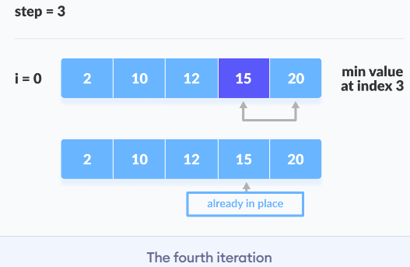
Contd…

Slide 12
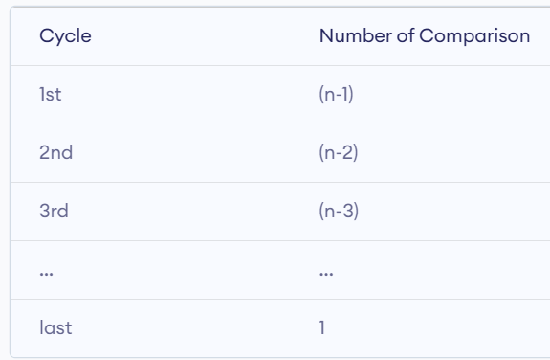

Contd…
Number of comparisons: (n - 1) + (n - 2) + (n - 3) + ..... + 1 = n(n - 1) / 2 nearly equals to $n^{2}$
Also, we can analyze the complexity by simply observing the number of loops. There are 2 loops so the complexity is

Slide 13
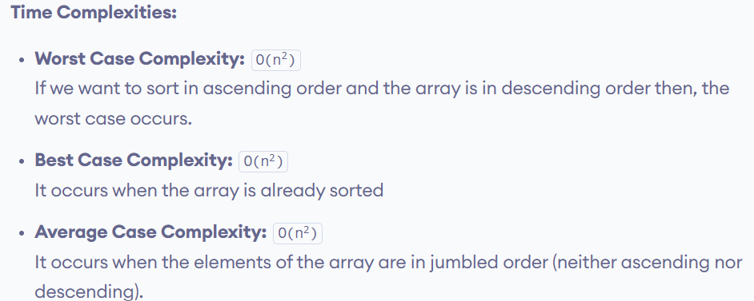
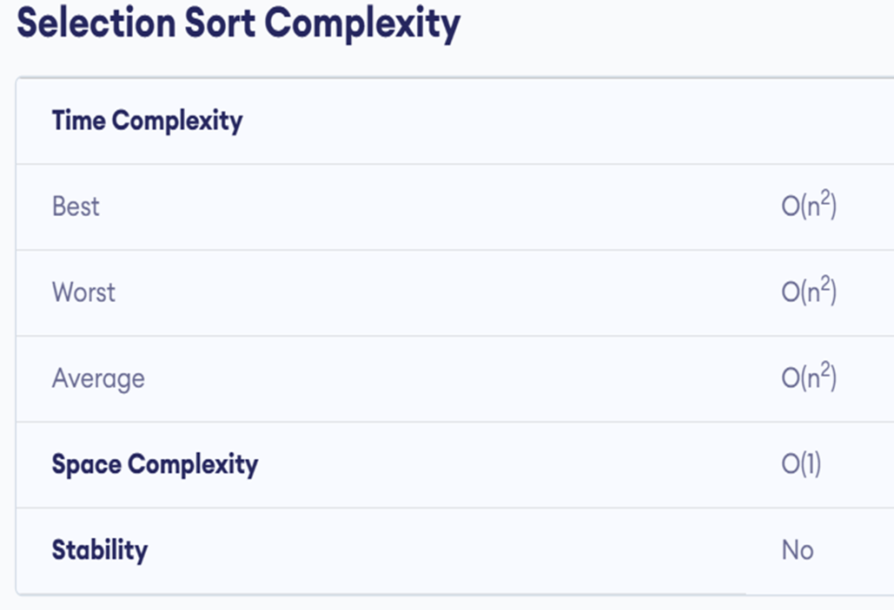
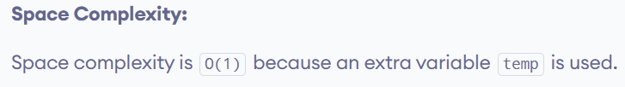
The time complexity of the selection sort is the same in all cases. At every step, you have to find the minimum element and put it in the right place. The minimum element is not known until the end of the array is not reached.

Slide 14
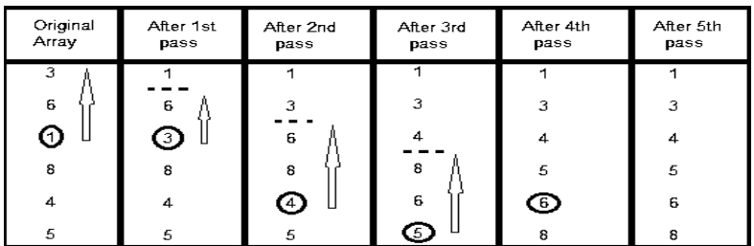
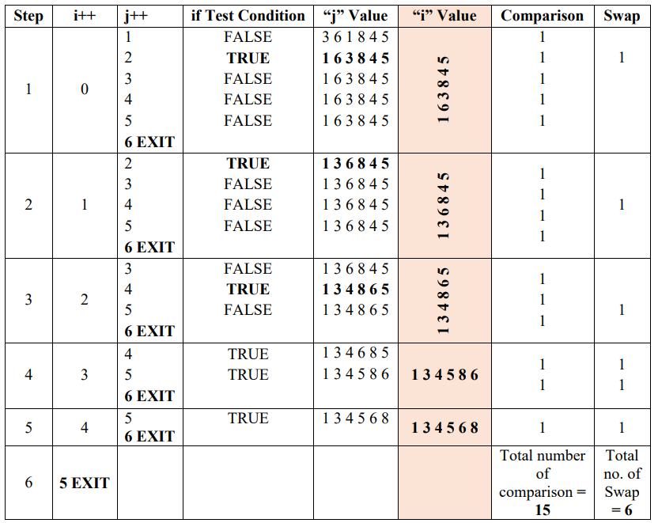
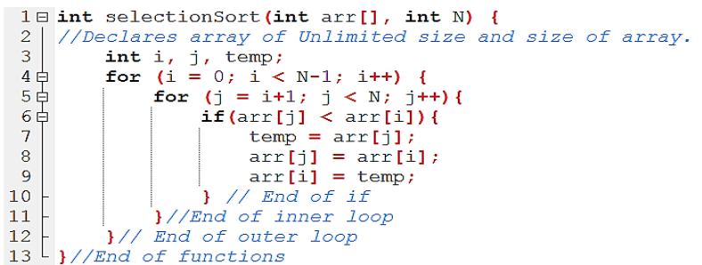
Exercise
Sort {3, 6, 1, 8, 4, 5} using selection sort.

Slide 15
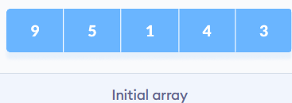
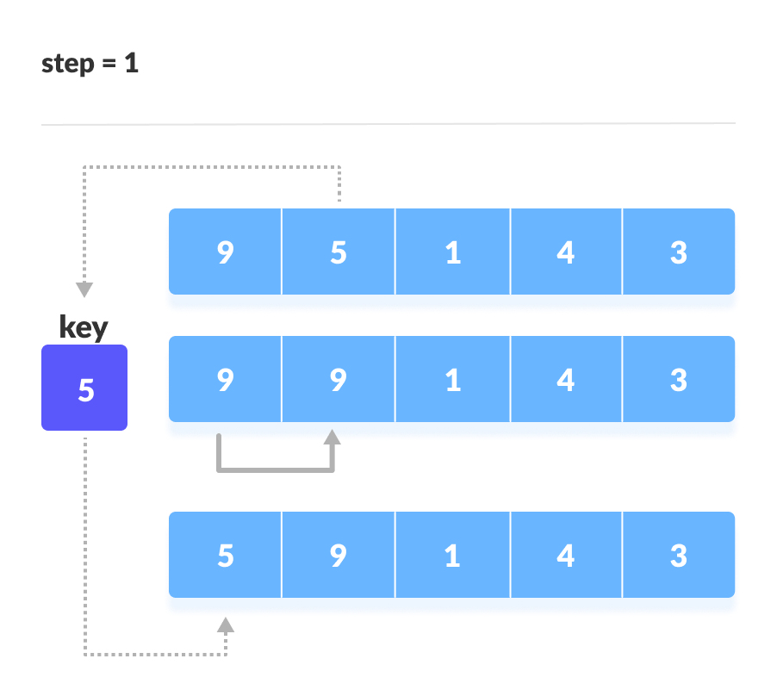
2. Working of Insertion Sort
Suppose we need to sort the following array.
The first element in the array is assumed to be sorted. Take the second element and store it separately in key.
Compare key with the first element. If the first element is greater than key, then key is placed in front of the first element.
If the first element is greater than key, then key is placed in front of the first element.

Slide 16
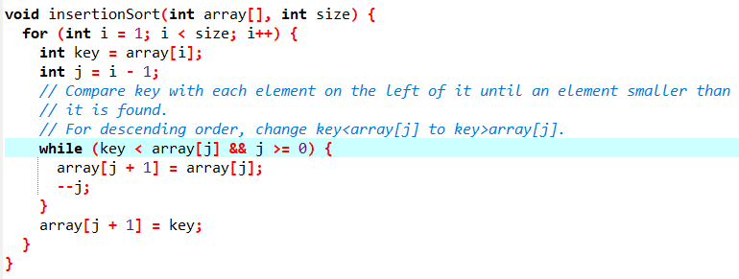
Insertion sort

Slide 17
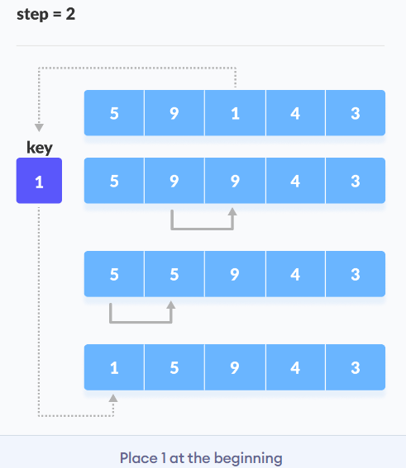
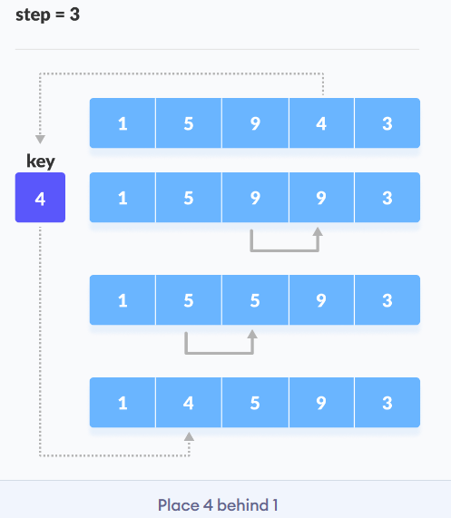
Contd…
2. Now, the first two elements are sorted. Take the third element and compare it with the elements on the left of it. Placed it just behind the element smaller than it. If there is no element smaller than it, then place it at the beginning of the array.
3. Similarly, place every unsorted element at its correct position.

Slide 18
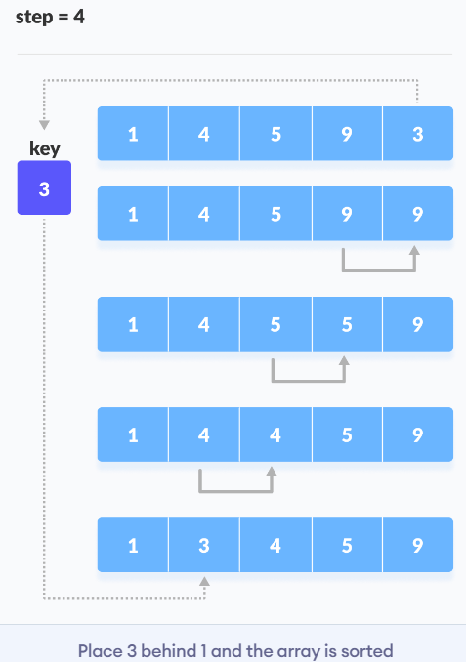
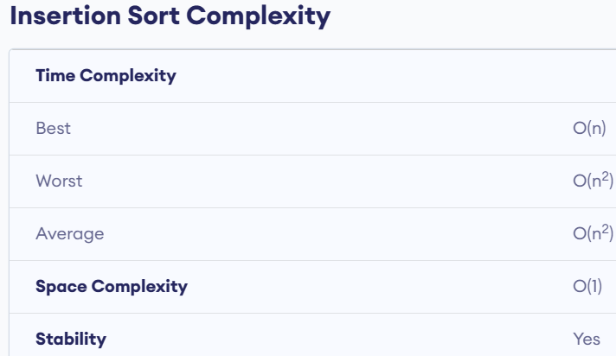
Contd…

Slide 19
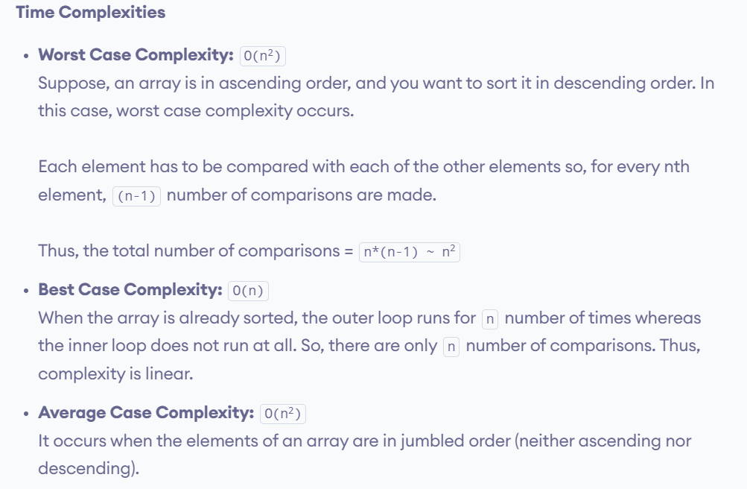
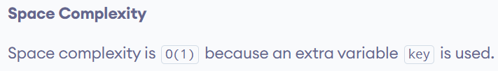

Slide 20
3. Bubble Sort
Bubble sort is a sorting algorithm that compares two adjacent elements and swaps them until they are in the intended order.
Just like the movement of air bubbles in the water that rise up to the surface, each element of the array move to the end in each iteration. Therefore, it is called a bubble sort.
Working of Bubble Sort
1. First Iteration (Compare and Swap)
Starting from the first index, compare the first and the second elements.
If the first element is greater than the second element, they are swapped.
Now, compare the second and the third elements. Swap them if they are not in order.
The above process goes on until the last element.

Slide 21
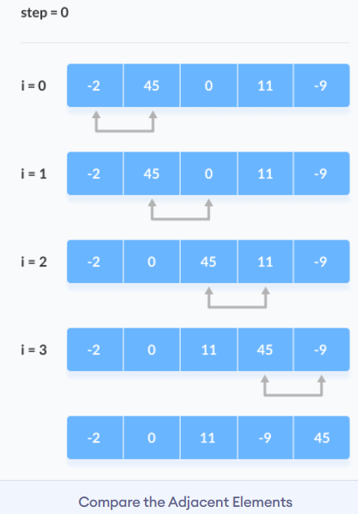
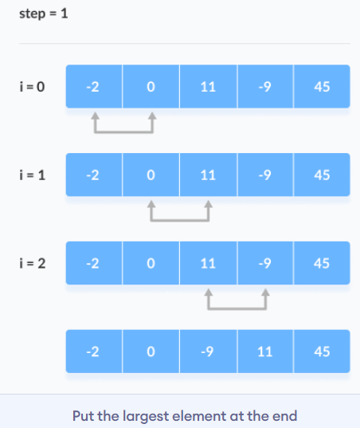
Contd…
2. Remaining Iteration
The same process goes on for the remaining iterations.
After each iteration, the largest element among the unsorted elements is placed at the end.

Slide 22
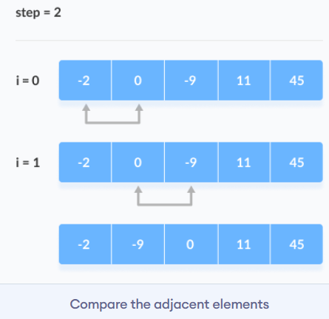
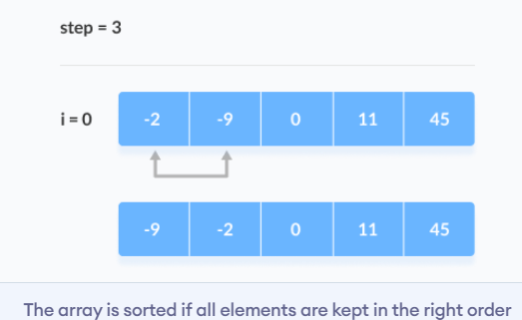
Contd…
In each iteration, the comparison takes place up to the last unsorted element.
The array is sorted when all the unsorted elements are placed at their correct positions.

Slide 23
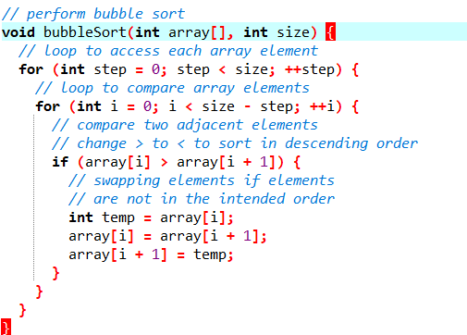
Bubble Sort

Slide 24
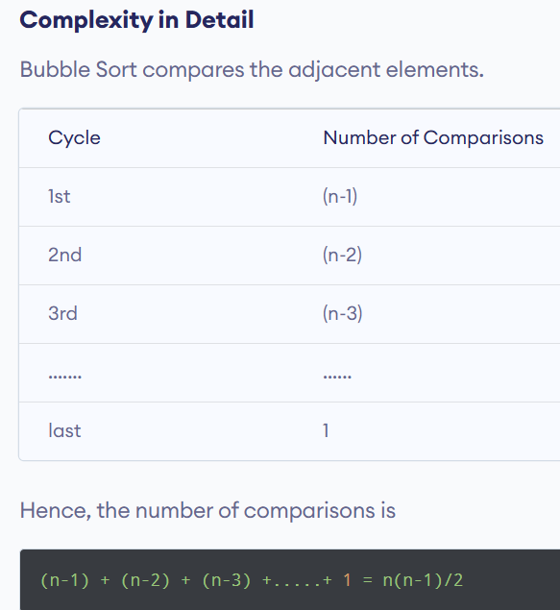
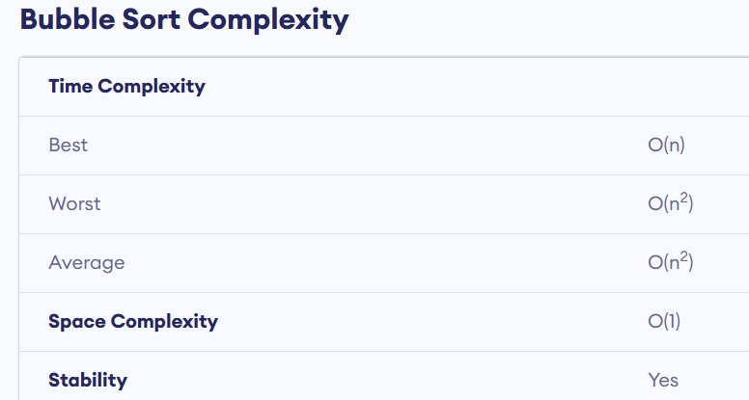
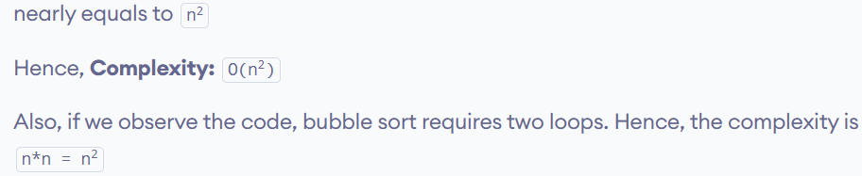

Slide 25
Time and Space Complexity Comparison Table :
Sorting Algorithm | Time Complexity |  |  | Space Complexity
 | Best Case | Average Case | Worst Case | Worst Case
Bubble Sort | Ω(N) | Θ(N²) | O(N²) | O(1)
Selection Sort | Ω(N²) | Θ(N²) | O(N²) | O(1)
Insertion Sort | Ω(N) | Θ(N²) | O(N²) | O(1)

Slide 26
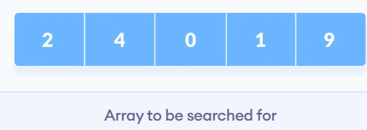
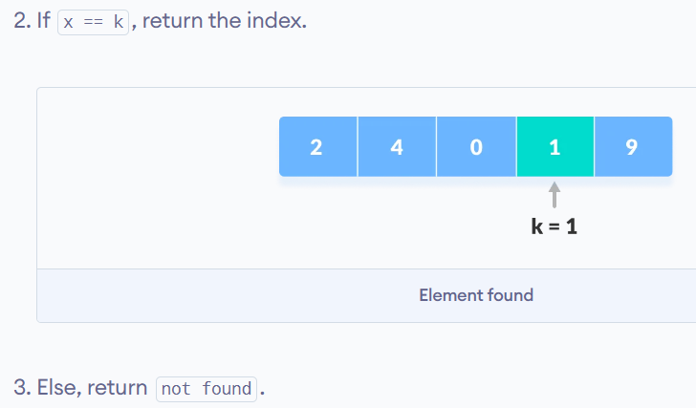
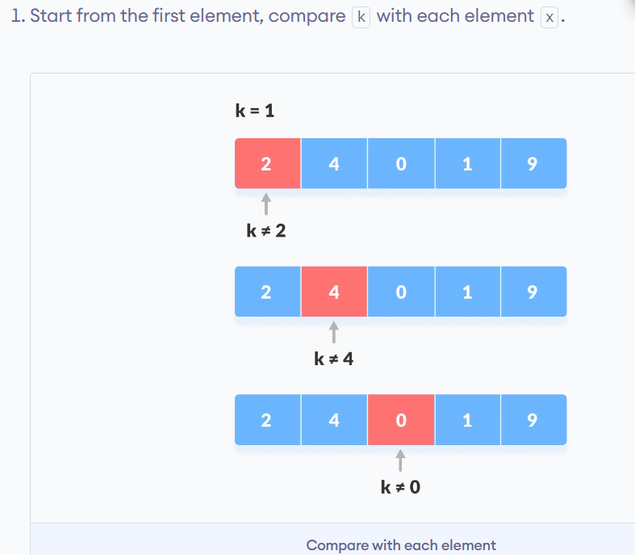
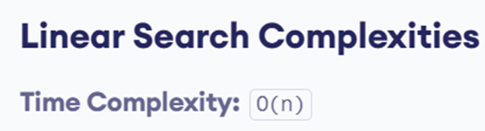

Linear Search
Linear search is a sequential searching algorithm where we start from one end and check every element of the list until the desired element is found. It is the simplest searching algorithm.
How Linear Search Works?
The following steps are followed to search for an element k = 1 in the list below.

Slide 27
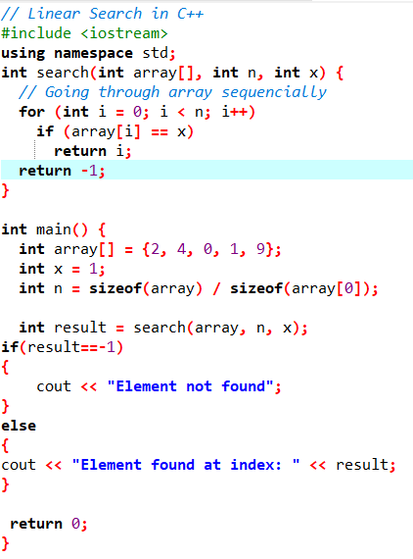
C++ Linear Search Implementation

Slide 28
Binary Search
Binary Search is a searching algorithm for finding an element's position in a sorted array.
In this approach, the element is always searched in the middle of a portion of an array.
Binary search can be implemented only on a sorted list of items. If the elements are not sorted already, we need to sort them first.
Binary Search Working
Binary Search Algorithm can be implemented in two ways which are discussed below.
Iterative Method
Recursive Method
The recursive method follows the divide and conquer approach.

Slide 29
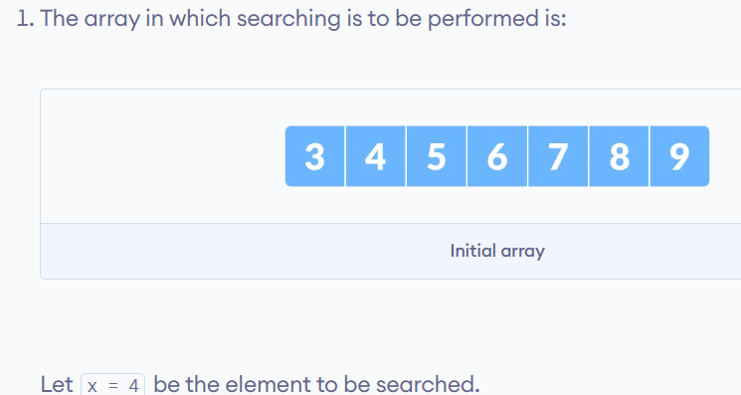
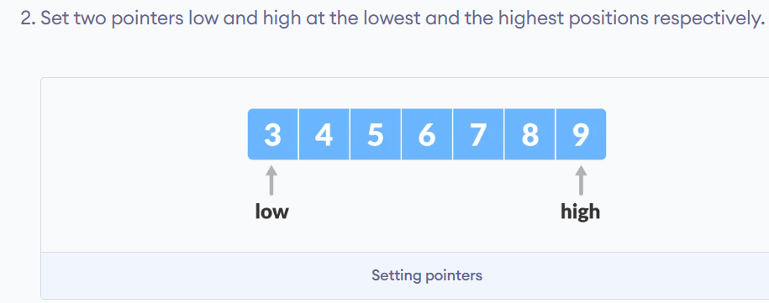
The general steps for both methods are discussed below.

Slide 30
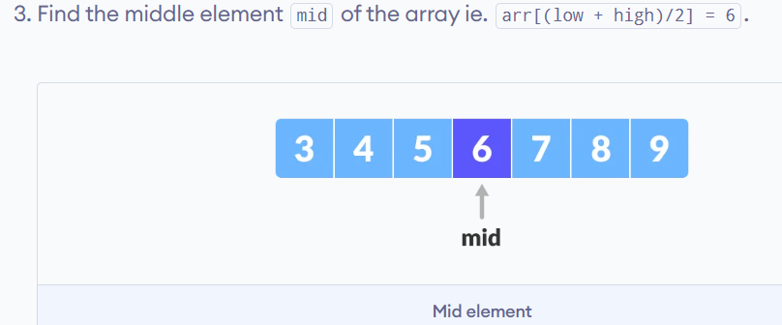
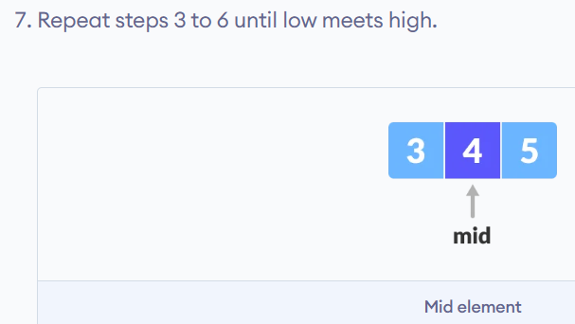
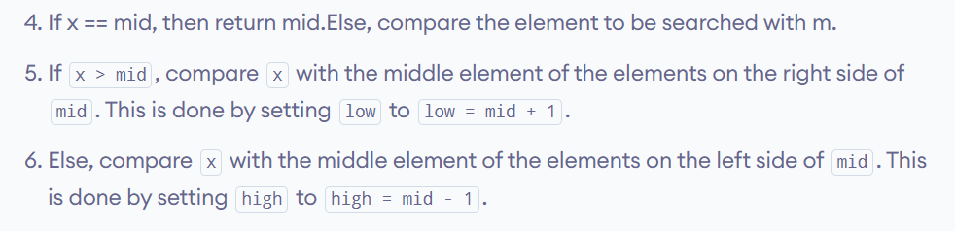
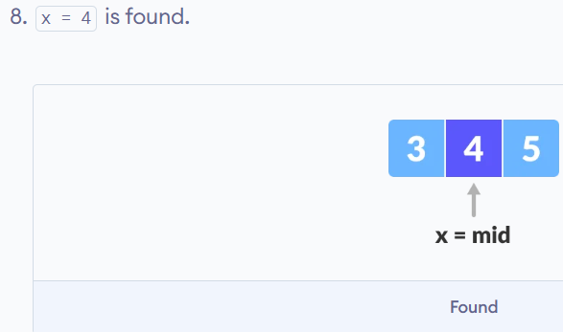
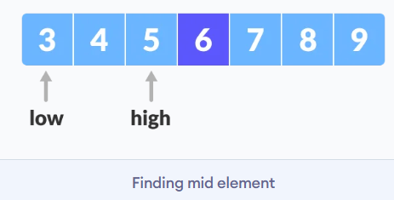
Steps

Slide 31
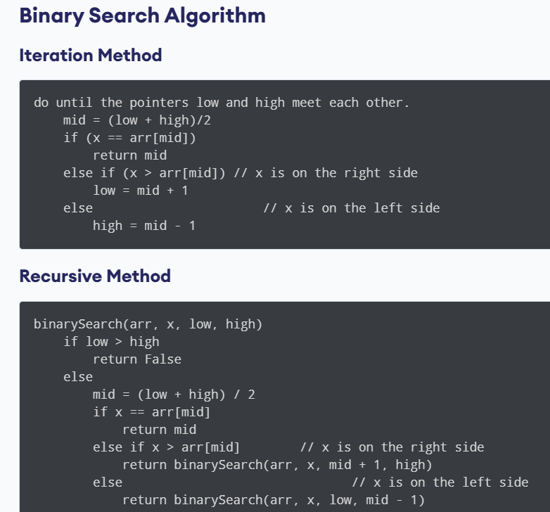
Binary Search Algorithm

Slide 32
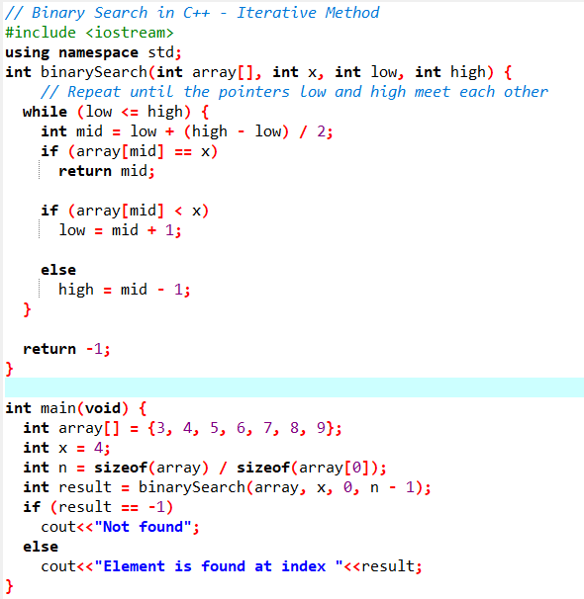
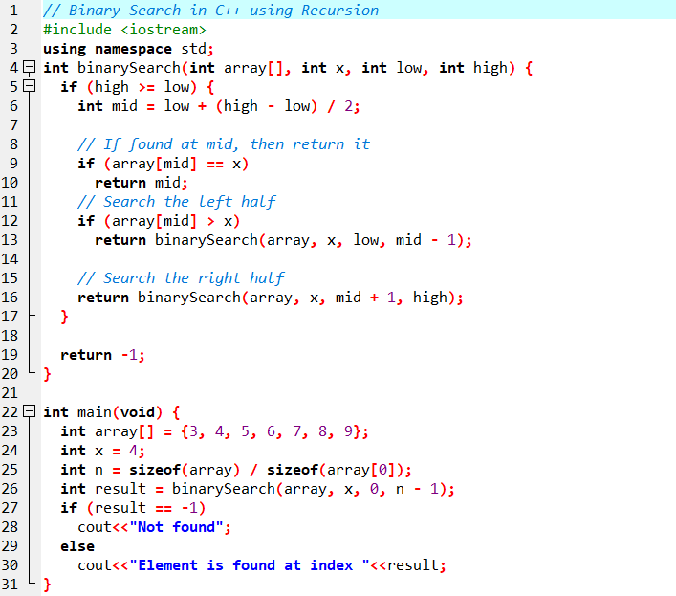
C++ Binary Search Implementation

Slide 33
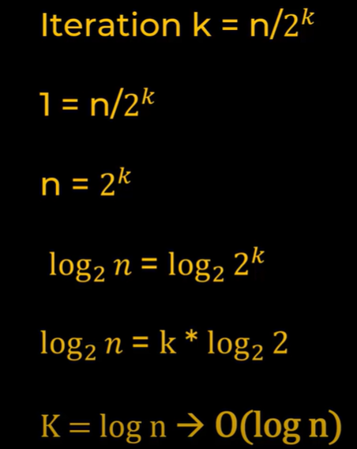


Binary Search Complexity

Slide 34


Contd…

Slide 35
Exercise
1. When I try to find number 5 in below list using binary search, it doesn't work and returns me -1 index. Why is that?
numbers = [1,4,6,9,10,5,7]
# Answer: It is because the list is not sorted! Binary search requires that list has to be sorted
2, Find index of all the occurances of a number from sorted list
numbers = [1,4,6,9,11,15,15,15,17,21,34,34,56]
number_to_find = 15
This should return 5,6,7 as indices containing number 15 in the array

Slide 36
~~End of Chapter 2~~

