Slide 1
Study Case-RevoU: Game Series Sales Analysis
Syafika Zalfanissa

Slide 2
Data Source
01
02
03
Data set
Link dataset
Google Colaboratory
Link google colaboratory
GitHub
Link GitHub

Slide 3
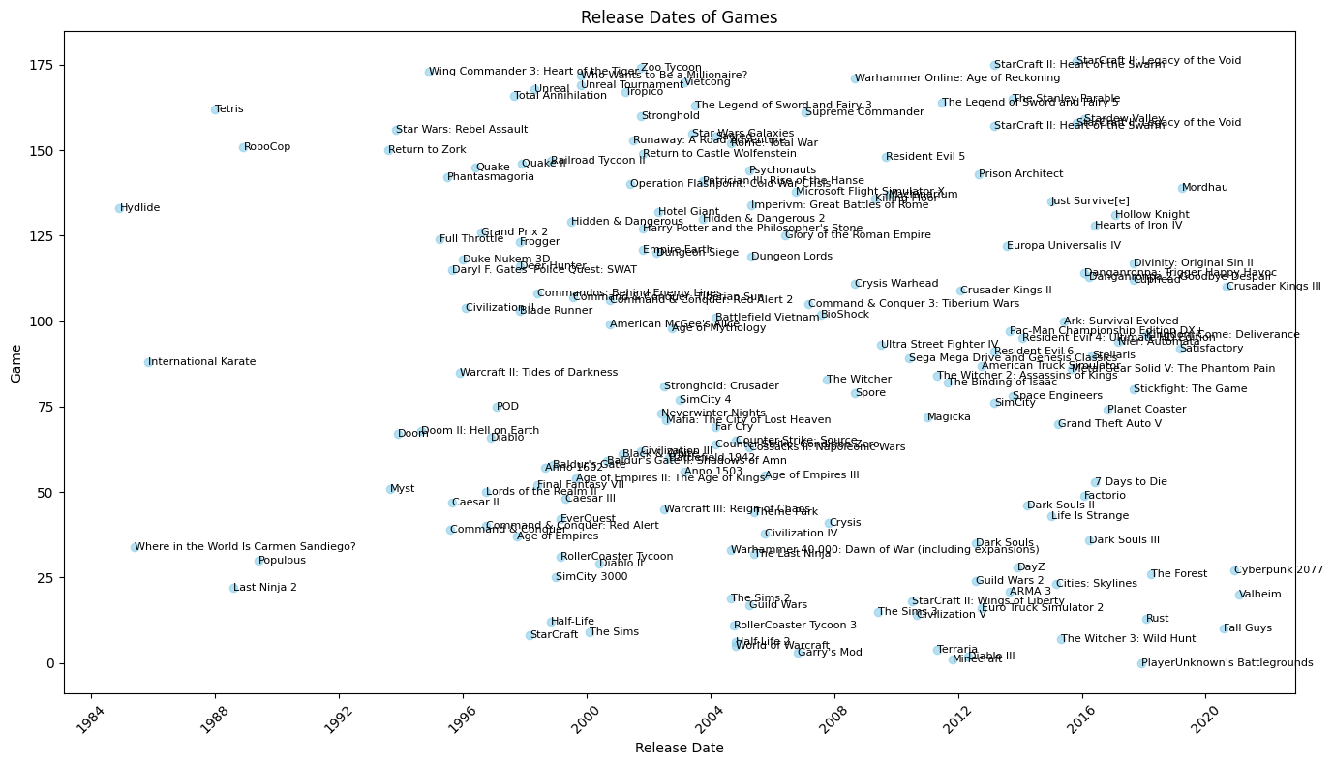
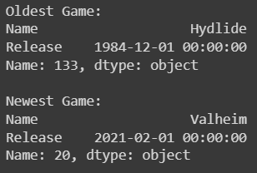
Analysis 1
The oldest and the newest games in that dataset

Slide 4
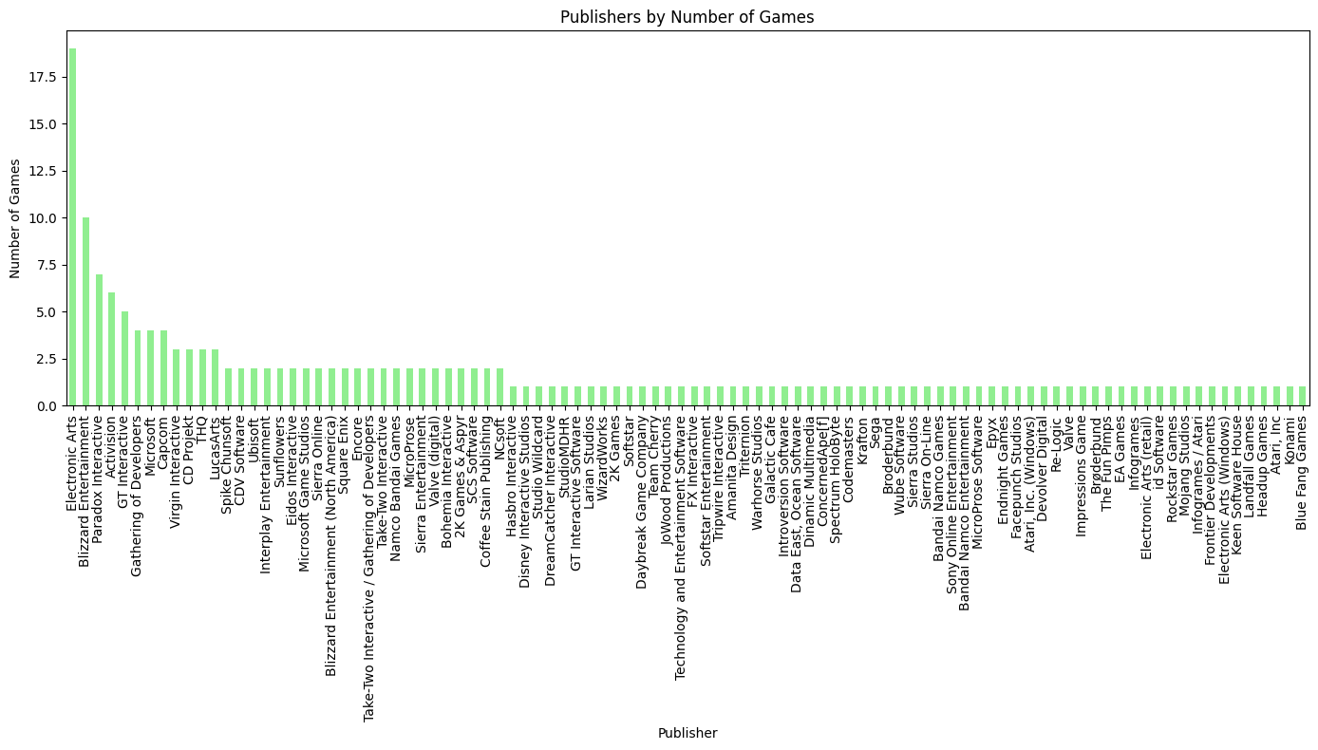
Analysis 2
Publisher who published most of the games?

Slide 5
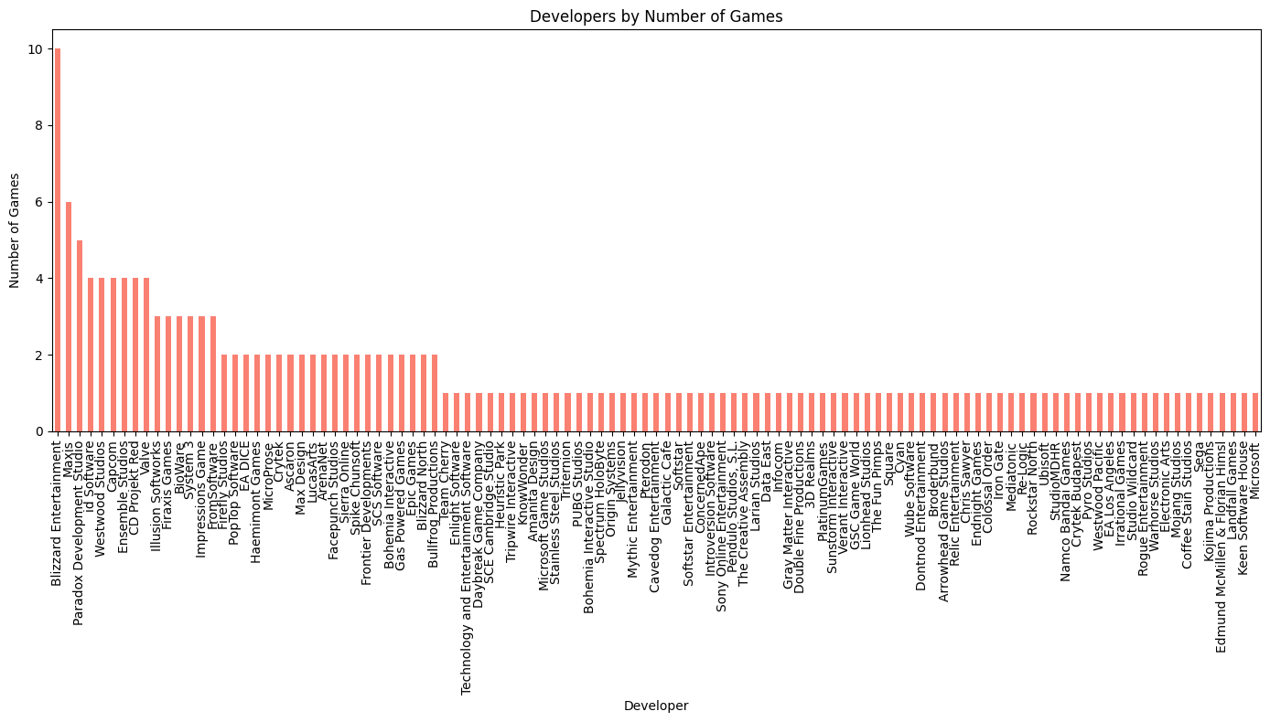
Analysis 3
Developer who developed most of the game

Slide 6
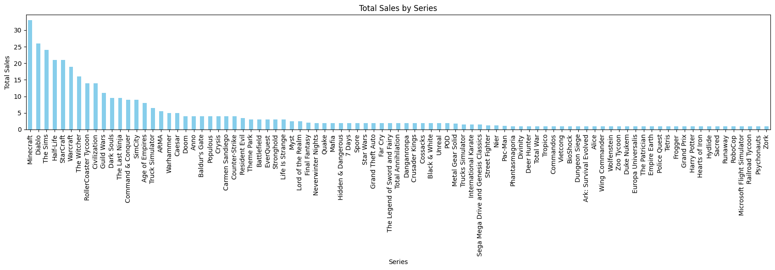

Analysis 4
Series which has the most sales?

Slide 7
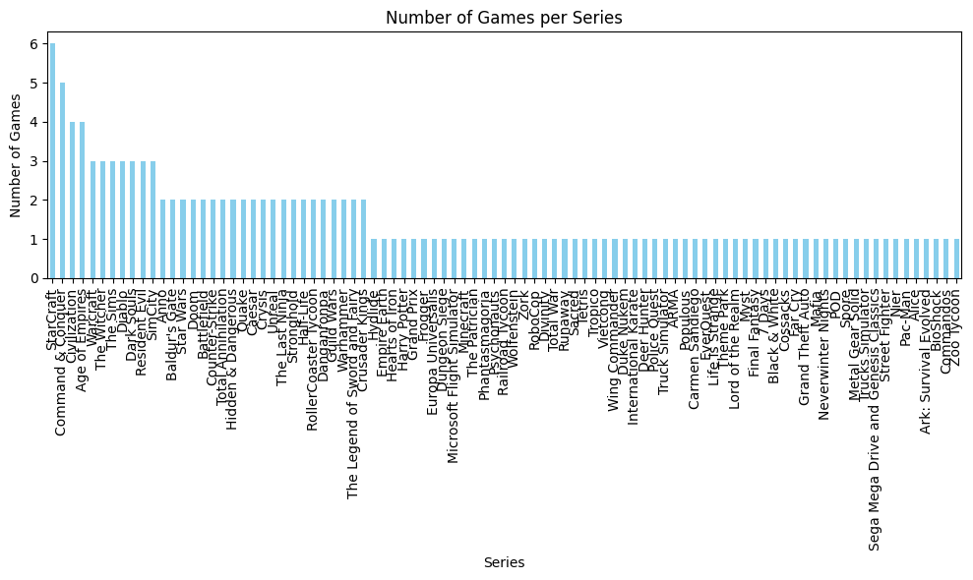

Analysis 5
Series which have the most games?

Slide 8
Thank You

