Slide 1


10 April 2014

Slide 2

Doa
Safety Induction
OHSAS 18001

Slide 3


Slide 4

Evacuation Route

Slide 5

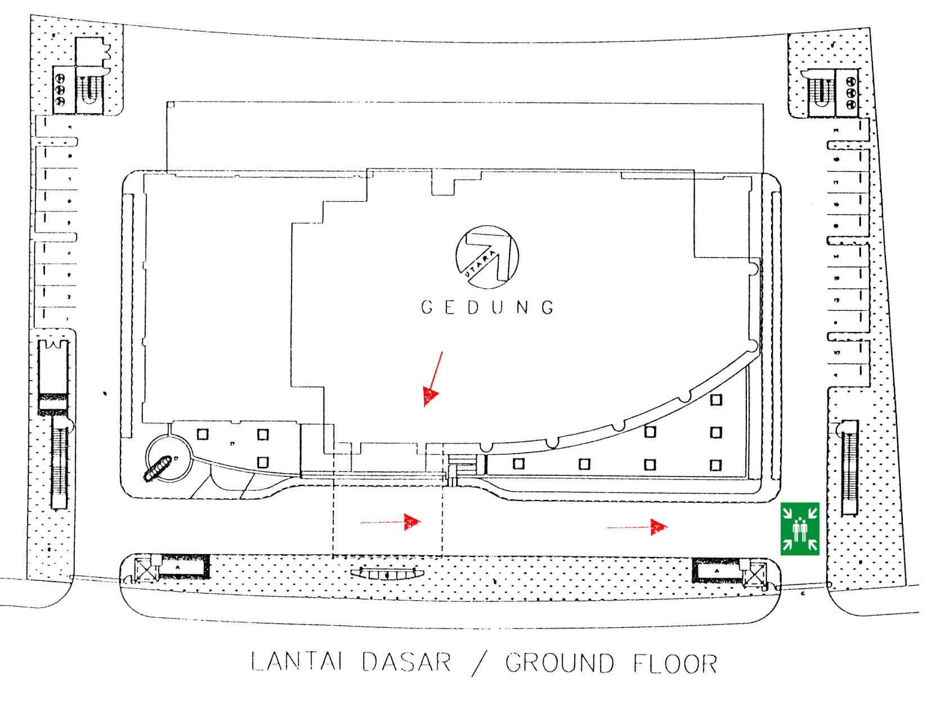

Slide 6

Mengetahui manfaat dari OH&S MS
Mengetahui prinsip-prinsip OH&S MS

Slide 7


Slide 8

PDCA Cycle;
Prinsip-prinsip OHSAS 18001
Pemahaman Persyaratan OHSAS 18001:2007

Slide 9


Slide 10


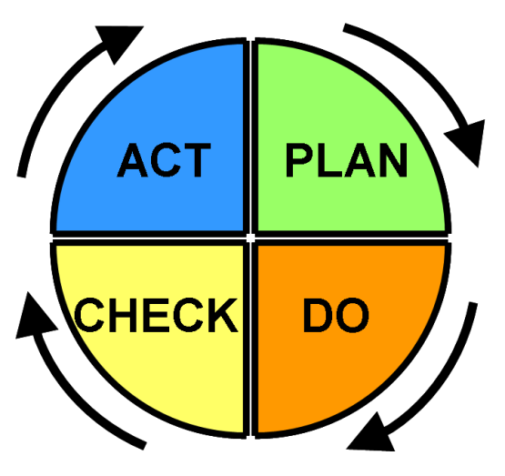
PLAN : establish the objectives and processes necessary to deliver results in accordance with the organization’s QHSE policy.
ACT: take actions to continually improve QHSE performance
CHECK: monitor and measure processes against QHSE policy,
objectives, legal and other requirements, and report the results.
DO: implement the processes

Slide 11
OHSAS 18001:2007

Slide 12


Slide 13

OHSAS menyatakan persyaratan sistem manajemen keselamatan dan kesehatan kerja, agar organisasi mampu mengendalikan risiko-risiko K3 dan meningkatkan kinerjanya.

Slide 14
PLAN : establish the objectives and processes necessary to deliver results in accordance with the organization’s QHSE policy.
ACT: take actions to continually improve QHSE performance
CHECK: monitor and measure processes against QHSE policy,
objectives, legal and other requirements, and report the results.
DO: implement the processes

Slide 15

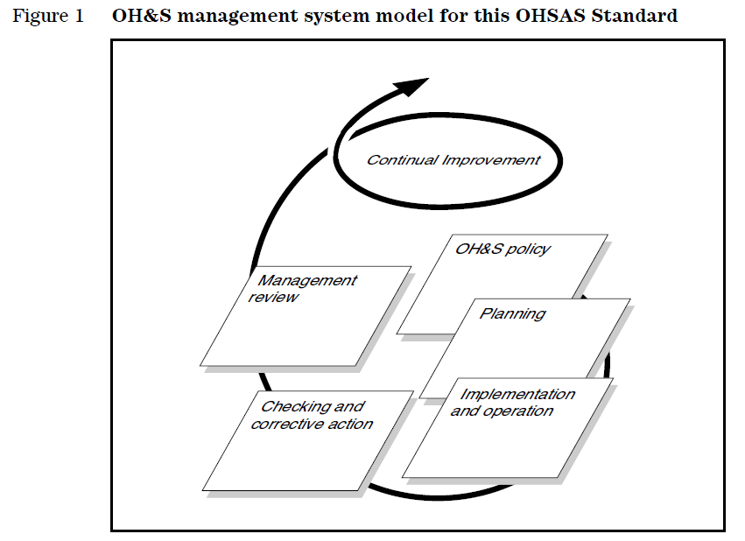

Slide 16


Slide 17


