Slide 1
1st HSSE Meeting PHE ONWJ – Temporary Storage Tanker
Nov 2nd, 2014

Slide 2
Scope
ERP (Emergency Response Plan)
ONWJ Personnel Requirements
HSSE Document List

Slide 3
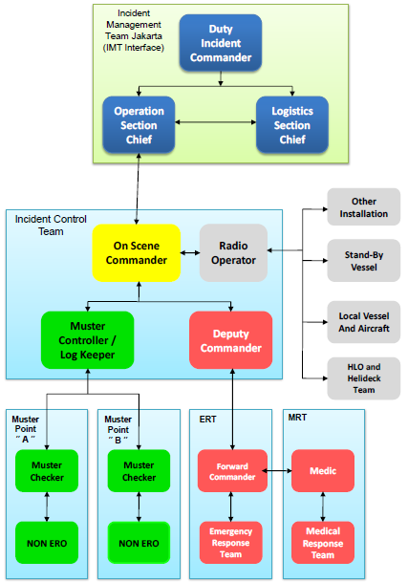
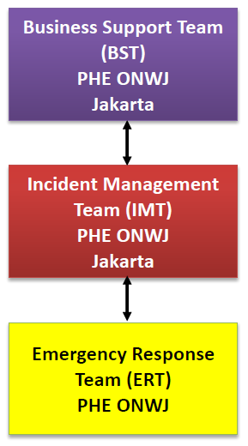
Incident Response Org.

Slide 4
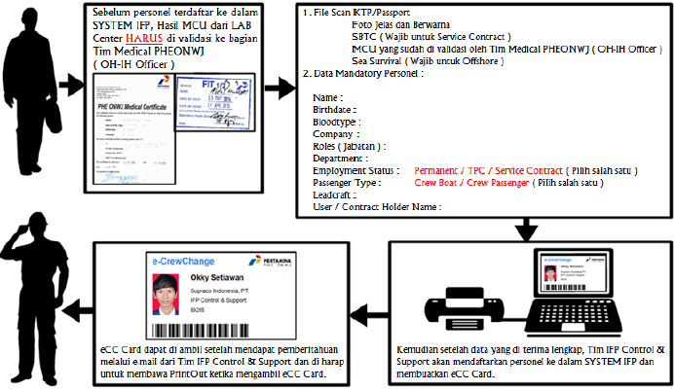
Personnel Requirements

Slide 5
HSSE Document List
PC-1065 Contractor
Project HSSE Plan
Emergency Response Procedure
MCU & Fitness for Work Procedures
HSSE Performance Procedure
Oil Spill Contingency Procedure
HSSE Training And Induction Procedure
Bridging Control of Work (CoW) Execution Procedure
Risk Assessment & Hazard Identification Procedure
General Lifting & Rigging Operation Procedure
Material Handling Procedure
Accident, Incident Investigation and Reporting Procedure
Personnel Transfer Procedure
Simultaneous Operations (SIMOPS) Procedure
Confined Space Entry Procedure
Personal Protective Equipment (PPE) Procedure
Sea Transportation Procedure
Industrial Hygiene Procedure
Working at Height Procedure
Project Risk Register

Slide 6
TERIMA KASIH

Slide 7
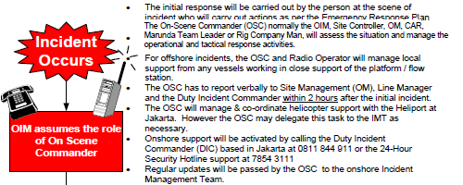
Initial Notification

Slide 8
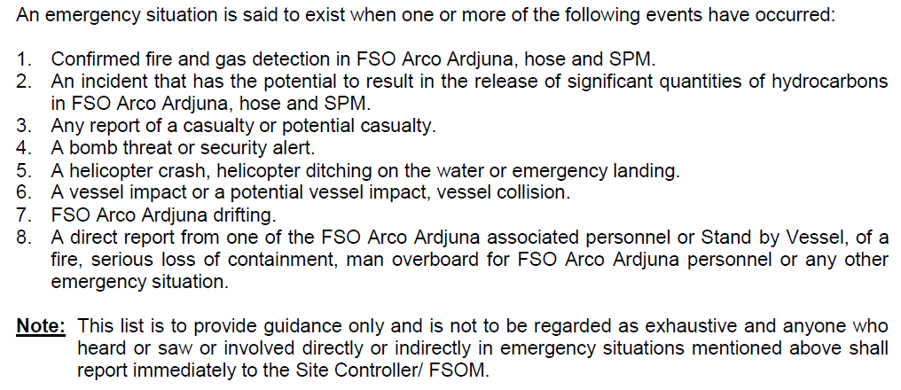
Emergency Incident Criteria

